Slide 1
Language Independent Noun And Verb Acquisition From Psychological Videos
By: Diwakar Chauhan
Guide : Amit Mukerjee
email : {diwakarc, amit}@cse.iitk.ac.in

Slide 2
Introduction
Processing a natural language
Requirement of huge resources
Applicable to languages with rich corpus e.g. English
Can’t learn meaning of sentences
Need of method applicable on multiple languages
Zero prior knowledge
Learning process of child

Slide 3
Language learning by Infants
Environment
Auditory Perception
Visual Perception
Syllables/Words
Shapes/Faces
Motion
Others
Nouns
Association
Objects
Verbs
Association
Actions

Slide 4
Videos
Commentaries
Action Labeling
Object Identification
Word Separation
Word Clustering
Feature extraction
HMM
Association Measure
Association measure
Verbs Supervised
Hierarchical Clustering
Nouns
Word Clustering
Action clusters
Association Measure
Verbs Unsupervised

Slide 5
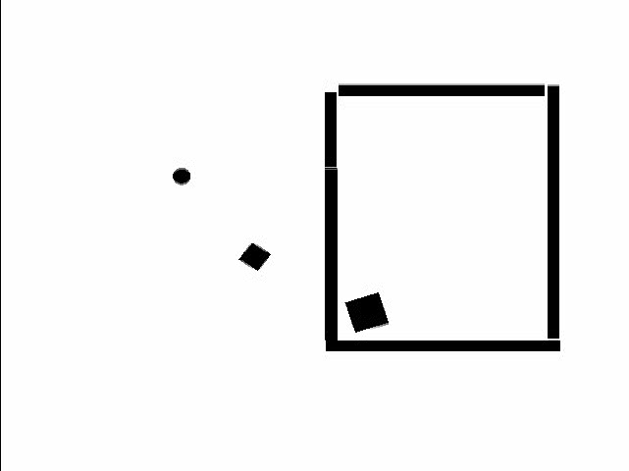
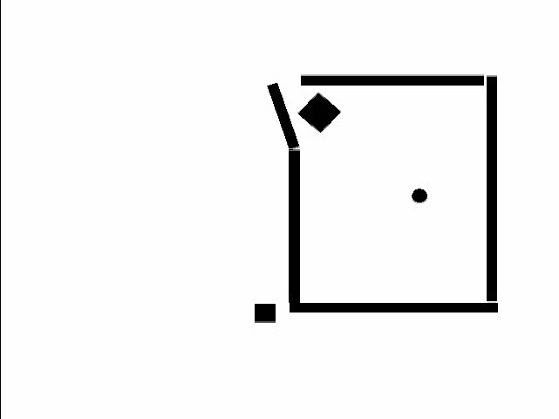
Psychological Videos
Manually created goal driven videos
Difficult to generate automatically
Available Videos
Heider Simmel Video
Frith Happes Animations
Stills from Heider Simmel Video

Slide 6
Previous Works on Psychological Videos
G.Satish-Mukerjee, Acquiring Linguistic argument Structure
Merge Neural Gas method for action clustering
Nayak-Mukerjee 2012, Learning Containment Metaphor
Learn the language structure and then semantics to get metaphor

Slide 7
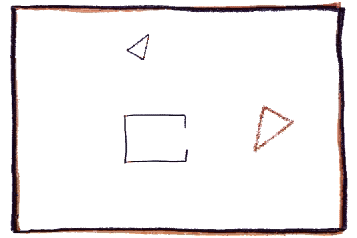
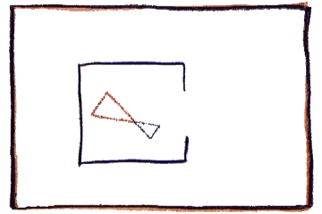
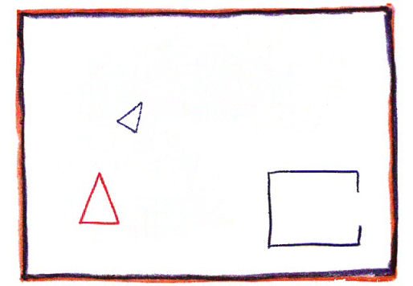
Actions in Psychological videos
Limited actions(chase, go away, come closer) in Heider-Simmel Video
Need of generalization
Actions in Frith-Happe Animations
Large Variety of actions
Chase, push, pull, rotate, play, dance
Stills from Frith Happe Animations

Slide 8
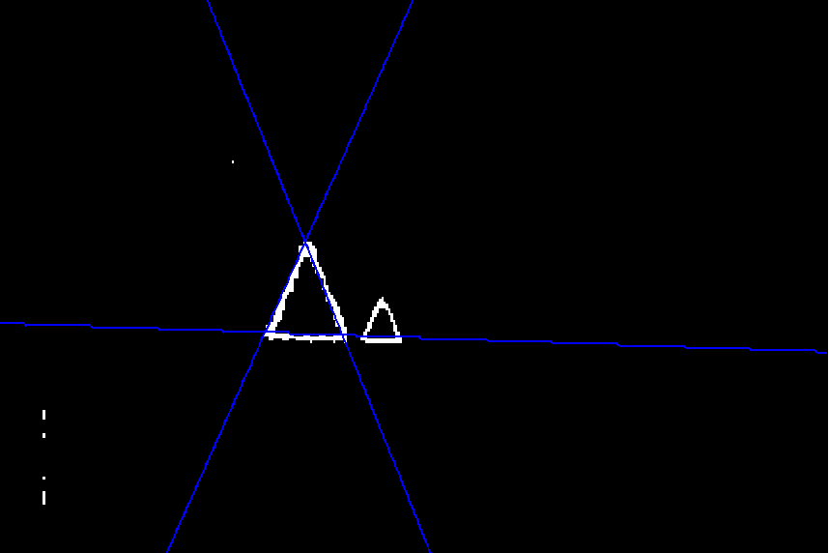
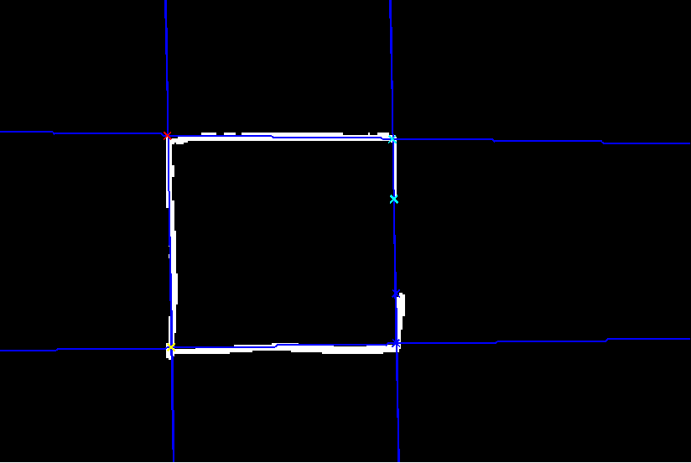
Preprocessing of Data and Feature Extraction
Identification of triangles and Rectangle
Line detection : Hough Transform
Vertices : Intersection of sides of triangle
Feature Extraction
Features relevant to motion and interaction of triangles
Centroids of triangles
Captures relative positions of triangles
Orientation of triangles
Capture direction and relative orientations of triangles

Slide 9
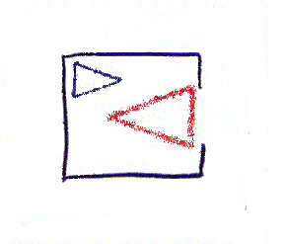
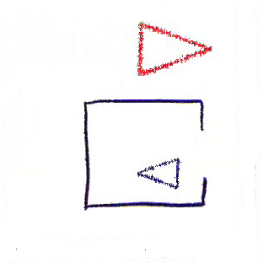
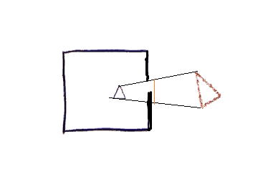

Preprocessing of Data and Feature Extraction
Feature Extraction
Visibility of triangles
Measure of how much one triangle can see other triangle
Feature Vector
$\left[\begin{matrix}x_{1} & y_{1} & θ_{1} \\ x_{2} & y_{2} & θ_{2} \\ & v_{12} & \end{matrix}\right]$ or $\begin{matrix}x_{1} & y_{1} & θ_{1} \\ x_{2} & y_{2} & θ_{2}\end{matrix} or \begin{matrix}x_{1} & y_{1} & sinθ_{1} \\ x_{2} & y_{2} & sinθ_{2}\end{matrix} \begin{matrix}cosθ_{1} \\ cosθ_{2}\end{matrix}$

Slide 10
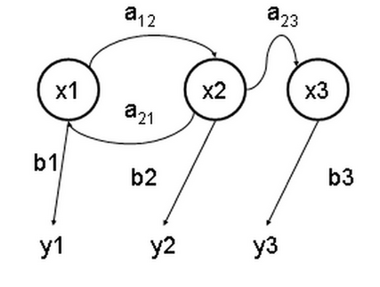

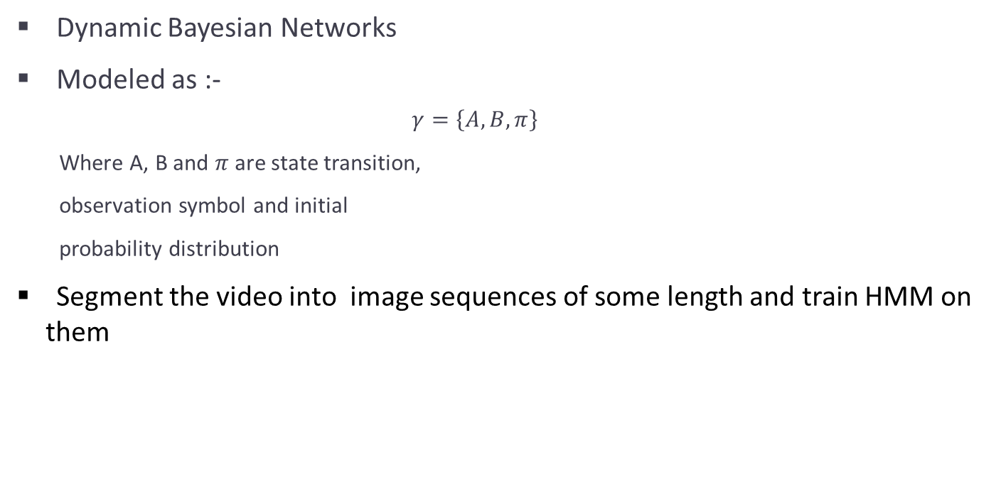
Hidden Markov Models
Dynamic Bayesian Networks
Modeled as :-
$$γ=\left\{A, B, π\right\}$$
Where A, B and $π$are state transition,
observation symbol and initial
probability distribution
Segment the video into image sequences of some length and train HMM on them

Slide 11
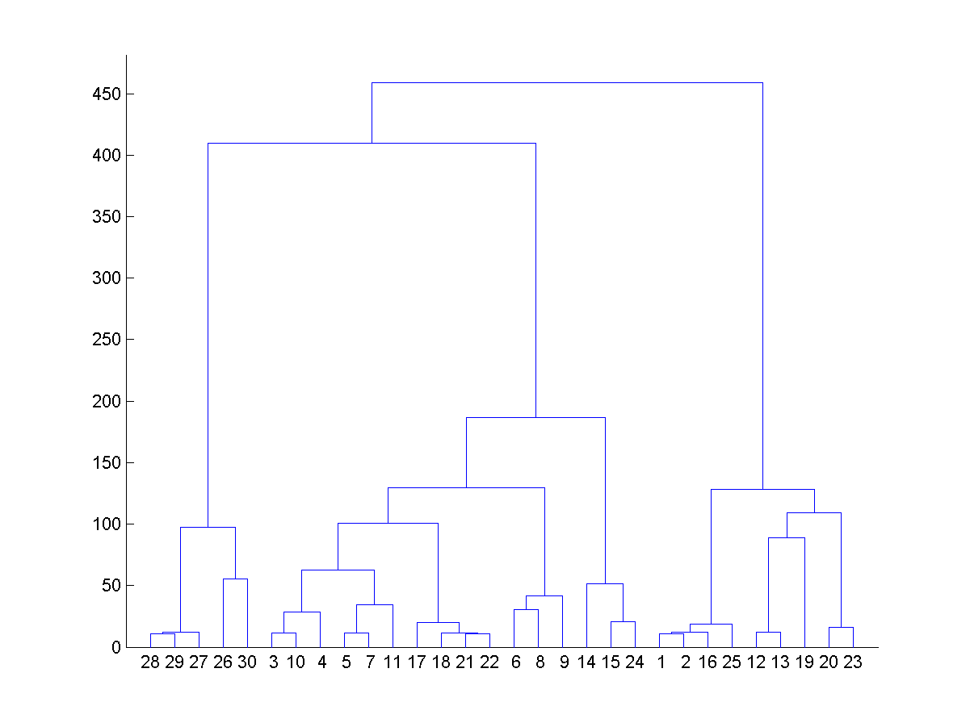
Distance in HMMs and Hierarchical Clustering
Trained HMMs on all image sequences
Calculated the Mutual Acceptance measure between HMMs
Created cluster tree of image segments based on this measure
Wards method used for cluster distances
Cut the tree at appropriate height to get 6-8 clusters
Clusters used for unsupervised verb learning

Slide 12
Language
Lexicons
Words or basic units consisting a language (e.g. pitifully)
Morphology
Smallest meaningful elements
Word forming from the morpheme (e.g. pity + ful + ly)
Phonology
Syllables (pi + ty + ful + ly)
Syntax
Organization of words to form sentence
Lexical and phonological properties of a language are considered here
Notes:
Dog and dogs are same lexemes

Slide 13
Hindi Corpus
Obtained Hindi Corpus from CFILT, IIT Bombay
Corpus has more than 2.8 Million words
For each unique word in corpus, calculated its frequency and fraction of frequency
Used it in filtering the equally occurring words in the commentary
Also Used to remove very common words in results

Slide 14
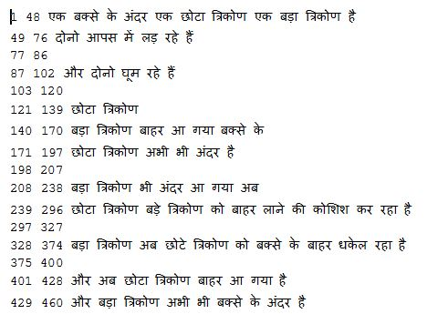
Commentary Collection and Movement Record
Collected commentaries in two languages
22 Commentaries in Hindi for Coaxing video
13 Commentaries in English for Coaxing video
Instructions to subjects before they give commentary
Converted audio to texts manually
Merged commentaries of all subjects
Manually recorded the motion intervals
of both triangles in video

Slide 15
Words and K-Gram Calculation
Determined all the unique words in the commentaries and their frequency
Removed common words from the commentary by relative frequency in corpus and in commentary for all words
Found 1, 2, 3, 4 grams from filtered words
Determined the frequency and relative frequency of k-grams separately

Slide 16
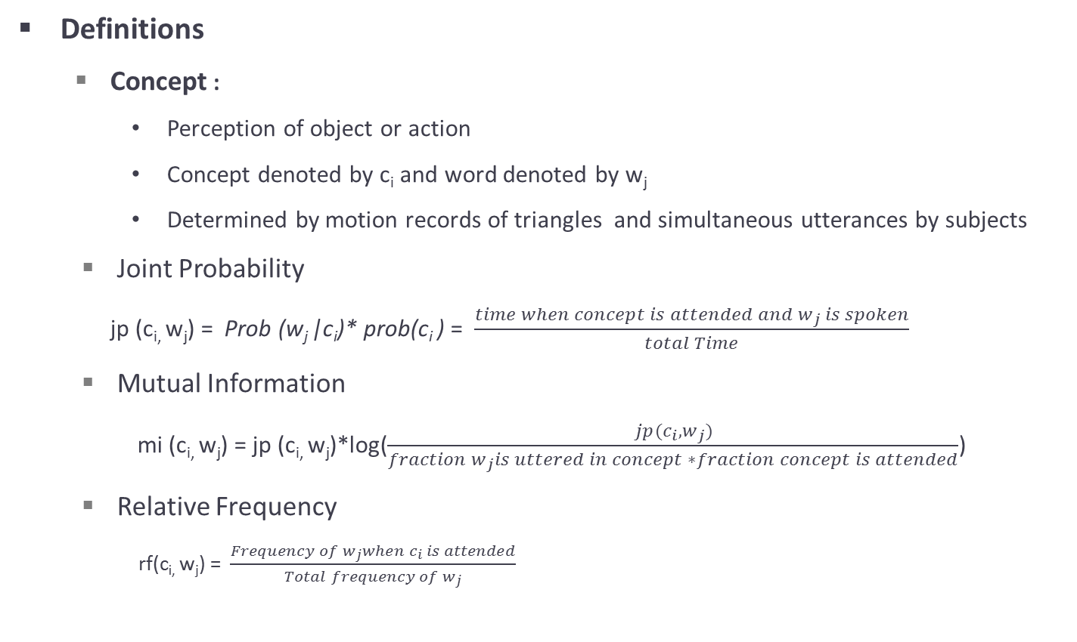
Noun Learning and Association Measures
Definitions
Concept :
Perception of object or action
Concept denoted by c_{i} and word denoted by w_{j}
Determined by motion records of triangles and simultaneous utterances by subjects
Joint Probability
jp (c_{i,} w_{j}) = Prob (w_{j} |c_{i})* prob(c_{i} ) = $\frac{time when concept is attended and w_{j} is spoken}{total Time}$
Mutual Information
mi (c_{i,} w_{j}) = jp (c_{i,} w_{j})*log($\frac{jp(c_{i}, w_{j})}{fraction w_{j}is uttered in concept ∗fraction concept is attended}$)
Relative Frequency
rf(c_{i,} w_{j}) = $\frac{Frequency of w_{j}when c_{i} is attended}{Total frequency of w_{j}}$

Slide 17
Noun Learning
Concepts used :
Red triangle is c₁ and blue triangle is c₂
When c₁ is moving
When c₂ is moving
When c₁ is moving but c₂ is not moving
When c₁ is not moving but c₂ is moving
When both c₁ and c₂ are moving
When both c₁ and c₂ are not moving
Calculated Mutual Information and Joint Probability measures of all k-grams for each of these concepts

Slide 18
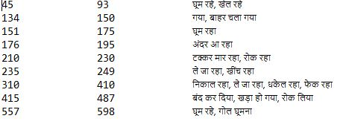
User Labeled Action Clustering
Manually labeled the video with actions
Total 9 segments of coaxing video labeled
Learned HMMs on all of these segments
Feature vectors were same as that in unsupervised learning
Calculated Mutual Acceptance measure on all these HMMs
Merged the clusters with very low HMM distance
Left with 7 clusters in the end

Slide 19
Verbs in User Labeled Clusters
For the intervals labeled, obtained overlapping commentaries
Selected commentary based on overlap threshold
Calculated the relative frequency words all words in each cluster/interval
Filtered the words based on threshold
This contains very less nouns because nouns are uniform in all clusters/intervals
Removed the most common words by matching with 1000 most common words in corpus

Slide 20
Verbs in HMM Based Clusters
Merged all the overlapping clusters from the results of cluster tree cutting
Removed all very small intervals
Very less chance that, they will have actions
For all the remaining intervals, obtained fairly overlapping commentaries
Calculated the Relative Frequency measure for all the words in each cluster
Filtered words based on threshold
Removed the most common words by comparing them with top 1000 most common words in corpus

Slide 21
Hindi Results : Noun Learning
A. Concept 1(Red Triangle)
Monograms
Joint Probability
Mutual Information
Bigrams
Joint Probability
Mutual Information
त्रिभुज | 0.245
बाहर | 0.237
लाल | 0.145
बड़ा | 0.124
लाल त्रिभुज | 0.100
नीला त्रिभुज | 0.054
छोटे त्रिभुज | 0.045
बाहर धकेल | 0.041
त्रिकोण | 0.510
बाहर | 0.404
बड़ा | 0.335
त्रिभुज | 0.206
लाल त्रिभुज | 0.120
बाहर धकेल | 0.117
छोटे त्रिकोण | 0.101
छोटे त्रिभुज | 0.089

Slide 22
Hindi Results : Noun Learning
C. Concept 1 but Not Concept 2(Strong Red Triangle)
Monograms
Joint Probability
Mutual Information
Bigrams
Joint Probability
Mutual Information
त्रिभुज | 0.034
बड़ा | 0.029
त्रिकोण | 0.029
छोटा | 0.021
बड़ा त्रिभुज | 0.010
लाल त्रिभुज | 0.009
छोटा त्रिभुज | 0.008
नीला त्रिभुज | 0.007
त्रिकोण | 0.158
बड़ा | 0.094
छोटा | 0.065
टकरा | 0.023
छोटा त्रिभुज | 0.025
बड़ा त्रिभुज | 0.023
त्रिकोण छोटे | 0.021
छोटे त्रिकोण | 0.021

Slide 23
English Results : Noun Learning
A. Concept 1(Red Triangle)
Monograms
Joint Probability
Mutual Information
Bigrams
Joint Probability
Mutual Information
triangle | 0.165
Smaller | 0.127
Outside | 0.112
Box | 0.104
Smaller triangle | 0.100
Bigger triangle | 0.054
Small triangle | 0.045
Triangle outside | 0.041
Triangle | 0.211
Trying | 0.205
Smaller | 0.190
both | 0.180
Bigger triangle | 0.094
Smaller triangle | 0.087
Inner square | 0.072
Small triangle | 0.069

Slide 24
English Results : Noun Learning
C. Concept 1 but Not Concept 2(Strong Red Triangle)
Monograms
Joint Probability
Mutual Information
Bigrams
Joint Probability
Mutual Information
Triangles | 0.022
Box | 0.014
Triangle | 0.010
object | 0.010
Basically both | 0.008
Smaller object | 0.006
Red object | 0.006
Blue object | 0.006
triangles | 0.071
Basically | 0.039
Hence | 0.036
squares | 0.030
Basically both | 0.047
Smaller object | 0.032
Blue smaller | 0.032
Squares here | 0.030

Slide 25
Hindi Results : Noun Learning
Blue Triangle : Mutual Information
Monograms
Concept-2
Not Concept-1 Concept-2
Bigrams
Concept-2
Not Concept-1 Concept-2
बाहर | 0.448
त्रिकोण | 0.430
छोटे | 0.216
त्रिभुज | 0.188
लाल त्रिभुज | 0.151
बाहर निकल | 0.100
छोटे त्रिभुज | 0.090
नीले त्रिभुज | 0.071
नीला | 0.050
बाहर | 0.037
कोशिश | 0.032
अंदर | 0.028
नीला त्रिभुज | 0.055
अंदर ना | 0.018
लाल त्रिभुज | 0.013
वो बाहर | 0.013

Slide 26
Hindi Results : Noun Learning
Joint Probability
Monograms
Concept-2
Not Concept-1 Concept-2
Bigrams
Concept-2
Not Concept-1 Concept-2
बाहर | 0.255
त्रिभुज | 0.243
लाल | 0.136
त्रिकोण | 0.094
लाल त्रिभुज | 0.104
नीला त्रिभुज | 0.060
नीले त्रिभुज | 0.048
त्रिभुज बाहर | 0.046
त्रिभुज | 0.033
बाहर | 0.030
नीला | 0.024
लाल | 0.017
नीला त्रिभुज | 0.024
लाल त्रिभुज | 0.014
त्रिभुज बाहर | 0.011
त्रिभुज लाल | 0.006

Slide 27
English Results : Noun Learning
Blue Triangle : Mutual Information
Monograms
Concept-2
Not Concept-1 Concept-2
Bigrams
Concept-2
Not Concept-1 Concept-2
Triangle | 0.324
Outside | 0.291
Smaller | 0.245
box | 0.185
Smaller triangle | 0.186
Bigger triangle | 0.107
Red triangle | 0.050
Blue object | 0.041
Outside | 0.070
Triangle | 0.066
Smaller | 0.054
Success | 0.051
Gets success | 0.051
Red triangle | 0.051
Ring basically | 0.040
Cannot enter | 0.040

Slide 28
English Results : Noun Learning
Joint Probability
Monograms
Concept-2
Not Concept-1 Concept-2
Bigrams
Concept-2
Not Concept-1 Concept-2
Triangle | 0.204
Outside | 0.156
Smaller | 0.146
box | 0.112
Smaller triangle | 0.096
Bigger triangle | 0.064
Triangle outside | 0.028
Red triangle | 0.023
triangle | 0.036
Outside | 0.031
Smaller | 0.027
box | 0.016
Smaller triangle | 0.014
Red triangle | 0.012
Gets success | 0.009
Ring basically | 0.007

Slide 29
Hindi Verbs from User labeled clusters
Ground Truth
Results
Interval | Verbs
45-93, 151-175,557-598 | घूम रहे, खेल रहे, घूम रहा, गोल घूमना
134 - 150 | गया, बाहर चला गया
176 - 195 | अंदर आ रहा
210 - 230 | टक्कर मार रहा, रोक रहा
- 249 | ले जा रहा, खींच रहा
- 410 | निकाल रहा, ले जा रहा, धकेल रहा, फेक रहा
415 - 487 | बंद कर दिया, खड़ा हो गया, रोक लिया
Verbs
खुश, पकड़, गोल, घूम, कोण, दोनो, दोस्त
घूमे
वापस
निकाल, धकेल, फेक, तरीक़ो, धक्का, सिरे, जुड़, धक्के, मारकर, अधूरे, धकेलने, चतुर्भुज
रास्ता,खड़ा, युध, दरवाजा, ना, भगा, विरूध, पाए, पड़ा, वो, रोक

Slide 30
English Verbs from User labeled clusters
Ground Truth
Results
Interval | Verbs
45-93, 151-175,557-598 | Circle, rotate, play
134 - 150 | Go away
176 - 195 | Come
210 - 230 | Hit, stop
- 249 | Pull
- 410 | Throw, push
415 - 487 | Block, stand, roam
Verbs
Fighting, playing, interacting, circling, touching, connected, enjoying, enclosed
Chasing, dancing
Still
Funny, ways, corner
Pushing, Push, Win, wait, moving, ahead
Blocks, completely, explore, roam, reason

Slide 31
Hindi Results : Unsupervised Verb Learning
Ground Truth
Results
Interval | Expected
190-255 | आना, टकराना
150-195 | घूमना, आना
520-595 | घूमना
370-405 | धक्का
400-455, 460-515 | बंद करना
Verbs Discovered
भिड़ा, हिचक, निकालना, चिढ़ा, शरमा, खींचने, टक्करमारने
डरता, खेलना, घूमे, घूमते
वापस
युध,

Slide 32
Conclusion and Further work
The nouns are successfully discovered
Verbs obtained in user labeled clusters are vey much same as the ground truth
In the unsupervised learning, the verbs are not mapped very well to action
Clustering by HMM
Changing time lag in commentary by each subject
Use of gaze data for building attention model
Syntax of the language can also be learned after verbs are discovered

Slide 33
Questions?
Thank You!

