Slide 1
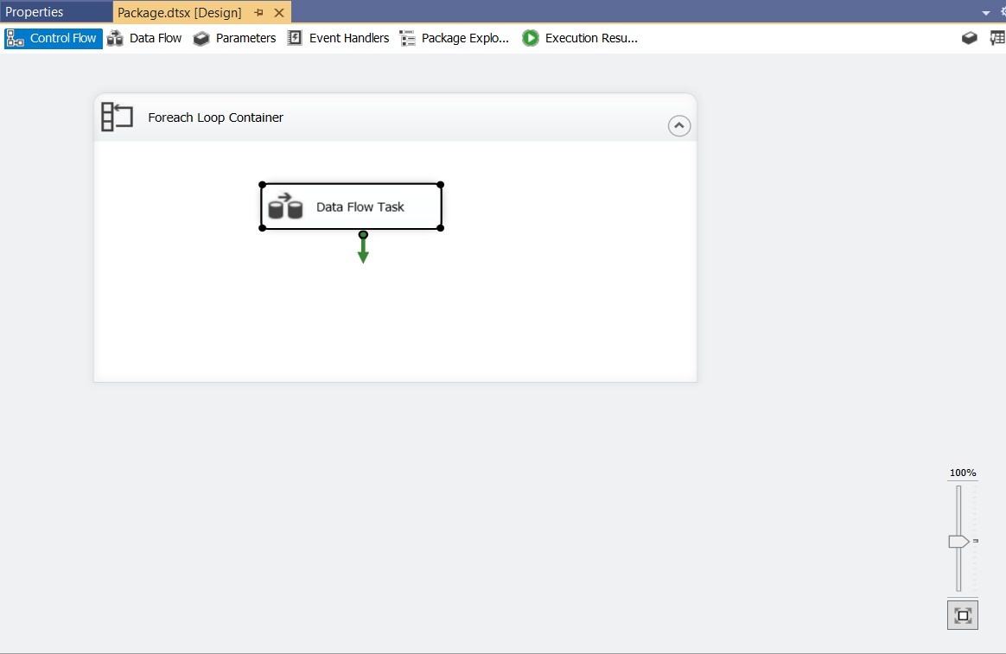
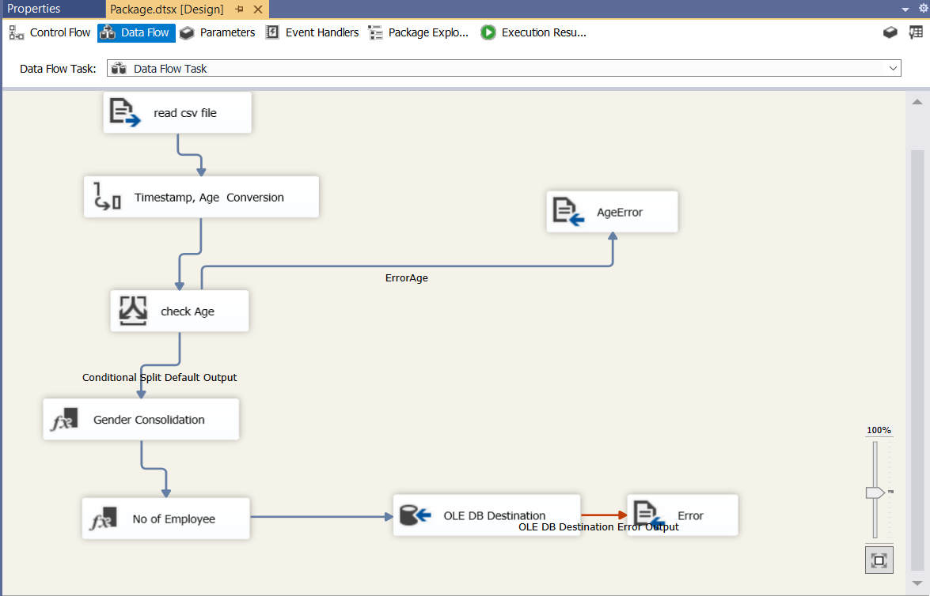
SSIS Model
Control Flow
Data Flow
Task: Create a SSIS data pipeline to import data in multiple csv files and store the cleaned data in a database in Microsoft sql server.

Slide 2
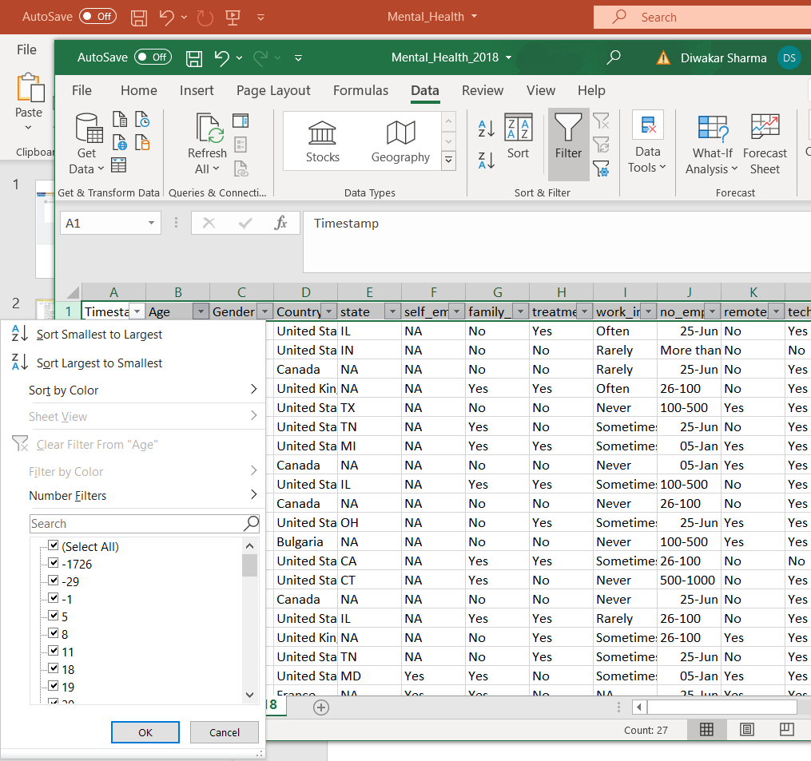
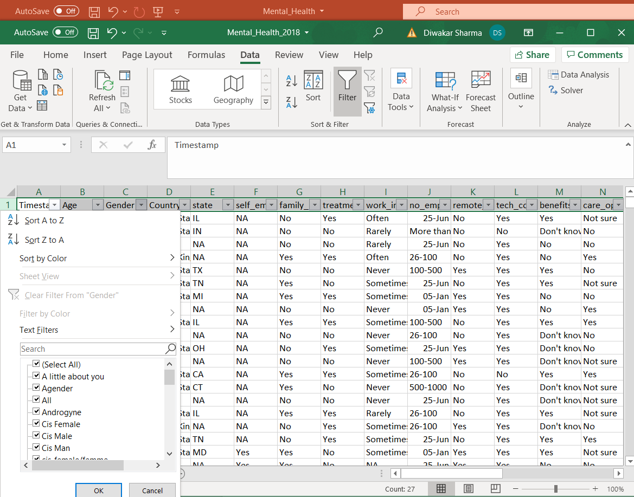
Data Exploration
Observe the data in Excel , created filter and found data discrepancy in Age , Gender and No_employee,
Strategy to handle the data error in SSIS
Different descriptions were used to define gender. Derived column is used to replace similar meaning words with single definition for gender, categorized in only three categories
From data the range should be in the form 26-100; 25-Jun means jun stands for 6 so it should be 25-6 or correctly ordered as 6-25, similarly 05-Jan as 1-5
Used conditional split to redirect the rows with error age (negative and unrealistic age numbers)

Slide 3
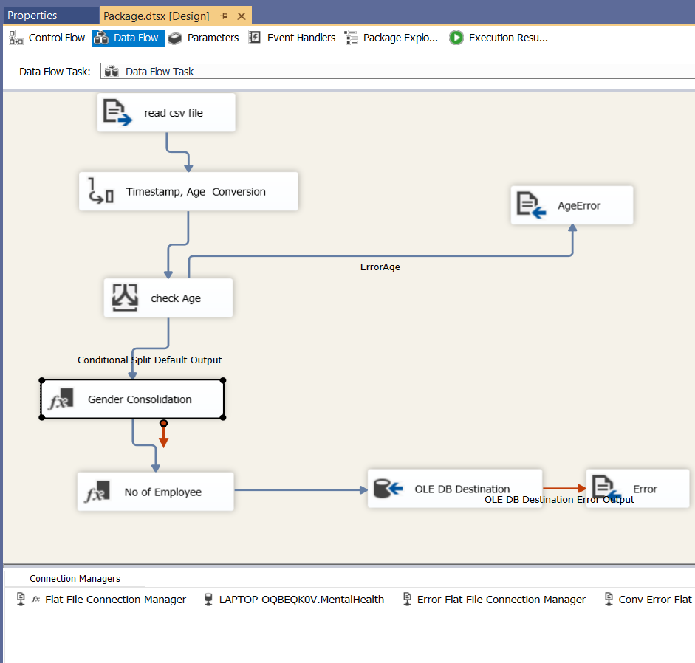
SSIS Process Flow
SSIS simple flow for single file data transfer.
First used single step data transfer from csv to database to check the connection and created the table in database with relevant column .
Found issue with column “Comments”, ignored it for the detailed process.
Detailed process for single file
Data conversion for date ( Timestamp) and Age (numeric)as Age data needs to be filtered based on its value.
Error rows ( based on Age values are directed to text file)
Gender is categorized in three categories using derived column
UPPER(Gender) == "M" ? "Male" : (UPPER(Gender) == "CIS MALE" ? "Male" : (Gender == "Cis Man" ? "Male" : (Gender == "Mail" ? "Male" : (Gender == "maile" ? "Male" : (Gender == "make" ? "Male" :([Gender]=="Mal"?"Male":([Gender]=="Male"?"Male":([Gender]=="Male (Cis)"?"Male":([Gender]=="Malr"?"Male":([Gender]=="msle"?"Male":([Gender]=="Cis Female"?"Female":([Gender]=="cis-female/femme"?"Female":(UPPER([Gender])=="F"?"Female":([Gender]=="femail"?"Female":([Gender]=="Female"?"Female":([Gender]=="femake"?"Female":([Gender]=="Female (cis)"?"Female":(UPPER([Gender])=="WOMAN"?"Female":([Gender]=="male"?"Male":([Gender]=="female"?"Female":"Other"))))))))))))))))))))
No of employee data range is also corrected using derived column transformation
Finally data is transferred to database

Slide 4
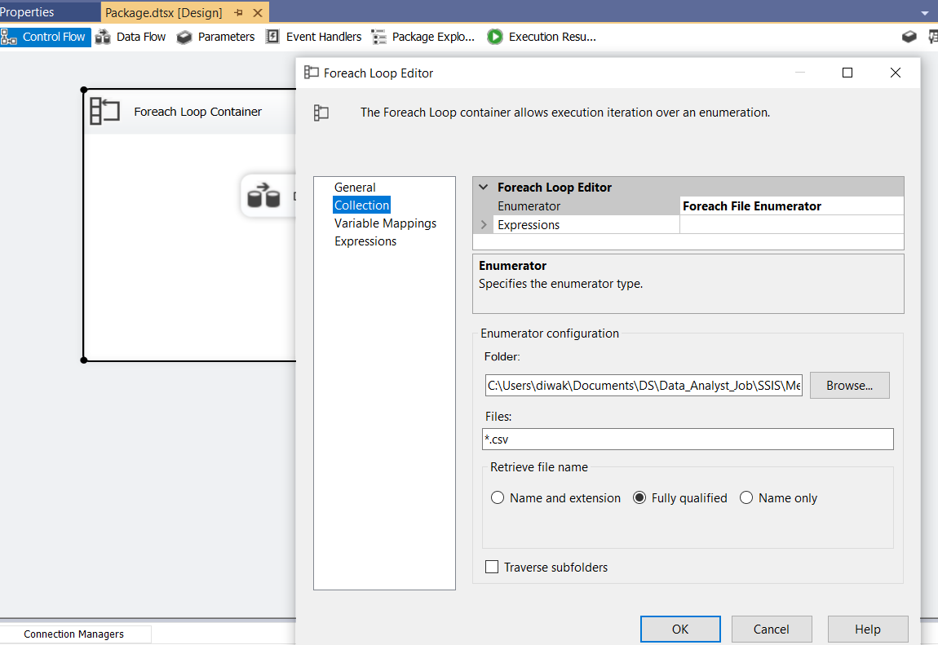
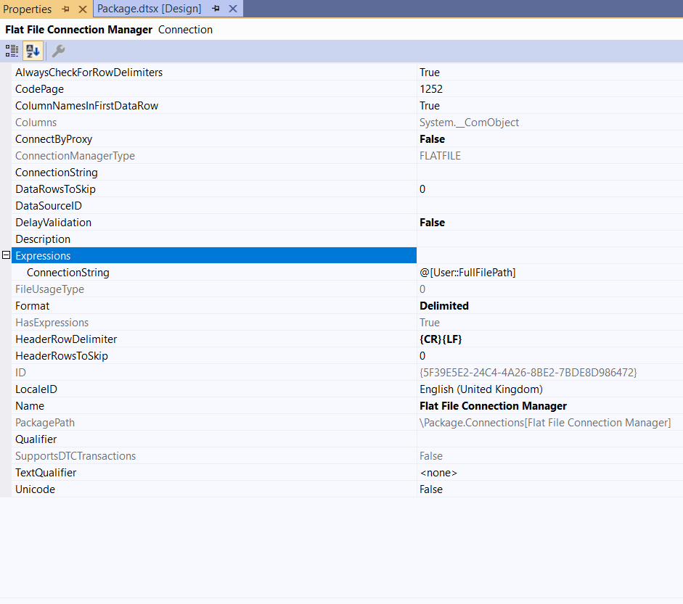
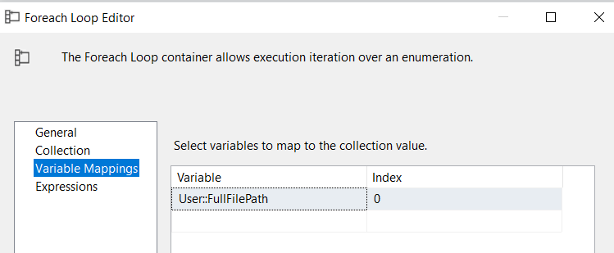
SSIS Process Flow
Data flow extended to extract and load data from multiple csv file.
ForEachLoop is used to loop for files in the folder
Variable “FullFilePath” is created to pass the file path to read csv in data flow.
FullFilePath variable is used in flat file connection manager properties.
1
3
2

Slide 5
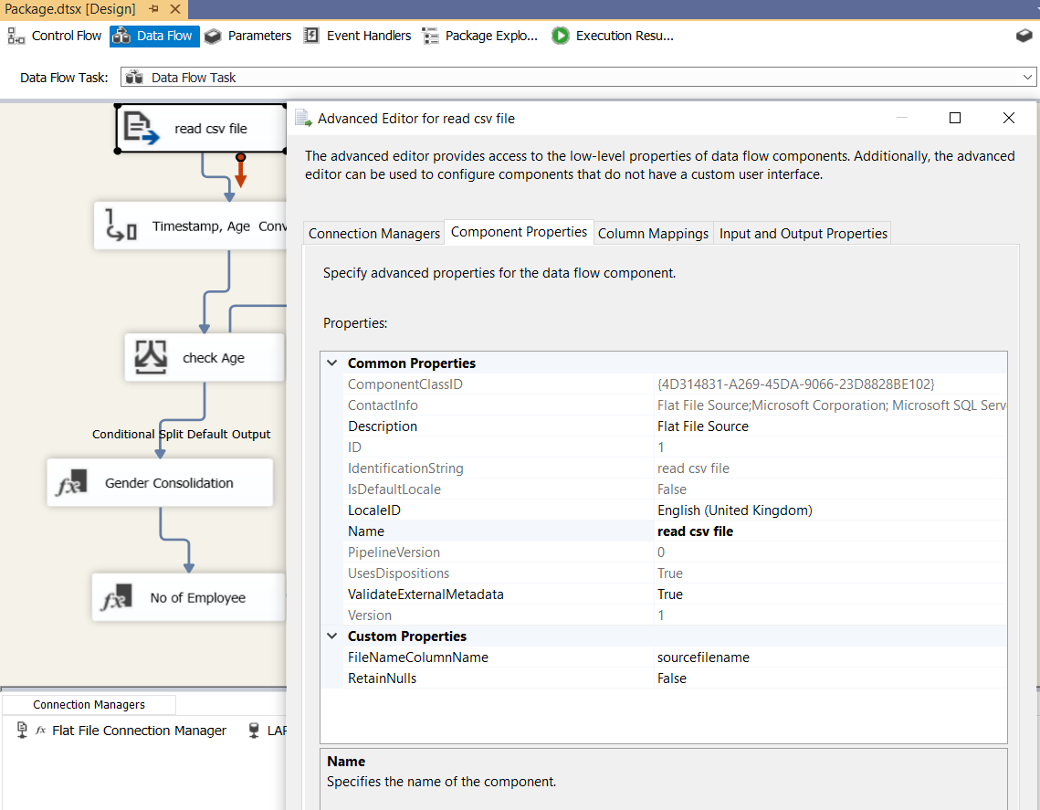
SSIS Process Flow
File path name is included in the data transfer
Right click read csv file -> column name “sourcefilename” added to FilenameColumnName
Sourcefile name column added to table in database with type nvarchar(260)
Mapping updated in dataflow relevant objects
1
2

Slide 6
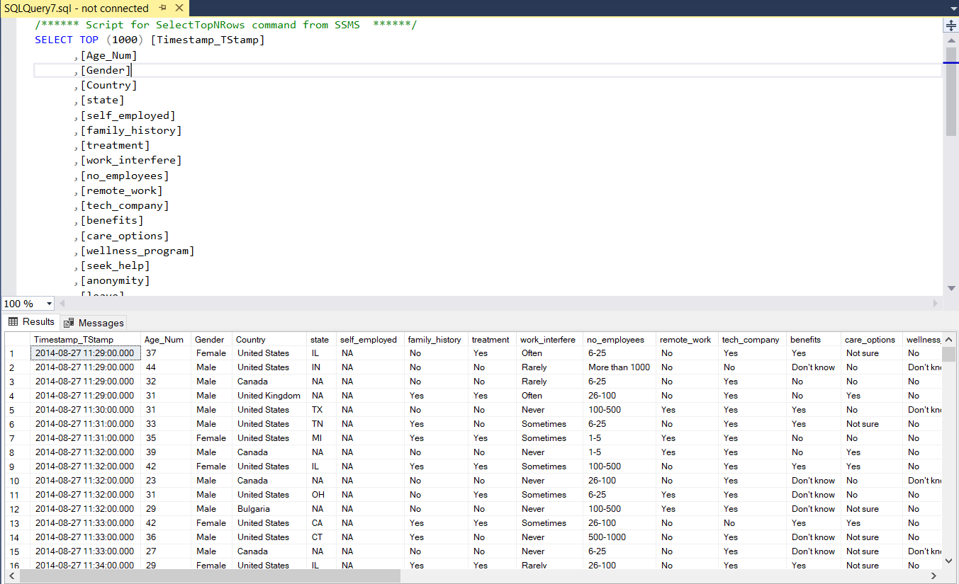
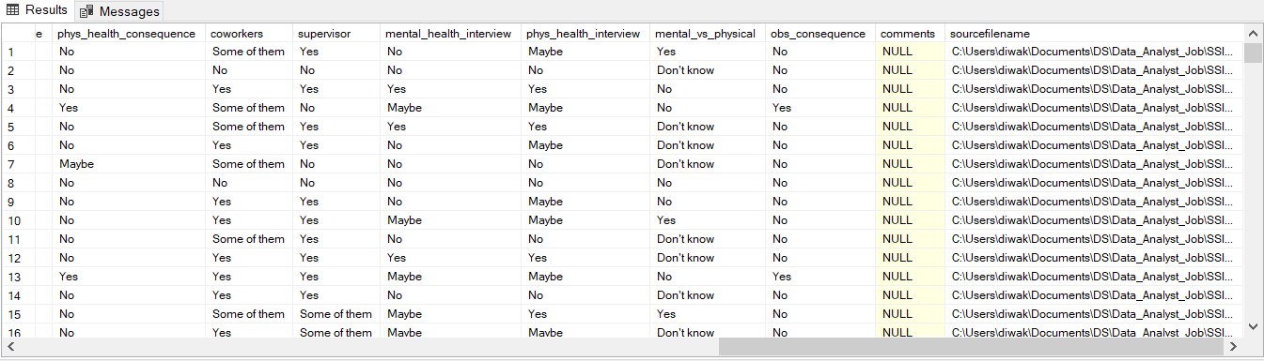
Result
Sql server database: Table top rows

