Slide 1
Presentation on RENTO
Presented By:
Diwakar Shrestha
Mani Maharjan
Anit Shrestha

Slide 2
Content
Introduction
Objectives
Features
Existing System Overview
System Analysis
Requirement Specification
Feasibility study
Development Environment
System Design
DFD
ER-Diagram
Use Case Diagram
Limitations And Future Enhancement
Conclusion
Gantt Chart

Slide 3
INTRODUCTION

Slide 4
Introduction
A part of real estate system which deals with the room renting services and developed to facilitate the room owner and room seeker
User in system are room owner and room seeker
Room seeker can search and enquire for rooms available in platform without login and as well as by logging in
Room owner can post rooms but should be logged in

Slide 5
OBJECTIVES

Slide 6
Objectives
To create platform to rent room for room owners and find room for room seekers

Slide 7
FEATURES

Slide 8
Features
Room owner gets to add rooms detail and manage rooms setting either to make private (if room is not empty) or public (if room is empty)
Rooms seekers can search for rooms in the location they wish by using filter bar
Room owners also are able to maintain their rent detail sheets to manage their rent
Room seeker can view rooms detail provided by room owner and can enquire room and report misleading rooms
Room owner can feature their rooms by requesting to admin

Slide 9
EXISTING SYSTEM OVERVIEW

Slide 10
Existing System Overview
Rental Nepal:
Buying and selling houses, office spaces, apartments, shutters and shops, rooms, and lands.
But the users cannot use location and facility based search

Slide 11
SYSTEM ANALYSIS

Slide 12
Requirement Specification
Functional Requirement:
Requirement Name | Requirement Statement | Must/Want
Add room | New member shall be able to sign up and add their rooms | must
Show rooms | Website shall have the page “Rooms” to show the rooms added by users | must
Search room | Website should have search filter to search the room on required location | must
Enquire | User shall be able to enquire on the room detail page | must
Manage room | User who is registered shall be able to manage the rooms added | must
Manage rent account | Website should provide a rent management system to registered user | must

Slide 13
Requirement Specification(cont.)
Non-Functional Requirement:
Requirement Name | Requirement Statement | Must/Want
Compatibility | The website shall support all browsers and also should be responsive on smart mobile devices | must
Maintainability | Website shall be able to be modified to adapt the changing environment | must
Usability | User shall be provided easy interface to use the system | must
Security | User shall be able to hide or show their detail and their data must be protected | must

Slide 14
DEVELOPMENT ENVIRONMENT

Slide 15
Development Environment
Frontend Tools:
HTML, CSS, BOOTSTRAP
Backend Tools:
PYTHON, DJANGO
SQLITE

Slide 16
SYSTEM DESIGN

Slide 17
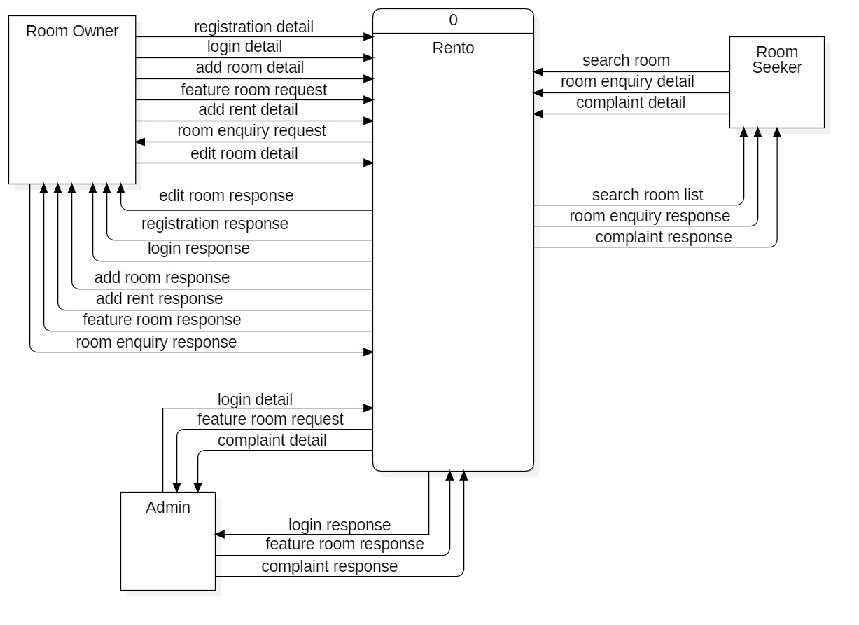
DFD (Context Diagram)

Slide 18
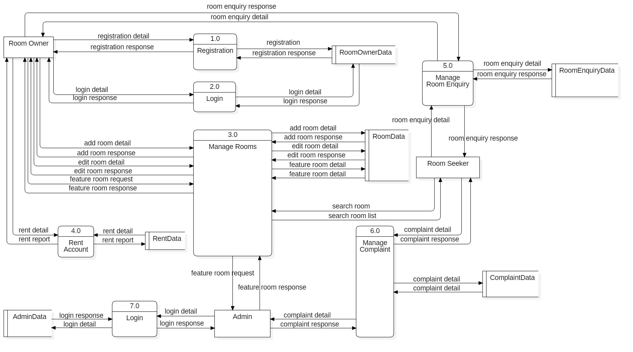
DFD (Level-0)

Slide 19
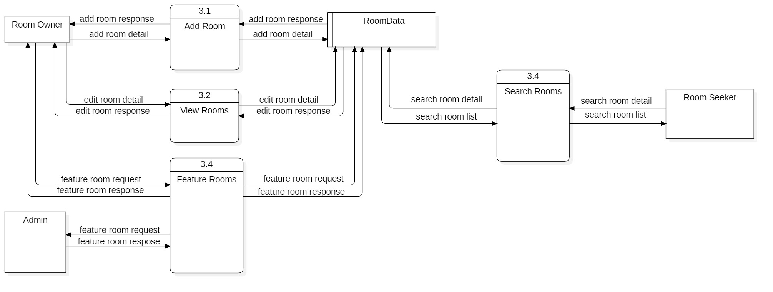
DFD (Level-1(3.0))

Slide 20
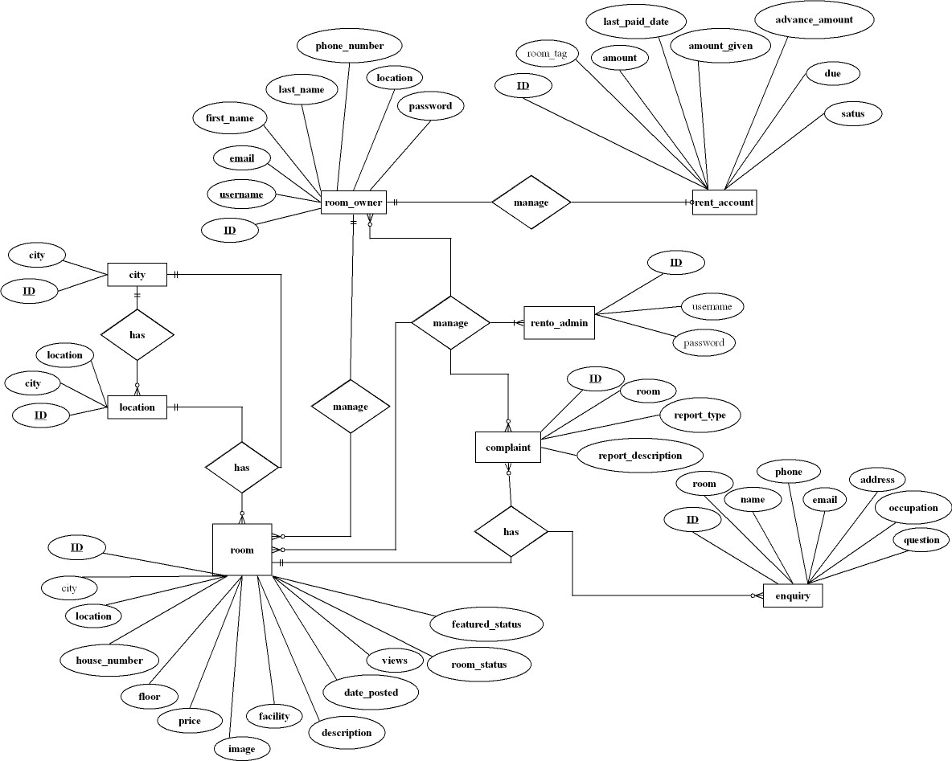
ER-Diagram

Slide 21
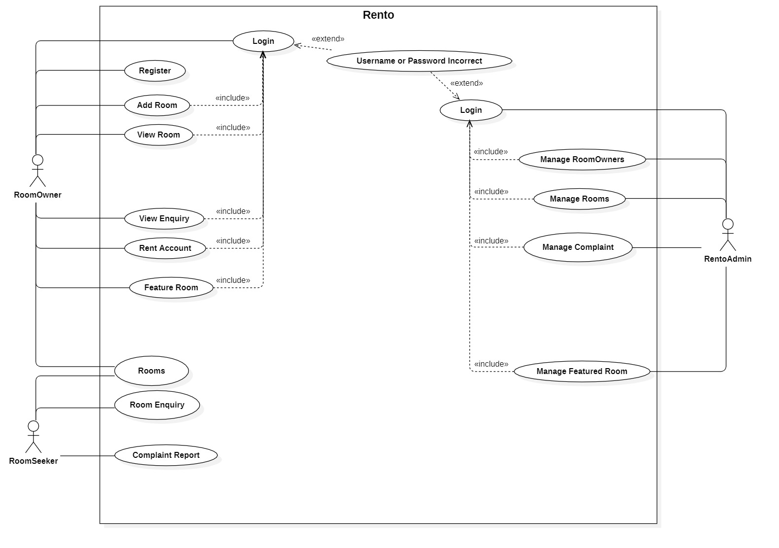
Use Case Diagram

Slide 22
LIMITATIONS AND FUTURE ENHANCEMENT

Slide 23
Limitations
Room seekers can only enquire the available rooms not book them
There is no any pinned map location of the room that may create little trouble for Room seekers to find room

Slide 24
Future Enhancement
Direct payment from the website itself
Full chat system for the owner and room seeker
Live notification system for the room owner

Slide 25
CONCLUSION

Slide 26
Conclusion
Rento website will provide a platform to rent rooms or search available rooms which will create an online platform to interact between house owners and room seekers.
Instead of roaming to search for rooms at convenient location, this system will let user control their search desire.

Slide 27
GANTT CHART

Slide 28
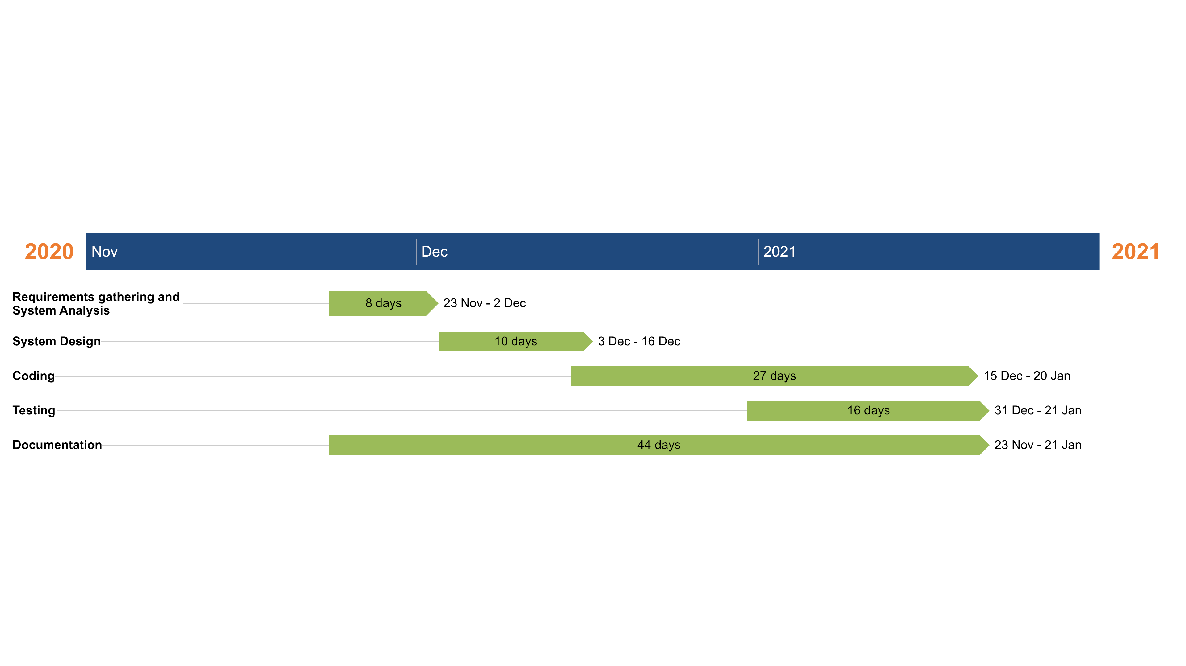
Gantt Chart

Slide 29
Thank You!!!

