Slide 1

Synergy Framework

Slide 2
Framework Implementation with cucumber :
Setup: Java,Maven,Cucumber,Eclipse,Extend Reports,Git, Jenkins.
Java-Scripting Language
Eclipse –IDE
Maven-Build Tool
Cucumber-Gherkin Language
Test Scripts- Java, Gherkin, Cucumber and Selenium.
Execution-Cucumber Options
GIT-Version Control system
Extent Reporting-Advanced Reporting
Jenkins-Continuous Integration Tool

Slide 3
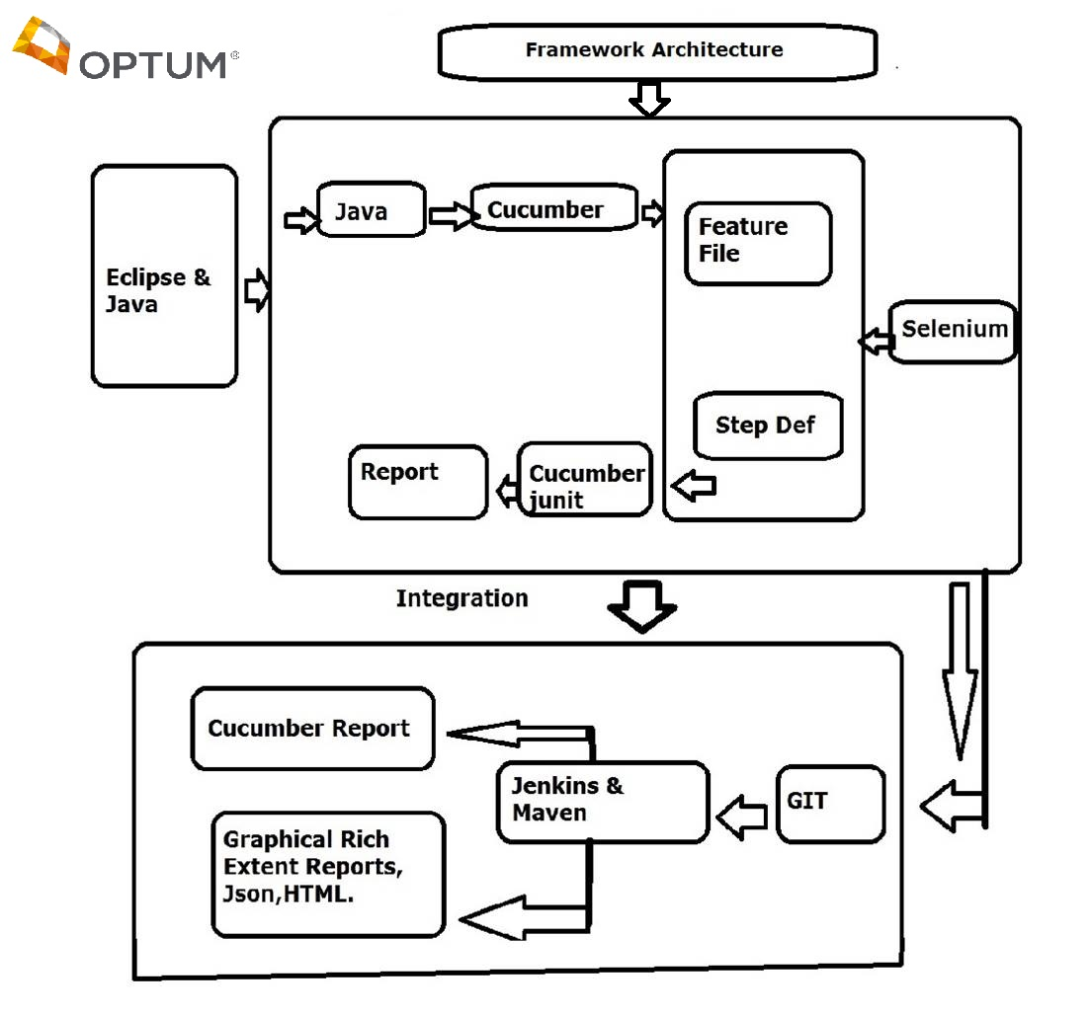

Slide 4
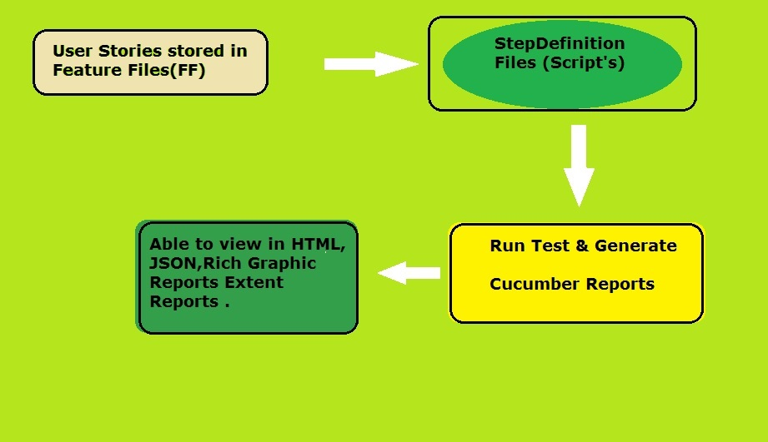
Running Process in Framework

Slide 5
Need Software's to integrate for FM:
1.Java 1.8 or the latest version
2.Eclipse
3.Maven-BuildTool
4.Selenium
5.Cucumber-plugin
6.Extent-Report jar
7.Gherkin-BDD language
8.TestScripts-Java,Gherkin,Selenium
9.Jenkins
10.Git

Slide 6
Configuration of Jenkins
Cucumber Reports GLOBAL TOOL CONFIG
Html Publish Plugin 1.Maven Path
Maven Plugin 2.Java Path
Build Timeout 3.Git Path
Email Extension Plugin 4.Jenkins
GitHub Branch source plugin
Maven Integration Plugin
Pipeline
Subversion Plugin
Time Stamper
Workspace Cleanup Plugin

Slide 7
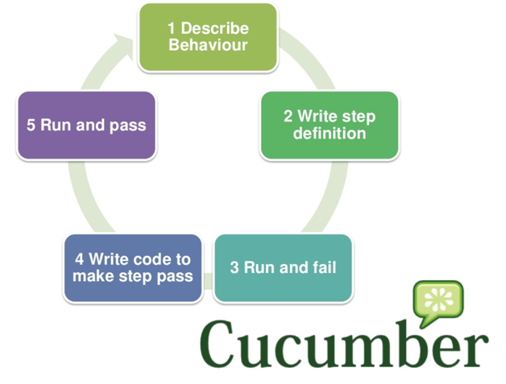
Cucumber Process

Slide 8
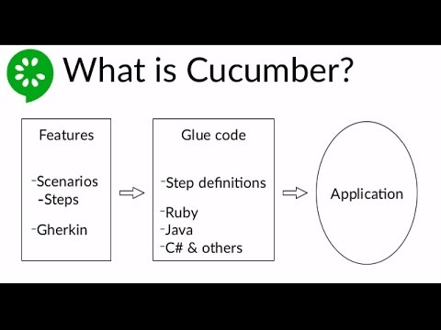
Cucumber Flow :

Slide 9
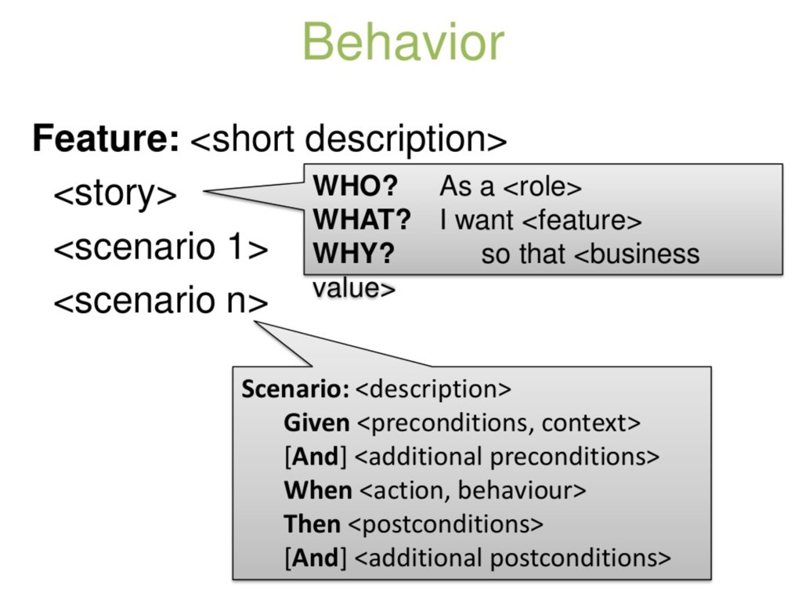
What is in Feature File?

Slide 10
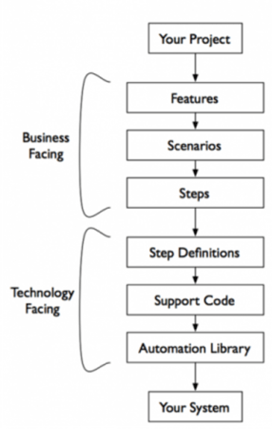
Gherkin Language
Given….
When ...
Then….

Slide 11
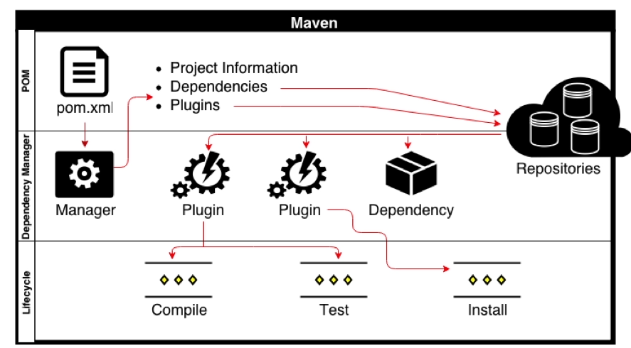
Maven Integration

Slide 12
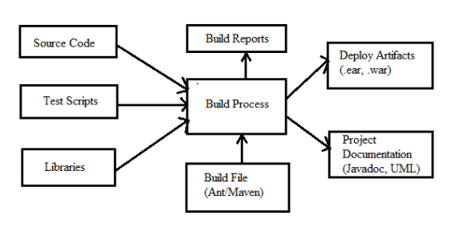
Maven Process Architecture

Slide 13
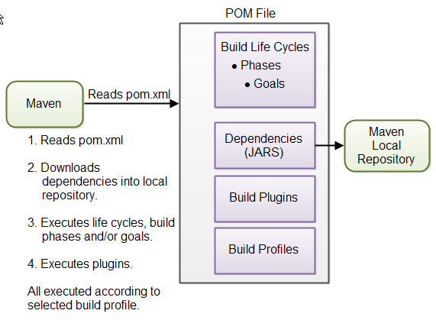
POM file in Maven

Slide 14
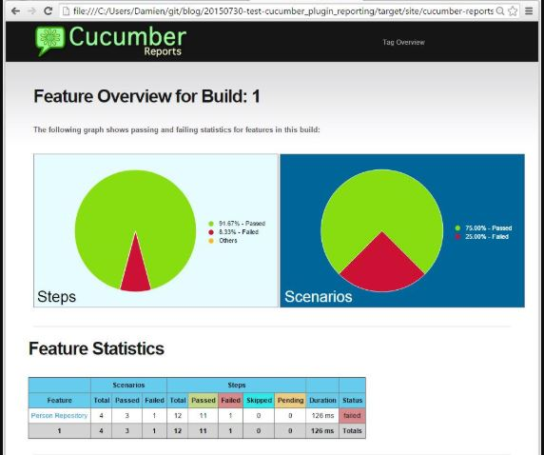
Cucumber Report
Cucumber Report in Graphic View
Pass And Fail Report

Slide 15
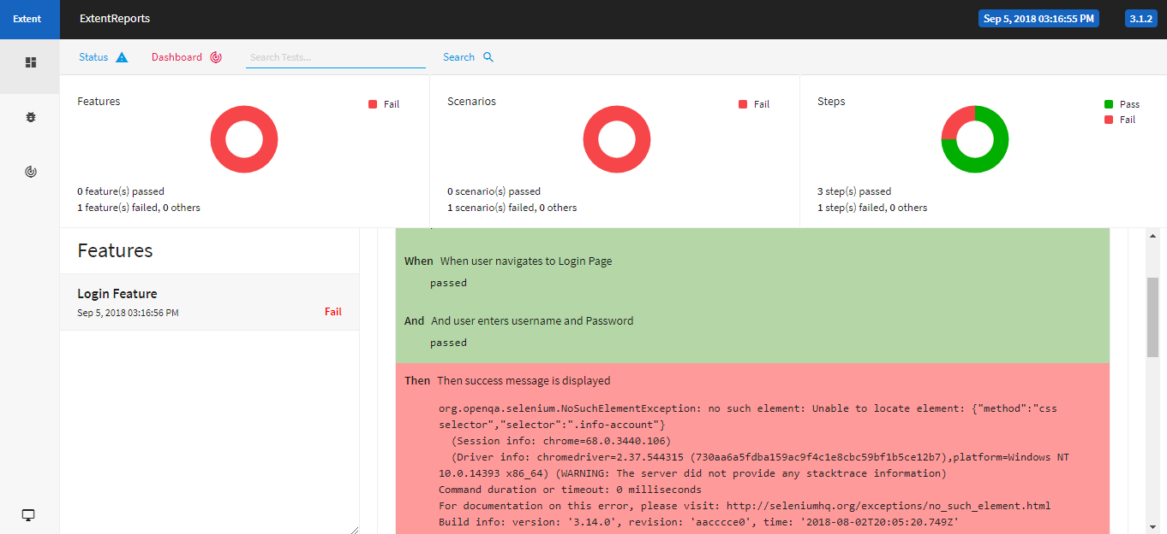
Failure Report with Error Description

Slide 16
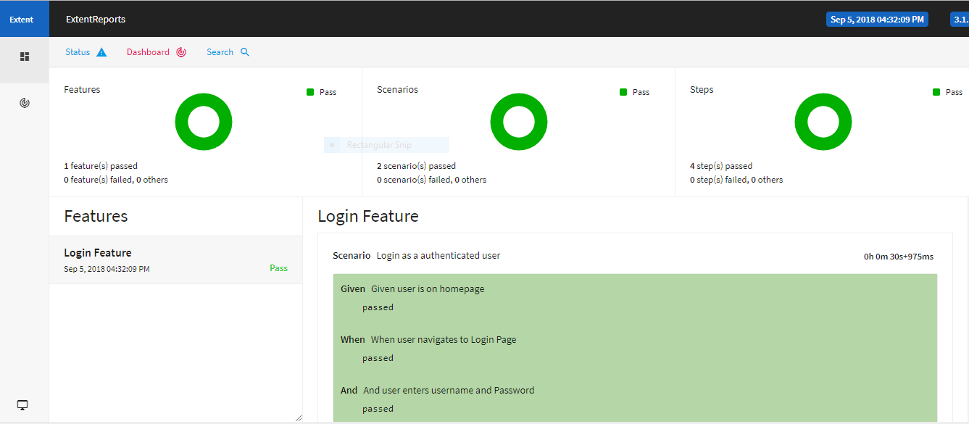
Success Report Shown in Dashboard in HTML Format

Slide 17
Thanks Every One
Any Queries?

