Slide 1
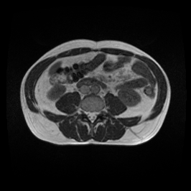




Input Image
Stomach or Small Bowel or Large Bowel?
ResNetClassifier
YES
NO
SegFormer
Segment
Image
Create
Zero Mask
Mask
Zero Mask

Slide 2
Input Image
SegFormer
Segment
Image
Mask

