Slide 1
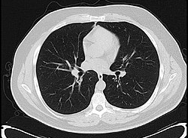
train.csv
- W, H
- file name
- class labels: {bkg: 0, l.b: 1, s.b: 2, st: 3)
EDA
Generate
Mask
Read Image
Normalize, Padding
CNN
Segmented Image
.PNG
np.array:
(1, W, H, 1)
np.array:
(1, W, H, 1)
Overlay
App

