Slide 1
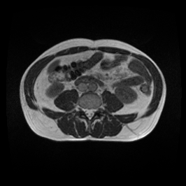


The Model (Baseline)
Input Image
Produces lots of false positive masks
Computationally complex
SegFormer
Segment
Image
Mask

Slide 2


The Model
(Enhanced)
Input Image
Reduces false positive rate
Reduces segmentation time
Stomach or Small Bowel or Large Bowel?
ResNetClassifier
YES
NO
SegFormer
Segment
Image
Create
Zero Mask
Mask
Zero Mask

Slide 3
The Model in Numbers
Segmentation accuracy: Achieved 92%
Improvements over baseline
Accuracy: 26% higher
Speed (segmentation only): 45% faster
Overall speed (web app): 15% faster

