Slide 1
PROGRAMMING TASK
for the Internship role
at Volkswagen Group Research (AI and Deep Learning for Automated Driving)
Diwakar Manickavelu
Contact:
Mail: diwakar.manickavelu@alumni.fh-aachen.de
Phone: +49 – 15219438625
Address: Schillerstraße 86, 52064 Aachen

Slide 2
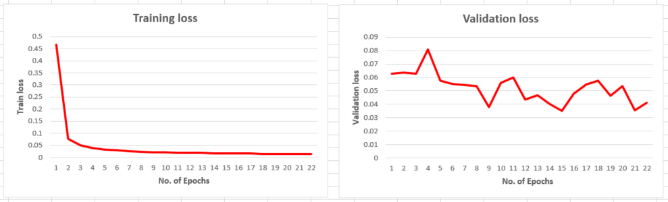
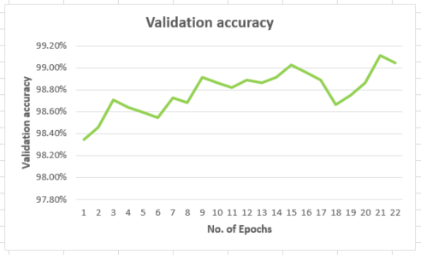
EXPERIMENT NO. 1 (WITH STN)
The pipeline has been run as instructed and the data acquired during the training is plotted against the No. Of epochs
Evaluation Results:
Test loss: 0.025329; Test accuracy: 99.287%

Slide 3
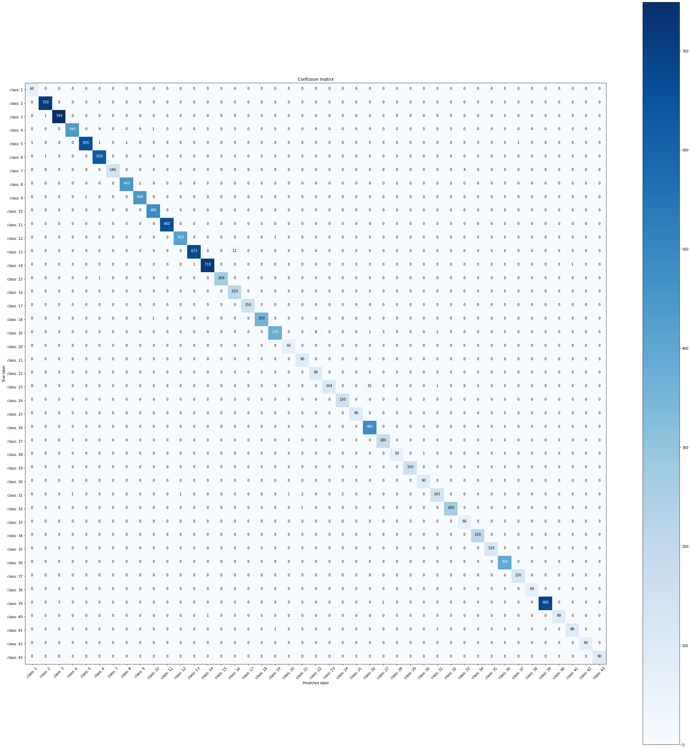
EXPERIMENT NO. 1 (WITH STN)
CONFUSION MATRIX
The confusion matrix is generated and plotted as a heat map
One can witness the blue diagonal in the heat map, which proves the effectiveness of the model
We can also understand where the model gets confused by understanding the map in depth
Performance metrics:
Accuracy: 0.992874= 99.29%
Recall: 0.991303 = 99.13 %
Precision : 0.988662 = 98.87 %
F1_Score : 0.989980 = 99 %

Slide 4
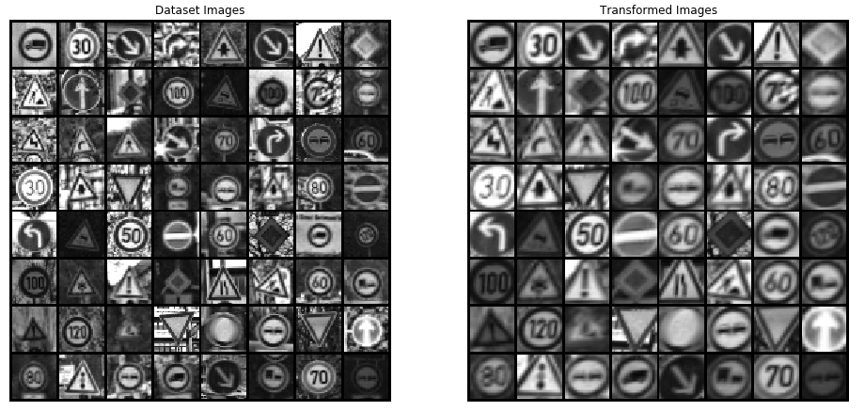
EXPERIMENT NO. 1 (WITH STN)
The role of STN layer in a model is clearly depicted in this visualization. The traffic signs are made to go through a spatial transformations to achieve the geometric invariance of the model

Slide 5
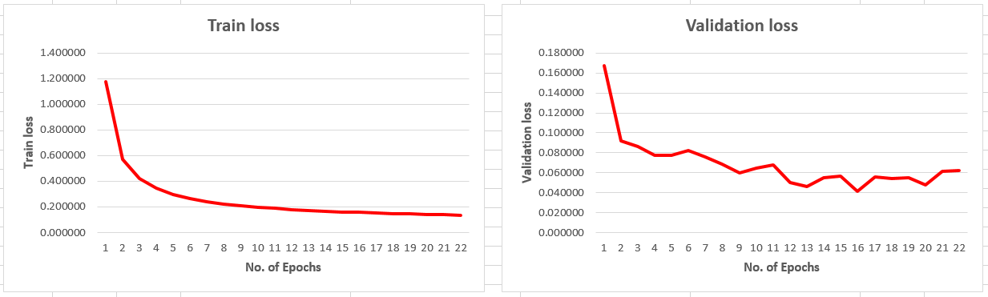
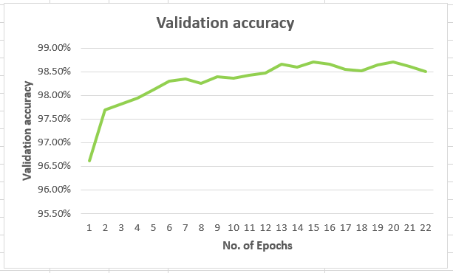
EXPERIMENT NO. 2
The layer STN is removed from the model, rerun the pipeline and plotted the results
Evaluation Results:
Test loss: 0.041385; Test accuracy: 98.678%

Slide 6

EXPERIMENT NO. 2 (W/O STN)
CONFUSION MATRIX
From the performance metrics values comparison with both the experiments 1 and 2, we can clearly say that the STN layer addition to the model enhances the classifier‘s ability to correct identify the traffic sign and give better results
Performance metrics:
Accuracy: 0.986778 = 98.68 %
Recall: 0.986499 = 98.65 % Precision : 0.977475 = 97.75 % F1_Score : 0.981967 = 98.20 %

Slide 7
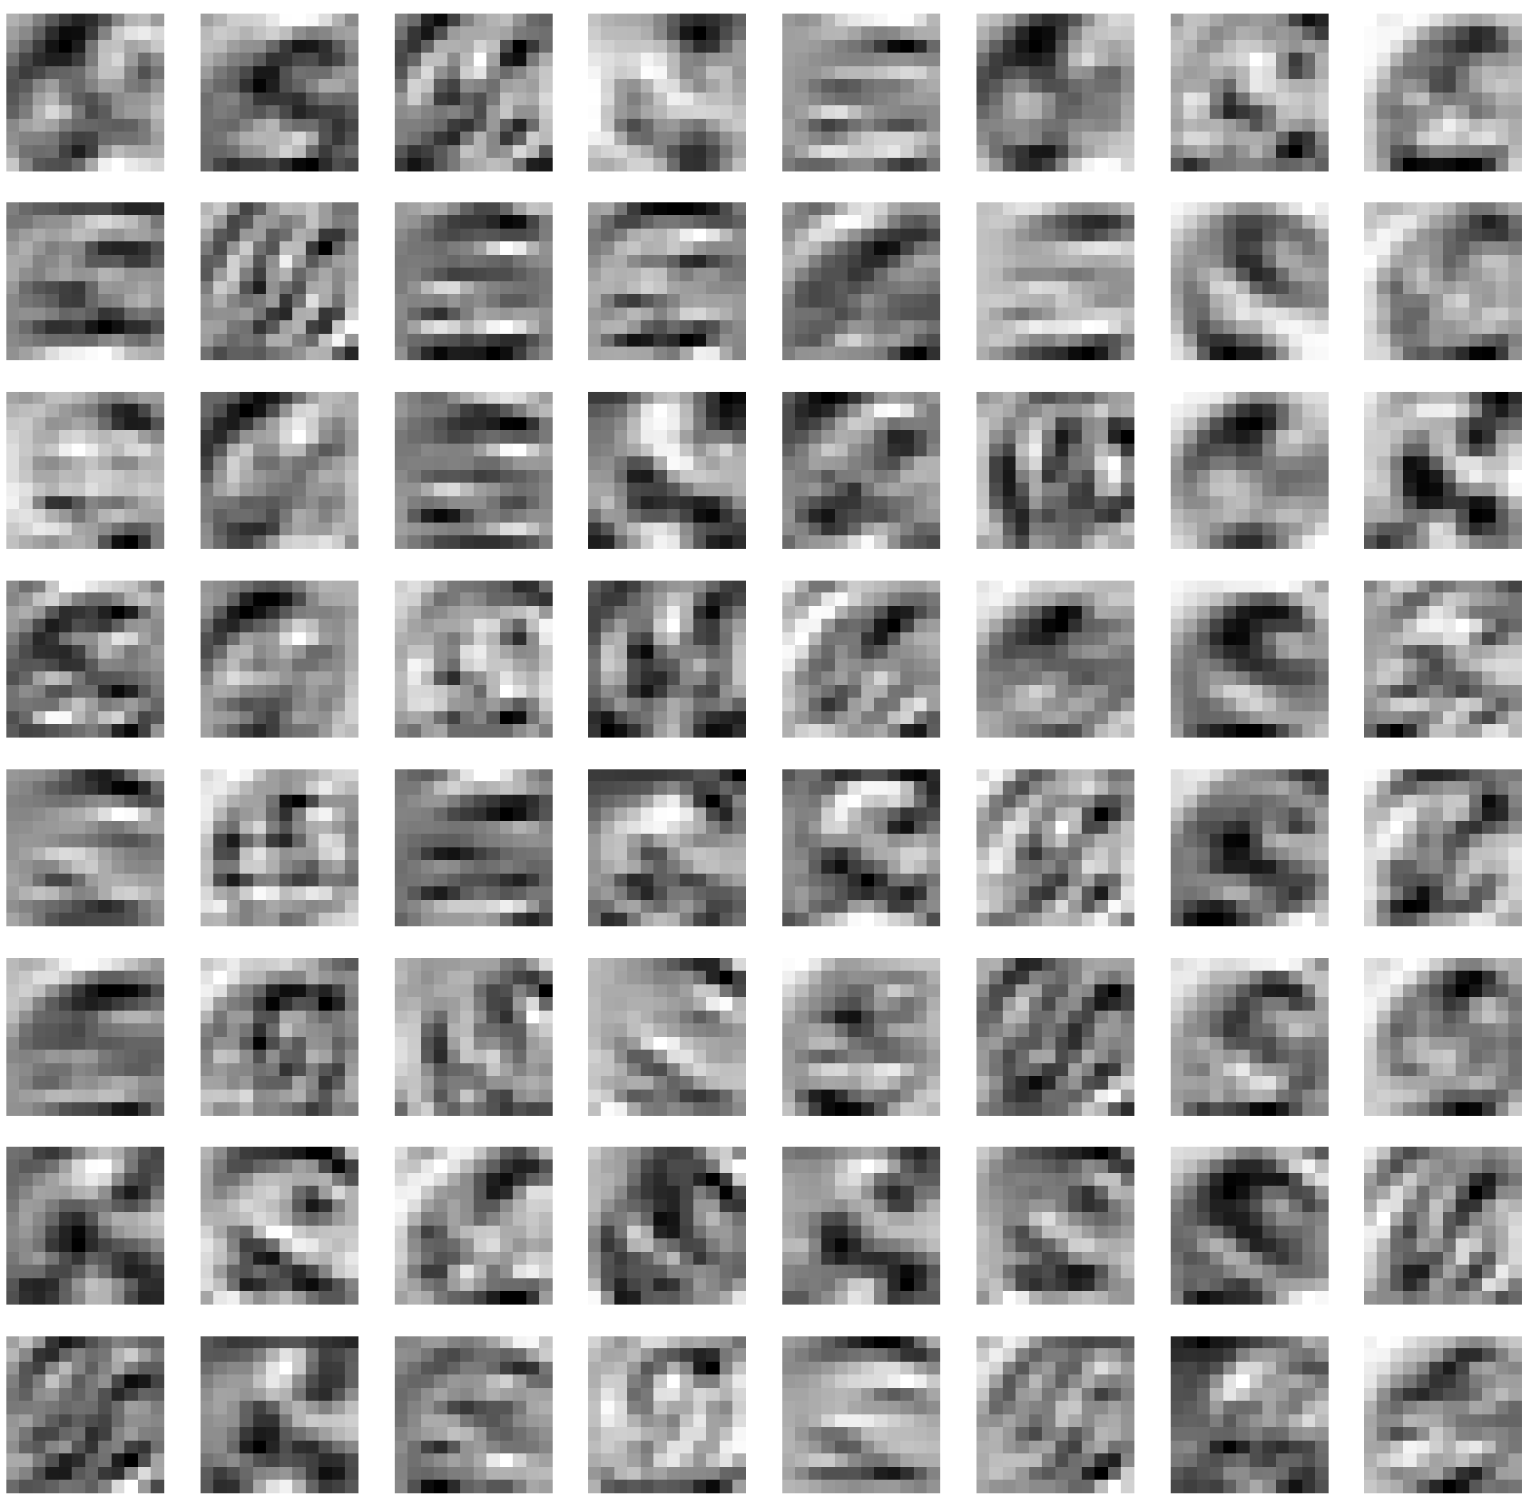
EXPERIMENT NO. 3
Activation output of conv3 layer of one image: Class 16 (with STN)
The feature map clearly captures only the central element of the traffic sign, which increases the spatial invariance for the end result
(It is mainly due to the spatial transformations that took place at the start of the network).

Slide 8
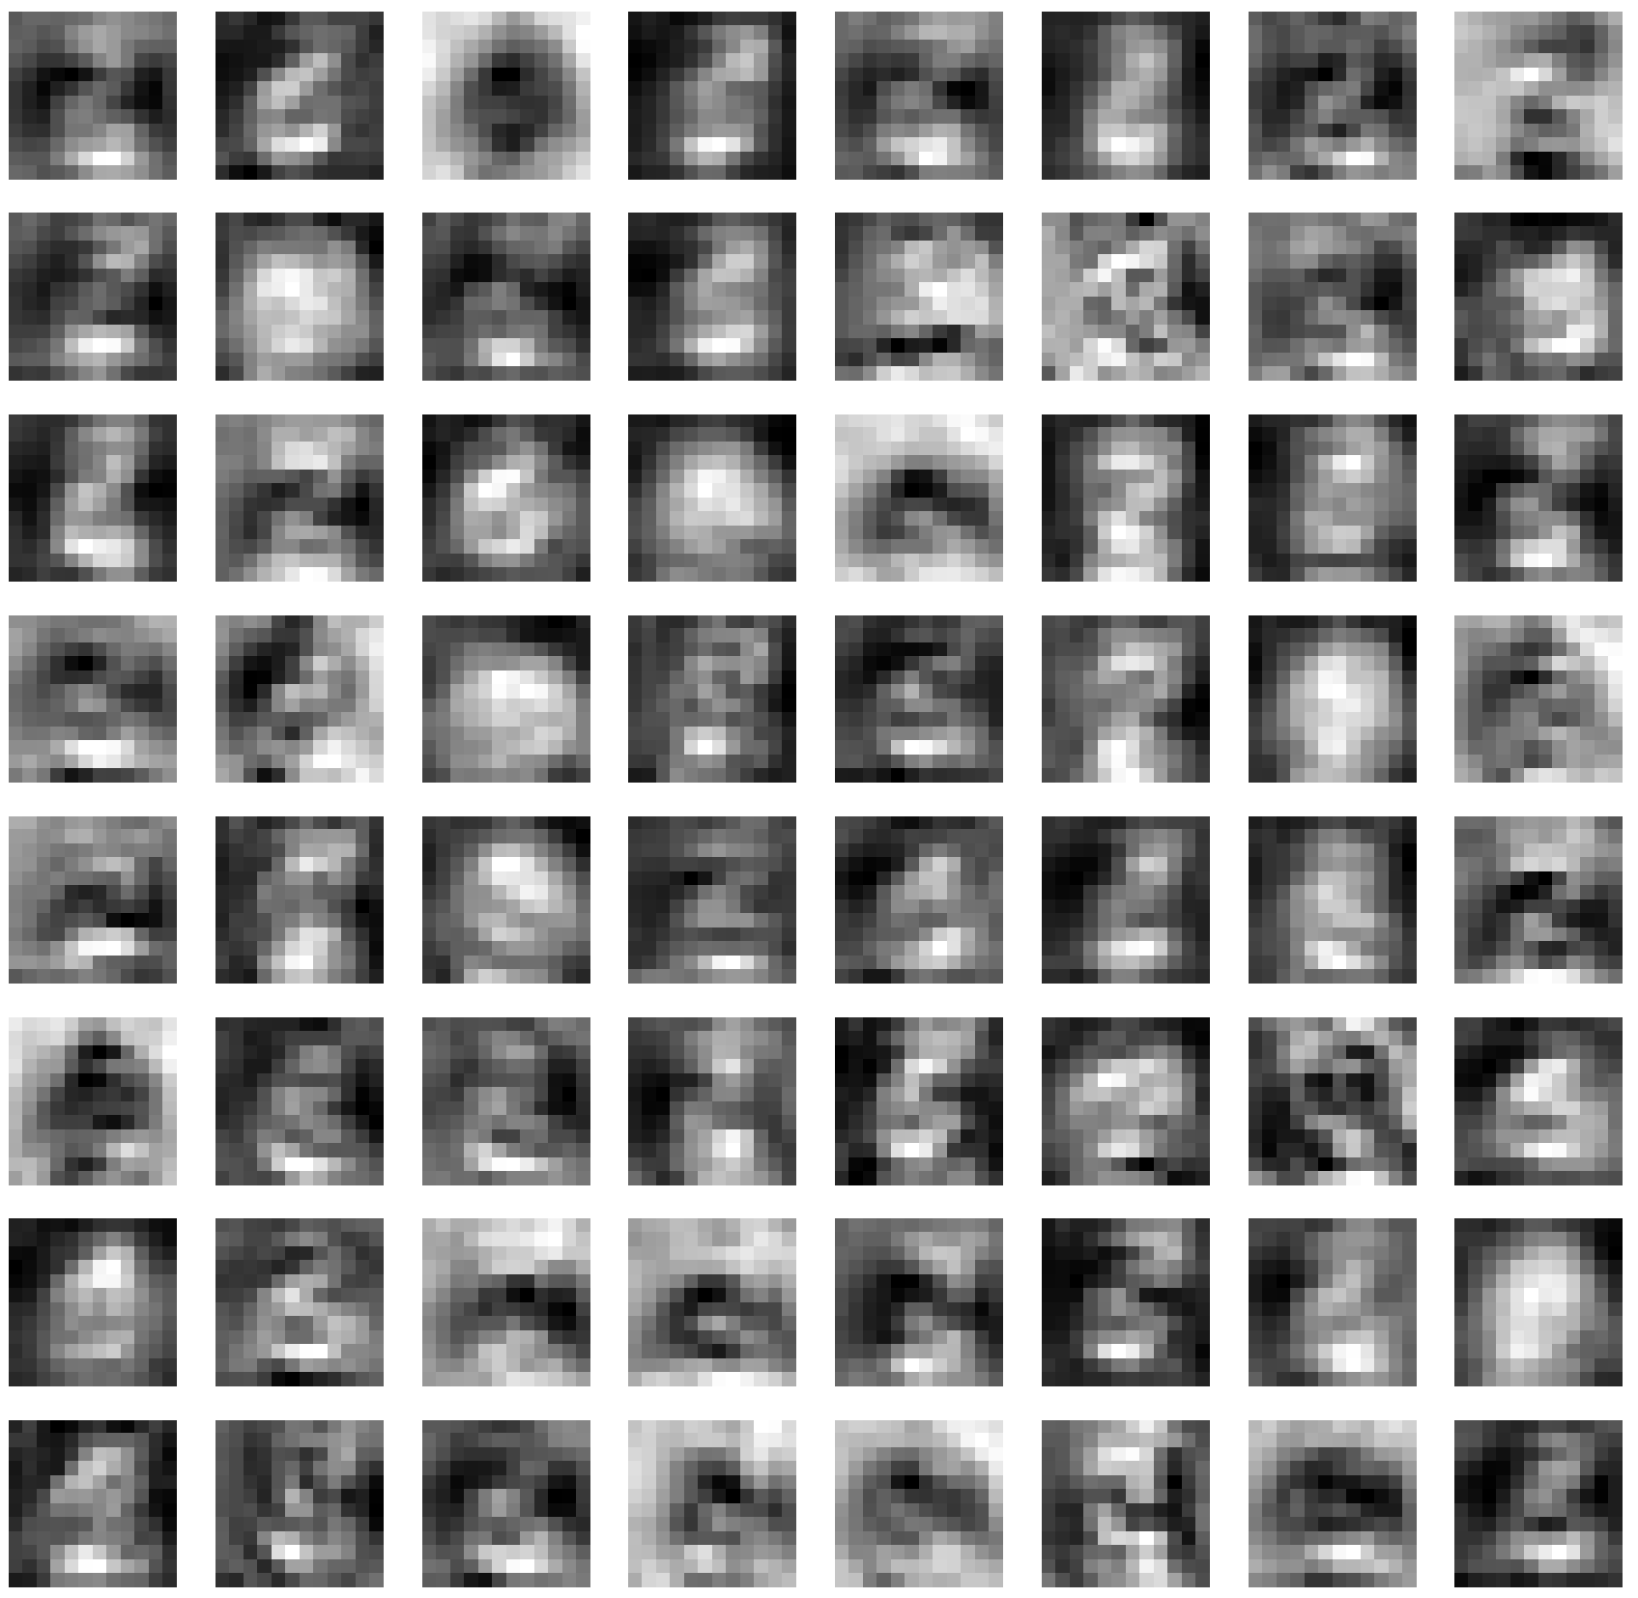
EXPERIMENT NO. 3
Activation output of conv3 layer of one image: Class 16 (w/o STN)
The absense of STN layer in the spatial invariance is clearly perceivable in this conv layer.
As opposed to the fig. in the previous slide, the background of the sign is also present in the feature maps, which would influence the final result of classification

Slide 9
CHALLENGES AND DEADLOCKS:
As I do not have enough computing power and due to time constraints, with your acknowledgement, I reduced the number of epochs to 22, hence, the performance of the results might have taken a hit, compared to the original performance.
In the Experiment 3, I have been asked to get the gradients calculated for the layer „conv3“ for the images from both of the trained models in the Experiments 1 and 2
To my understanding, only during the training process, the model would carry the gradient values of the convolutional layer. With the trained model, and during the prediction, there would be no gradients present in the layer
Please correct me also, if I am wrong. I am humbly open to learn it, if I am mistaken

Slide 10
I hope you liked my presentation. I am happy to answer any questions, if there are any….
THANK YOU

