Slide 1

English Dictionary using Python

Slide 2
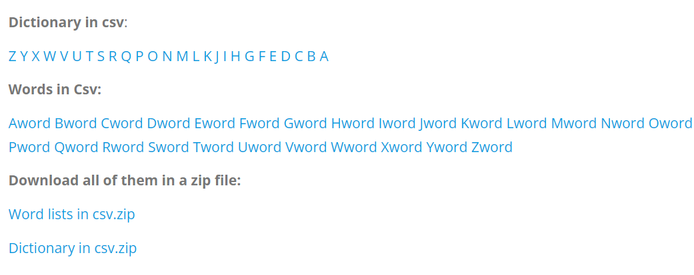
Obtaining the dictionary data
https://www.bragitoff.com/2016/03/english-dictionary-in-csv-format/
Found CSV for each word from this link

Slide 3
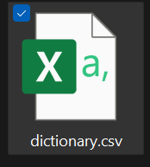
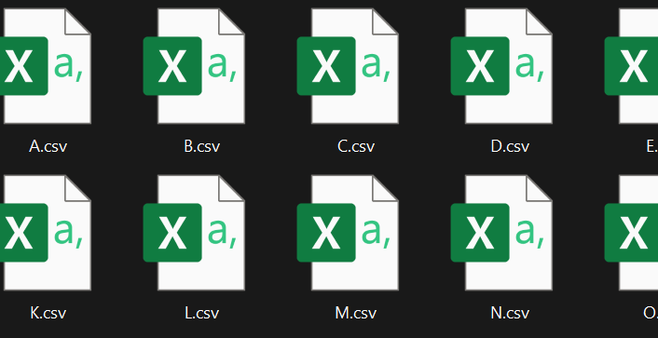
Merge CSV Files into a single CSV

Slide 4
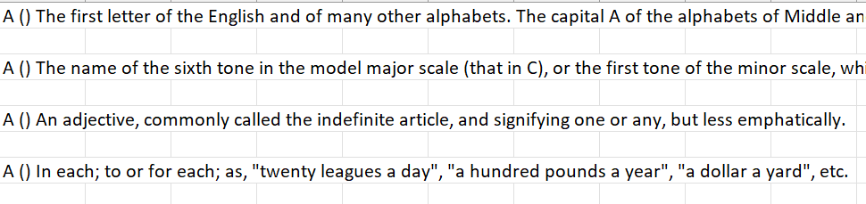
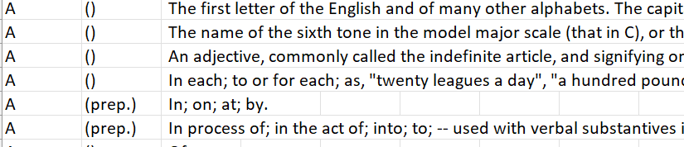
Merge CSV Files into a single CSV

Slide 5
Merge CSV Files into a single CSV
def merge_csv_files(foldername="dictionary"): csv.field_size_limit(256 << 20) meaning_list_all = [] csv_files = glob.glob(foldername + "/*.csv") for filename in csv_files: with open(filename, newline='') as csvfile: meaning_list_all = meaning_list_all + list(csv.reader(csvfile)) meaning_list = [e for e in meaning_list_all if e] for i in range(len(meaning_list)): try: split_opening = meaning_list[i][0].split(' (', 1) meaning_list[i][0] = split_opening[0] split_closing = split_opening[1].split(')', 1) split_middle = f"({split_closing[0]})" meaning_list[i].append(split_middle) meaning_list[i].append(split_closing[1]) except Exception as e: continue meaning_list = sorted(meaning_list, key=lambda s: s[0].lower()) with open('dictionary.csv', 'w', newline='') as f: # using csv.writer method from CSV package write = csv.writer(f) write.writerows(meaning_list) return meaning_list
Add each CSV to a list
Split each row into three parts
Append the data to sub-lists
Sort the list (Tim sort) O(nlogn)
Save the list to csv

Slide 6
Merge CSV Files into a single CSV
Inefficient algorithm
Looped through the list three times to perform operations that could have been done within one loop
However, not very important because had to run this only once at the beginning of the project

Slide 7
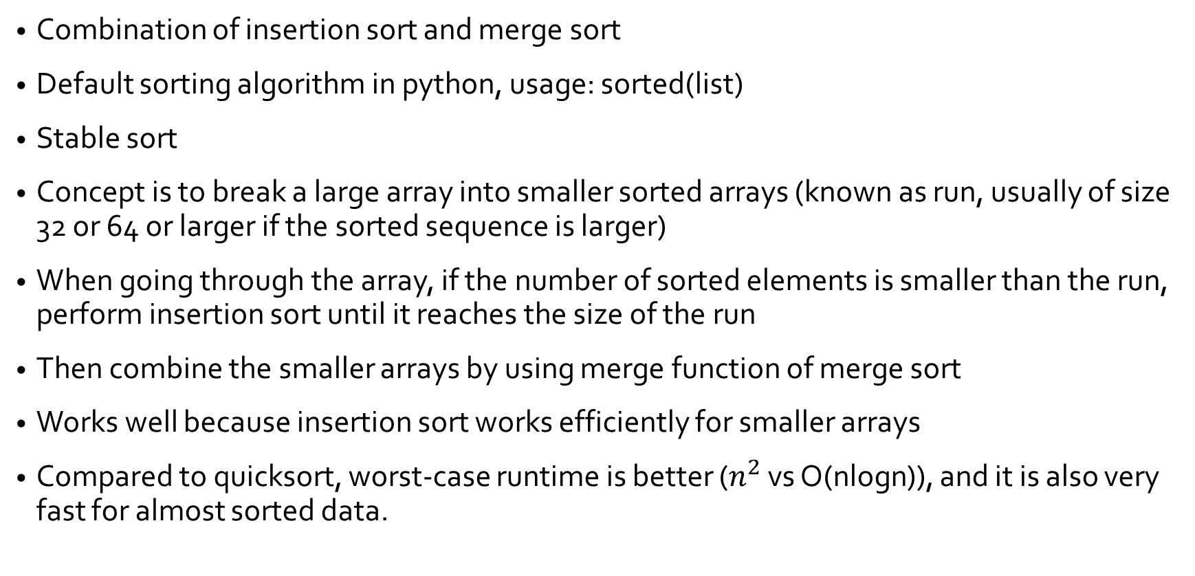
Tim Sort O(nlogn)
https://svn.python.org/projects/python/trunk/Objects/listsort.txt
Combination of insertion sort and merge sort
Default sorting algorithm in python, usage: sorted(list)
Stable sort
Concept is to break a large array into smaller sorted arrays (known as run, usually of size 32 or 64 or larger if the sorted sequence is larger)
When going through the array, if the number of sorted elements is smaller than the run, perform insertion sort until it reaches the size of the run
Then combine the smaller arrays by using merge function of merge sort
Works well because insertion sort works efficiently for smaller arrays
Compared to quicksort, worst-case runtime is better ($n^{2}$ vs O(nlogn)), and it is also very fast for almost sorted data.

Slide 8
Data Structures Used
Python List (Similar to Dynamic Array, can use index, as well as dynamically insert or delete elements)
Python Dictionary (Hash Table) ← As the name itself might suggest, one of the best data structures to implement a word dictionary
Doubly linked list (self implemented)
Still using python list inside the aforementioned data structures to store meanings as an object.
Another good algorithm for implementing a word dictionary is “Trie”, where the search operation takes running time of the length of characters, but not implemented. Tries are known to be good for prefix search.

Slide 9
Lists

Slide 10
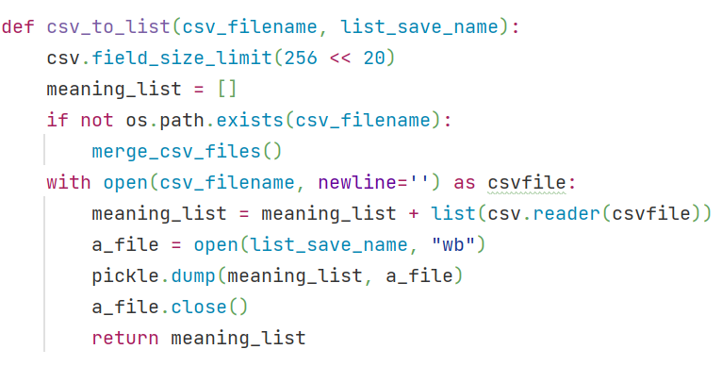
List Implementation
Structure:
[…, [“Bat”, “n.”, “A large stick”][“Bat”, “n.”, “A part of brick with one whole end”],…]
Initially loaded from the CSV and saved as a pickle file for faster future use

Slide 11
Operations on List
Searching, two ways:
Binary search (works because we are using a sorted list)
Linear search
Deleting a word, two ways:
Binary search and delete
Linear (list comprehension)
Insert, two ways:
Append to the list at the end and sort the list (inefficient)
Perform binary search to find the suitable place for the new word

Slide 12
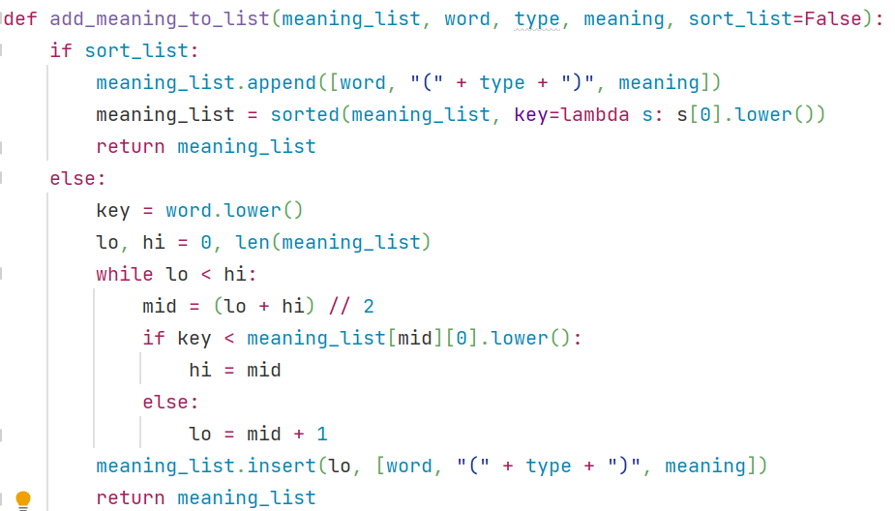
Insert Word or Meaning
If the option to sort the list is checked, add the element to the end and then sort the list
Otherwise, perform binary search on the list to find a suitable position to insert the word, and then insert
According to python time complexity wiki, appending an element is O(1) and inserting is O(n).
For the first case, we append and sort O(nlogn), while in the second, we perform binary search O(logn) and then insert O(n), thus it is faster.
Another way (more efficient than the first one) would be to perform a linear search to find a suitable position for the new word

Slide 13
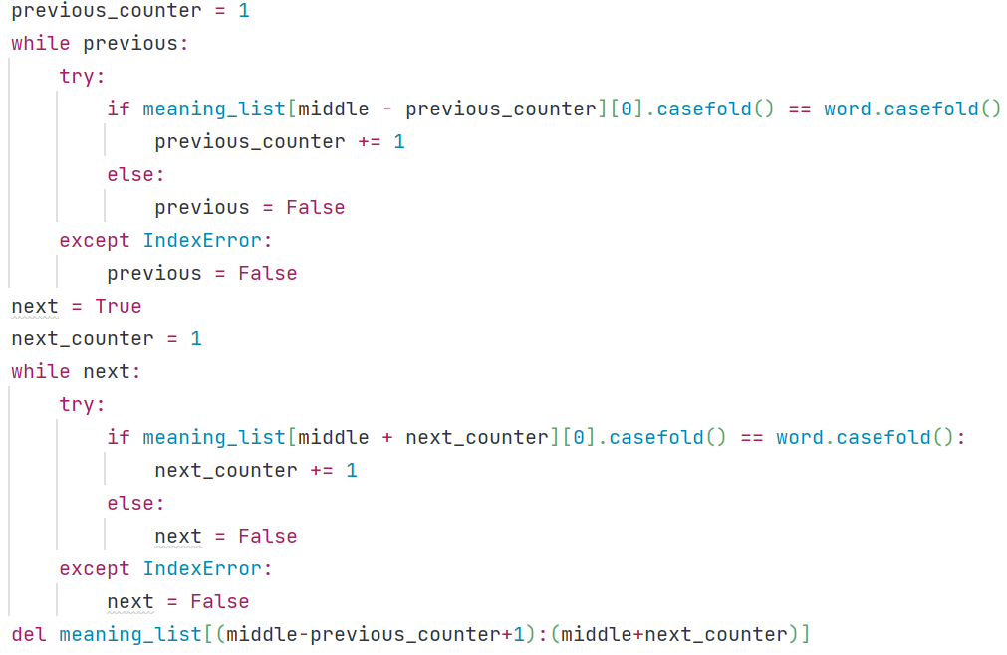
Search
Either simple linear search, or binary search
While performing binary search, as there could be more than one instance of a word, need to search for the words within the range
Because the list is already sorted, other words can only be within the same range as the found word
The code at the left is doing the same within a binary search (if the word is found)

Slide 14
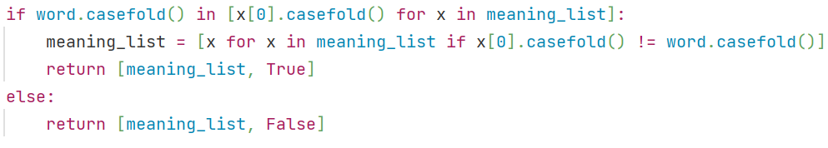
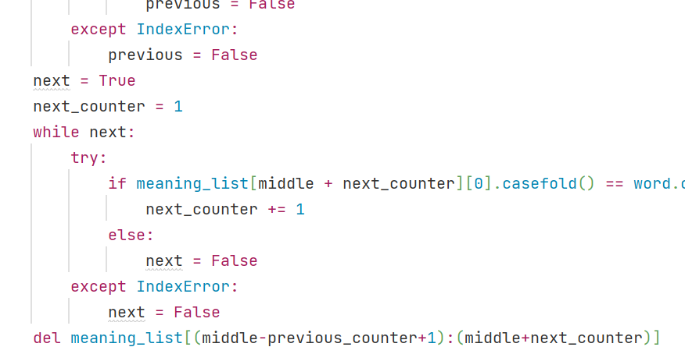
Delete Word
Either delete the word using python list comprehension (linear), or using similar approach to searching
Like with searching, perform binary search to find the word, and then delete the words within the range.
Can then use the del function which runs at O(n)

Slide 15
DICTIONARIES

Slide 16
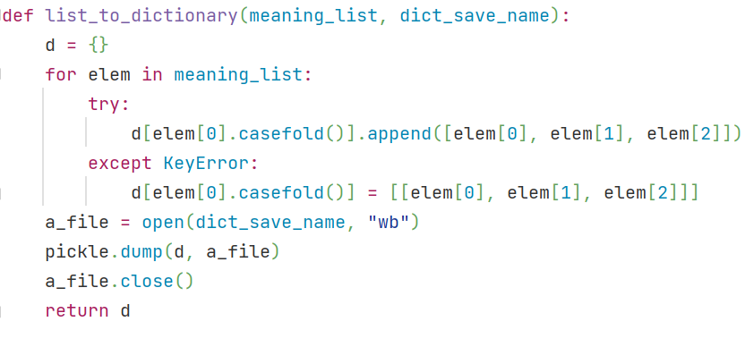
Dictionary Implementation
Structure:
{…,
“bat” : [[“Bat”, “n.”, “A large stick”], [“Bat”, “n.”, “A part of brick with one whole end”]],
…}
Created by traversing through the list and appending each element to the dictionary
Using try catch makes it more efficient than searching if the key exists
Another thing to note here is that the dictionary keys are being stored as lowercase letters. This is for case-insensitive search.

Slide 17
Operations on Dictionary
Searching, two ways:
Binary search (works because we are using a sorted list)
Linear search
Deleting a word, two ways:
Binary search and delete
Linear (list comprehension)
Insert, two ways:
Append to the list at the end and sort the list (inefficient)
Perform binary search to find the suitable place for the new word

Slide 18
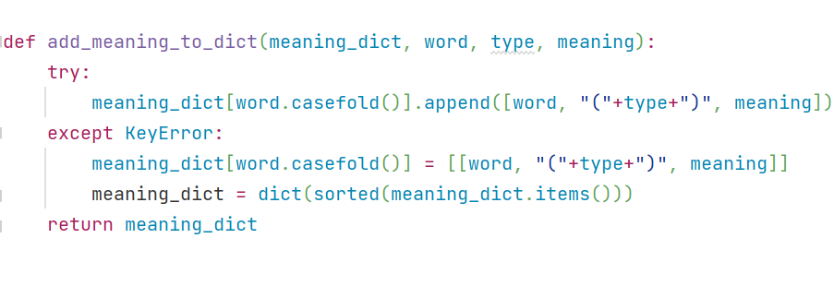
Insert Word or Meaning
Like converting a given list to a dictionary as seen earlier, can use exception handling to attempt appending an element to the end of the matched value from the given key (word to be added)
If the word is not found, KeyError is thrown, and the word can be appended to the list.
Doing so also requires the dictionary to be sorted, however
Thus, the time taken is O(1) if the key already exists, or O(nlogn) for sorting if the key was appended at the end

Slide 19
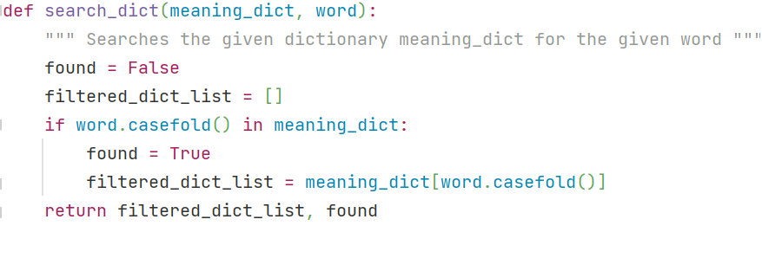
Search
Searching a dictionary, which is a hash-table, is simply matching with the key and takes O(1).

Slide 20
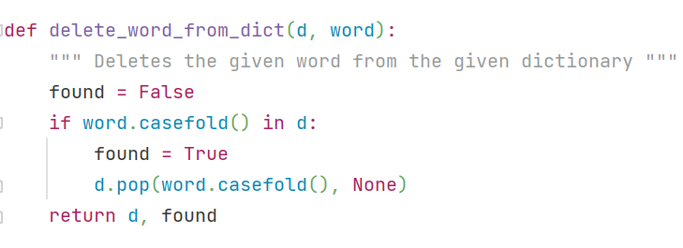
Delete Word
As with searching, deletion also requires matching the key and using the pop command to remove the key-value pair.

Slide 21
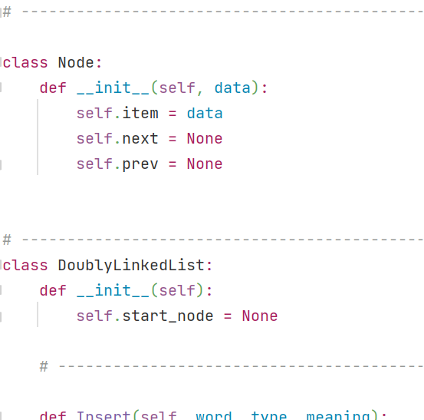
Doubly Linked List

Slide 22
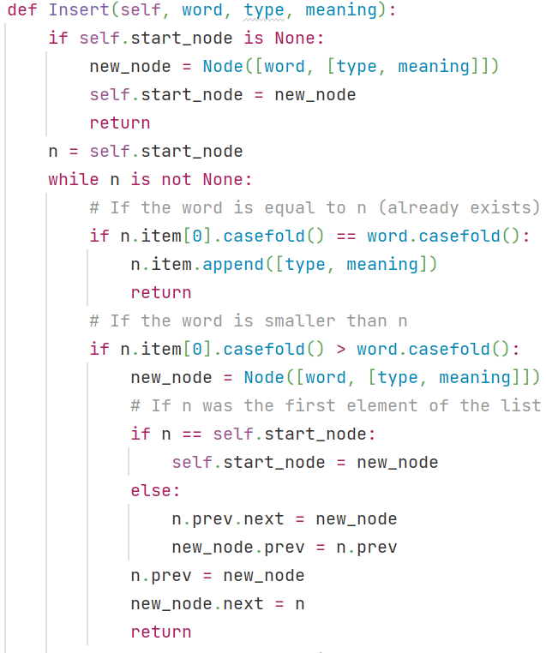
Insert Word or Meaning
If the DoublyLinkedList is empty, insert at the beginning
If the word already exists, append the type and meaning to the word list
Otherwise, insert in sorted order

Slide 23
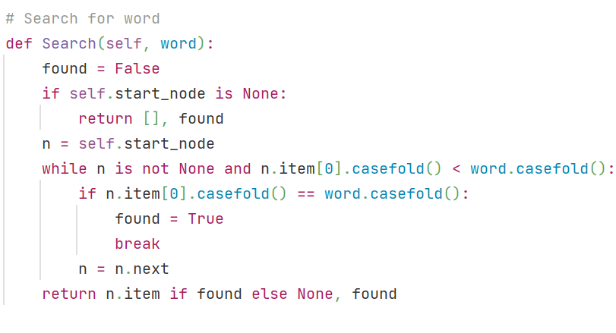
Search
As the DoublyLinkedList is sorted, we can only traverse from the beginning (linear search)
Cannot perform binary search, as we cannot access the middle element

Slide 24
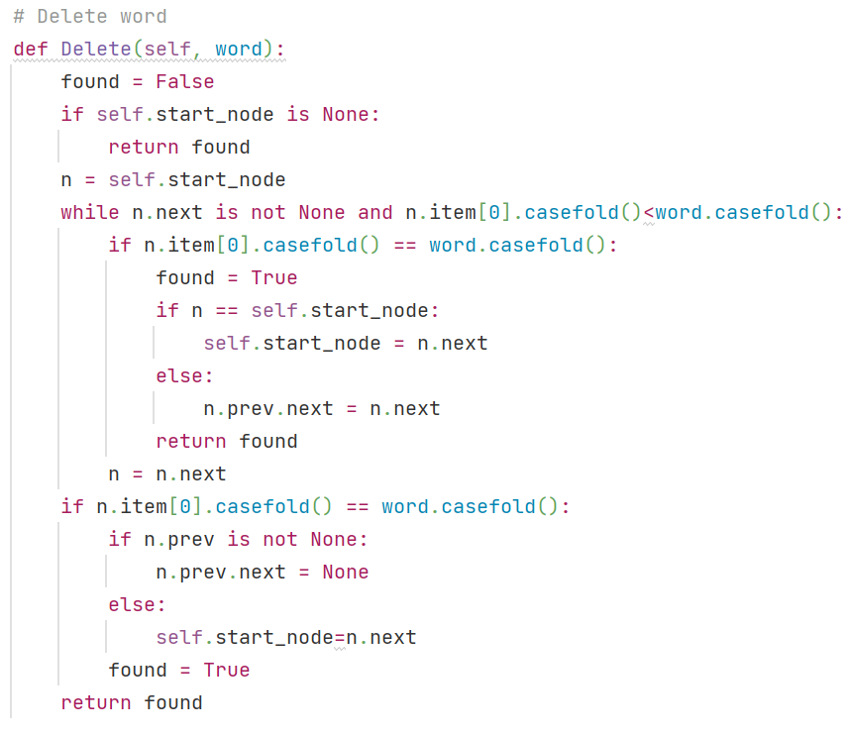
Delete Word
Deletion is faster than for list because we can delete at the middle.
The part that causes delete to take long time and not O(1) is to find the word

Slide 25
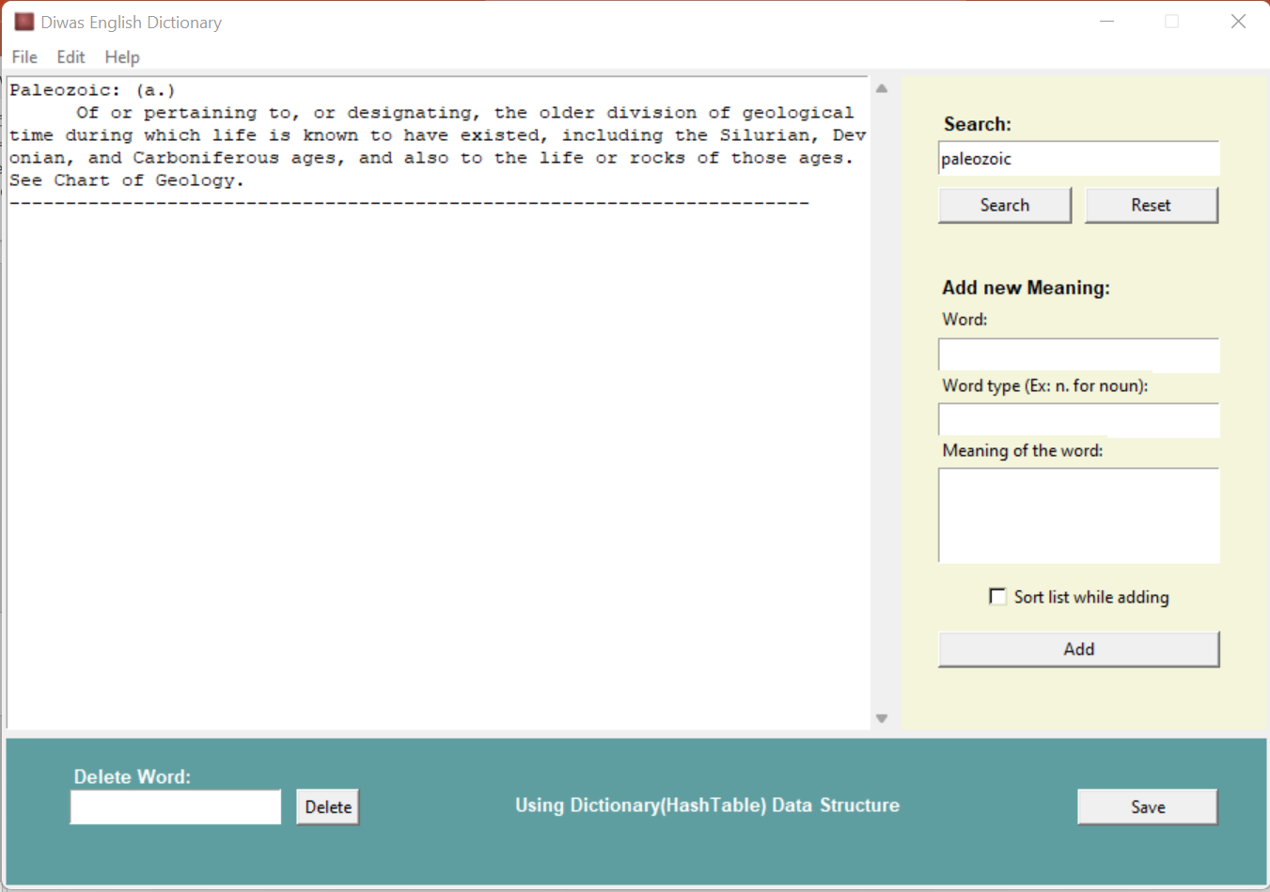

Slide 26
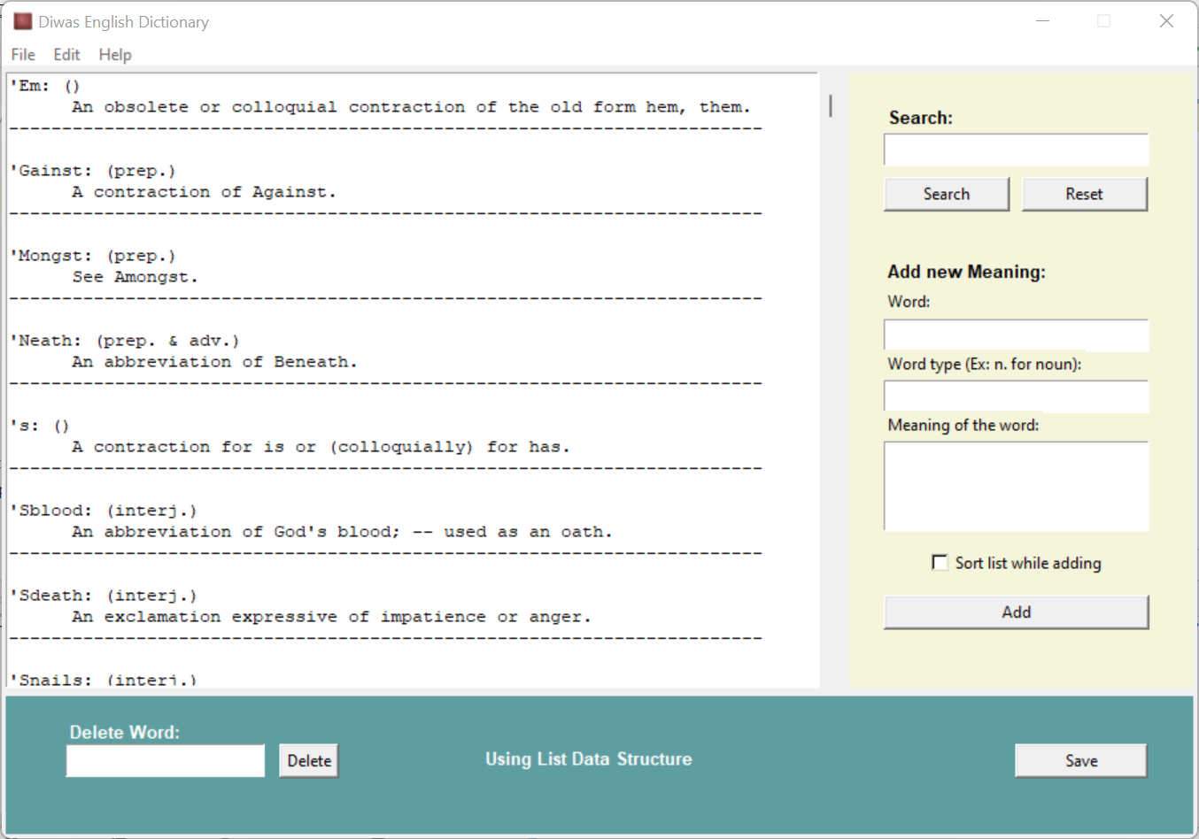
The Application
Searching
Deleting word
Adding word/meaning
Saving the updated dictionary with added/deleted word (for future runs)

Slide 27
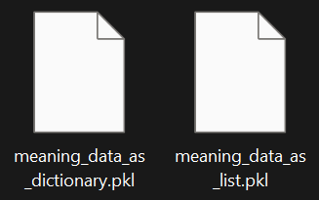
Loading the Word Dictionary
The dictionary is saved as a pickle file for each data structure
The program checks if these pickle files exist in the directory.
If not, it will create the and load the objects for each data structures using “dictionary.csv” and store them into relevant pickle files
If the dictionary is updated (after adding or deleting a word or a meaning), the pickle files are deleted and need to be recreated during the next run

Slide 28
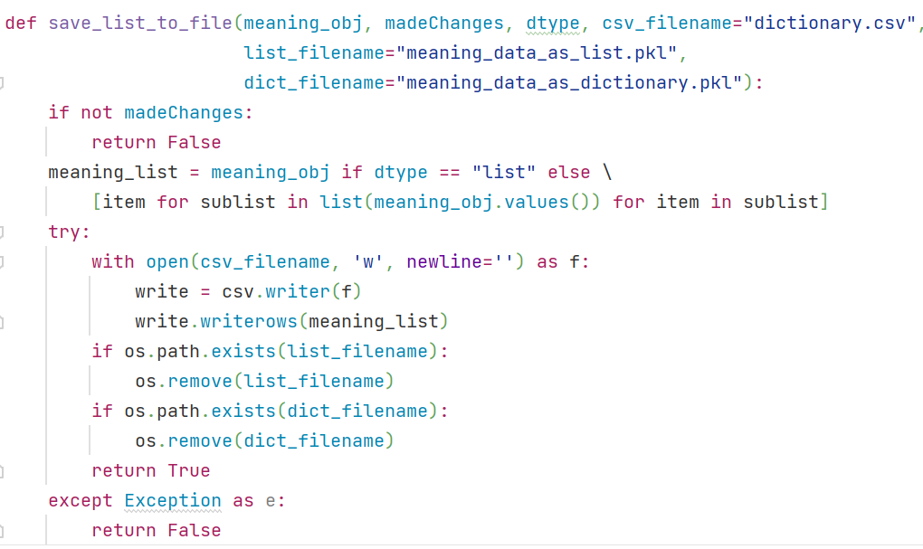
Saving the Word Dictionary
While saving, if the data-type being used is a list, it is as simple as simply writing the list to the csv file.
If the data-type is a dictionary, need to flatten the list generated by taking all the values from the dictionary
After writing the csv file, the pickle files are deleted to be updated in the next run
There is also a global variable that tracks any changes to the word dictionary. If the dictionary has not been changed, the save attempt does nothing

Slide 29

Performance

Slide 30
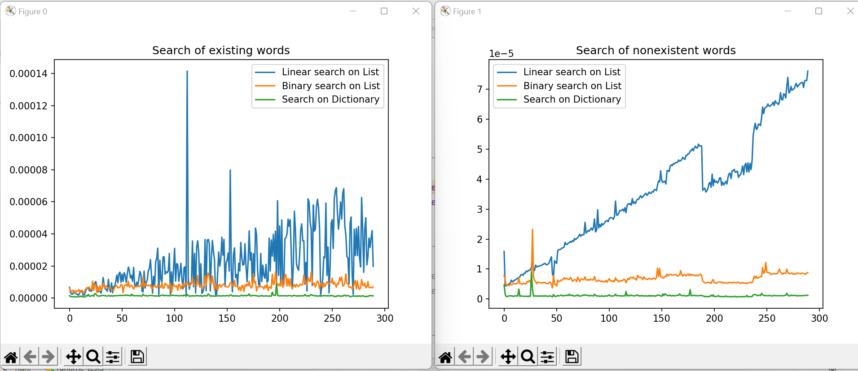
Comparing performance (Searching)

Slide 31
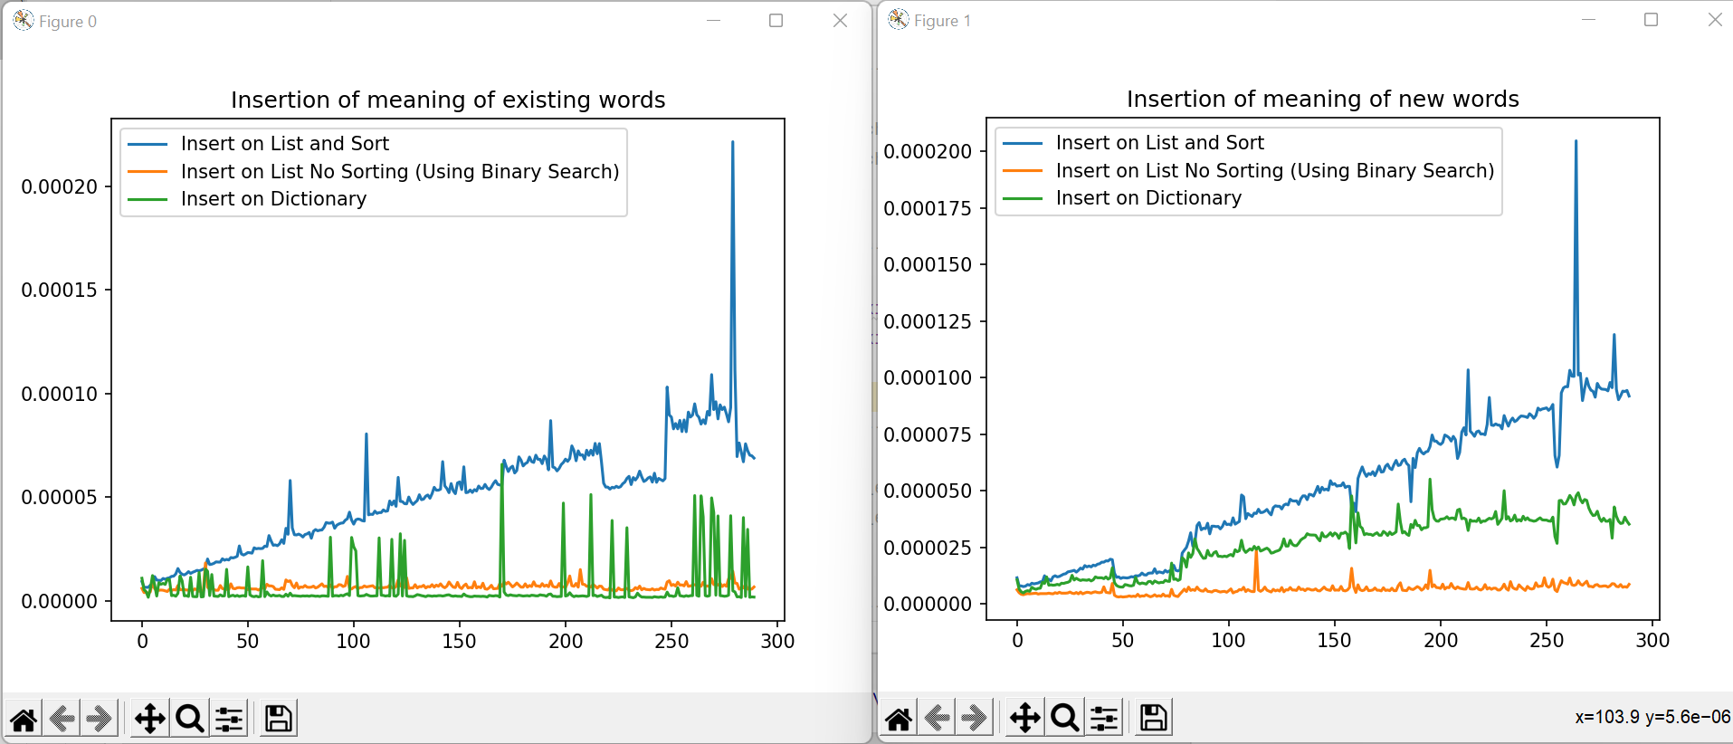
Comparing performance (Insertion)

Slide 32
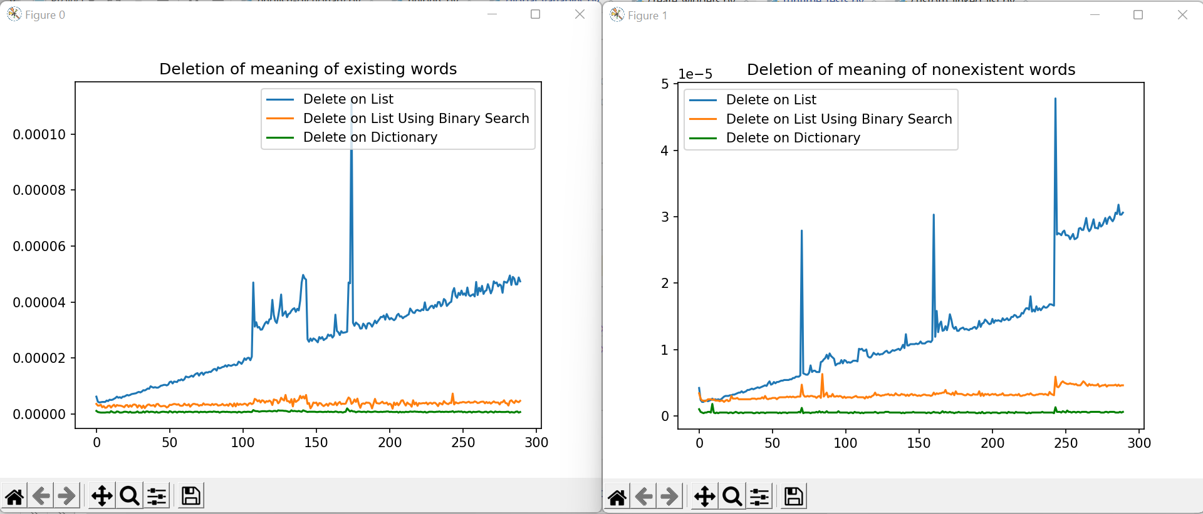
Comparing performance (Deletion)

Slide 33
Why some Data Structures Cannot be Used
Arrays cannot be used because they have a fixed size whereas the word dictionary requires the ability to add or delete a word or meaning
Stacks and queues would be extremely inefficient as we are more often trying to access the elements belonging at the middle of the dataset
Linked lists, while could be used, would perform very poorly (because cannot revisit the previous node during deletion or insertion between two words – solved using doubly linked list)

Slide 34
Limitations
Cannot delete specific meaning for a word
No search autocomplete, which could be implemented using “Trie” data structure (efficient) or a linear search (inefficient)

Slide 35
Possible Improvements
When using linked list, can implement it like dictionary, i.e., for a word, storing all the meanings in another sub-list instead of one sub-list per meaning.
While it does not provide O(1) during access, sorting is quicker, and operations like binary search, delete, and binary search insert are simpler
Current implementation:
[…, [“Bat”, “n.”, “A large stick”][“Bat”, “n.”, “A part of brick with one whole end”],…] could be changed to
[…, [“Bat”, [[“n.”, “A large stick”], [“n.”, “A part of brick with one whole end”]],…].

