Slide 1
Low latency audio
...through core isolation
David Henningsson

Slide 2

Their advertising said...
This soundcard can do 2.7 ms round-trip latency on Mac and 3.2 ms on Windows 10
Can we beat that on Linux?

Slide 3
Sources of latency
ADC hardware latency | unknown
Period size (16 samples @ 96 kHz) | 0.16 ms
USB microframe | 0.125 ms
Computer processing | Variable
Buffer size (32 samples @ 96 kHz) | 0.33 ms
USB microframe | 0.125 ms
Period size (16 samples @ 96 kHz) | 0.16 ms
DAC hardware latency | unknown

Slide 4
USB audio buffer handling
Wakeup
Userspace
process
IRQ
USB controller
chip
Kernel
(hardIRQ)
Shared
memory
Command

Slide 5
The classic way
Make the kernel schedule your process ASAP
Use RT priority scheduling to do so
But the CPU might be busy:
  Processing an interrupt
  Running a kernel thread that disables preemption
  (kernel cannot “schedule while atomic”)
Other kernel drivers (graphics, wifi etc) don’t always consider other real time critical processes

Slide 6
The “isolated core” way
Dedicate one core for audio
Run audio process on that core
Audio IRQ processing on that core
And nothing else.
Kernel, please leave my core alone!

Slide 7
Basic tool: isolcpus
Kernel parameter
Keeps the kernel from scheduling tasks on specific cores
Use taskset to move task to core
Example:
  Boot with: isolcpus=1
  Run: taskset -c 1 <cmd>

Slide 8
Basic tool: irqaffinity
Kernel parameter
  (added in 4.6, but mostly a convenience)
Schedules irqs only on specific cores
Use /proc/irq/<x>/smp_affinity_list to move an irq to a specific core
Example:
  Boot with: irqaffinity=0,2,3
  Run: echo 1 > /proc/irq/<x>/smp_affinity_list

Slide 9
Basic tool: nohz_full
Timer interrupts are run on all cores by default (regardless of irqaffinity and isolcpus)
But we can turn them off, if there is only one process to be scheduled on a core.
Example:
  Boot with nohz_full=1 to turn off timer interrupts on core 1

Slide 10
Sleeping
If your thread goes to sleep, the kernel still needs to wake you up (i e schedule your process)
But the kernel might be in “preempt disable” mode

Slide 11


Slide 12
Basic tool: scaling_governor
Controls the frequency of cores
By setting it to performance for our particular core, we avoid two problems:
  The core pauses during frequency changes (hardware limitation)
  No kernel thread run periodically to check load
Example:
  echo performance > /sys/devices/system/cpu/cpu1/cpufreq/scaling_governor

Slide 13
The setup:
We boot with isolcpus=2,3 irqaffinity=0,1 nohz_full=2,3
Move the right IRQ to our isolated core:
  echo “2,3” > /proc/irq/20/smp_affinity_list
Start the task on our isolated core: taskset -c 2,3 ./lowlatencytask

Slide 14
Isolated core strategy summary
RT prio? Doesn’t matter – no other process should run on my core
IRQ RT prio? Doesn’t matter – no other IRQ should run on my core
Kernel is Preempt disabled? Doesn’t matter – my process doesn’t sleep, so it doesn’t need the kernel to wake it up
Threaded IRQ handlers? Probably makes things worse if the kernel has to schedule my IRQ.

Slide 15


Slide 16
Test subjects
AMD Ryzen 1700 desktop
A Dell laptop from 2016, i3-6100U (Skylake)
An HP laptop from 2010, core i3 M350 (Arrandale)
Raspberry Pi 2

Slide 17
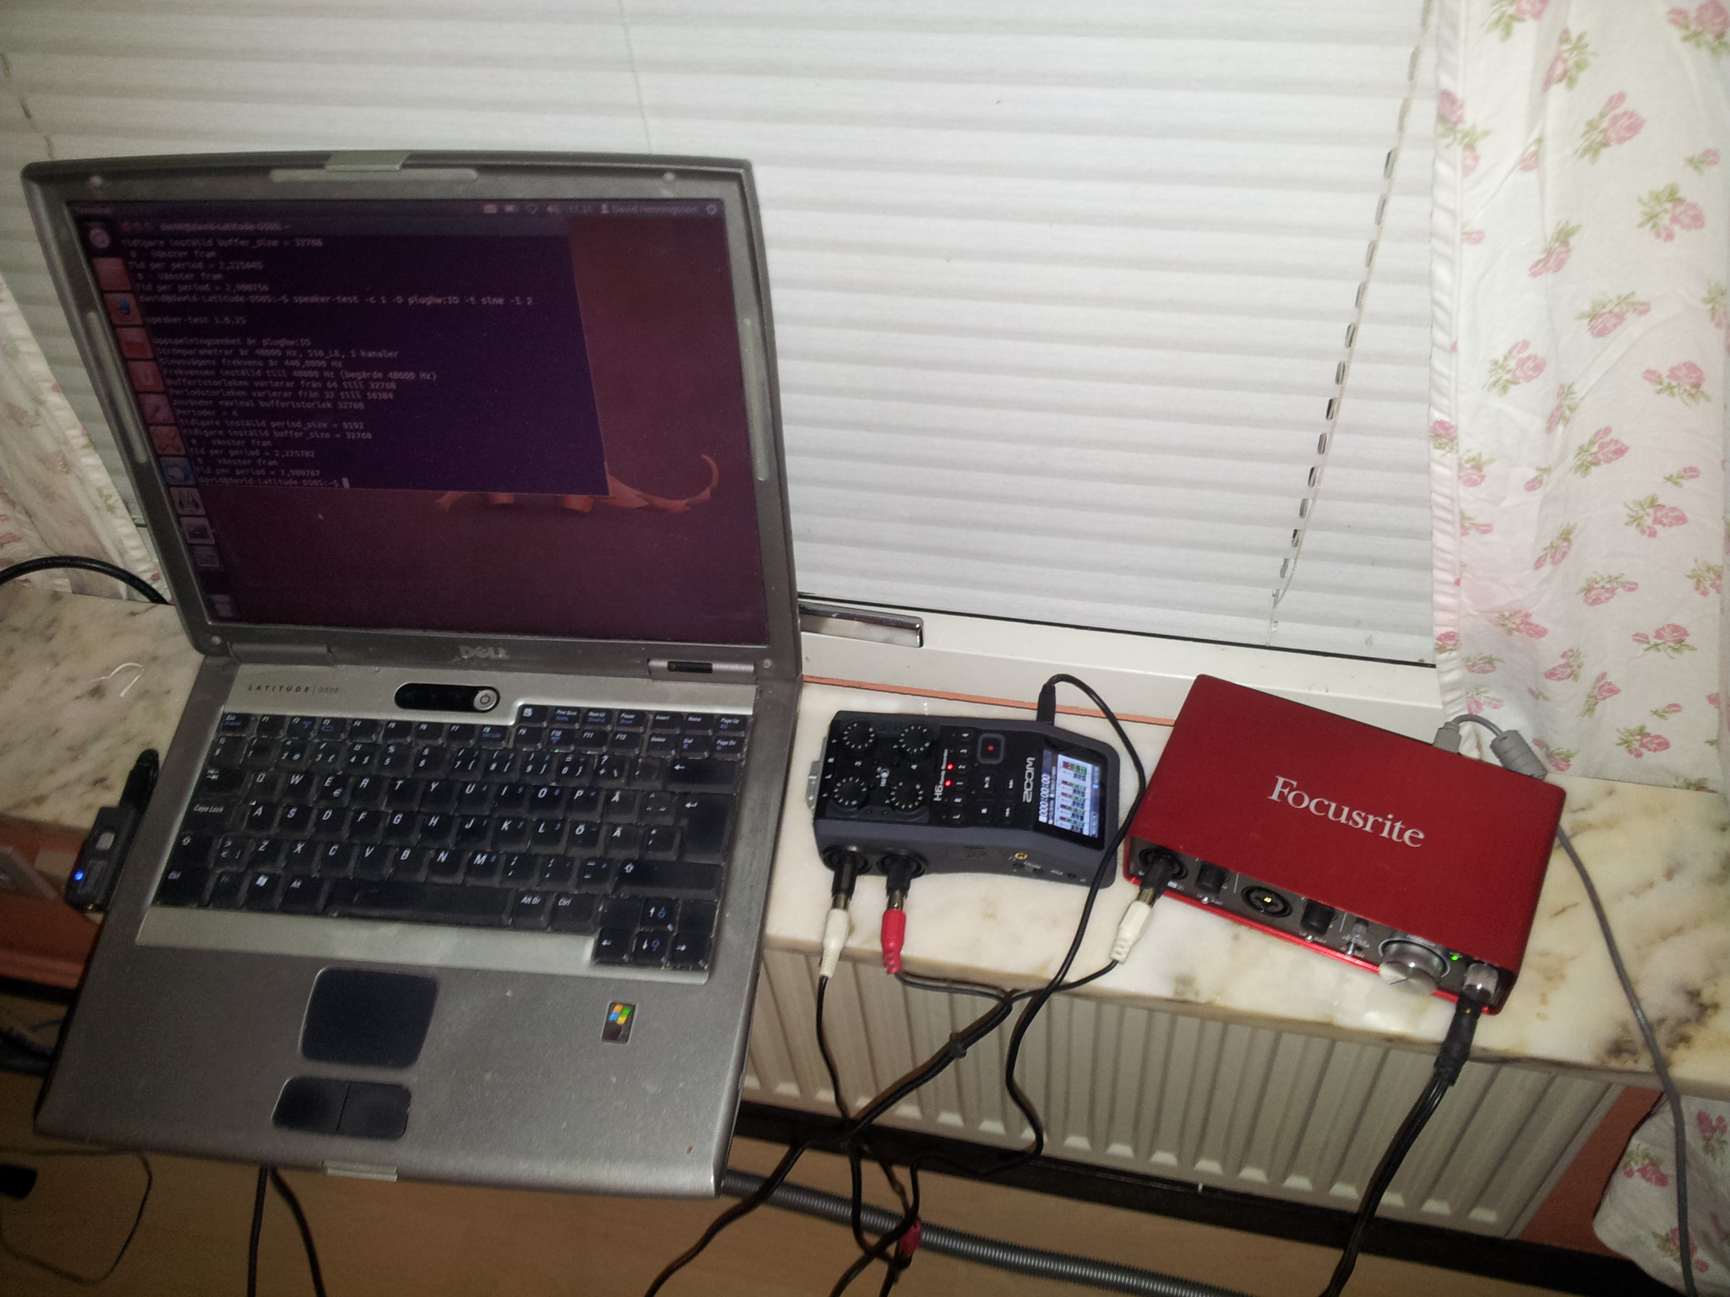
Testing equipment
1. Generate pulse
2. Split signal
8. Record
both
signals
3. ADC
7. DAC
4. USB
5. Linux
computer
6. USB

Slide 18
Raspberry Pi 2 (or 3)
Quad-core, but…
All interrupts arrive at core 0. This is a hardware limitation.
Note: many other ARM boards do not suffer from this.

Slide 19
Skylake (i3-6100U) laptop
This one has one USB interrupt only
If you have a laptop, everything else is on that USB bus too:
  Bluetooth
  Touchscreen
  Webcam
  Sensor chip (accelerometer / gyro / etc)
Didn’t boot with irqaffinity=0,1

Slide 20
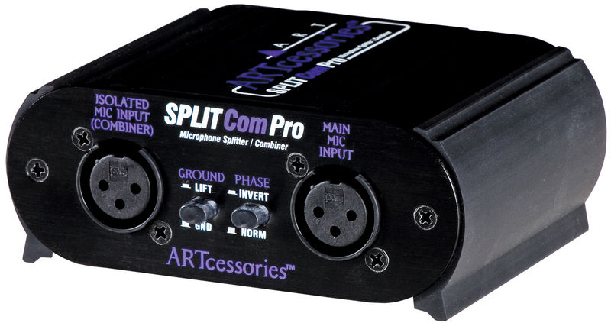
Mic splitter
Passive microphone splitter – added up to 0.5 ms of latency (for tapping mic).

Slide 21
Core / thread lesson learned
If you’re on a system with hyperthreading, dedicate an entire physical core to audio
Look for core id in /proc/cpuinfo
This made a lot of difference on the Ryzen system

Slide 22
Hardware latency varies
For this card (Focusrite 2i2 2nd gen), hardware latency is lower at 96 kHz than 48 kHz
So roundtrip latency for 16 samples @ 48 kHz is larger than 32 samples @ 96 kHz, despite both buffers being 0.33 ms

Slide 23
Test results
Two systems tested successfully:
AMD Ryzen 1700 desktop
An HP laptop from 2010, core i3 M350 (Arrandale)

Slide 24
First test: timedloop
Rdtsc is a computer instruction which reads the cpu’s internal clock tick count.
timedloop just reads this value in a loop, and checks for the maximum difference (compared to the previous read).

Slide 25
Timedloop test results

Slide 26
Main test: neversleep-alsa
Starts capture and playback
Busy-loops checking for incoming data in capture buffer
Any data in capture buffer is copied to playback buffer ASAP

Slide 27
Test result...
AMD Ryzen 1700 system:
  32 (2 x 16) samples @ 96 kHz (0.33 ms buffer size)
2010 (i3-350M) laptop:
  72 (3 x 24) samples @ 96 kHz (0.75 ms buffer size)

Slide 28
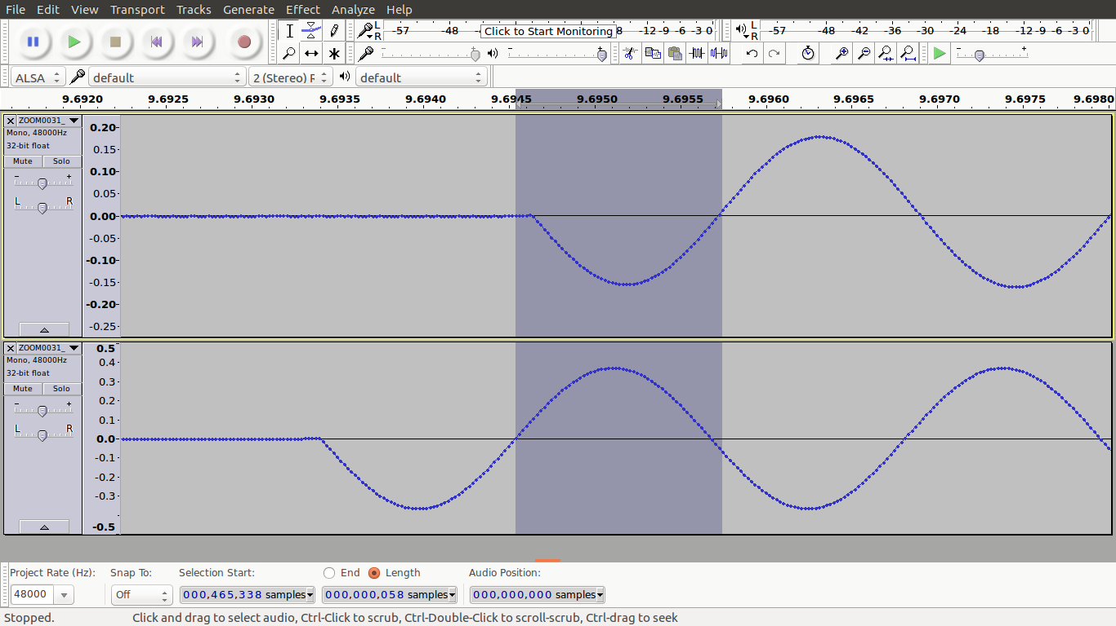
1,2 ms roundtrip latency!

Slide 29
32 samples @ 96 kHz

Slide 30
Conclusions
ALSA drivers are really good
For USB, a “prioritize my audio” feature could be useful
Core isolation (as a kernel feature) could be improved (isolcpus is not a silver bullet)
Still a matter of knowing your hardware

Slide 31
Interesting future work
Implement core isolation in JACK to see how well it works, both with sleeping and with busy-waiting
Investigate (e g with ftrace) if wakeup time can be trimmed further, i e what still runs on the core and why

Slide 32
AMD Ryzen system information
Ryzen 1700, 8 cores, 16 threads
MSI Tomahawk B350, Bios 1.3
Soundcard connected to the “Ryzen” USB controller, other USB devices connected to the “B350” USB controller
Overclocked to 3.5 GHz, 16 GB DDR4 @ 2667 MHz
Kernel: 4.10.1-041001-generic, isolcpus=6,7 nohz_full=6,7
Cmd: taskset -c 6,7 timedloop (Result: 17 us max latency)
Cmd: taskset -c 6,7 neversleep-alsa hw:USB 32 16 96000 (Result: 1,2 ms roundtrip latency)

Slide 33
Laptop from 2010, system info
Core i3 M350, 2,3 GHz (2 cores, 4 threads)
HP Probook 4520s
Kernel: 4.8.0-46-generic, isolcpus=2,3 irqaffinity=0,1 nohz_full=2,3
“performance” set as scaling_governor for cpus 2 and 3
Cmd: taskset -c 2,3 timedloop (Result: max 67 us latency)
Put soundcard in outermost USB jack on right side (otherwise it ends up on the same IRQ as other devices)
/proc/irq/20/smp_affinity_list set to 2
Cmd: taskset -c 2,3 neversleep-alsa hw:USB 72 24 96000 (Result: 2,3 ms roundtrip latency)

Slide 34
Source code at...
https://github.com/diwic/core-isolation
Questions?

