Slide 1
Application Build to analyse geological data of earthquake
Ankur Dixit

Slide 2
Project Requirement :-
1) Take a look at this site for the US Geological service Rest API for Earthquake. 2) Create a request that returns all earthquake data for Jan-2016 in geojson format. 3) Write python code to call the API and store the result in suitable python data structure. 4) Extend the code to pick up all earthquake data for Jan-2016 to till date. 5) Use a suitable visualisation approach in order to find and demonstrate trends or patterns. 6) Be creative with the visualisation & also explain about the unusual pattern in the data. 7) Follow the same practices which we apply to production standard code. i.e Unit-test

Slide 3
Flow of Application :-
Finding the startdate and enddate.
Creating the URL by appending startdate and enddate dynamically.
Sending the request to consume the Web Services to get the data for the listed startdate and enddate in geojson format.
Reading the jeojson file and storing the ‘features’ containing header like ‘geometry’ and ‘properties’ data into a dictionary.
Iterating the loop to append the same attributes in a list. By this we have 28 attributes list containing all the data from geojson file in distributed way.

Slide 4
Flow of Application :-
6) Creating a Data Frame from the dictionary of attributes having all the data.
7) Iterating the whole logic for different startdate and enddate and appending the sub Data Frames to a main Data frame.
8) After getting all the data in the main Data Frame start calling the create_stats() to create different visualisations on the data to analyse.

Slide 5
Execution & outcome of the Application :-
1) During the execution application will print out the dynamically created URL for which the processing is going on.
2) Application will be executed from Jan-2016 to till date in equally distributed different segments. So, that it will not get any prompt of Bad Request from Web service.
3) Different type of statistical graph will be created at the end of the execution on the data retrieved from web.
4) The application will take around 2mins to 4mins based on getting the web response.

Slide 6
Explaining the data structure containing the Data Frames from variable explorer :-
PageSrc = urllib.request.urlopen(up_Url).read()
data =json.loads(PageSrc.decode('utf-8'))

Slide 7
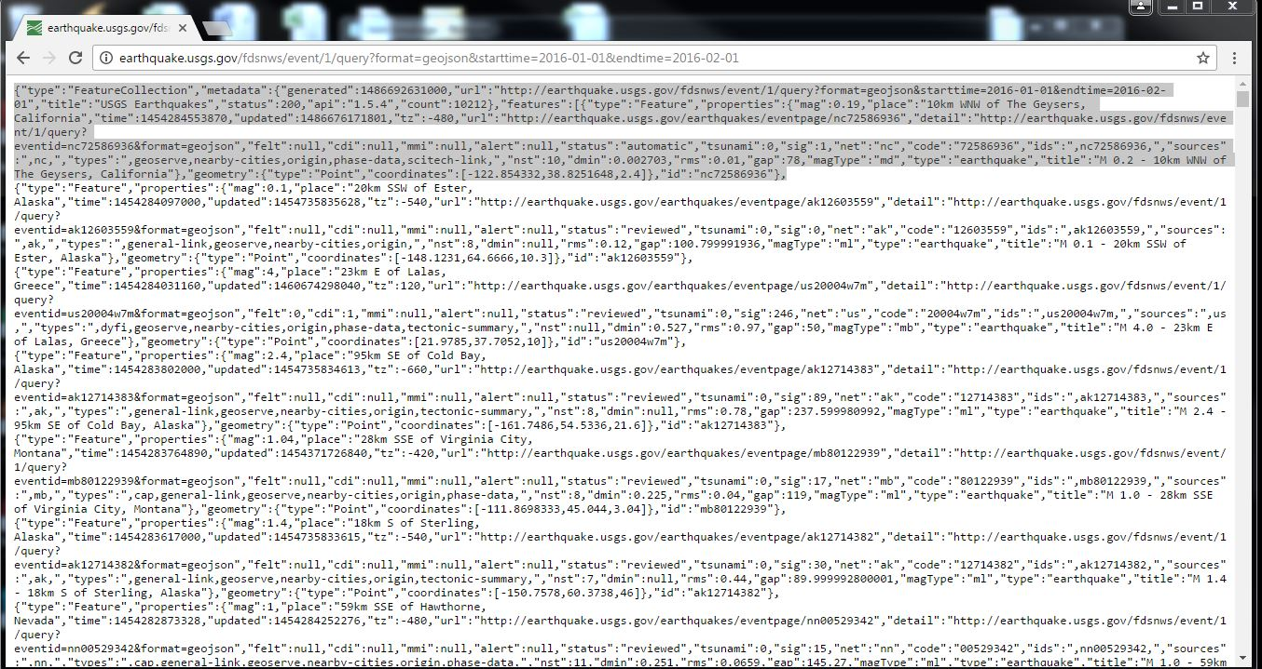
Json request data for a specific URL :-

Slide 8
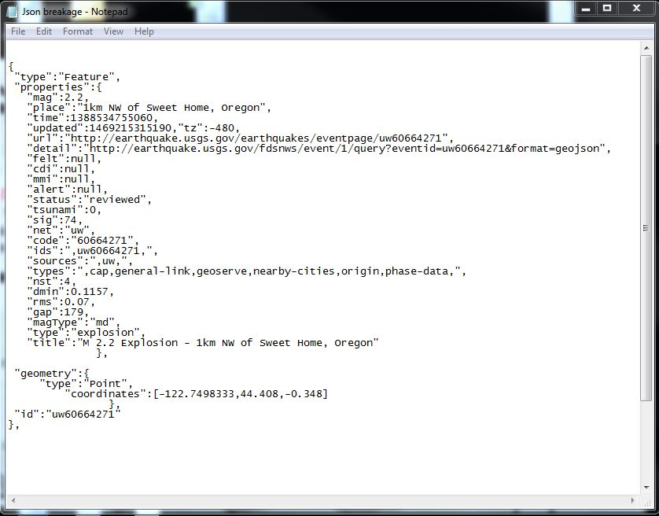
One row of Json in breakage format:-

Slide 9
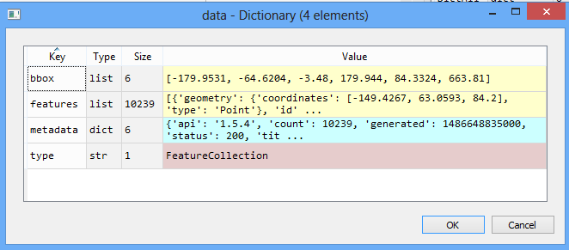
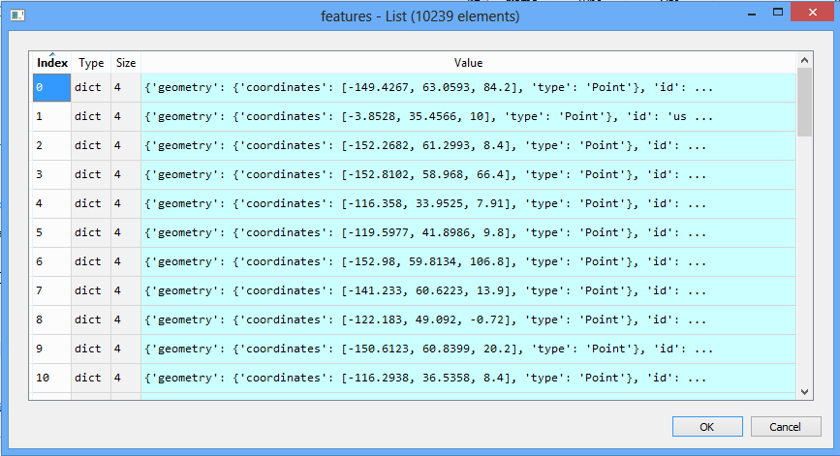

Slide 10
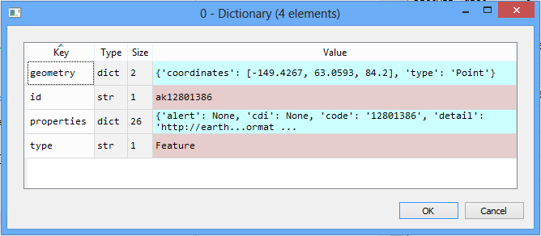
separating geometry , id, properties, type and making a list :

Slide 11
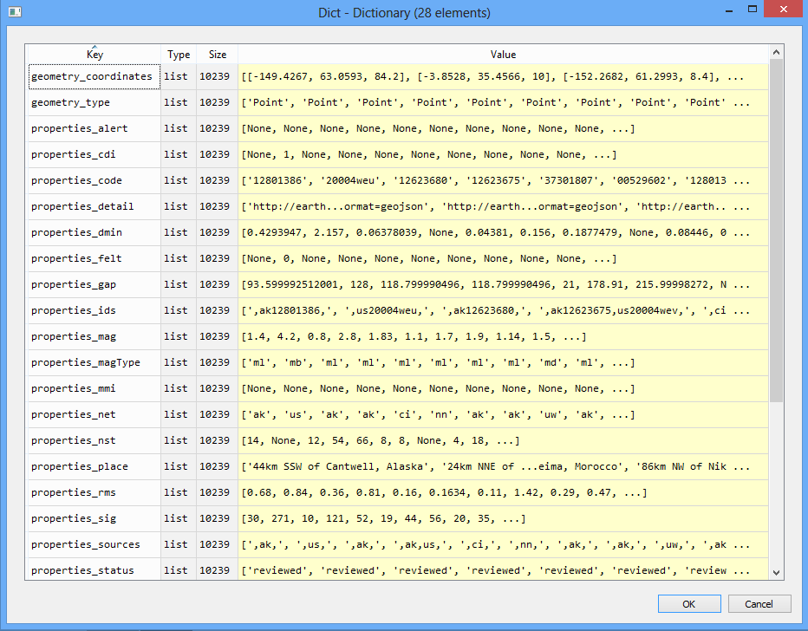
Dataframe contains list of variables present under Json :

Slide 12
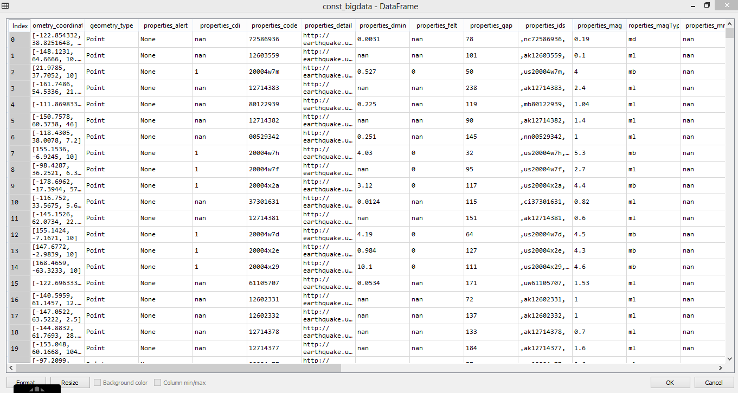
Data Frame:-

Slide 13
Generic Methods Created :-
1) def check_attribute(data, **kwargs):
"""This module checks for geographical attributes for each line ""“
2) def check_date(ytdstatus):
"""This module set startdate and enddate for url """Errors
3) def load_data(pagesrc):
"""This module loads data in jsn format and store it in data object """

Slide 14
Generic Methods Created :-
4) def open_url(url):
"""This module reads the data from url passed by check_date function "“”

Slide 15
Static code Analysis :-
Convention
Refractor
Errors
Warnings

Slide 16
Graphical representation of Data :-
Modules used :
MatplotLib
Seaborn

Slide 17
Columns to be consider for analytics :-
Gap :- Seismic gap. It is a zone along a tectonically active area where no earthquakes have occurred recently, but it is known that elastic strain is building in the rocks.
Nst :- The total number of seismic stations used to determine earthquake location. Number of Sesimic stations which reported P_ and S_ arrival times for this earthquake.
Mag :- Magnitude of the earthquake.
Rms :- Root Mean Square. This parameter provides a measure of the fit of the observed arrival times to the predicted arrival times for this location.

Slide 18
Continued :
Sig :- How significant the event is occuring.
Sources :- The places where the earthquake occured.
dmin :- Horizontal distance from the epicenter to the nearest station(in degrees)

Slide 19
Generic methods created :- :-
Primary method to call generic methods -
I) def create_stats(dataframe):
Methods :
def create_hist(dataframe):
def create_violin(dataframe):
def create_linechart(dataframe):
def create_stackedchart(dataframe):
def create_piechart(dataframe):

Slide 20
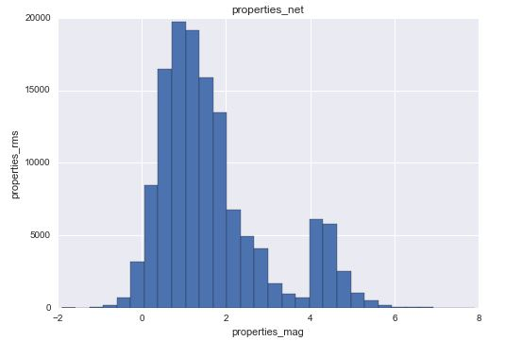
Histogram :-

Slide 21
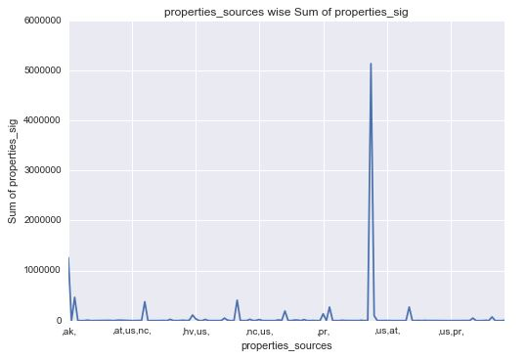
Line Chart :-

Slide 22
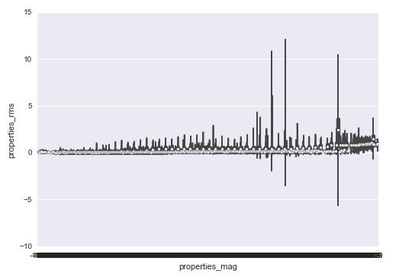
Violin :-

Slide 23
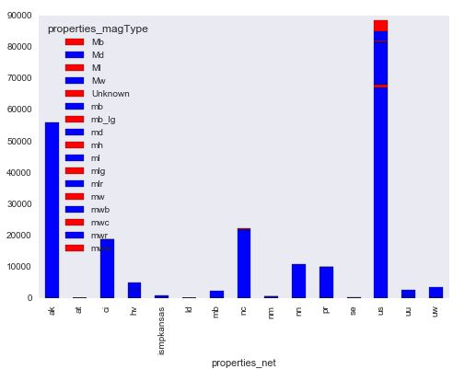
Stacked Chart :-

Slide 24
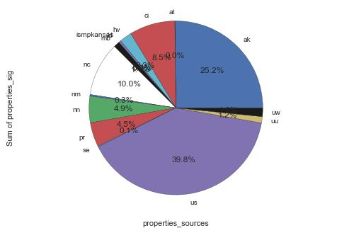
Pie-Chart :-

Slide 25
Observations :-
Earthquakes occur mainly as a result of plate tectonics, which involves blocks of the Earth moving about the Earth's surface. The blocks of rock move past each other along a fault. Smaller earthquakes, called foreshocks, may precede the main earthquake, and aftershocks may occur after the main earthquake. Earthquakes are mainly confined to specific areas of the Earth known as seismic zones, which coincide mainly with ocean trenches, mid-ocean ridges, and mountain ranges.
The point of origin of an earthquake is called the focus. The epicenter is the point on the Earth's surface directly above the focus. Most earthquake foci are within a few tens of kilometers of the Earth's surface. Earthquakes less than 70 km deep are classified as shallow-focus. Intermediate-focus earthquakes are 70-300 km deep, and deep-focus earthquakes more than 300 km deep. Shallow-focus earthquakes occur in all of the Earth's seismic zones, but intermediate- and deep-focus earthquakes are almost exclusively associated with seismic zones near ocean trenches.
The destructiveness of an earthquake depends on the size, the depth (shallow ones are more destructive) and the location. Earthquake size can be stated in terms of the damage caused (the intensity) or the amount of ground motion and the energy released by the earthquake (related to the Richter magnitude).

Slide 26
TEST Scenarios :

Slide 27
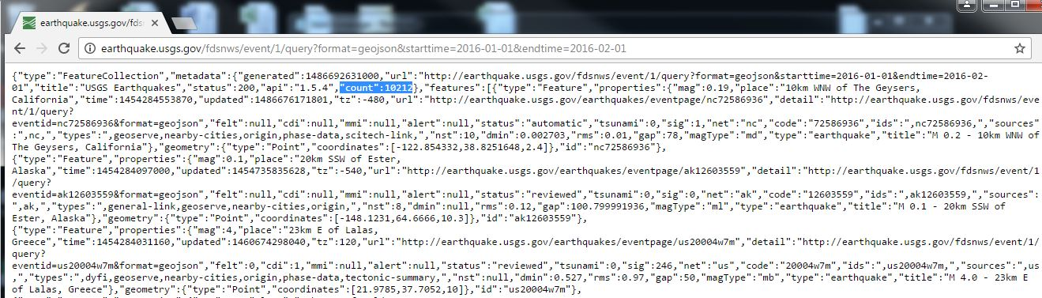
Json response to test the total count for a request URL :-

Slide 28
Explanation of Unit Test:-
1) Created a method named testDataCntChk(self)
to check the count of rows retrieved from the request by using the web service.
2) Getting the value of count from the logic of reading the geojson format for the particular startdate and enddate and comparing it with the actual count.

Slide 29
Questions ?
Thanks,
Ankur

