Slide 1
Internship and project presentation
Name: Dharmesh Bhalani
Enrollment : 190130111029
Department: Electronics and Communication Engineering

Slide 2
ABOUT me
My name is Dharmesh Bhalani and I am excited to share with you today about my internship experience as a software developer trainee at Lanet Team Software Solutions Pvt. Ltd. in Surat.
I developed a keen interest in software development and was eager to apply my skills in a professional setting.
Fortunately, I had the opportunity to intern at Lanet Team Software Solutions Pvt. Ltd. During my internship, I was able to work on a variety of projects and learn about a range of technologies, including JavaScript, React JS, Github, Node, Nest, and REST API framework.
In this presentation, I will share with you what I learned during my internship, the projects I worked on, the skills I developed, and my plans for the future.

Slide 3
Technologies
Learned the fundamentals of JavaScript programming language, which is essential for developing modern web applications and dynamic user interfaces. I gained proficiency in writing JavaScript code, manipulating the Document Object Model (DOM), and using various JavaScript libraries and frameworks.
Javascript
A popular JavaScript library for building reusable and interactive user interfaces. I gained knowledge in developing single-page applications, using React components, and managing application state with Redux.
React Js
Node.js
Node.js is an open-source and cross-platform JavaScript runtime environment. It is a popular tool for almost any kind of project! Node.js runs the V8 JavaScript engine, the core of Google Chrome, outside of the browser. This allows Node.js to be very performant.
Nest.js
Nest. JS is a framework that helps build Node. JS server-side applications. The Nest framework is built using TypeScript which allows developers to build highly scalable and testable applications.

Slide 4
Project E-Commerce (MERN Stack)
One of the highlights of my internship at Lanet Team Software Solutions Pvt. Ltd. was the opportunity to work on a real-world project called E-Commerce Web App. Using the technologies I learned during my internship, I was able to contribute to the development of this web application.

Slide 5
Project Features
Authentication
Range of Products
I implemented a secure login and registration system using node built-in authentication framework. Users could register and log in to their accounts and their credentials were securely stored in the database.
User has the access to 1000+ products . Form various categories such as Electronics,Grocery,etc..
Product Video Suggestion
User gets the Product video suggestion based on the selected Product.

Slide 6
Glimpse of my project

Slide 7
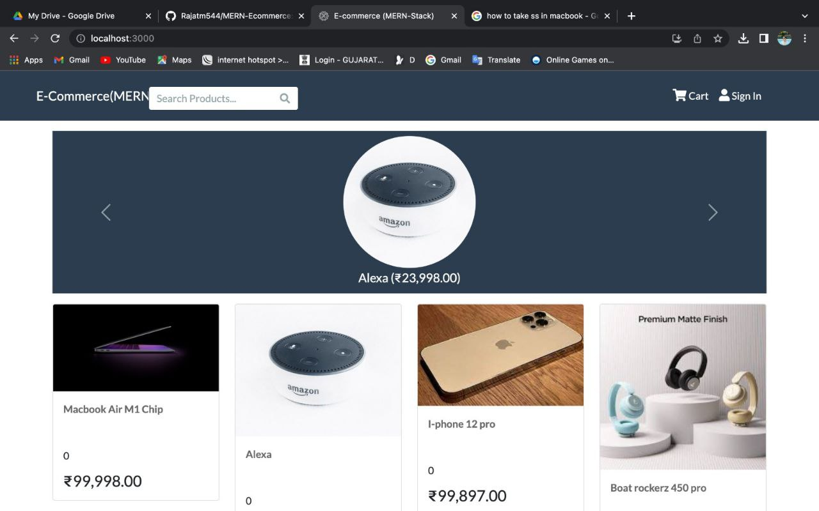
Landing Page

Slide 8
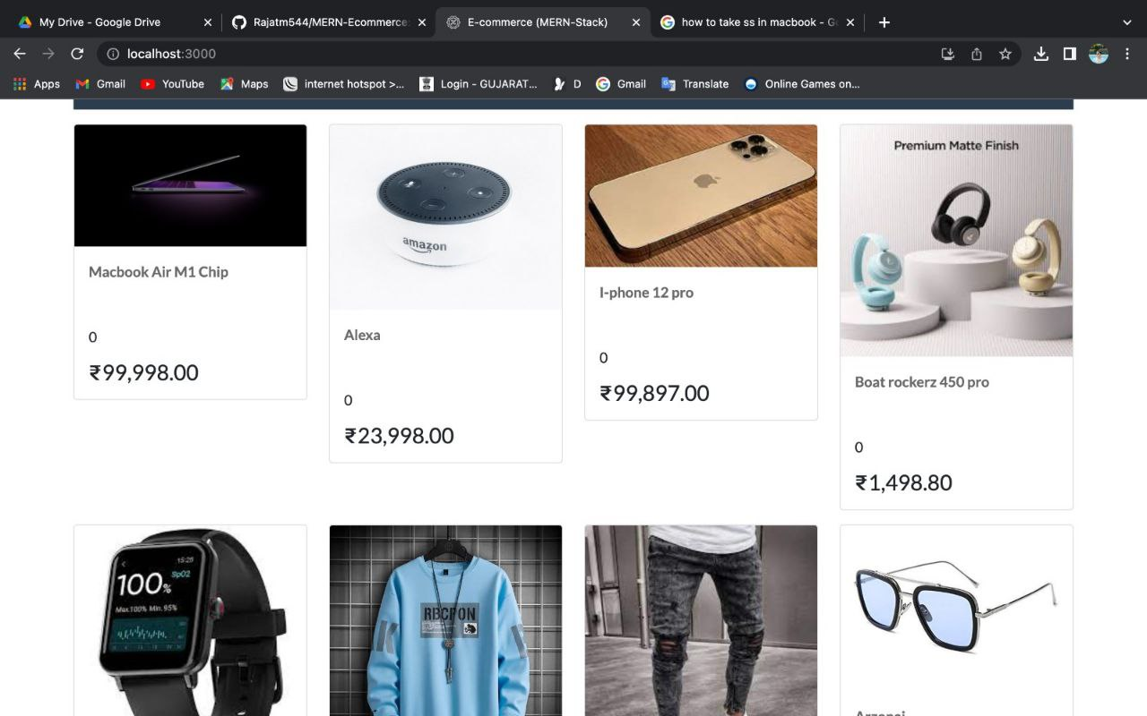
Search Product page

Slide 9
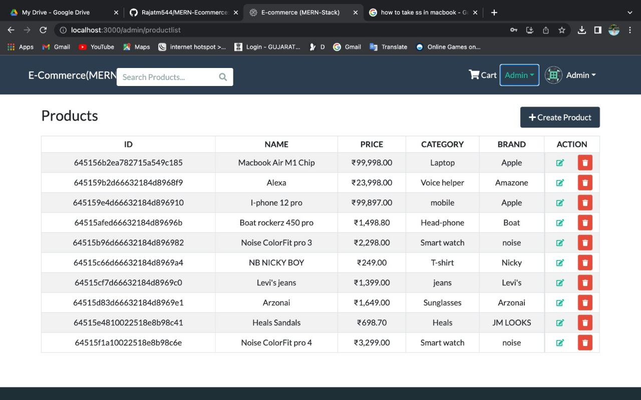
Admin detail Page

Slide 10
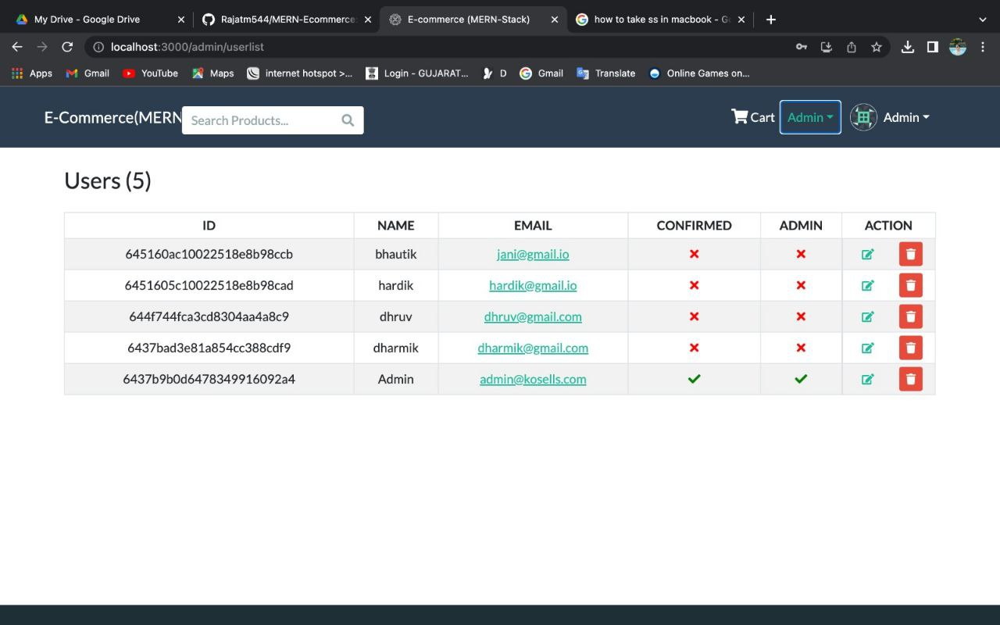
Admin & User DETAIL Page

Slide 11
Skills Developed
Problem-solving skills
Collaboration skills
As a software developer trainee, I was faced with several challenging problems that required creative solutions. I learned how to analyze problems, break them down into smaller components, and develop solutions that were efficient, effective, and scalable.
I worked as part of a team on several projects, which required me to collaborate with other developers, designers, and project managers. I learned how to communicate effectively, share ideas, and work together to achieve our common goals.

Slide 12
Technical skills
I gained proficiency in several technologies, including JavaScript, React JS, GitHub, Node, Nest, and REST framework. I learned how to write clean, efficient, and maintainable code, and how to use various tools and frameworks to develop web applications and APIs.
Agile development
Communication skills
I learned about agile development practices, which are widely used in the software industry to develop software in an iterative and incremental manner.
I improved my communication skills by participating in team meetings, stand-ups, and presentations. I learned how to communicate technical concepts to non-technical stakeholders, and how to listen actively and ask questions to clarify requirements and expectations.

Slide 13
Conclusion
My internship at Lanet Team Software Solutions Pvt. Ltd. was a valuable learning experience that allowed me to develop technical and soft skills that are essential for success in the software development industry
I had the opportunity to work on e_store, a Product Assistant Web App, where I was able to apply the technologies I learned during my internship. Working on E-store was an exciting and challenging experience that allowed me to contribute to a real-world project and learn about project management and agile development practices.
Finally, I am excited to apply the knowledge and skills I gained during my internship to future projects and continue learning and growing as a software developer. Thank you for listening to my presentation.

Slide 14
Thankyou
a

