Slide 1
Debugging Proxy For Linux
CS436 Assignment,
Final Review

Slide 2

How it all started?
Choosing the problem!

Slide 3
Choosing the problem!

Slide 4
The Problem!
To build a some stuff which………

Slide 5
The Problem contd
Look at HTTP(s) traffic
Enable break points
Tamper with HTTP(s) traffic

Slide 6
Sniffer?
Attempt zero!

Slide 7
Threaded Proxy-1?
Attempt one!

Slide 8
Threaded Proxy-2?
Attempt Two!

Slide 9
start
end
Towards
destination
Incoming
Packet
recvPacket()
forwardPacket()
No Break
Point
renderTo View()
Break
Point Set

Slide 10
notifyWaitingThread()
end
enqueue
Packet()
Wait
tamperPacket()
forwardPacket()
checkForQueuedPacket()
end
start

Slide 11
What I Implemented!
Break-Points
Support For Tampering
graphical User Interface

Slide 12
Meta
Version-Control: Change log
Progress log
Bug history

Slide 13
Challenges?
Understanding the problem.
Performance
Marketing

Slide 14
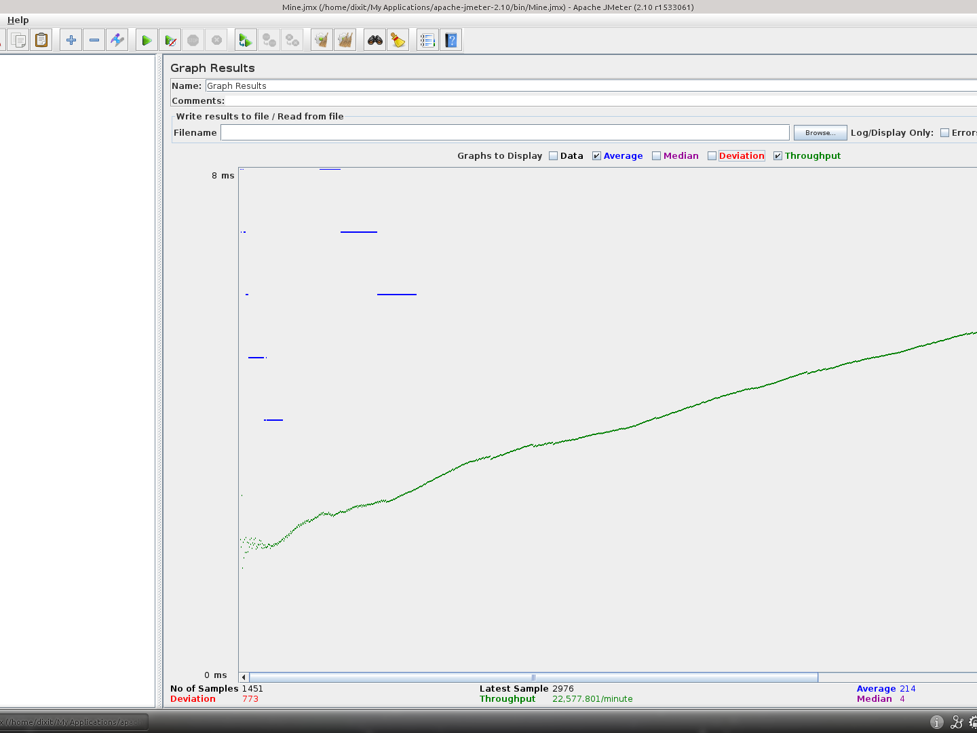
w/o proxy

Slide 15
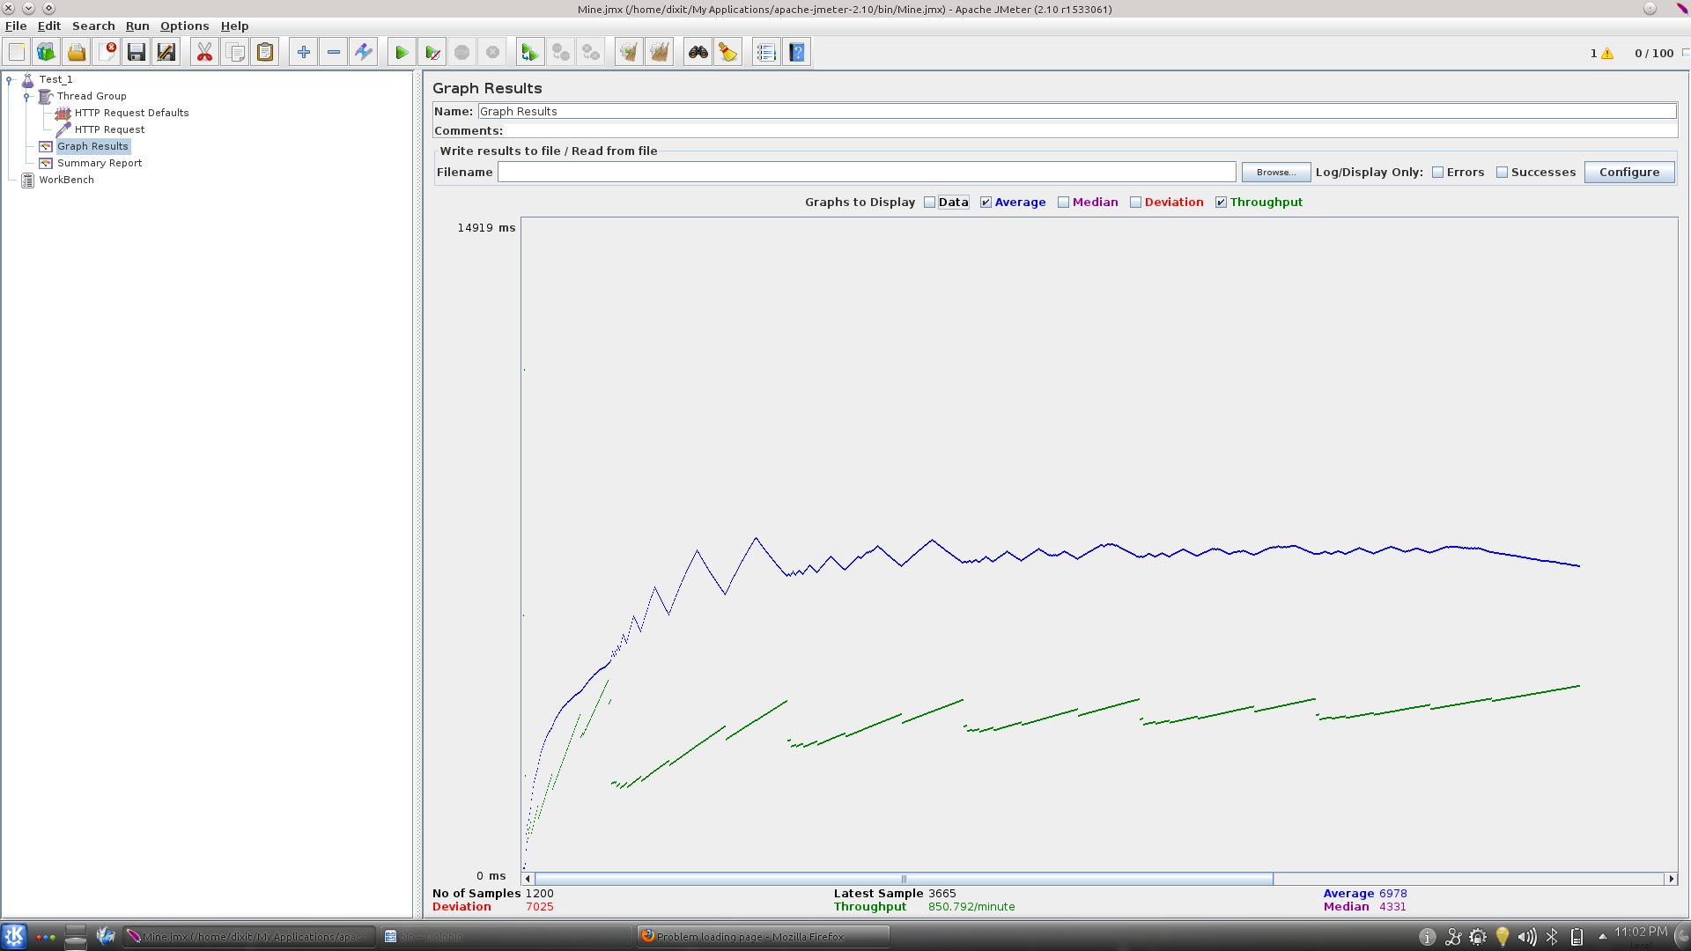
Attempt_1

Slide 16
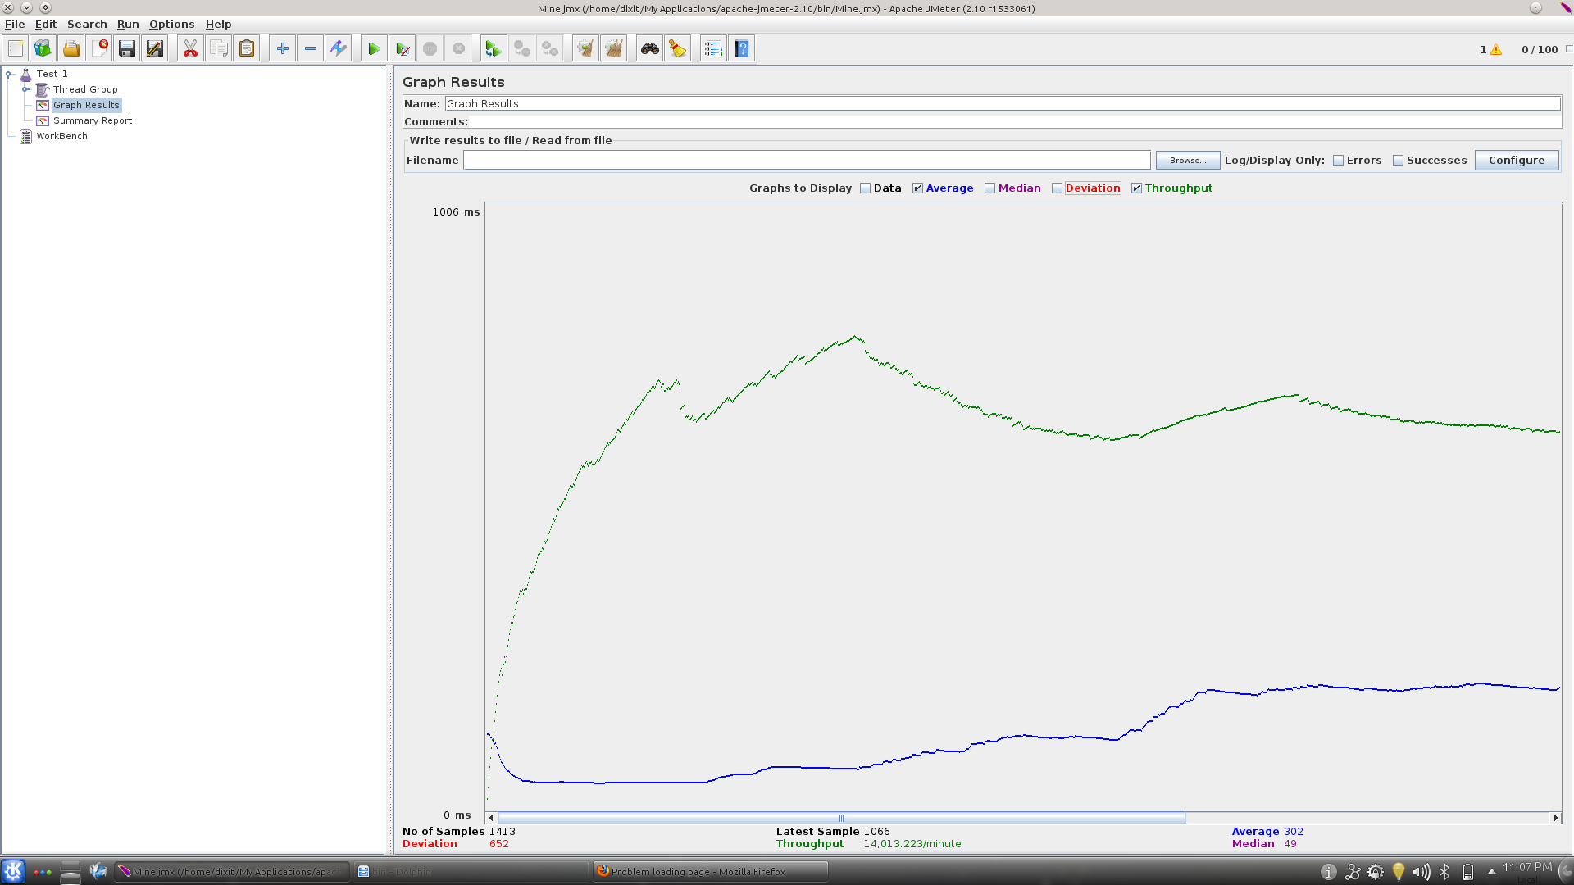
Attempt_2

Slide 17
Future Upgrades?
Session Based Break-Points
Attach File Support
Fix Known Bugs

Slide 18
Some Things I Would Like to Say!
More Check-Points
Introduce Course At The 3rd Semester
Make 3 People Team Compulsory

Slide 19


