Slide 1
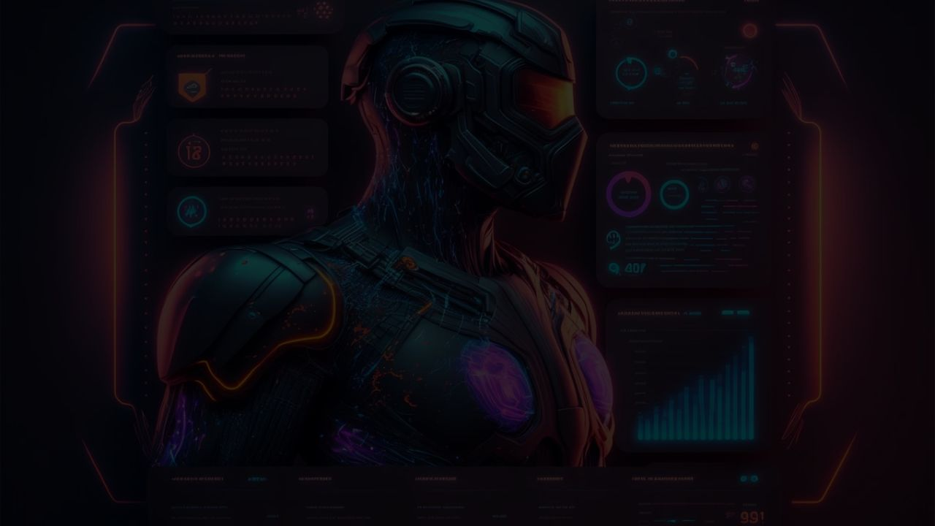
MCP Server and Client:
The Future of AI Automation
Revolutionizing Web Scraping with Model Context Protocol
A powerful implementation of the Model Context Protocol (MCP) using n8n workflows, Google Gemini AI, and Firecrawl API to create an intelligent web scraping ecosystem that represents the future of AI automation.
MCP Server and Client: The Future of AI Automation

Slide 2

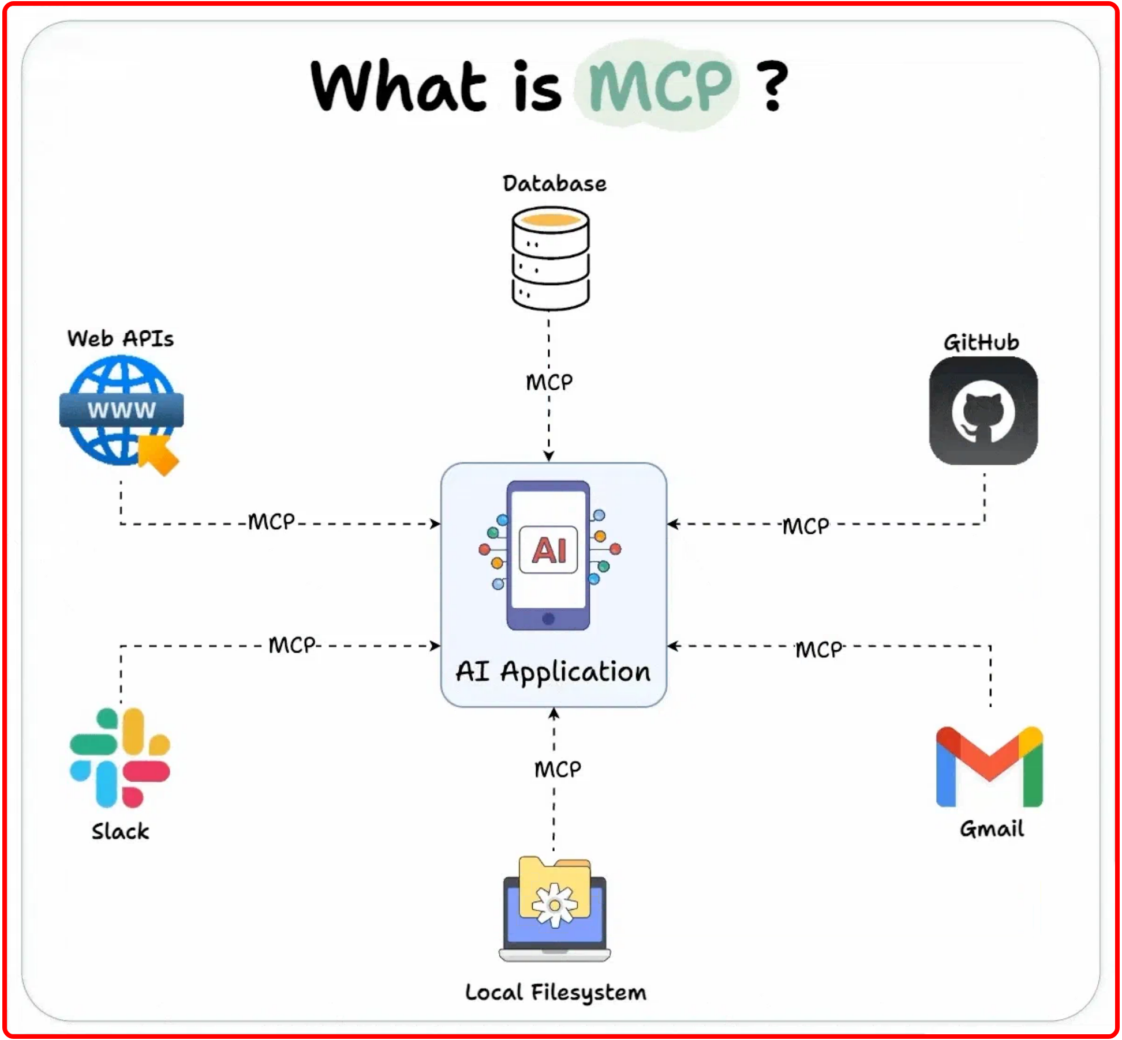




Model Context Protocol (MCP)
MCP is a standardized protocol that enables
AI agents to
access tools and services
through a consistent interface,
revolutionizing how AI systems interact with external
capabilities.
Key Concepts
Standardized communication between AI models and tools
Bidirectional data flow with structured formats
Tool-agnostic architecture for maximum flexibility
Enhanced security through controlled access patterns
Benefits
MCP transforms AI systems from
isolated models
into
powerful agents
capable of performing complex tasks by
leveraging external tools and services.
MCP Server and Client: The Future of AI Automation
2

Slide 3

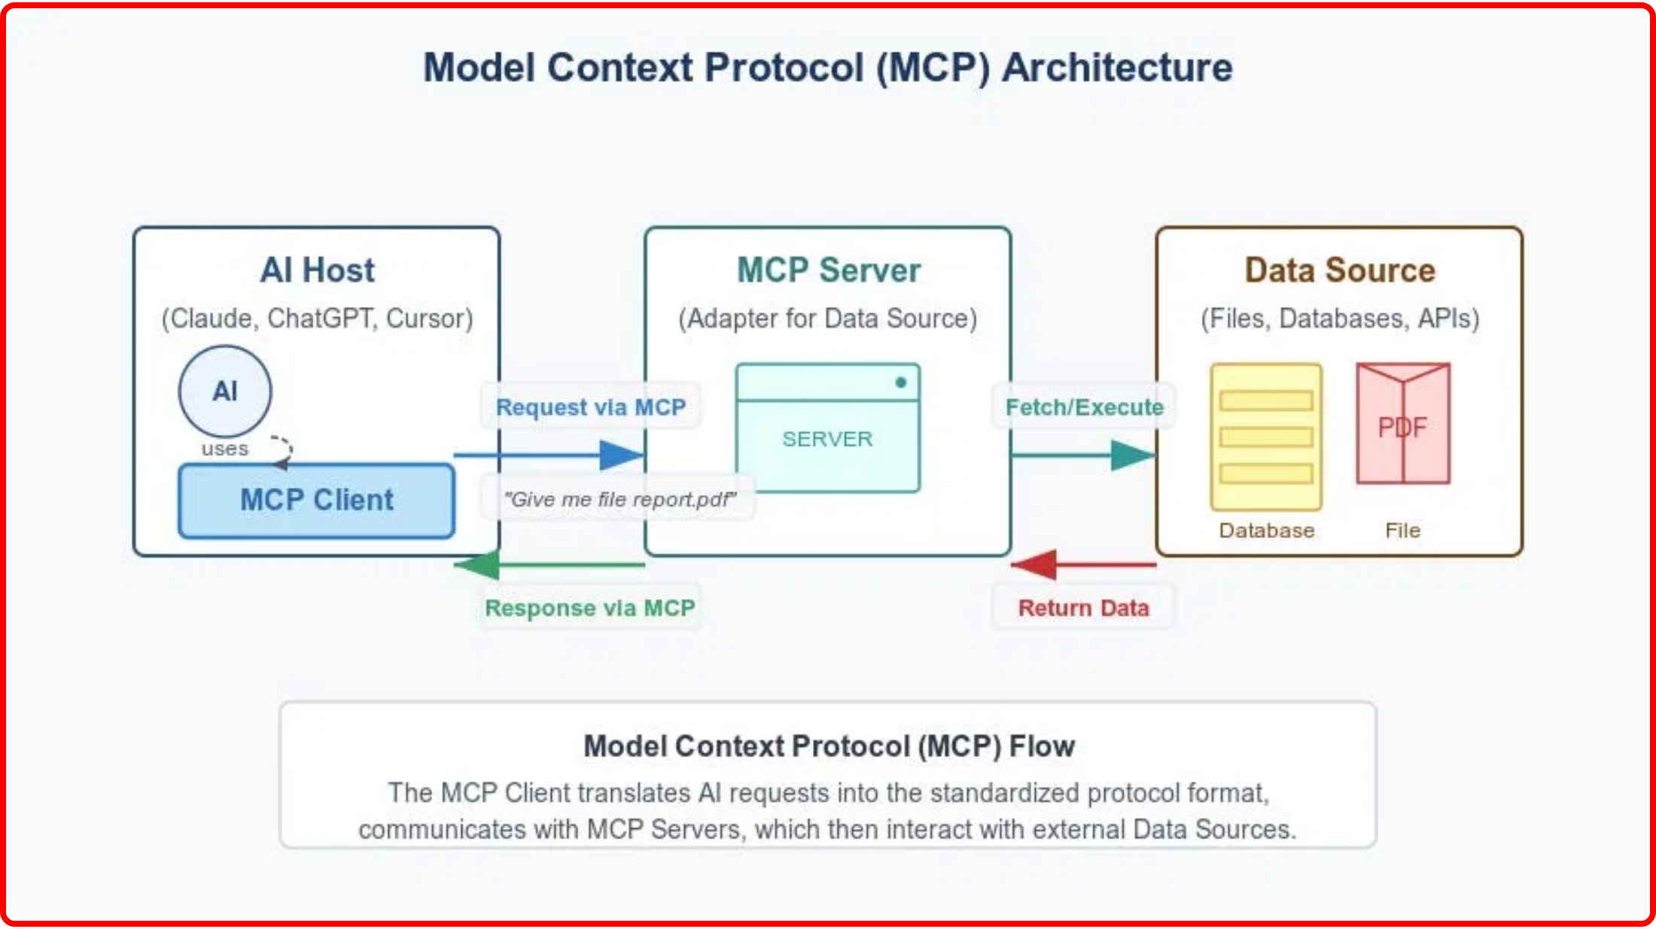
System Architecture
Our MCP implementation follows a
client-server architecture
where the AI-powered client communicates with a specialized
server through the Model Context Protocol.
Communication Flow
User sends natural language request to the Scraping Agent Client
Google Gemini AI processes and understands the request
Client sends structured request to server via MCP
Server executes web scraping using Firecrawl API
Server returns structured results to client via MCP
Client presents results to user in natural language
Key Technical Aspects
• Server-Sent Events (SSE)
for real-time communication
• HTTP Header Authentication
for secure connections
• Webhook-based triggers
for event-driven architecture
MCP Server and Client: The Future of AI Automation
3

Slide 4

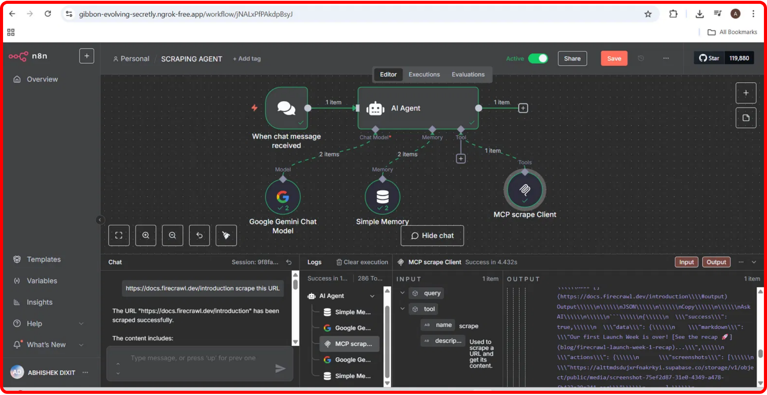


Intelligent Scraping Agent
The client component is an
AI-powered scraping agent
built
with n8n that understands natural language requests.
Client Components
Chat Trigger
Webhook endpoint that receives user messages.
Google Gemini AI
Advanced language model that processes requests.
Memory Buffer
Maintains conversation context for coherent interactions.
MCP Client Tool
Actual Scraping Agent Client with Successful Execution
Connects to the MCP server via SSE for scraping operations.
Key Features
Natural language understanding for complex requests
Secure communication with server via authentication
MCP Server and Client: The Future of AI Automation
4

Slide 5

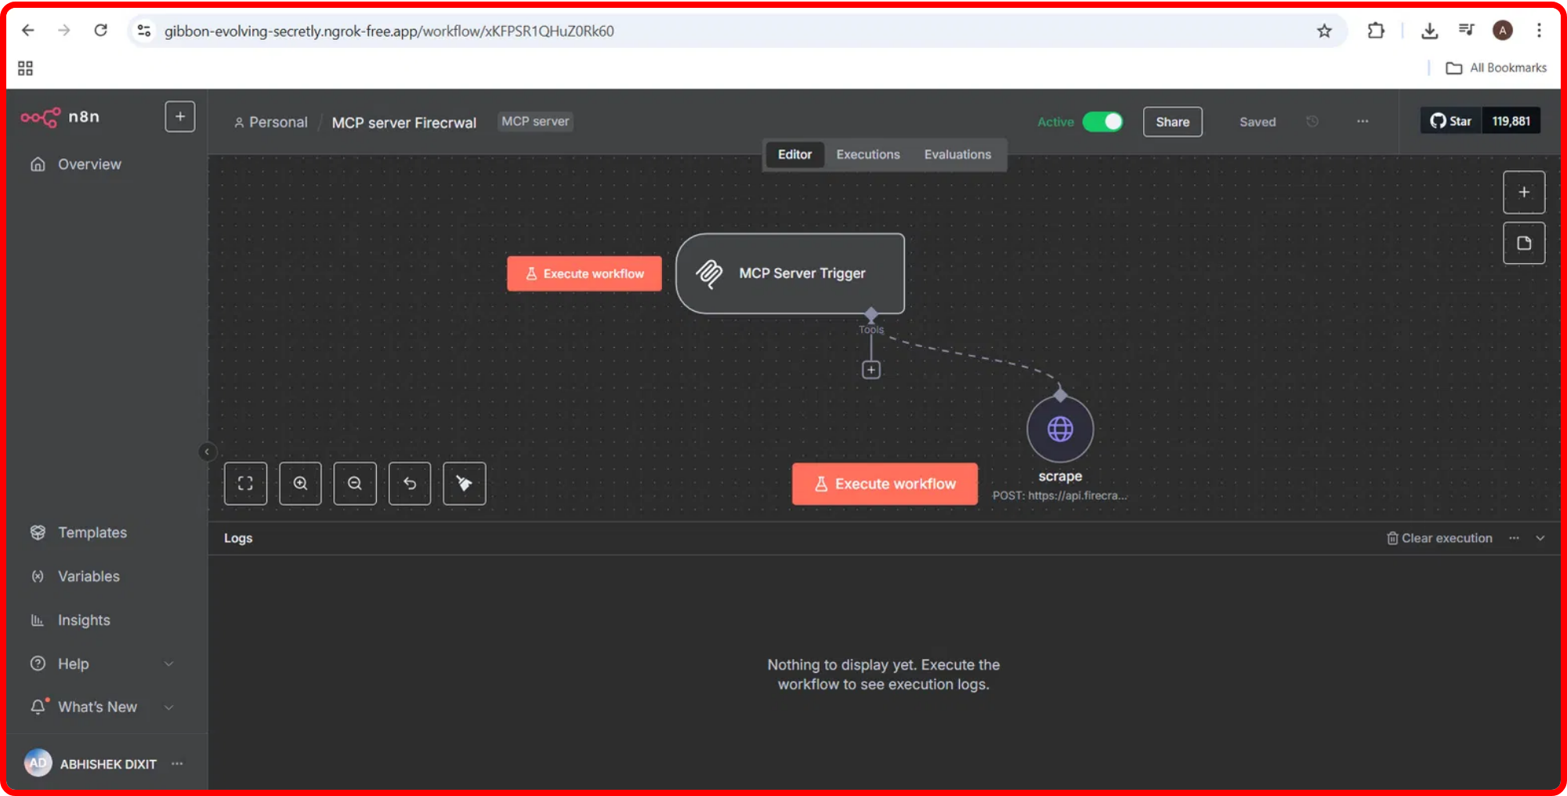
MCP Server with Firecrawl
The server component acts as the
execution engine
for web
scraping operations, leveraging the powerful Firecrawl API to
extract structured content.
Server Components
• MCP Server Trigger:
Handles incoming requests from
clients
• HTTP Request Tool:
Interfaces with the Firecrawl API
Firecrawl API Configuration
// API Endpoint
POST https://api.firecrawl.dev/v1/scrape
Actual MCP Server Implementation in n8n
"url":
"https://docs.firecrawl.dev"
,
"formats":
["markdown"]
Server Endpoint
/mcp/da34892c-8018-4f03-9322-f49a2ed49853
MCP Server and Client: The Future of AI Automation
5

Slide 6

Setup and Configuration
Setting up the MCP system requires configuring both the client and server components in n8n.
Server Configuration
Prerequisites
# Update Firecrawl API key
Authorization: Bearer fc-your-api-key
• n8n instance
(self-hosted or cloud)
• Google Gemini API key
for the AI agent
# Server webhook URL format
• Firecrawl API key
for web scraping
https://your-domain.ngrok-free.app/mcp/da34892c-
• ngrok
for exposing local endpoints
8018-4f03-9322-f49a2ed49853
Installation Steps
Client Configuration
Import both workflow JSON files into n8n
# Update MCP client endpoint
Configure Google Gemini API credentials
sseEndpoint: https://your-domain.ngrok-
free.app/mcp/da34892c-8018-4f03-9322-f49a2ed49853
Update Firecrawl API key in the server workflow
# Configure HTTP Header Auth
Activate the MCP Server workflow
Create credentials for "HTTP Header Auth"
Update the MCP client endpoint in the client workflow
Activate the client workflow
MCP Server and Client: The Future of AI Automation
6

Slide 7

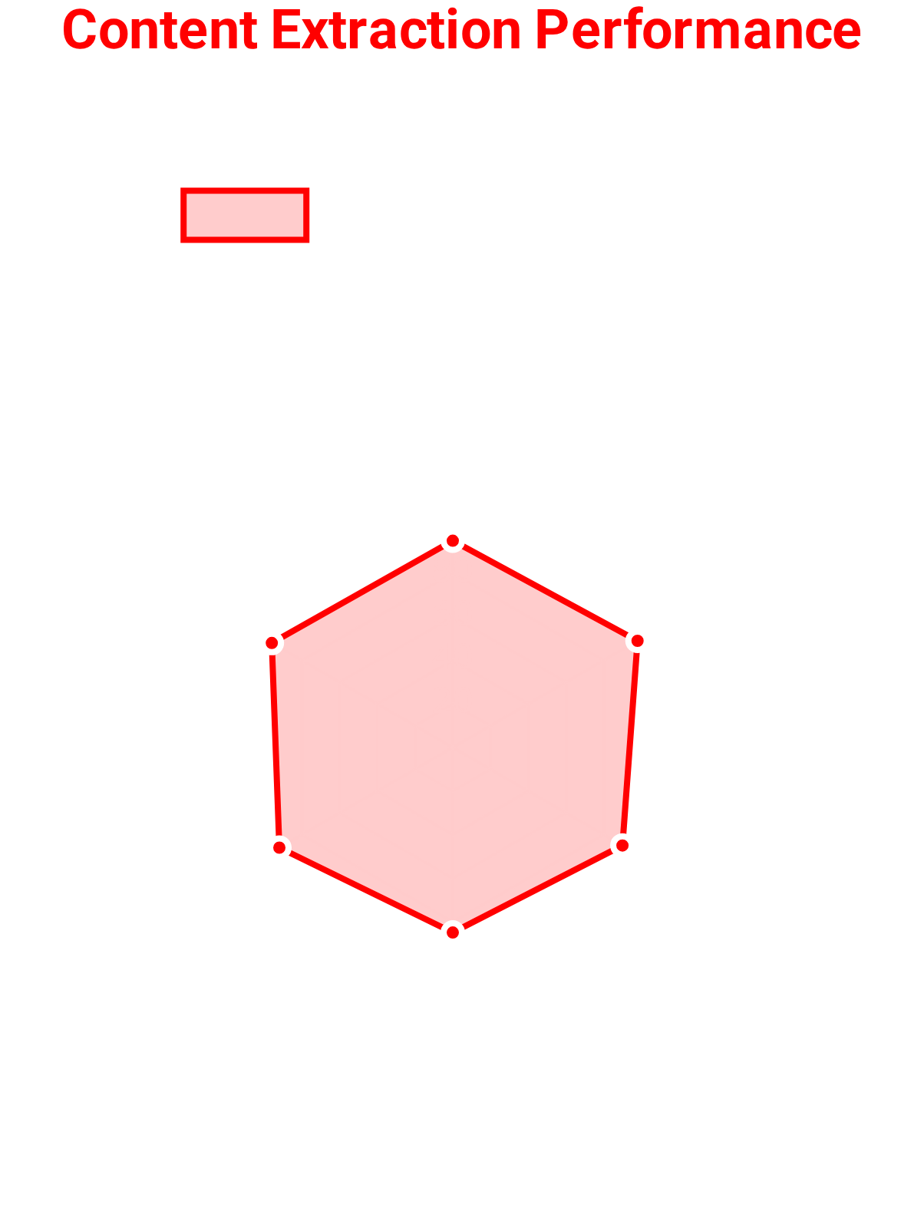

Using the System
The MCP system provides a
natural language interface
for web scraping operations, making
complex data extraction accessible through simple conversational requests.
Example Requests
"Scrape the latest news from https://news.example.com"
"Extract the main content from this blog post: https://blog.example.com/post"
"Get the markdown content of the Firecrawl documentation"
API Request Format
POST https://your-domain.ngrok-free.app/webhook/91178f0e-a59d-4c0a-b006-f6d3a32d702d
Content-Type: application/json
{
"message": "Please scrape the content from https://docs.firecrawl.dev"
}
Response Format
The system returns scraped content in
Markdown format
, making it easy to process and
display in various applications. Results include structured data with proper formatting and
links preserved.
MCP Server and Client: The Future of AI Automation
7

Slide 8

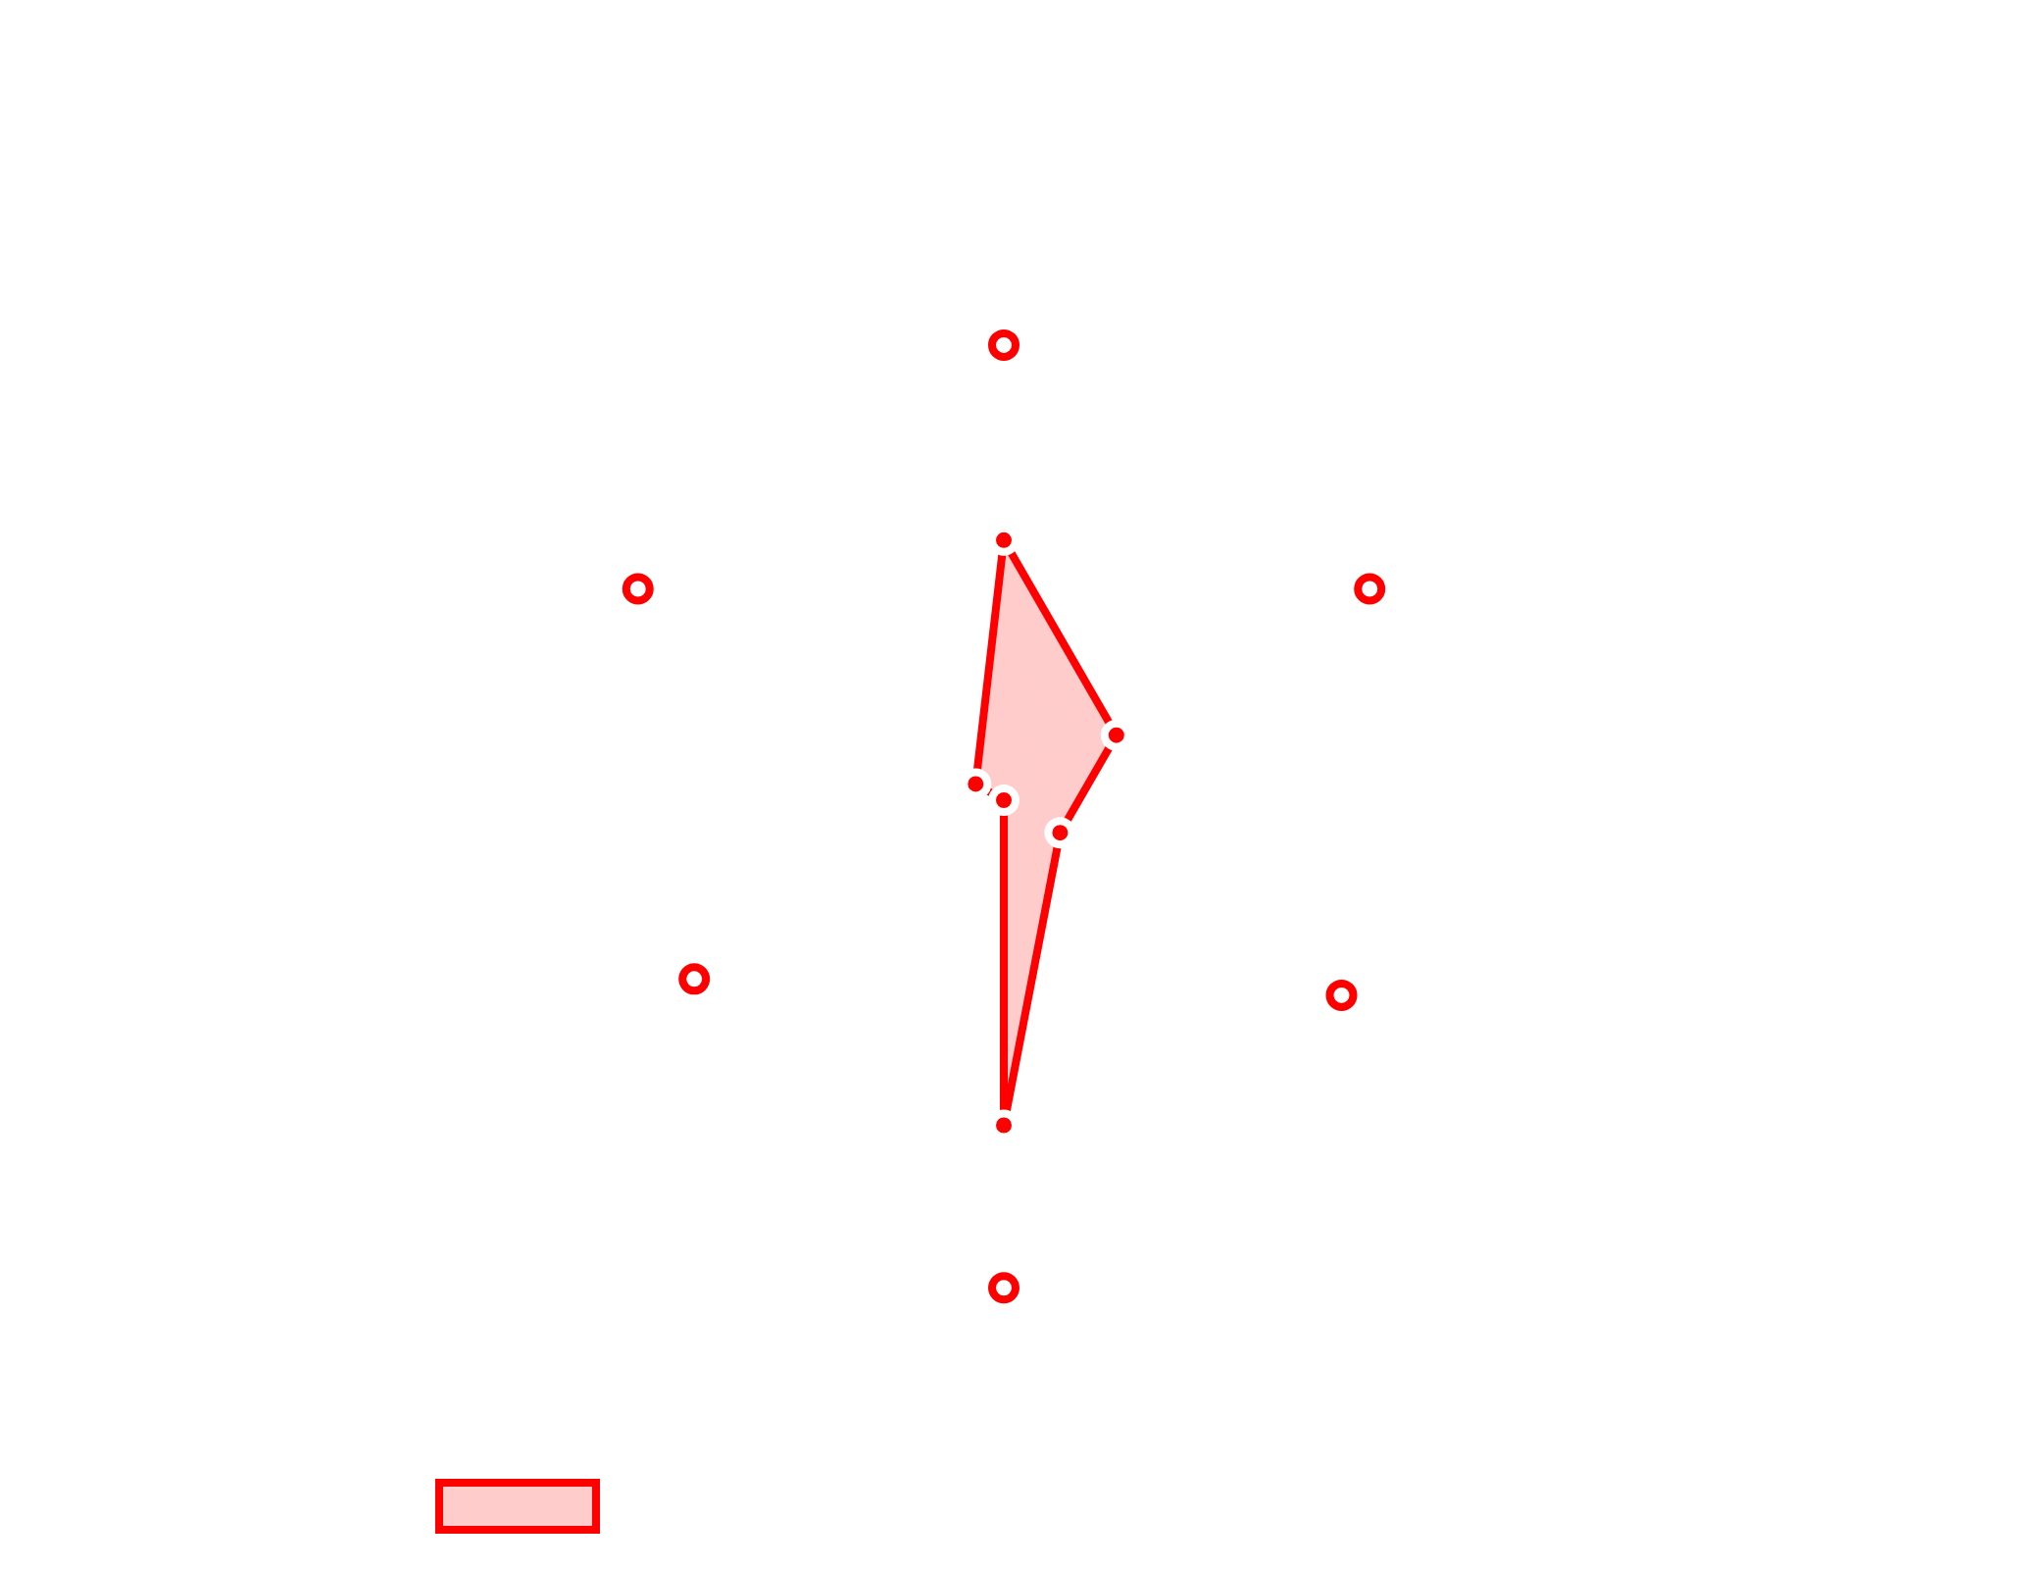




Future Applications
The MCP server and client architecture opens up numerous
possibilities for
extending AI capabilities
beyond basic web
scraping.
Potential Extensions
Data Integration Hub
- Connect to multiple data sources
through a unified MCP interface
Multi-Agent Systems
- Create specialized agents that
collaborate through MCP
Process Automation
- Trigger complex workflows based
on AI analysis
Advanced Research Assistant
- Gather and synthesize
information from diverse sources
Implementation Roadmap
• Short-term:
Add support for additional data sources
• Mid-term:
Implement caching and result persistence
• Long-term:
Develop a comprehensive agent ecosystem
MCP Server and Client: The Future of AI Automation
8

Slide 9
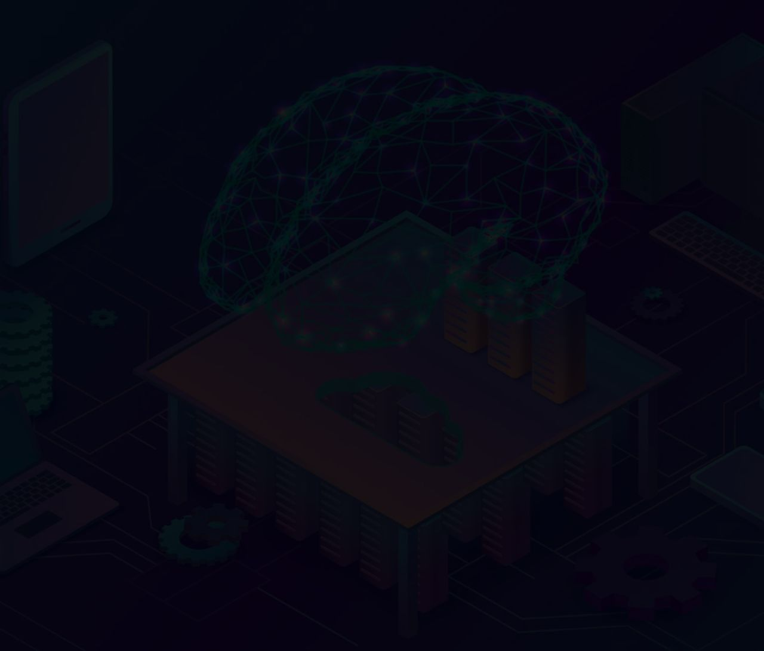
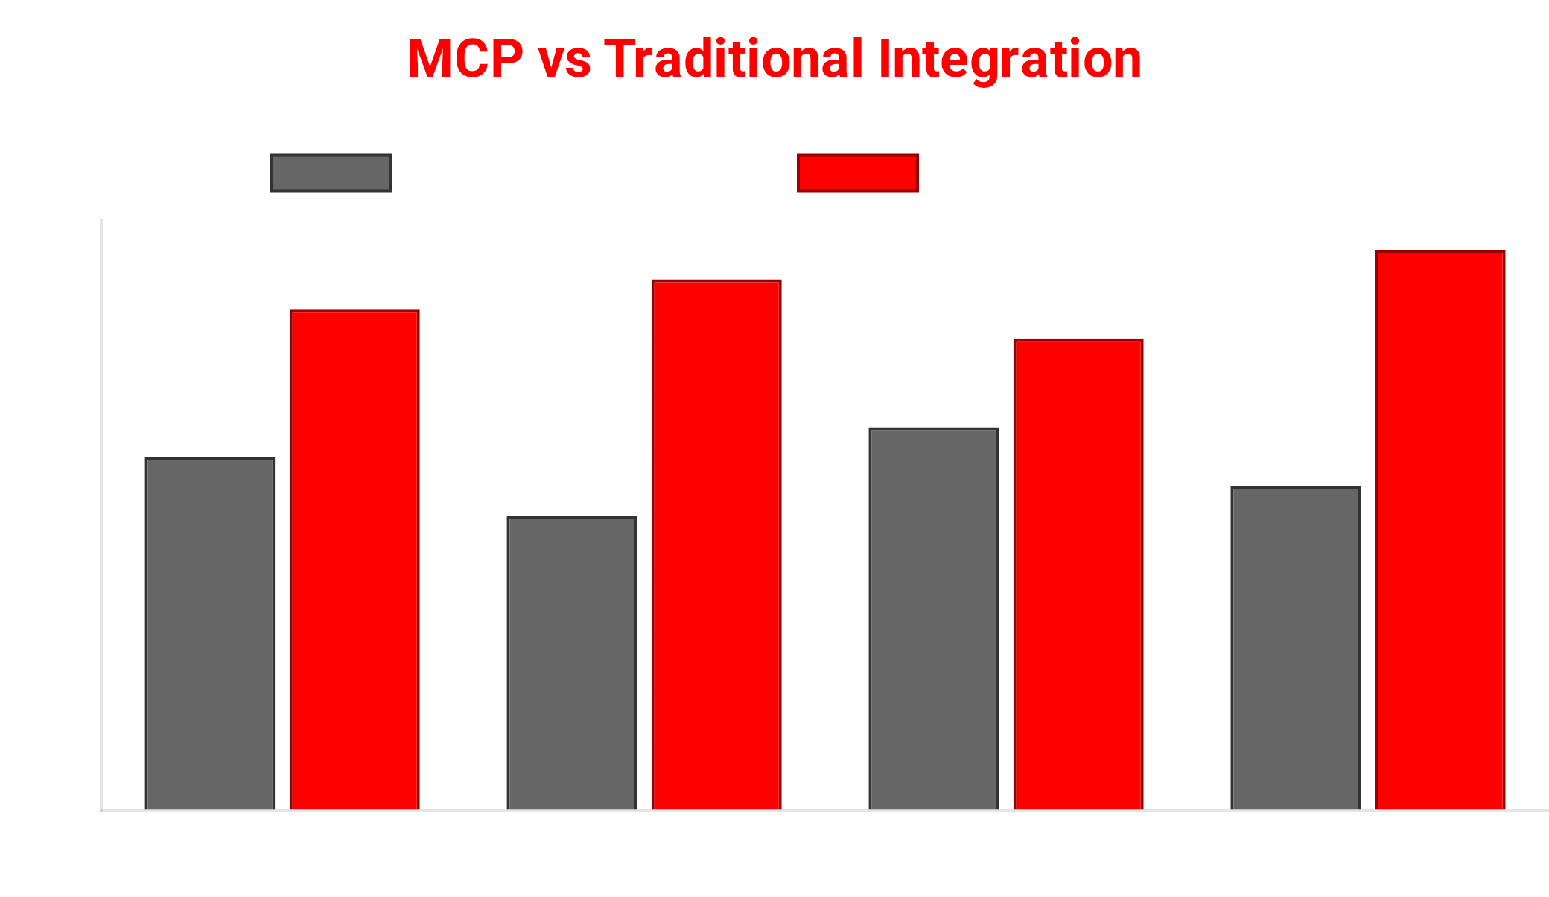


Conclusion
The MCP Server and Client implementation represents a
significant step forward in
AI automation
, demonstrating
how standardized protocols can enable powerful AI-driven
workflows.
Key Benefits
Standardized Communication
MCP provides a consistent interface between AI agents and tools, enabling seamless integration.
No-Code Implementation
Built entirely with n8n workflows, making it accessible to non-developers.
Extensible Architecture
Contact Information
Easily add new tools and capabilities to expand the system's functionality.
abhishek1530002@gmail.com
github.com/dixitabhi1/mcp-n8n-firecrawl
The Future of AI Automation
This implementation showcases how
AI agents can become
more powerful
by leveraging external tools through
standardized protocols, pointing toward a future where AI
systems can seamlessly interact with a wide range of
specialized services.
MCP Server and Client: The Future of AI Automation
9

