Slide 1

AI-Based
Full Body
Measurement
Estimation
Voms Tech Machine Round
Final Assignment
Abhishek Dixit

Slide 2

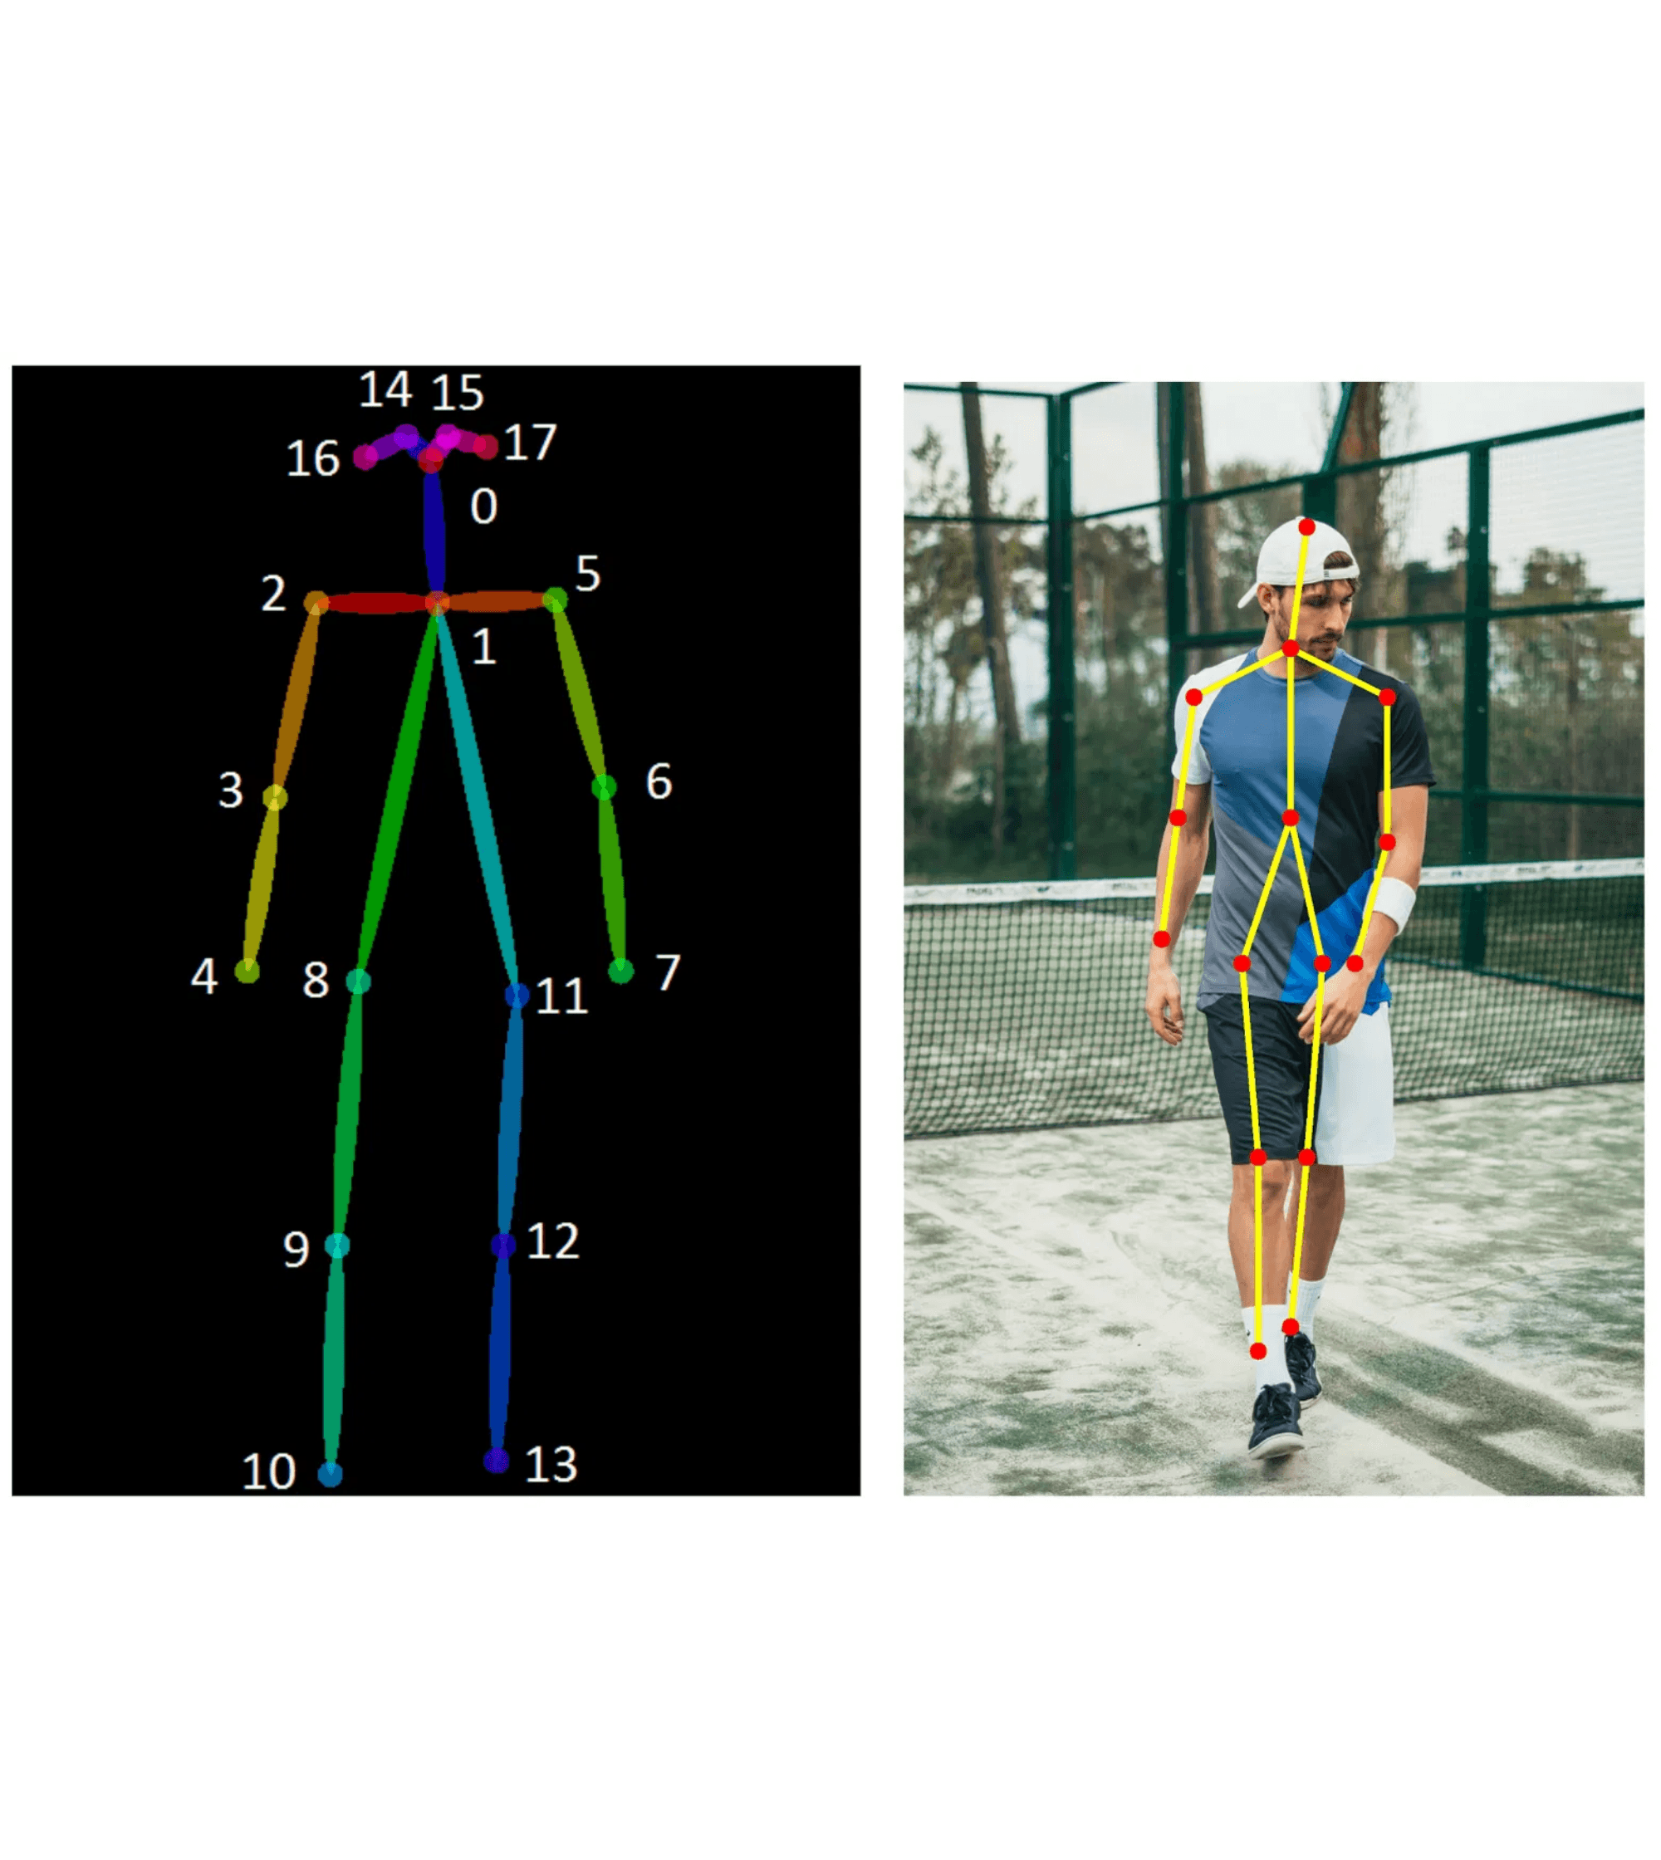
Project Overview
Objective
Estimate approximate human body measurements from three standard pose images (Front, Side, Standing).
Mandatory Outputs
Height (User Input)
Shoulder Width
Hip Width
Arm Length
Leg / Inseam Length
Core Value
A non-invasive, fast, and scalable alternative to manual tape measurements for e-commerce and fitness.

Slide 3

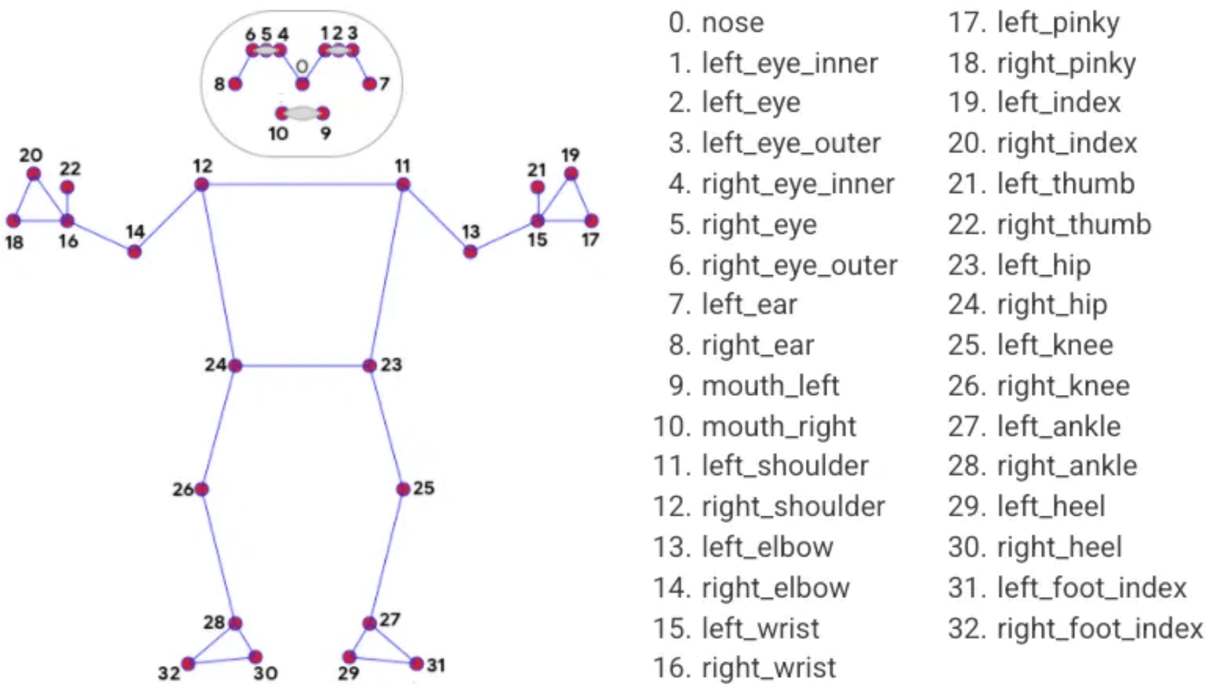
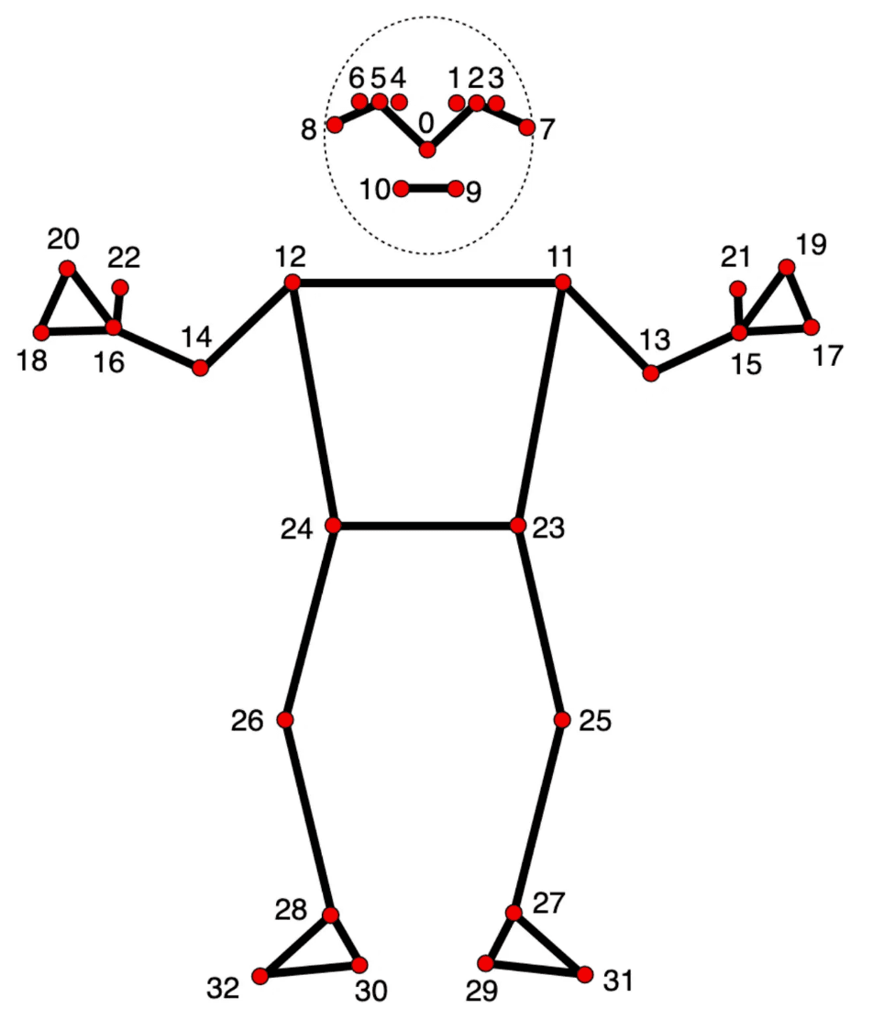
Hybrid Pipeline Approach
STAGE 01
STAGE 02
STAGE 03
STAGE 04
Pose Estimation
Feature Engineering
Normalization
ML Refinement
MediaPipe Pose extracts 2D landmarks from input images.
Calculating pixel distances between key landmark pairs.
Converting distances into scale-invariant ratios relative to height.
Random Forest Regressor corrects for noise and distortion.

Slide 4

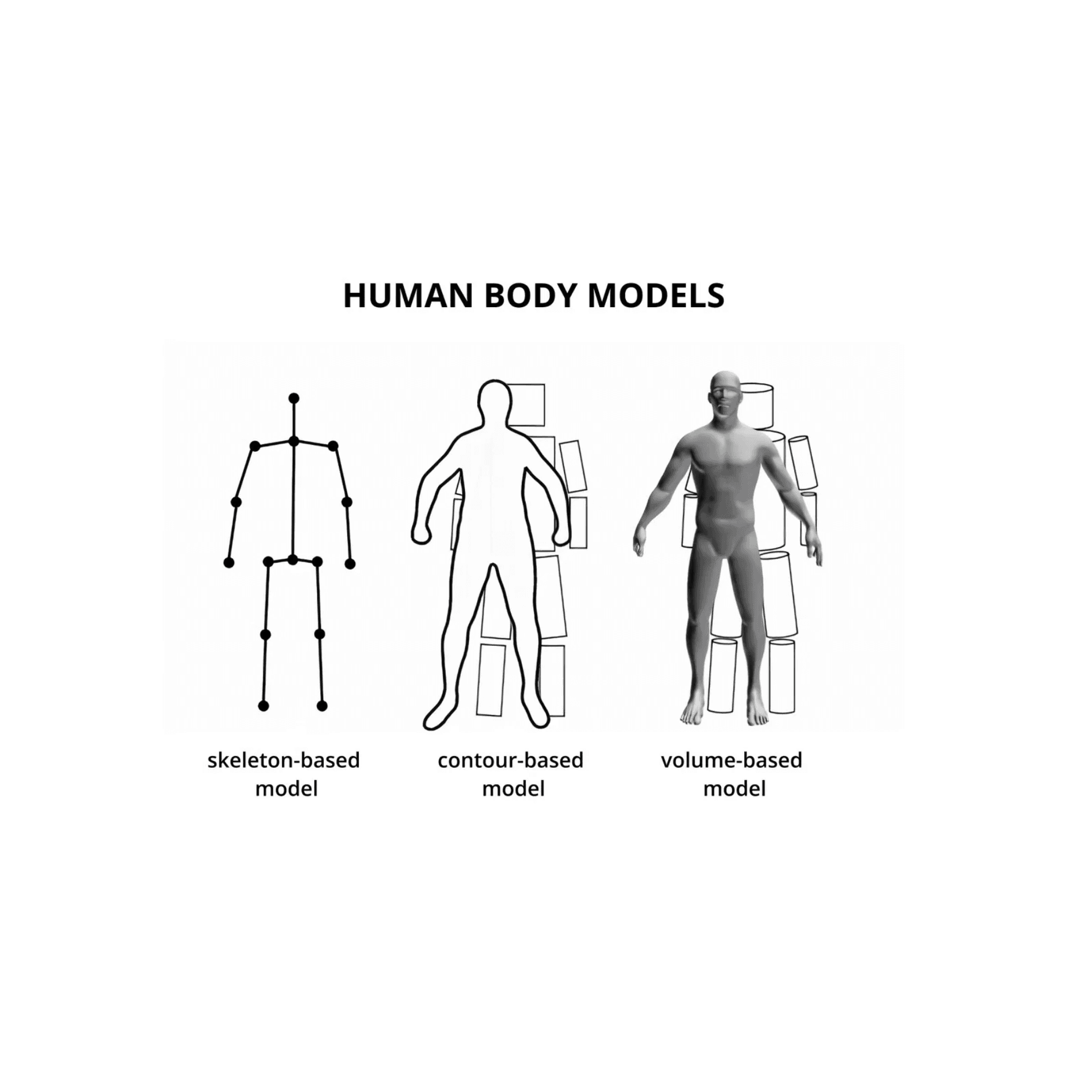
Scaling Logic
The Core Calculation
Measurement (cm) =
Predicted Ratio × User Height (cm)
Absolute Reference
The user-provided height serves as the single source of truth, eliminating the need for complex camera calibration or reference objects.
Scale Invariance
By working with ratios, the system remains robust across different image resolutions and camera distances.
ML Refinement
The Random Forest model predicts the most probable anthropometric ratios, smoothing out noise from 2D landmark detection.

Slide 5

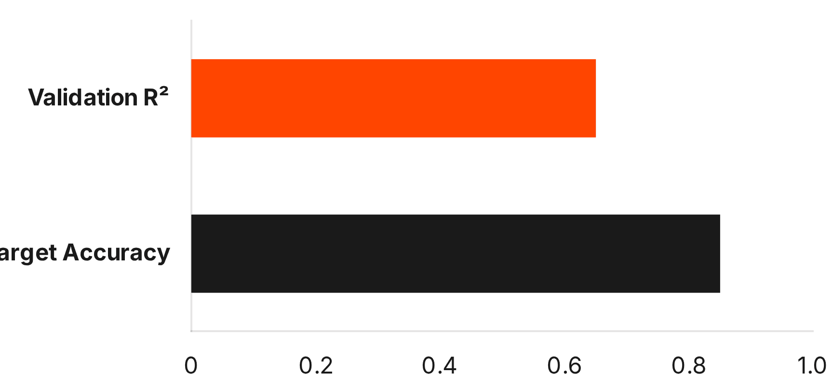
Performance Scenarios & Justification
0.65
R² Variance: Worst-Case vs. Optimal-Case
Scenario
R² Score
Key Conditions
**Worst-Case (Real-World)**
$\sim 0.65$
Uncontrolled lighting, loose clothing, perspective distortion, consumer camera.
Current R² Score
**Optimal-Case (Lab/Controlled)**
$> 0.85$
Uniform lighting, tight clothing, professional camera, strict pose adherence.
Justification:
The $\sim 0.65$ score is the expected baseline due to the inherent information loss of 3D estimation from noisy 2D inputs. The $> 0.85$ score demonstrates the model's true predictive power when the computer vision pipeline is provided with high-quality, low-noise data, validating the core ML approach.
*Score reflects real-world, uncontrolled conditions.

Slide 6


Assumptions for
Optimal Performance
Standardized Pose
Full Visibility
Users must stand upright and face the camera directly for front and side views to ensure landmark accuracy.
The entire body (head to feet) must be visible in the standing image for precise height normalization.
Clothing Choice
Consistency
Minimal or tight-fitting clothing is required to prevent landmark occlusion and contour distortion.
All images must be of the same person taken under similar lighting and perspective conditions.

Slide 7

Limitations & Constraints
The 2D Constraint
Data Dependency
Lack of depth information means the system cannot capture body curvature or volume, resulting in linear approximations of 3D forms.
The model relies on synthetic anthropometric datasets due to the scarcity of public paired image-and-measurement data.
Perspective Sensitivity
Non-Medical Grade
Extreme camera angles, lens distortion, or inconsistent distances can skew landmark coordinates and ratio calculations.
Measurements are approximate and intended for sizing/virtual fitting, not for medical diagnostics or professional tailoring.
Note: Accuracy is highly dependent on user compliance with pose and clothing requirements.

Slide 8

Tech Stack: Modern & Scalable Architecture
Computer Vision
Machine Learning
Image Processing
Predictive Modeling
Python 3.10+
Scikit-learn
MediaPipe Pose
Random Forest Regressor
OpenCV (cv2)
NumPy & Pandas
Backend & API
Frontend & Demo
Inference Engine
User Interface
FastAPI
React & Vite
Hugging Face Spaces
Tailwind CSS
Uvicorn
Shadcn UI

Slide 9
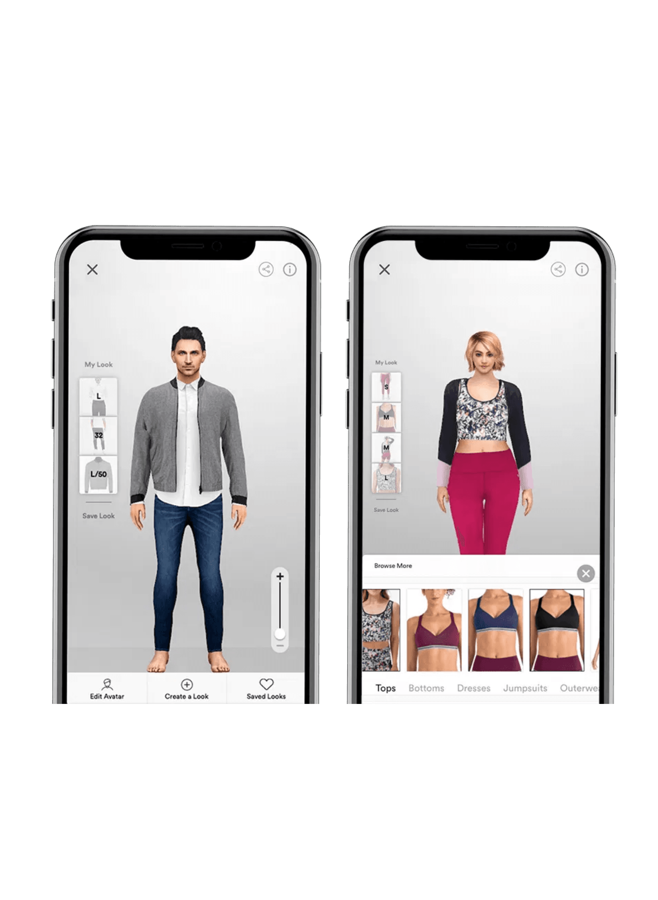
Conclusion: A Robust &
Deployable Solution
Requirement Fulfillment
Explainable AI
Successfully delivers all mandatory outputs, a working web-based demo, and a scalable API-first architecture.
Clear scaling logic and a well-defined hybrid pipeline ensure transparency and trust in the measurement results.
Scalability
Future Work
The FastAPI backend and React frontend are ready for integration into larger e-commerce or fitness platforms.
Potential for 3D body reconstruction and depth-sensing integration to further enhance measurement precision.
Thank You

