Slide 1
BLUE SHIELD OF CALIFORNIA · PROVIDER CONTRACTING · DATABRICKS
Contract
Intelligence Platform
GOVERNED FOUNDATION
EVIDENCE & ANSWERS
Turning provider contracts into trusted business intelligence
BUSINESS SERVING
10K+
300+
31
CURRENT TERMS
CONTRACT DOCUMENTS
PROVIDER ORGANIZATIONS
PRODUCTION TABLES
AMENDMENT-AWARE LOGIC
Executive discussion · Blue Shield of California · Confidential — Internal
Notes:
Opening. '10,372 provider contracts. 27 gigabytes of legal documents. Every rate, every clause, every amendment — locked in PDFs and inaccessible at scale. This platform changes that.' Do not jump to the solution. Let the scale of the corpus land first.

Slide 2
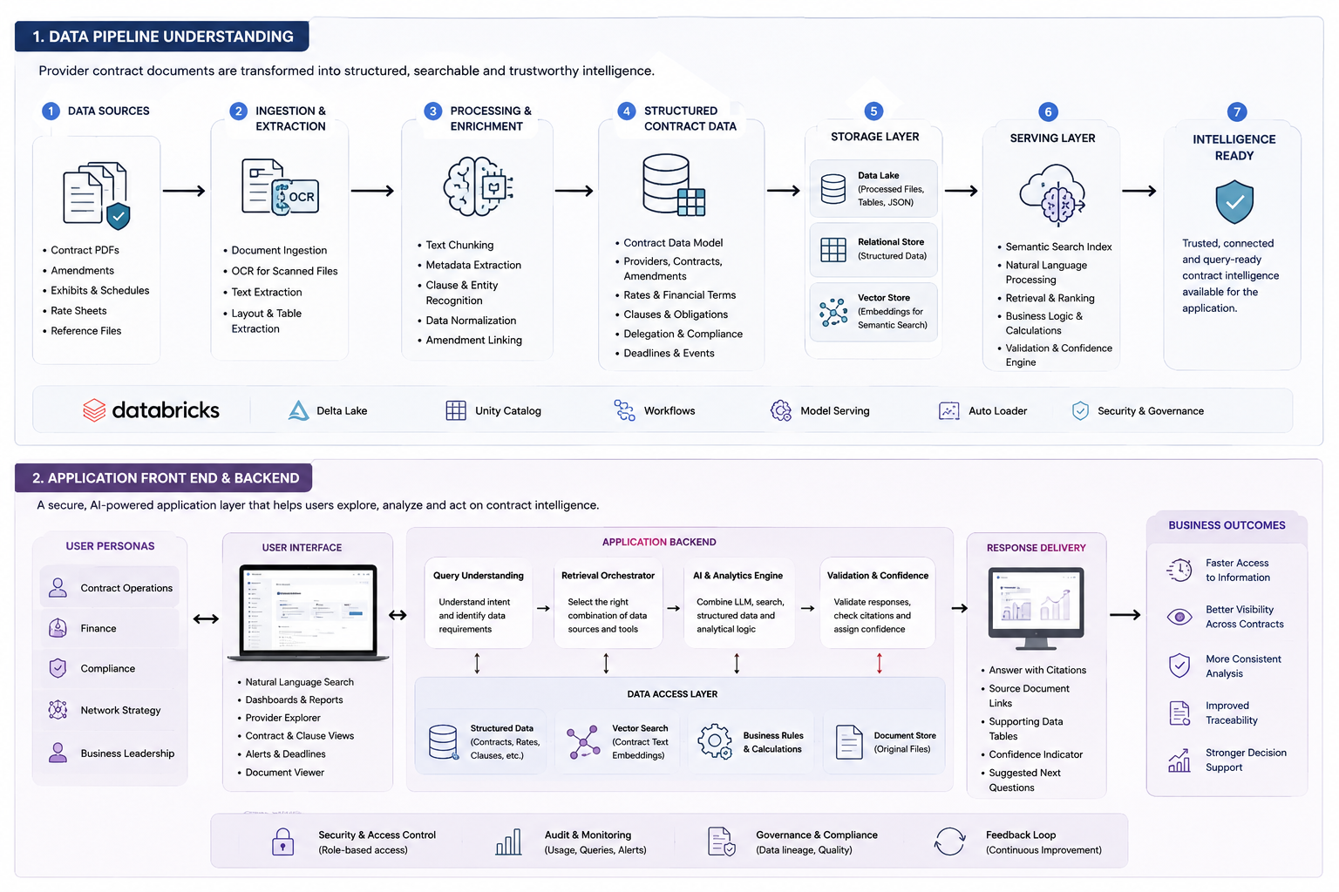

Slide 3
SECTION 01 · EXECUTIVE THESIS
Contract intelligence is a strategic operating asset—not simply document search
Unlock governed intelligence
WHY INVEST NOW
Transform complex agreements into reusable, structured data with traceable provenance.
A documented foundation already exists
Make decisions defensible
Priority business use cases are identifiable
Give teams evidence-linked answers, not isolated document interpretations.
Remaining effort is completion and hardening—not a restart
Scale the capability
Trust and value gates can control each scale decision
Reuse the same governed pipeline for new contracts, entities and future Blue plans.
The opportunity is to convert a difficult-to-use contract estate into a governed enterprise decision capability.
Contract Intelligence Platform · Confidential — Internal
02
Notes:
Lead with the thesis: contract intelligence is a strategic operating asset, not document search. Emphasize the governed foundation, defensible evidence-linked decisions, reusable scale, and the trust-and-value gates that control each investment step.

Slide 4
SECTION 02 · THE BUSINESS PROBLEM
Critical contract intelligence is fragmented, slow to verify and difficult to reuse
Manual research
THE COST OF THE
STATUS QUO
Teams must locate files, compare terms and interpret documents before they can act.
Slow answer cycles
Amendment complexity
Inconsistent interpretation risk
A current answer depends on understanding what has changed, what was superseded and what remains in force.
Limited portfolio comparability
No portfolio view
Critical knowledge concentrated in a few experts
Cross-provider insight is constrained when terms, rates and obligations remain locked in separate documents.
The result: experts spend time finding and validating information instead of acting on it.
Contract Intelligence Platform · Confidential — Internal
03
Notes:
State the problem in business terms only. No technology. No solution yet. Three structural pains: you cannot query, you cannot trust amendment currency, you cannot benchmark. The right panel captures the qualitative reality — not fabricated numbers. Let the pain land before moving on.

Slide 5
SECTION 03 · WHY CHANGE
The platform closes the gap between raw documents and governed decisions
Manual research
Keyword / generic AI
Traditional CLM
DOCUMENT ESTATE
Contracts, exhibits and amendments create a fragmented evidence base.
Slow to repeat Difficult to compare Hard to govern at scale
Finds text, not current terms Weak provenance Limited enterprise control
Optimized for authoring Not historical extraction Limited portfolio analytics
STRUCTURED & GOVERNED
Contract terms, rates, entities and lineage are organized in governed data products.
NOT SCALABLE
NOT TRUSTWORTHY
NOT FIT FOR PURPOSE
ASKABLE
Plain-language questions return evidence-linked answers with confidence signals.
AI accelerates extraction and retrieval. Governance, validation and accountable ownership make the capability usable.
Contract Intelligence Platform · Confidential — Internal
04
Notes:
Left: three approaches that fail and exactly why. Right: the transformation arc in three steps. Bottom principle is the responsible AI frame — use it word for word. The message: none of the alternatives gets you all four things simultaneously: full corpus, validated, amendment-aware, governed.

Slide 6
SECTION 04 · FOUNDATION READINESS
The platform has a documented foundation designed for controlled, scalable operation
COMPONENT / READINESS · TEAL = DOCUMENTED · AMBER = HARDENING
DOCUMENTED FOUNDATION · ONBOARDING PROGRESS
Document intake & extraction
Documented implementation
10K+
Data quality & validation
Layered controls designed into pipeline
CONTRACT DOCUMENTS IN SCOPE
Structured contract foundation
Governed model across contract facts
300+
Evidence retrieval
Semantic search for clause-level context
PROVIDER ORGANIZATIONS
31
Security & access controls
Governance capabilities designed in platform
PRODUCTION TABLES
Orchestration & monitoring
Operationalization focus for scale
Foundation exists; investment completes onboarding, hardens controls and operationalizes reuse.
Contract Intelligence Platform · Confidential — Internal
05
Notes:
Be honest: green items are genuinely live and production-ready. Amber items are known gaps on the roadmap. The corpus progress bar is key: ~70% complete, ~3,000 files remaining — not starting over, nearly there. The closing statement is important: this is live, not a prototype.

Slide 7
SECTION 05 · QUESTIONS ENABLED
Business users can ask questions in familiar language—within defined, governed use cases
Business question
SCOPE OF USE
Rate intelligence
Current reimbursement terms
Genie semantic layer
(curated gold tables + business column descriptions → governed SQL)
Contract status
Active, expiring and amended agreements
Evidence selection (governed structured + document evidence)
Portfolio comparisons
Variation across providers
Program coverage
Provider support by line of business
Answer with citations and confidence
Legal & clause queries
Source-backed obligations and notices
Portfolio analytics
Contract vintage, rates and coverage gaps
One governed interface for contracting, finance, network, compliance and leadership.
Contract Intelligence Platform · Confidential — Internal
06
Notes:
Walk the left flow once: English question → semantic layer → governed SQL → curated gold tables → answer in seconds. The right scope shows breadth. Key message: not just a rate lookup tool — it covers the full range of contracting intelligence needs across every business persona.

Slide 8
SECTION 06 · INFORMATION MODEL
Structured data answers known questions; evidence retrieval handles source-specific ones
STRUCTURED DATA EXPERIENCE
EVIDENCE RETRIEVAL EXPERIENCE
Fast, governed business analytics
Clause-level, source-backed research
BEST FOR
Rates, contract status, portfolio metrics and provider comparisons
BEST FOR
Questions requiring exact language, context or document evidence
WORKS OVER
Curated contract, provider, rate, amendment and obligation data
WORKS OVER
Original contract text, exhibits and semantically indexed passages
RETURNS
Lists, measures, comparisons and status views
RETURNS
Cited passages, source links and confidence signals
AUDIENCE
Contracting, finance, network and leadership
AUDIENCE
Analysts, legal and compliance teams
EXAMPLE QUESTIONS
EXAMPLE QUESTIONS
Which contracts are approaching renewal?
What notice requirement applies?
How do current rates vary by provider?
Which agreements contain this obligation?
Where are network coverage gaps?
What is the exact source language?
One governed foundation, two complementary answer modes—so the system uses the right evidence for the question.
Contract Intelligence Platform · Confidential — Internal
07
Notes:
Frame as complementary, not competing. Genie = fast structured answers for business users. RAG = deep citation-grounded legal retrieval for analysts and compliance. Bottom line is the key: both front doors read from the same governed, validated foundation.

Slide 9
SECTION 07 · REUSABLE DATA PIPELINE
A controlled path from document to intelligence
Unstructured PDF enters on the left — governed, validated intelligence exits on the right.
1
2
3
4
5
6
INGEST
CLASSIFY
EXTRACT
RESOLVE
INDEX
SERVE
Files, OCR and text
Document type and metadata
Terms, entities and tables
Amendment-aware current state
Evidence retrieval and citations
Governed products and feedback
PRODUCTION CONTROLS
Model assistance is bounded by deterministic checks at every stage.
Per-document isolation
Checkpoint and rerun
Parameterized reuse
Failures are contained and can be retried without compromising completed records.
Progress and provenance are retained to support controlled reprocessing.
The same pipeline can be configured for future contract populations and onboarding waves.
Validation is embedded throughout the pipeline—rather than added at the end.
Contract Intelligence Platform · Confidential — Internal
08
Notes:
Walk left to right. Highlight the interleaving: teal (AI) steps are wrapped by grey (deterministic) checks at every stage. The three bottom cards are the hard-won engineering decisions that make this production-grade — especially per-file REST API isolation which eliminated multi-hour batch stalls.

Slide 10
SECTION 08 · AMENDMENT INTELLIGENCE
A trustworthy answer must distinguish current terms from superseded history
Contracts are living records: base agreements, exhibits and amendments must be interpreted together before a term is presented as current.
BASE
AGREEMENT
AMENDMENT
1
AMENDMENT
2
AMENDMENT
3
RESOLVED CURRENT STATE
Original terms
Rate or language update
Targeted revision
Exhibit replacement
Scope-aware terms in force
BASE + AMENDMENTS → RESOLVED CURRENT TERMS
AMENDMENT SCOPE TYPES
Why it matters
Citing a superseded rate in a negotiation is a real financial and relationship risk. Scope-aware supersession makes the current state automatic and auditable.
Full replacement
Targeted change
Term extension
Replaces an earlier rate schedule or section
Updates only identified terms or lines
Extends a period while retaining applicable terms
Contract Intelligence Platform · Confidential — Internal
09
Notes:
Walk the chain left to right. The last box (dark) is the only one that counts — the platform resolves to the current state only. Explain the three scope types because real amendments behave differently. Land on the right-hand risk message: citing a superseded rate is a real exposure.

Slide 11
SECTION 09 · THE ANSWER JOURNEY
The application selects and verifies evidence before it generates an answer
A question is interpreted, routed to the right evidence, checked for grounding and returned with source context.
UNDERSTAND
RETRIEVE
RANK
VALIDATE
ANSWER
Intent and entities
Structured + document evidence
Prioritize fit and authority
Grounding, scope and consistency
Citations + confidence
EVIDENCE PATHS
VALIDATION CONTROLS
Semantic
(vector search)
Current-term logic
Lexical
(keyword)
Grounding checks
Numeric consistency
Metadata
(SQL direct)
Scope matching
Structural
(section-aware)
Decline if evidence is insufficient
The system shows the evidence behind each answer—and declines when support is insufficient.
Contract Intelligence Platform · Confidential — Internal
10
Notes:
Walk every stage. The 4-channel box shows why this is more reliable than a simple keyword search. The citation check is what makes output trustworthy — six independent checks before an answer is returned. The refuse behavior is a feature: if evidence is insufficient, the system says so rather than guessing.

Slide 12
SECTION 10 · TRUST BY DESIGN
Trust is built through layered controls, evidence and accountable use—not a claim of perfect AI
1 · PREVENT
Instructions and extraction rules focus the system on what is explicitly present; absence is treated as absence.
DEFENSE IN DEPTH
We do not claim hallucinations are eliminated. We claim risk is bounded through layered controls, measured confidence and accountable escalation.
2 · CONSTRAIN
Schema and business-rule constraints limit outputs to defined, usable structures.
3 · VERIFY
Deterministic checks assess dates, amounts, codes, completeness and consistency against source-derived records.
CITED
4 · REVIEW
Quality review and exception handling surface uncertainty before data reaches trusted serving layers.
Evidence linked to source material
CHECKED
5 · GROUND
Answer-time citations, confidence signals and refusal thresholds keep responses tied to available evidence.
Controls applied at data and answer stages
ESCALATE
Low-evidence cases are flagged or declined
Human and legal owners retain accountability for negotiations, compliance and other high-impact decisions.
Contract Intelligence Platform · Confidential — Internal
11
Notes:
Slow down on this slide. Five independent layers, each catching what the previous might miss. The framing on the right is exact — use it word for word. NEVER say hallucinations are eliminated. Say risk is layered, measured and controlled. The 'refuse rather than guess' behavior is a trust feature, not a limitation.

Slide 13
SECTION 04 · OPERATING MODEL
Clear ownership makes contract intelligence accountable
ACCOUNTABLE ROLES
PLATFORM & DATA
BUSINESS PRODUCT
RISK & LEGAL
EXECUTIVE SPONSOR
Own onboarding and metadata quality
Operate pipelines, lineage and access
Resolve defects and service health
Prioritize use cases and users
Drive workflow adoption
Own outcomes and value evidence
Define controls and permitted use
Review material exceptions
Maintain escalation paths
Name accountable owners
Fund completion and pilot
Enforce decision gates
Scale only after value is proven
SCALE GATE · QUALITY + ADOPTION + CONTROL EVIDENCE + VALIDATED VALUE
Executive discussion · Blue Shield of California · Confidential — Internal
12
Notes:
Walk the four accountable roles: platform and data, business product, risk and legal, and executive sponsor. Emphasize that scale requires evidence across quality, adoption, controls and validated value.

Slide 14
SECTION 12 · VALUE, ECONOMICS & SCALE
Scale only after quality, adoption and value are demonstrated
COMPLETE
MEASURE
SCALE
Complete the governed foundation
Measure trust and economics
Scale selectively
Finish contract onboarding
Baseline research effort and cycle time
Expand only after validated benefit
Harden quality and operations
Track adoption, quality and exception rates
Reuse governed onboarding patterns
Owner: platform + business product
Include operating cost in the value case
Approve through an executive scale gate
SCALE GATE → QUALITY · ADOPTION · CONTROL EVIDENCE · VALIDATED NET BENEFIT
Contract Intelligence Platform · Confidential — Internal
13
Notes:
Present the sequence as three gated decisions: complete the governed foundation, measure trust and economics, then scale selectively. Make clear that no expansion is approved until quality, adoption, control evidence and net benefit are demonstrated.

Slide 15
SECTION 13 · RECOMMENDATION
The opportunity is to operationalize contract value—governed, measurable and reusable
REUSABLE DATA ASSET
TRUST & ACCOUNTABILITY
IMPLEMENTATION LEVERAGE
Any rate. Any provider. Any clause—through governed data and evidence.
Every answer linked to source evidence, controls and accountable review.
Built on the current platform foundation, with scale gated by measured value.
THE EXECUTIVE ASK
1
Name an executive sponsor and accountable business product owner
2
Approve completion and hardening of the governed data and trust foundation
3
Authorize a pilot with success criteria for quality, adoption, cycle time and value
The decision is whether Blue Shield will operationalize contract value through a governed, measurable pilot.
Contract Intelligence Platform · Confidential — Internal
14
Notes:
Close with conviction. Read the title line slowly. Recap the three things they should remember. Make a SPECIFIC ask — not vague sponsorship but the three items listed. End on the final italic line and hand to Q&A.

Slide 16
APPENDIX · REFERENCE ARCHITECTURE
Governed architecture links contracts to trusted applications
ARCHITECTURE LAYERS
SOURCE DOCUMENTS
Contract repositories | PDFs, exhibits and amendments
CROSS-CUTTING
GOVERNANCE
INGEST & STRUCTURE
Intake + OCR | Metadata + terms | Normalization + validation
UNITY CATALOG
Role-based access
Data lineage
Audit logging
Quality monitoring
Feedback loop
GOVERNED DATA
Contract registry | Amendment registry | Rates + current-state logic
EVIDENCE RETRIEVAL
Chunking + embeddings | Vector search | Source citations
APPLICATION DELIVERY
Business search | Evidence answers | Portfolio analytics
Executive discussion · Blue Shield of California · Confidential — Internal
15
Notes:
Walk top to bottom from source documents through ingestion, governed data, evidence retrieval and application delivery. The governance rail applies across every layer and keeps access, lineage, audit, quality and feedback controls consistent.

