Slide 1
By-
Madhurs Pise, Omkar Dixit,Abdulmalik Alluhidan, Vishnu Sarvagna Gollamudi, David Balash, Aditya Dharne, Ishan Sharma, Fnu Afreen Shahanaaz
Database Project:
Catering Company

Slide 2
Objective
Design database system for catering company.
Catering company has one hall and it has to manage orders.
Company has to keep track of orders and have different menus.
Catering company also have contractors which can perform at ceremony.
Customer has a choice whether to have ceremony in company hall or their own hall

Slide 3
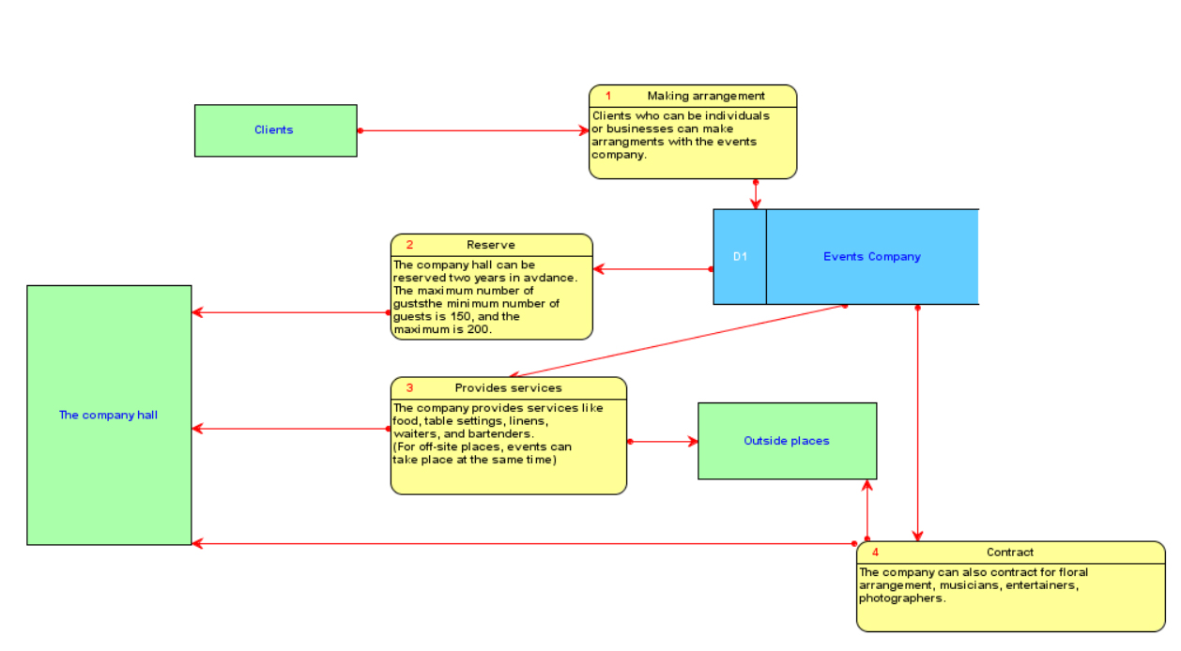
Data flow diagram

Slide 4
E-R Diagram

Slide 5
Relational database design

Slide 6
Dependency diagram
client table:
clientLName, cFName → cPhone, cStreet, cZip
zips table:
zip → city, state
location table:
locationName → locationStreet, locationZip
event table:
clientLName, cFName, eventDate, eventStartTime → eventDuration, eventType, numberGuests, locationName, linenColorRequested, numberWaiters, numberBartenders, totalPrice, floristName, floristCost, musicContact, musicCost, entertainerName, entertainerCost, photographerName, photographerCost, menuNumberChosen
menu table:
menuNumberChosen → menuAppetizer, menuSalad, menuMain, menuDessert
florist table:
floristName → floristPhone
music table:
musicContact → musicContactPhone, musicType
entertainer table:
entertainerName → entertainerPhone, entertainerType
photographer table:
photographerName → photographerPhone

Slide 7
Modified E-R Diagram

Slide 8
Modification E-R Diagram
Added attribute hall_type
Hall_type1 signifies company hall will be used.
Added attribute services_required
Separated tables for contractor
Added attribute order_status to track whether order is cancellled or not

Slide 9
Modification to E-R diagram
Cost calculation
Added hall_cost with default value
Added menu_cost for each menu
Added misc_cost to calculate cost due to intangible factors such as how much busy they are on the date.
Added cost_cotractor
Total price= halltype*hallcost + 1.1*servicesrequired*contractorcost+menucost*noguests+ misccost

Slide 10
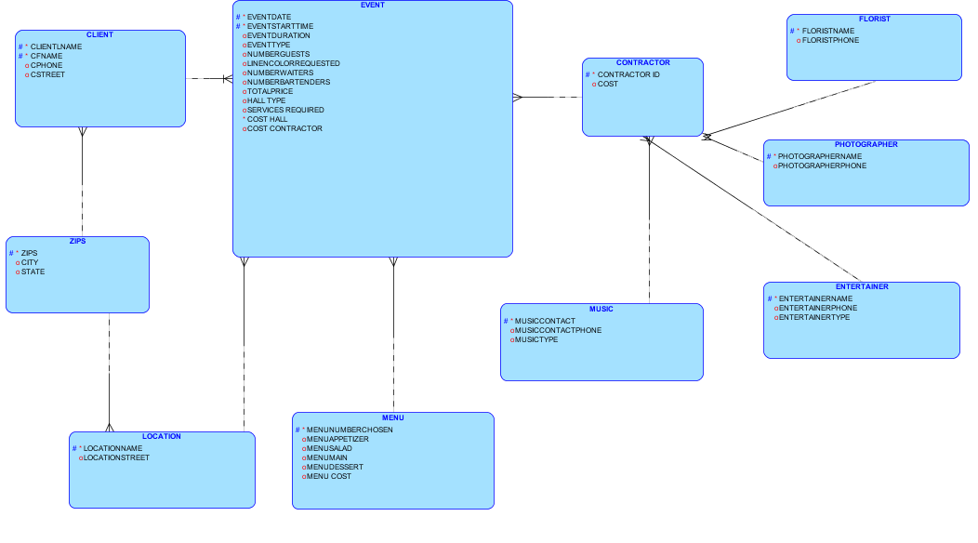
Modified E-R Diagram

Slide 11
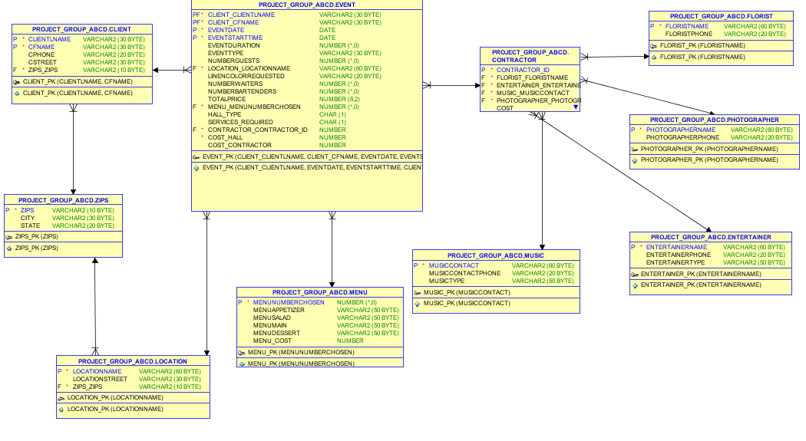
Modified Relationship diagram

Slide 12
Primary keys, foreign keys
CONTRCTOR_ID is primary key for contractor.
FLORISTNAME is foreign key for contractor.
PHOTOGRAPHERNAME is foreign key for contractor.
MUSICIANNAME is foreign key for contractor.
ENTERTRAINERNAME is foreign key for contractor.

Slide 13
Check constraints
To check number of guests.
They should be 150 to 200.
Also this constraint should only be imposed when company hall is used
To check event date. It should be maximum 2 years later than today’s date/

Slide 14
Sequences
Created sequences in order to keep track of values which are not containing any useful business information.
SEQUENCE ORDERID_SEQ
SEQUENCE CONTRACTORID_SEQ
SEQUNCE MENUNUMBERCHSEN_SEQ

Slide 15
Population of tables
Inserted data to each tables
To avoid referential integrity constraints, I disabled the foreign key constraint and then inserted data and again I enabled foreign key constraint.
Populated sequence using NEXTVAL

Slide 16
Sample insert statements
Location
Insert into LOCATION (LOCATIONNAME,LOCATIONSTREET,ZIPS_ZIPS) values ('Columbia Plaza','Virginai Avenue NW','20037');
Zips
Insert into ZIPS (ZIPS,CITY,STATE) values ('20022','Washington','District of Columbia'); Client
Insert into CLIENT (CLIENTLNAME,CFNAME,CPHONE,CSTREET,ZIPS_ZIPS) values ('Omkar','dominos','20245621000',null,'20037');
Menu
insert into menu values(MENU_MENUNUMBERCHOSEN_SEQ.nextval,'cheese bread','caesar salad','chipotle','Luscious lemon',20);

Slide 17
Sample insert statements
insert into contractor values(CONTRACTOR_CONTRACTOR_ID_SEQ.nextval,'Sachin','Ronaldo','Ronaldo','Vishwanathan',150);
Florist
insert into florist values('Sachin','2024501234');
Music
insert into music values('Sachin','2034501234','Rock');

Slide 18
Sample insert statements
Photographer
insert into photographer values('Gary','2034501234');
Entertainer
insert into ENTERTAINER values('Ronaldo','2434501234','Dance');
Event
Insert into EVENT (CLIENT_CLIENTLNAME,CLIENT_CFNAME,EVENTDATE,EVENTSTARTTIME,EVENTDURATION,EVENTTYPE,NUMBERGUESTS,LOCATION_LOCATIONNAME,LINENCOLORREQUESTED,NUMBERWAITERS,NUMBERBARTENDERS,TOTALPRICE,MENU_MENUNUMBERCHOSEN,HALL_TYPE,SERVICES_REQUIRED,COST_HALL,CONTRACTOR_CONTRACTOR_ID,COST_CONTRACTOR,ORDER_ID,ORDER_STATUS) values ('Omkar','dominos',to_date('25-12-15','DD-MM-RR'),to_date('25-12-15','DD-MM-RR'),2,'Entertainment',160,'Columbia Plaza','Red',10,10,2000,1,'0','0',100,10,0,1,'T');

Slide 19
Sample select statements
To find out number of events between 20dec to 27 dec.
select count(*) from EVENT where eventdate between '20122015' and '27122015';
To find out how many contracts were given between 20dec to 28 dec.
select count(*) from EVENT where eventdate between '20122015' and '28122015' and services_required=1;
To find out total profit earned between 20dec to 28dec.
select sum(totalprice) from EVENT where eventdate between '20122015' and '28122015'

Slide 20
Sample select queries using join
To find out client phone number for the event on 20151225.
select c.cphone from event e join client c on (c.CLIENTLNAME=e.CLIENT_CLIENTLNAME) where e.EVENTDATE='25122015';
To find entertainer name performing for order number 3.
select c.entertainer_entertainername from event e join contractor c on (c.contractor_id=e.contractor_contractor_id) where e.order_id=3;

Slide 21
Thank You

