Slide 1
Named Entity Recognition
Vivek
Omkar
Puneet
Peter

Slide 2
Inspiration
Key part of Information Extraction system
Robust handling of proper names essential for many applications
Pre-processing for different classification levels
Information filtering
Information linking

Slide 3
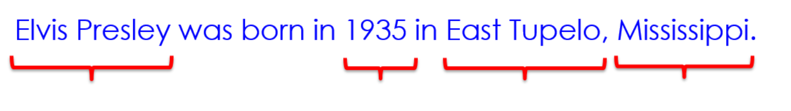
Problem Definition
Named Entity Recognition (NER) is the process of finding entities (people, cities, organizations, dates, ...) in a text
Example:
Three universally accepted categories: person, location and organisation

Slide 4
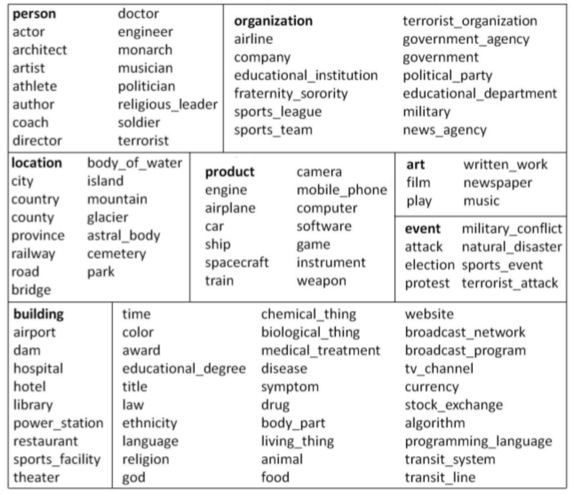
Fine Grained Entity Tag set [2]

Slide 5
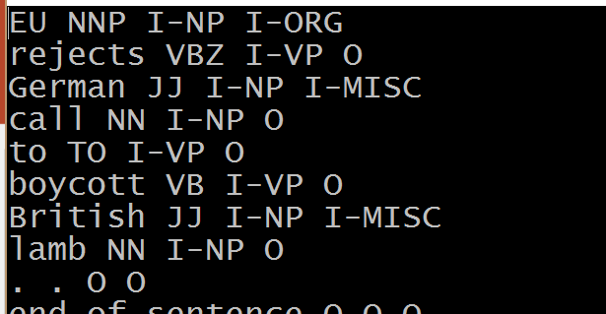
Data Set
Dataset was retrieved from Named Entity (NE) tagging (CoNLL2003 data)[1]
Data set consists of word, pos-tag, label. Sample:
Test data is in similar format. There are 217336 words in traindata and 54394 in testdata

Slide 6
Gazetteers
We used the dictionary lookup for checking whether word in in either of following category:
Name
Location
Organization
Misc
For good results, we used Stanford nltk package for gazetters

Slide 7
Approach
Generally 2 approaches are used :
Traditional Rule Based approach
Classification
We have combined both the approaches

Slide 8
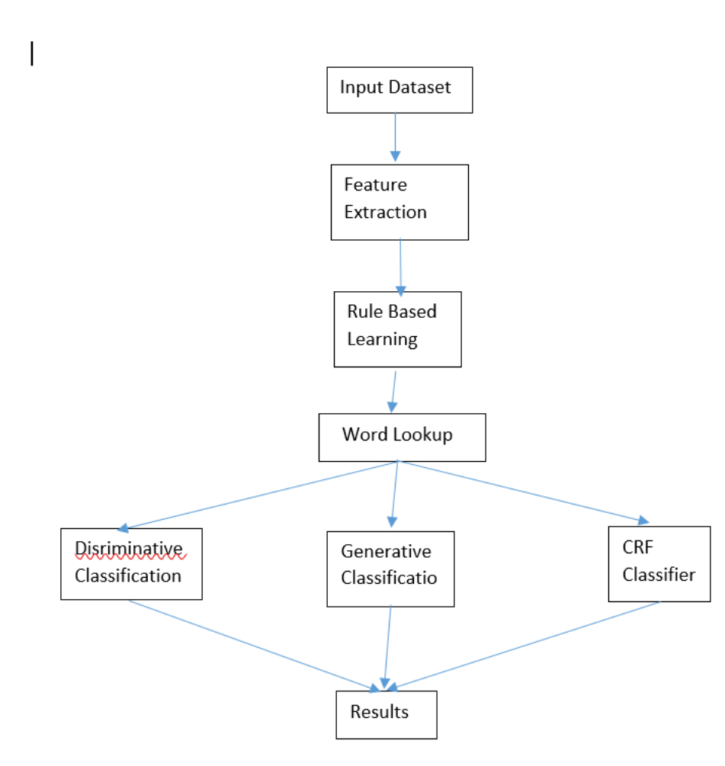
Flowchart

Slide 9
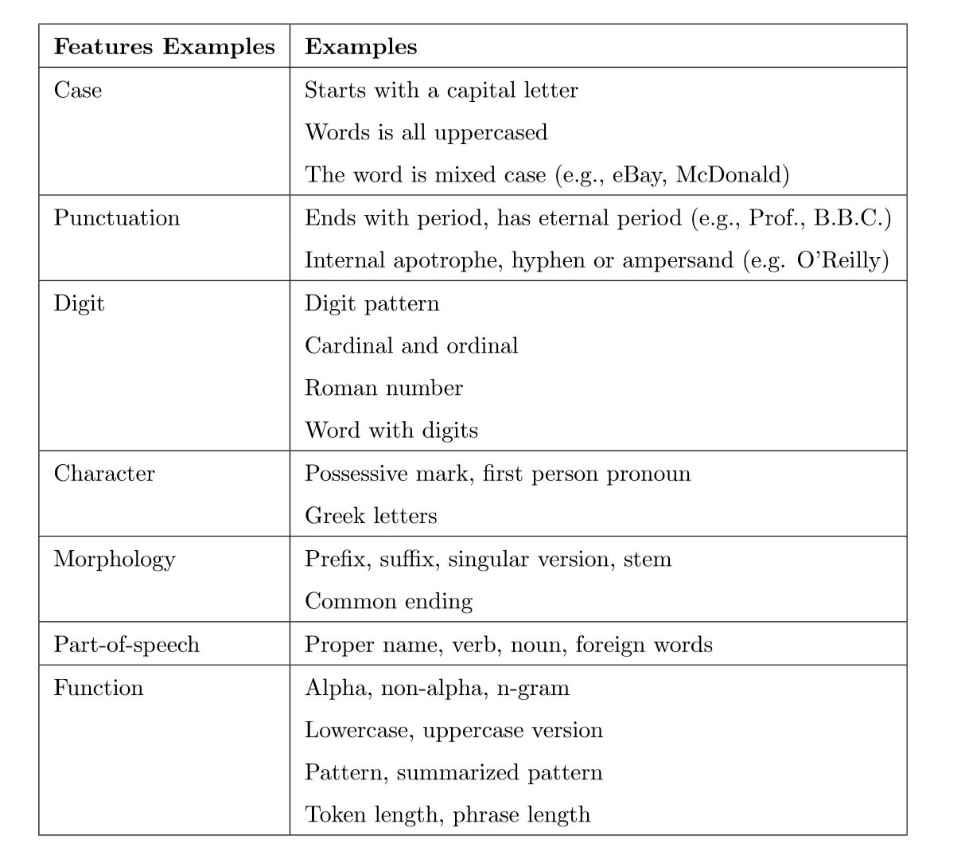
Feature Extraction ---1
Find out word level features

Slide 10
Feature Extraction –II(Histories, bin. features & futures)
History h_{t}: information derivable from the corpus relative to a token t:
text window around token w_{i}, e.g. w_{i-2},...,w_{i+2}
word features of these tokens
POS, other complex features

Slide 11
Hand crafted Rules : Shallow Parsing
Location:
CapWord + {City, Forest, Center} e.g. Sherwood Forest
Cap Word + {Street, Boulevard, Avenue, Crescent, Road} e.g. Portobello Street
at + CapWord e.g: at Washington
Name:
Mr. /Dr. / Miss./ + CapWord e.g. Mr. Omkar
Organization:
CapWord + Corp./Ltd. / e.g. Infosys Ltd.

Slide 12
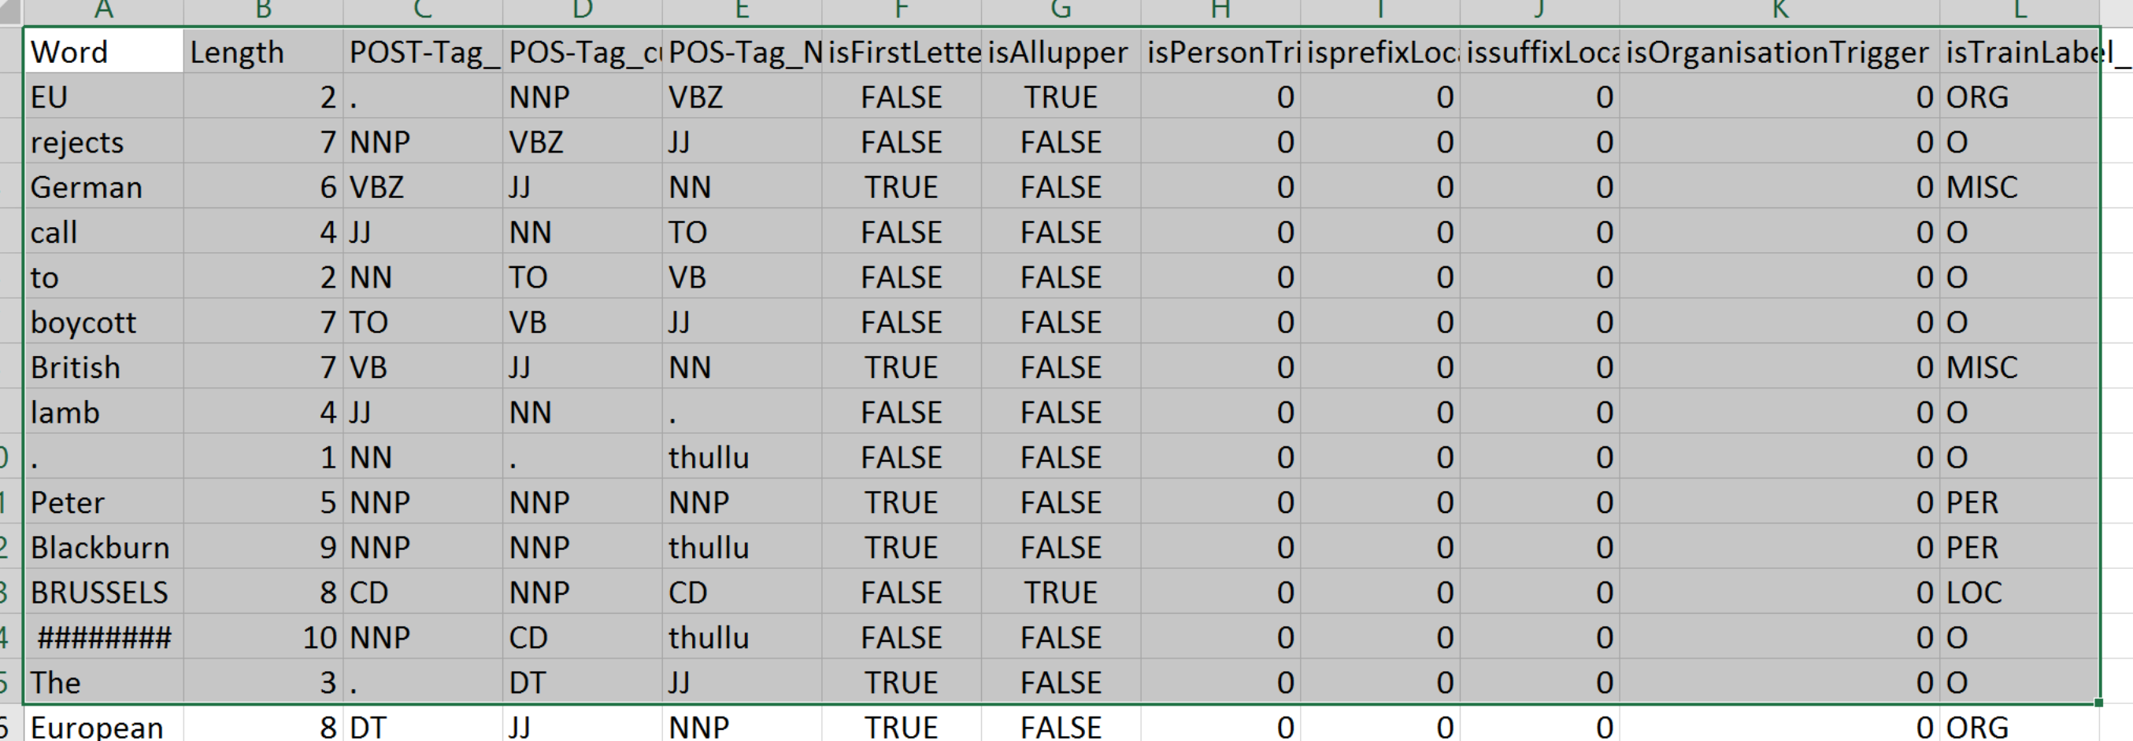
Sample TrainData

Slide 13
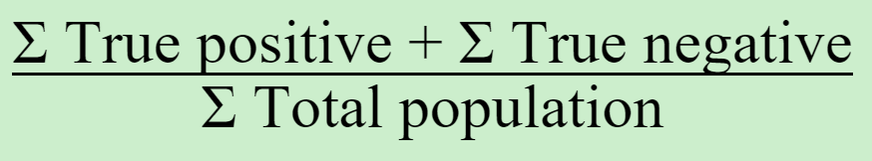
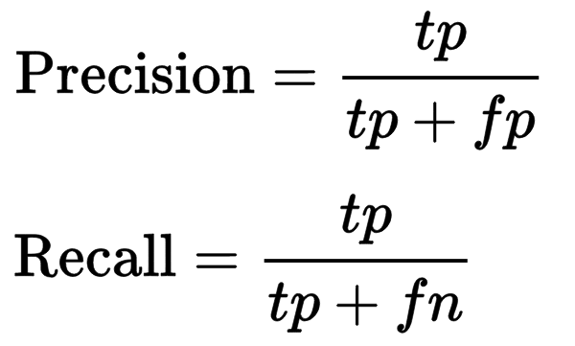
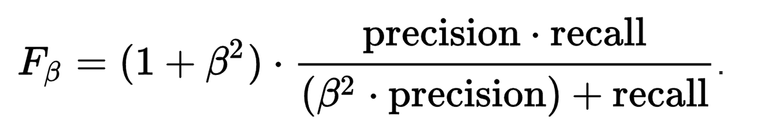
Performance Measures
Accuracy
Precision
Recall
F-score
Confusion matrix was also used to find the accuracy
We used random classification as performance measures. Due to 5 classes, baseline accuracy comes to be 20%.

Slide 14
Tools used
Python
NLTK package
Stanford pos tagger
Weka

Slide 15
Generative Classification
Naïve Baye’s classfier
Results
Correctly Classified Instances 37606 92.9645 %
Incorrectly Classified Instances 2846 7.0355 %
Error Rate Confusion Matrix
a | b | c | d | e | classified as
1398 | 104 | 68 | 195 | 159 | a = ORG
525 | 32292 | 313 | 220 | 371 | b = O
126 | 54 | 614 | 60 | 54 | c = MISC
101 | 30 | 21 | 1964 | 74 | d = PER
204 | 36 | 40 | 91 | 1338 | e = LOC
FP Rate | Precision | Recall | F-Measure | Class
0.727 | 0.025 | 0.594 | 0.727 | ORG
0.958 | 0.033 | 0.993 | 0.958 | O
0.676 | 0.011 | 0.581 | 0.676 | MISC
0.897 | 0.015 | 0.776 | 0.897 | PER
0.783 | 0.017 | 0.67 | 0.783 | LOC

Slide 16
Results without considering class group Others
Correctly Classified Instances 96 74.4186 %
Incorrectly Classified Instances 33 25.5814 %
Error rate Confusion Matrix
TP Rate | FP Rate | Precision | Recall | F-Measure | Class
0.725 | 0.09 | 0.784 | 0.725 | 0.753 | ORG
0.321 | 0 | 1 | 0.321 | 0.486 | MISC
0.964 | 0.228 | 0.54 | 0.964 | 0.692 | PER
0.939 | 0.021 | 0.939 | 0.939 | 0.939 | LOC
0.744 | 0.083 | 0.818 | 0.744 | 0.73
a | b | c | d | classified as
29 | 0 | 10 | 1 | a = ORG
8 | 9 | 11 | 0 | b = MISC
0 | 0 | 27 | 1 | c = PER
0 | 0 | 2 | 31 | d = LOC

Slide 17
Decision Tree
The classifier has a tree structure, where each node is either:
a leaf node which indicates the value of the target attribute (class) of examples
a decision node which specifies some test to be carried out on a single attribute-value, with one branch and sub-tree for each possible outcome of the test
An instance xp is classified by starting at the root of the tree and moving through it until a leaf node is reached, which provides the classification of the instance

Slide 18
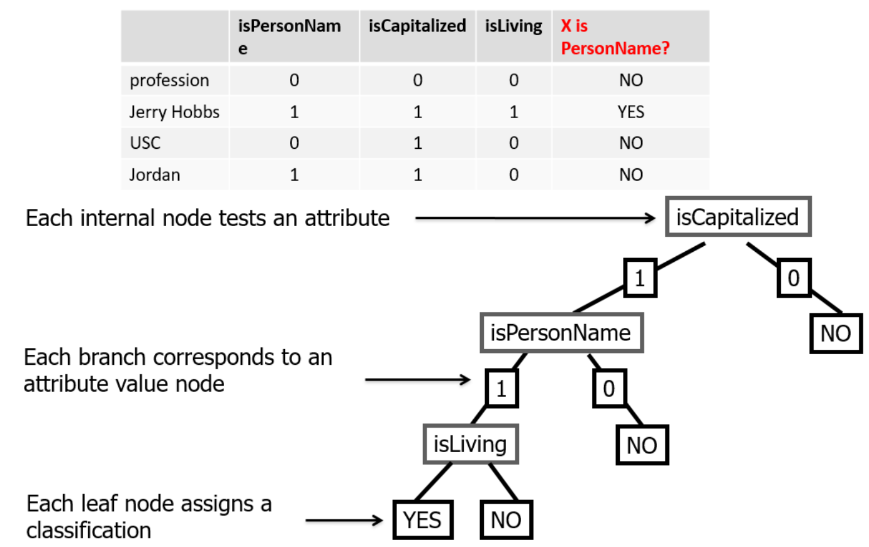
Decision Trees Sample

Slide 19
Decision Tree Results with others attribute
Correctly Classified Instances 783 79.9796 %
Incorrectly Classified Instances 196 20.0204 %
Error rate Confusion Matrix
FP Rate | Precision | Recall | F-Measure
0.325 | 0.149 | 0.085 | 0.325 | ORG
0.856 | 0.356 | 0.932 | 0.856 | O
0.519 | 0.002 | 0.875 | 0.519 | MISC
0.447 | 0.001 | 0.944 | 0.447 | PER
0.634 | 0.001 | 0.963 | 0.634 | LOC
a | b | c | d | e | <-- classified
13 | 25 | 0 | 1 | 1 | a = ORG
118 | 713 | 2 | 0 | 0 | b = O
5 | 8 | 14 | 0 | 0 | c = MISC
12 | 9 | 0 | 17 | 0 | d = PER
5 | 10 | 0 | 0 | 26 | e = LOC

Slide 20
Decision Tree
Correctly Classified Instances 113 70.1863 %
Incorrectly Classified Instances 48 29.8137 %
Error Rate Confusion Matrix
TP Rate | FP Rate | Precision | Recall | F-Measure | Class
0.216 | 0 | 1 | 0.216 | 0.355 | ORG
1 | 0.336 | 0.405 | 1 | 0.577 | MISC
0.821 | 0.008 | 0.97 | 0.821 | 0.889 | PER
0.976 | 0.025 | 0.93 | 0.976 | 0.952 | LOC
a | b | c | d | classified as
11 | 38 | 1 | 1 | a = ORG
0 | 30 | 0 | 0 | b = MISC
0 | 5 | 32 | 2 | c = PER
0 | 1 | 0 | 40 | d = LOC

Slide 21
Sequential Classification (CRF)
Sample Test: Input:
CRICKET NNP I-NP O
- : O O
LEICESTERSHIRE NNP I-NP I-ORG
TAKE NNP I-NP O
OVER IN I-PP O
AT NNP I-NP O
TOP NNP I-NP O
AFTER NNP I-NP O
INNINGS NNP I-NP O
VICTORY NN I-NP O
. . O O
end_of_sentence
('Predicted:', 'O O I-ORG O O O O O O O O')
('Correct: ', 'O O I-ORG O O O O O O O O')

Slide 22
Sequential Classification (CRF)
Results on complete dataset
 | precision | recall | f1-score | support
I-LOC | 0.89 | 0.83 | 0.86 | 2084
B-MISC | 0 | 0 | 0 | 4
I-MISC | 0.9 | 0.79 | 0.84 | 1261
I-ORG | 0.82 | 0.8 | 0.81 | 2077
I-PER | 0.91 | 0.91 | 0.91 | 3136
avg/ total | 0.88 | 0.85 | 0.86 | 8562

Slide 23
CRF : More results
Top likely transitions:
I-ORG -> I-ORG 3.363676
I-MISC -> B-MISC 3.297053
I-LOC -> I-LOC 3.110618
I-PER -> I-PER 2.971661
I-MISC -> I-MISC 2.725905
B-ORG -> B-ORG 2.618440
I-LOC -> B-LOC 2.476681
B-MISC -> I-MISC 2.439903
Top unlikely transitions:
I-LOC -> I-MISC -1.096426
I-MISC -> I-PER -1.159522
O -> B-LOC -1.630725
I-MISC -> I-LOC -1.818290
O -> B-ORG -2.136435
I-ORG -> I-MISC -2.304391
Top negative:
-2.265162 I-PER word[-2:]=ue
-2.312942 O word[-2:]=TT
-2.319032 I-PER word[-3:]=can
-2.319206 I-MISC -1:word.lower=french
-2.350751 O word[-2:]=AN
-2.379951 O word[-2:]=na
-2.382619 O word[-3:]=ray
Top positive:
8.187533 O word.lower=minister
7.272869 I-LOC +1:word.lower=1996-08-26
7.243620 I-ORG +1:word.lower=inc.
7.235043 I-LOC +1:word.lower=1996-08-25

Slide 24
References
https://sites.google.com/site/ermasoftware/getting-started/ne-tagging-conll2003-data
Stanford NLP(nlp.stanford.edu)
www.cs.cmu.edu/afs/cs.cmu.edu/project/theo-11/www/wwkb/s.cmu.edu/afs/cs.cmu.edu/project/theo-11/www/wwkb/
www.nltk.org/book/ch07.html
http://nlp.stanford.edu/software/CRF-NER.shtml

Slide 25
Thank
You

