Slide 1
Named Entity Recognition
Vivek
Omkar
Puneet
Peter

Slide 2
Inspiration
Key part of Information Extraction system
Robust handling of proper names essential for many applications
Pre-processing for different classification levels
Information filtering
Information linking

Slide 3
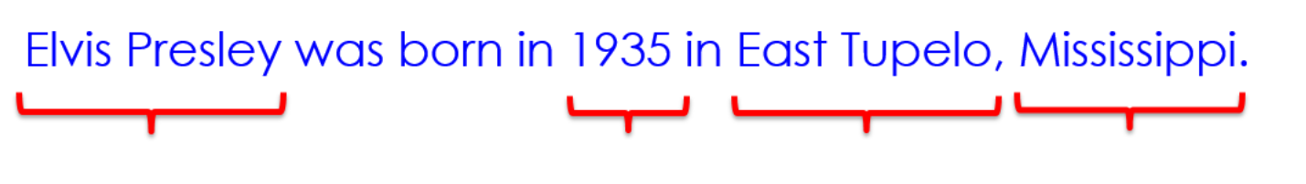
Problem Definition
Named Entity Recognition (NER) is the process of finding entities (people, cities, organizations, dates, ...) in a text
Example:
Three universally accepted categories: person, location and organisation

Slide 4
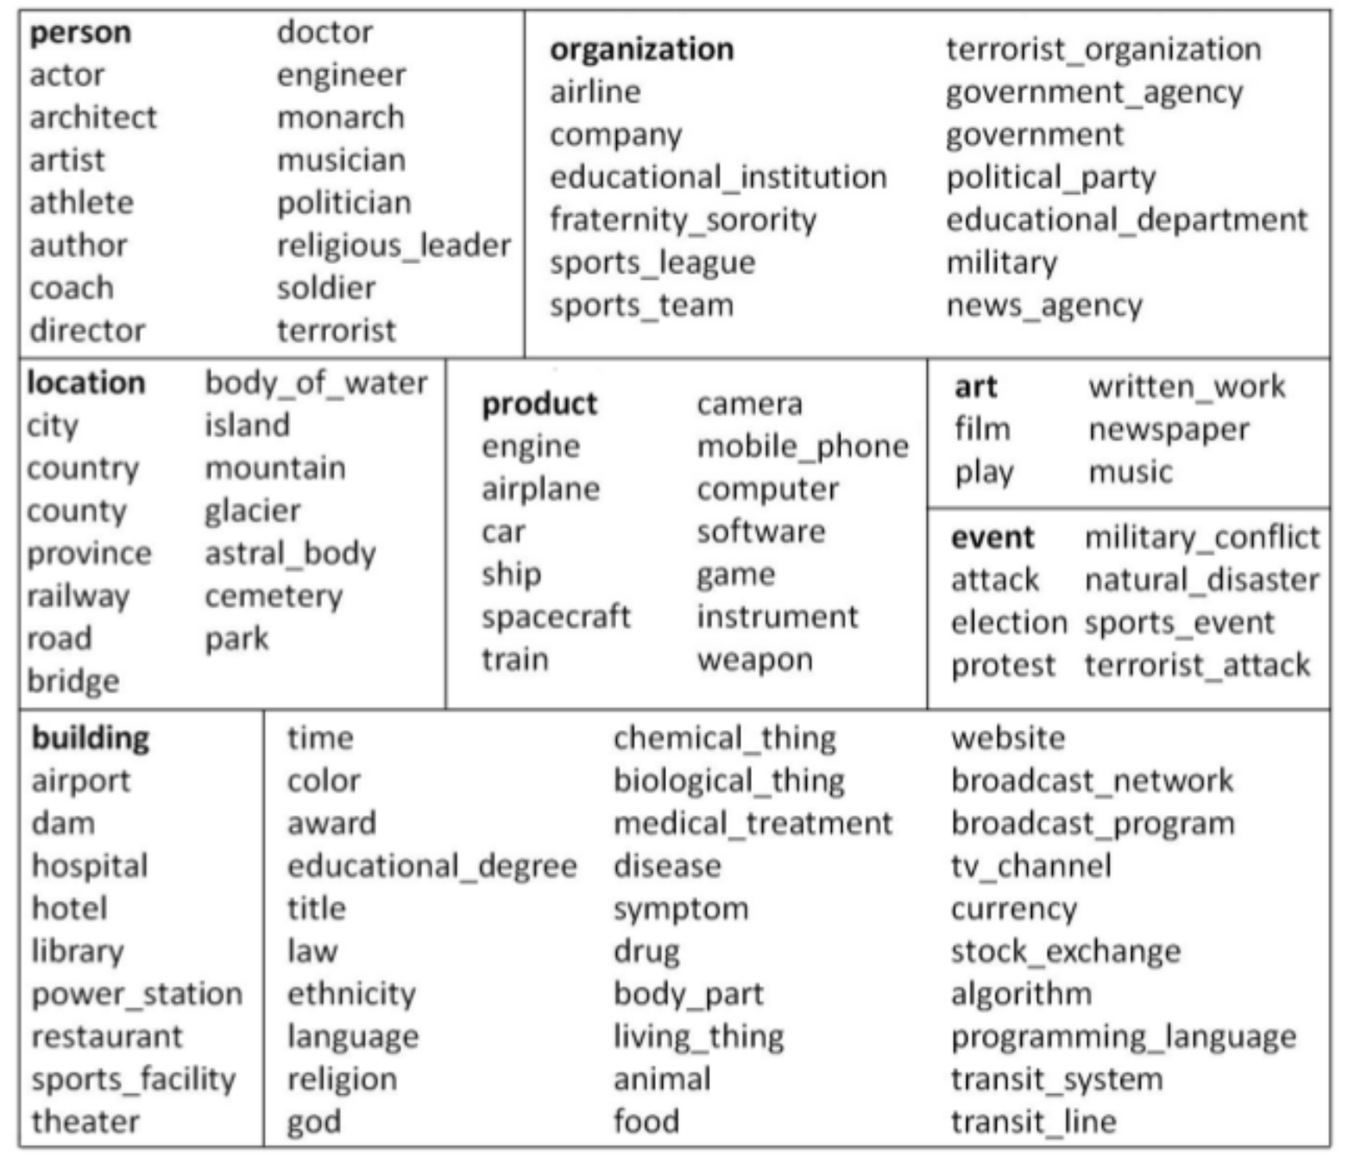
Fine Grained Entity Tag set [2]

Slide 5
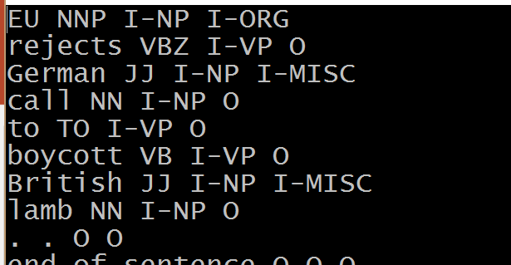
Data Set
Dataset was retrieved from Named Entity (NE) tagging (CoNLL2003 data)[1]
Data set consists of word, pos-tag, label. Sample:
Test data is in similar format. There are 217336 words in traindata and 54394 in testdata

Slide 6
Gazetters
We used the dictionary lookup for checking whether word in in either of following category:
Name
Location
Organization
Misc
For good results, we used Stanford nltk package for gazetters

Slide 7
Approach
Generally 2 approaches are used :
Traditional Rule Based approach
Classification
We have combined both the approaches

Slide 8
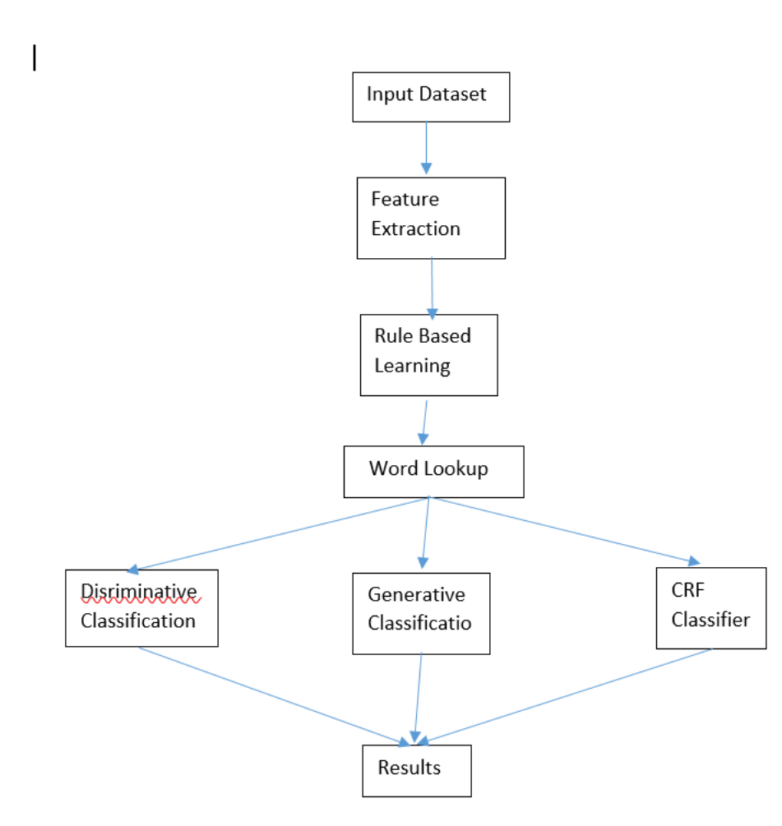
Flowchart

Slide 9
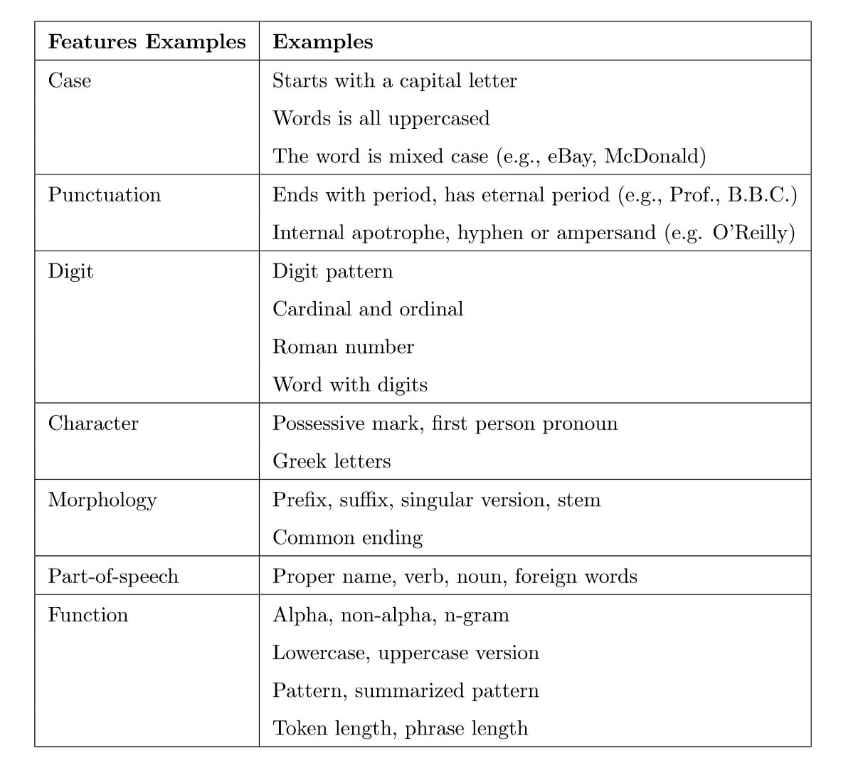
Feature Extraction ---1
Find out word level features

Slide 10
Feature Extraction –II(Histories, bin. features & futures)
History h_{t}: information derivable from the corpus relative to a token t:
text window around token w_{i}, e.g. w_{i-2},...,w_{i+2}
word features of these tokens
POS, other complex features

Slide 11
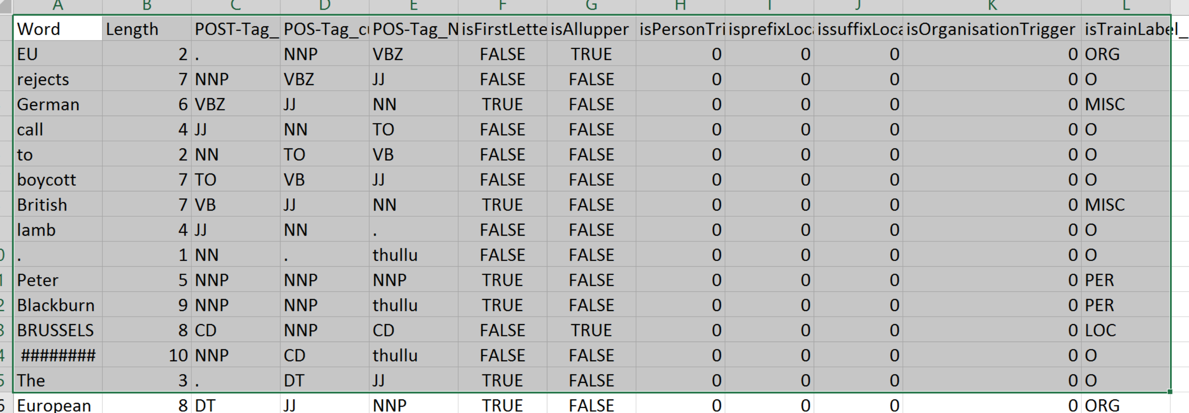
Sample TrainData

Slide 12
Performance Measures

Slide 13
Hand crafted Rules : Shallow Parsing
Location:
CapWord + {City, Forest, Center} e.g. Sherwood Forest
Cap Word + {Street, Boulevard, Avenue, Crescent, Road} e.g. Portobello Street
at + CapWord e.g: at Washington
Name:
Mr. /Dr. / Miss./ + CapWord e.g. Mr. Omkar
Organization:
CapWord + Corp./Ltd. / e.g. Infosys Ltd.

Slide 14
Generative Classification
Naïve Baye’s classfier
Results
Correctly Classified Instances 37606 92.9645 %
Incorrectly Classified Instances 2846 7.0355 %
Error Rate Confusion Matrix
a | b | c | d | e | classified as
1398 | 104 | 68 | 195 | 159 | a = ORG
525 | 32292 | 313 | 220 | 371 | b = O
126 | 54 | 614 | 60 | 54 | c = MISC
101 | 30 | 21 | 1964 | 74 | d = PER
204 | 36 | 40 | 91 | 1338 | e = LOC
FP Rate | Precision | Recall | F-Measure | Class
0.727 | 0.025 | 0.594 | 0.727 | ORG
0.958 | 0.033 | 0.993 | 0.958 | O
0.676 | 0.011 | 0.581 | 0.676 | MISC
0.897 | 0.015 | 0.776 | 0.897 | PER
0.783 | 0.017 | 0.67 | 0.783 | LOC

Slide 15
Results without considering class group Others
Correctly Classified Instances 96 74.4186 %
Incorrectly Classified Instances 33 25.5814 %
Error rate Confusion Matrix
TP Rate | FP Rate | Precision | Recall | F-Measure | Class
0.725 | 0.09 | 0.784 | 0.725 | 0.753 | ORG
0.321 | 0 | 1 | 0.321 | 0.486 | MISC
0.964 | 0.228 | 0.54 | 0.964 | 0.692 | PER
0.939 | 0.021 | 0.939 | 0.939 | 0.939 | LOC
0.744 | 0.083 | 0.818 | 0.744 | 0.73
a | b | c | d | classified as
29 | 0 | 10 | 1 | a = ORG
8 | 9 | 11 | 0 | b = MISC
0 | 0 | 27 | 1 | c = PER
0 | 0 | 2 | 31 | d = LOC

Slide 16
Decision Tree
The classifier has a tree structure, where each node is either:
a leaf node which indicates the value of the target attribute (class) of examples
a decision node which specifies some test to be carried out on a single attribute-value, with one branch and sub-tree for each possible outcome of the test
An instance xp is classified by starting at the root of the tree and moving through it until a leaf node is reached, which provides the classification of the instance

Slide 17
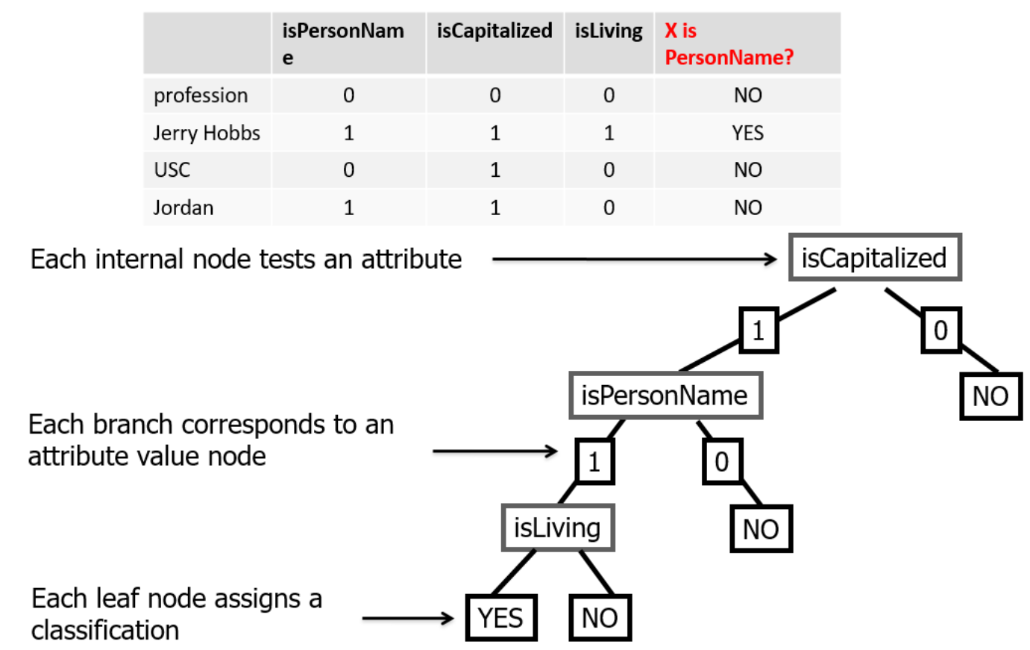
Decision Trees Sample

Slide 18
Decision Tree Results with others attribute
Correctly Classified Instances 783 79.9796 %
Incorrectly Classified Instances 196 20.0204 %
Error rate Confusion Matrix
FP Rate | Precision | Recall | F-Measure
0.325 | 0.149 | 0.085 | 0.325 | ORG
0.856 | 0.356 | 0.932 | 0.856 | O
0.519 | 0.002 | 0.875 | 0.519 | MISC
0.447 | 0.001 | 0.944 | 0.447 | PER
0.634 | 0.001 | 0.963 | 0.634 | LOC
a | b | c | d | e | <-- classified
13 | 25 | 0 | 1 | 1 | a = ORG
118 | 713 | 2 | 0 | 0 | b = O
5 | 8 | 14 | 0 | 0 | c = MISC
12 | 9 | 0 | 17 | 0 | d = PER
5 | 10 | 0 | 0 | 26 | e = LOC

Slide 19
Decision Tree
Correctly Classified Instances 113 70.1863 %
Incorrectly Classified Instances 48 29.8137 %
Error Rate Confusion Matrix
TP Rate | FP Rate | Precision | Recall | F-Measure | Class
0.216 | 0 | 1 | 0.216 | 0.355 | ORG
1 | 0.336 | 0.405 | 1 | 0.577 | MISC
0.821 | 0.008 | 0.97 | 0.821 | 0.889 | PER
0.976 | 0.025 | 0.93 | 0.976 | 0.952 | LOC
a | b | c | d | classified as
11 | 38 | 1 | 1 | a = ORG
0 | 30 | 0 | 0 | b = MISC
0 | 5 | 32 | 2 | c = PER
0 | 1 | 0 | 40 | d = LOC

