Slide 1
Named Entity Recognition
Maschinelle Lernverfahren
für Informationsextraktion und Text Mining
Stephan Lesch

Slide 2
Contents
Task & Motivation, example
Hand-crafted approach
Automated (ML) approaches
  Decision Trees
  Hidden Markov Models
  Maximum Entropy Models
Hand-crafted vs. automated
Increasing performance

Slide 3
The who, where, when & how much in a sentence
The task: identify atomic elements of information in text
person names
company/organization names
locations
dates&times
percentages
monetary amounts

Slide 4
example from MUC-7
Delimit the named entities in a text and tag them with NE categores:
<ENAMEX TYPE=„LOCATION“>Italy</ENAMEX>‘s business world was rocked by
the announcement <TIMEX TYPE=„DATE“>last Thursday</TIMEX> that Mr.
<ENAMEX TYPE=„PERSON“>Verdi</ENAMEX> would leave his job as vice-president
of <ENAMEX TYPE=„ORGANIZATION“>Music Masters of Milan, Inc</ENAMEX>
to become operations director of
<ENAMEX TYPE=„ORGANIZATION“>Arthur Andersen</ENAMEX>.
„Milan“ is part of organization name
„Arthur Andersen“ is a company
„Italy“ is sentence-initial => capitalization useless

Slide 5
difficulties
too numerous to include in dictionaries
changing constantly
appear in many variant forms
subsequent occurrences might be abbreviated
list search/matching doesn‘t perform well

Slide 6
Whether a phrase is a proper name, and what name class it has, depends on
Internal structure:
„Mr. Brandon“
Context:
„The new company, SafeTek, will make air bags.“

Slide 7
Applications
Information Extraction
Summary generation
Machine Translation
document organization/classification
automatic indexing of books
increase accuracy of Internet search results
(location Clinton/South Carolina vs. President
Clinton)

Slide 8
The hand-crafted approach
uses hand-written context-sensitive reduction rules:
title capitalized word => title person_name
compare „Mr. Jones“ vs. „Mr. Ten-Percent“
=> no rule without exceptions
2) person_name, „the“ adj* „CEO of“ organization
„Fred Smith, the young dynamic CEO of BlubbCo“
=> ability to grasp non-local patterns
plus help from databases of known named entities
Notes:
Regeln von der Intuition der Linguisten abhaengig.

Slide 9
Word features
Easily determinable token properties:
Feature Example Intuition
fourDigitNum 1990 four digit year
containsDigitAndAlpha A123-456 product code
containsCommaAndPeriod 1.00 monetary amount, percentage
otherNum 34567 other number
allCaps BBN Organisation
capPeriod M. Person name initial
firstWord first word of sentence ignore capitalization
initCap Sally capitalized word
lowerCase can uncapitalized word
other , punctuation, all other words

Slide 10
Histories, bin. features & futures
History h_{t}: information derivable from the corpus relative to a token t:
  text window around token w_{i}, e.g. w_{i-2},...,w_{i+2}
  word features of these tokens
  POS, other complex features
Binary features: yes/no-questions on history
used by models to determine probabilities of
Futures: name classes

Slide 11
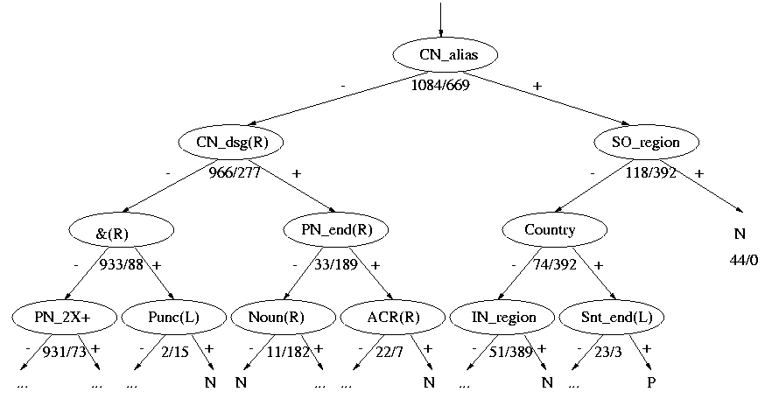
Decision Trees
(L/R) indicates feature must appear to left/right of left boundary of proper noun
Numbers represent numbers of negative/positive examples from training corpus

Slide 12
Hybrid system by A. Gallippi[1]
Hand-built phrasal templates for delimitation
Separate DT for each name class
Step 1: delimit proper nouns
Step 2: to classify a PN
  Compute features for window around PN
  Compute weight for each name class using its DT
  Merge results to choose a name class

Slide 13
Hidden Markov Models
Example: NYMBLE [2] (informal)
START_OF_SENTENCE
END_OF_SENTENCE
PERSON
ORGANIZATION
5 other name classes
NOT_A_NAME

Slide 14
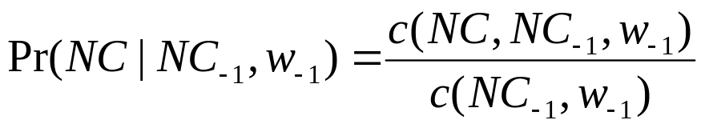
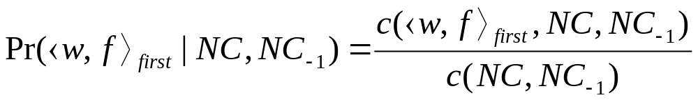
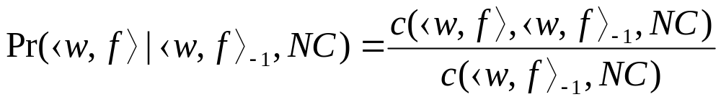
Statistic models in NYMBLE
name-class bigram:
first-word-bigram:
non-first-word-bigram:
where c(event) = #occurrences of event in training corpus

Slide 15



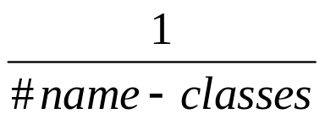
Back-off models
Models trained on hand-tagged corpus
=> Pr(X|Y,Z) is not always available
=> fall back to weaker models:

Slide 16
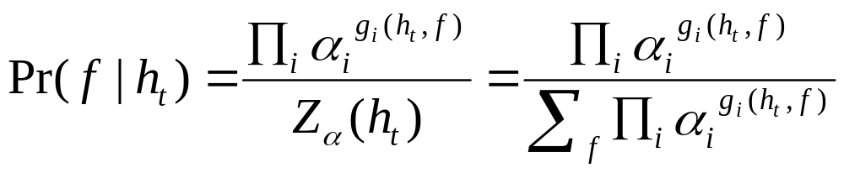

Maximum Entropy Models
Example: MENE[3]
for each token t and history h_{t}, calculate weightings for all futures f (NE class tags):
i: feature index
: weight for feature i
Pr(f|h_{t}) = product of weightings for all features active on h_{t}
normalized over the products for all the futures

Slide 17
Tagging with a state sequence
define extended set of futures:
person
location
organization
date
time
percentage
monetary value
start
continue
end
unique
X
U
other
John flew to New York.
person_unique other other location_start location_end

Slide 18
Viterbi Search
Model generates state lattice with weights on states, we want one sequence of states
Viterbi Search determines the most probable state sequence
helps to avoid invalid taggings, e.g.
Andrew Borthwick
person_unique 0.3 person_end 0.4
person_start0.5 location_unique 0.4
must be tagged as person_start person_end

Slide 19
Hand-crafted vs. automated (1)
hand-made systems:
+ can achieve higher performance than ML systems
+ non-local phenomena best handled by regular expressions
- several person-months for rule-writing,
requires experienced linguists
- rules depend on specific properties of language, domain & text format
=> manual adaption necessary when domain changes
=> re-write rules for other languages

Slide 20
Hand-crafted vs. automated
automated approaches:
+ Train on human-annotated texts
  no expensive computational linguists needed
  100.000 words can be tagged in 1-3 days
+ ideally, no manual work required for domain
changes
+ easier to port to other languages
- features are locally limited

Slide 21
Cross-language porting
software requirements:
tokenizer (non-trivial for non-token languages, e.g. Japanese)
word feature identification
POS tagger etc.
needed data:
annotated training texts in new language
translated dictionary (word lists)

Slide 22
Increasing performance(1)
combine several systems:
e.g. MENE trained on output from other systems
Systems MUC-7 formal run dry run
F-measure F-measure
MENE 84.22 92.20
Proteus 86.21 92.24
Manitoba 86.37 93.32
IsoQuest 91.60 96.27
Me/Pr 88.80 95.61
ME/Pr/Ma 90.34 96.48
ME/Pr/Ma/IQ 92.00 97.12

Slide 23
Increasing performance (2)
long-range capabilities can be useful:
„Andrew Borthwick“: easy to identify as person
later reference abbreviated as „Borthwick“: could be mistagged
coreference-finding/resolving mechanisms
long-range-features, like longest-common-substring,

Slide 24
Literature
(1) A. Gallippi, Learning to Recognize Names Across Languages. In Proceedings of the Sixteenth International Conference on Computational Linguistics.
Copenhagen, Denmark. August, 1996
(2) Bikel, Miller, Schwartz and Weischedel, Nymble: a High-Performance Learning Name-finder,In proceedings of ANLP-1997, Washington, DC, pages 195-201
(3) A. Borthwick, A Maximum Entropy Approach to Named Entity Recognition, Ph.D. (1999) New York University. Department of Computer Science, Courant Institute

