Slide 1
CS 6359 – Object Oriented Analysis and Design
Gang Of Four
Visitor and Bridge Design Patterns
Omkar Dixit
Graduate, Computer Science
Notes:
Hello everyone my name is Omkar Dixit, I am going to talk about two GOF Patterns -
1) Visitor Design Pattern
2) Bridge Design Pattern

Slide 2
WHAT WILL BE COVERED
What is Gang of Four (GOF)?
What are design patterns ?
Usage of Design Pattern
Types of Design Pattern
Visitor Design Pattern
Bridge Design Pattern
Notes:
So Rather than jumping directly to particular patterns lets just see quickly
what GOF is
what are design pattern
where can we use them
what are the types of patterns
Then we will talk about Visitor and Bridge Design Pattern

Slide 3
What is Gang of Four (GOF)?
In 1994, four authors Erich Gamma, Richard Helm, Ralph Johnson and John Vlissides published a book titled Design Patterns - Elements of Reusable Object-Oriented Software which initiated the concept of Design Pattern in Software development.
These authors are collectively known as Gang of Four (GOF). According to these authors design patterns are primarily based on the following principles of object orientated design.
Program to an interface not an implementation
Favor object composition over inheritance
Notes:
So, Erich Gamma, Richard Helm, Ralph Johnsson and John Vlissides published a book on Desing Patterns which initiated the Concept of Design Patterns in Software Development. These four authors are collectively known as the Gang of four.
The basis of these patterns are on the following principles:
1) Program to an interface not an implementation
2) Favor Object composition over inheritence

Slide 4
What are design patterns ?
Design patterns represent the best practices used by experienced object-oriented software developers.
Design patterns are solutions to general problems that software developers faced during software development.
These solutions were obtained by trial and error by numerous software developers over quite a substantial period of time
Notes:
Design patters are the solution to the general problem that software developer face
Well, thats the reason that they were obtained after a lot of trial and error by numerous developers

Slide 5
Usage of Design Pattern
Common platform for developers
Design patterns provide a standard terminology and are specific to particular scenario.
For example, a singleton design pattern signifies use of single object so all developers familiar with single design pattern will make use of single object and they can tell each other that program is following a singleton pattern.
Best Practices
Design patterns have been evolved over a long period of time and they provide best solutions to certain problems faced during software development.
Learning these patterns helps un-experienced developers to learn software design in an easy and faster way.
Notes:
Design Patterns are used to
1) provide common platform to the developer as they provide standard terminology
2) provide the best solutions as these patterns are evolved over a long period of time

Slide 6
Types of Design Pattern
As per the design pattern reference book Design Patterns - Elements of Reusable Object-Oriented Software, there are 23 design patterns. These patterns can be classified in three categories: Creational, Structural and behavioral patterns. We'll also discuss another category of design pattern: J2EE design patterns.
Creational Patterns
Structural Patterns
Behavioral Patterns
J2EE Patterns
Notes:
Structural Patters are design patterns that concern with class and object composition, here the concept of inheritance is used to compose interfaces and define ways to compose objects to obtain new functionalities
Behavioral Patterns are concerned with specifically communication between objects

Slide 7
Creational Patterns These design patterns provides way to create objects while hiding the creation logic, rather than instantiating objects directly using new operator. This gives program more flexibility in deciding which objects need to be created for a given use case.
Structural Patterns These design patterns concern class and object composition. Concept of inheritance is used to compose interfaces and define ways to compose objects to obtain new functionalities.
Behavioral Patterns These design patterns are specifically concerned with communication between objects.
J2EE Patterns These design patterns are specifically concerned with the presentation tier. These patterns are identified by Sun Java Center.

Slide 8
Visitor Design Pattern
In Visitor pattern, we use a visitor class which changes the executing algorithm of an element class. By this way, execution algorithm of element can varies as visitor varies.
This pattern comes under behavior pattern category.
As per the pattern, element object has to accept the visitor object so that visitor object handles the operation on the element object.
So,
VDP allows you to add methods to classes different types without much altering to those classes
With VDP you can make completely different methods depending on the class used
VDP allows you to define external classes that can extend other classes without majorly editing them
Notes:
Visitor design pattern is one of the behavioral design pattern. It is used when we have to perform an operation on a group of similar kind of Objects. With the help of visitor pattern, we can move the operational logic/ algorithm from the objects to another class.
The visitor pattern consists of two parts:
1) a method called Visit() which is implemented by the visitor and is called for every element in the data structure
2) visitable classes providing Accept() methods that accept a visitor

Slide 9
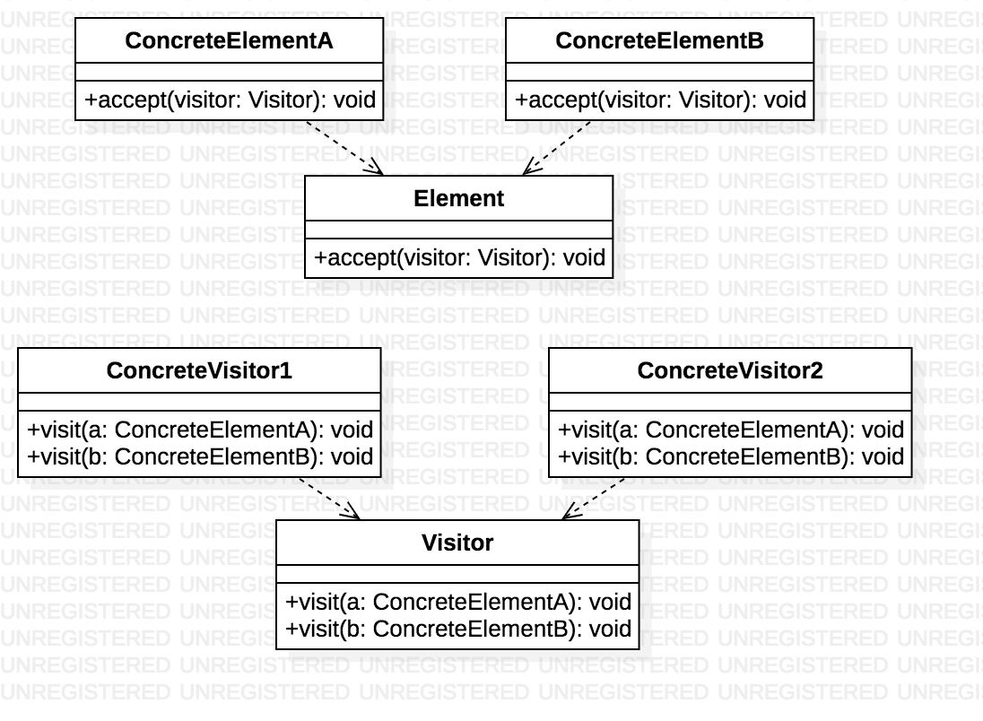
Basic Design
Notes:
Visitor : This is an interface or an abstract class used to declare the visit operations for all the types of visitable classes.
ConcreteVisitor : For each type of visitor all the visit methods, declared in abstract visitor, must be implemented. Each Visitor will be responsible for different operations.
Elements
Visitable : is an interface which declares the accept operation. This is the entry point which enables an object to be “visited” by the visitor object.
ConcreteVisitable : Those classes implements the Visitable interface or class and defines the accept operation. The visitor object is passed to this object using the accept operation.
Lets take an example -
Next Slide

Slide 10
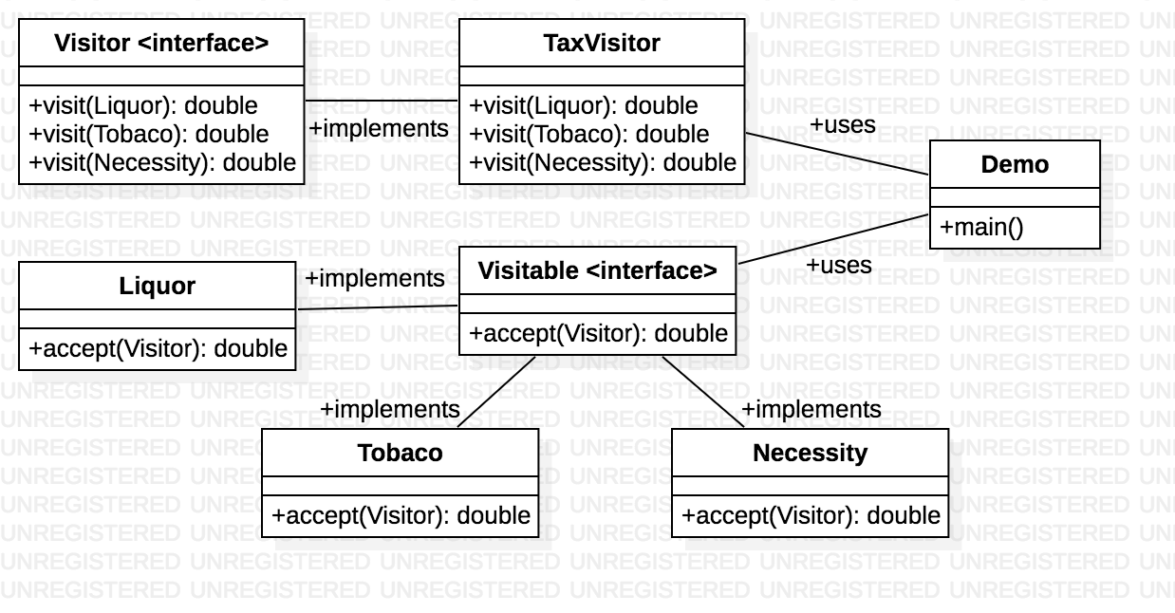
Example - Visitor design pattern uml class diagram
Notes:
We will implement Visitor interface through Tax visitor,
What we will do here is that we will assume that there is no tax system that exist on items like liquor, tobacco products and necessities.
But now we have to implement a taxing system in which tax varies with products.
Visitable interface has a method called accept which will be implemented by all product yypes may that be liquor tobacco or necessity items
In the main method we will create a tax visitor, then we will define a class object may that be necessity item or liquor or tobacco products.
-- The visitor pattern is used when you have to perform the same action on many objects of different types
Visitable interface
Allows the Visitor to pass the object so the right operations occur on the right type of object.
accept() is passed the same visitor object but then the method visit() is called using the visitor object. The right version of visit() is called because of method overloading

Slide 11
Explanation
We will implement Visitor interface through Tax visitor,
We assume that there is no tax system that exist on items
But now we have to implement a taxing system in which tax varies with products(Liquor, Tobacco and necessities).
Visitable interface has a method called accept which will be implemented by all product types
In the main method we create a tax visitor, then we define a class object may that be necessity item or liquor or tobacco products.

Slide 12
Code
interface Visitor {
public double visit(Liquor liquorItem);
public double visit(Tobacco tobaccoItem);
public double visit(Necessity necessityItem);
}
class Liquor implements Visitable {
private double price;
Liquor(double item) {
price = item;
}
public double accept(Visitor visitor) {
return visitor.visit(this);
}
public double getPrice() {
return price;
}
interface Visitable {
public double accept(Visitor visitor);
}

Slide 13
class TaxVisitor implements Visitor {
public TaxVisitor() {
}
public double visit(Liquor liquorItem) {
System.out.println("Liquor Item: Price with Tax");
return Double.parseDouble(df.format((liquorItem.getPrice() * .18) + liquorItem.getPrice()));
}
public double visit(Tobacco tobaccoItem) {
System.out.println("Tobacco Item: Price with Tax");
return Double.parseDouble(df.format((tobaccoItem.getPrice() * .32) + tobaccoItem.getPrice()));
}
public double visit(Necessity necessityItem) {
System.out.println("Necessity Item: Price with Tax");
return Double.parseDouble(df.format(necessityItem.getPrice()));
}
}
class Necessity implements Visitable {
private double price;
Necessity(double item) {
price = item;
}
public double accept(Visitor visitor) {
return visitor.visit(this);
}
public double getPrice() {
return price;
}
}

Slide 14
class TaxHolidayVisitor implements Visitor {
DecimalFormat df = new DecimalFormat("#.##");
public TaxHolidayVisitor() {
}
public double visit(Liquor liquorItem) {
System.out.println("Liquor Item: Price with Tax");
return Double.parseDouble(df.format((liquorItem.getPrice() * .10) + liquorItem.getPrice()));
}
public double visit(Tobacco tobaccoItem) {
System.out.println("Tobacco Item: Price with Tax");
return Double.parseDouble(df.format((tobaccoItem.getPrice() * .30) + tobaccoItem.getPrice()));
}
public double visit(Necessity necessityItem) {
System.out.println("Necessity Item: Price with Tax");
return Double.parseDouble(df.format(necessityItem.getPrice()));
}
}
class Tobacco implements Visitable {
private double price;
Tobacco(double item) {
price = item;
}
public double accept(Visitor visitor) {
return visitor.visit(this);
}
public double getPrice() {
return price;
}
}

Slide 15
public class VisitorTest {
public static void main(String[] args) {
TaxVisitor taxCalc = new TaxVisitor();
TaxHolidayVisitor taxHolidayCalc = new TaxHolidayVisitor();
Necessity milk = new Necessity(3.47);
Liquor vodka = new Liquor(11.99);
Tobacco cigars = new Tobacco(19.99);
System.out.println(milk.accept(taxCalc) + "\n");
System.out.println(vodka.accept(taxCalc) + "\n");
System.out.println(cigars.accept(taxCalc) + "\n");
System.out.println("TAX HOLIDAY PRICES\n");
System.out.println(milk.accept(taxHolidayCalc) + "\n");
System.out.println(vodka.accept(taxHolidayCalc) + "\n");
System.out.println(cigars.accept(taxHolidayCalc) + "\n");
}
}
Output -
Necessity Item: Price with Tax
3.47
Liquor Item: Price with Tax
14.15
Tobacco Item: Price with Tax
26.39
TAX HOLIDAY PRICES
Necessity Item: Price with Tax
3.47
Liquor Item: Price with Tax
13.19
Tobacco Item: Price with Tax
25.99
Notes:
here when we create a milk object with price 3.47 thats a double, and then when we execute milk.accept that is milk is a visitor and the accept method implemented will calculate the tax and return a double

Slide 16
Advantages
If the logic of the operation changes, then we need to make change only in the visitor implementation rather than doing it in all the item classes
Adding a new item to the system is easy, it will require change only in visitor interface and implementation and existing item class will not be affected.

Slide 17
Disadvantages
We should know the return type of visit() methods at the time of designing otherwise we will have to make changes in the interface and all of its implementations
If there are too many implementations of visitor interface, it makes it hard to extend

Slide 18
More about Visitor Design Pattern
Visitor is a many to many relationship, compared to a strategy design pattern which more like a one to many relation
A Strategy pattern is used to expose various algorithms to a standardized interface, where as a Visitor pattern lives at a different level. It details a mechanism with which objects can accept a reference to another object (the visitor) which exposes a predetermined interface that the target object can call upon itself

Slide 19
Questions ?

Slide 20
Bridge Design Pattern
Bridge Design Pattern is used when we have to decouple an abstraction from its implementation so that the two can vary independently
The Bridge pattern is explained differently in various sources, but we would be talking about it in the way I have understood it since, everyone seems to explain it differently
Progressively adding functionality while separating out major differences using abstract classes
This type of design pattern comes under structural pattern as this pattern decouples implementation class and abstract class by providing a bridge structure between them.
Notes:
The Bridge design pattern allows you to separate the abstraction from the implementation.
It is a structural design pattern.
This is a design mechanism that encapsulates an implementation class inside of an interface class.
The bridge pattern allows the Abstraction and the Implementation to be developed independently and the client code can access only the Abstraction part without being concerned about the Implementation part.
The abstraction is an interface or abstract class and the implementor is also an interface or abstract class.
The abstraction contains a reference to the implementor. Children of the abstraction are referred to as refined abstractions, and children of the implementor are concrete implementors.
Since we can change the reference to the implementor in the abstraction, we are able to change the abstraction’s implementor at run-time. Changes to the implementor do not affect client code.
It increases the loose coupling between class abstraction and it’s implementation.

Slide 21
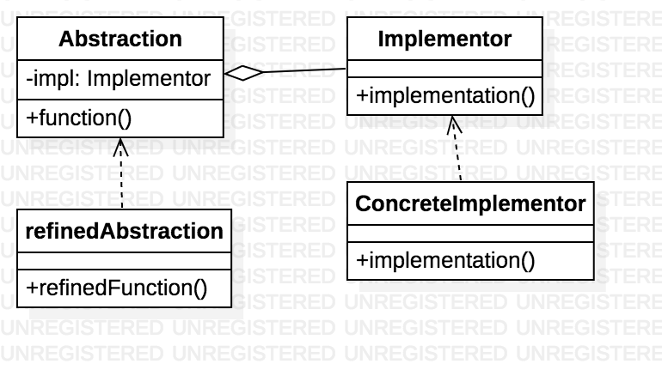
Basic Design
Notes:
Abstraction – core of the bridge design pattern and defines the crux. Contains a reference to the implementer.
Refined Abstraction – Extends the abstraction takes the finer detail one level below. Hides the finer elements from implemetors.
Implementer – It defines the interface for implementation classes. This interface does not need to correspond directly to abstraction interface and can be very different. Abstraction imp provides an implementation in terms of operations provided by Implementer interface.
Concrete Implementation – Implements the above implementer by providing concrete implementation.
The Bridge design pattern allows you to separate the abstraction from the implementation.
It is a structural design pattern.
This is a design mechanism that encapsulates an implementation class inside of an interface class.
The bridge pattern allows the Abstraction and the Implementation to be developed independently and the client code can access only the Abstraction part without being concerned about the Implementation part.
The abstraction is an interface or abstract class and the implementor is also an interface or abstract class.
The abstraction contains a reference to the implementor. Children of the abstraction are referred to as refined abstractions, and children of the implementor are concrete implementors.
Since we can change the reference to the implementor in the abstraction, we are able to change the abstraction’s implementor at run-time. Changes to the implementor do not affect client code.
It increases the loose coupling between class abstraction and it’s implementation.
use inheritance and the

Slide 22
Example 1
TV 1
Remote 1
Abstract TV
Abstract Remote
TV 2
Remote 2
2 layers of abstraction between classes
1 class is dependent upon the other
Notes:
We will have various buttons on the remote Five, Six, Seven, Eight, Nine
Seven Eight will have the volume control functionality
Five, Six will be for channel control for the TVs
Remote also has a button nine which will be independent on the TVs
One will have the mute function, while the other will have a pause function
Nine is abstract

Slide 23
Explanation
We will have various buttons on the remote Five, Six, Seven, Eight, Nine
Seven Eight will have the volume control functionality
Five, Six will be for channel control for the TVs
Remote also has a button nine which will be independent on the TVs
One will have the mute function, while the other will have a pause function
Nine is abstract

Slide 24
When to use the bridge Design pattern ?
When you want to be able to change both the abstractions (abstract classes) and concrete classes independently
When you want the first abstract class to define rules (Abstract TV)
The concrete class ads additional rules (Concrete TV)
An abstract class has reference to the device and its defines abstract methods that will be defined (Abstract Remote)
The concrete remote defines the abstract methods required

Slide 25
abstract class EntertainmentDevice {
public int deviceState;
public int maxSetting;
public int volumeLevel = 0;
public abstract void buttonFivePressed();
public abstract void buttonSixPressed();
public void deviceFeedback() {
if(deviceState > maxSetting || deviceState < 0) { deviceState = 0; }
System.out.println("On Channel " + deviceState);
}
public void buttonSevenPressed() {
volumeLevel++;
System.out.println("Volume at: " + volumeLevel);
}
public void buttonEightPressed() {
volumeLevel--;
System.out.println("Volume at: " + volumeLevel);
}
}
public class TVDevice extends EntertainmentDevice {
public TVDevice(int newDeviceState, int newMaxSetting){
deviceState = newDeviceState;
maxSetting = newMaxSetting;
}
public void buttonFivePressed() {
System.out.println("Channel Down");
deviceState--;
}
public void buttonSixPressed() {
System.out.println("Channel Up");
deviceState++;
}
}

Slide 26
public abstract class RemoteButton{
private EntertainmentDevice theDevice;
public RemoteButton(EntertainmentDevice newDevice){
theDevice = newDevice;
}
public void buttonFivePressed() {
theDevice.buttonFivePressed();
}
public void buttonSixPressed() {
theDevice.buttonSixPressed();
}
public void deviceFeedback(){
theDevice.deviceFeedback();
}
public abstract void buttonNinePressed();
}
public class TVRemoteMute extends RemoteButton{
public TVRemoteMute(EntertainmentDevice newDevice) {
super(newDevice);
}
public void buttonNinePressed() {
System.out.println("TV was Muted");
}
}
public class TVRemotePause extends RemoteButton{
public TVRemotePause(EntertainmentDevice newDevice) {
super(newDevice);
}
public void buttonNinePressed() {
System.out.println("TV was Paused");
}
}

Slide 27
public class TestTheRemote{
public static void main(String[] args){
RemoteButton theTV = new TVRemoteMute(new TVDevice(1, 200));
RemoteButton theTV2 = new TVRemotePause(new TVDevice(1, 200));
System.out.println("Test TV with Mute");
theTV.buttonFivePressed();
theTV.buttonSixPressed();
theTV.buttonNinePressed();
System.out.println("\nTest TV with Pause");
theTV2.buttonFivePressed();
theTV2.buttonSixPressed();
theTV2.buttonNinePressed();
theTV2.deviceFeedback();}
}
Output -
Test TV with Mute
Channel Down
Channel Up
TV was Muted
Test TV with Pause
Channel Down
Channel Up
TV was Paused
On Channel 1

Slide 28
advantages
Bridge pattern decouple an abstraction from its implementation so that the two can vary independently.
It is used mainly for implementing platform independence feature.
It adds one more method level redirection to achieve the objective.
Publish abstraction interface in a separate inheritance hierarchy, and put the implementation in its own inheritance hierarchy.
Use bridge pattern to run-time binding of the implementation.
Use bridge pattern to map orthogonal class hierarchies
Bridge is designed up-front to let the abstraction and the implementation vary independently.

Slide 29
More on Bridge pattern
This pattern involves an interface which acts as a bridge which makes the functionality of concrete classes independent from interface implementer classes. Both the classes can be altered structurally without affecting each other
We will now talk about bridge pattern via an example in which a circle can be drawn in different colors using same abstract class method but different bridge implementer classes.

Slide 30
implementation
We’ve an interface DrawAPI interface which is acting as a bridge implementer and concrete classes RedCircle, GreenCircle implementing the DrawAPI interface.
Shape is an abstract class and will use object of DrawAPI, BridgePatternDemo, our demo class will use Shape class to draw different colored circle

Slide 31
Step 1 – Create bridge implementer interface – DrawAPI.java
public interface DrawAPI {
public void drawCircle(int radius, int x, int y);
}
Step 3 – Create an abstract class Shape using the DrawAPI interface - Shape.java
public abstract class Shape {
protected DrawAPI drawAPI;
protected Shape(DrawAPI drawAPI){
this.drawAPI = drawAPI;
}
public abstract void draw();
}
Step 2 – Create concrete bridge implementer classes implementing the DrawAPI interface – RedCircle.java and GreenCircle.java
public class RedCircle implements DrawAPI {
@Override
public void drawCircle(int radius, int x, int y) {
System.out.println("Drawing Circle[ color: red, radius: " + radius +", x: " +x+", "+ y +"]");
}
}
public class GreenCircle implements DrawAPI {
@Override
public void drawCircle(int radius, int x, int y) {
System.out.println("Drawing Circle[ color: green, radius: " + radius +", x: " +x+", "+ y +"]");
}
}
Step 4 – Create concrete class implementing the Shape interface - Circle.java
public class Circle extends Shape {
private int x, y, radius;
public Circle(int x, int y, int radius, DrawAPI drawAPI) { super(drawAPI);
this.x = x; this.y = y; this.radius = radius;
}
public void draw() {
drawAPI.drawCircle(radius,x,y);
}
}

Slide 32
Step 5 – Use the Shape and DrawAPI classes to draw different colored circles - BridgePatternDemo.java
public class BridgePatternDemo {
public static void main(String[] args) {
Shape redCircle = new Circle(100,100, 10, new RedCircle());
Shape greenCircle = new Circle(100,100, 10, new GreenCircle());
redCircle.draw(); greenCircle.draw();
}
}
OUTPUT –
Drawing Circle[ color: red, radius: 10, x: 100, 100]
Drawing Circle[ color: green, radius: 10, x: 100, 100]

Slide 33
Sources & References
https://en.wikipedia.org/wiki/Design_Patterns#Patterns_by_Type
https://www.tutorialspoint.com/design_pattern/design_pattern_quick_guide.htm
http://www.newthinktank.com/2012/11/visitor-design-pattern-tutorial/
http://www.newthinktank.com/2012/10/bridge-design-pattern-tutorial/
https://stackoverflow.com

Slide 34
Questions ?

