Slide 1
CS 485/584 PS 3
Name
Email
ID#

Slide 2
Part 1: Tiny Image Representation and Nearest-Neighbor Classification

Slide 3
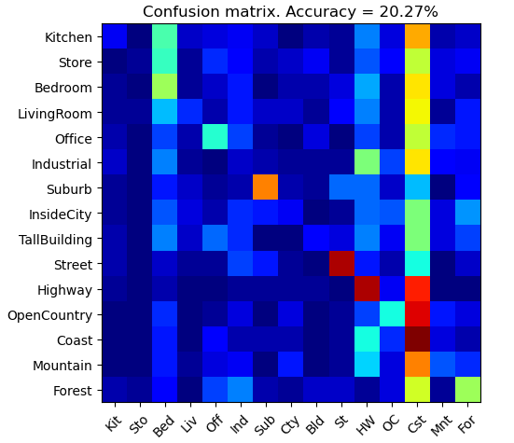
Part 1.3.a: Your confusion matrix, together with the accuracy for Part 1 with the standard parameter set (image_size = 16, k = 3)
<Plot here>

Slide 4
Part 1.3.b: Experiments: change image size and k individually using the following values, and report the accuracy (when tuning one parameter, keep the other as the standard (16 x 16, 3)):
ie. when you’re tuning image size, keep k at 3, when changing k, keep image size as 16x16
image size:
8 x 8: 19.27%
16 x 16: 20.27%
32 x 32: 20.73%
k:
1: 20.07%
3: 20.27%
5: 20.80%
10: 21.93%
15: 22.73%

Slide 5
Part 1.3.c: When tuning the parameters (image size and k), what did you observe about the processing time and accuracy? What do you think led to this observation?
<Write here>

Slide 6
Part 2: Bag-of-words with SIFT Features

Slide 7
Part 2.3: Reflection on Tiny Image Representation vs. Bag of Words with SIFT features:
Why do you think that the tiny image representation gives a much worse accuracy than bag of words? Additionally why do you think Bag of Words is better in this case?
<Write here>

Slide 8
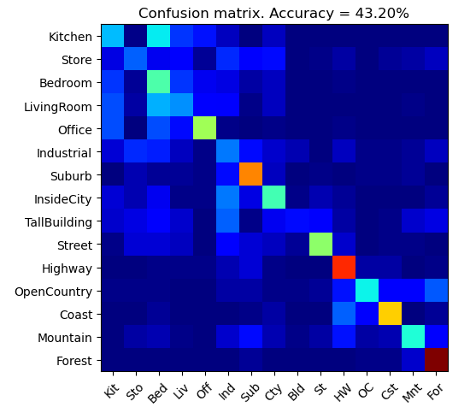
Part 2.4.a: Your confusion matrix, together with the accuracy for Part 2 with the standard parameter set (vocab_size = 50, k = 3, max_iter = 10, stride(build_vocab) = 20, stride(get_bags_of_sift) = 5
<Accuracy here>
<Plot here>

Slide 9
Part 2.4.a: Experiments: change vocab_size and k individually using the following values, and report the accuracy (when tuning one parameter, keep the other as the standard (50, 3)):
ie. when you’re tuning vocab_size, keep k at 3, when changing k, keep vocab_size as 50. (Other params max_iter = 10, stride(build_vocab) = 20, stride(get_bags_of_sift) = 5)
k:
1: <>
3: <>
5: <>
10: <>
15: <>
vocab size:
50: <>
100: <>
200: <>

Slide 10
Part 2.4.a: Paste the confusion matrix for your best result with the previous experimentation in this slide.
<Plot here>
vocab_size: <>
k: <>
max_iter: <>
stride(build_vocab): <>
stride(get_bags_of_sift): <>

Slide 11
Part 2.4.b: Reflection: when experimenting with the value k in kNN, what did you observe? Compare the performance difference with the k value experiment in Part 1.3, what can you tell from this?
<Text solution here>

Slide 12
Part 3: Extra Credit

Slide 13
EXTRA CREDIT
Part 3.1: Post best confusion matrix, together with the accuracy out of all the parameters you tested. Report the parameter settings used to obtain this result.
<Plot here>
Parameter settings:
max_iter: <>
stride(build_vocab): <>
stride(get_bags_of_sift): <>
vocab_size: <>
k (kNN): <>

Slide 14
EXTRA CREDIT
Part 3.2: Post confusion matrix along with the distance metric that you used for achieving a better accuracy on standard parameters. Why do you think it performs better?
<Plot here>
Distance metric and why it works better:
<>

Slide 15
EXTRA CREDIT
Part 3.3: Post confusion matrix along with your explanation of your SVM model and detail any other changes your made to reach an accuracy of 65% or greater.
<Plot here>
Description of your model: <>

