Slide 1
CS 485/584 PS 3
Name
Email
ID#

Slide 2
Part 1: Tiny Image Representation and Nearest-Neighbor Classification

Slide 3
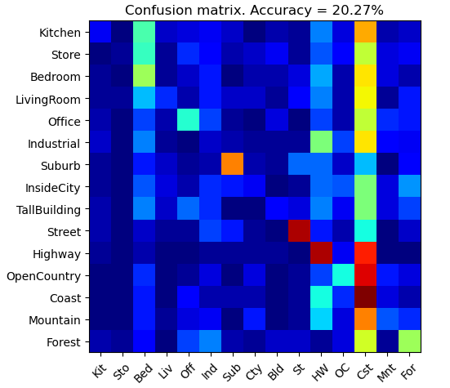
Part 1.3.a: Your confusion matrix, together with the accuracy for Part 1 with the standard parameter set (image_size = 16, k = 3)
<Plot here>

Slide 4
Part 1.3.b: Experiments: change image size and k individually using the following values, and report the accuracy (when tuning one parameter, keep the other as the standard (16 x 16, 3)):
ie. when you’re tuning image size, keep k at 3, when changing k, keep image size as 16x16
image size:
8 x 8: 19.27%
16 x 16: 20.27%
32 x 32: 20.73%
k:
1: 20.07%
3: 20.27%
5: 20.80%
10: 21.93%
15: 22.73%

Slide 5
Part 1.3.c: When tuning the parameters (image size and k), what did you observe about the processing time and accuracy? What do you think led to this observation?
The accuracy increases as tiny image size and k increases. For tiny image size, larger images captures more information from the original image, resulting in better predictions. For k, greater k mitigates the influence of outliers, resulting in better predictions.
In terms of processing time, theoretically a higher image size and k would significantly increase the processing time, but due to it being a much faster algorithm than the BoW SIFT this processing time advantage is not observed.

Slide 6
Part 2: Bag-of-words with SIFT Features

Slide 7
Part 2.3: Reflection on Tiny Image Representation vs. Bag of Words with SIFT features:
Why do you think that the tiny image representation gives a much worse accuracy than bag of words? Additionally why do you think Bag of Words is better in this case?
Tiny images resizes images to a small fixed size, resulting in feature loss comparing to SIFT. It also ignores rotation and transformation and lacks the ability to discriminate according to feature importance. BoW with SIFT, on the other hand, can find more abstract and discriminated set of features using vocabulary generated from SIFT descriptors. It is also capable of acknowledging rotations and transformations in an image. Therefore it has a much higher accuracy.

Slide 8
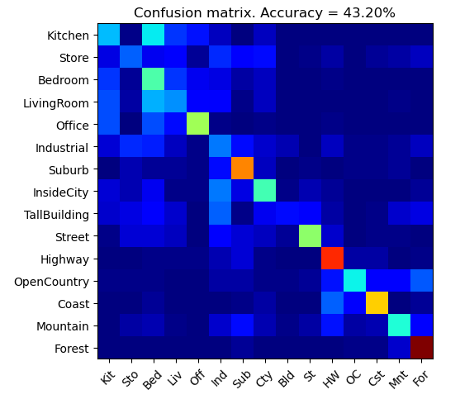
Part 2.4.a: Your confusion matrix, together with the accuracy for Part 2 with the standard parameter set (vocab_size = 50, k = 3, max_iter = 10, stride(build_vocab) = 20, stride(get_bags_of_sift) = 5
<Accuracy here>
<Plot here>

Slide 9
Part 2.4.a: Experiments: change vocab_size and k individually using the following values, and report the accuracy (when tuning one parameter, keep the other as the standard (50, 3)):
ie. when you’re tuning vocab_size, keep k at 3, when changing k, keep vocab_size as 50. (Other params max_iter = 10, stride(build_vocab) = 20, stride(get_bags_of_sift) = 5)
k:
1: 44.00%
3: 43.00%
5: 45.87%
10: 46.27%
15: 47.27%
vocab size:
50: 43.00%
100: 46.80%
200: Taking too long

Slide 10
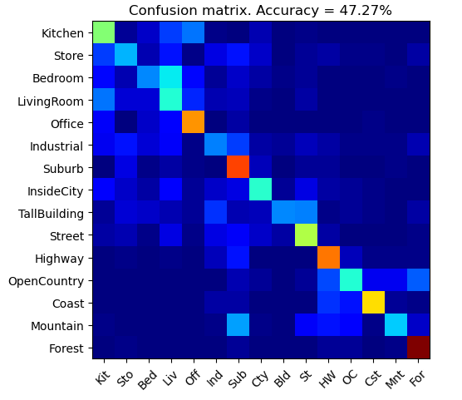
Part 2.4.a: Paste the confusion matrix for your best result with the previous experimentation in this slide.
<Plot here>
vocab_size: 50
k: 15
max_iter: 10
stride(build_vocab): 20
stride(get_bags_of_sift): 5

Slide 11
Part 2.4.b: Reflection: when experimenting with the value k in kNN, what did you observe? Compare the performance difference with the k value experiment in Part 1.3, what can you tell from this?
Greater K gives better performance using vocab size = 50. Since k is how many closest neighbors chosen to vote, a larger k can mitigate the influence of outliers in the nearest points, and generate better performance. Comparing with the experiment in Part 1, the perf gain from increasing k is lower, which means there may be less outliers skewing the predictions in bag of SIFTs.

Slide 12
Part 3: Extra Credit

Slide 13
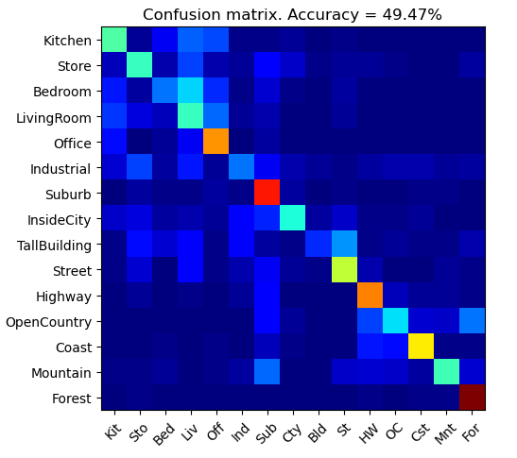
EXTRA CREDIT
Part 3.1: Post best confusion matrix, together with the accuracy out of all the parameters you tested. Report the parameter settings used to obtain this result. (I have experimented with strides and iters but none better than this run)
<Plot here>
Parameter settings:
max_iter: 10
stride(build_vocab): 20
stride(get_bags_of_sift): 5
vocab_size: 100
k (kNN): 15

Slide 14
EXTRA CREDIT
Part 3.2: Post confusion matrix along with the distance metric that you used for achieving a better accuracy on standard parameters. Why do you think it performs better?
<Plot here>
Distance metric and why it works better:
Used Manhattan Dist, Chebyshev Dist, Cosine Similarity, Mahalanobis Dist, but none better than Euclidean.

Slide 15
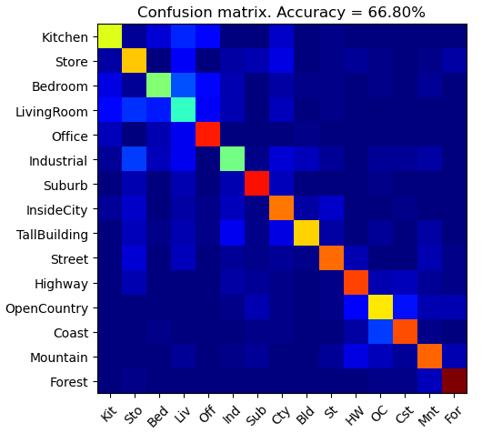
EXTRA CREDIT
Part 3.3: Post confusion matrix along with your explanation of your SVM model and detail any other changes your made to reach an accuracy of 65% or greater.
<Plot here>
Description of your model: sklearn with polynomial kernel
Other params indicated in part 3.1

