Slide 1
EDA in R
BeVera Solutions

Slide 2
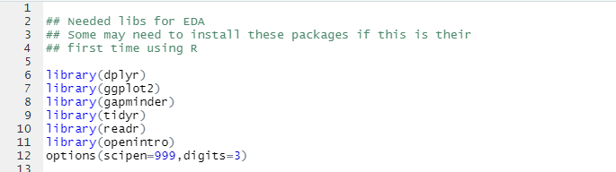
Useful Packages

Slide 3

EDA of Categorical Data

Slide 4
The Dataset
https://www.kaggle.com/xordux/india-corona-severity-zones
The zones are:
Green Zone: Least impacted zone, A district will be considered under green zone if there has been no confirmed cases of COVID-19 so far or there is no reported case since last 21 days in the district.
Orange Zone: Districts that do not have enough confirmed cases to meet the ‘red zone’, but are being seen as potential hotspots, are part of the ‘orange zone’. A Red Zone can be categorised as a Orange Zone if no new confirmed case is reported there for 14 consecutive days.
Red Zone: Districts reporting a large number of cases or high growth rates. Inclusion criteria for Red Zone:
Highest case-load districts contributing to over 80 percent of cases in India, or
Highest case-load districts contributing to more than 80 percent of cases for each state in the country, or
Districts with doubling rate at less than four days (calculated every Monday for last seven days, to be determined by the state government).

Slide 5

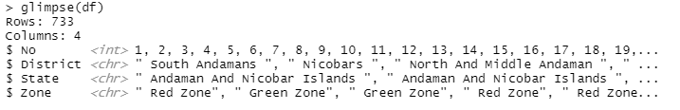
Upload Data

Slide 6
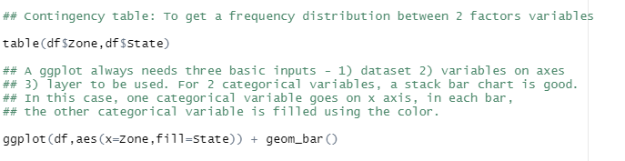
Contingency Table

Slide 7
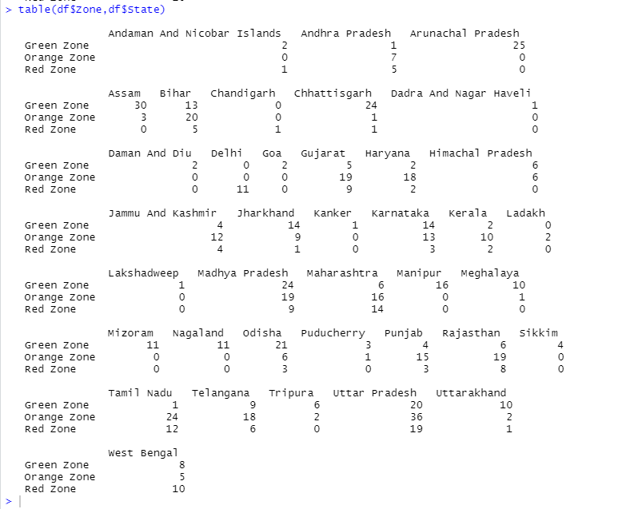
Output for Contingency Table

Slide 8
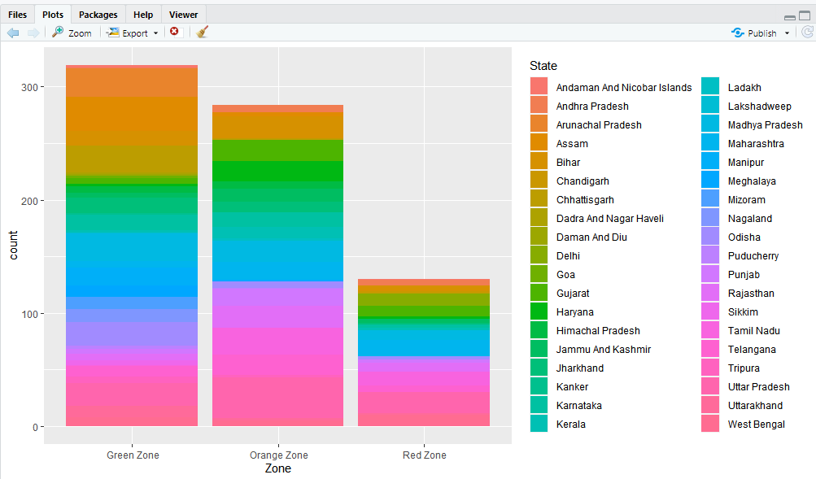
Output for ggplot()

Slide 9

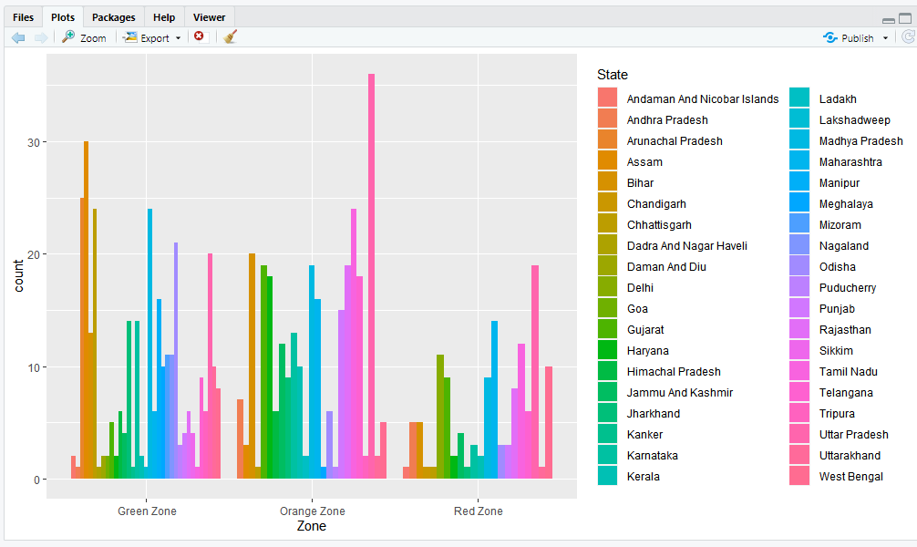
Side-by-Side?

Slide 10
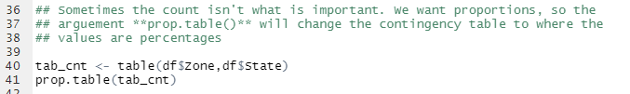
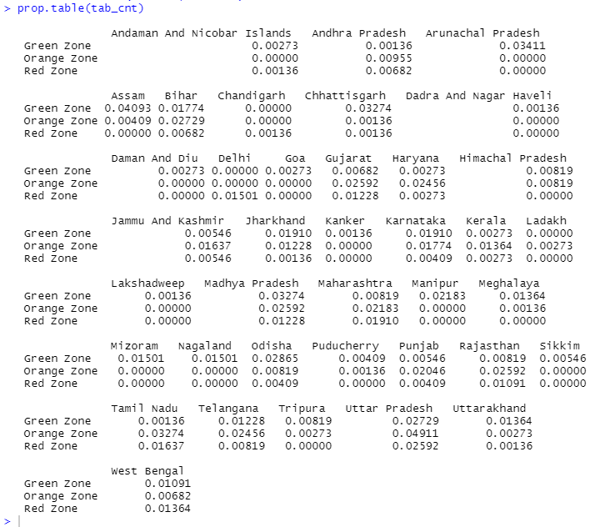
Proportions
Output

Slide 11

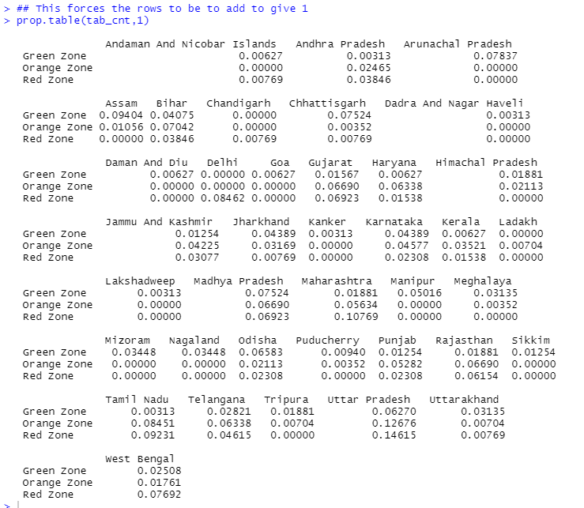
Proportions (con’t)

Slide 12

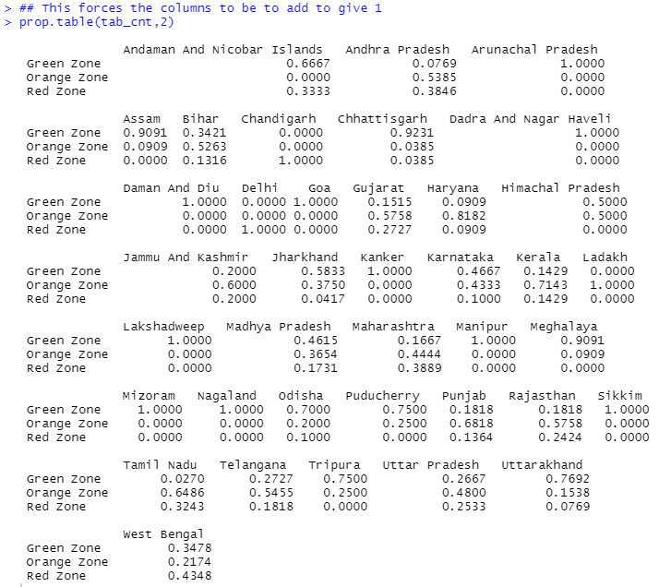
Proportions (con’t)

Slide 13
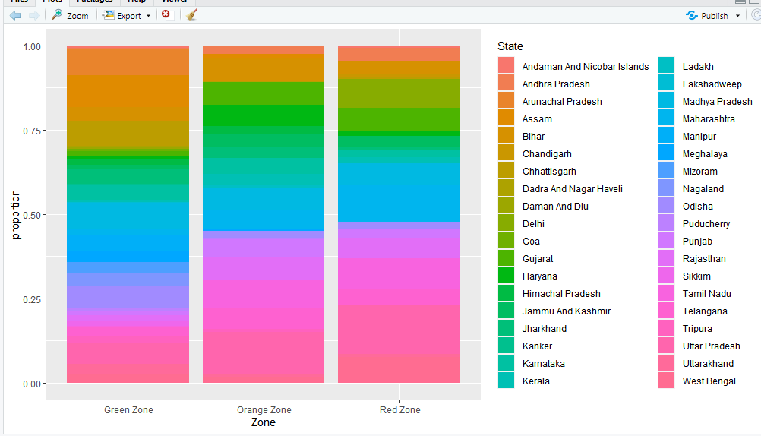
100% stack chart, conditioned on Zone

Slide 14
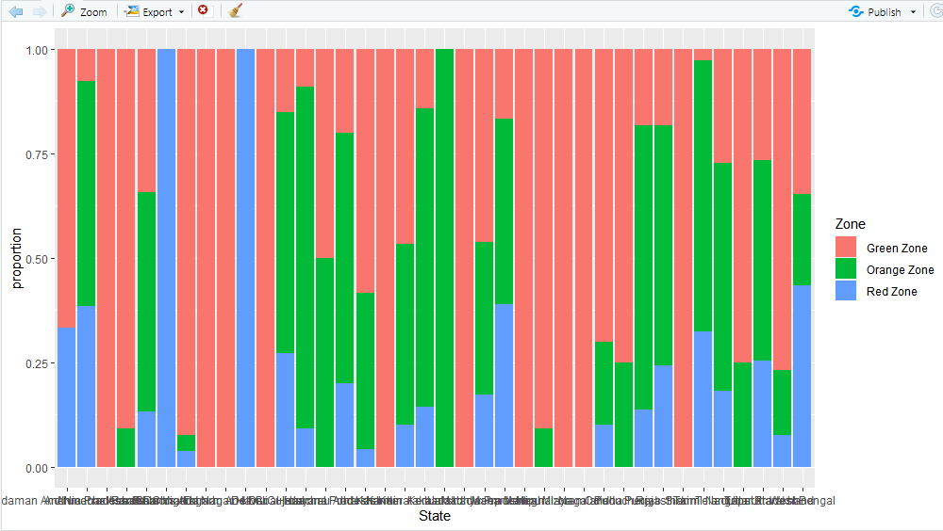
100% stacked bar chart, conditioned on State
Let’s Clean the labels up!

Slide 15
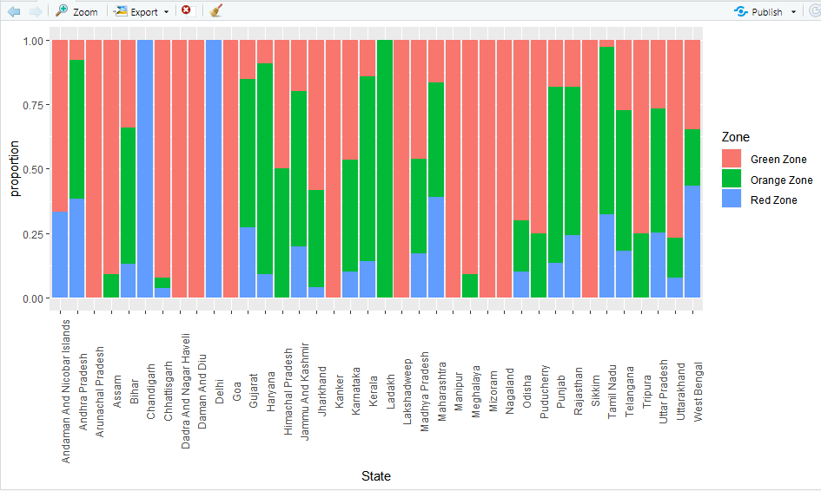

Slide 16

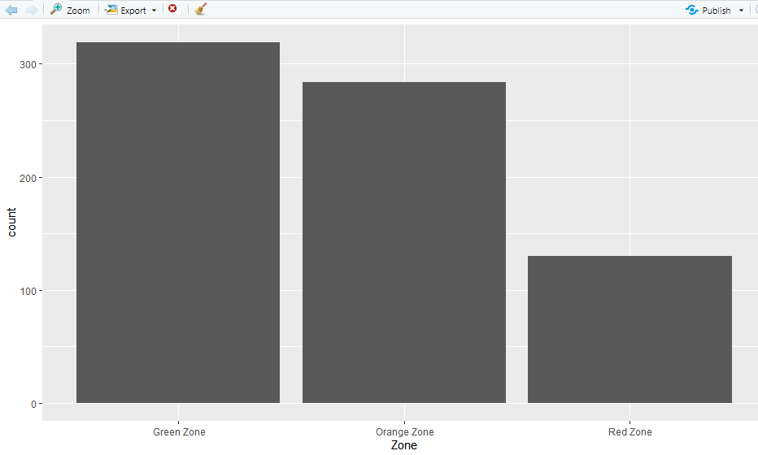
Marginal Distribution

Slide 17
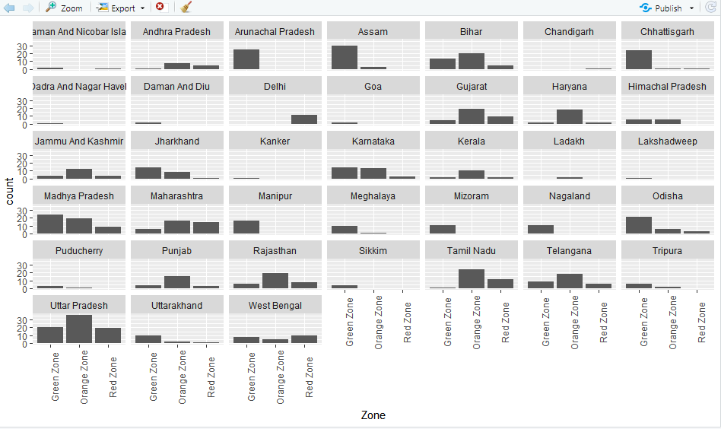
Distribution against one variable

Slide 18
EDA of Numeric Data

Slide 19
The Dataset
https://stat.ethz.ch/R-manual/R-devel/library/datasets/html/airquality.html
Daily air quality measurements in New York, May to September 1973.
Daily readings of the following air quality values for May 1, 1973 (a Tuesday) to September 30, 1973.
Ozone: Mean ozone in parts per billion from 1300 to 1500 hours at Roosevelt Island
Solar.R: Solar radiation in Langleys in the frequency band 4000–7700 Angstroms from 0800 to 1200 hours at Central Park
Wind: Average wind speed in miles per hour at 0700 and 1000 hours at LaGuardia Airport
Temp: Maximum daily temperature in degrees Fahrenheit at La Guardia Airport.
Month: Numeric value between 1-12
Day: Numeric value between 1-31

Slide 20

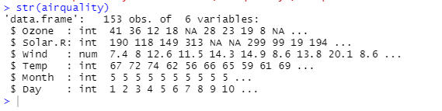
Upload Numeric Data

Slide 21
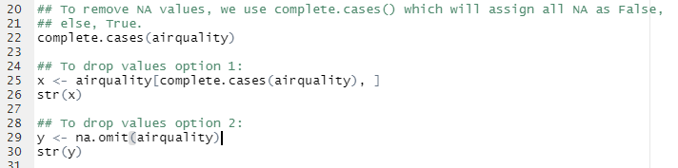
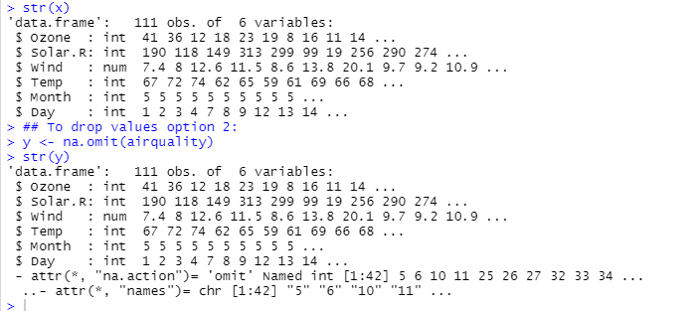
Data Cleaning
Output

Slide 22
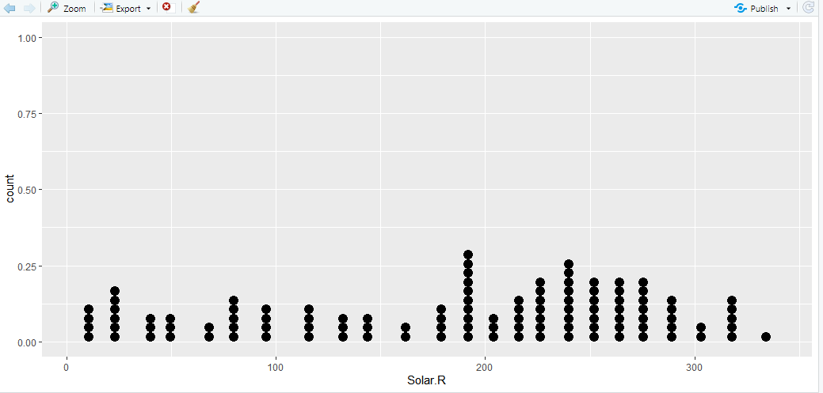
Dotplot

Slide 23
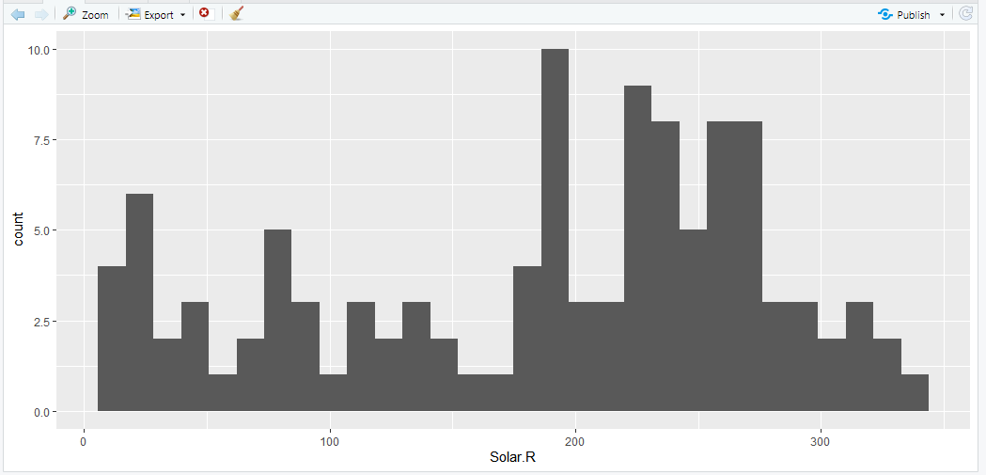
Histogram

Slide 24
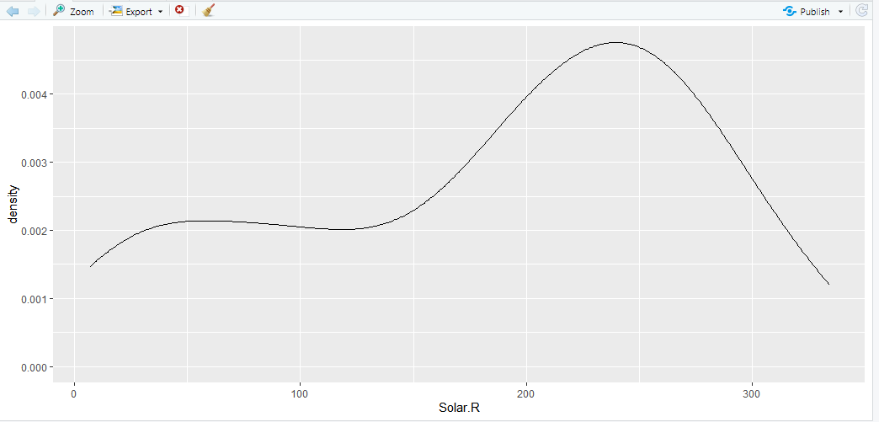
Density plot

Slide 25
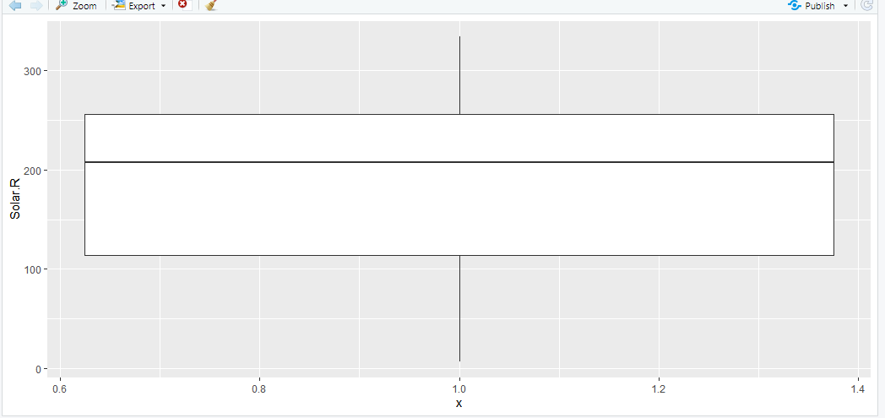
Boxplot

Slide 26
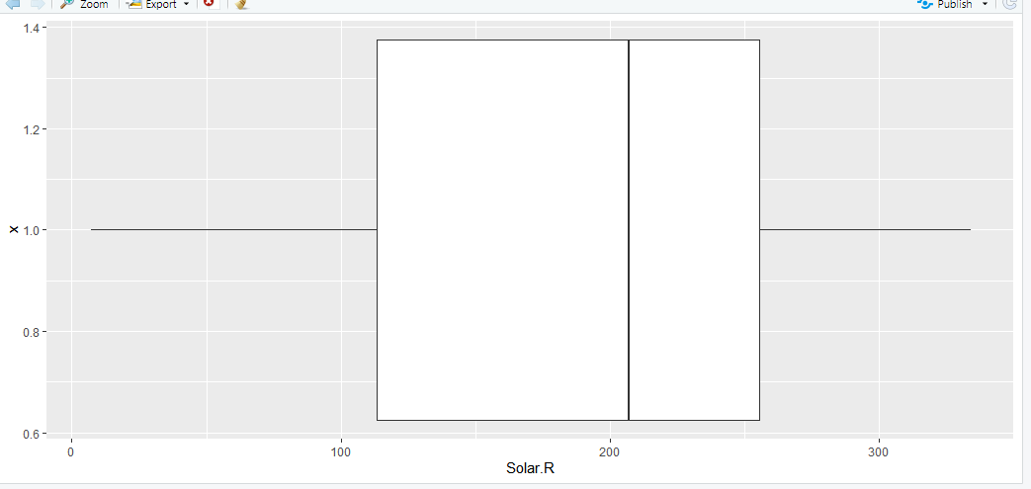
Boxplot (coord_flipped)

Slide 27
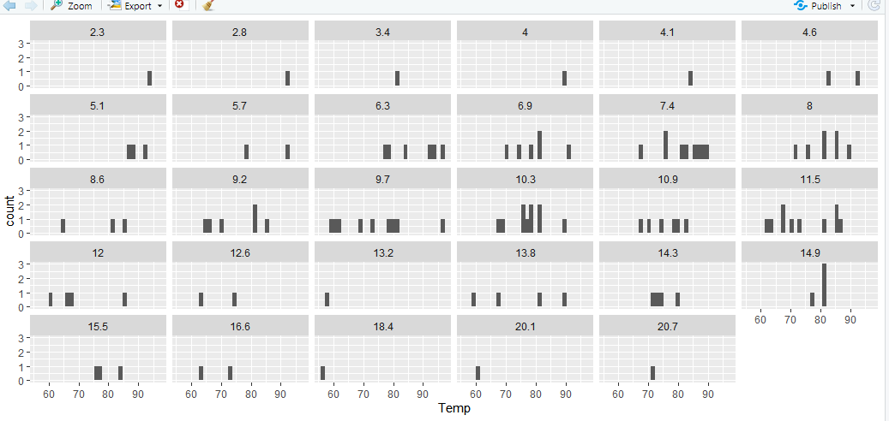
Faceted plots

