Slide 1
Sentiment Analysis of Soccer Games Natural Language Processing of Twitter in Python using Tweepy, TextBlob, and BM25Okapi
Dixon Liang
University of Illinois Urbana-Champaign
MCS – CS 410

Slide 2
General Information
Example Game: Chelsea vs. Leeds United (12/5/2020), Chelsea won 3-1.
Ziyech and Koch went off injured
Player Ratings Consensus:
Entire Chelsea team played well
Several players could have been MOTM
Entire Leeds team was OK
Two Parts
Sentiment Analysis using TextBlob
Ranking using BM25Okapi
Everything can be found on my GitHub (https://github.com/dixonliang)
File used: “12_5_20_ChelseaLeeds_Demo.ipynb”
Empty demo: “Demo.ipynb”
Open to collaboration ☺

Slide 3
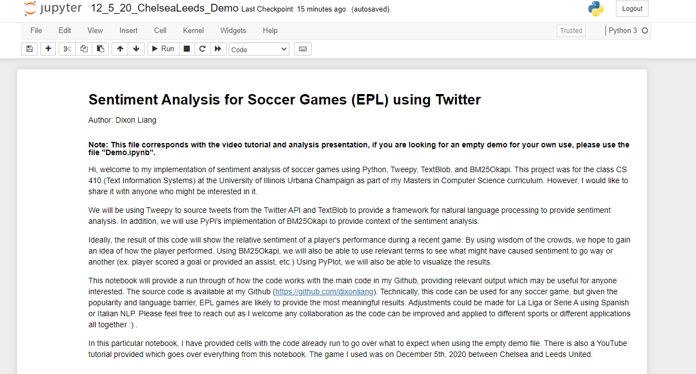

Slide 4
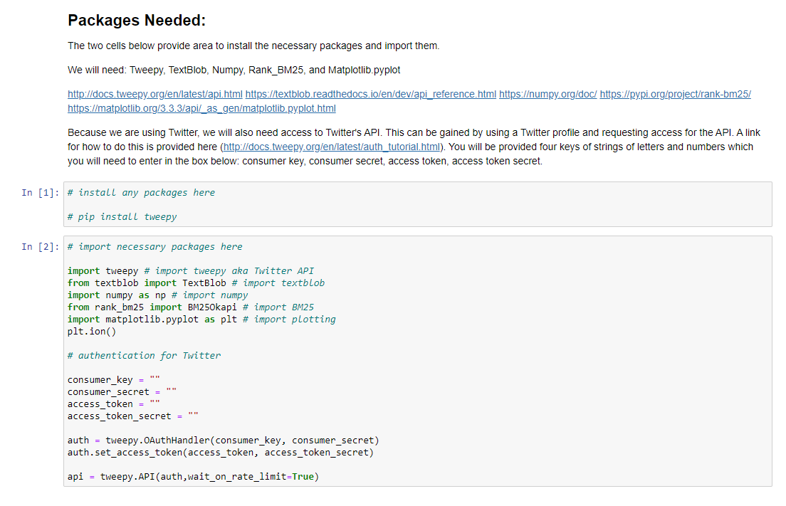

Slide 5
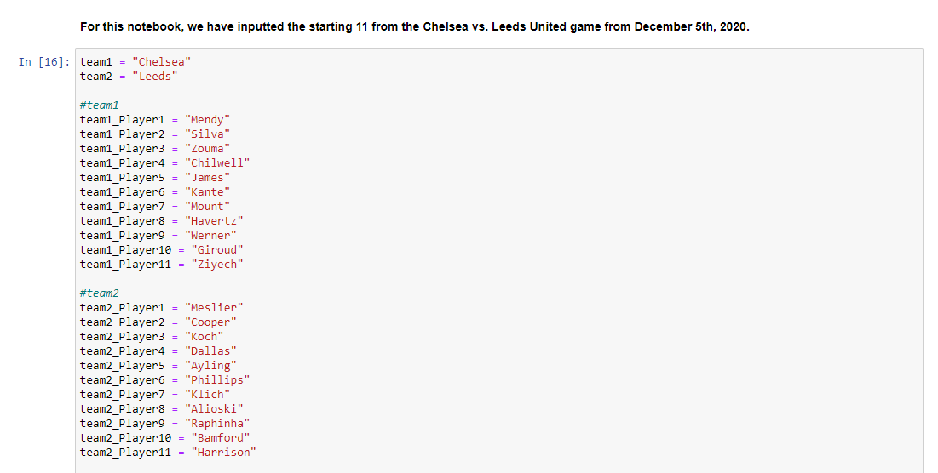
Setting Game Parameters

Slide 6
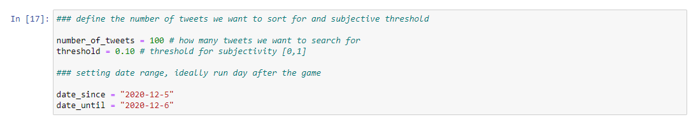
Sentiment Algorithm Parameters
Number of tweets to be retrieved for each player (limited by API)
Threshold for subjectivity
Date range

Slide 7
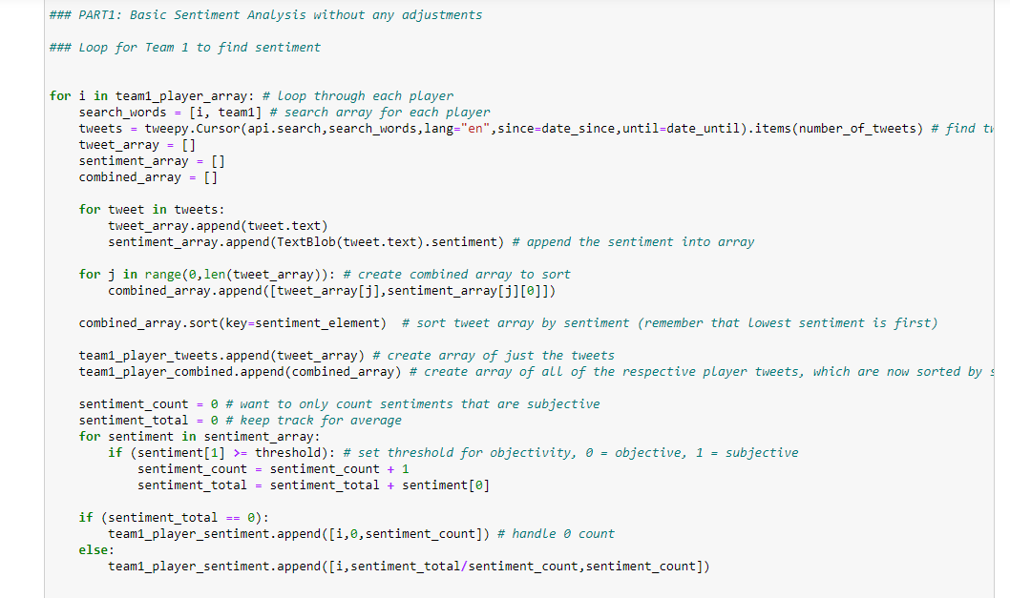
Sentiment Algorithm: Part 1

Slide 8
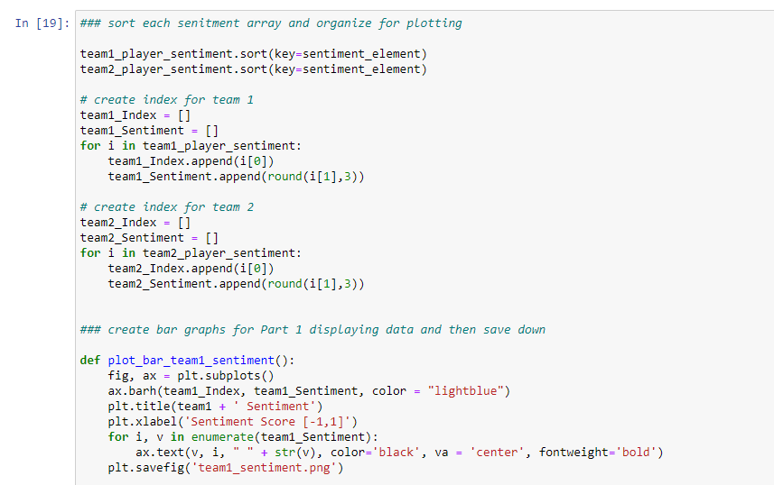
Sentiment Algorithm: Part 2

Slide 9
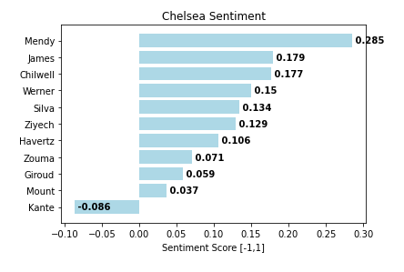
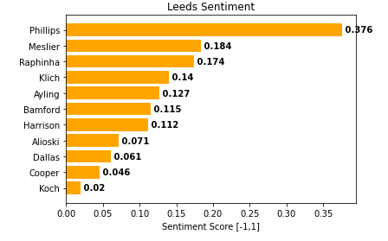
Sentiment Results

Slide 10
Chelsea Example Tweets
Kante (CM):
[['RT @StatmanDave: N’Golo Kanté vs. Leeds United [Chelsea rank]:\n\n12 ball recoveries [1st]\n3 tackles won [=1st]\n2 interceptions [=1st]\n\nDoing…', -0.8]
['RT @marshyleeds: Kante was the best player on the field and made the difference for Chelsea. Has that change of pace in midfield we sometim…', 1.0]]
The negative sentiment tweet does not appear to be accurate… We can use BM25Okapi to further investigate…
Mendy (GK):
[@goal Our starting 11 have all scored😍\nRemains Mendy😁\nHold on a second, he is keeping goals from entering, win win for Chelsea', 0.4], ['The presence of Mendy and Thiago have given Chelsea a huge impact at defensive line https://t.co/CD93QjlYLc', 0.4]”
Did not have any negative sentiment tweets

Slide 11
Leeds Example Tweets
Philips (CM):
[Kevin Phillips deserves to play for a top 5 team, the guy is so good. He literally runs this leeds team.', 0.6]
Some negative tweets, but not particularly focused on him
Likely best player on the field for Leeds based on this – seemed to be agreed by other match ratings
Cooper (CB):
[['@leeds_lord Cooper was terrible. Hideously exposed.', -1.0], ['@kennybrown1964 @maz7555 Llorente was class. It’s cooper who is and always has been the weak link. Hopefully that’s… https://t.co/68jwJ2rX0W', -0.375]
["@Laurencewegner I thought he was good Cooper did well, yeah but for me have to credit Chelsea's movement in the box… https://t.co/JjWhYFbfGW", 0.7]
Some very negative tweets, some positive tweets
Implies wasn’t great, but wasn’t terrible as some suggest

Slide 12
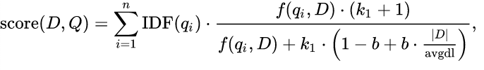
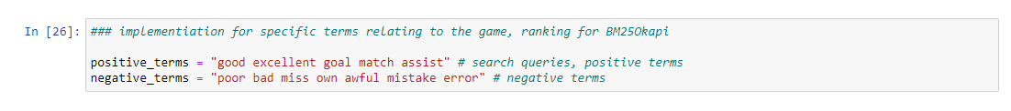
BM25Okapi for Context

Slide 13
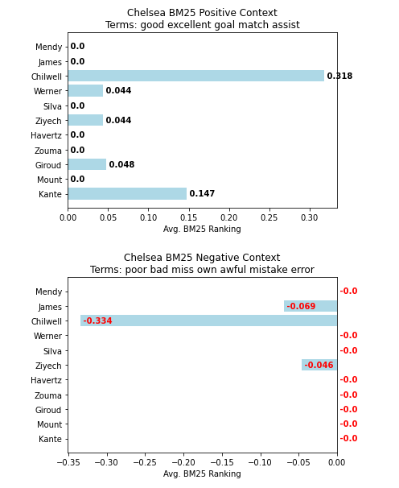
Chelsea BM25Okapi Results
Kante matching most of the positive terms
Giroud, Werner, Chilwell all had decent games as well
Werner seems to have had a great game taking the two into consideration
Ziyech injury, Chilwell foul (VAR)

Slide 14
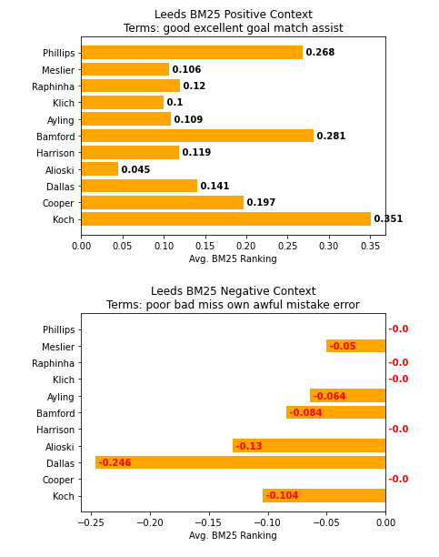
Leeds BM25Okapi Results
For most part matches the sentiment rating
Bamford was the goal scorer for Leeds
Phillips confirmed best player for Leeds based on the two
Koch injury
Dallas matches the most “bad terms”, was one of the lowest ranked players in sentiment

Slide 15
Conclusion and Improvements
Provides accurate idea of what happened in each game
BM25Okapi is flexible, will provided needed context in the cases where sentiment analysis might not make sense
Can easily be adapted to other sports
Can be extended for multiple games or even an entire season
Algorithm likely needs to be improved
Efficiency poor and API limitations
Best to be used with statistical analysis
Open to work with others! ☺

