Slide 1
Final Year Internship Defense
on
Klik-Read App
at
KTM Bees Pvt. Ltd.
By:
Bidisha Koirala (21277/075)
Notes:
Goodmorning respective teachers and my dear friends
My name is Samik Maharjan and today I am here to present about my internship

Slide 2
Introduction
During my internship period at KTM Bees, I was assigned to a mobile development department where I worked in a project named “KlikRead”. It is an application for book readers to enhance their reading experience. This app allows user to upload and organize their reading wish-list based on book genres, creating a personalized digital bookshelf.
The main goal of this project is to enhance the reading experience of book enthusiasts by facilitating book organization, uploading favorite quotes of the book, and creating community of readers for book discussion.
Notes:
This is the presentation outline where it includes

Slide 3
Internship program objectives
To develop an ability to work in the team.
To gain practical work experience in the field of mobile development.
To enhance the intern's professional readiness to work in real-world IT industry.

Slide 4
Internship project objectives
To enhance the reading experience for book enthusiasts.
To create a community of readers who can engage in book discussion.

Slide 5
Scope and Limitation
Scope
The major goal of developing KlikRead is to create a versatile platform that enhances the reading experience by allowing users to upload and organize their books by genre, share their favorite book quotes, and engage in discussions within a community of readers.
Limitation
Compatibility Limitations across devices
Network Dependancy affect some real-time features.
Notes:
This is the organizational hierarchy of Nepbud Info Tech

Slide 6

Organization Details
Fig 1 : Logo of organization
Table 1 : Organization Details
Organization | KTM Bees Pvt. Ltd.
Organizational Type | Private Limited
Location: | New-Baneshwor, Kathmandu
Opening Hours: | 9:00am - 4:00pm
Contact No.: | 9843187599
Email Address: | info@ktmbees.com
Website: | https://ktmbees.com
Notes:
This is the organizational hierarchy of Nepbud Info Tech

Slide 7
Working Domain Of Organization
.
Mobile App Development
Web Development
Custom Software development
UI UX Designing
Graphic Designing
Digital Marketing

Slide 8
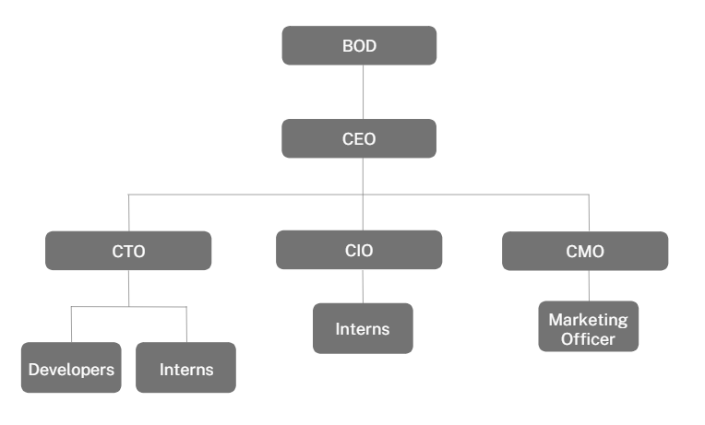
Organization Hierarchy
Fig 2 : Organization Hierarchy

Slide 9
Internship Activities
Understand the working patterns of the organization.
Complete the task assigned by the supervisors on weekly basis.
Update the supervisor on a regular basis.
Work on the frontend of the project using flutter and dart.
Integrating frontend with backend part of the project.
Handling the errors that occur in the project.
Testing various part of the system.
Create good network with the professionals.
Practice to use the tools and technology correctly.
Code review and optimization.
Notes:
As a Flutter Developer (Intern) at Nepbud Info Tech, my roles and responsibilities were

Slide 10
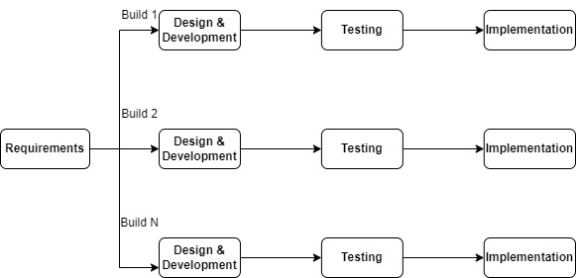
Implementation Details
Methodology Used
Incremental Methodology
Tools Used
Front End : Flutter, Dart
Back End: Python, PostgreSQL, Fig: Incremental Model
Django, REST Framework
API: Postman

Slide 11


Duration
As per the requirement of T.U, Bsc. CSIT students are required to do intern for 180 hours or ten weeks. So, I worked in the following routine:
Start date : 16 April, 2023
End date : 3 August, 2023
Total Duration : 3.5 Months
Office hour : 10 am – 4 pm
Working days : 5 days per week
Notes:
Fourth diagram is the food items that have been added to the cart

Slide 12
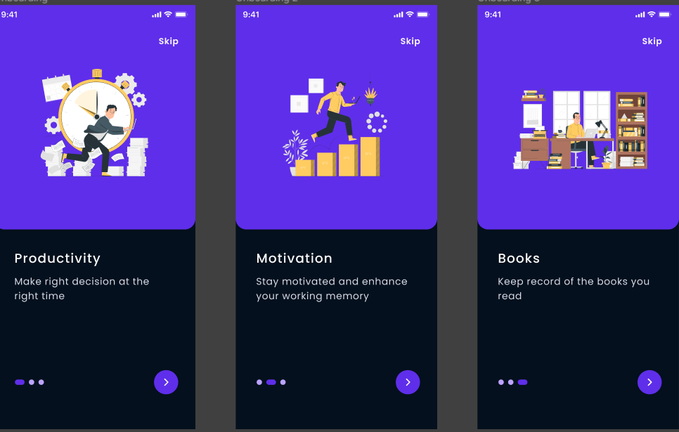
Completed Activites
On Boarding Page
Notes:
The first diagram shows the menu list page from admin application
Second diagram shows the add menu page

Slide 13
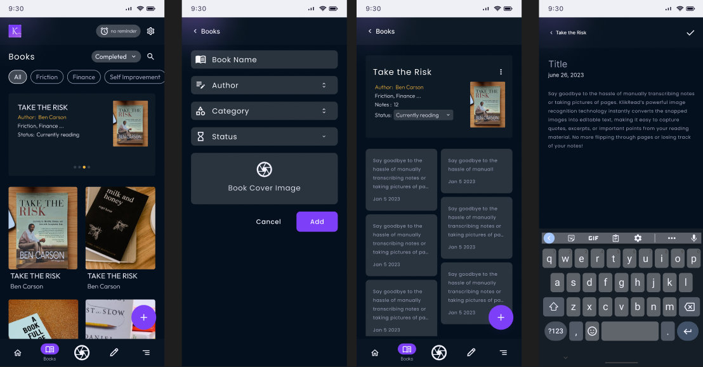
Completed Activites
Book Page
Notes:
The first diagram shows the menu list page from admin application
Second diagram shows the add menu page

Slide 14
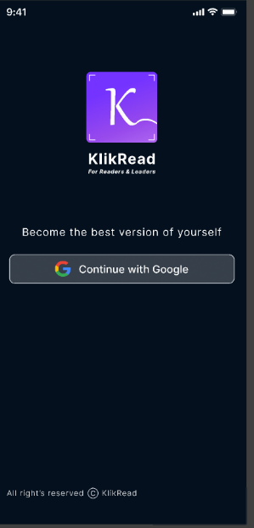
Completed Activites
Login Page
Notes:
The first diagram shows the menu list page from admin application
Second diagram shows the add menu page

Slide 15
Conclusion
Learning Outcome
Able to develop, build and deploy mobile applications
A handful of new knowledge about the working process of an IT company
Time Management skills and communication skills.
Learned collaborative teamwork, state management and user-centric design importance.
Working with multiple features under pressure to meet deadlines
Notes:
The tools that I have used for this project are

Slide 16
Thank You!

