Slide 1
Introduction
Organization Introduction
Intern Department
Project Introduction

Slide 2
Organization Introduction
Neputer Tech Pvt. Ltd. is a custom software company in Nepal.
It started as a startup software company in 2018 and growing every year by serving various small and medium sized business institutions and government agencies in and out of Nepal.
Located on Narefat, Kathmandu
Services are:
Website Development (Design)
Mobile Application Development
Web Application Development

Slide 3
Organization Contact Details
Name of the Organization | Neputer Tech Pvt. Ltd.
Organization Type | Private
Address | Narefat, Kathmandu, Nepal
Established | 2018
Phone Number | +977-16201277
Email | contact@neputer.com
Website | https://www.neputer.com

Slide 4
Intern Department
Neputer Tech provide 3 months long internship program according to domain they worked on.
I was hired as an intern in backend learning and development department (.NET internship program) in the language or framework ASP.NET Core (C#).
This internship is essential for Neputer Tech as it prepares interns to become professional software developers, and some may even receive job offers from the company upon completion.

Slide 5
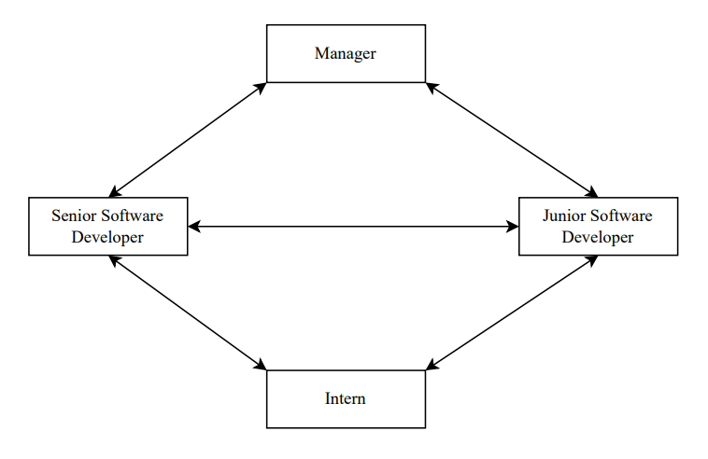
Intern Department

Slide 6
Internship Duration
Internship Title | ASP.Net Developer
Start Date | 10th June 2023
End Date | 10th September 2023
Location for Internship | Narephat, Kathmandu, Nepal
Supervisor for Internship | Lokendra Chand
Working Time | 10:00 – 18:00

Slide 7
Project Introduction
During the internship period, I was assigned to an active project named “DeviceHaven”.
This project is an Electric Store Ecommerce Web Application using ASP.NET Core MVC with an n-tier architecture and repository pattern with unitofwork implementation using generic classes.
With this people can buy electrical products such as Mobiles, laptops, Headphones etc. online.
In essence, this project was developed using ASP.Net Core MVC framework which use MSSQL Server as database management system, Entity as Models(M), Controllers Classes(C) and Cshtml File as Views(V).

Slide 8
Project Architectural Pattern
Model-View-Controller (MVC)
This pattern separates an application into three main components: Model, View, and Controller.
This separation helps to achieve a clean and organized structure, making the application more maintainable and testable.
N-tier / Layer Architecture (DLL-BAL-UI)
Presentation Layer (UI): This layer focuses on the user interface, ensuring a user-friendly shopping experience.
Business Logic Layer (BLL): It separates business rules, enhancing adaptability and maintenance.
Data Access Layer (DAL): This layer interacts with the database using a repository pattern, improving modularity and testability.

Slide 9
Project Architectural Pattern
Repository with UnitOfWork pattern
Use to decouple the Data Access Layer from the whole application by implemented repository pattern with UnitOfWork.
The Unit of Work Pattern in C# is used to group one or more operations (usually database CRUD operations) into a single transaction and execute them by applying the principle of do everything or do nothing.

Slide 10
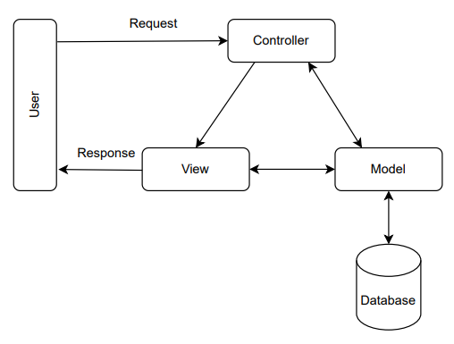
MVC Pattern

Slide 11
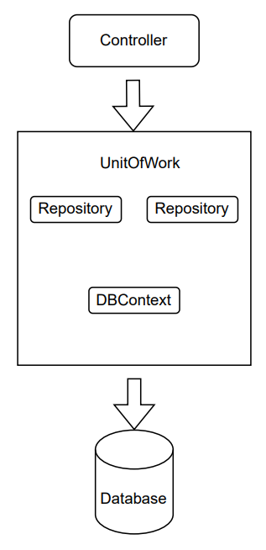
Repository with UnitOfWork Pattern

Slide 12
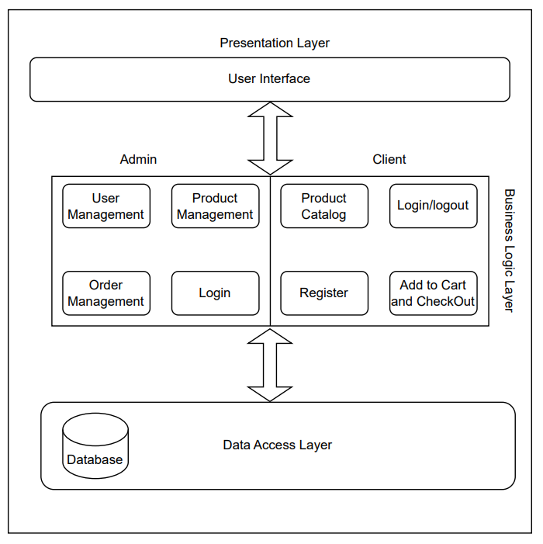
N-Tier/Layer Pattern

Slide 13
Internship Activities
Task/Activities Performed
Challenges

Slide 14
Task/Activities Performed
Architectural Patterns
MVC
MVVM
N-Layer/N-Tier Architecture
Repository Pattern with UnitOfWork
Perform User Login and Registration
Perform CRUD with EF Core
Understanding and Implementing Dependency Injection

Slide 15
Task/Activities Performed
Payment Gateway Integration
Securing Web Application
Debugging and Testing

Slide 16
Challenges
Understanding Architectural and Design Patterns
Dependency Injection: Since dependency injection is a core concept in ASP.NET Core, understanding how to use it is crucial for building scalable and maintainable applications.
Security Concerns: Security is paramount in web development. Interns need to understand authentication, authorization, and how to secure their applications against common vulnerabilities.
Entity Framework: Dealing with databases is a common task, and Entity Framework is a powerful tool. Understanding how to work with it for database operations is essential.
Front-end Integration: Integrating the back-end (ASP.NET Core) with front-end frameworks is common in modern web development. This skill is crucial for building dynamic and responsive applications.

Slide 17
Conclusion and Learning Outcome

Slide 18
Conclusion
The internship in Neputer Tech Pvt. Ltd. has provided a great opportunity to enhance my knowledge and skills.
It helped me to gain the experience of working in real and practical field and most importantly working in team.
The main objective of the internship is learning the things that is necessary to get myself into the real field of work.
It has given me the opportunity to understand this industry and how the work is actually done.
Overall, the internship program helped me develop skills such as handling real-world problems, working under the rules and regulations of an organization, working under a deadline and under pressure, working in a team.

Slide 19
Learning Outcomes
Experiencing the environment of professional Software Industry
How real world tasks are actually executed
What actually professionalism means
Real life projects
Challenges
Appreciate success, do not discourage for failure
Planning
Patience

Slide 20
The End

