Slide 1

Diyanshi Shah and Diya Gupta
GOLD PRICE PREDICTION

Slide 2
Business Problem
Gold price volatility, driven by macroeconomic factors like GDP, interest rates, and inflation, creates forecasting challenges essential for informed investment and policy decisions. This study leverages Random Forest and LSTM models to predict future gold prices, with Random Forest identifying influential factors and LSTM capturing time-based patterns. By comparing these methods, the project aims to offer a reliable tool for investors and analysts seeking accurate, data-driven forecasting solutions.

Slide 3
Introduction
Aims & Objective
Research Methodology
About The Dataset
Exploratory Data Analysis
Data Preprocessing
Overfitting
Machine Learning Models
Conclusion,
Future Work
References
Content

Slide 4

Introduction
Gold is a key investment asset, often used to hedge against inflation and economic uncertainties.
Gold prices are influenced by complex factors, including GDP, interest rates, inflation, and investor sentiment.
Accurate price prediction is vital but challenging due to the interdependence and volatility of influencing factors.
Machine learning advancements offer improved time-series forecasting:
Random Forest: Identifies key economic factors influencing gold prices.
LSTM: Captures historical trends and temporal patterns for sequential predictions.
This study compares Random Forest and LSTM models to determine the most effective approach for reliable gold price forecasting.

Slide 5
Aim & Objective
Develop an Accurate Gold Price Prediction Model: Use machine learning models like Random Forest and LSTM to predict future gold prices based on historical data and economic indicators.
Incorporate Economic Indicators: Include key factors such as treasury yields, inflation, and GDP in the models to improve accuracy by capturing macroeconomic influences.
Compare Machine Learning Techniques: Assess and compare the performance of Random Forest (traditional method) and LSTM (deep learning) to determine which model better predicts gold price trends.
Detect and Mitigate Overfitting: Apply regularization methods like Ridge and Lasso to prevent overfitting, ensuring models generalize well to new data.
Create a User-Friendly Prediction Tool: Build a web-based interface that provides easy access to gold price forecasts, model visualizations, and insights into economic trends affecting prices.

Slide 6
Research Methodology

Slide 7
About the dataset
Open: The price at which the gold futures contract started trading when the market opened for that specific day. This value reflects the first trade of the day.
High: The highest price reached by the gold futures contract during the trading day. It indicates the maximum price that traders were willing to pay for the futures contract within the trading session.
Low: The lowest price reached by the gold futures contract during the trading day. It reflects the minimum price that traders were willing to accept during the session, providing insight into the intraday market volatility.
Close: The final price at which the gold futures contract traded at the close of the market for the day. It is widely used as a benchmark for the asset’s performance on that day.
Adj Close (Adjusted Close): The closing price of the gold futures contract, adjusted for any corporate actions like dividends, splits, or new contracts.

Slide 8
Data Features
Close_Diff: Difference between the adjusted closing price of the current and previous day (Adj Close.diff()). This helps capture daily price changes.
Moving Averages (MA): MA200, MA100, MA50, MA26, MA20, MA12: These are simple moving averages of the closing prices over different time windows (e.g., 200-day, 100-day, etc.). Moving averages help smooth out price data and identify trends.
SMA Differences: DIFF-MA200-MA50, DIFF-MA200-MA100, etc.: These features represent the difference between different moving averages (e.g., 200-day vs. 50-day moving average). These help capture momentum and crossovers, which are often used as trading signals. When a shorter moving average crosses above a longer one, it may signal an upward trend, and vice versa.
Highs and Lows: MA200_low, MA14_low, MA200_high, MA14_high: These capture the minimum and maximum values over different period.
Standard Deviation: MA20dSTD: The standard deviation of closing prices over 20 days, used in volatility calculations.
Exponential Moving Averages (EMA): EMA12, EMA20, EMA26, EMA100, EMA200: These are exponentially weighted moving averages, which give more importance to recent data points while still showing the overall trend.
Shifted Prices: close_shift-1, close_shift-2: These are closing prices from one and two days before, helping the model learn patterns from recent days.
Notes:
1. **Close_Diff**: This represents the change in the adjusted closing price between the current day and the previous day. Calculated using `Adj Close.diff()`, it shows the day-to-day change, helping us track how much the price moved daily.
2. **Moving Averages (MA)**: These are averages of the closing prices over different time frames, which help identify long-term trends in the data. Here are the key moving averages used:
- **MA200**: A 200-day moving average, reflecting the average price over the past 200 days.
- **MA100, MA50, MA26, MA20, MA12**: Other moving averages calculated over shorter time frames (100, 50, 26, 20, and 12 days).
- **Purpose**: Moving averages "smooth out" the price data, making it easier to identify upward or downward trends in the price over time.
3. **SMA Differences**: These features capture the differences between specific moving averages, such as:
- **DIFF-MA200-MA50**: Difference between the 200-day and 50-day moving averages.
- **DIFF-MA200-MA100**: Difference between the 200-day and 100-day moving averages.
- **Purpose**: These differences help capture price momentum and crossover signals. When a shorter moving average crosses above a longer one, it may signal an upward trend, and vice versa.
4. **Highs and Lows**:
- **MA200_low, MA14_low**: Minimum price values over the last 200 and 14 days, respectively.
- **MA200_high, MA14_high**: Maximum price values over the last 200 and 14 days, respectively.
- **Purpose**: Highs and lows provide an idea of the range within which the price fluctuates, helping to identify support and resistance levels in the market.
5. **Standard Deviation (MA20dSTD)**: The standard deviation of the closing prices over the past 20 days, which helps assess price volatility.
- **Purpose**: A higher standard deviation shows greater volatility, indicating larger price fluctuations, while a lower value suggests a more stable price.
6. **Exponential Moving Averages (EMA)**:
- **EMA12, EMA20, EMA26, EMA100, EMA200**: Similar to simple moving averages but place more weight on recent prices, making them more responsive to recent changes.
- **Purpose**: EMAs are helpful in capturing short-term price movements while still showing the overall trend.
7. **Shifted Prices (close_shift-1, close_shift-2)**: These are the closing prices from one and two days earlier.
- **Purpose**: Including prices from previous days can help the model understand short-term patterns and trends in recent price movements.

Slide 9
External Data Sources
These yields are important as they influence investor sentiment, especially for safe-haven assets like gold. When bond yields rise, gold might become less attractive because bonds provide better returns.
Treasury Yields: The yields for different U.S. Treasury bonds are fetched using the following symbols:
^TNX: 10-Year Treasury Yield
^IRX: 13-Week Treasury Yield
^FVX: 5-Year Treasury Yield
^TYX: 30-Year Treasury Yield
GDP: Gross Domestic Product (GDP) data is loaded from an external CSV file and merged with the gold data based on the date. GDP can serve as a proxy for the overall economic health of a country, influencing gold prices indirectly.
Inflation: Inflation data is loaded from another external CSV file. Inflation affects the purchasing power of money, and higher inflation often leads to higher gold prices as investors use gold to hedge against inflation.
Notes:
1. **Treasury Yields**: These are interest rates on various U.S. Treasury bonds, fetched using specific symbols. Treasury yields give insight into investor confidence and the economic environment:
- **^TNX (10-Year Treasury Yield)**: Interest rate on a 10-year bond, widely watched as an indicator of long-term economic trends.
- **^IRX (13-Week Treasury Yield)**: Reflects the interest rate on a 13-week bond, useful for gauging short-term economic conditions.
- **^FVX (5-Year Treasury Yield)**: Interest rate on a 5-year bond, providing a medium-term economic perspective.
- **^TYX (30-Year Treasury Yield)**: Interest rate on a 30-year bond, often considered a measure of long-term inflation expectations.
Treasury bonds, often called T-bonds, are long-term debt securities issued by the U.S. Department of the Treasury. When the U.S. government needs to raise funds, it sells these bonds to investors, who, in turn, lend money to the government in exchange for a promise to be repaid with interest over a set period. However, they often have an inverse relationship, meaning that when Treasury bond yields go up, gold prices tend to go down, and vice versa.
Interest Rate Influence: Treasury bonds offer regular interest payments (yield) to investors.
When Treasury yields are high, bonds become more attractive because investors earn more income from holding them. This makes gold, which doesn’t pay interest or dividends, less appealing by comparison, often resulting in a decrease in gold prices. Opportunity Cost: Gold does not generate any yield (interest). Therefore, when Treasury bond yields increase, the "opportunity cost" of holding gold (the income investors forgo by not choosing an interest-bearing asset) rises. This often leads to reduced demand for gold and can push its price down.
Economic Outlook and Safe-Haven Demand: In times of economic stress or uncertainty, both Treasury bonds and gold may see increased demand as investors seek safety. However, when the economic outlook is stable or improving, investors may prefer bonds over gold due to the fixed income they provide, which can lower gold prices. Conversely, if the economy is weak and interest rates are low, gold often becomes more attractive as a safe store of value, which can increase its price.
Inflation Expectations: Higher Treasury yields can signal rising inflation expectations. While rising inflation can increase gold prices (as gold is seen as a hedge against inflation), high Treasury yields can offset this by providing an alternative investment with returns that can keep up with inflation, leading to mixed effects on gold prices.
2. **GDP (Gross Domestic Product)** : **Purpose**: GDP reflects a country's economic health. When economic growth is strong, investors may favor traditional investments over gold. In contrast, economic uncertainty often boosts gold prices, as it’s seen as a safer asset.
3. **Inflation** : Rising inflation reduces the purchasing power of money, prompting investors to buy assets like gold to protect their wealth. This makes inflation an important factor in predicting gold prices.

Slide 10
Methodology
Exploratory Data Analysis
Data Overview
Distribution of Gold Prices
Handling Missing Data
Data Splitting
Overfitting and Regularization in Data Preprocessing
Modeling Process
Model Evaluation & Validation

Slide 11
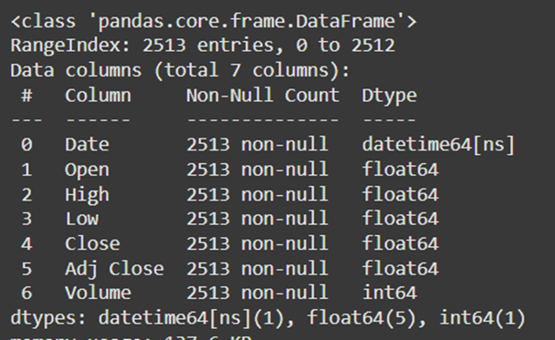
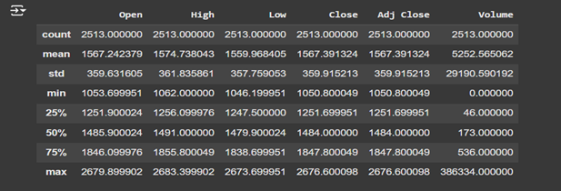
Exploratory Data Analysis
Data Overview
Summary Statistics
Mean and standard deviation of the gold price over the 10-year period.
Minimum and maximum prices indicating the price range within the dataset.
This step helped confirm that most of the data was numerical, except for the Date column, which needed conversion to a datetime object.

Slide 12
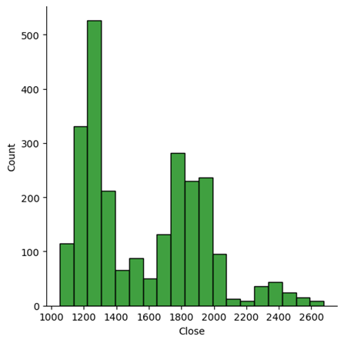
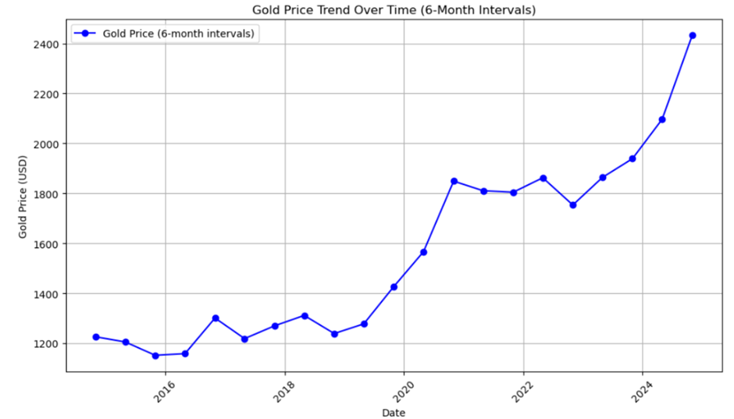
Exploratory Data Analysis
This plot helped assess the spread and skewness of the gold price data.
This line graph shows the gold prices over tha last 10 years with a 6 month interval.

Slide 13

Overfitting
Ridge Regression : Ridge regression adds a penalty term proportional to the square of the coefficients. This discourages the model from having excessively large coefficients, which can lead to overfitting. By controlling the model's complexity, Ridge regression allows it to generalize better, preventing it from becoming too dependent on the training data.
Lasso Regression : Lasso regression penalizes the absolute values of the coefficients, which has the added effect of shrinking some coefficients to zero. This means Lasso can automatically select important features, reducing the feature set and simplifying the model. Lasso helps in preventing overfitting by focusing the model on only the most relevant predictors, effectively reducing model complexity and improving generalization.

Slide 14
Model Evaluation & Validation
Mean Absolute Error (MAE):
Definition: Average magnitude of errors, ignoring direction.
Usage: When interested in the average error size, indifferent to error direction.
Mean Squared Error (MSE):
Definition: Squares errors before averaging, emphasizing larger errors.
Usage: Preferred when larger errors are especially undesirable; less intuitive due to squared units.
Root Mean Squared Error (RMSE):
Definition: Square root of MSE, returning error to the original units.
Usage: Suitable for contexts where large errors are problematic, provides direct magnitude evaluation.
R² Score (Coefficient of Determination):
Definition: Proportion of variance explained by the model (1 = perfect, 0 = none).
Usage: Ideal for assessing how well the model captures data variability.
Mean Absolute Percentage Error (MAPE):
Definition: Error size in percentage terms; useful for scale-independent comparison.
Usage: For percentage-based accuracy, though unreliable if values are near zero.
Notes:
1. **Mean Absolute Error (MAE)**
- **Definition**: The average size of errors, ignoring whether they're positive or negative.
- **Usage**: Use MAE when you only care about the average size of the error and not its direction.
2. **Mean Squared Error (MSE)**
- **Definition**: Squares each error before averaging, which makes large errors stand out more.
- **Usage**: Helpful when large errors are especially undesirable. Note that it’s harder to interpret since the errors are squared.
3. **Root Mean Squared Error (RMSE)**
- **Definition**: The square root of MSE, bringing errors back to the original scale of the data.
- **Usage**: Good for cases where large errors need extra attention. RMSE provides a clear error size on the same scale as the data.
### 4. **R² Score (Coefficient of Determination)**
- **Definition**: Shows how much of the data’s variance the model explains (1 means perfect, 0 means none).
- **Usage**: Ideal for understanding how well the model captures overall data patterns and variability.
### 5. **Mean Absolute Percentage Error (MAPE)**
- **Definition**: Expresses errors as a percentage, useful for comparing across different scales.
- **Usage**: Suitable when you need percentage-based accuracy. Be cautious, though, as it becomes unreliable if values are close to zero.

Slide 15
Machine Learning Models
LSTM
Gold prices are highly dependent on historical trends, meaning that the order and time dependencies of past prices can heavily influence future predictions. LSTMs are well-suited to this kind of problem because they are designed to learn from sequential data, retaining long-term dependencies over time.
Random Forest Regressor
Gold price prediction is influenced by many features, such as historical prices, treasury yields, economic indicators. These variables are not necessarily linear, meaning that more complex models are needed to capture the patterns in the data. This is where Random Forest shines.

Slide 16
Random Forest Regressor
Capturing Feature Interactions: Random Forest captures complex interactions, such as how short- and long-term moving averages (e.g., MA50, MA200) and indicators like RSI influence gold prices. It can also assess how changes in treasury yields impact future prices.
Reducing Overfitting: Uses bootstrapping and ensemble methods to handle market noise, training on random subsets to prevent sensitivity to specific data quirks—key for predicting volatile markets like gold.
Handling High Dimensionality: Effectively manages multiple features, selecting the most predictive indicators (e.g., moving averages, treasury yields) for future price forecasts.
Model Evaluation: By splitting data into training and test sets, Random Forest demonstrated strong predictive power with a solid R² score, accurately capturing trends and reliably forecasting next-day gold prices.

Slide 17
LSTM
Time-Series Dependency: Gold prices depend on historical trends; LSTMs are effective as they learn from sequential data and capture long-term dependencies.
Capturing Time Patterns: LSTM models time-based influences on gold prices, recognizing seasonal and cyclical trends tied to economic factors, geopolitical events, and market sentiment.
Feature Engineering: Engineered features are used in sequences for LSTM to understand how these indicators evolve over time and affect future prices.
Predictive Modeling: LSTM predicts future prices by learning patterns from historical data, helping it to anticipate trends like sudden price drops or gradual rises.
Challenges: Effective use of LSTM requires tuning hyperparameters (e.g., sequence length, learning rate) to capture long-term patterns without overfitting to short-term fluctuations.

Slide 18
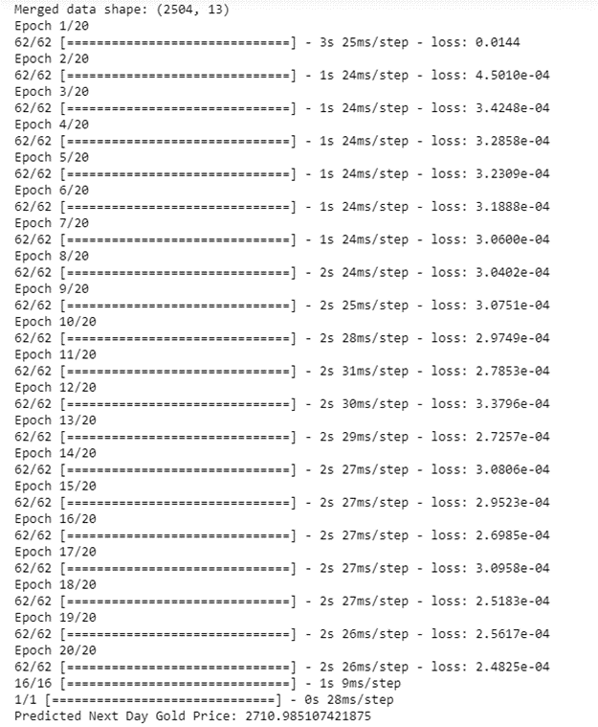
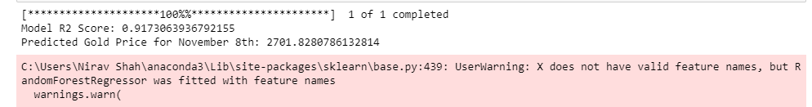
Results

Slide 19
Analysis and Conclusion
In our analysis of gold price prediction, the Random Forest model provided a closer approximation to the actual price of 2691.70 on November 8 compared to the LSTM model. The Random Forest model’s prediction of 2701.83 was more accurate than the LSTM's 2710.99, suggesting that Random Forest better captured the relationships between economic factors and gold prices in our dataset. This result indicates that, for our data and selected features, the Random Forest model is a more effective tool for short-term gold price prediction, offering analysts and investors a reliable method to anticipate market movements with greater accuracy.

Slide 20

Demonstration
This webpage displays the predicted gold price for the next day, powered by a machine learning model running in the background. Built using Streamlit, it provides an easy-to-use interface for viewing forecasted prices based on key economic factors.

Slide 21
Future Work
Future work could involve creating hybrid models that merge the clear interpretability of Random Forest with the ability of LSTM to recognize patterns over time. By combining these methods, we can capture complex, time-based relationships while also understanding which economic factors impact gold prices the most. Additional refinements might include using more financial indicators—like exchange rates, oil prices, or central bank policies—and incorporating sentiment analysis from financial news and social media. This approach could improve the accuracy and stability of predictions, helping investors and policymakers make more confident, well-informed decisions amidst economic fluctuations.

Slide 22
Breiman, L. & Statistics Department, University of California. (2001). Random forests. In Random Forests (p. 4). https://www.stat.berkeley.edu/~breiman/randomforest2001.pdf
Tang, Q., Fan, T., Shi, R., Huang, J., & Ma, Y. (2021, March 5). Prediction of financial time series using LSTM and data denoising methods. arXiv.org. https://arxiv.org/abs/2103.03505
Davis, J. (2024, September 5). How to build LSTM models for time series prediction in Python. Statology. https://www.statology.org/how-to-build-lstm-models-for-time-series-prediction-in-python/
The future trajectory of gold prices (2024-2026): navigating economic and geopolitical crossroads. (2023, December 28). Kitco News. https://www.kitco.com/opinion/2023-12-28/future-trajectory-gold-prices-2024-2026-navigating-economic-and-geopolitical
Baur, D. G., & Lucey, B. M. (2009). Is Gold a Hedge or a Safe Haven? an Analysis of Stocks, Bonds and Gold. SSRN Electronic Journal. https://doi.org/10.2139/ssrn.952289
Zhang, C., Sjarif, N. N. A., & Ibrahim, R. (2023b). Deep learning models for price forecasting of financial time series: A review of recent advancements: 2020–2022. Wiley Interdisciplinary Reviews Data Mining and Knowledge Discovery, 14(1). https://doi.org/10.1002/widm.1519
https://finance.yahoo.com/quote/GC%3DF/
https://fred.stlouisfed.org/series/T10YIE
https://data.worldbank.org/indicator/NY.GDP.MKTP.CD
https://finance.yahoo.com/markets/bonds/
References

Slide 23
Thank you!
Do you have any questions?

