Slide 1

FocusLearn AI
AI-Enforced Learning Platform
Attention, Enforced. Retention.
Computer Vision · Local LLM Reasoning · Real-Time Accountability
FOCUSLEARN AI
1

Slide 2




The Problem
Online learning is fundamentally broken.
Tab-Switching & Phones
Very low course completion rate for passive video learning
Students open a second screen within the first 90 seconds of playback.
Silent Disengagement
Video keeps running while attention drops to zero — no system notices.
Zero accountability once the play button is hit
No Real Retention
Content is 'watched,' not learned. Quizzes and certificates mean little.
FOCUSLEARN AI
2

Slide 3


Our Solution
Active, AI-enforced learning.
We turn passive videos into interactive classrooms that force you to pay attention.
Perceive
Decide
Enforce
Computer vision continuously verifies the student is watching — in real time, entirely in-browser.
A local LLM reasons over the transcript to detect gaps in comprehension, not just gaps in attention.
The platform intervenes automatically — pausing, quizzing, or restarting until mastery is proven.
FOCUSLEARN AI
3

Slide 4


Feature 01
Real-Time Attention Tracking
Webcam-based monitoring powered by TensorFlow.js (BlazeFace)
Tracks gaze direction, face presence, and focus continuity while the video plays.
Distraction detected → video auto-pauses instantly and issues an on-screen warning.
No footage ever leaves the browser: private, low-latency, zero server load.
TRACKING
Focus Confirmed — Playback Continuing
Live confidence: 96%
FOCUSLEARN AI
4

Slide 5


Feature 02
Adaptive Accountability Quizzes
Zone out, and the AI immediately tests what you missed.
1
2
3
4
→
→
→
Attention Check Failed
Ollama (Llama 3) Triggered
Custom Quiz Generated
< 60% → Forced Restart
Computer vision flags disengagement mid-video.
Django backend sends the transcript to the local LLM.
Instant multiple-choice questions on exactly what was missed.
Score below threshold restarts the video from the top.
FOCUSLEARN AI
5

Slide 6

Feature 03
AI Video Chatbot — Your Personal Tutor
Chat panel sits beside the video — ask anything, anytime, without pausing your flow.
Powered entirely by a locally-hosted LLM (Ollama + Llama 3) — no third-party API calls.
Fully contextual: understands the exact transcript segment you're currently watching.
Answers instantly, cites the relevant moment in the video, and never leaves your data.
FocusLearn Tutor
Why did the algorithm use recursion here instead of a loop?
At 04:32 the instructor explains recursion mirrors the problem's self-similar structure, reducing state-tracking overhead versus an iterative loop.
Ask a question about this video...
FOCUSLEARN AI
6

Slide 7

Feature 04
Automated Smart Notes
AI auto-generates time-stamped notes as the video plays — no manual transcription.
Key concepts, definitions, and summaries extracted automatically by the local LLM.
Every note links back to its exact video timestamp for one-click review.
Exportable to PDF or Markdown — saves students hours per course module.
Auto-Generated Notes
00:42
Introduction to gradient descent and the loss surface.
04:15
Learning rate trade-offs: convergence speed vs. stability.
09:03
Key concept: local minima vs. global minima.
13:47
Summary: three practical tuning strategies.
FOCUSLEARN AI
7

Slide 8




Tech Stack & Architecture
Modern, modular, and built for secure, intelligent processing.
Frontend
Client-Side Vision
Backend
AI Engine
React.js (Vite)
TensorFlow.js — BlazeFace
Python · Django · DRF
Ollama (Llama 3)
CSS Modules for a sleek, componentized UI
Real-time in-browser attention detection
Secure API layer and session orchestration
Local LLM — transcripts, quizzes, chatbot
100% local AI inference — transcripts and student data never touch a third-party API.
FOCUSLEARN AI
8

Slide 9




Target Audience & Market
Anywhere guaranteed watch-time and verified comprehension matter.
Students with ADHD
Coding Bootcamps
Structured, enforced focus intervals replace unstructured, easy-to-abandon video.
Verified engagement on dense technical material, module by module.
Corporate Compliance Training
Online Universities
Auditable proof that employees actually absorbed required material.
Guaranteed watch-time and integrity for accredited, at-scale course delivery.
FOCUSLEARN AI
9

Slide 10

The Future of Accountable Learning
FocusLearn AI doesn't just deliver video — it guarantees the learning actually happens.
Roadmap: What's Next
The Impact
Eye-Tracking Heatmaps
Granular visual attention maps across every frame of content.
Turns passive completion rates into active, verified mastery.
Gives institutions defensible proof of engagement, not just play counts.
Built on a private, local-AI stack — no data leaves the platform.
A single interactive layer works on any imported video, at scale.
Emotion Detection
Sentiment-aware AI that senses confusion or frustration in real time.
Instructor Analytics Dashboard
Cohort-wide engagement and comprehension reporting for educators.
FOCUSLEARN AI
10

Slide 11
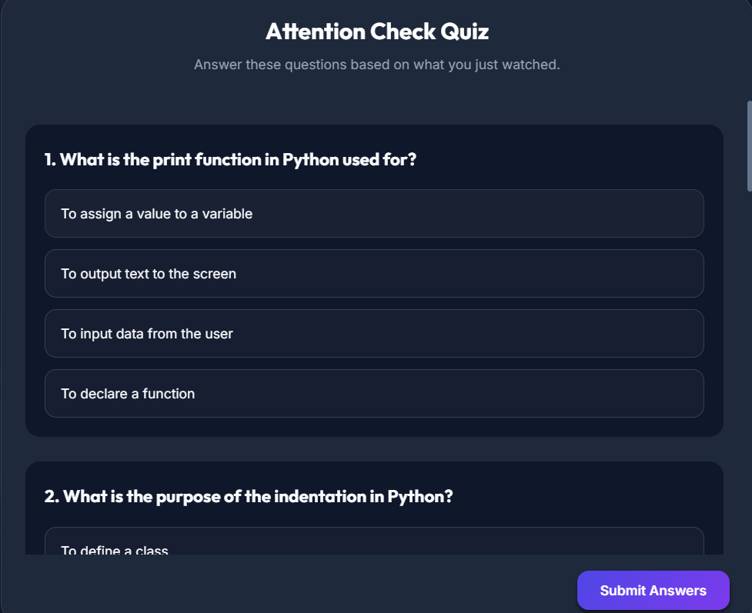

Slide 12
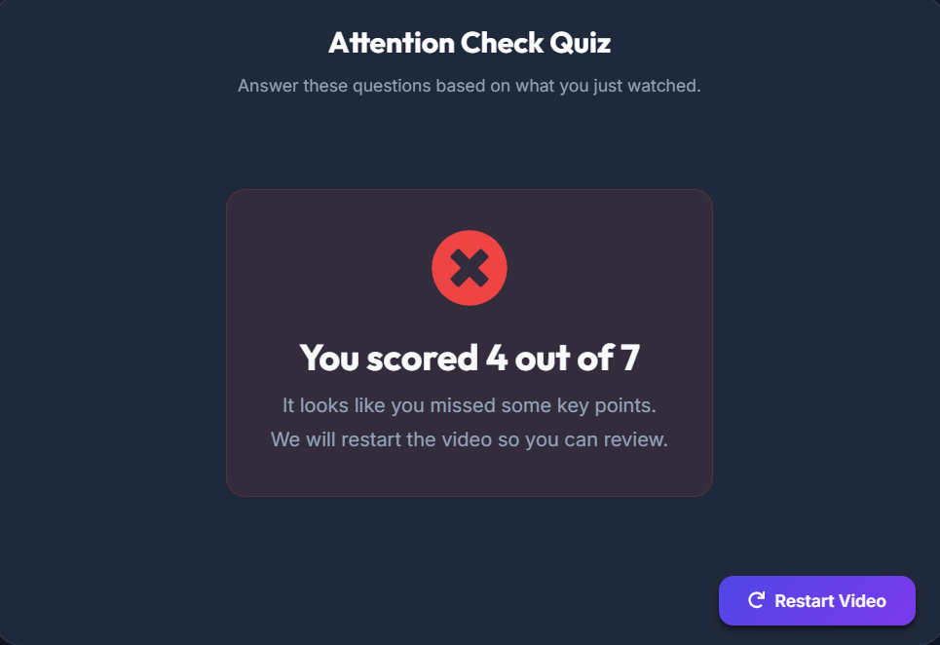

Slide 13
