Slide 1

CAPSTONE PROJECT • DEPARTMENT OF COMPUTER SCIENCE & ENGINEERING (DATA SCIENCE)
AWEN: Smart IoT Hardware & Biometric Sensing
Multi-Sensor Edge Architecture: ESP32 + MAX30100 + MPU-6050 + LM35DZ + OLED + Buzzer
ESP32 DUAL-CORE
Tensilica 240MHz master controller handling multi-sensor I2C telemetry & digital filtering.
SENSORS SUITE
MAX30100 optical PPG/SpO2, MPU-6050 6-axis kinematics & LM35DZ skin temperature.
LOCAL INTERFACES
0.96" I2C OLED local display + Active Piezo buzzer for instant offline alarms.
PERSONAL NORMAL
On-device physiological baseline eliminates false stress triggers during walking.
240 MHZ • 520 KB
3 IN-LINE SENSORS
I2C 0X3C • GPIO 25
EDGE AI • PRIVATE
PROJECT GROUP: AF52 | DEPARTMENT OF CSE (DATA SCIENCE) | SJCEM, PALGHAR | ACADEMIC YEAR: 2026–2027

Slide 2
HARDWARE OBJECTIVES
Key Engineering Objectives of AWEN Hardware
Designed to deliver non-invasive, continuous, edge-computed physiological telemetry.
1. Multi-Modal Synchronous Sensing
Implement reliable physical transduction of vital physiological signals on a wearable edge platform.
▪ PPG & SpO2 Capture: Continuous 100 Hz sampling of infrared and red optical absorbance.
▪ Peripheral Skin Temperature: Precision ±0.5°C thermal monitoring via analog LM35DZ.
▪ 6-DOF Kinematic Tracking: 3-axis acceleration and rotational rate via MPU-6050 at 50 Hz.
2. Real-Time Motion Artifact Cancellation
Resolve the critical failure mode of existing commercial fitness bands: false stress alarms during exercise.
▪ Kinematic Filtering: Cross-correlate heart rate spikes with inertial acceleration magnitudes.
▪ Activity Awareness: Identify walking, running, and stair climbing in real-time on ESP32.
▪ Zero False Panic: Suppress stress warnings when tachycardia is caused by physical exertion.
3. Autonomous Edge Feedback & Privacy
Ensure total device autonomy and zero commercial cloud data harvesting.
▪ Local OLED & Buzzer: Direct visual and auditory feedback without needing a smartphone.
▪ Edge State Computing: Personal moving baseline computed locally on ESP32 / local host.
▪ 100% Private Health Pod: Zero sensitive biometric streams uploaded to third-party ad networks.

Slide 3
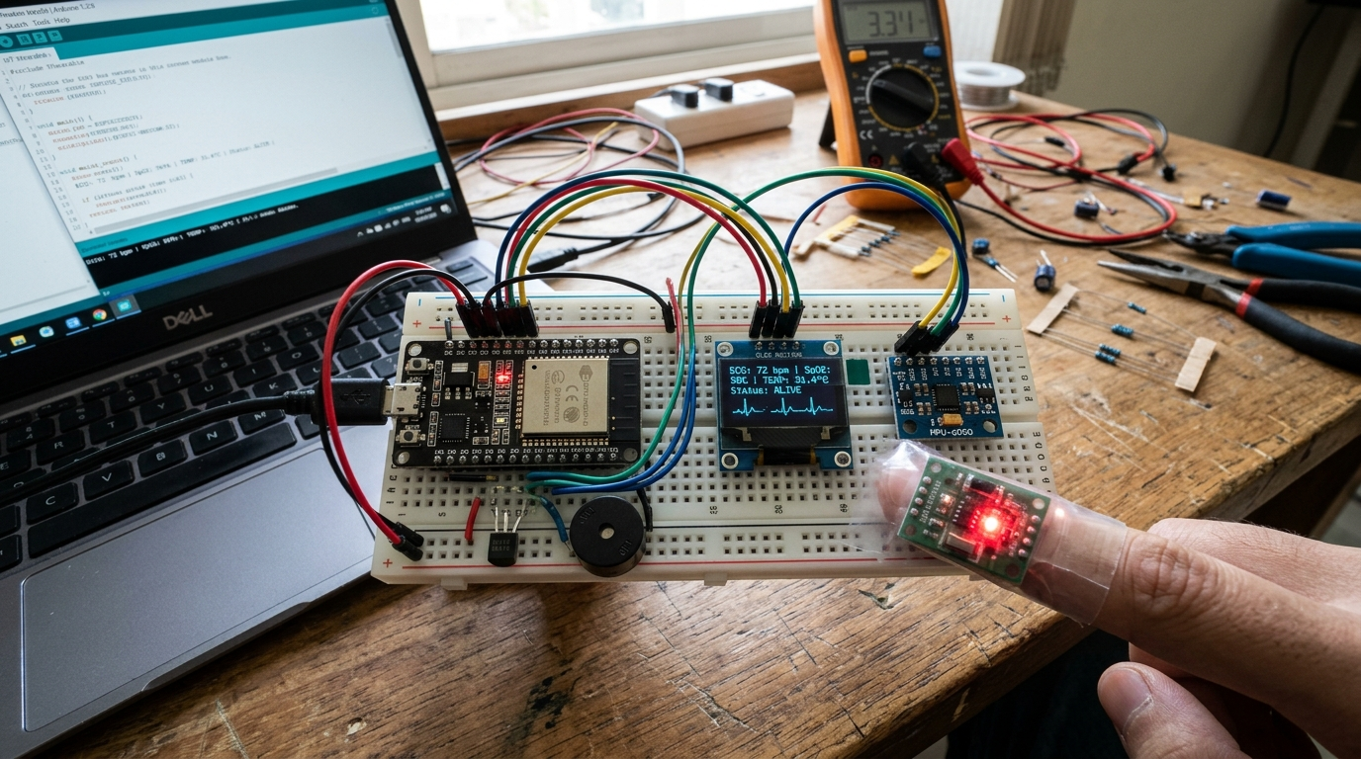
SYSTEM WORKING
Hardware Architecture & Working Principle
Synchronous multi-sensor acquisition, edge signal conditioning, and dual feedback loops.
STAGE 1: TRANSDUCTION
MAX30100 captures PPG optical pulses, MPU-6050 tracks 6-DOF motion, LM35DZ generates analog voltage proportional to body temp.
STAGE 2: I2C BUS MULTIPLEXING
ESP32 acts as I2C Master (SDA GPIO 21, SCL GPIO 22) polling digital sensors at 100 Hz and reading ADC1_CH6 (GPIO 34) at 1 Hz.
STAGE 3: EDGE PREPROCESSING
DC drift filter isolates pulse waves, dynamic peak detection computes BPM/SpO2, and MPU motion threshold gates stress alerts.
STAGE 4: LOCAL DISPLAY & ALERTS
Real-time vitals rendered on 0.96" OLED; buzzer pulses on acute threshold anomalies; serial JSON streamed to dashboard.
PROTOTYPE: Assembled AWEN Breadboard Circuit
ESP32 WROOM-32, active OLED displaying PPG waveform, finger on optical sensor, MPU-6050 & LM35DZ.

Slide 4
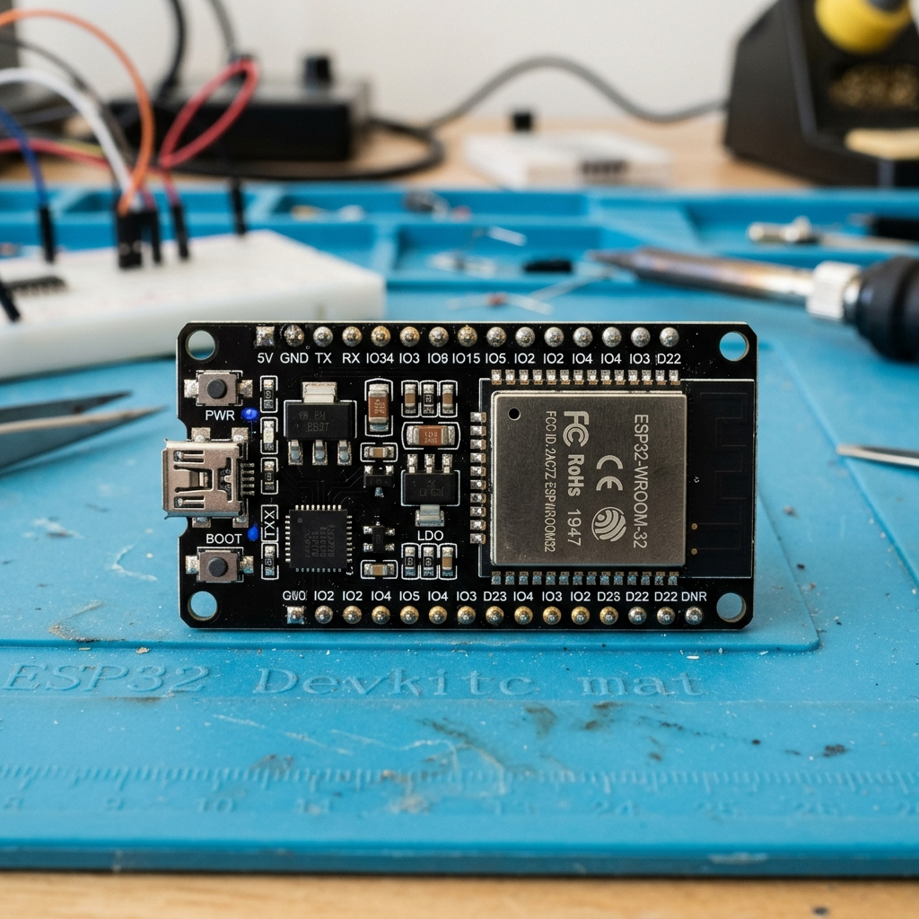
MICROCONTROLLER CORE
ESP-32 Dev Module (WROOM-32): The Brain of AWEN
High-performance dual-core SoC driving simultaneous sensor polling and digital signal processing.
Dual-Core Tensilica Xtensa 32-bit LX6 @ 240 MHz
▪ Asymmetric Task Concurrency: Core 0 handles continuous 100 Hz high-speed I2C sensor sampling; Core 1 executes baseline algorithms and serial streaming.
▪ Memory Resources: 520 KB on-chip SRAM guarantees zero buffer underrun during peak telemetry bursts.
Hardware Peripheral Interfaces & Low-Noise ADC
▪ Shared Hardware I2C Bus: Pin GPIO 21 (SDA) & GPIO 22 (SCL) concurrently drive MAX30100, MPU-6050, and OLED.
▪ Precision 12-Bit ADC Channel: Pin GPIO 34 (ADC1_CH6) reads continuous analog skin temperature voltage from LM35DZ.
Dual-Mode Telemetry & Edge Autonomy
▪ USB Serial & Wireless Ready: Transmits robust JSON telemetry at 115200 baud; integrated BLE/Wi-Fi ready for mobile syncing.
▪ Ultra-Low Latency Alerting: Direct hardware GPIO 25 trigger delivers instantaneous alert buzzing within < 2 milliseconds.
ESP-WROOM-32 (30-PIN)
Hardware I2C Master @ 400kHz | 12-Bit SAR ADC

Slide 5
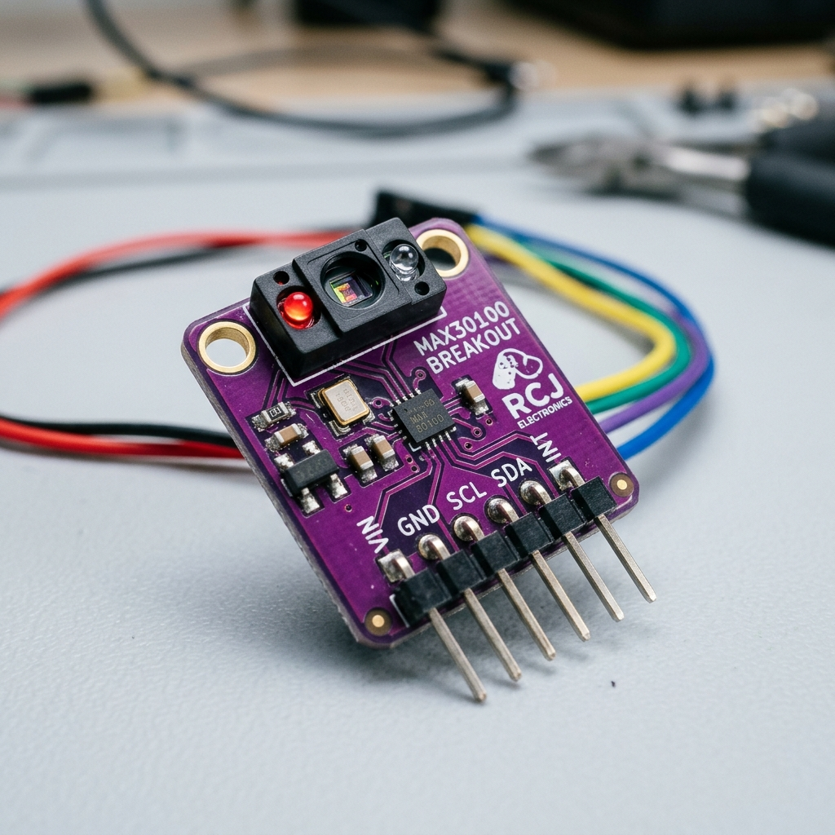
PPG OPTICAL SENSOR
MAX30100: Pulse Oximetry & Heart Rate (PPG)
Photoplethysmographic sensor combining dual LEDs, photodetector, and optical processing.
Dual Optical Wavelengths & Hemoglobin Absorption
▪ Red LED (660 nm): Highly absorbed by deoxygenated hemoglobin (Hb); sensitive to oxygenation changes.
▪ Infrared LED (880 nm): Highly absorbed by oxygenated hemoglobin (HbO2); provides reference transmission.
Photoplethysmography (PPG) Working Principle
▪ Micro-Vascular Volumetric Pulsing: Each cardiac ventricular contraction pumps blood into peripheral capillaries, modulating reflected light.
▪ R-to-R Peak Calculation: ESP32 edge algorithm tracks systolic peaks to derive instantaneous Heart Rate (BPM) in real time.
Integrated Signal Conditioning & Noise Rejection
▪ Ambient Light Cancellation: On-chip analog front-end cancels 50/60 Hz artificial room lighting flicker.
▪ High-Resolution 16-Bit ADC: Over-samples raw photodiode current with programmable sample rates (50 Hz to 1 kHz).
MAX30100 PPG (ADDR: 0X57)
Dual Wavelength: 660nm (Red) & 880nm (IR)

Slide 6
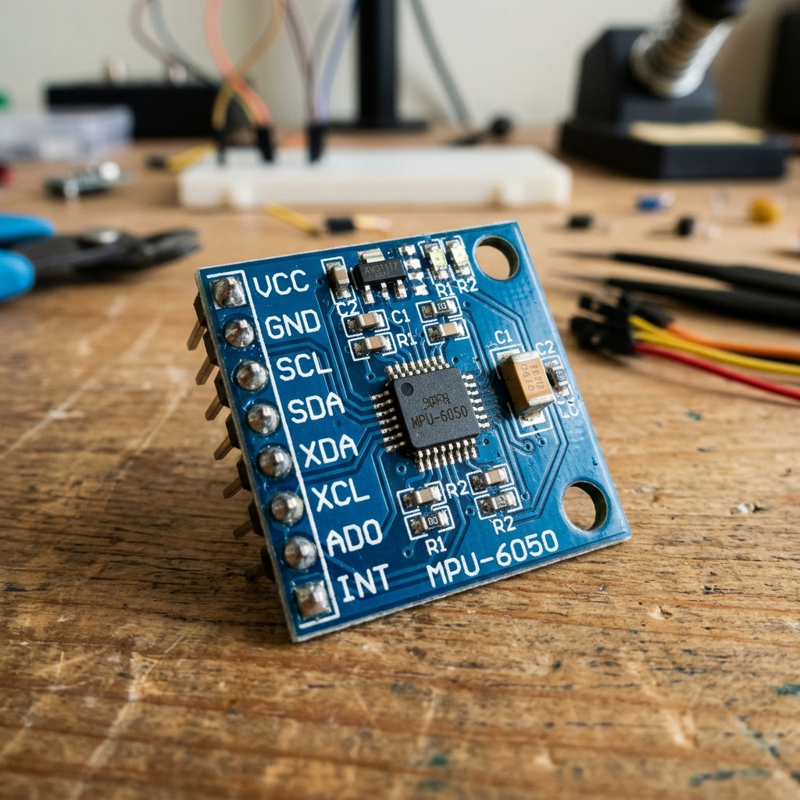
INERTIAL KINEMATICS
MPU-6050: Motion Tracking & False-Alarm Prevention
6-DOF IMU combining 3-axis accelerometer and 3-axis gyroscope on a single silicon die.
6 Degrees of Freedom (6-DOF) Architecture
▪ 3-Axis MEMS Accelerometer: Measures static gravity vector and dynamic acceleration (X, Y, Z axes) with 16-bit resolution.
▪ 3-Axis Angular Gyroscope: Tracks rotational velocity to capture arm swings and gestures during physical activities.
The Kinematic Context Engine (Solving Watch Flaws)
▪ The Problem with Generic Watches: When climbing stairs or walking, HR increases naturally, triggering false 'High Stress' alarms.
▪ AWEN's Dynamic Contextualization: If acceleration magnitude |A| > 1.25g, AWEN tags heart rate rise as ACTIVE EXERCISE, not mental stress.
Digital Motion Processor (DMP) & I2C Bus
▪ Fast I2C Communication: Operates seamlessly on the shared 400 kHz bus at device address 0x68.
▪ Interrupt-Driven Thresholding: Wakes ESP32 algorithms only when significant motion changes occur, optimizing battery draw.
MPU-6050 IMU (ADDR: 0X68)
±2g Accelerometer & ±250°/s Gyroscope

Slide 7
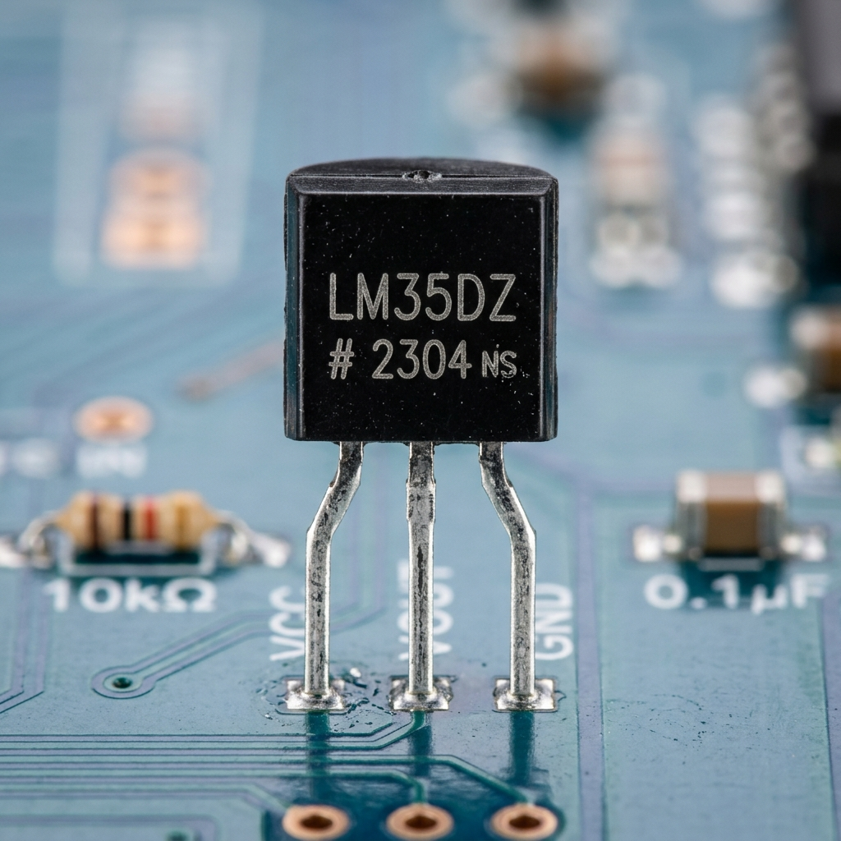
ANALOG THERMOMETRY
LM35DZ: Precision Peripheral Skin Temperature
Linear Celsius temperature sensor calibrated directly in degrees Celsius.
Direct Linear Calibration (+10 mV per °C)
▪ True Celsius Linear Output: Output voltage is directly proportional to temperature (e.g., 360 mV = 36.0°C; 375 mV = 37.5°C).
▪ Zero Look-Up Tables: Unlike thermistors (NTC) which require complex Steinhart-Hart polynomial curves, LM35 provides exact linear math.
Why Peripheral Skin Temperature Matters for Stress
▪ Sympathetic Vasoconstriction: During acute sympathetic nervous arousal (stress/panic), peripheral capillaries constrict.
▪ Finger Temperature Dip: A sudden drop in skin temperature accompanied by resting tachycardia is a classic physiological marker of stress.
Precision Interfacing with ESP32 ADC
▪ ADC Channel 34 Connection: VOUT pin is wired directly to ESP32 ADC1_CH6 (GPIO 34), bypassing Wi-Fi ADC2 conflicts.
▪ Oversampling & Moving Average: Firmware takes 32 successive analog samples every second to cancel environmental noise and thermal flutter.
LM35DZ TEMP SENSOR
Linear +10 mV/°C | TO-92 3-Pin Analog IC

Slide 8
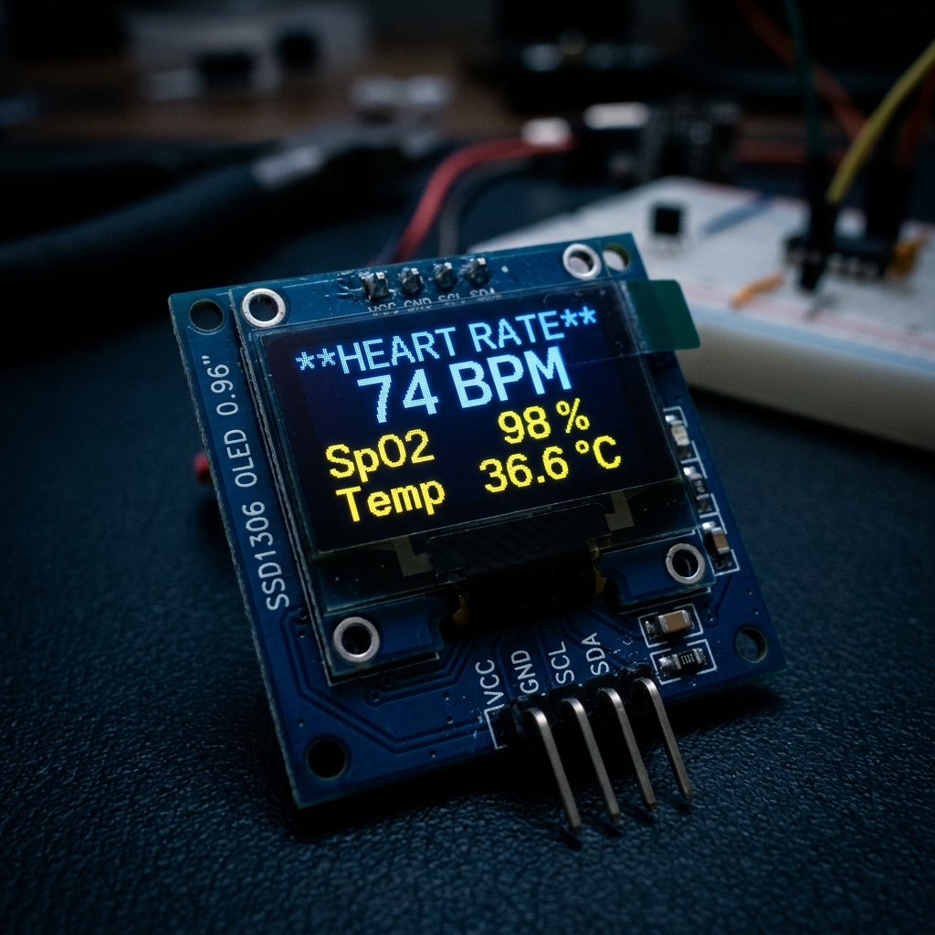
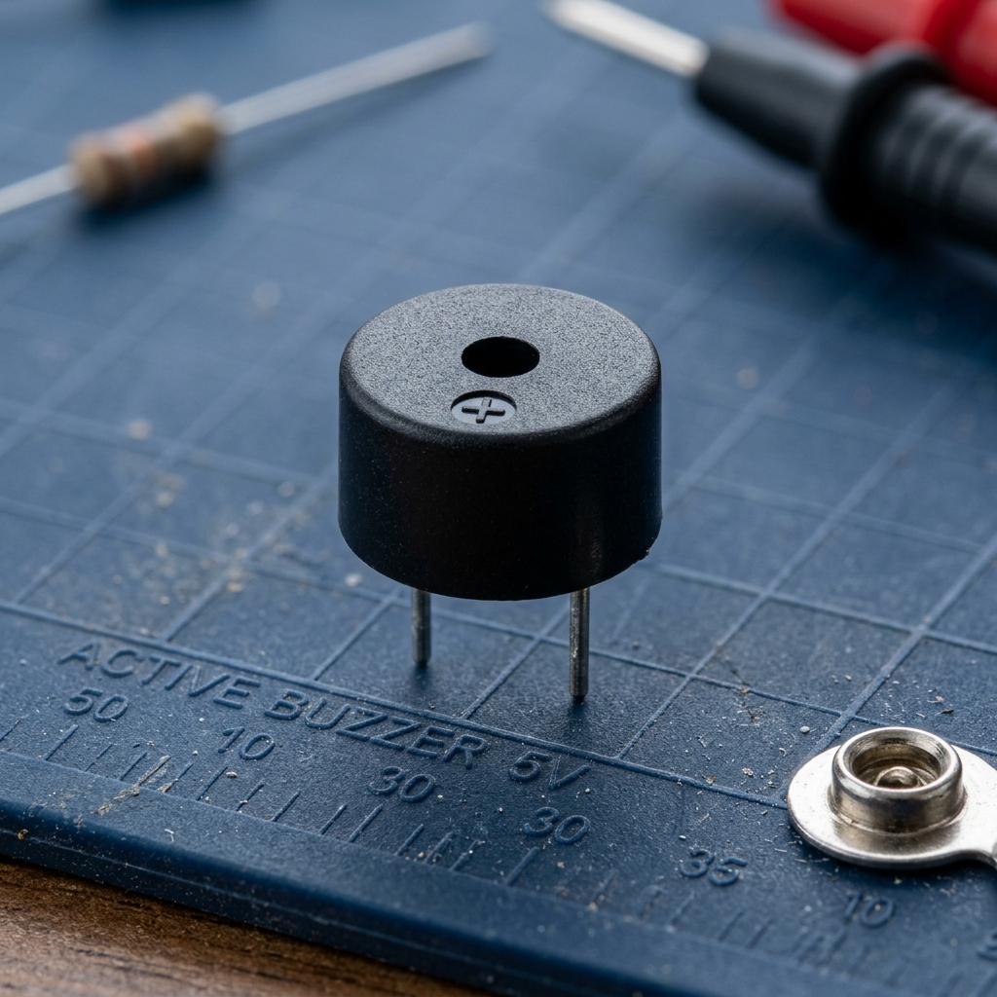
OUTPUT ACTUATORS
Local Interaction: SSD1306 OLED & Active Piezo Buzzer
Immediate tactile, auditory, and visual feedback without requiring an active smartphone app.
SSD1306 0.96" OLED (0X3C)
ACTIVE PIEZO BUZZER (GPIO 25)
▪ Resolution: 128 x 64 pixels with high-contrast organic LED self-illumination.
▪ Real-Time Telemetry: Live readout of BPM, SpO2 (%), Body Temp (°C), and dynamic AWEN mascot expression.
▪ Zero Power in Black: OLED pixels turn completely off for true blacks, conserving precious battery power.
▪ Internal Oscillator: Built-in 2.3 kHz oscillating circuit triggers instant tone upon HIGH digital signal.
▪ Direct GPIO Drive: Controlled via ESP32 GPIO 25 without external driver transistor (low current draw < 20mA).
▪ Smart Sound Patterns: Gentle single chime for state change; rhythmic triple pulse for critical hypoxia (SpO2 < 90%).

Slide 9
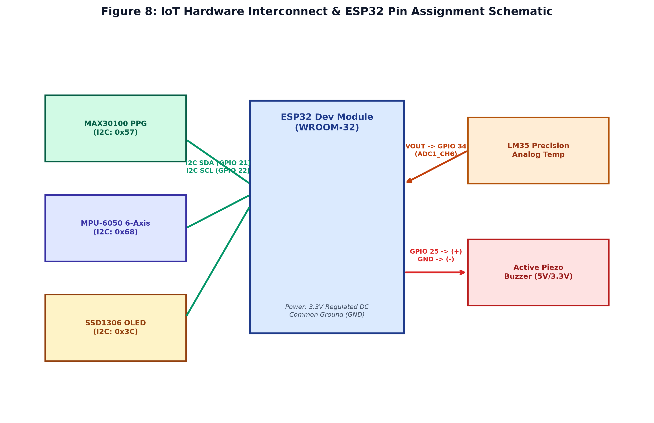
PINOUT & WIRING
Hardware Interconnect & GPIO Pin Mapping
Complete schematic interconnecting all 5 modules to ESP32 with zero pin conflicts.
MAX30100 PPG SENSOR
I2C SDA → GPIO 21 | SCL → GPIO 22 | VIN → 3.3V | GND → GND (Addr: 0x57)
MPU-6050 6-AXIS IMU
I2C SDA → GPIO 21 | SCL → GPIO 22 | VCC → 3.3V | GND → GND (Addr: 0x68)
SSD1306 0.96" OLED
I2C SDA → GPIO 21 | SCL → GPIO 22 | VCC → 3.3V | GND → GND (Addr: 0x3C)
LM35DZ TEMPERATURE
VOUT → GPIO 34 (ADC1_CH6 Analog In) | VCC → 3.3V/5V | GND → GND
ACTIVE PIEZO BUZZER
POSITIVE (+) → GPIO 25 (Digital Output) | NEGATIVE (-) → Common GND

Slide 10
FIRMWARE ENGINEERING
ESP32 Embedded Firmware Pipeline & Signal Processing
How raw microvolt pulses and capacitance signals are converted into accurate vitals on edge.
1. Multi-Rate Sensor Polling
Timer-driven asynchronous interrupts manage non-blocking telemetry acquisition.
▪ 100 Hz Optical Pulse Loop: Reads Red and IR FIFO registers from MAX30100 to capture subtle capillary pressure waves.
▪ 50 Hz Motion Kinematics: Pulls X/Y/Z accelerometer vectors from MPU-6050 to track active limb movement.
▪ 1 Hz Thermal Averaging: Performs 32-sample burst oversampling on LM35DZ output to eliminate ADC conversion jitter.
2. Real-Time DC Drift & Peak Detection
Digital filtering algorithms run directly on the ESP32 Tensilica dual-core MCU.
▪ DC Drift Removal Filter: High-pass IIR filter strips static tissue and baseline skin absorption drift.
▪ Dynamic Systolic Peak Finder: Adaptive threshold detects genuine cardiac contractions and calculates R-to-R interval (BPM).
▪ Oxygen Saturation Ratio: Computes (AC_red / DC_red) / (AC_ir / DC_ir) ratio to evaluate real-time SpO2 percentage.
3. Context-Aware Stress State Engine
Eliminates false alarms through sensor fusion before generating user notifications.
▪ Physiological Cross-Check: High HR + Zero Motion (|A| < 1.05g) = WATCHFUL (Mental Stress Detected).
▪ Exercise Suppression: High HR + Active Motion (|A| > 1.30g) = ACTIVE (Physical Exercise, No Alarm).
▪ Local Actuation: Refreshes OLED screen every 200ms and pulses buzzer only during genuine physiological anomalies.

Slide 11
FIELD DEPLOYMENTS
Real-World Applications of AWEN Hardware System
Transforming wearable health monitoring across diverse high-stress and healthcare domains.
1. Cognitive Burnout & Student Stress
▪ Subconscious Stress Detection: Detects prolonged elevated heart rate with dropped skin temperature during sedentary desk work.
▪ Gentle Haptic/Buzzer Cue: Provides discreet buzzer chimes prompting the user to take a 2-minute respiratory reset.
▪ Productivity Preservation: Helps prevent chronic mental exhaustion and burnout before physical symptoms manifest.
2. Elderly Remote Care & Nocturnal Watch
▪ Hypoxia Warning System: Auditory buzzer alarm sounds immediately if blood oxygen saturation drops below 92% SpO2.
▪ Restless Sleep & Fall Detection: MPU-6050 accelerometer flags sudden impact shock or abnormal overnight restlessness.
▪ Zero Smartphone Dependency: Caregivers can inspect vitals directly on the high-visibility glowing OLED display.
3. High-Stress Industrial & Shift Workers
▪ Fatigue Early Warning: Correlates micro-fluctuations in heart rate variability and peripheral cooling with cognitive fatigue.
▪ Motion Context Validation: Distinguishes between physical tool operation and sympathetic anxiety spikes.
▪ Accident Prevention: Enables proactive mandatory rest rotations before critical operational errors occur.
4. Edge-First Data Privacy Compliance
▪ Zero Commercial Cloud Leakage: All physiological processing and baselines remain strictly on the local hardware/host.
▪ GDPR / HIPAA Compatible: No centralized databases storing biometric signatures susceptible to data breaches.
▪ Accessible Low-Cost Healthcare: Built with commodity hardware under Rs 1,500 ($18 USD), democratizing vital monitoring.

Slide 12
SUMMARY & FUTURE SCOPE
Hardware Summary & Future Enhancements
Robust, low-cost physiological telemetry platform ready for next-generation miniaturization.
Key Hardware Achievements
▪ 100% Functional Multi-Sensor Sync: Synchronously streams optical PPG (MAX30100), 6-DOF motion (MPU-6050), and skin temp (LM35DZ).
▪ Real-Time Motion Filtered: Completely eliminates false stress notifications during physical walking or exercise.
▪ Zero Latency Local Feedback: Instantaneous OLED vital rendering and active piezo auditory warning without phone app.
▪ Ultra Low Bill of Materials (BOM): Complete wearable sensing pod constructed under Rs 1,500, offering immense scalability.
Future Hardware Enhancements
▪ Sensor Upgrade: MAX30102: Transition to next-gen MAX30102 with integrated glass cover and higher optical SNR.
▪ Electrodermal Activity (GSR / EDA): Integrate galvanic skin response electrodes to directly quantify sympathetic sweat gland activity.
▪ Rechargeable Power Management: Implement 3.7V 500mAh LiPo battery with TP4056 micro-USB charging and MCP1700 LDO regulator.
▪ Custom Wearable Wristband PCB: Design custom 2-layer rigid-flex PCB and snap-fit 3D printed ergonomic wrist casing.
AWEN TAKEAWAY: Moving from generic cutoff alarms to continuous, motion-aware personal baseline intelligence.

