Slide 1
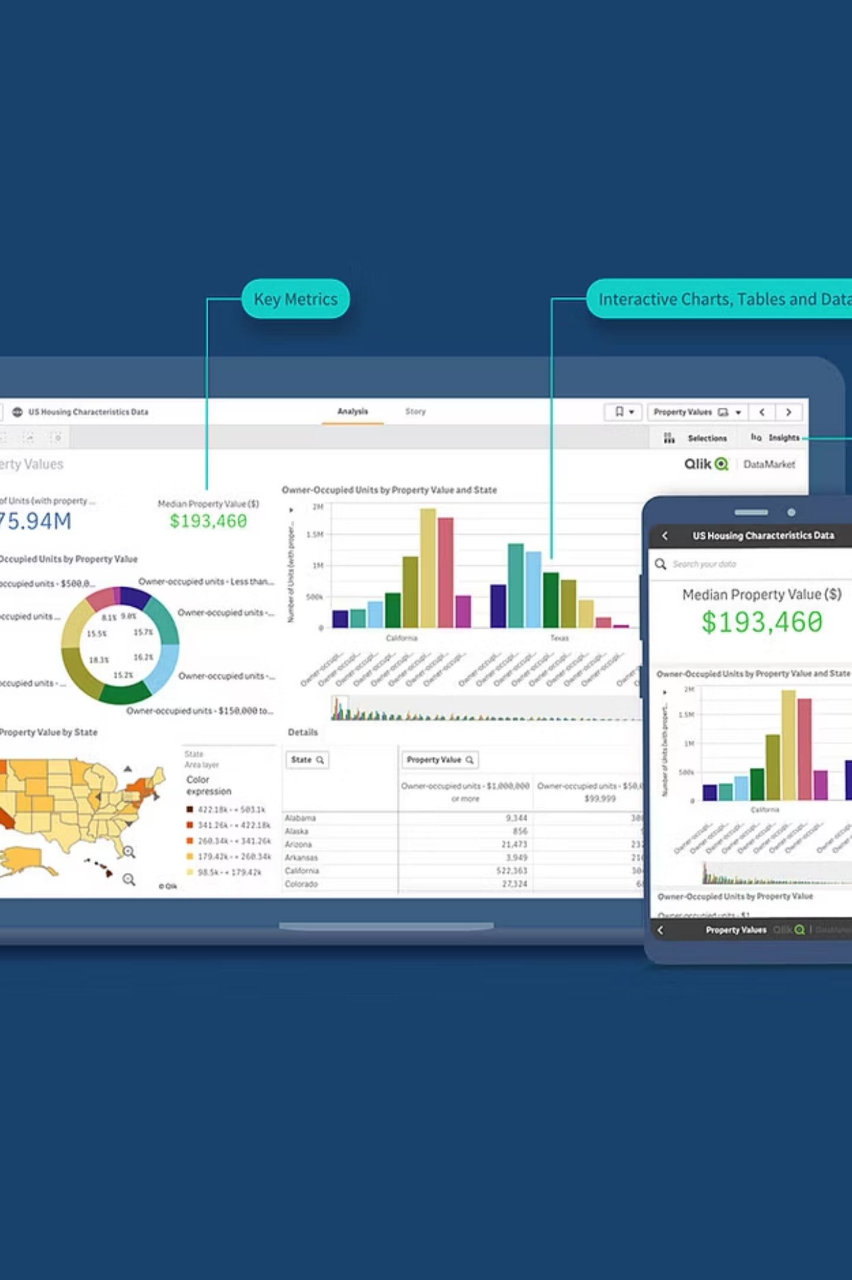
Customer Shopping Behavior Analysis
3,900 transactions · 18 features · 4 product categories

Slide 2

Dataset at a Glance
3,900
Transactions
18
Features
37
Missing Values
Review Rating only
$59.76
Avg Purchase

Slide 3
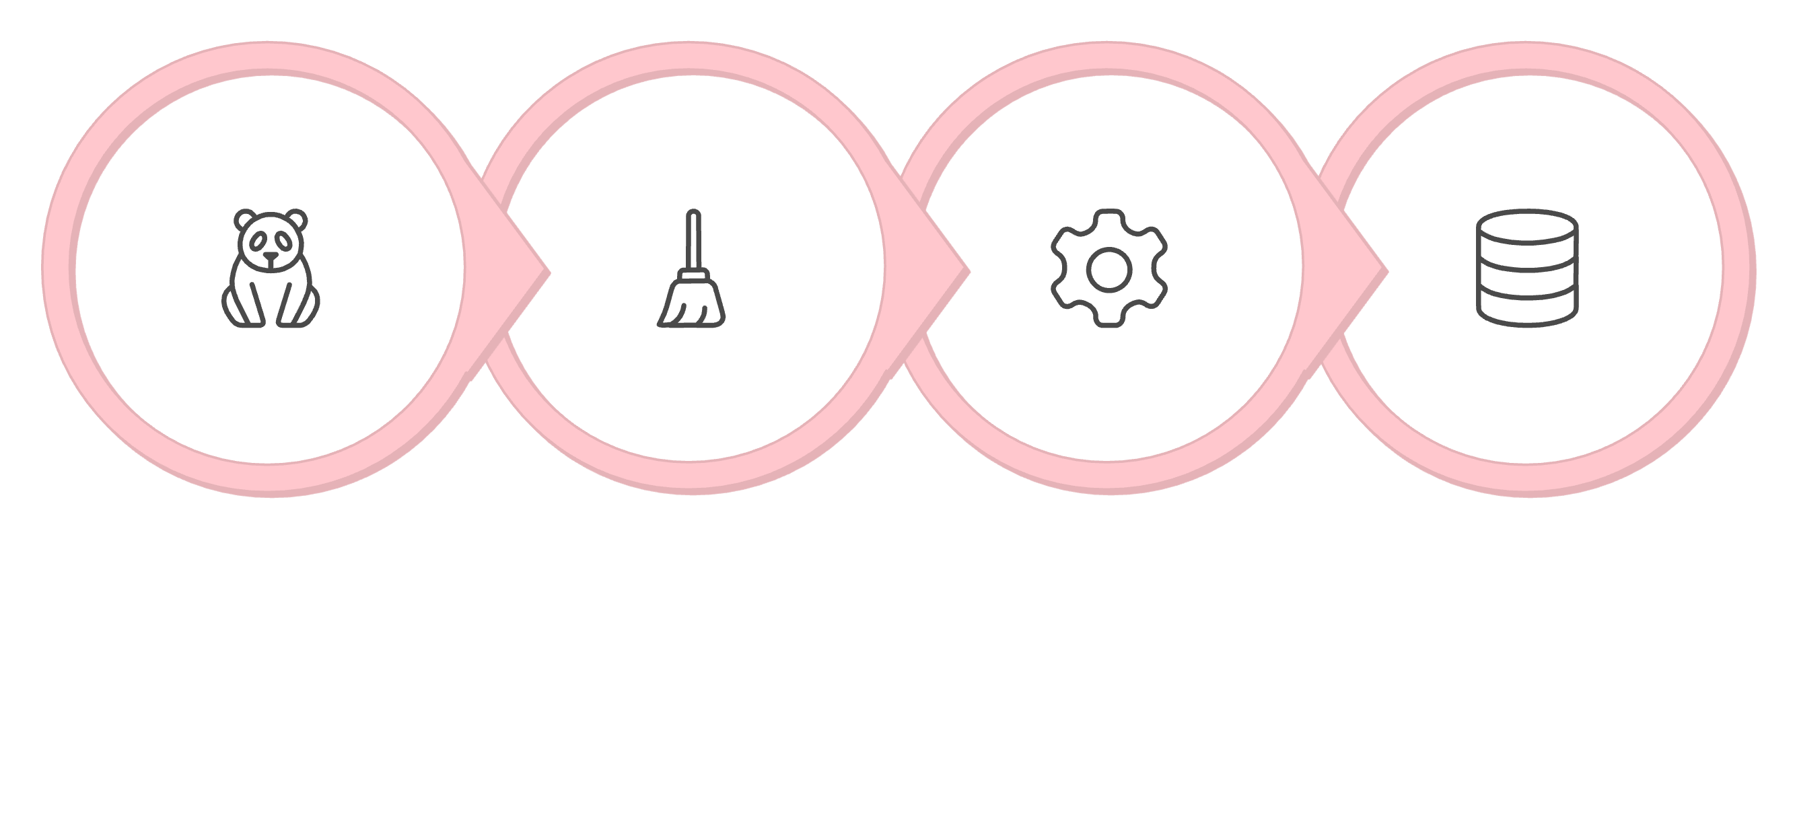
Data Preparation Pipeline
Load & Explore
Clean & Impute
Engineer Features
Load to PostgreSQL
Columns standardized to snake_case; promo_code_used dropped as redundant with discount_applied.

Slide 4
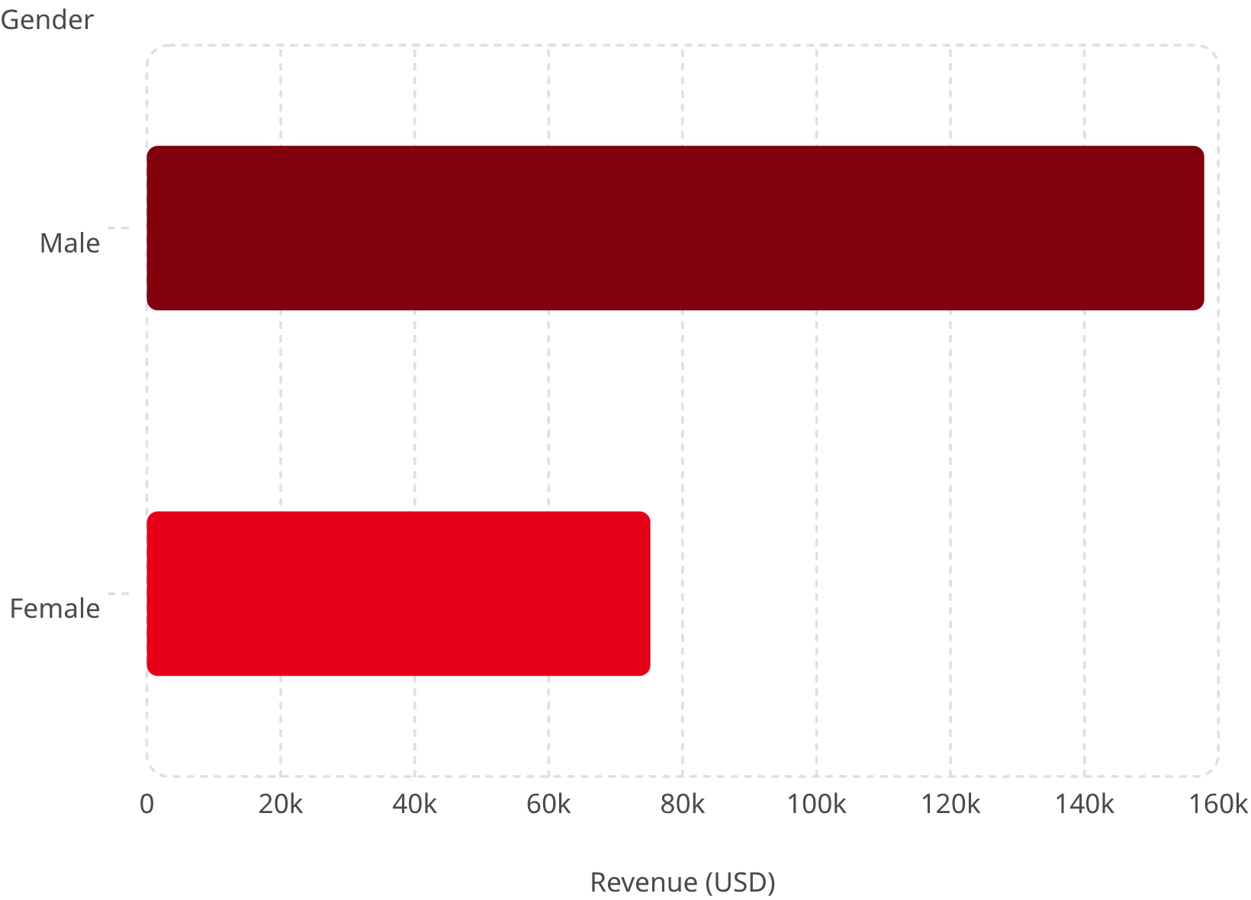
Revenue by Gender
Male Customers Drive 2× Revenue
Male customers generated $157,890 vs. $75,191 for females — a critical segment gap to investigate.

Slide 5
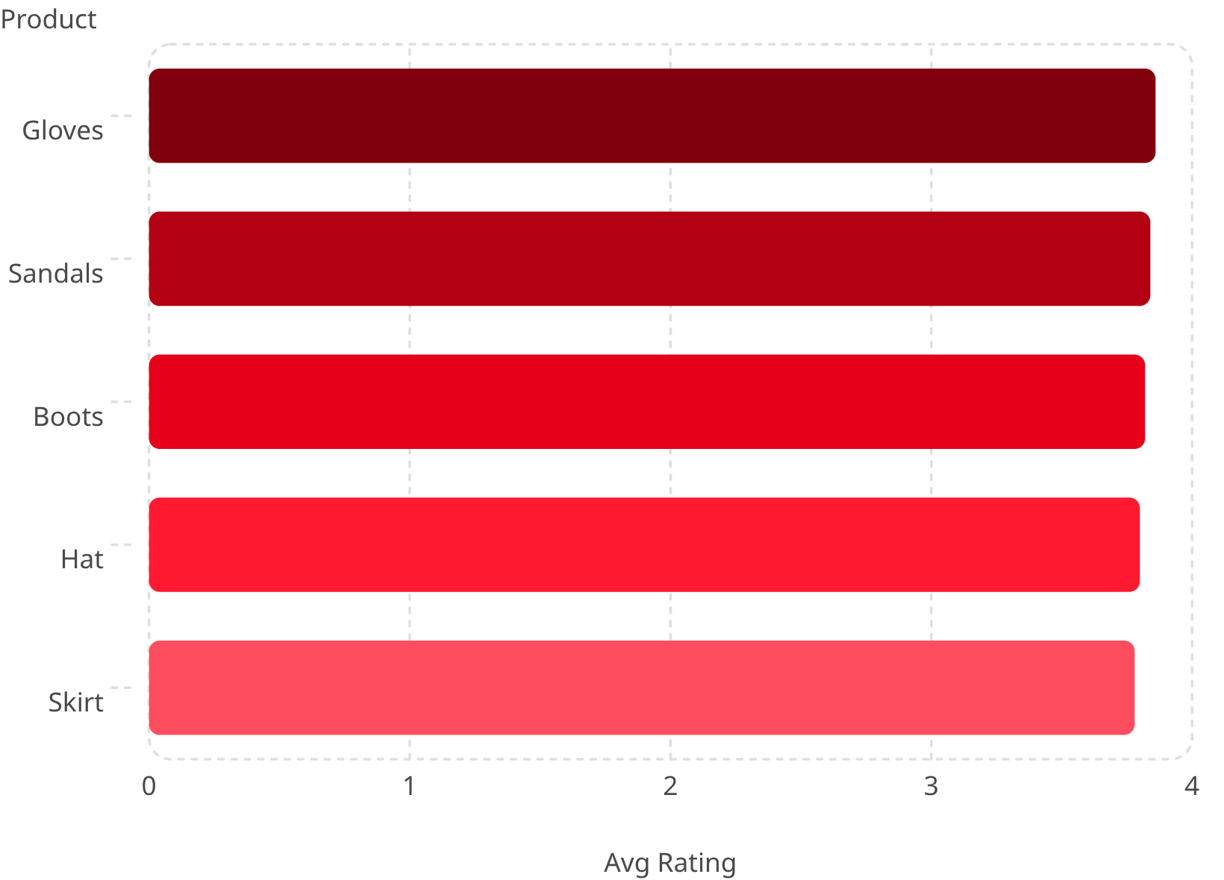
Top Products by Rating
Consistent High Ratings
Top 5 products cluster tightly between 3.78–3.86 out of 5. Overall average: 3.75.

Slide 6

Shipping & Subscriptions
Express Shipping
Avg spend: $60.48
Standard Shipping
Avg spend: $58.46
Subscribers (27%)
1,053 customers · $62,645 revenue
Non-Subscribers (73%)
2,847 customers · $170,436 revenue

Slide 7
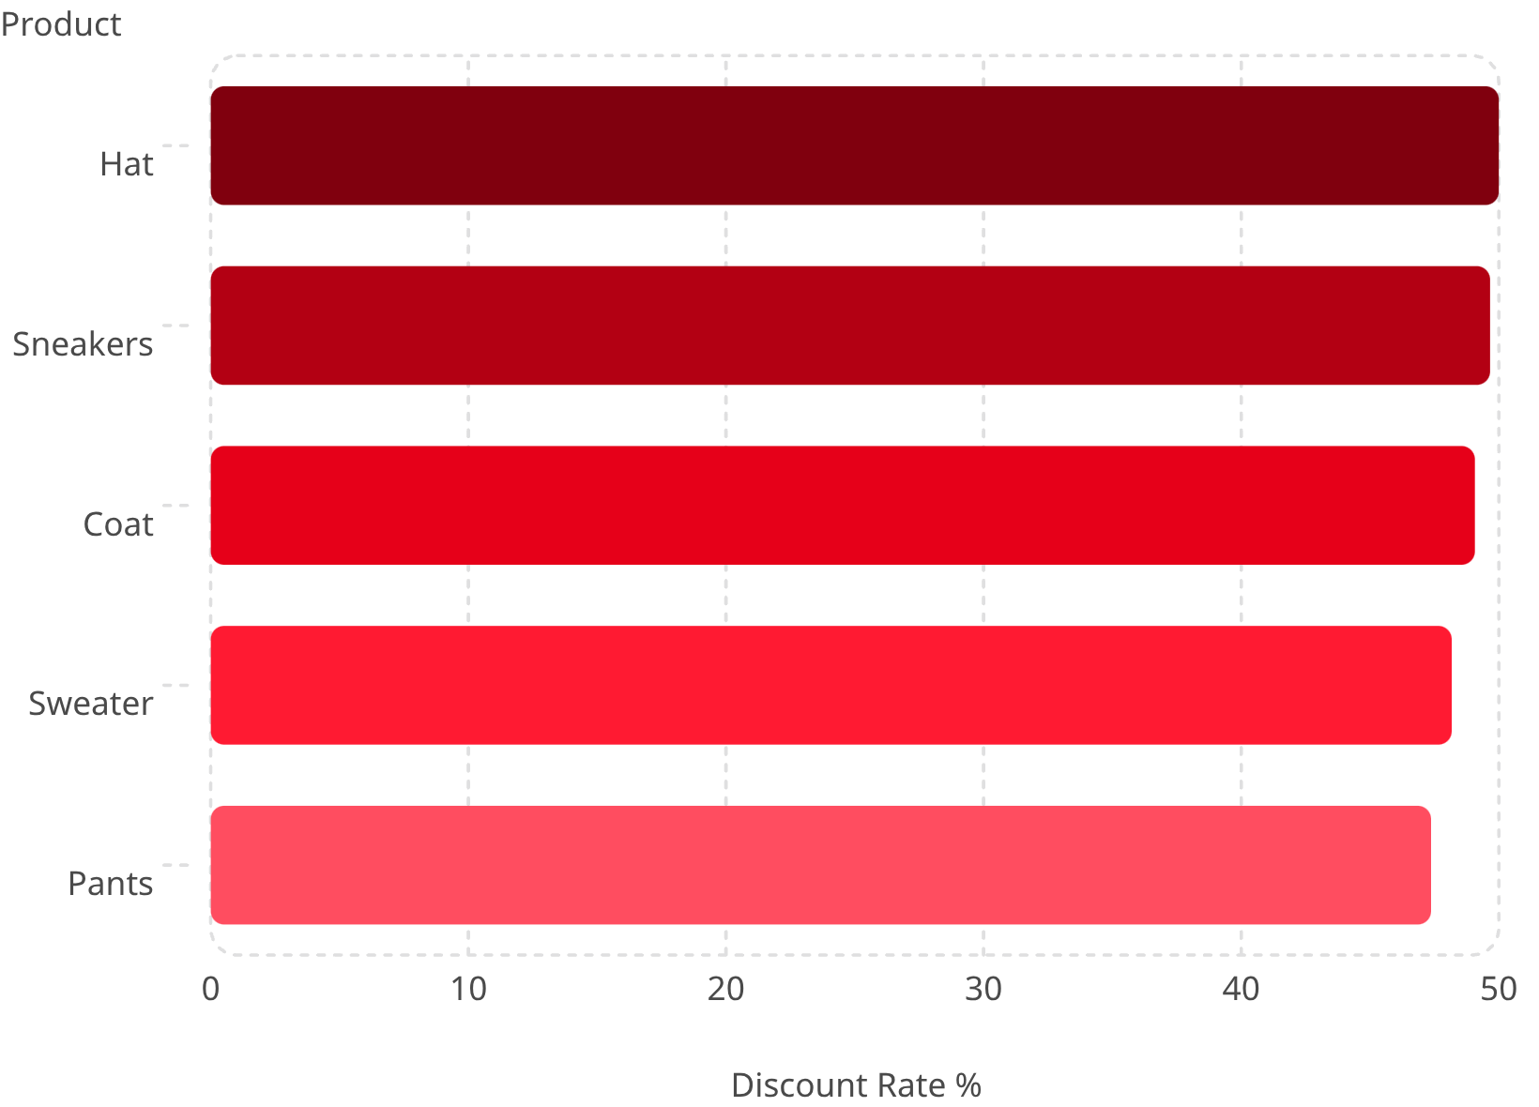
Discount-Dependent Products
~50% of Purchases Use Discounts
Top 5 products all show 47–50% discount rates — review margin impact and policy.

Slide 8

Customer Segmentation
3,116
701
Loyal
Returning
Highest repeat purchase frequency
Moderate purchase history
83
New
First-time buyers
Of 958 repeat buyers (>5 purchases), most remain non-subscribers — untapped subscription opportunity.

Slide 9
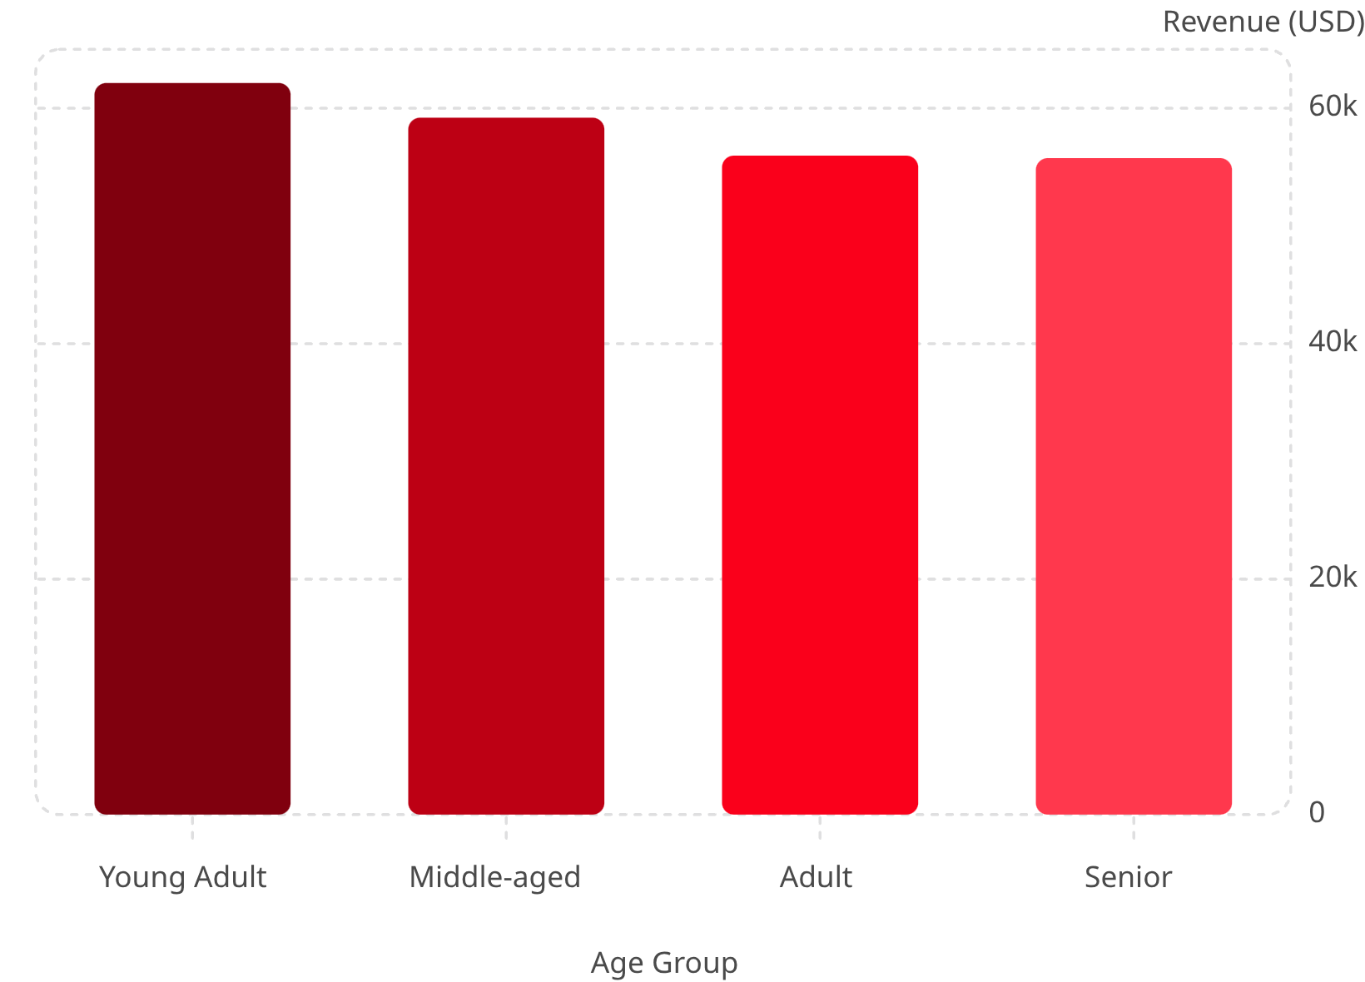
Revenue by Age Group & Category
Young Adults Lead Revenue
Clothing dominates category revenue (~$100K), followed by Accessories (~$60K), Footwear (~$30K), and Outerwear (~$15K).

Slide 10


Business Recommendations
Boost Subscriptions
Promote exclusive subscriber benefits
Loyalty Programs
Reward repeat buyers → Loyal segment
Review Discount Policy
Balance sales lift vs. margin control
Targeted Marketing
Focus on high-revenue age groups & express-shipping users

