Slide 1

NumPy – Numerical Python

Slide 2
NumPy
Fundamental package and library for scientific computing in Python
Acts as basis for Pandas
NumPy provides
  Multidimensional Array Object
  Derived Objects (such as masked arrays and matrices)
  Routines for fast operations on arrays, including mathematical, logical, shape manipulation, sorting, selecting, I/O, discrete Fourier transforms, basic linear algebra, basic statistical operations, random simulation and much more.

Slide 3
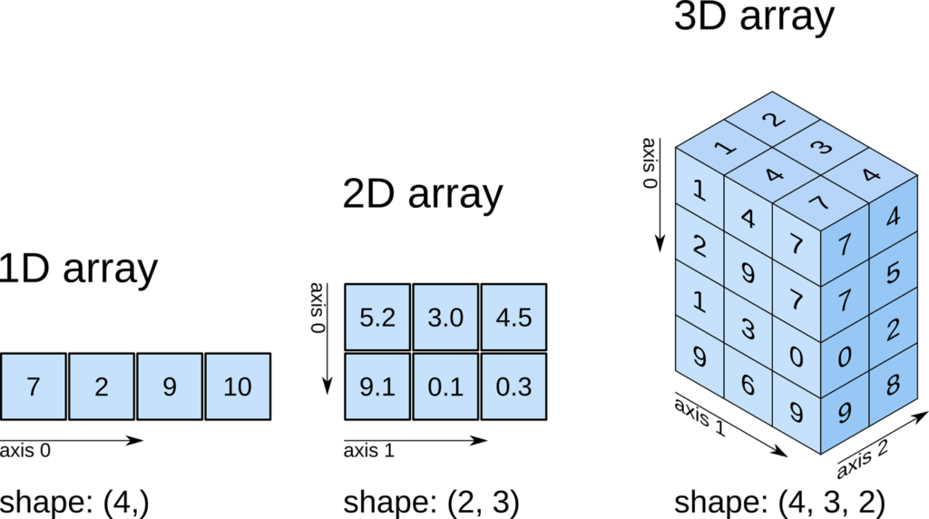
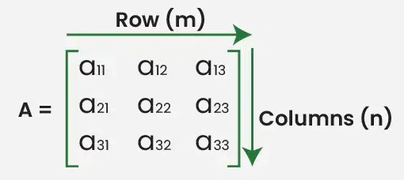
Arrays vs Matrices
Always 2-D
Specifically designed for linear algebra and its operations
Deprecated in new versions of Numpy (use Array instead)
Can be n-dimensional (1-D,2-D, 3-D,…n-D)
Designed for data storage and computation

Slide 4
Numpy Array (ND Array)
A = [0 ,1 , 2, 3, 4]
Python List
0 | 1 | 2 | 3 | 4
A[0] :0
A[1] : 1
A[2] : 2
A[3] : 3
import numpy as np
A Numpy array or ND array is similar to a list.
It's usually fixed in size and each element is of the same type (here, integers)
a = np.array( )
[0, 1, 2, 3, 4]
>> type(a)
>> numpy.ndarray
Notes:
Cast the list as numpy array

Slide 5
ND Array - Attributes
import numpy as np
a = np.array([0,1,2,3,4]) // can be list/tuple i.e. a=np.array((0,1,2,3,4))
>> a.dtype //Datatype of individual elements of array
>> dtype(‘int64’)
>> a.size
>> 5
>> a.ndim : 1 // no. of array dimension or rank of array
>> a.shape : (5,) //size of array in each dimension
Notes:
Cast the list as numpy array
Sets donot maintain an order so not preferred

Slide 6
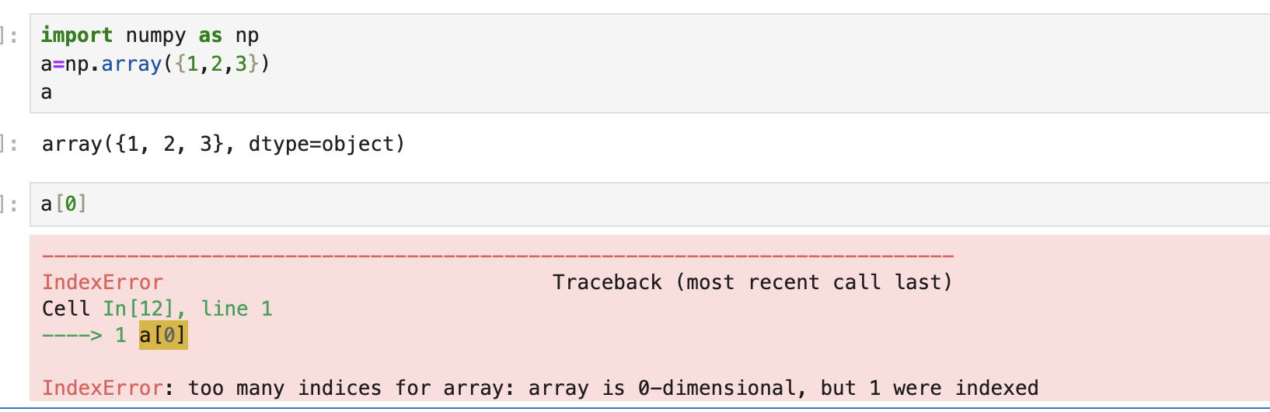
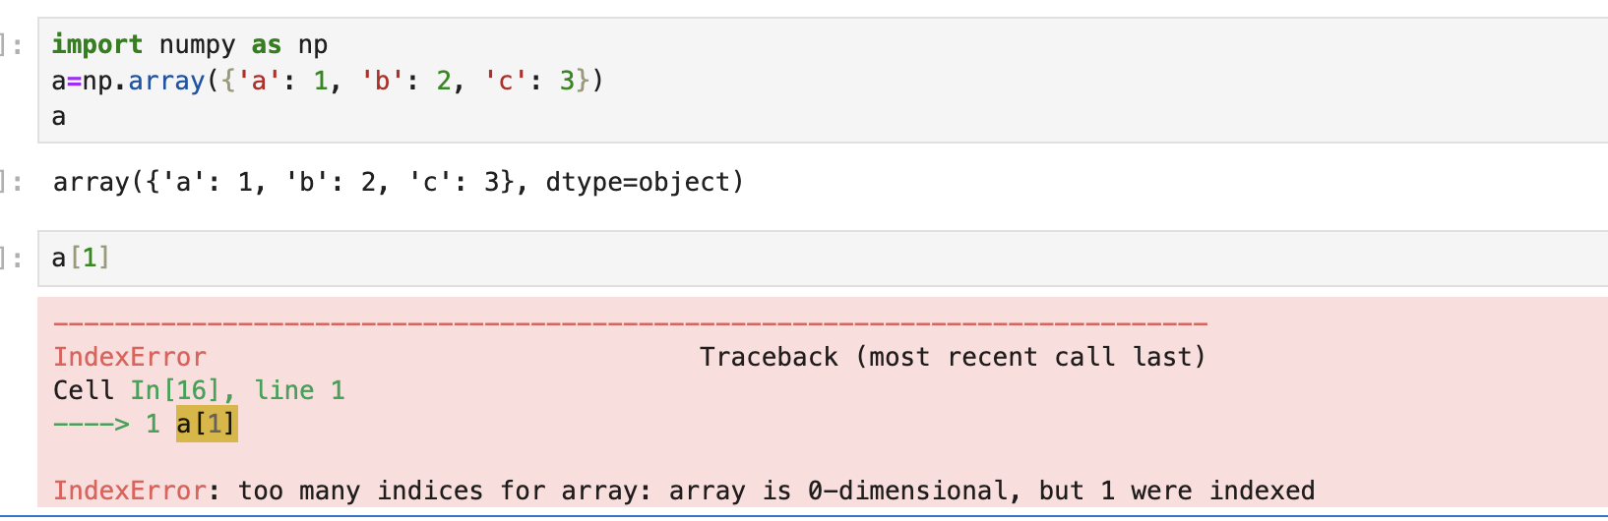
What about creating numpy array from sets and dictionaries?
When you pass a set or a dictionary directly to np.array(), NumPy treats the dictionary as one object. It does not unpack it into individual key-value pairs (as it would for lists or tuples). Therefore, the resulting NumPy array is a 0-dimensional object (essentially a single object), and trying to index it like an array will give you the error.
Sets are unordered collections of unique elements, and NumPy doesn't know how to handle them in the same way it handles lists or tuples.

Slide 7
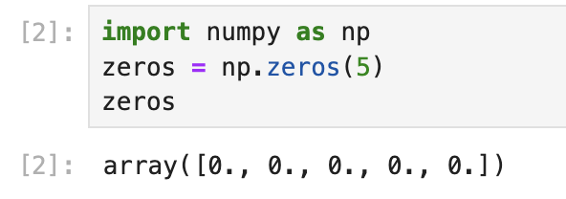
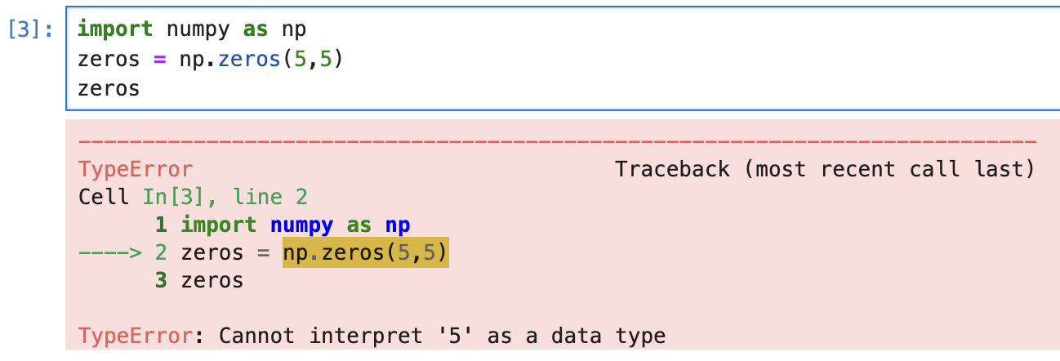
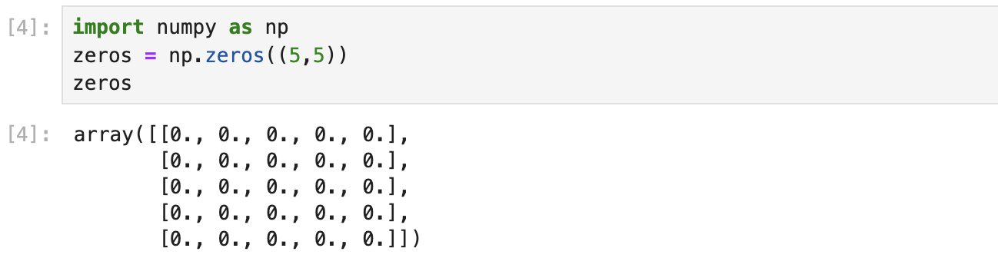
Creating an Array of Zeros
zeros = np.zeros(5)
Creating an Array of Ones
ones = np.ones(5)
np.zeros() function accepts only single argument i.e.
tuple representing the shape of the array

Slide 8
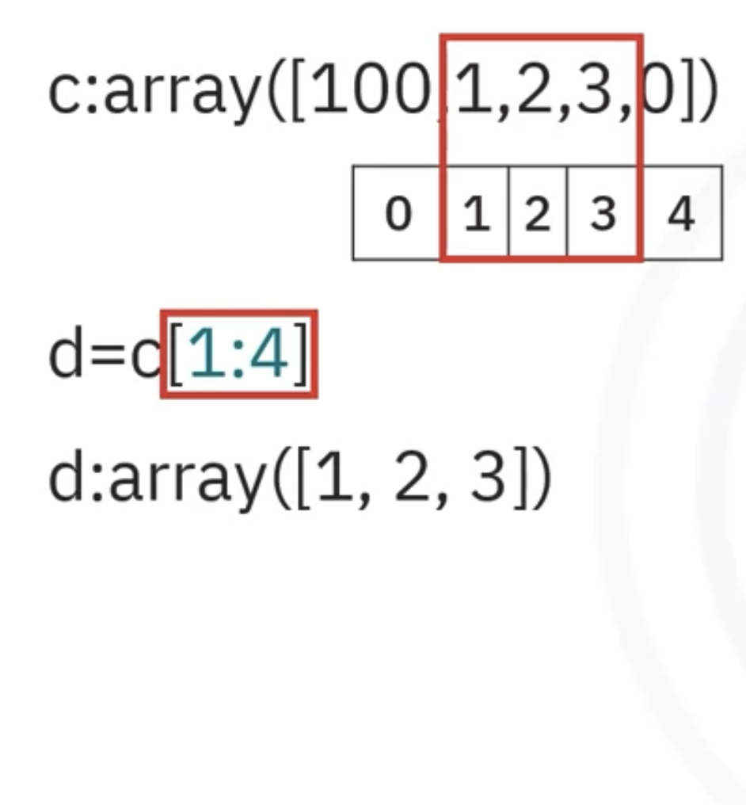
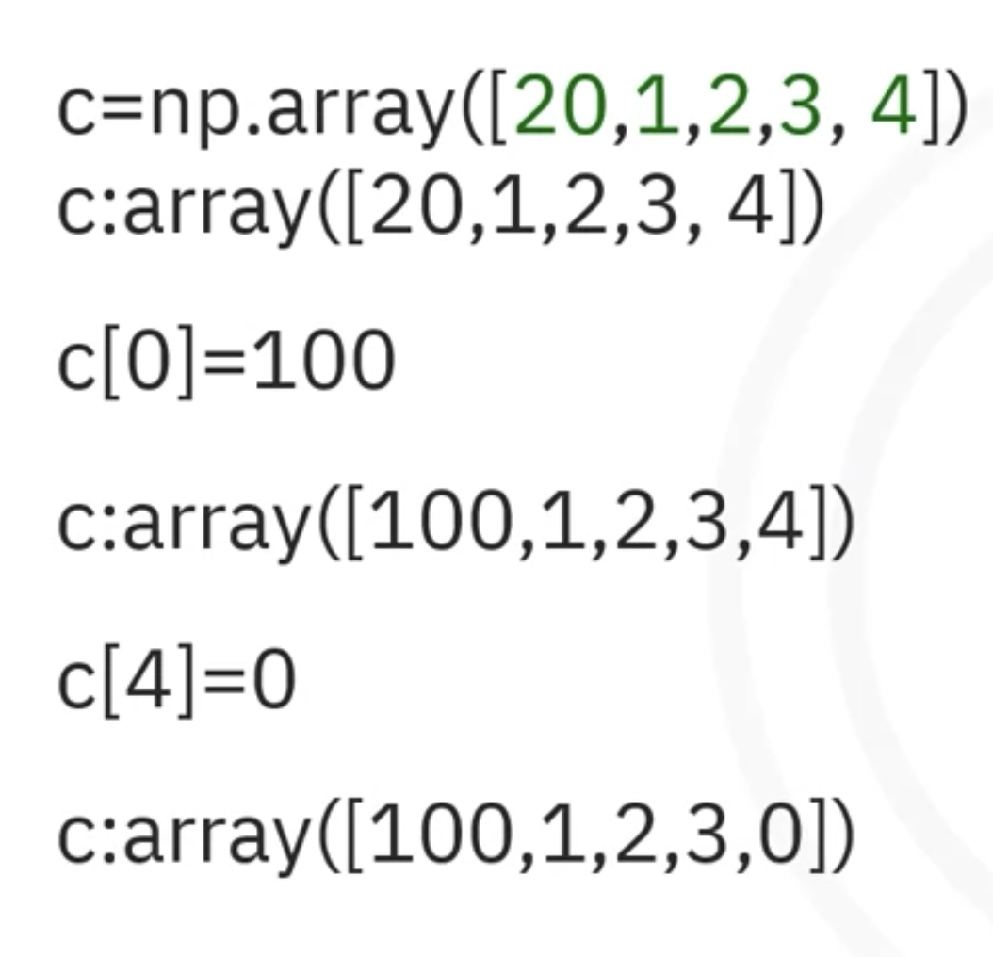
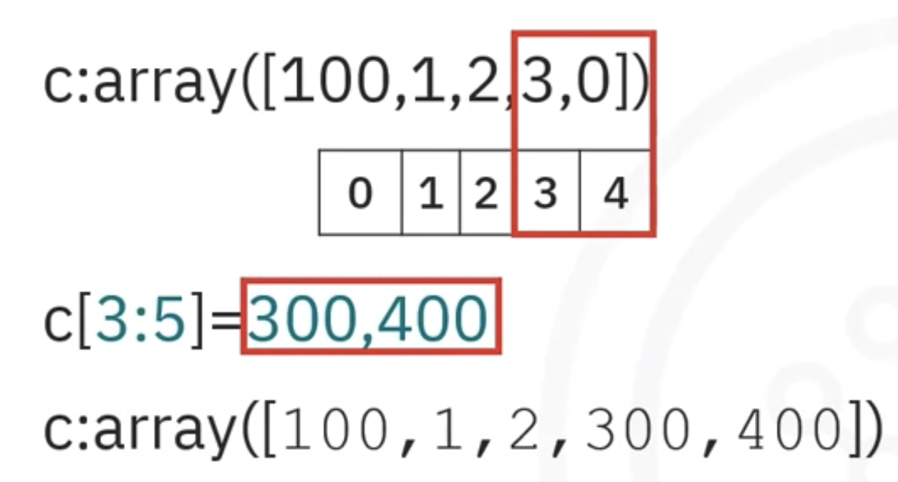
ND Array – Indexing & Slicing
Notes:
Cast the list as numpy array

Slide 9
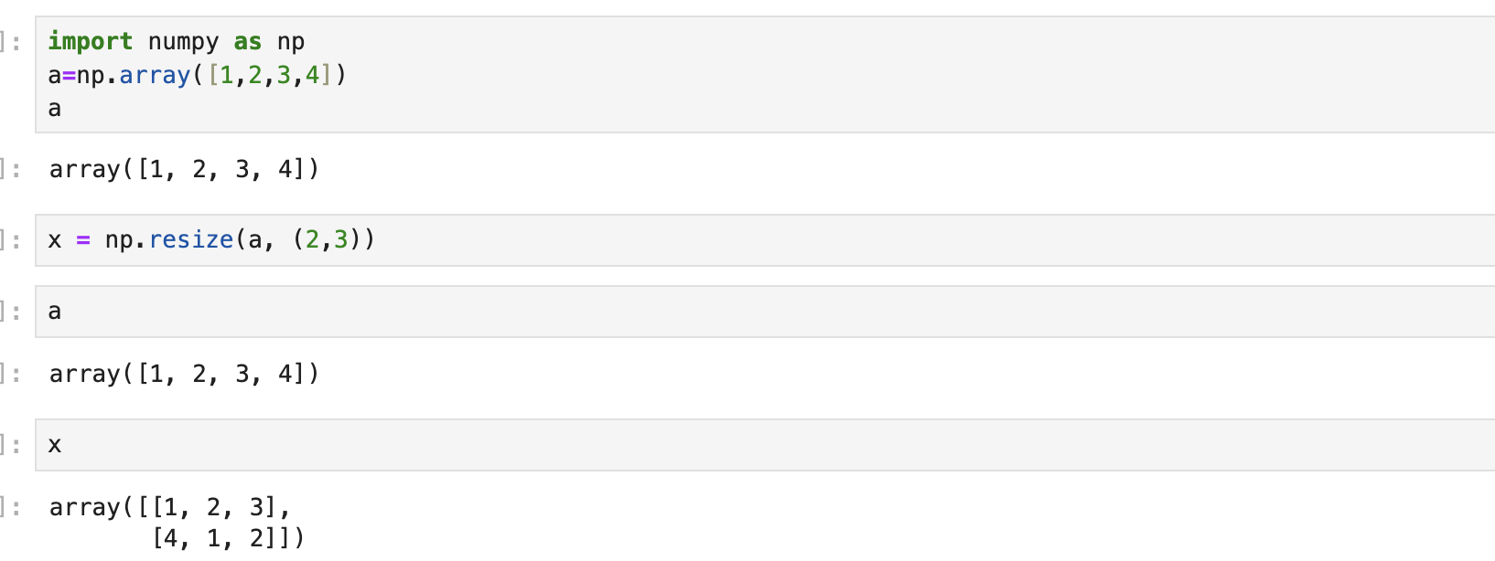
Numpy array vs Other Python Sequences
Have a fixed size at creation
  Changing the size of an ndarray will create a new array and delete the original
Elements same datatype, and thus will be the same size in memory*
Vectorized Operations
  Executed more efficiently and with less code
Python list can grow dynamically
Elements of different data type
Looping overhead
  Slower because each operation is interpreted and executed one-by-one
*Exception – Array of objects
Notes:
Vectors in Data Science tell the properties of a data point in different dimensions. Different components of a data point forms a vector each component is related to one dimension.

Slide 10
Example - Multiplying each element in a 1-D sequence with the corresponding element in another sequence of the same length
c = []
for i in range(len(a)):
c.append(a[i]*b[i])
What if a and b each contain millions of numbers; we will pay the price for the inefficiencies of looping in Python.
Python is an interpreted language, which makes it slower for tasks like loops or element-wise operations due to:
  Type checking for every element
  High-level abstractions
  Interpreted execution (not compiled)

Slide 11
1. Dynamic Type Checking
Type of a variable is determined at runtime.
In operations like loops or element-wise calculations, Python performs type checks for every single element to ensure the operation is valid.
data = [1, 2, 3, 4, 5]
result = []
for i in data:
result.append(i + 2) # Python checks the type of `i` and `2` on every iteration
In contrast, C:
C variables have fixed types (e.g., int, float) determined at compile time, so no type checks are needed during execution.
Why is it slow?
For every addition (i + 2), Python:
  Checks the type of i (e.g., is it an int, float, or str?).
  Checks the type of 2.
  Decides how to perform the operation (int + int, float + int, etc.).

Slide 12
2. High Level Abstractions (List, Tuple,..)
Lists, dictionaries, and objects that are easy to use but have additional overhead.
For example, a Python list can store elements of different types, requiring Python to handle memory allocation dynamically.
data = [1, 2.5, ‘3’, 4, 5]
In contrast, C:
Arrays in C are simple and store raw data without additional metadata or memory management overhead.
Why is it slow?
Each element in the list is a Python object, not a raw integer.
  Every element comes with additional metadata (e.g., type, size).
  Python dynamically allocates and manages memory for the list and its elements.

Slide 13
3. Interpreted Execution (Not Compiled)
Translates Python code to machine code during execution, adding overhead
Evaluates each line, figures out the meaning of data, i, *, and append, and executes the operations.
This is repeated for each iteration of the loop.
In contrast, C:
Compiled languages like C translate code into machine instructions ahead of time. During execution, the CPU directly executes those instructions without interpreting the code line by line.
data = [1, 2, 3, 4, 5]
result = []
for i in data:
result.append(i * 2) # Each iteration involves interpretation

Slide 14
Numpy:
Gives us the best of both worlds: element-by-element operations are the “default mode” when an ndarray is involved, but the element-by-element operation is speedily executed by pre-compiled C code.
In Python:
In C:
c = []
for i in range(len(a)):
c.append(a[i]*b[i])
for (i = 0; i < rows; i++) {
c[i] = a[i]*b[i];
}
c = a * b
for (i = 0; i < rows; i++) {
for (j = 0; j < columns; j++) {
c[i][j] = a[i][j]*b[i][j];
}
}
Same operation
Near C-speed
Numpy has C backend

Slide 15
Why is NumPy fast?
NumPy - Handles array operations in vectorized manner
c = a * b
Process of applying operations directly to entire arrays or large blocks of data, rather than iterating over individual elements.
Absence of any explicit looping, indexing, etc., in the code - these things are taking place, of course, just “behind the scenes” in optimized, pre-compiled C code.
Advantages of Vectorized Code
Enhanced Speed
Conciseness and Readability
Fewer Bugs
Applications: Machine Learning & Data Science, Simulations, Image Processing etc.
Notes:
Machine Learning and Data Science
Vectorized operations speed up mathematical computations, such as matrix multiplication or applying functions to datasets.
Simulations
NumPy’s speed advantage is critical when running computational simulations with large datasets.
Image Processing
Operations on pixel matrices (e.g., filtering, resizing) benefit greatly from NumPy’s efficiency.

Slide 16
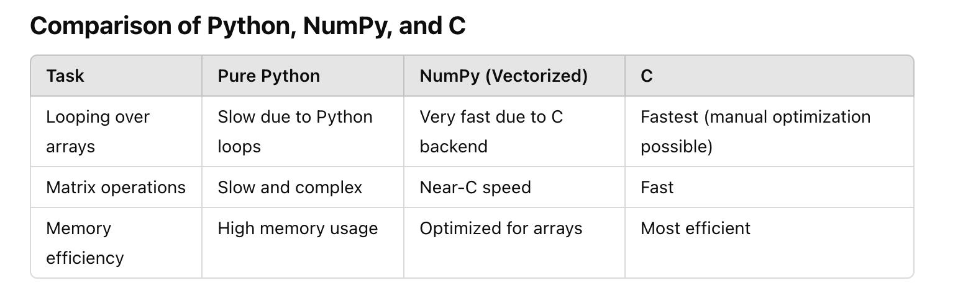

Slide 17
DataFrames -> Numpy
Almost all machine learning libraries convert Pandas DataFrames into NumPy arrays (or similar raw memory tensors) internally before performing mathematical operations

Slide 18
Basic Operations
Operations are usually computationally faster and require less memory in NumPy compared to regular Python
Why ? - Vectorization

Slide 19
Why Numpy arrays instead of list?
a = [1, 2, 3]
a * 2
[1, 2, 3, 1, 2, 3]
a = np.array([1, 2, 3])
a * 2
[2 4 6]

Slide 20
Recall
Vector – Magnitude and Direction
Vector in Python - 1D Array – Row Major / Column Major
B = np.array([[4], [5], [6]])
B.Shape
>> (3,1)
A = np.array([[1, 2, 3]])
A.Shape
>> (3,)
1 2 3
4
5
6

Slide 21
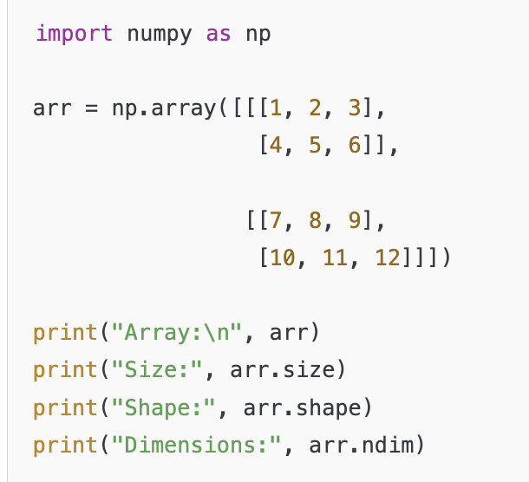
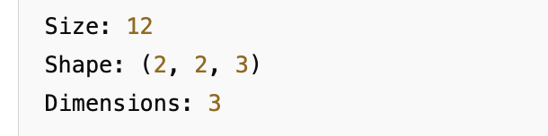
7 | 8 | 9
10 | 11 | 12
1 | 2 | 3
4 | 5 | 6

Slide 22
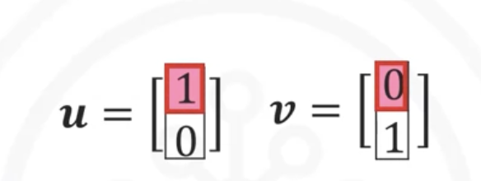
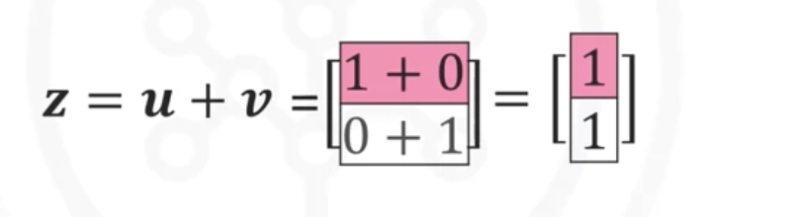
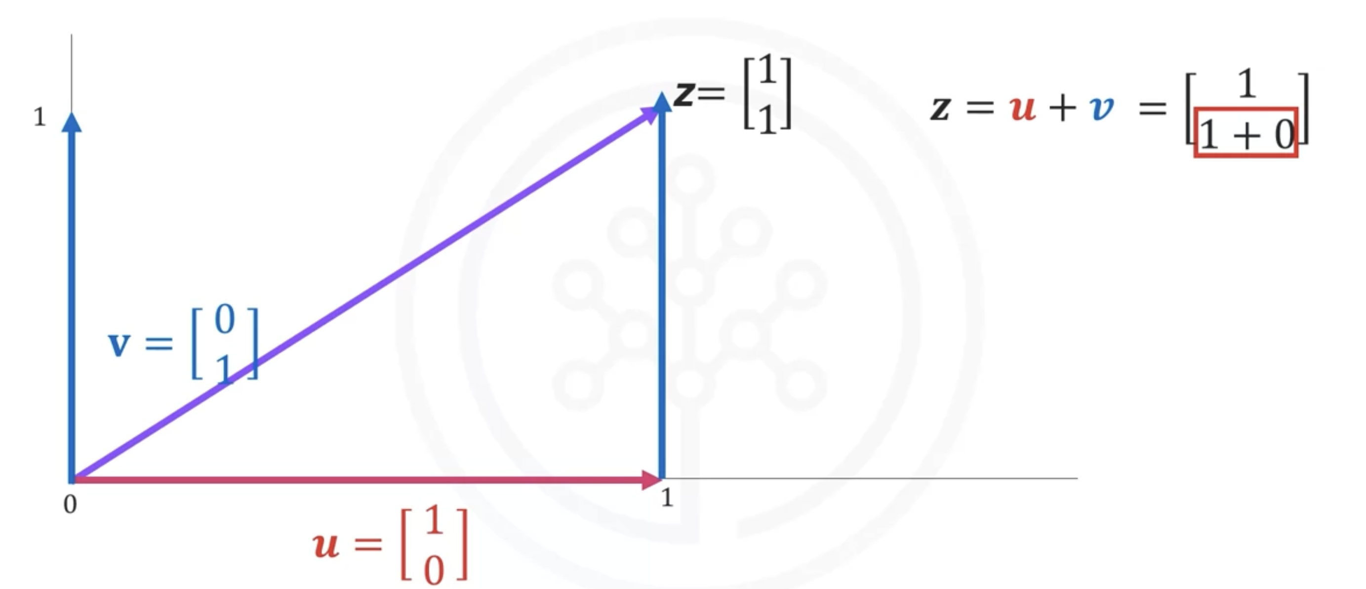
Vector Addition
Notes:
Let's review some of these operations on one-dimensional arrays.
We will look at many of the operations in the context of
Euclidian vectors to make things more interesting.
Vector addition is a widely used operation in data science. Consider the vector u with two elements, the elements are distinguished by the different colors.
Similarly, consider the vector v with two components.
In vector addition, we create a new vector in this case z.
The first component of z
is the addition of the first component
of vectors u and v. Similarly,
the second component is
the sum of the second components of
u and v. This new vector z is now
a linear combination of the vector u and
v. Representing vector addition
with line segment or arrows is helpful.
The first vector is represented in red.
The vector will point in
the direction of the two components.
The first component of the vector is one.
As a result the arrow is offset
one unit from the origin in the horizontal direction.
The second component is zero,
we represent this component in the vertical direction.
As this component is zero,
the vector does not point in the vertical direction.
We represent the second vector in blue.
The first component is zero,
therefore the arrow does not
point to the horizontal direction.
The second component is one.
As a result the vector points in
the vertical direction one unit.
When we add the vector u and v,
we get the new vector z.
We add the first component,
this corresponds to the horizontal direction.
We also add the second component.
It's helpful to use the tip to
tail method when adding vectors,
placing the tail of the vector v on the tip of vector u.
The new vector z is constructed by connecting
the base of the first vector u with the tail of the
second v. The following three lines of code
will add the two lists and place
the result in the list z.
We can also perform
vector addition with one line of Numpy code.
It would require multiple lines to perform
vector addition on two lists
as shown on the right side of the screen.
In addition, the Numpy code will run much faster.
This is important if you have lots of data.
We can also perform vector subtraction by changing
the addition sign to a subtraction sign.
It would require multiple lines
to perform vector subtraction
on two lists as shown on the right side of the screen.

Slide 23
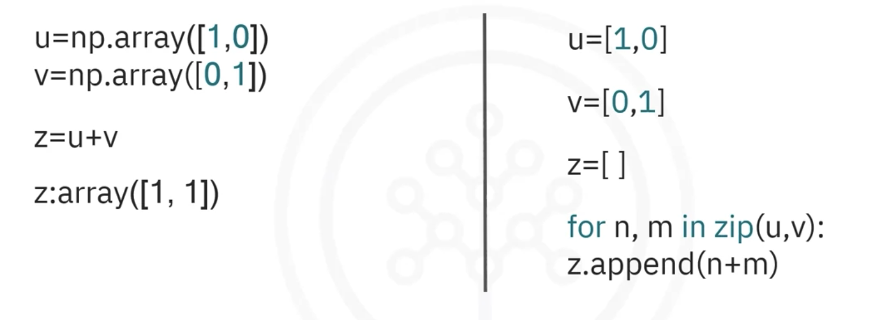
Vector Addition

Slide 24
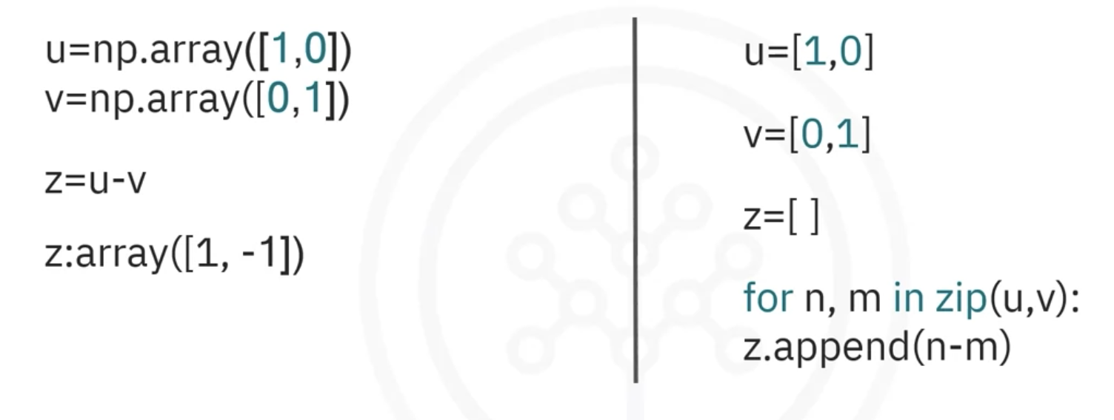
Vector Subtraction

Slide 25
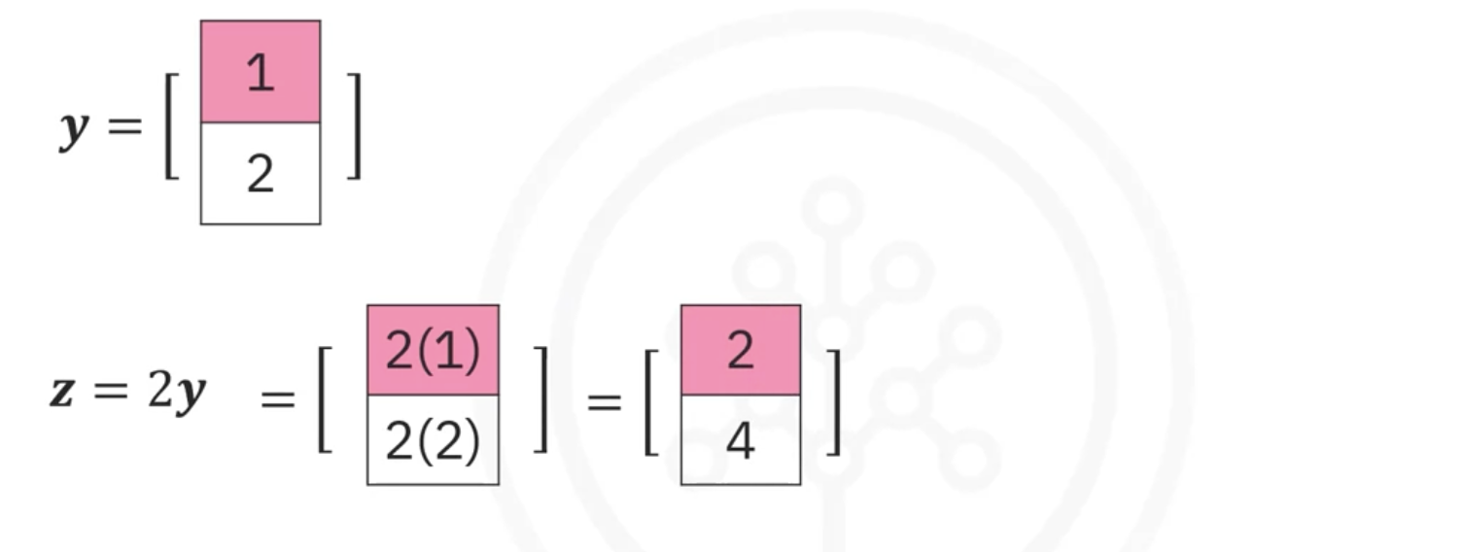
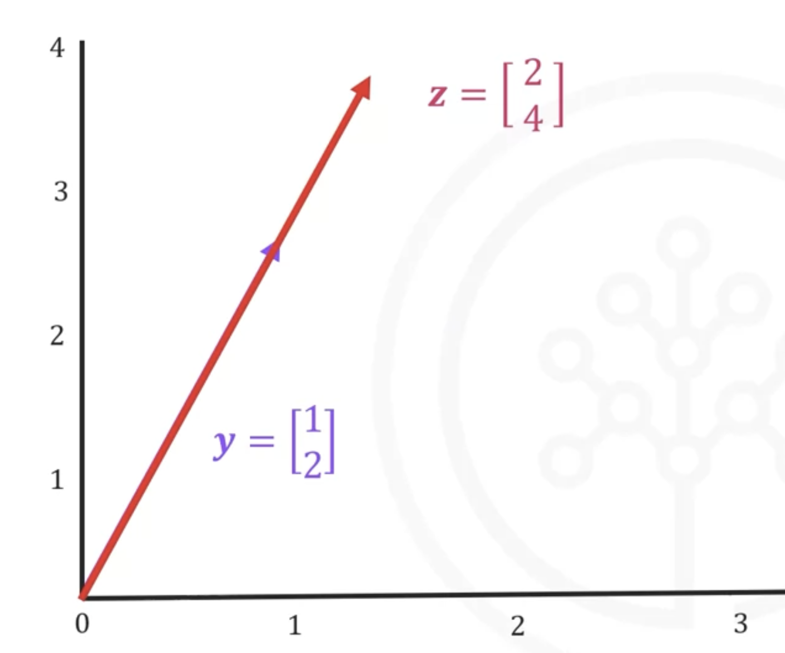
Array/Vector Multiplication with Scalar

Slide 26
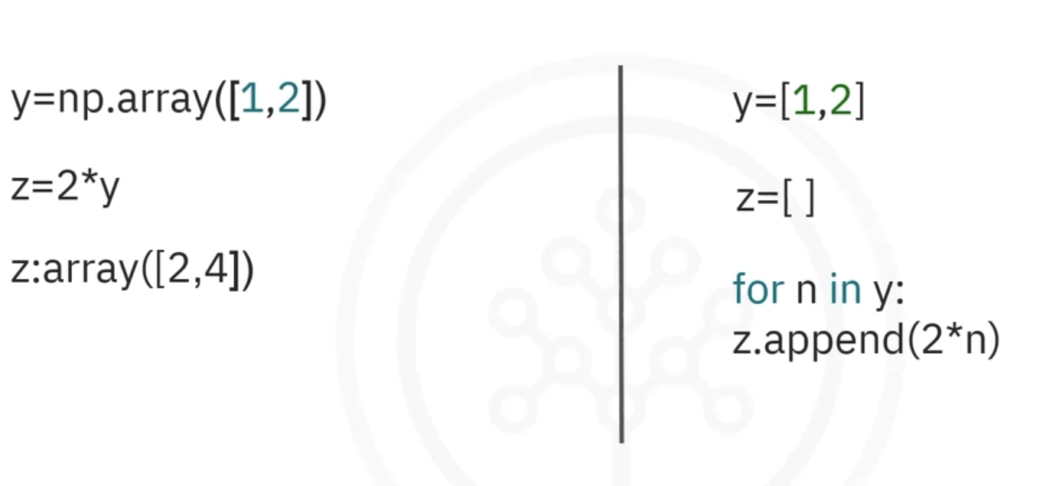
Array/Vector Multiplication with Scalar

Slide 27
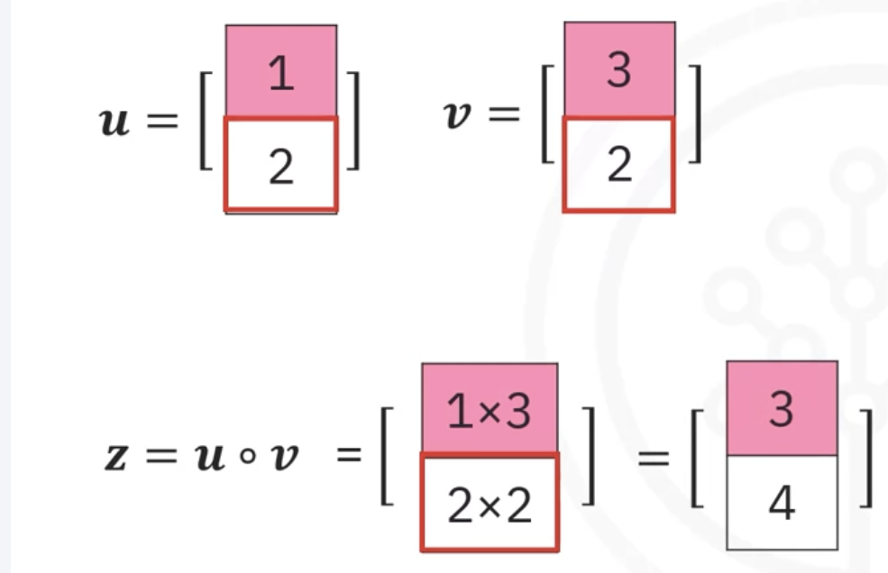
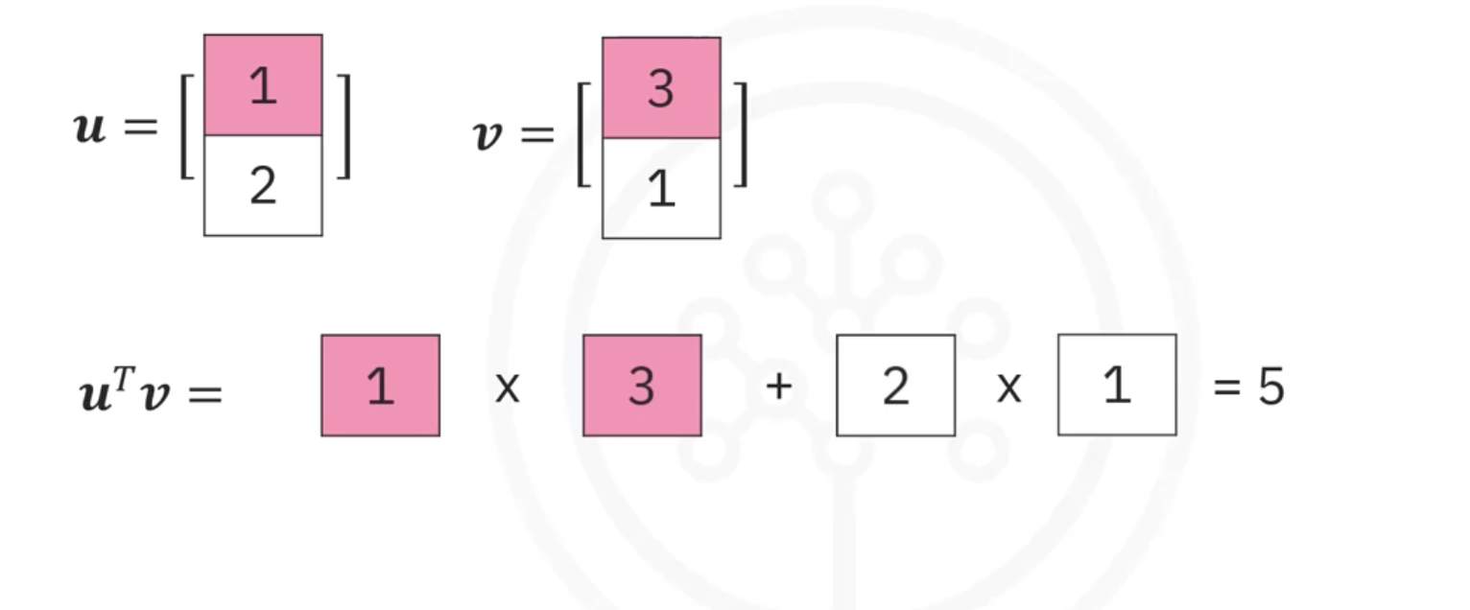
Product of two Arrays
Product
Hadamard
(Element wise)
Dot
(Matrix Multiplication)
Cross
(Vector Product)
u o v
u . v
u x v

Slide 28
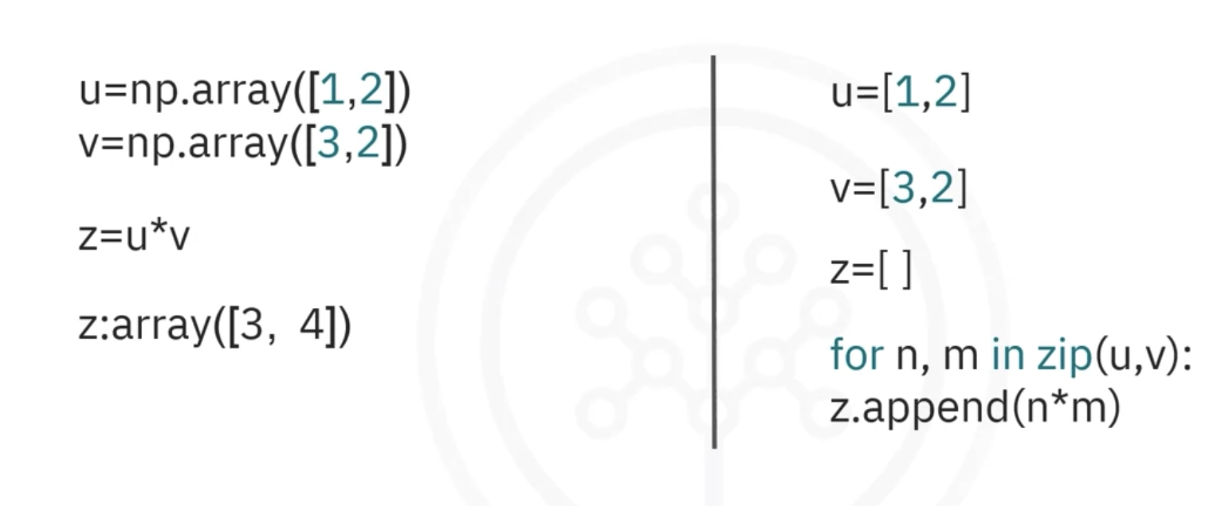
Hadamard Product (*)
u = np.array([[1, 2, 3],[3,4,6]])
v = np.array([[4, 5, 6],[2,7,8]])
z = u *v
Z:array([4,10,18],[6,28,48])

Slide 29
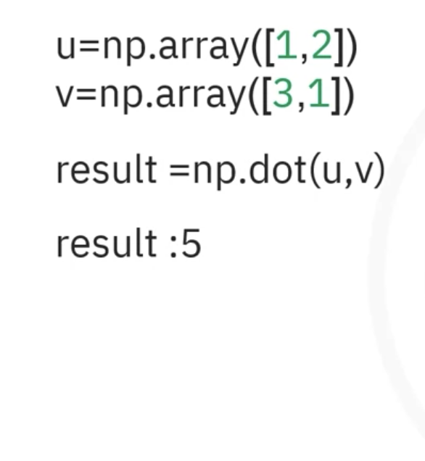
Dot Product (@)
1
2
3
4 5 6
import numpy as np
# Dot Product
u = np.array([1, 2, 3])
v = np.array([4, 5, 6])
dot_product = u @ v
print(”Dot Product:", dot_product)
# Matrix Multiplication
A = np.array([[1, 2], [3, 4]])
B = np.array([[5, 6], [7, 8]])
matrix_product = np.dot(A, B)
print("Matrix Multiplication:\n", matrix_product)
Dot Product: 32
Matrix Multiplication:
[[19 22]
[43 50]]
1 2
3 4
5 6
7 8
19 22
43 50

Slide 30
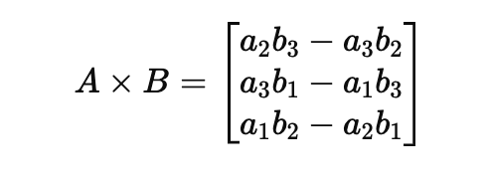
Cross Product
Binary operation on two vectors in three-dimensional space, resulting in another vector that is perpendicular to both of the input vectors.
import numpy as np
# Cross Product
u = np.array([1, 2, 3])
v = np.array([4, 5, 6])
cross_product = np.cross(u, v)
print("Cross Product:", cross_product)
Cross Product: [-3 6 -3]
Only works for vectors in 3D or higher-dimensional spaces where vector fields exist.

Slide 31
Broadcasting in NumPy
NumPy – All operations follow implicit element by element behaviour
What about arrays having different shapes or operation between an array and a scalar?
Broadcasting - Smaller array is “broadcast” across the larger array so that they have compatible shapes.
  Means of vectorizing array operations so that looping occurs in C instead of Python.
  Sometimes, a bad idea because it leads to inefficient use of memory that slows computation.
Broadcasting - Perform operations on arrays of different shapes without explicitly reshaping them and without explicit Python loops

Slide 32
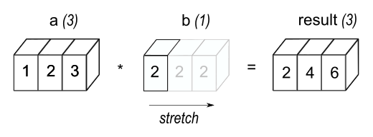
Same shape
Array and Scalar
array([2., 4., 6.])
More efficient than that in the first because broadcasting moves less memory around during the multiplication

Slide 33
How Broadcasting Works
Broadcasting works by expanding the smaller array to match the shape of the larger array without actually copying the data. NumPy follows specific rules to do this:
Rule 1: If the arrays differ in the number of dimensions, prepend 1s to the shape of the smaller array.
Rule 2: If the shape of the arrays does not match in a dimension:
  One of them must be 1, in which case it is stretched to match the other shape.
  Otherwise, broadcasting is not possible, and an error is raised.

Slide 34
Broadcasting Rules
When operating on two arrays, NumPy compares their shapes element-wise. It starts with the trailing (i.e. rightmost) dimension and works its way left. Two dimensions are compatible when:
  they are equal, or
  one of them is 1.
If these conditions are not met, a ValueError: operands could not be broadcast together exception is thrown, indicating that the arrays have incompatible shapes.

Slide 35
Rule 1: CHECK SHAPE: If the arrays differ in the number of dimensions, prepend 1s to the shape of the smaller array.
arr1 = np.array([1, 2, 3])
arr2 = np.array([[10], [20], [30]])
result = arr1 + arr2
Arr1.shape = (3,)
Arr2.shape = (3,1)
<- Smaller
Conceptually, Change arr1.shape to (1,3)
If the shape of the arrays does not match in a dimension:
  One of them must be 1, in which case it is stretched to match the other shape.
  Otherwise, broadcasting is not possible, and an error is raised.
Change arr1.shape to (3,3) and arr2.shape to (3,3)

Slide 36
arr1 = np.array([1, 2, 3])
arr2 = np.array([[10], [20], [30]])
result = arr1 + arr2
1 | 2 | 3
arr1.shape = (3,)
arr1.shape = (1,3)
1 | 2 | 3
1 | 2 | 3
1 | 2 | 3
10
20
30
10 | 20 | 30
10 | 20 | 30
10 | 20 | 30
arr2.shape = (3,1)
11 | 12 | 13
11 | 12 | 13
11 | 12 | 13

Slide 37
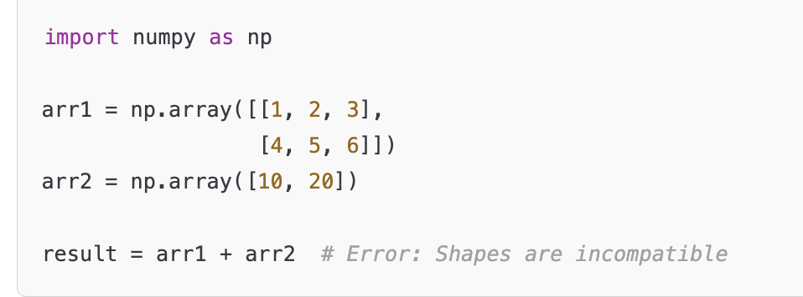
arr1 has shape (2, 3) and arr2 has shape (2,).
Shapes are incompatible because the second dimension does not match, and neither is 1.
Broadcasting fails, and an error is raised.

Slide 38
Always compare shapes from right to left.
The basic rule
Two dimensions are compatible if:
They are equal, or One of them is 1
If neither condition is true → broadcasting fails.
Array 1 | Array 2 | Broadcasting? | Why?
(3,) | (2,) | ❌ | 3 ≠ 2
(2,3) | (2,2) | ❌ | 3 ≠ 2
(3,4) | (2,1) | ❌ | 3 ≠ 2
(4,3) | (2,3) | ❌ | 4 ≠ 2
(3,4) | (3,1) | ✅ | 4 vs 1
(2,3) | (3,) | ✅ | 3 vs 3; 2 vs 1
(2,3) | (1,3) | ✅ | 1 can expand
(2,3,4) | (3,4) | ✅ | equivalent to (1,3,4)

Slide 39
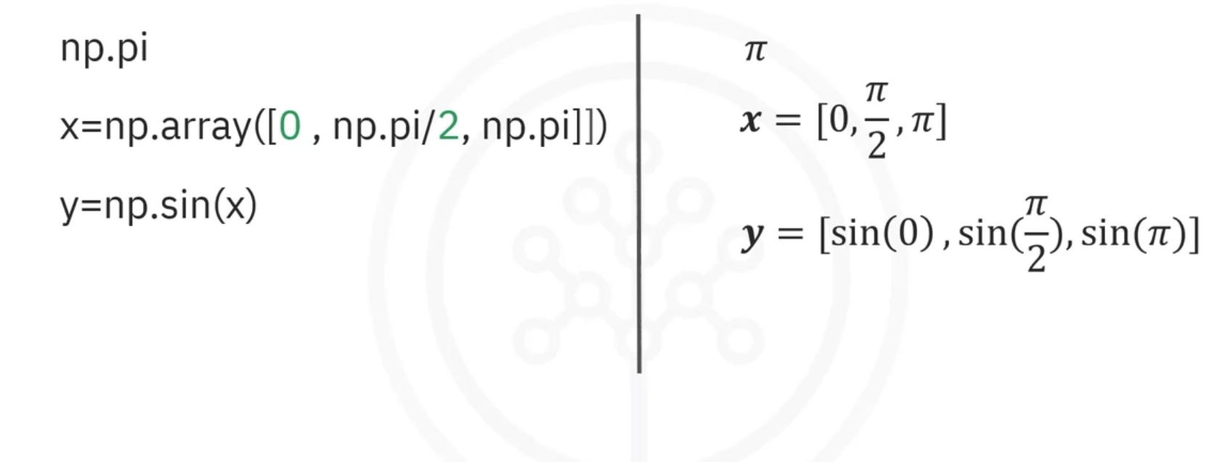
Universal Functions
a = np.array([1,-1,1,-2])
a.mean()
a.max()

Slide 40
Creating Numpy Arrays
np.array() - Creates an array from an existing Python sequence.
np.arange() - Creates evenly spaced values within a specified range.
np.linspace() - Creates a specified number of evenly spaced values between two limits.
Np.zeros()
Np.ones()
np.random.randint() - Generates random integers.

Slide 41
Linspace vs arange
linspace allows you to specify the number of steps
arange allows you to specify the size of the steps
np.linspace(start, stop, num, …)
Includes stop
np.arange(start, stop, step, …)
Excludes stop

Slide 42
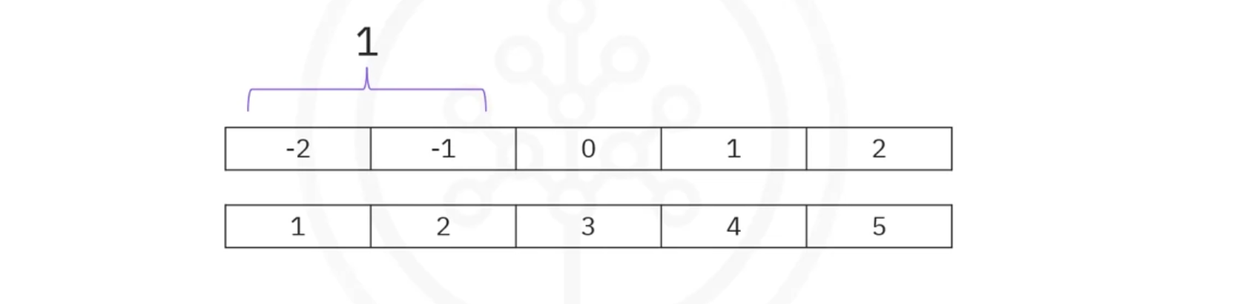

Plotting using NumPy
linspace: generate evenly spaced numbers over a specified range
np.linspace(-2,2,num=5)
np.linspace(-2,2,num=9)
np.arange(-2,2,5)
np.arange(-2,2,9)
np.arange(-2,2,3)

Slide 43
Random Seed and Reproducibility
np.random.randint(1, 100, 5)
np.random.seed(42)
will produce the same sequence whenever the same seed is used.

Slide 44
Views vs Copies
a = np.array([1, 2, 3, 4, 5])
b = a[1:4]
b[0] = 999
a = [1, 2, 3, 4, 5] Xwrong
a = [1, 999, 3, 4, 5]
//Because slicing a NumPy array generally produces a view of the original data rather than an independent copy.
To create an independent array:
b = a[1:4].copy()
b[0] = 999 does not modify a.

Slide 45
Flatten() vs Ravel()

Slide 46
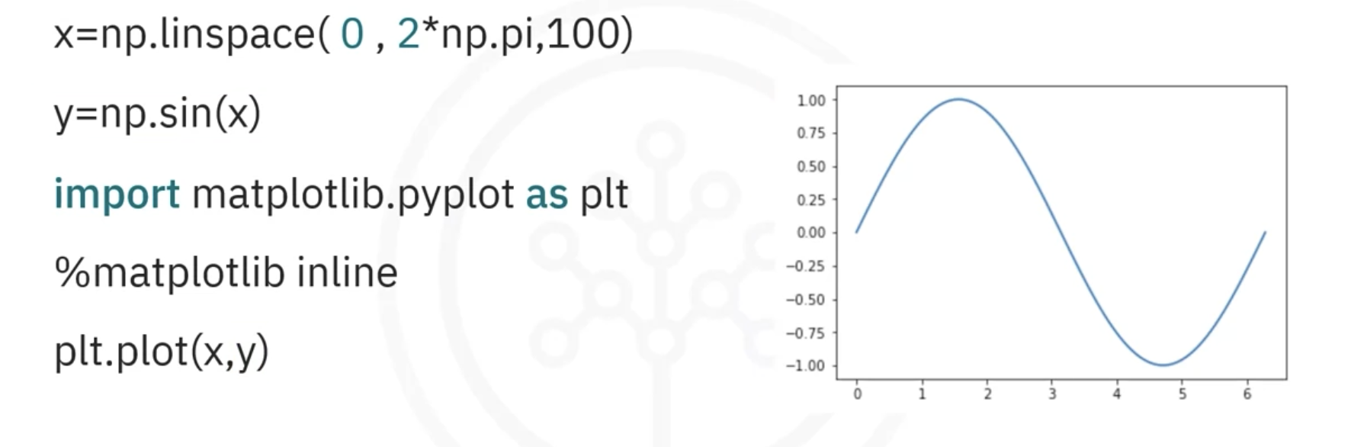
Notes:
Matplotlib inline to display the plot

Slide 47
Data Visualization Libraries in Python
Matplotlib
  Comprehensive library for creating static, animated, and interactive visualizations in Python.
  Provides a low-level infrastructure for drawing figures, allowing you to control every aspect of a plot.
  Working with Numpy arrays
  Modules:
    pyplot – High-level interface for creating plots.
    artist – Low-level primitives for custom drawings.
    backend_bases – For rendering in different formats (e.g., PNG, PDF).
Seaborn
  High-level data visualization library built on top of Matplotlib, designed to make statistical graphics attractive and informative.
  You're working with Pandas DataFrames for data analysis.

Slide 48
Matplotlib - Basic plots: Line, bar, scatter, histograms.

Slide 49
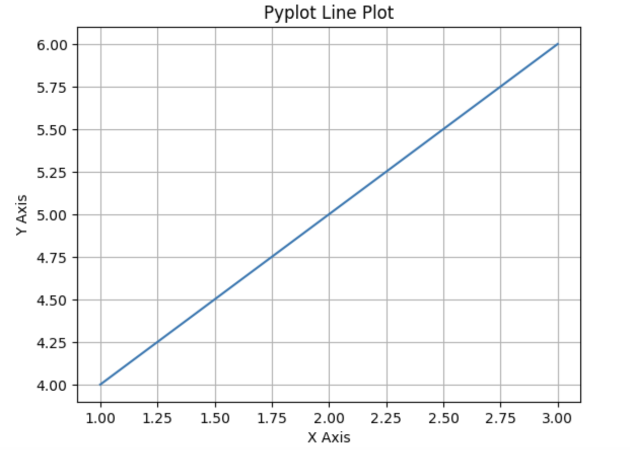
Line Chart
import matplotlib.pyplot as plt
# Create a simple line plot using pyplot
plt.plot([1, 2, 3], [4, 5, 6])
plt.title('Pyplot Line Plot')
plt.xlabel('X Axis')
plt.ylabel('Y Axis')
plt.grid(True)
plt.show()

Slide 50
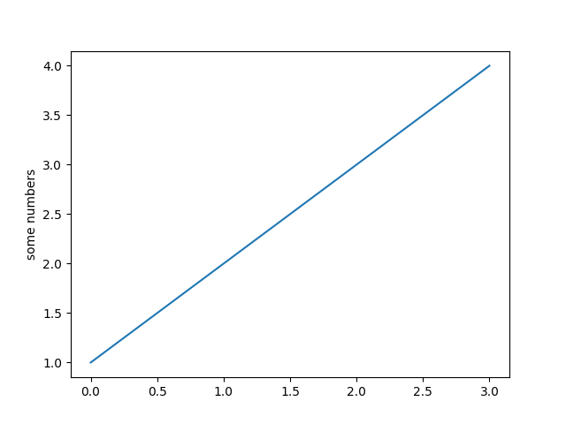
import matplotlib.pyplot as plt
plt.plot([1, 2, 3, 4])
plt.ylabel('some numbers’)
plt.show()
x-axis ranges from 0-3 and the y-axis from 1-4. If you provide a single list or array to plot, matplotlib assumes it is a sequence of y values, and automatically generates the x values for you. Since python ranges start with 0, the default x vector has the same length as y but starts with 0; therefore, the x data are [0, 1, 2, 3].

Slide 51
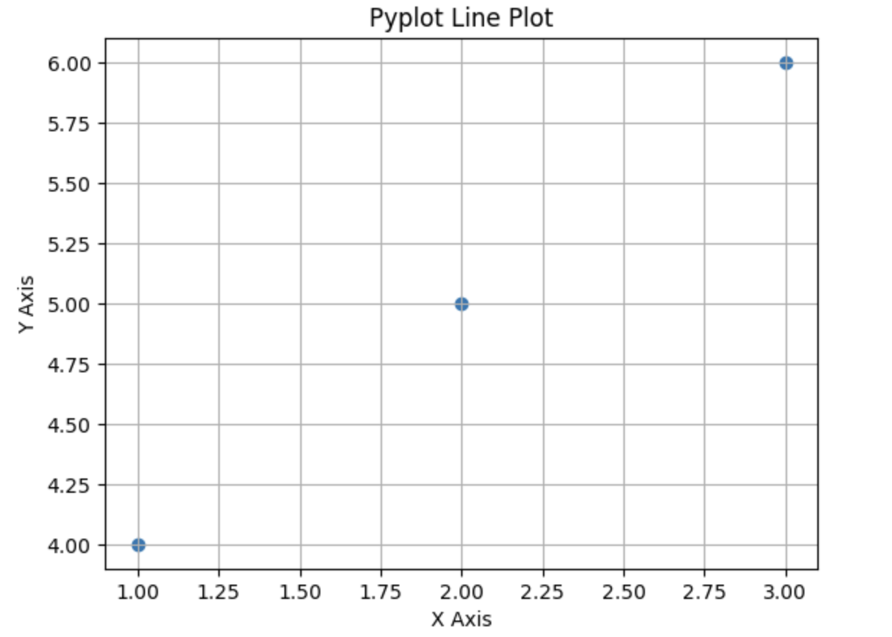
Scatter Plot
import matplotlib.pyplot as plt
# Create a simple line plot using pyplot
plt.scatter([1, 2, 3], [4, 5, 6])
plt.title('Pyplot Line Plot')
plt.xlabel('X Axis')
plt.ylabel('Y Axis')
plt.grid(True)
plt.show()

Slide 52
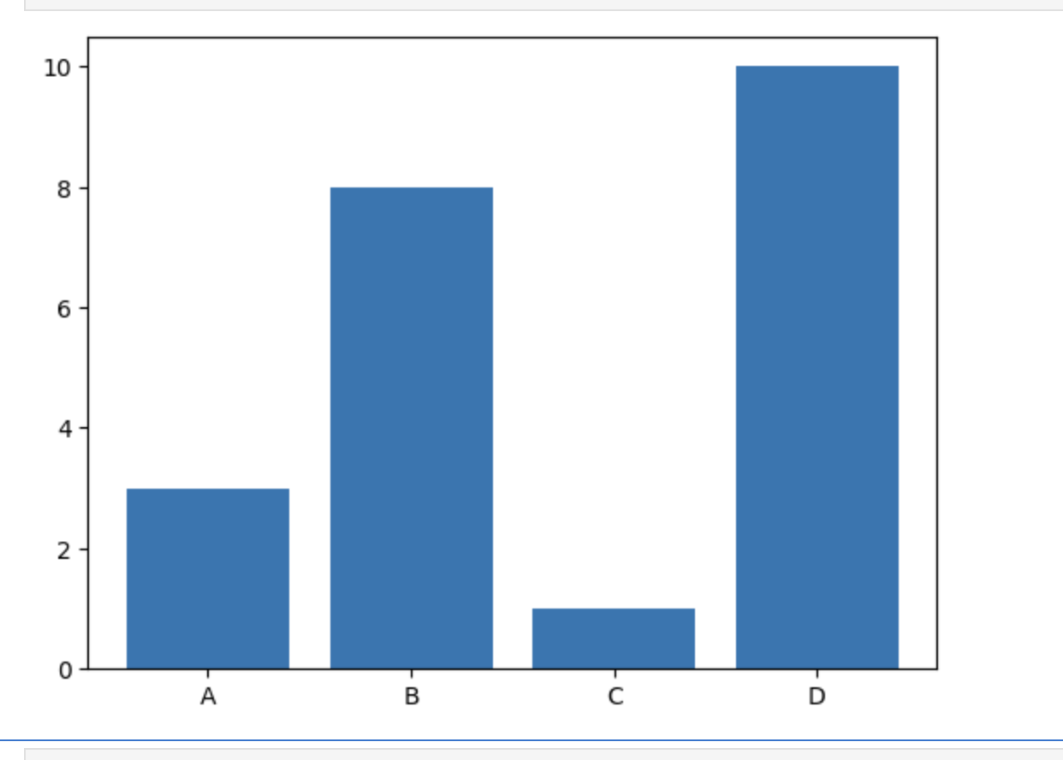
Bar Plot
import matplotlib.pyplot as plt
import numpy as np
x = np.array(["A", "B", "C", "D"])
y = np.array([3, 8, 1, 10])
plt.bar(x,y)
plt.show()

Slide 53
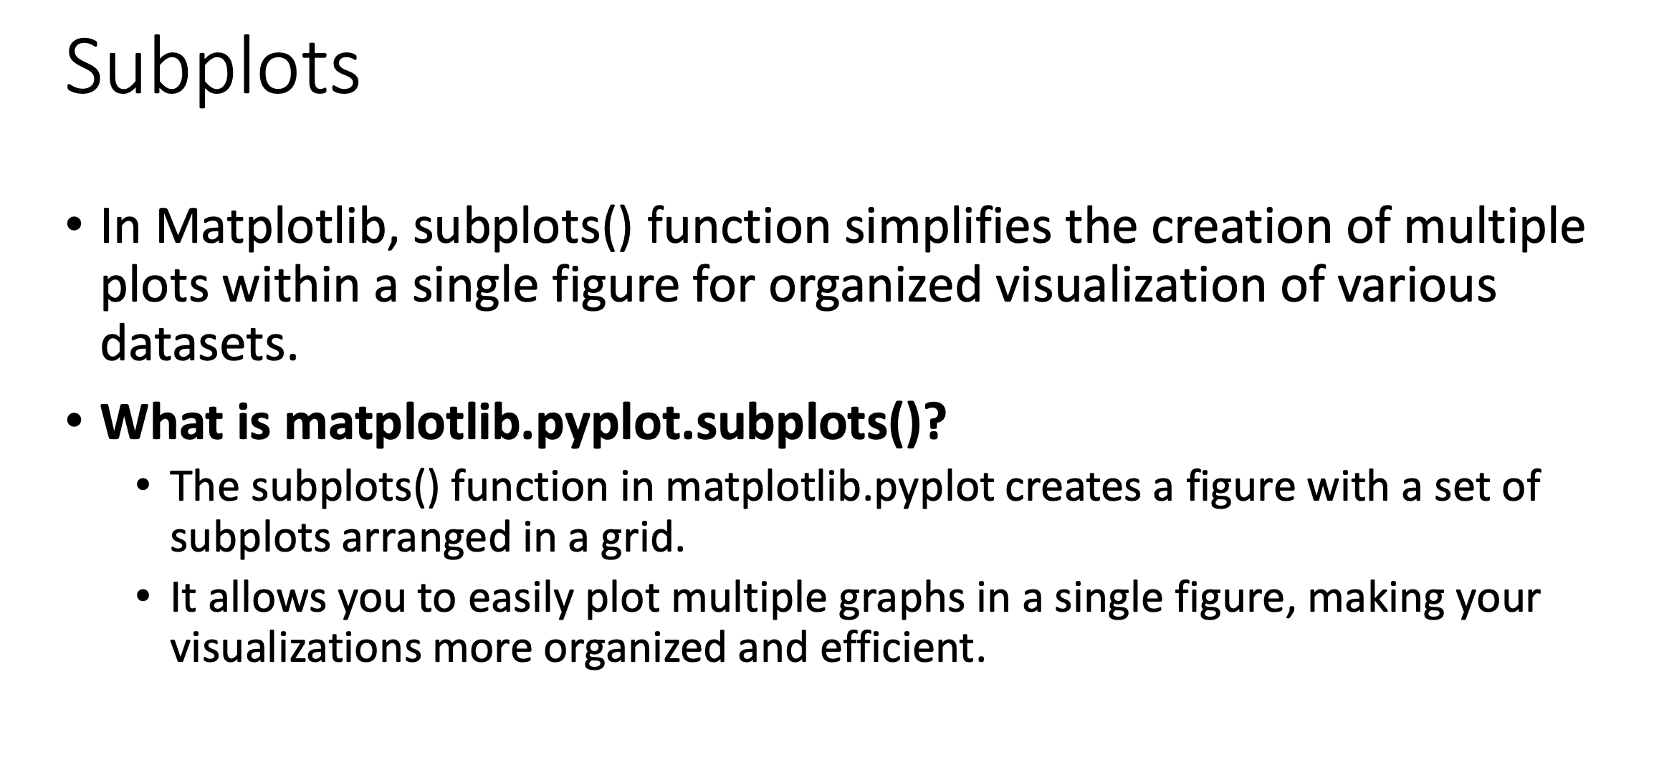

Slide 54
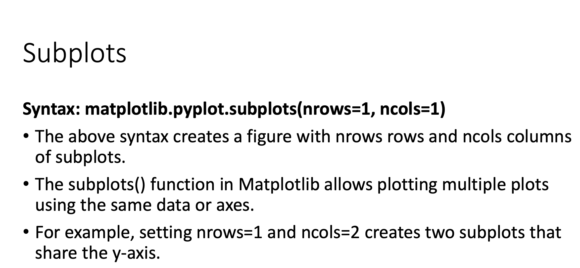

Slide 55
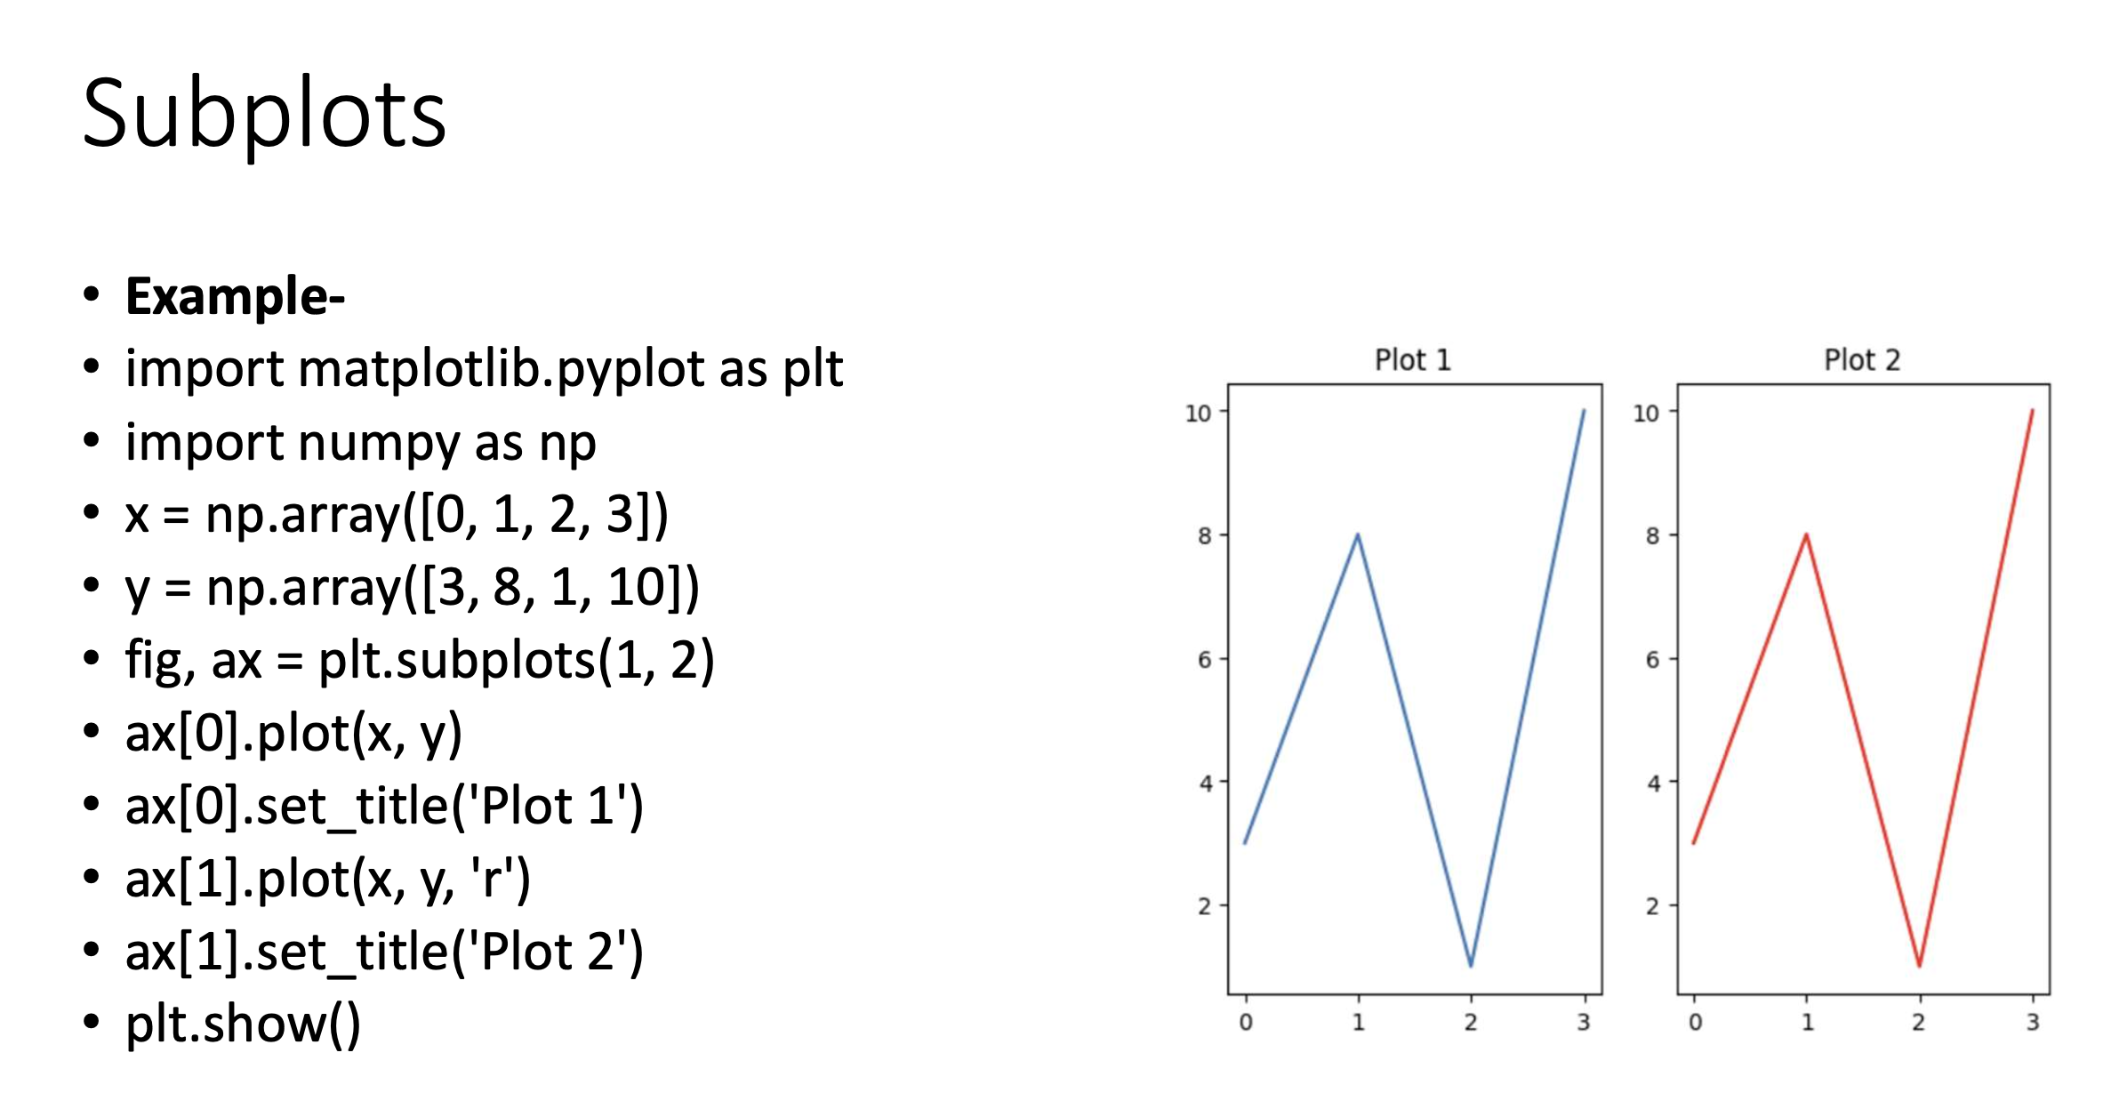

Slide 56
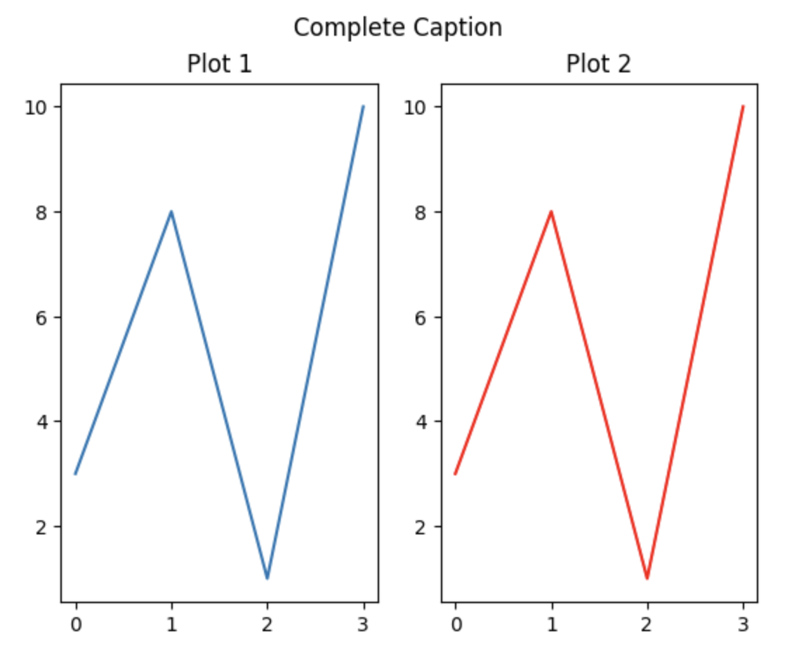
In Matplotlib, the subplots() function returns two values:
Figure (fig): This is an instance of the matplotlib.figure.Figure class. It represents the entire figure or window that holds one or more subplots. You can use this to set the overall title, size, or other properties of the figure.
Axes (ax): This can be:
  A single Axes object if only one subplot is created.
  A NumPy array of Axes objects if multiple subplots are created. The shape of this array corresponds to the grid layout specified (e.g., 2x2 grid).
fig.suptitle("Complete Caption")

Slide 57
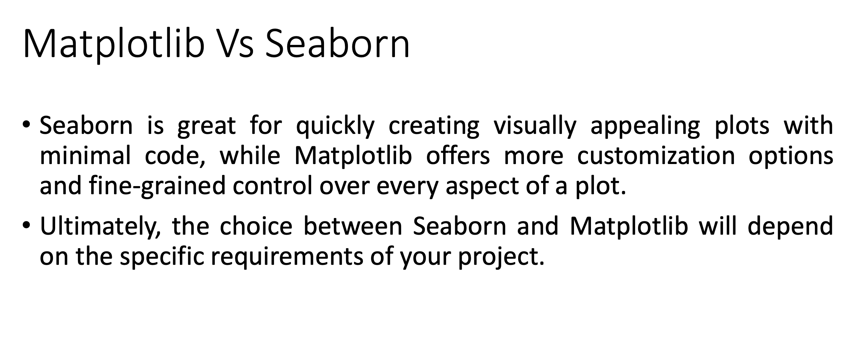

Slide 58
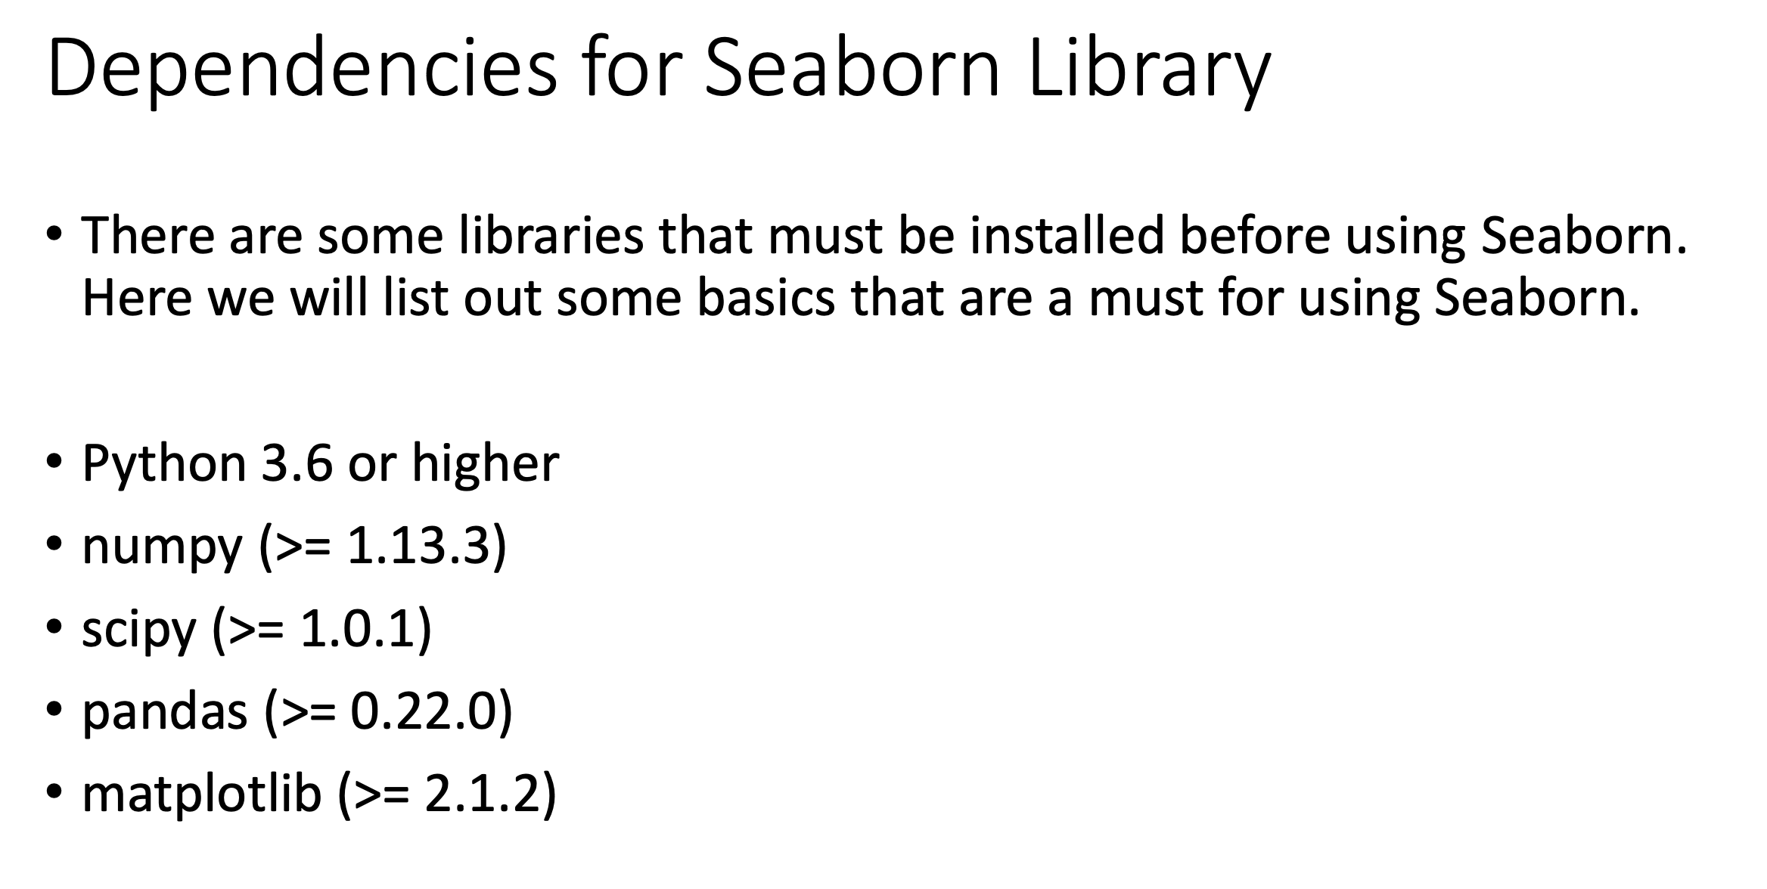

Slide 59
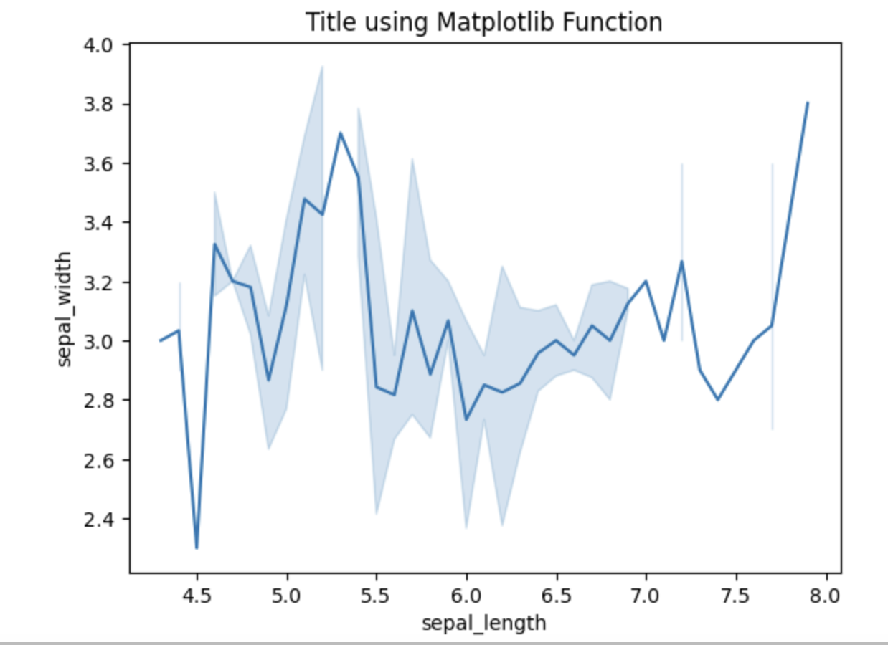
%pip install seaborn
import seaborn as sns
import matplotlib.pyplot as plt
import pandas as pd
# reading the database
data = pd.read_csv("iris.csv")
# draw lineplot
sns.lineplot(x="sepal_length", y="sepal_width", data=data)
plt.title('Title using Matplotlib Function')
plt.show()

Slide 60
2-Dimensional NumPy

Slide 61
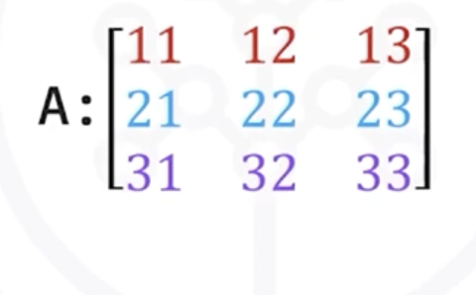
2-D NumPy
>> a = np.array([[1, 2, 3],[4, 5, 6]])
>> a.shape
(2, 3)
Create a numpy array of following list containing three nested lists:
a = [[11,12,13],[21,22,23],[31,32,33]]
A = np.array(a)

Slide 62
2-D NumPy
>> A.ndim
2
>> A.shape
(3,3) //a tuple
>>A.size
9
[[11,12,13],[21,22,23],[31,32,33]]

Slide 63
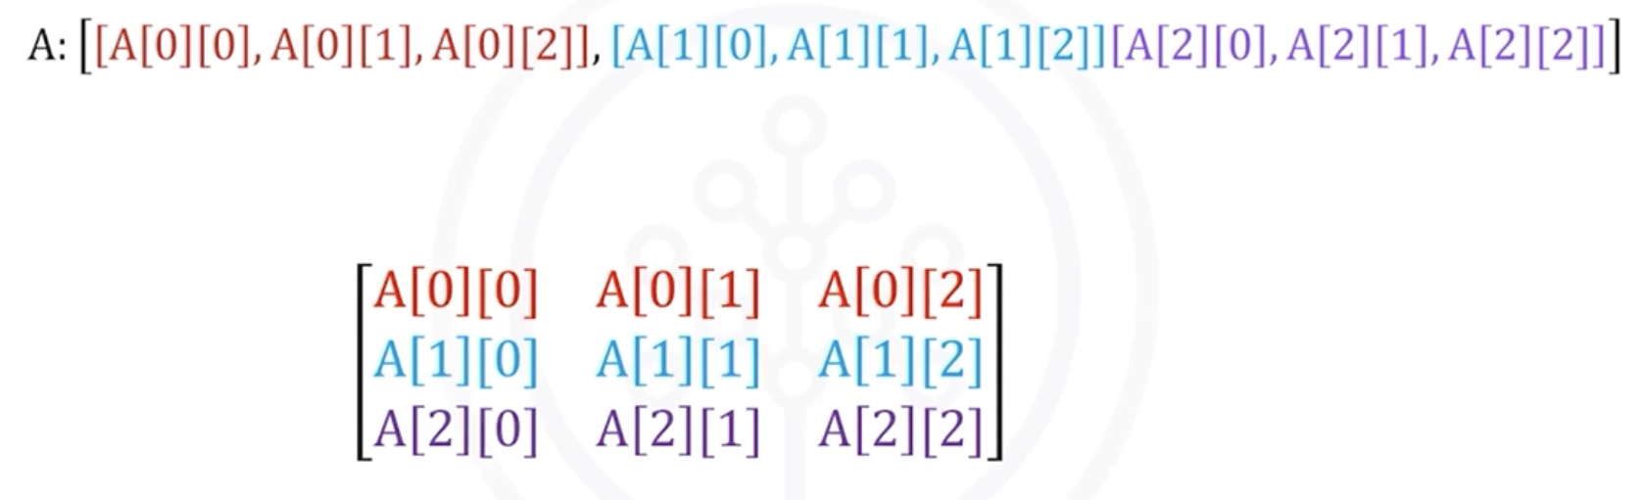
Accessing 2D NumPy

Slide 64
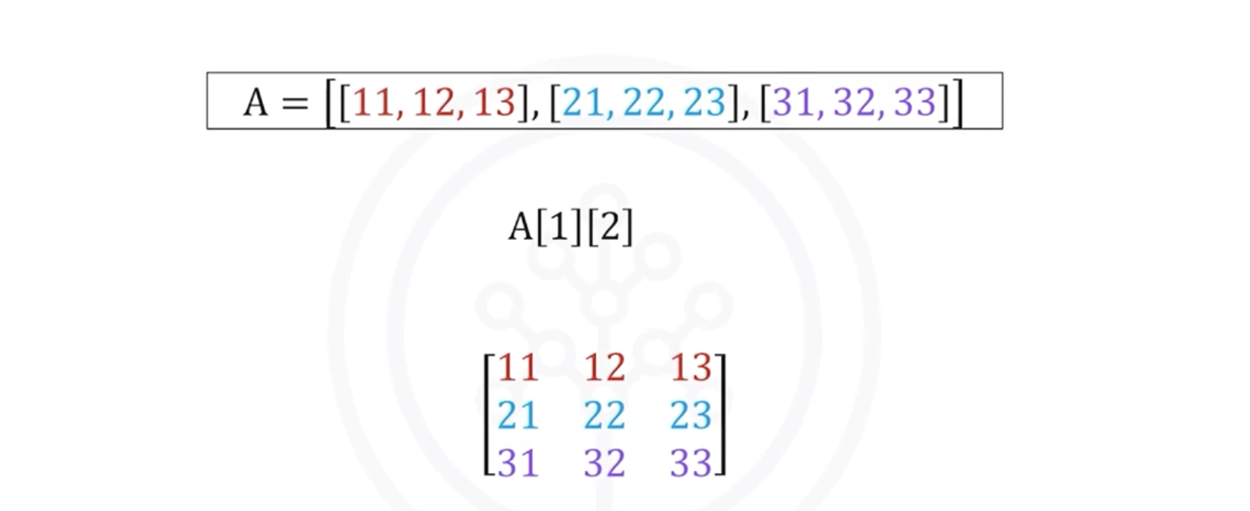
: 23

Slide 65
Slicing in 2D NumPy Array
>> A [0, 0 : 2]
Array([11,12])
>> A[0:2, 2]
Array([13,23])

Slide 66
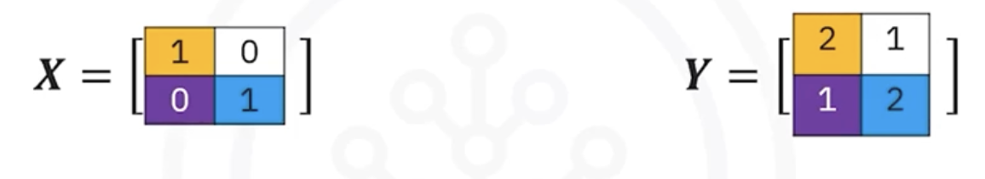
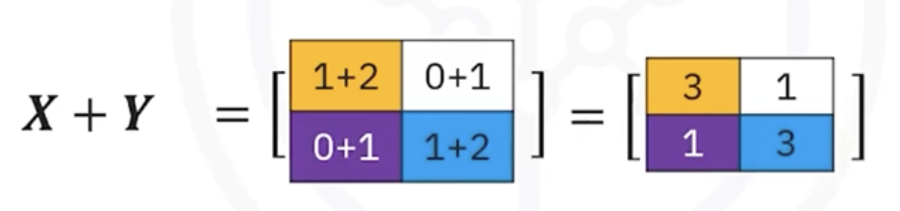
Addition in 2D NumPy Array
>> x= np.array([[1,0], [0, 1]])
>> y= np.array([[2,1], [1, 2]])
>> z = x + y
Z: array([[3,1],[1,3]])

Slide 67
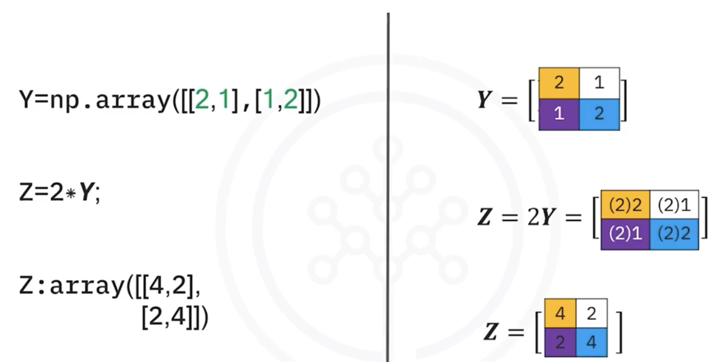
Multiplication (scalar) in 2D NumPy Array

Slide 68
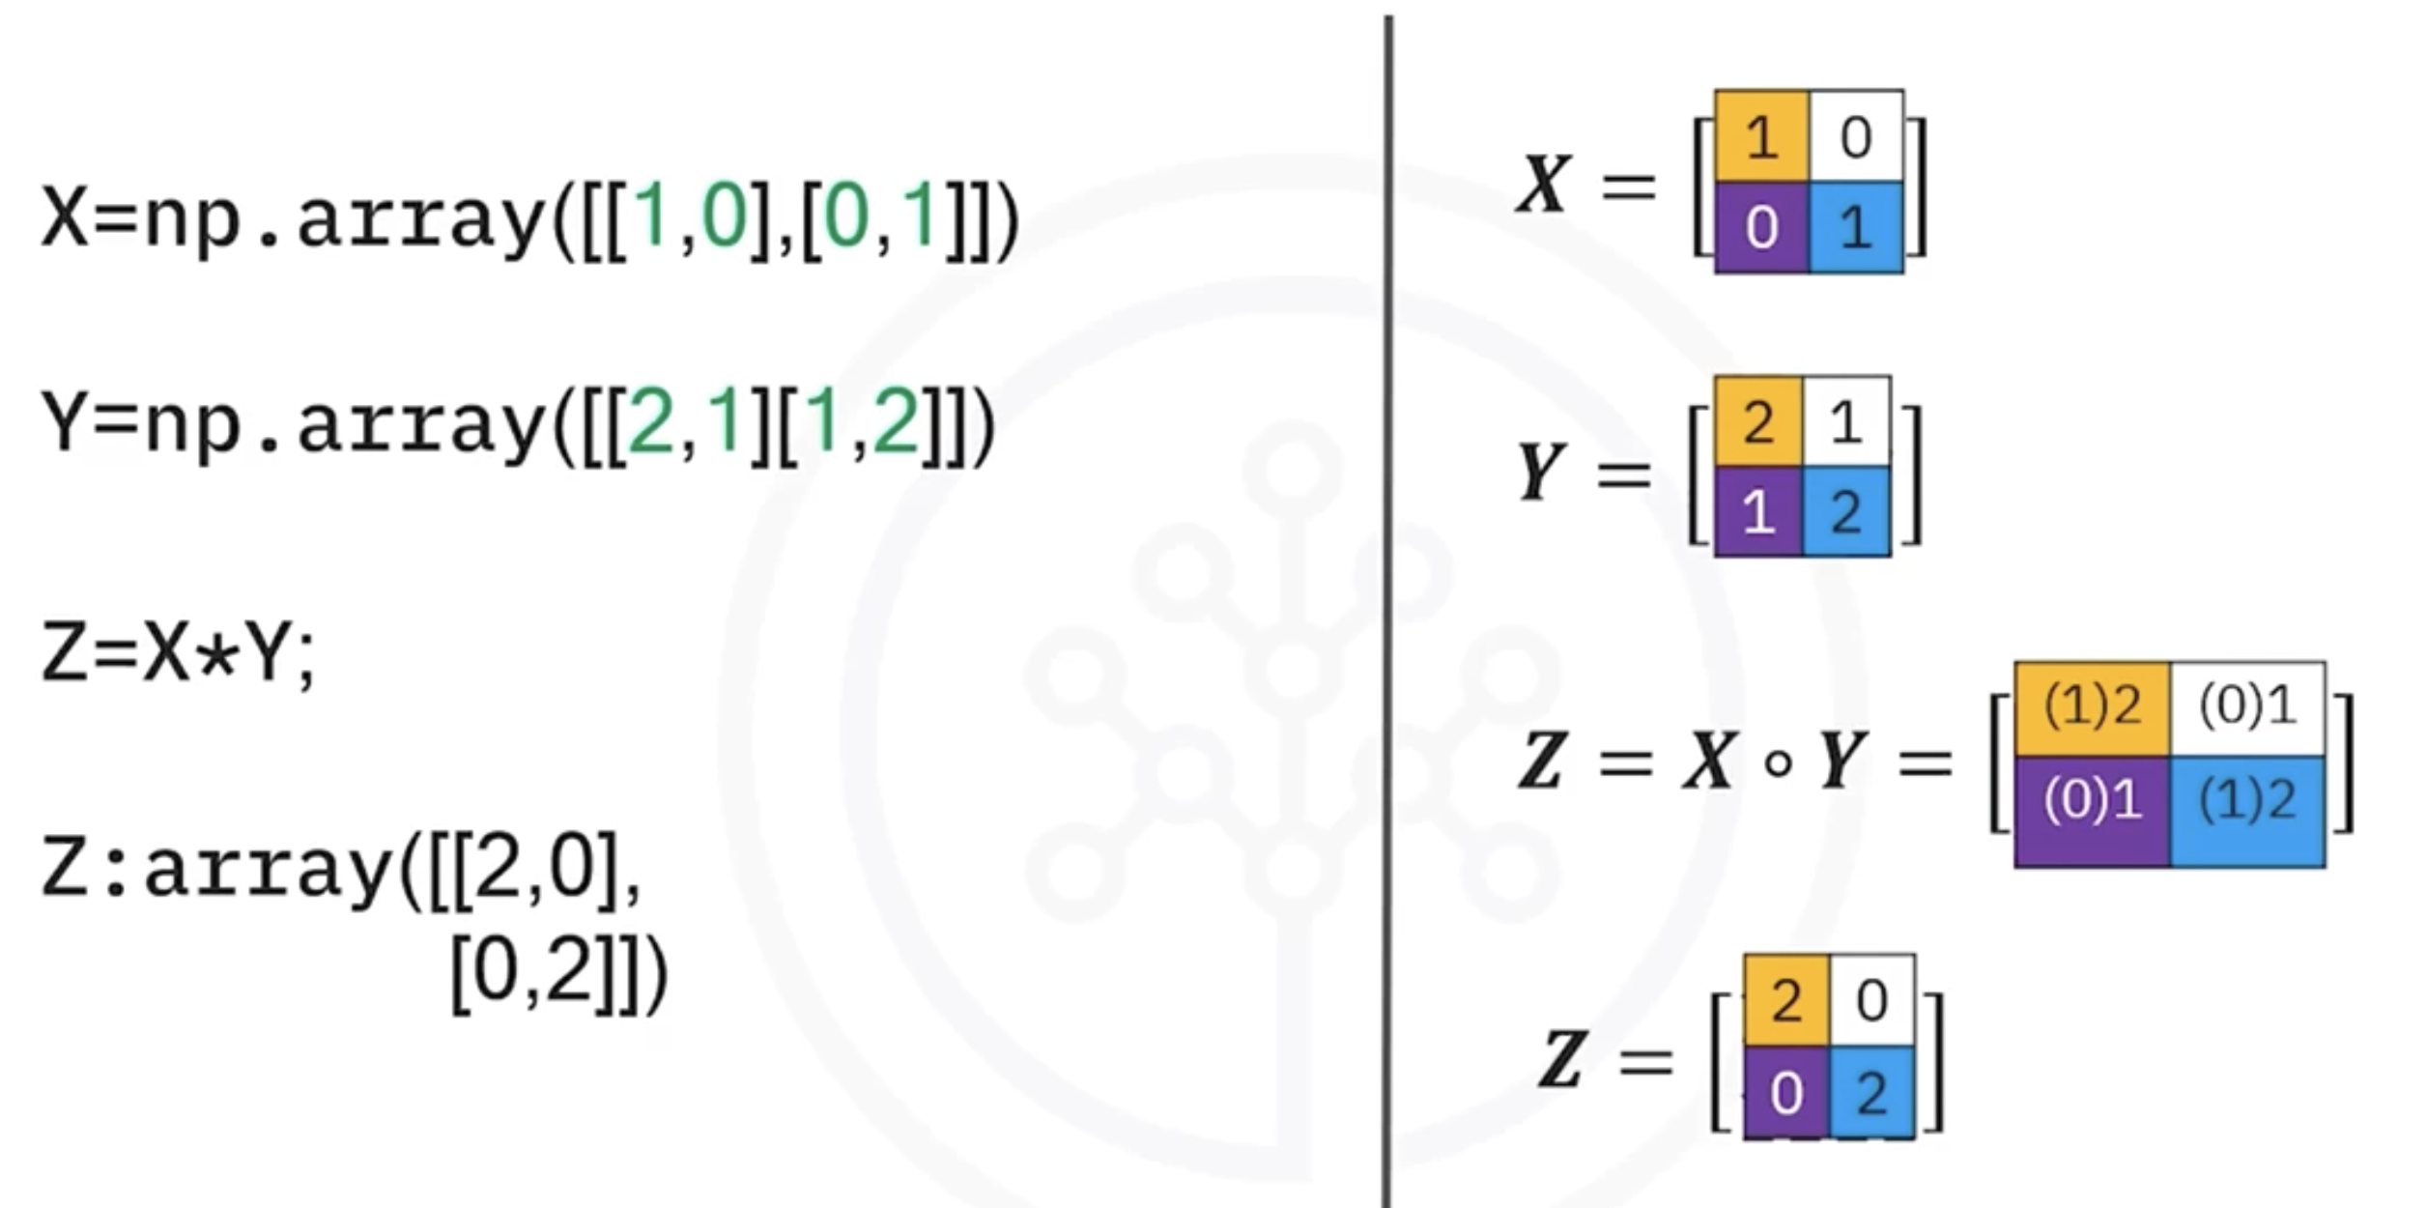
Multiplication (Hadamard Product) in 2D NumPy Array

Slide 69


Matrix Multiplication with NumPy Array
Number of columns in A is equal to number of rows of B

Slide 70

Best NumPy functions for Data Science
https://www.kaggle.com/code/abhayparashar31/best-numpy-functions-for-data-science-50#Replacing-Values-Inside-Array
https://stackoverflow.com/questions/4674473/valueerror-setting-an-array-element-with-a-sequence

Slide 71


