Slide 1


DBMS Group Project
Hospital Management System

Slide 2


Prepared by
Shlok Prajapati
Enrollment No : 21002170110139
Roll No : 9
Raj Shah
Enrollment No : 21002170110148
Roll No :
Krishna Patel
Enrollment No : 21002170110108
Roll No : 40
Aaliya Rangoonwala
Enrollment No : 21002170110152
Roll No : 41
Diya Shah
Enrollment No : 21002170110171
Roll No : 43

Slide 3
Table Of Contents
Introduction
ER Diagram
Tables Created
Initialised Data
Procedures
Triggers and Cursors

Slide 4
Introduction
Our Hospital Management System aims at developing the software that covers all the aspects of management and operations of hospital. It enables healthcare providers to improve operational effectiveness, reduce time consumption and enhance delivery of quality of care.
The health system is one of essential socio-economic activities; therefore, it requires rational and effective management. It is necessary to have a tool that allows adequate control of the information generated in health institutions.

Slide 5
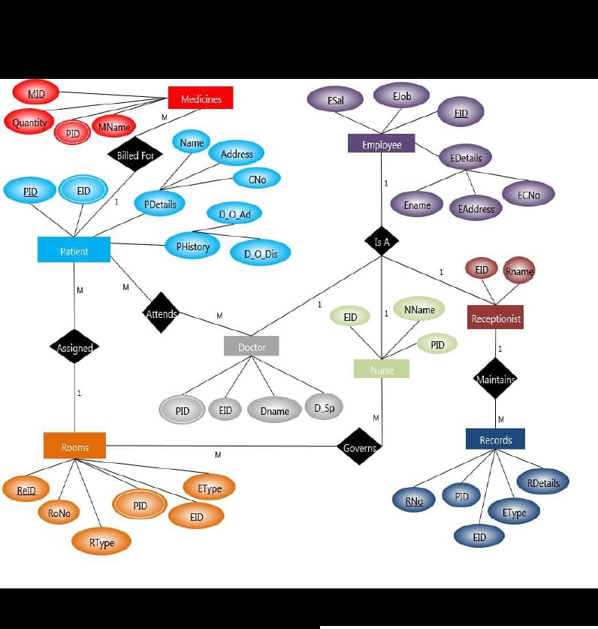
ER Diagram

Slide 6
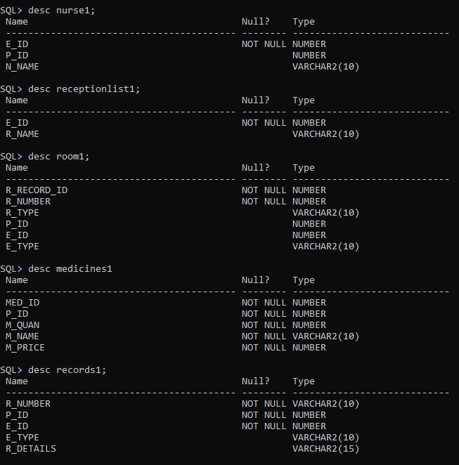
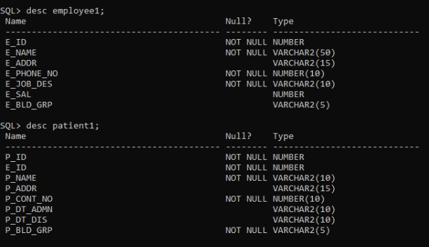
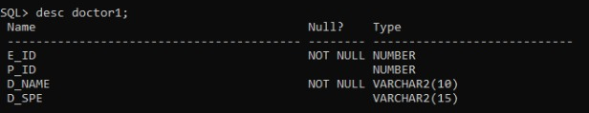
Tables Created

Slide 7
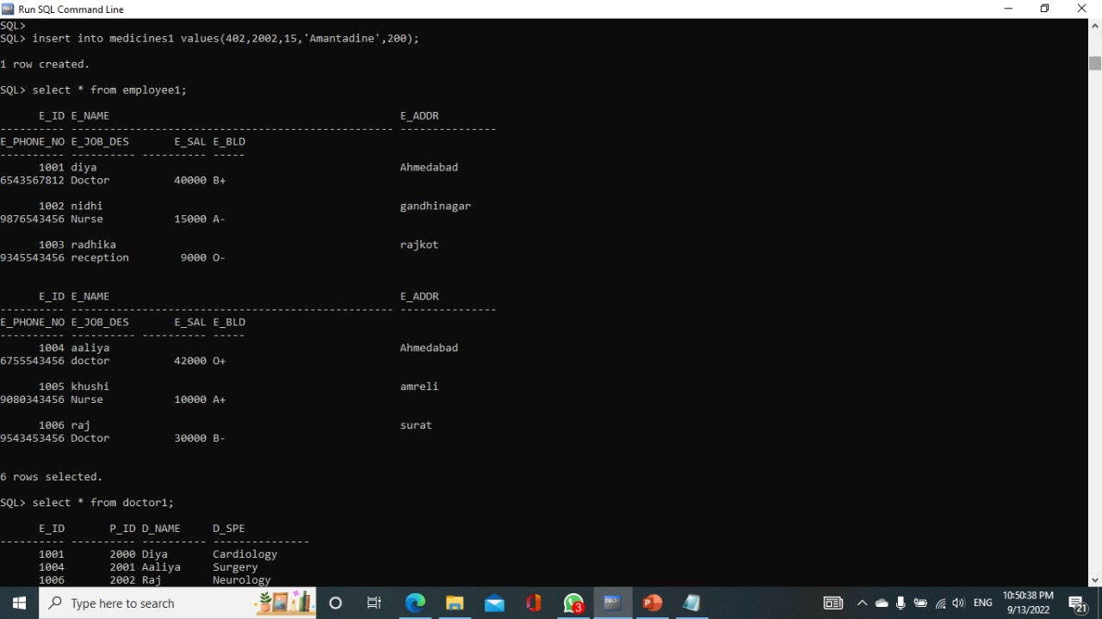
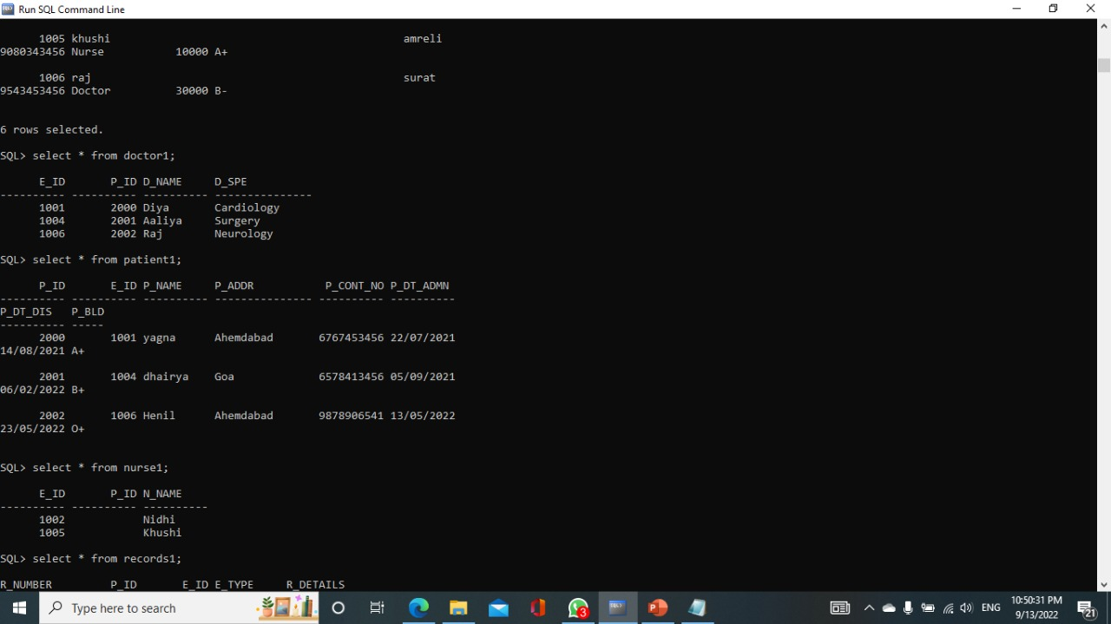
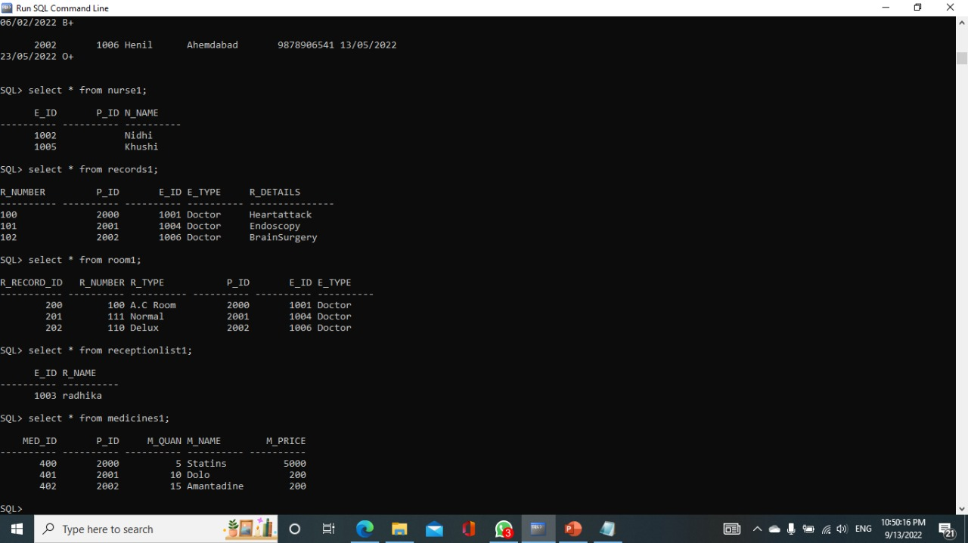
Initialised Data

Slide 8
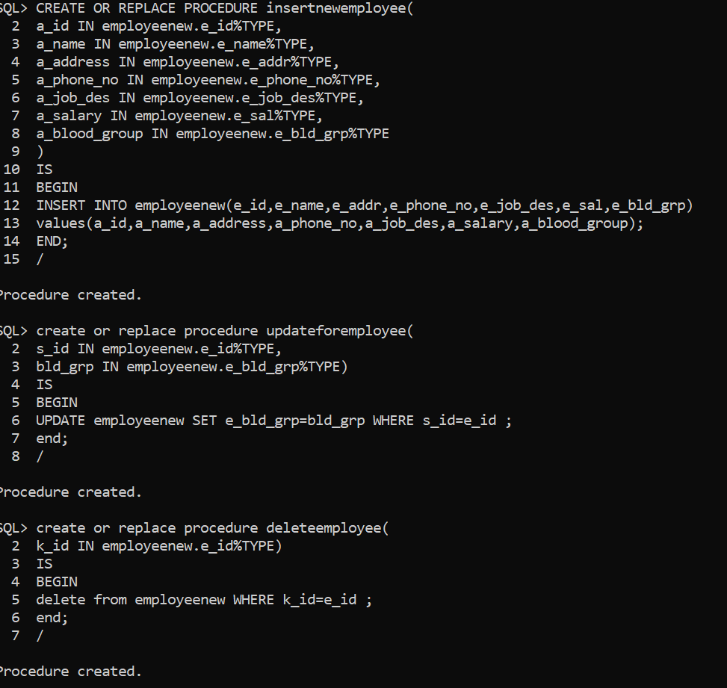
Procedures

Slide 9
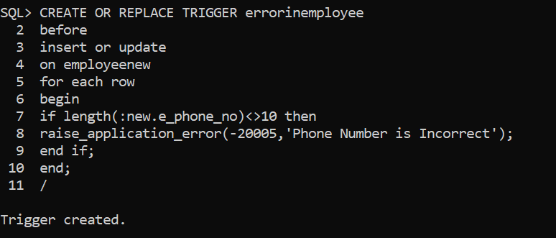
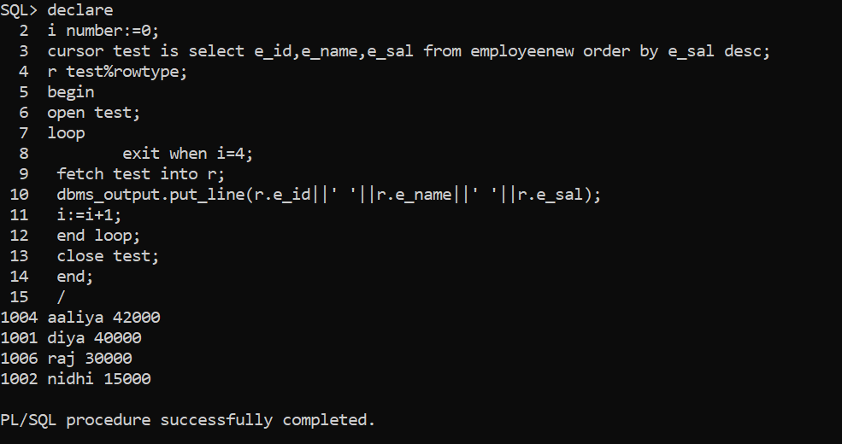
Triggers And Cursors

Slide 10
Thank You

