Slide 1
Data Structures & Algorithms
Part # 7 :
Stacks
Dr. Ali Al-Ibrahim

Slide 2
Outline
ADT Stacks
  Basic operations
  Examples of use
  Implementations
    Array-based and linked list-based
Stack Applications
  Balanced Symbol Checker
  Postfix Machines
  Tower of Hanoi
Summary
Dr.Ali Al-Ibrahim / wise / IT

Slide 3
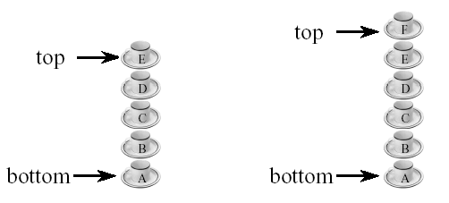
Stack of Cups
Add a cup on the stack.
Remove a cup from the stack.
A stack is a LIFO (Last-In, First-Out) list.
Read Example 5.3
Dr.Ali Al-Ibrahim / wise / IT

Slide 4
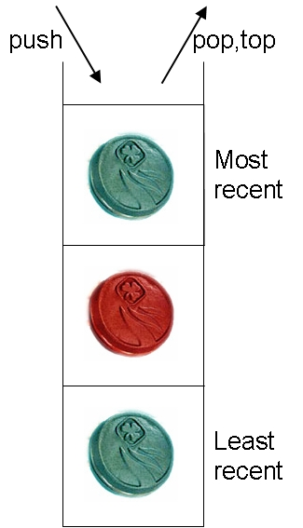
Stack
The last item added is pushed (added) to the stack.
The last item added can be popped (removed) from the stack.
The last item added can be topped (accessed) from the stack.
These operations all take constant time: O(1).
A typical stack interface:
void push(Thing newThing);
void pop();
Thing top();
Dr.Ali Al-Ibrahim / wise / IT

Slide 5
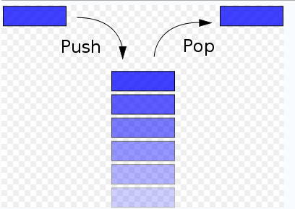
What is the Stack …
Stack: A stack is a collection of elements that are inserted and removed according to the last-in first-out (LIFO) principle.
Stack is a Dynamic and linear data structure in which data is added OR removed at only one end called the top
two fundamental operations:
push: The push operation adds to the top of the list,
pop: The pop operation removes an item from the top of the list, and returns this value to the caller.
Dr.Ali Al-Ibrahim / wise / IT

Slide 6
An Example of Stack
2
8
1
7
2
8
1
7
2
top
1
7
2
top
top
Push(8)
Push(2)
pop()
8
1
7
2
1
7
2
7
2
top
top
top
pop()
pop()
Dr.Ali Al-Ibrahim / wise / IT

Slide 7
Observations on Stack & Linear List
Stack is a restricted version of linear list
  All the stack operations can be performed as linear list operations
If we designate the left end of the list as the stack bottom and the right as the stack top
  Stack add (push) operation is equivalent to inserting at the right end of a linear list
  Stack delete (pop) operation is equivalent to deleting from the right end of a linear list
Dr.Ali Al-Ibrahim / wise / IT

Slide 8
Stack ADT
Abstract DataType stack {
instances
linear list of elements; one end is the bottom; the other is the top.
operations
empty() : Return true if stack is empty, return false otherwise;
size() : Return the number of elements in the stack;
top() : Return top element of stack;
pop() : Remove the top element from the stack;
push(x) : Add element x at the top of the stack;
}
Dr.Ali Al-Ibrahim / wise / IT

Slide 9
Stack Implementation: Array
A stack can be implemented as an array A and an
integer top that records the index of the top of the stack.
For an empty stack, set top to -1.
When push(X) is called, increment top, and write X to A[top].
When pop() is called, decrement top.
When top() is called, return A[top].
Dr.Ali Al-Ibrahim / wise / IT

Slide 10
Stack Implementation: Array
public class MyArrayStack<T>
{
private T[] array;
private int topOfStack;
public MyArrayStack() …
public boolean isEmpty() …
public double top() …
public double pop() …
public double isFull() …
public void push(double object) …
}
Dr.Ali Al-Ibrahim / wise / IT

Slide 11
StackAsArray – push() Method
push() method adds an element at the top the stack
It takes as argument an Object to be pushed.
It first checks if there is room left in the stack. If no room is left, it throws a StackFullException exception. Otherwise, it puts the object into the array, and then increments count variable by one.
public void push(Object obj){
if (count == array.length)
throw new ContainerFullException();
else
array[count++] = obj;
}
Complexity is O(1)
Dr.Ali Al-Ibrahim / wise / IT

Slide 12
StackAsArray – pop() Method
The pop method removes an item from the stack and returns that item.
The pop method first checks if the stack is empty. If the stack is empty, it throws a StackEmptyException. Otherwise, it simply decreases count by one and returns the item found at the top of the stack.
public Object pop()
{
if(count == 0)
throw new StackEmptyException();
else
Obj = array[--count];
return obj;
}
Complexity is O(1)
Dr.Ali Al-Ibrahim / wise / IT

Slide 13
StackAsArray – getTop() Method
getTop() method first checks if the stack is empty.
getTop() method is a stack accessor which returns the top item in the stack without removing that item. If the stack is empty, it throws a StackEmptyException. Otherwise, it returns the top item found at position count-1.
  public Object getTop(){
  if(count == 0)
  throw new ContainerEmptyException();
  else
  return array[count – 1];
  }
Complexity is O(1)
Dr.Ali Al-Ibrahim / wise / IT

Slide 14
Stack Application
Some applications of stacks are:
  Balancing symbols.
  Computing or evaluating postfix expressions.
  Converting expressions from infix to postfix
  Page-visited history in a Web browser
  Undo sequence in a text editor
  Chain of method calls in the Java Virtual Machine
Dr.Ali Al-Ibrahim / wise / IT

Slide 15
Evaluating Infix Expression
(5+9)*2+6*5
An ordinary arithmetical expression like the above is called infix-expression -- binary operators appear in between their operands.
The order of operations evaluation is determined by the precedence rules and parenthesis.
When an evaluation order is desired that is different from that provided by the precedence, parentheses are used to override precedence rules.
Dr.Ali Al-Ibrahim / wise / IT

Slide 16
Infix & Postfix Notation
Expressions can also be represented using postfix notation - where an operator comes after its two operands.
The advantage of postfix notation is that the order of operation evaluation is unique without the need for precedence rules or parenthesis.
Infix | Postfix
16 / 2 | 16 2 /
(2 + 14)* 5 | 2 14 + 5 *
2 + 14 * 5 | 2 14 5 * +
(6 – 2) * (5 + 4) | 6 2 - 5 4 + *
Dr.Ali Al-Ibrahim / wise / IT

Slide 17
Postfix Notation
The following algorithm uses a stack to evaluate a postfix expressions.
Start with an empty stack
for (each item in the expression) {
if (the item is a number)
Push the number onto the stack
else if (the item is an operator){
Pop two operands from the stack
Apply the operator to the operands
Push the result onto the stack
}
}
Pop the only one number from the stack – that’s the result of the evaluation
Dr.Ali Al-Ibrahim / wise / IT

Slide 18
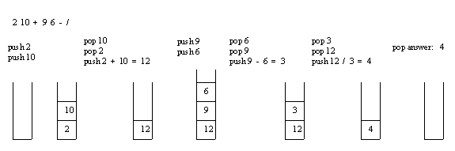
Postfix Notation
Example: Consider the postfix expression, 2 10 + 9 6 - /, which is (2 + 10) / (9 - 6) in infix, the result of which is 12 / 3 = 4.
The following is a trace of the postfix evaluation algorithm for the above.
Dr.Ali Al-Ibrahim / wise / IT

Slide 19
Infix to Postfix Conversion
A stack can also be used to convert an infix expression to postfix expression.
Example: infix expression
a + b * c + (d * e + f) * g
to postfix expression
a b c * + d e * f + g * +
Dr.Ali Al-Ibrahim / wise / IT

Slide 20
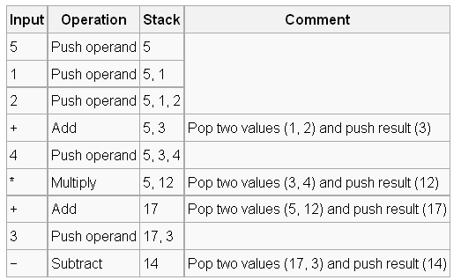
The Stack ADT
An example
5 + ((1 + 2) * 4) − 3
5 1 2 + 4 * + 3 −
Dr.Ali Al-Ibrahim / wise / IT

Slide 21
Application 1: Balancing Symbols
Braces, paranthenses, brackets, begin, ends must match each other
[ { [ ( )] } ]
[{]}()
Easy check using stacks
Dr.Ali Al-Ibrahim / wise / IT

Slide 22
The Stack ADT
Application 1: Balancing Symbols
  Balancing symbols: Given lines of code, every right brace }, bracket ], and parenthesis } must corresponds its left counterpart.
  legal: [ ( ) ] , { [ ] ( ) }
  wrong: [ ( ] ), { [ } ( ) ]
An algorithm uses a stack as follows:
  Make an empty stack
  Check every character by the following rules.
    if this character is an opening symbol, push it onto the stack
    if this character is closing symbol, then if the stack is empty report an error. Otherwise, pop the stack. If the symbol popped doesn’t match, then report an error.
  After all characters processed, if the stack isn’t empty, report an error.

Slide 23
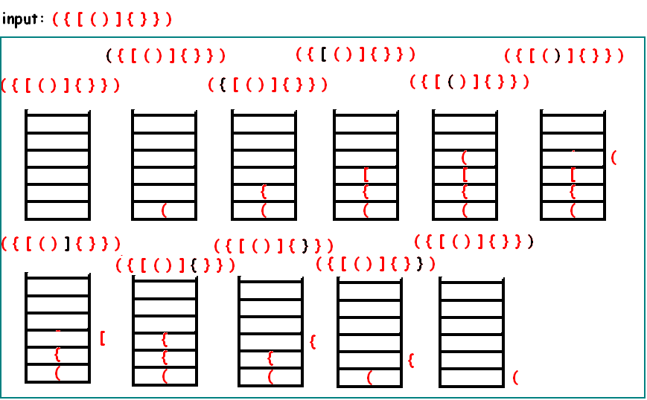
The Stack ADT
Dr.Ali Al-Ibrahim / wise / IT

Slide 24
Application: Parenthesis Matching
Problem: match the left and right parentheses in a character string
(a*(b+c)+d)
  Left parentheses: position 0 and 3
  Right parentheses: position 7 and 10
  Left at position 0 matches with right at position 10
(a+b))*((c+d)
  (0,4)
  Right parenthesis at 5 has no matching left parenthesis
  (8,12)
  Left parenthesis at 7 has no matching right parenthesis
Dr.Ali Al-Ibrahim / wise / IT

Slide 25
Parenthesis Matching
(((a+b)*c+d-e)/(f+g)-(h+j)*(k-1))/(m-n)
  Output pairs (u,v) such that the left parenthesis at position u is matched with the right parenthesis at v.
  (2,6) (1,13) (15,19) (21,25) (27,31) (0,32) (34,38)
How do we implement this using a stack?
  Scan expression from left to right
  When a left parenthesis is encountered, add its position to the stack
  When a right parenthesis is encountered, remove matching position from the stack
Dr.Ali Al-Ibrahim / wise / IT

Slide 26
Example of Parenthesis Matching
  (((a+b)*c+d-e)/(f+g)-(h+j)*(k-1))/(m-n)
…
stack
2
1
1
15
21
0
0
0
0
0
0
0
…
output
(2,6)
(1,13)
(15,19)
(21,25)
Do the same for (a-b)*(c+d/(e-f))/(g+h)
Dr.Ali Al-Ibrahim / wise / IT

Slide 27
Example
Evaluating Postfix Expressions:
  Infix expression: 4*2+5+6*3
  Value 31 correct← parenthesis used.
  Value 57 incorrect ← no parenthesis used.
  In postfix form, above expression becomes:
  4 2* 5 + 6 3*+
  →Advantage: no brackets are needed and a stack can be used to compute the expression.
Dr.Ali Al-Ibrahim / wise / IT

Slide 28
Stack Errors
Push(2)!!
Stack Overflow
  An attempt to add a new element in an already full stack is an error
  A common mistake often made in stack implementation
Stack Underflow
  An attempt to remove an element from the empty stack is also an error
  Again, a common mistake often made in stack implementation
top
89
78
9
….. …..
6
Stack Overflow
pop()
top
Stack Underflow
Dr.Ali Al-Ibrahim / wise / IT

Slide 29
The Stack Abstract Data Type
Stacks are the simplest of all data structures
Formally, a stack is an abstract data type (ADT) Mathematical Model that supports the following two methods:
  push(e): Insert element e to the top of the stack
  pop(): Remove from the stack and return the top element on the stack;
      an error occurs if the stack is empty – what error?
Additionally, Other methods :
  size(): Return the number of elements in the stack
  isEmpty(): Return a Boolean indicating if the stack is empty
  top(): Return the top element in the stack, without removing it
    an error occurs if the stack is empty
Dr.Ali Al-Ibrahim / wise / IT

Slide 30
The Stack Abstract Data Type
Example 5.3: The following table shows a series of stack operations and their effects on an initially empty stack S of integers.
Operation | Output | Stack Contents
push(5) | - | (5)
push(3) | - | (5, 3)
pop() | 3 | (5)
push(7) | - | (5, 7)
pop() | 7 | (5)
top() | 5 | (5)
pop() | 5 | ()
pop() | "error“ | ()
isEmpty() | true | ()
push(9) | - | (9)
push(7) | - | (9, 7)
push(3) | - | (9, 7, 3)
push(5) | - | (9, 7, 3, 5)
size() | 4 | (9, 7, 3, 5)
pop() | 5 | (9, 7, 3)
Dr.Ali Al-Ibrahim / wise / IT

Slide 31
A Stack Interface in Java
The stack data structure is included as a "built-in" class in the java.util package of Java.
Class java.util.Stack is a data structure that stores generic Java objects and includes the following methods:
  push()
  pop()
  peek() (equivalent to top()),
  size(), and
  empty() (equivalent to isEmpty()).
  Methods pop() and peek() throw exception EmptyStackException if they are called on an empty stack.
Dr.Ali Al-Ibrahim / wise / IT

Slide 32
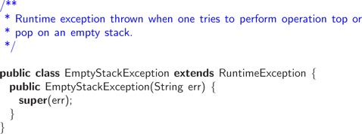
The Stack Abstract Data Type
Implementing an (ADT) in Java involves two steps.
  Definition of a Java Application Programming Interface (API), or simply interface which :
    Describes the names of methods that the ADT supports.
    How they are to be declared and used.
  Define exceptions for any error condition that can arise.
    An error condition occurs when calling method pop() or top() on an empty stack. This is signaled by throwing an exception of type EmptyStackException,
Dr.Ali Al-Ibrahim / wise / IT

Slide 33
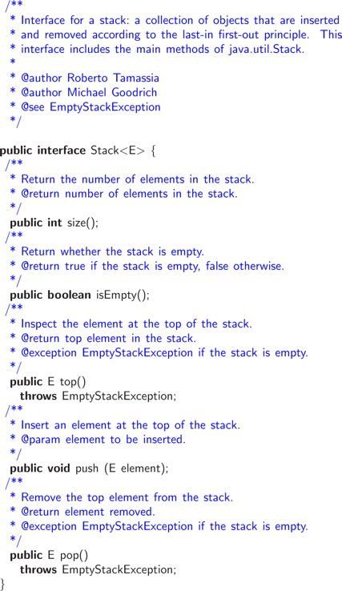
Dr.Ali Al-Ibrahim / wise / IT

