Slide 1
Data Structures & Algorithms
Part # 9:
Queues
Dr. Ali Al-Ibrahim

Slide 2
What is Queue?
Queue is a data structure in which insertion is done at one end (Front), while deletion is performed at the other end (Rear)
  Contrast with stack, where insertion and deletion at one and the same end
It is First In, First Out (FIFO) structure
  For example, customers standing in a check-out line in a store, the first customer in is the first customer served.

Slide 3
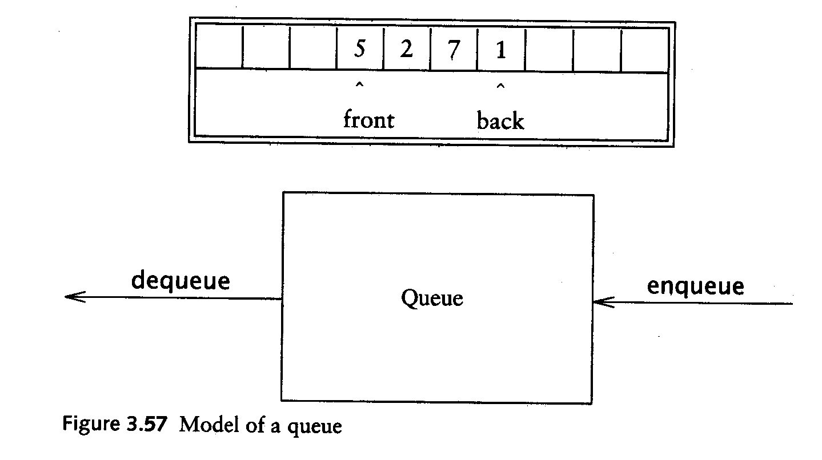
Queue operations
Enqueue: insert an element at the rear of the list
Dequeue: delete the element at the front of the list
Remove
(Dequeue)
Insert
(Enqueue)
front
rear

Slide 4
Building a Queue Step-by-Step
There are several different algorithms to implement Enqueue and Dequeue
Enqueuing
  The front index is always fixed
  The rear index moves forward in the array
rear
rear
rear
3
3
6
3
6
9
front
front
front
Enqueue(3)
Enqueue(6)
Enqueue(9)

Slide 5
Building a Queue Step-by-Step
Dequeuing
  The element at the front of the queue is removed
  Move all the elements after it by one position
rear
rear
rear = -1
6
9
9
front
front
front
Dequeue()
Dequeue()
Dequeue()

Slide 6
The Queue Abstract Data Type
Formally, the queue abstract data type defines a collection that keeps objects in a sequence, where
  element access and deletion are restricted to the first element in the sequence, the front of the queue,
  and element insertion is restricted to the end of the sequence, the rear of the queue.
  This restriction enforces the rule that items are inserted and deleted in a queue according to the first-in first-out (FIFO) principle.
The queue abstract data type (ADT) supports the following two fundamental methods:
  enqueue(e): Insert element e at the rear of the queue.
  dequeue(): Remove and return from the queue the object at the front;
    an error occurs if the queue is empty.
Additionally, similar to the case with the Stack ADT, the queue ADT includes the following supporting methods:
  size(): Return the number of objects in the queue.
  isEmpty(): Return a Boolean value that indicates whether the queue is empty.
front(): Return, but do not remove, the front object in the queue;
    an error occurs if the queue is empty.

Slide 7
The Queue Abstract Data Type
Example 5.4: The following table shows a series of queue operations and their effects on an initially empty queue Q of integer objects. For simplicity, we use integers instead of integer objects as arguments of the operations.
Operation | Output | front ← Q ← rear
enqueue(5) enqueue(3) dequeue( ) enqueue(7) dequeue( ) front( ) dequeue( ) dequeue( ) isEmpty( ) enqueue(9) enqueue(7) size() enqueue(3) enqueue(5) dequeue( ) | - - 5 - 3 7 7 "error" true - - 2 - - 9 | (5) (5, 3) (3) (3, 7) (7) (7) ( ) ( ) ( ) (9) (9, 7) (9, 7) (9, 7, 3) (9, 7, 3, 5) (7, 3, 5)

Slide 8
The Queue Abstract Data Type
Example Applications
There are several possible applications for queues.
  Stores,
  theaters,
  reservation centers,
  and other similar services typically process customer requests according to the FIFO principle.
A queue would therefore be a logical choice for a data structure to handle transaction processing for such applications.
For example, it would be a natural choice for handling calls to the reservation center of an airline or to the box office of a theater.

Slide 9
A Queue Interface in Java
A Java interface for the queue ADT is given in Code Fragment 5.13.
This generic interface specifies that objects of arbitrary object types can be inserted into the queue.
Thus, we don't have to use explicit casting when removing elements.
Note that the size and isEmpty methods have the same meaning as their counterparts in the Stack ADT.
These two methods, as well as the front method, are known as accessor methods, for they return a value and do not change the contents of the data structure.

Slide 10
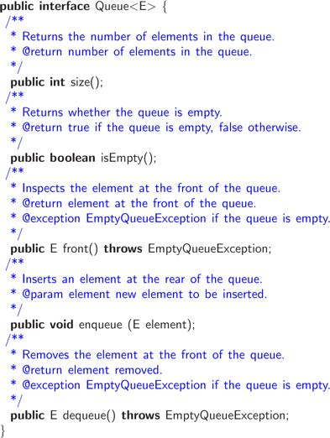
Code Fragment 5.13: Interface Queue documented with comments in Javadoc style.

Slide 11
A Simple Array-Based Queue Implementation
We present a simple realization of a queue by means of an array, Q, of fixed capacity, storing its elements.
Since the main rule with the queue ADT is that we insert and delete objects according to the FIFO principle, we must decide how we are going to keep track of the front and rear of the queue.
One possibility is to adapt the approach we used for the stack implementation,
  letting Q[0] be the front of the queue and then letting the queue grow from there.
    This is not an efficient solution, however, for it requires that we move all the elements forward one array cell each time we perform a dequeue operation.
    Such an implementation would therefore take O(n) time to perform the dequeue method, where n is the current number of objects in the queue.
    If we want to achieve constant time for each queue method, we need a different approach, but that approach may have its own demerits.

Slide 12
Using an Array in a Circular Way
To avoid moving objects once they are placed in Q,
  we define two variables f and r, which have the following meanings:
    f is an index to the cell of Q storing the first element of the queue (next candidate to be removed by a dequeue operation),
    f = r queue is empty.
    r is an index to the next available array cell in Q.
Initially, we assign f = r = 0, which indicates that the queue is empty.
When we remove an element from the front of the queue, increment f to index the next cell.
Adding an element, we store it in cell Q[r] and increment r to index the next available cell in Q.
This scheme allows us to implement methods front, enqueue, and dequeue in constant time, that is, O(1) time.
However, there is still a problem with this approach.
what happens if we repeatedly enqueue and dequeue a single element N different times.
  We would have f = r = N. If we were then to try to insert the element just one more time, we would get an array-out-of-bounds error (since the N valid locations in Q are from Q[0] to Q[N − 1]), even though there is plenty of room in the queue in this case.
  To avoid this problem and be able to utilize all of the array Q, we let the f and r indices "wrap around" the end of Q.
  That is, we now view Q as a "circular array" that goes from Q[0] to Q[N − 1] and then immediately back to Q[0] again. (See Figure 5.4.)

Slide 13
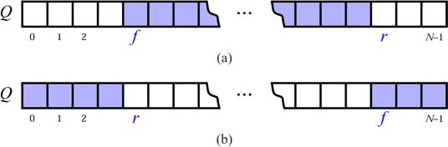
Figure 5.4: Using array Q in a circular fashion:
the "normal" configuration with f ≤ r; (b) the "wrapped around" configuration
with r < f. The cells storing queue elements are highlighted.

Slide 14
Using the Modulo Operator to Implement a Circular Array
Implementing this circular view of Q is actually pretty easy.
Each time we increment f or r, we compute this increment as "(f + 1) mod N" or "(r + 1) mod N," respectively.
"mod" is the modulo operator, which is computed by taking the remainder after an integral division.
For example, 14 divided by 4 is 3 with remainder 2, so 14 mod 4 = 2.
Java uses "%" to denote the modulo operator. By using the modulo operator, we can view Q as a circular array and implement each queue method in a constant amount of time (that is, O(1) time). We describe how to use this approach to implement a queue in Code Fragment 5.14.

Slide 15
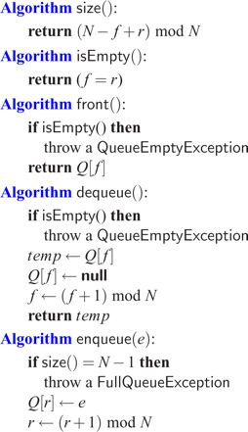
Code Fragment 5.14: Implementation of a queue using a circular array.
The implementation uses the modulo operator to "wrap" indices around the end of the array and it also includes two instance variables, f and r, which index the front of the queue and first empty cell after the rear of the queue respectively.

Slide 16
Using the Modulo Operator to Implement a Circular Array
The implementation above contains an important detail, which might be missed at first.
Consider the situation that occurs if we enqueue N objects into Q without dequeuing any of them. We would have f = r, which is the same condition that occurs when the queue is empty.
Hence, we would not be able to tell the difference between a full queue and an empty one in this case.
Fortunately, this is not a big problem, and a number of ways for dealing with it exist.
The solution we describe here is to insist that Q can never hold more than N − 1 objects.
This simple rule for handling a full queue takes care of the final problem with our implementation, and leads to the pseudo-coded descriptions of the queue methods given in Code Fragment 5.14.
Note our introduction of an implementation-specific exception, called FullQueueException, to signal that no more elements can be inserted in the queue.
Also note the way we compute the size of the queue by means of the expression (N − f + r) mod N, which gives the correct result both in the "normal" configuration (when f ≤ r) and in the "wrapped around" configuration (when r < f).
The Java implementation of a queue by means of an array is similar to that of a stack, and is left as an exercise (P-5.4).
Table 5.2 shows the running times of methods in a realization of a queue by an array. As with our array-based stack implementation, each of the queue methods in the array realization executes a constant number of statements involving arithmetic operations, comparisons, and assignments. Thus, each method in this implementation runs in O(1) time.

Slide 17
Table 5.2: Performance of a queue realized by an array
The space usage is O(N), where N is the size of the array, determined at the time the queue is created. Note that the space usage is independent from the number n < N of elements that are actually in the queue.
Method | Time
Size isEmpty front enqueue dequeue | O(1) O(1) O(1) O(1) O(1)
Problem is the capacity of the queue to be some fixed value. In a real application, we may actually need more or less queue capacity than this, but if we have a good capacity estimate, then the array-based implementation is quite efficient.

Slide 18
Implementing a Queue with a Generic Linked List
We can efficiently implement the queue ADT using a generic singly linked list.
For efficiency reasons,
  the front of the queue to be at the head of the list,
  and the rear of the queue to be at the tail of the list.
  In this way, we remove from the head and insert at the tail. (Why would it be bad to insert at the head and remove at the tail?) Note that we need to maintain references to both the head and tail nodes of the list. Rather than go into every detail of this implementation, we simply give a Java implementation for the fundamental queue methods in Code Fragment 5.15.

Slide 19
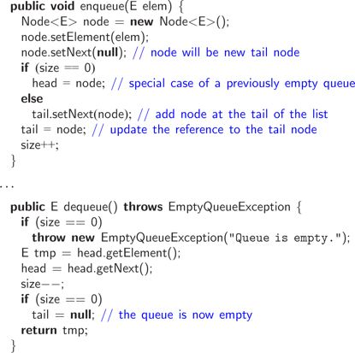
Code Fragment 5.15: Methods enqueue and dequeue in the implementation of the queue ADT by means of a singly linked list, using nodes from class Node of Code Fragment 5.6.
Each of the methods of the singly linked list implementation of the queue ADT runs in O(1) time. We also avoid the need to specify a maximum size for the queue, but this benefit comes at the expense of increasing the amount of space used per element. Still, the methods in the singly linked list queue implementation are more complicated than we might like, for we must take extra care in how we deal with special cases where the queue is empty before an enqueue or where the queue becomes empty after a dequeue.

Slide 20
Round Robin Schedulers
A popular use of the queue data structure is to implement a round robin scheduler, where
  we iterate through a collection of elements in a circular fashion and "service" each element by performing a given action on it.
  Such a schedule is used,
    for example, to fairly allocate a resource that must be shared by a collection of clients.
    For instance, we can use a round robin scheduler to allocate a slice of CPU time to various applications running concurrently on a computer.
We can implement a round robin scheduler using a queue, Q, by repeatedly performing the following steps (see Figure 5.5):
  1. e ← Q.dequeue()
  2. Service element e
  3. Q.enqueue(e)

Slide 21
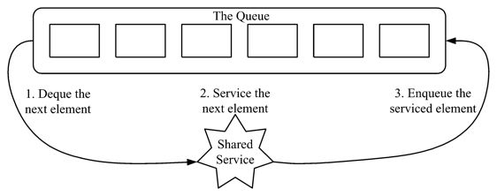
Figure 5.5: The three iterative steps for using a queue to implement a round robin
scheduler.

Slide 22
The Josephus Problem
In the children's game "hot potato," a group of n children sit in a circle passing an object, called the "potato," around the circle. The potato begins with a starting child in the circle, and the children continue passing the potato until a leader rings a bell, at which point the child holding the potato must leave the game after handing the potato to the next child in the circle. After the selected child leaves, the other children close up the circle. This process is then continued until there is only one child remaining, who is declared the winner. If the leader always uses the strategy of ringing the bell after the potato has been passed k times, for some fixed value k, then determining the winner for a given list of children is known as the Josephus problem.

Slide 23
Solving the Josephus Problem Using a Queue
We can solve the Josephus problem for a collection of n elements using a queue, by associating the potato with the element at the front of the queue and storing elements in the queue according to their order around the circle. Thus, passing the potato is equivalent to dequeuing an element and immediately enqueuing it again. After this process has been performed k times, we remove the front element by dequeuing it from the queue and discarding it. We show a complete Java program for solving the Josephus problem using this approach in Code Fragment 5.16, which describes a solution that runs in O(nk) time. (We can solve this problem faster using techniques beyond the scope of this book.)

Slide 24
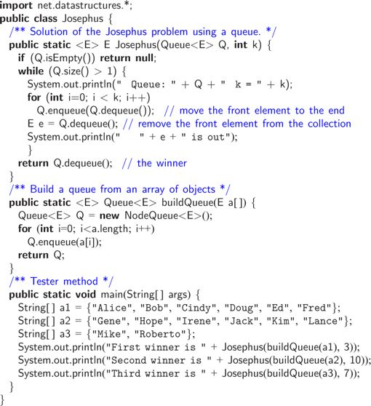
Code Fragment 5.16: A complete Java program for solving the Josephus problem
using a queue. Class NodeQueue is shown in Code Fragment 5.15.

