Slide 1
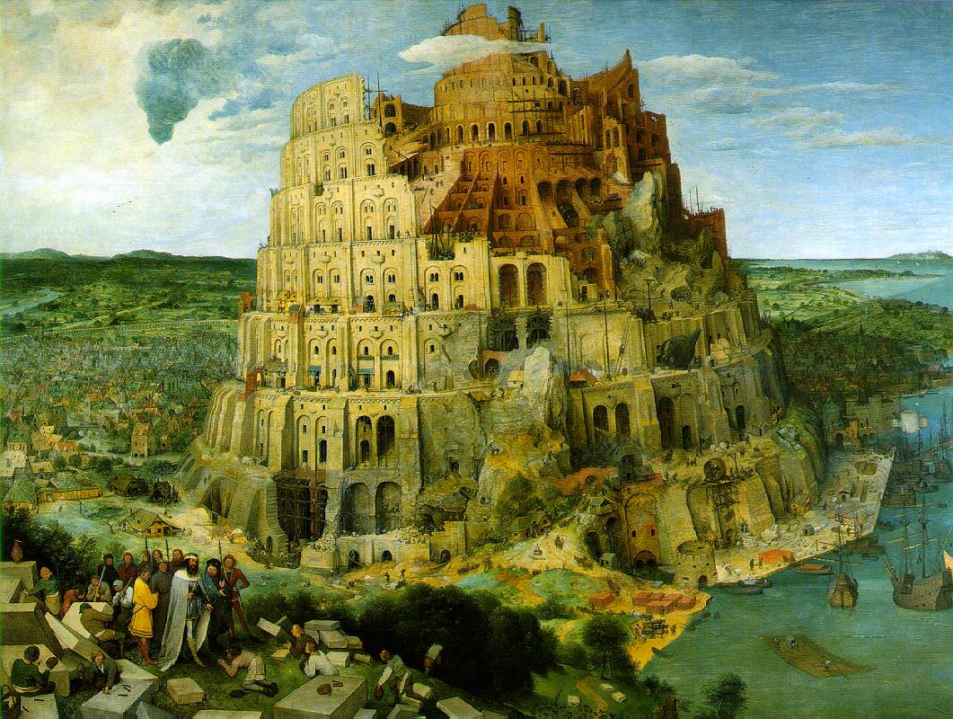
Requirements Engineering
From System Goals to UML Models to Software Specifications

Slide 2
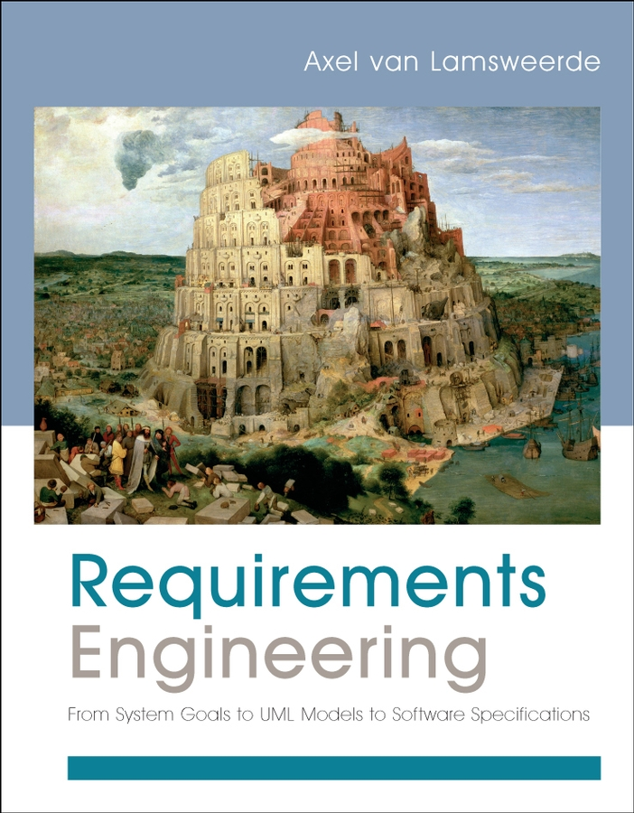
Book support
Requirements Engineering:
From System Goals
to UML Models
to Software Specifications
Axel van Lamsweerde
Wiley,
Jan. 2009

Slide 3

What is requirements engineering ?
Set of activities producing the requirements on a software-intensive system
  elicitation, evaluation, specification, analysis,
  evolution management
  system objectives, functionalities, target qualities, constraints, assumptions
Requirements quality assurance is a key concern for software quality assurance

Slide 4
Requirements engineering (RE), roughly ...
Identify & analyze problems with an existing system
(system-as-is),
Identify & evaluate objectives, opportunities, options for new system (system-to-be),
Identify & define functionalities of, constraints on, responsibilities in system-to-be,
Specify & organize all of these in a requirements document to be maintained throughout system evolution
System = software + environment
(people, devices, other software)

Slide 5
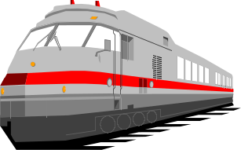
Example: transportation between airport terminals
Problem (system-as-is):
  passengers frequently missing flight connections among different terminals; slow & inconvenient transportation
  number of passengers regularly increasing
Objectives, options (system-to-be):
  support high-frequency trains between terminals
  with or without train drivers ?
Functionalities, constraints:
  software-based control of train accelerations, doors opening etc. to achieve prompt and safe transportation
RE deliverable: requirements document for system-to-be

Slide 6
Requirements in the software lifecycle
Getting
the
right
system
Requirements engineering
Software design
Getting
the
software
right
Software implementation
Software evolution

Slide 7
Why requirements engineering ?
RE is critical
  Major cause of software failure
    Requirements-related errors are the most numerous, persistent, expensive, dangerous
  Severe consequences: cost overruns, delivery delays, dissatisfaction, degradations, accidents, ...
  RE has multiple impact: legal, social, economical, technical
  Certification issues
RE is hard

Slide 8

What makes RE hard ?
Broad scope
  multiple system versions: as-is, to-be, to-be-next
  hybrid environment:
    human organizations, policies, regulations
    devices, physical laws
Multiple concerns
  functional, quality, development concerns
Multiple abstraction levels
  strategic objectives, operational details

Slide 9
What makes RE hard ? (2)
Multiple stakeholders
  with different background
  with different interests and conflicting viewpoints
Multiple intertwined tasks during iterative
elicitation-evaluation-specification-consolidation
  conflict management
  risk management
  evaluation of alternatives, prioritization
  quality assurance
  change anticipation

Slide 10
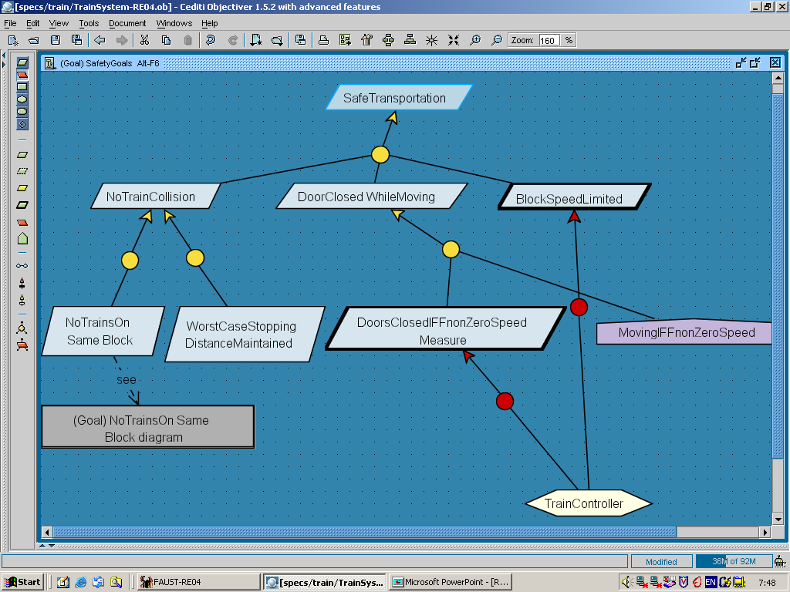
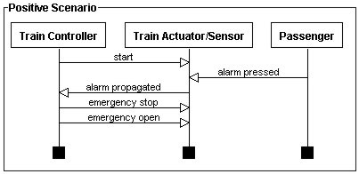
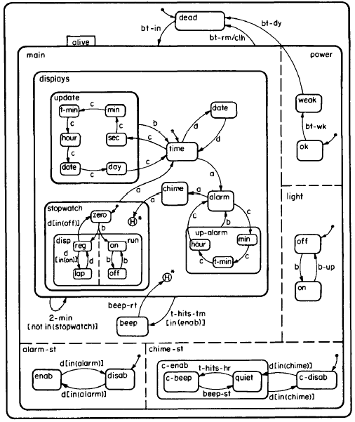
Model-based RE
Model:
  abstract representation of system (as-is or to-be)
  highlights, specifies, inter-relates key system features
Multi-view model:
  different system facets for requirements completeness

Slide 11
Why models for RE ?
Focus on key aspects (abstraction from multiple details)
Provides structure for RE activities
  target for what must be elicited, evaluated, specified, consolidated, modified
  interface among RE activities: produce/consume model items
Facilitates analysis
  support for early detection and fix of errors
Support for understanding, explanation to stakeholders
Basis for making decisions
  multiple options made explicit
Basis for generating the requirements document

Slide 12

Learning RE: objectives
Get a sound, precise understanding of concepts, principles, processes, and products involved in RE
Master state-of-the art techniques for requirements elicitation, evaluation, specification, analysis, evolution
Be able to construct, analyze and exploit high-quality models for RE in a systematic way
Gain practical experience in applying techniques in concrete, realistic situations

