Slide 1
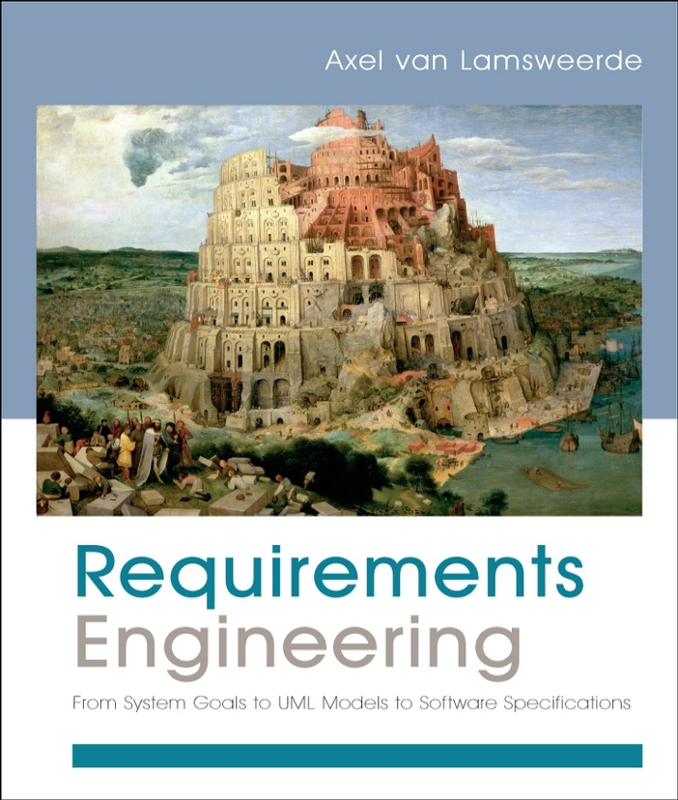
Requirements Engineering
From System Goals to UML Models to Software Specifications
Axel Van Lamsweerde

Slide 2

Fundamentals of RE
Chapter 1
Setting the Scene

Slide 3


Setting the scene: outline
What is Requirements Engineering (RE) ?
  The problem world & the machine solution
  The scope of RE: the WHY, WHAT and WHO dimensions
  Types of statements involved: descriptive vs. prescriptive
  Categories of requirements: functional vs. non-functional
  The requirements lifecycle: actors, processes, products
  Target qualities and defects to avoid
  Types of software projects
  Requirements in the software lifecycle
  Relationship to other disciplines

Slide 4
Setting the scene: outline (2)
Why engineer requirements?
  The requirements problem: facts, data, citations
  Role and stakes of Requirements Engineering
Obstacles to good RE practice
Agile development and RE
To fully apprehend the material in this chapter and the next ones, you should carefuly read the 3 case study descriptions in Section 1.1.2 of the book

Slide 5



The problem world and the machine solution
To make sure a software solution “correctly” solves some real-world problem, we must first fully understand and define ...
  what problem needs to be solved in the real world
  the context in which the problem arises
Example: car control
  Problem: manual handbrake release can be inconvenient in certain situations
  Context: car driving, braking, driver ’s intent, safety rules, ...

Slide 6
The problem world and the machine solution (2)
World: problematic part of the real-world, made of
  human components: organization units, staff, operators, ...
  physical components: devices, legacy software, mother Nature, ...
Machine: what needs to be installed to solve the problem
  software to be developed and/or purchased
  hardware/software implementation platform, associated input/output devices (e.g. sensors & actuators)
Requirements engineering (RE) is concerned with ...
  the desired machine’s effect on the problem world
  the assumptions and relevant properties about this world

Slide 7


The problem world involves two system versions
System: set of interacting components structuring the problem world
System-as-is: system as it exists before the machine is built into it
System-to-be: system as it should be when the machine will operate into it
Concepts, phenomena, rules about car handbraking
Car
Driver
Brake
System-as-is
Concepts, phenomena, rules about automated handbraking
System-to-be
Machine

Slide 8

RE: a preliminary definition
Coordinated set of activities ...
  for exploring, evaluating, documenting, consolidating, revising and adapting the objectives, capabilities, qualities, constraints & assumptions on a software-intensive system
  based on problems raised by the system-as-is and opportunities provided by new technologies

Slide 9
System requirements vs. software requirements
Software-to-be: software to be developed - part of the machine, component of the system-to-be
Environment: all other components of the system-to-be, including people, devices, pre-existing software, etc.
System requirements: what the system-to-be should meet; formulated in terms of phenomena in the environment
  “The handbrake shall be released when the driver wants to start.”
Software requirements: what the software-to-be should meet on its own; formulated in terms of phenomena shared by the software and the environment
  “The software output variable handBrakeCtrl shall have the value off when the software input variable motorRegime gets the value up.”

Slide 10




The scope of RE: the WHY, WHAT, WHO dimensions
System-as-is
System-to-be
WHY
a new system?
problems,
opportunities,
system knowledge
Objectives
satisfy
requirements,
constraints,
assumptions
WHAT
services?
assignment
WHO
will be responsible
for what ?

Slide 11
The WHY dimension
?
Identify, analyze, refine the system-to-be’s objectives
  to address analyzed deficiencies of the system-as-is
  in alignment with business objectives
  taking advantage of technology opportunities
Example: airport train control
  “Serve more passengers”
  “Reduce transfer time among terminals”
Difficulties
  Acquire domain knowledge
  Evaluate alternative options (e.g. alternative ways of satisfying the same objective)
  Match problems-opportunities, and evaluate these: implications, associated risks
  Handle conflicting objectives

Slide 12
The WHAT dimension
?
Identify & define the system-to-be’s functional services (software services, associated manual procedures)
  to satisfy the identified objectives
  according to quality constraints: security, performance, ...
  based on realistic assumptions about the environment
Example: airport train control
  “Computation of safe train accelerations”
  “Display of useful information for passengers inside trains”
Difficulties
  Identify the right set of features
  Specify these precisely for understanding by all parties
  Ensure backward traceability to system objectives

Slide 13
The WHO dimension
?
Assign responsibilities for the objectives, services, constraints among system-to-be components
  based on their capabilities and on the system’s objectives
  yielding the software-environment boundary
Example: airport train control
  “Safe train acceleration” ... under direct responsibility of software-to-be (driverless option) or of driver following software indications ?
  “Accurate estimation of train speed/position” ... under responsibility of tracking system or of preceding train ?
Difficulties
  Evaluate alternative options to decide on the right degree of automation

Slide 14
Setting the scene: outline
What is Requirements Engineering?
  The problem world & the machine solution
  The scope of RE: the WHY, WHAT and WHO dimensions
  Types of statements involved: descriptive vs. prescriptive
  Categories of requirements: functional vs. non-functional
  The requirements lifecycle: actors, processes, products
  Target qualities and defects to avoid
  Types of software projects
  Requirements in the software lifecycle
  Relationship to other disciplines

Slide 15
Statements may differ in mood
Descriptive statements state system properties holding regardless of how the system should behave (indicative mood)
  natural law, physical constraint, etc
  e.g. “If train doors are closed, they are not open”
    “If the train’s acceleration is positive, its speed is non-null”
Prescriptive statements state desirable properties holding or not depending on how the system behaves (optative mood)
    e.g. “Doors shall always remain closed when the train is moving”
Important distinction for RE:
  prescriptive statements can be negotiated, weakened, replaced by alternatives
  descriptive statements cannot

Slide 16
Types of statements: system requirements, software requirements
System requirement: prescriptive statement refering to environment phenomena (not necessarily shared)
  to be enforced by the software-to-be possibly together with other system components
  formulated in a vocabulary understandable by all parties
  TrainMoving → DoorsClosed
Software requirement: prescriptive statement refering to shared phenomena
  to be enforced by the software-to-be solely
  formulated in the vocabulary of software developers
  measuredSpeed ≠ 0 → doorsState = 'closed’
  (A software req is a system req; the converse is not true)

Slide 17
Categories of requirements
Functional requirements: prescribe what services the software-to-be should provide
  capture intended software effects on environment, applicability conditions
  units of functionality resulting from software operations
  “The software shall control the acceleration of all trains”
Non-functional requirements: constrain how such services should be provided
  Quality requirements: safety, security, accuracy, time/space performance, usability, ...
  Others: compliance, architectural, development reqs
  To be made precise in system-specific terms
  “Acceleration commands shall be issued every 3 seconds to every train”

Slide 18
A taxonomy of non-functional requirements
Non-Functional Requirement
Quality of Service
Compliance
Architectural Constraint
Development Constraint
Accuracy
Safety
Security
Reliability
Performance
Interface
Installation
Distribution
Cost
Maintainability
Cost
Deadline
Variability
Confidentiality
Integrity
Availability
Time
Space
User
Device
Software
interaction
interaction
interoperability
Subclass link
Usability
Convenience
See definitions and examples in the book
No clear-cut boundaries, possible overlaps
  Functional/non-functional: e.g. functional reqs for firewall management are security-related
  Non-functional overlaps: e.g. “high frequency of train commands” is related to performance and safety

Slide 19

Setting the scene: outline
What is Requirements Engineering?
  The problem world & the machine solution
  The scope of RE: the WHY, WHAT and WHO dimensions
  Types of statements involved: descriptive vs. prescriptive
  Categories of requirements: functional vs. non-functional
  The requirements lifecycle: actors, processes, products
  Target qualities and defects to avoid
  Types of software projects
  Requirements in the software lifecycle
  Relationship to other disciplines

Slide 20
The RE process (1)
alternative proposals
domain understanding
& elicitation
start

Slide 21

Domain understanding
Studying the system-as-is
  Business organization: structure, dependencies, strategic objectives, policies, workflows, operational procedures, ...
  Application domain: concepts, objectives, tasks, constraints, regulations, ...
  Strengths & weaknesses of the system-as-is
Identifying the system stakeholders:
  Groups or individuals affected by the system-to-be, who may influence its elaboration and its acceptance
  Decision makers, managers, domain experts, users, clients, subcontractors, analysts, developers, ...
Products: Initial sections for preliminary draft proposal
Glossary of terms

Slide 22

Requirements elicitation
Exploring the problem world ...
Further analysis of problems with system-as-is: symptoms, causes, consequences
Analysis of technology opportunities, new market conditions
Identification of ...
  improvement objectives
  organizational/technical constraints on system-to-be
  alternative options for satisfying objectives, for assigning responsibilities
  scenarios of hypothetical software-environment interaction
  requirements on software, assumptions on environment
Product: Additional sections for preliminary draft proposal

Slide 23
Setting the scene: outline
What is Requirements Engineering?
  The problem world & the machine solution
  The scope of RE: the WHY, WHAT and WHO dimensions
  Types of statements involved: descriptive vs. prescriptive
  Categories of requirements: functional vs. non-functional
  The requirements lifecycle: actors, processes, products
  Target qualities and defects to avoid
  Types of software projects
  Requirements in the software lifecycle
  Relationship to other disciplines

Slide 24

Target qualities for RE process
Completeness of objectives, requirements, assumptions
Consistency of RD items
Adequacy of requirements, assumptions, domain props
Unambiguity of RD items
Measurability of requirements, assumptions
Pertinence of requirements, assumptions
Feasibility of requirements
Comprehensibility of RD items
Good structuring of the RD
Modifiability of RD items
Traceability of RD items

Slide 25

Types of RE errors & flaws: a wide palette
Omission (critical error!)
Contradiction (critical error!)
Inadequacy (critical error!)
Ambiguity (critical error!)
Unmeasurability
Noise, overspecification
Unfeasibility (wishful thinking)
Unintelligibility
Poor structuring, forward reference, remorse
Opacity

Slide 26

Errors in a requirements document (RD)
Omission: problem world feature not stated by any RD item
e.g. no req about state of train doors in case of emergency stop
Contradiction: RD items stating a problem world feature in an incompatible way
“Doors must always be kept closed between platforms”
and “Doors must be opened in case of emergency stop”
Inadequacy: RD item not adequately stating a problem world feature
“Panels inside trains shall display all flights served at next stop”
Ambiguity: RD item allowing a problem world feature to be interpreted in different ways
“Doors shall be open as soon as the train is stopped at platform”
Unmeasurability: RD item stating a problem world feature in a way precluding option comparison or solution testing
“Panels inside trains shall be user-friendly”

Slide 27

Flaws in a requirements document (RD)
Noise: RD item yielding no information on any problem world feature (Variant: uncontrolled redundancy)
“Non-smoking signs shall be posted on train windows”
Overspecification: RD item stating a feature not in the problem world, but in the machine solution
“The setAlarm method shall be invoked on receipt of an Alarm message”
Unfeasibility: RD item not implementable within budget/schedule
“In-train panels shall display all delayed flights at next stop”
Unintelligibility: RD item incomprehensible to those needing to use it
A requirement statement containing 5 acronyms
Poor structuring: RD item not organized according to any sensible & visible structuring rule
Intertwining of acceleration control and train tracking issues

Slide 28
Flaws in a requirements document (2)
Forward reference: RD item making use of problem world features not defined yet
Multiple uses of the concept of worst-case stopping distance before its definition appears several pages after in the RD
Remorse: RD item stating a problem world feature lately or incidentally
After multiple uses of the undefined concept of worst-case stopping distance, the last one directly followed by an incidental definition between parentheses
Poor modifiability: RD items whose changes must be propagated throughout the RD
Use of fixed numerical values for quantities subject to change
Opacity: RD item whose rationale, authoring or dependencies are invisible
“The commanded train speed must always be at least 7 mph above physical speed” without any explanation of rationale for this

Slide 29
Contradiction requirements exemple
REQ1 Dates shall be displayed in the mm/dd/yyyy format.
REQ2 Dates shall be displayed in the dd/mm/yyyy format.
Solve:
REQ1 For users in the U.S., dates shall be displayed in the mm/dd/yyyy format.
REQ2 For users in France, dates shall be displayed in the dd/mm/yyyy format.
Or
REQ3 Dates shall be displayed based on the format defined in the user’s web browser.

Slide 30
Inadequacy requirements example
Inadequate software performance - This refers to slow system response times and transaction throughput rates.

Slide 31
Ambiguous requirements examples
The black dog and cat were walking.
Trigger an automatic log out when a user attempts to download up to 5 times.
Display is up to large screen size.
Upload will fail if the file is invalid.
On the “Stored Flight” screen, the user can only view one record.

Slide 32
Non-redundant requirements
Example: in two different places of the requirement specifications:
“The max withdrawal is of 1.800€” and “The amount of withdrawals is between 100€ and 1.800€”.

