Slide 1
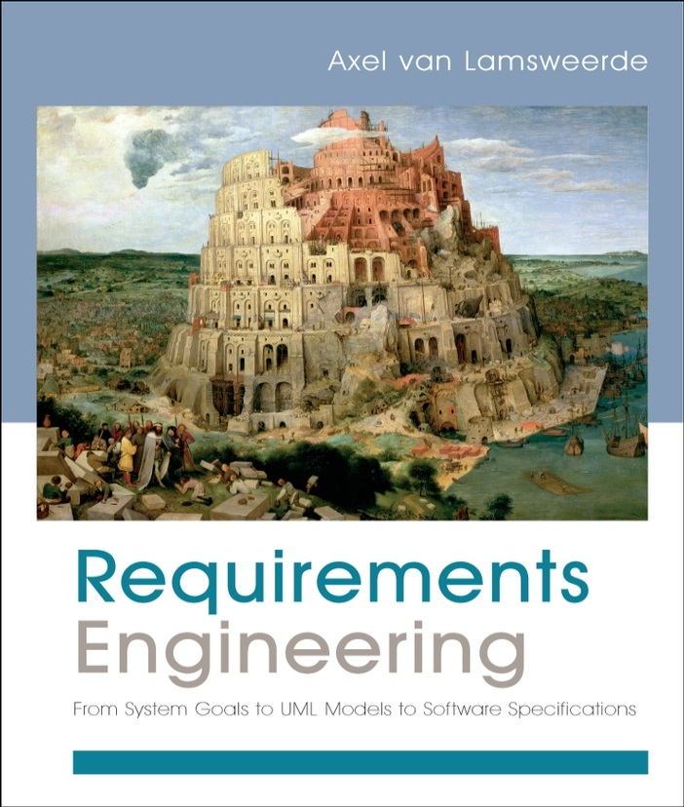
Requirements Engineering
From System Goals to UML Models to Software Specifications
Axel Van Lamsweerde

Slide 2

Fundamentals of RE
Chapter 2
Domain Understanding
& Requirements Elicitation

Slide 3


Chap.1: RE products and processes
alternative options
Chap. 2:
Elicitation
techniques
consolidated
start
agreed
requirements
requirements
documented requirements

Slide 4

A great deal of knowledge acquisition is involved: as introduced in Chapter 1 ...
Studying the system-as-is
  Business organization: structure, dependencies, strategic objectives, policies, workflows, operational procedures, ...
  Application domain: concepts, objectives, tasks, constraints, regulations, ...
  Analysis of problems with system-as-is: symptoms, causes, consequences
Analyzing technology opportunities, new market conditions
Identifying the system stakeholders
Identifying improvement objectives; organizational & technical constraints on system-to-be; alternative options for satisfying objectives, for assigning responsibilities; scenarios of hypothetical software-environment interaction; requirements on software, assumptions on environment

Slide 5
Domain analysis & requirements elicitation: outline
Identifying stakeholders & interacting with them
Artefact-driven elicitation techniques
  Background study
  Data collection, questionnaires
  Repertory grids, card sorts for concept acquisition
  Scenarios, storyboards for problem world exploration
  Prototypes, mock-ups for early feedback
  Knowledge reuse: domain-independent, domain-specific
Stakeholder-driven elicitation techniques
  Interviews
  Observation and ethnographic studies
  Group sessions

Slide 6

Stakeholder analysis
Stakeholder cooperation is essential for successful RE
  Elicitation = cooperative learning
Representative sample must be selected to ensure adequate, comprehensive coverage of the problem world
  dynamic selection as new knowledge is acquired
Selection based on ...
  relevant position in the organization
  role in making decisions, reaching agreement
  type of contributed knowledge, level of domain expertise
  exposure to perceived problems
  personal interests, potential conflicts
  influence in system acceptance

Slide 7

Knowledge acquisition from stakeholders is difficult
Distributed sources, conflicting viewpoints
Difficult access to key people & data
Different background, terminology, culture
Tacit knowledge, hidden needs
Irrelevant details
Internal politics, competition, resistance to change, ...
Personnel turnover, changes in organization, in priorities, ...
⇒ Needed:
  Communication skills: for talking to, listening from diverse people
  Trust relationship
  Knowledge reformulation & restructuring (review meetings)

Slide 8

Background study
Collect, read, synthesize documents about...
  the organization: organizational charts, business plans, financial reports, meeting minutes, etc
  the domain: books, surveys, articles, regulations, reports on similar systems in the same domain
  the system-as-is: documented workflows, procedures, business rules; exchanged documents; defect/complaint reports, change requests, etc.
Provides basics for getting prepared before meeting stakeholders => prerequisite to other techniques
Data mining problem: huge documentation, irrelevant details, outdated info
Solution: use meta-knowledge to prune the doc space
  know what you need to know & what you don’t need to know

Slide 9

Data collection
Gather undocumented facts & figures
  marketing data, usage statistics, performance figures, costs, ...
  by designed experiments or selection of representative data sets from available sources (use of statistical sampling techniques)
May complement background study
Helpful for eliciting non-functional reqs on performance, usability, cost etc.
Difficulties:
  Getting reliable data may take time
  Data must be correctly interpreted

Slide 10

Questionnaires
Submit a list of questions to selected stakeholders, each with a list of possible answers (+ brief context if needed)
  Multiple choice question: one answer to be selected from answer list
  Weighting question: list of statements to be weighted...
    qualitatively (‘high’, ‘low”, ...), or
    quantitatively (percentages)
    to express perceived importance, preference, risk etc.
Effective for acquiring subjective info quickly, cheaply, remotely from many people
Helpful for preparing better focussed interviews (see next)

Slide 11
Questionnaires should be carefully prepared
Subject to ...
  multiple biases: recipients, respondents, questions, answers
  unreliable info: misinterpretation of questions, of answers, inconsistent answers, ....
=> Guidelines for questionnaire design/validation:
  Select a representative, statistically significant sample of people; provide motivation for responding
  Check coverage of questions, of possible answers
  Make sure questions, answers, formulations are unbiased & unambiguous
  Add implicitly redundant questions to detect inconsistent answers
  Have your questionnaire checked by a third party

Slide 12

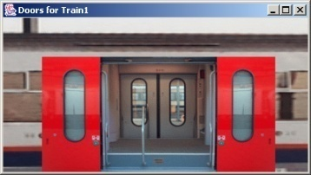
Prototypes & mock-ups
Goal: check req adequacy from direct user feedback, by showing reduced sketch of software-to-be in action
  focus on unclear, hard-to-formulate reqs to elicit further
Prototype = quick implementation of some aspects ...
  Functional proto: focus on specific functional reqs
    e.g. initiating meeting, gathering participant constraints
  User interface proto: focus on usability by showing input-output forms, dialog patterns
    e.g. static/dynamic interaction to get participant constraints
Quick implementation: by use of very high-level programming language, executable spec language, generic services, ...

Slide 13

Requirements prototyping
Elaborate
requirements
Prototype
requirements
Demonstrate proto
& get feedback
[ not Proto_OK ]
[ Proto_OK ]
…
Mock-up: proto is thrown away (product = adequate reqs)
Evolutionary proto: transformed towards efficient code

Slide 14
Prototypes & mock-ups: pros & cons
☺ Concrete flavor of what the software will look like
=> clarify reqs, elicit hidden ones, improve adequacy,
understand implications, ...
☺ Other uses: user training, stubb for integration testing, ...
☹ Does not cover all aspects
  missing functionalities
  ignores important non-functional reqs (performance, cost, ...)
☹ Can be misleading, set expectations too high
☹ ‘Quick-and-dirty’ code, hard to reuse for sw development
☹ Potential inconsistencies between modified code and documented reqs

Slide 15

Knowledge reuse
Goal: speed up elicitation by reuse of knowledge from experience with related systems
  knowledge about similar organization, domain, problem world: requirements, assumptions, dom props, ...
General reuse process:
  1. RETRIEVE relevant knowledge from other systems
  2. TRANSPOSE it to the target system
  3. VALIDATE the result, ADAPT it if necessary & INTEGRATE it with the system knowledge already acquired

Slide 16
Knowledge reuse: pros & cons
☺ Expert analysts naturally reuse from past experience
☺ Significant guidance and reduction of elicitation efforts
☺ Inheritance of structure & quality of abstract domain spec
☺ Effective for completing RD with overlooked aspects
☹ Effective only if abstract domain sufficiently “close”, accurate
☹ Defining abstract domains for significant reusability is hard
☹ Validation & integration efforts
☹ Near-matches may require tricky adaptations

Slide 17
Domain analysis & requirements elicitation: outline
Identifying stakeholders & interacting with them
Artefact-driven elicitation techniques
  Background study
  Data collection, questionnaires
  Repertory grids, card sorts for concept acquisition
  Scenarios, storyboards for problem world exploration
  Prototypes, mock-ups for early feedback
  Knowledge reuse: domain-independent, domain-specific
Stakeholder-driven elicitation techniques
  Interviews
  Observation and ethnographic studies
  Group sessions

Slide 18

Interviews
Primary technique for knowledge elicitation
  1. Select stakeholder specifically for info to be acquired
  (domain expert, manager, salesperson, end-user, consultant, ...)
  2. Organize meeting with interviewee, ask questions, record answers
  3. Write report from interview transcripts
  4. Submit report to interviewee for validation & refinement
Single interview may involve multiple stakeholders
  ☺ saves times
  ☹ weaker contact; individuals less involved, speak less freely
Interview effectiveness:
  (utility x coverage of acquired info) / acquisition time

Slide 19
Types of interview
Structured interview: predetermined set of questions
  specific to purpose of interview
  some open-ended, others with pre-determined answer set
  => more focussed discussion, no rambling among topics
Unstructured interview: no predetermined set of questions
  free discussion about system-as-is, perceived problems, proposed solutions
  => exploration of possibly overlooked issues
=> Effective interviews should mix both modes ...
  start with structured parts
  shift to unstructured parts as felt necessary

Slide 20
Interviews: strengths & difficulties
☺ May reveal info not acquired through other techniques
  how things are running really, personal complaints, suggestions for improvement, ...
☺ On-the-fly acquisition of info appearing relevant
  new questions triggered from previous answers
☹ Acquired info might be subjective (hard to assess)
☹ Potential inconsistencies between different interviewees
☹ Effectiveness critically relies on interviewer’s attitude, appropriateness of questions
=> Interviewing guidelines

Slide 21
Guidelines for effective interviews
Identify the right interviewee sample for full coverage of issues
  different responsibilities, expertise, tasks, exposure to problems
Come prepared, to focus on right issue at right time
  backgound study first
  predesign a sequence of questions for this interviewee
Centre the interview on the interviewee’s work & concerns
Keep control over the interview
Make the interviewee feel comfortable
  Start: break ice, provide motivation, ask easy questions
  Consider the person too, not only the role
  Do always appear as a trustworthy partner

Slide 22
Guidelines for effective interviews (2)
Be focused, keep open-ended questions for the end
Be open-minded, flexible in case of unexpected answers
Ask why-questions without being offending
Avoid certain types of questions ...
  opiniated or biased
  affirmative
  obvious or impossible answer for this interviewee
Edit & structure interview transcripts while still fresh in mind
  including personal reactions, attitudes, etc
Keep interviewee in the loop
  co-review interview transcript for validation & refinement
Model-driven interviews may help structure them
(see Part 2 of the book)

Slide 23

Observation & ethnographic studies
Focus on task elicitation in the system-as-is
Understanding a task is often easier by observing people performing it (rather than verbal or textual explanation)
  cf. tying shoelaces
Passive observation: no interference with task performers
  Watch from outside, record (notes, video), edit transcripts, interpret
  Protocol analysis: task performers concurrently explain it
  Ethnographic studies: over long periods of time, try to discover emergent properties of social group involved
    about task performance + attitudes, reactions, gestures, ...
Active observation: you get involved in the task, even become a team member

Slide 24
Observation & ethnographic studies: pros & cons
☺ May reveal ...
  tacit knowledge that would not emerge otherwise
  e.g. ethnographic study of air traffic control => implicit mental
  model of air traffic to be preserved in system-to-be
  hidden problems through tricky ways of doing things
  culture-specific aspects to be taken into account
☺ Contextualization of acquired info
☹ Slow & expensive: to be done over long periods of time,
at different times, under different workload conditions
☹ Potentially inaccurate (people behave differently when observed)
☹ Data mining problem, interpretation problem
☹ Focus on system-as-is
Some of the interviewing guidelines are relevant

Slide 25

Group sessions
More perception, judgement, invention from interactions within group of diverse people
Elicitation takes place in series of group workshops (a few days each) + follow-up actions
  audiovisuals, wall charts to foster discussion, record outcome
Structured group sessions:
  Each participant has a clearly defined role
  (leader, moderator, manager, user, developer, ...)
  Contributes to req elaboration according to his/her role, towards reaching synergies
  Generally focused on high-level reqs
  Variants: focus groups, JAD, QFD, ...

Slide 26
Group sessions (2)
Unstructured group sessions (brainstorming):
  Participants have a less clearly defined role
  Two separate stages ...
    1. Idea generation to address a problem:
    as many ideas as possible
    from each participant
    without censorship/criticism
    2. Idea evaluation:
    by all participants together
    according to agreed criteria (e.g. value, cost, feasibility)
    to prioritize ideas

Slide 27
Group sessions: pros & cons
☺ Less formal interactions than interviews
=> may reveal hidden aspects of the system (as-is or to-be)
☺ Potentially ...
  wider exploration of issues & ideas
  more inventive ways of addressing problems
☺ Synergies => agreed conflict resolutions
☹ Group composition is critical ...
  time consuming for key, busy people
  heavily relying on leader expertise & skills
  group dynamics, dominant persons => biases, inadequacies
☹ Risk of ...
  missing focus & structure => rambling discussions, little concrete outcome, waste of time
  superficial coverage of more technical issues

Slide 28
Combining techniques
Elicitation techniques have complementary strengths & limitations
Strength-based combinations are more effective for full, adequate coverage
  artefact-driven + stakeholder-driven
Examples
  Contextual Inquiry: workplace observation + open-ended interviews + prototyping
  RAD: JAD group sessions + evolutionary prototyping (with code generation tools)
Techniques from other RE phases support elicitation too
  Resolution of conflicts, risks, omissions, etc.

Slide 29
Domain analysis & requirements elicitation: summary
Identifying the right stakeholders, interacting the right way
Artefact-driven elicitation techniques
  Background study as a prerequisite
  Data collection, questionnaires for preparing interviews
  Repertory grids, card sorts for concept characterization
  Scenarios, storyboards for concrete exploration
  Prototypes, mock-ups for early feedback & adequacy check
  Knowledge reuse brings a lot: domain-independent, domain-specific
Stakeholder-driven elicitation techniques
  Interviews are essential - structured, unstructured, cf. guidelines
  Observation, ethnographic studies for hidden knowledge
  Group sessions for broader, more inventive acquisition & agreement
Model-driven elicitation provides focus & structure for what needs to be elicited (see Part 2 of the book)

