Slide 1
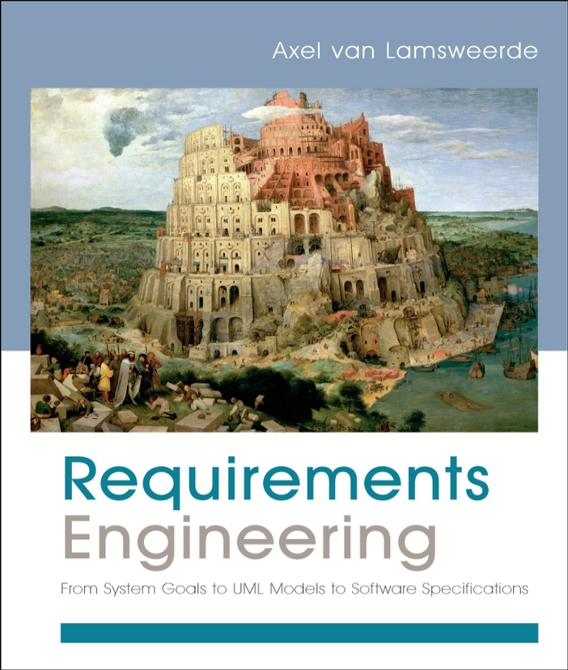
Requirements Engineering
From System Goals to UML Models to Software Specifications
Axel Van Lamsweerde

Slide 2

Fundamentals of RE
Chapter 3
Requirements Evaluation

Slide 3



Chap.1: RE products and processes
alternative options
Chap. 2:
Chap. 3:
Elicitation
techniques
Evaluation
techniques
consolidated
start
agreed
requirements
requirements
documented requirements

Slide 4
Negotiation-based decision making: as introduced in Chapter 1 ...
Identification & resolution of inconsistencies
  conflicting stakeholder viewpoints, non-functional reqs, ...
  to reach agreement
Identification, assessment & resolution of system risks
  critical objectives not met, e.g. safety hazards, security threats, development risks, ...
  to get new reqs for more robust system-to-be
Comparison of alternative options, selection of preferred ones
  different ways of: meeting same objective, assigning responsibilities, resolving conflicts & risks
Requirements prioritization
  to resolve conflicts, address cost/schedule constraints, support incremental development

Slide 5
Requirements evaluation: outline
Inconsistency management
  Types of inconsistency
  Handling inconsistencies
  Managing conflicts: a systematic process
Risk analysis
  Types of risk
  Risk management
  Risk documentation
  DDP: quantitative risk management for RE
Evaluating alternative options for decision making
Requirements prioritization

Slide 6

Inconsistency management
Inconsistency = violation of consistency rule among items
Inconsistencies are highly frequent in RE
  inter-viewpoints: each stakeholder has its own focus & concerns (e.g. domain experts vs. marketing dept)
  intra-viewpoint: conflicting quality reqs (e.g. security vs. usability)
Inconsistencies must be detected and resolved ...
  not too soon: to allow further elicitation within viewpoint
  not too late: to allow software development
  (anything may be developed from inconsistent specs)

Slide 7
Types of inconsistency in RE
Terminology clash: same concept named differently in different statements
  e.g. library management: “borrower” vs. “patron”
Designation clash: same name for different concepts in different statements
  e.g. “user” for “library user” vs. “library software user”
Structure clash: same concept structured differently in different statements
  e.g. “latest return date” as time point (e.g. Fri 5pm)
  vs. time interval (e.g. Friday)

Slide 8
Types of inconsistency in RE (2)
Strong conflict: statements not satisfiable together
  i.e. logically inconsistent: S, not S
  e.g. “participant constraints may not be disclosed to anyone else”
  vs. “the meeting initiator should know participant constraints”
Weak conflict (divergence): statements not satisfiable together under some boundary condition
  i.e. strongly conflicting if B holds: potential conflict
  MUCH more frequent in RE
  e.g. (staff’s viewpoint)
  “patrons shall return borrowed copies within X weeks”
  vs. (patron’s viewpoint)
  “patrons shall keep borrowed copies as long as needed”
  B: “a patron needing a borrowed copy more than X weeks”

Slide 9

Handling inconsistencies
Handling clashes in terminology, designation, structure: through agreed glossary of terms to stick to
  For some terms, if needed: accepted synonym(s)
  To be built during elicitation phase
Weak, strong conflicts: more difficult, deeper causes...
  Often rooted in underlying personal objectives of stakeholders => to be handled at root level and propagated to requirements level
  Inherent to some non-functional concerns (performance vs. safety, confidentiality vs. awareness, ...) => exploration of preferred tradeoffs
  Example: spiral, negotiation-based reconciliation of win conditions [Boehm et al, 1995]

Slide 10
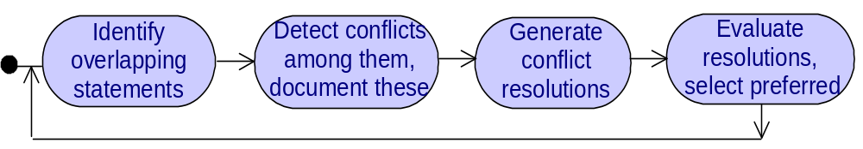
Managing conflicts: a systematic process
Overlap = reference to common terms or phenomena
  precondition for conflicting statements
  e.g. gathering meeting constraints, determining schedules
Conflict detection ... (see Chapters 16, 18)
  informally
  using heuristics on conflicting req categories
    “Check information req & confidentiality req on related objects”
    “Check reqs on decreasing & increasing related quantities”
  using conflict patterns
  formally (theorem proving techniques)

Slide 11

Detected conflicts should be documented
For later resolution, for impact analysis
? statement in multiple conflicts, most conflicting statements, ... ?
Using documentation tools, query tools along Conflict links recorded in requirements database
Or in interaction matrix:
Statement S1 S2 S3 S4 Total S_{ij} =
S1 0 1000 1 1 1002 1: conflict
S2 1000 0 0 0 1000 0: no overlap
S3 1 0 0 1 2 1000: no conflict
S4 1 0 1 0 2
Total 1002 1000 2 2 2006
#Conflicts(S₁) = remainderOf (1002 div 1000)
#nonConflictingOverlaps(S₁) = quotientOf (1002 div 1000)

Slide 12
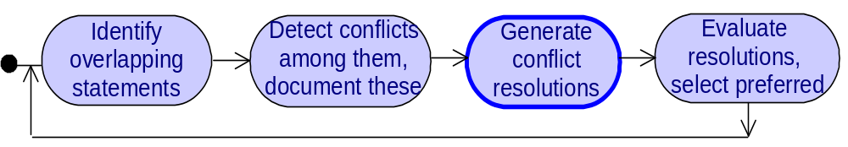
Managing conflicts: a systematic process (2)
For optimal resolution, better to ...
  explore multiple candidate resolutions first,
  compare, select/agree on most preferred next
To generate candidate resolutions, use ...
  elicitation techniques
  (interviews, group sessions)
  resolution tactics

Slide 13

Conflict resolution tactics
Avoid boundary condition
    e.g. “Keep copies of highly needed books unborrowable”
Restore conflicting statements
    e.g. “Copy returned within X weeks and then borrowed again”
Weaken conflicting statements
    e.g. “Copy returned within X weeks unless explicit permission”
Drop lower-priority statements
Specialize conflict source or target
    e.g. “Book loan status known by staff users only”
Transform conflicting statements or involved objects, or introduce new requirements

Slide 14
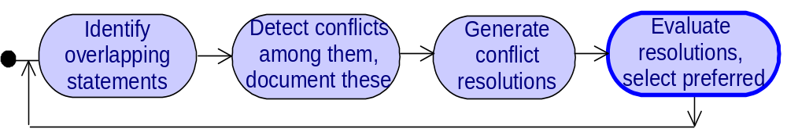
Managing conflicts: a systematic process (3)
Evaluation criteria for preferred resolution:
  contribution to critical non-functional requirements
  contribution to resolution of other conflicts & risks
See ...
  Sect. 3.3 in this chapter (“Evaluating alternative options”)
  Chapters 16, 18

Slide 15
Requirements evaluation: outline
Inconsistency management
  Types of inconsistency
  Handling inconsistencies
  Managing conflicts: a systematic process
Risk analysis
  Types of risk
  Risk management
  Risk documentation
  DDP: quantitative risk management for RE
Evaluating alternative options for decision making
Requirements prioritization

Slide 16

What is a risk ?
Uncertain factor whose occurrence may result in loss of satisfaction of a corresponding objective
  e.g. a passenger forcing doors opening while train moving
  a meeting participant not checking email regularly
A risk has...
  a likelihood of occurrence,
  one or more undesirable consequences
  e.g. passengers falling out of train moving with doors open
Each risk consequence has ...
  a likelihood of occurrence if the risk occurs
    (not to be confused with risk likelihood)
  a severity: degree of loss of satisfaction of objective

Slide 17

Types of RE risk
Product-related risks: negative impact on functional or non-functional objectives of the system
  => failure to deliver services or quality of service
e.g. security threats, safety hazards
Process-related risks: negative impact on development objectives
  => delayed delivery, cost overruns, ...
e.g. personnel turnover

Slide 18

Evaluating alternative options for decision making
The RE process raises multiple alternative options of different types
  alternative ways of satisfying a system objective
  alternative assignments of responsibilities among system components
  alternative resolutions of a conflict
  alternative countermeasures to reduce a risk
Preferred alternatives must be negotiated, selected ...
  agree on evaluation criteria (e.g. contribution to NFRs)
  compare options according to criteria
  select best option
Qualitative or quantitative reasoning techniques for this

