Slide 1

Fundamentals of RE
Chapter 6
Requirements Evolution

Slide 2






Chap.1: RE products and processes
alternative options
Chap. 2:
Chap. 3:
Elicitation
techniques
Evaluation
techniques
consolidated
start
agreed
requirements
requirements
Chap. 5:
Chap. 4:
QA
techniques
Spec/doc
techniques
documented requirements
Chap. 6: Requirements evolution techniques

Slide 3
Requirements changes must be managed
The problem world keeps changing
  organizational changes, new regulations, new opportunities, alternative technologies, evolving priorities & constraints
  better understanding of system features, strengths, limitations, defects
Causes changes in objectives, concepts, reqs, assumptions
  during RE, during software development, after deployment
Triggers new RE cycle (elicit, evaluate, document, consolidate)
  facilitated by change anticipation, traceability management
Information management problem
  consistency maintenance, change propagation, versioning
Requirements (change) management = process of anticipating, evaluating, agreeing on, propagating changes in RD items
→

Slide 4

Requirements evolution: outline
The time-space dimension: revisions and variants
Change anticipation
Traceability management for evolution support
  Traceability links
  The TM process, benefits & cost
  Traceability management techniques
  Determining an adequate cost-benefit tradeoff
Change control
  Change initiation
  Change evaluation & prioritization
  Change consolidation
Runtime spec monitoring for dynamic change management

Slide 5
Requirements evolution: outline
The time-space dimension: revisions and variants
Change anticipation
Traceability management for evolution support
  Traceability links
  The TM process, benefits & cost
  Traceability management techniques
  Determining an adequate cost-benefit tradeoff
Change control
  Change initiation
  Change evaluation & prioritization
  Change consolidation
Runtime spec monitoring for dynamic change management

Slide 6
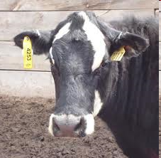
Evolution support requires traceability management
An item is traceable if we can fully figure out ...
  WHERE it comes from, WHY it is there
  WHAT it will be used for, HOW it will be used
Traceability management (TM), roughy ...
  identify, document, retrieve the rationale & impact of RD items
Objectives of RE-specific traceability
  assess impact of proposed changes
  easily propagate changes to maintain consistency ...
    among RD items (objectives, functional reqs, NFRs, assumptions, domain properties, concept definitions, etc)
    between RD items & downward software items (design specs, architectural decisions, test data, user manuals, code, etc)

Slide 7

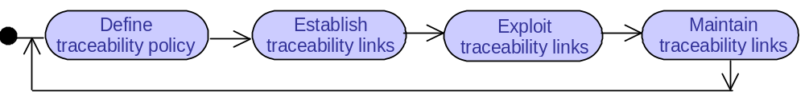
The traceability management process
Optimal
cost-benefit trade-off
for guiding next steps ?
update traceability graph after RD changes
What items should be traced ?
What link types should be used?
=> traceability graph
retrieve items along paths of traceability graph for
evolution support, rationale analysis, coverage analysis, etc.

Slide 8
Requirements evolution: outline
The time-space dimension: revisions and variants
Change anticipation
Traceability management for evolution support
  Traceability links
  The TM process, benefits & cost
  Traceability management techniques
  Determining an adequate cost-benefit tradeoff
Change control
  Change initiation
  Change evaluation & prioritization
  Change consolidation
Runtime spec monitoring for dynamic change management

Slide 9
Requirements evolution: outline
The time-space dimension: revisions and variants
Change anticipation
Traceability management for evolution support
  Traceability links
  The TM process, benefits & cost
  Traceability management techniques
  Determining an adequate cost-benefit tradeoff
Change control
  Change initiation
  Change evaluation & prioritization
  Change consolidation
Runtime monitoring for dynamic change management

Slide 10
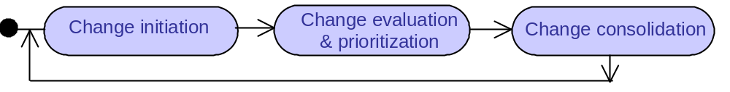
Change control
Submission of motivated
change request
approved changes trigger new RE cycle
+ implementation
by review board
Change anticipation & traceability management are preconditions for effective change control
More or less formal process depending on ...
  - importance of changes
  - type of project, application domain (e.g. mission-critical projects)

Slide 11
Change initiation
Wishlist accumulates changes asked by insiders or outsiders
  might be classified as corrective, ameliorative, adaptative
  with perceived degree of urgency
Periodically consolidated in motivated change request
  spec of proposed changes, target items involved
  why these items were introduced, where/how they are used
  rationale for change
  stakeholders asking for it
  level of priority & urgency, why
  estimated change impact on dependent RD/software items
  estimated cost of changes, resources required
On ad-hoc, project-specific form & periodicity

Slide 12
Change evaluation & prioritization
By independent review board
  stakeholder representatives: decision makers, domain experts, developers, marketing dept, etc.
Value/cost assessment of requested changes
  understand reason, check well-foundedness
  assess benefits, risks
  assess impact of change, feasibility, cost
  ☞ Cf. requirements evaluation techniques (Chap.3)
Outcome: agreed status for each requested change
  approve, ignore, amend, defer
  to be documented for next board meetings

Slide 13
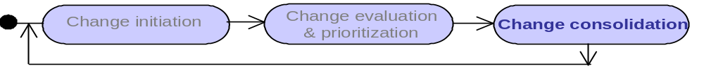
Change consolidation
Perform all approved changes => new system version
  forward propagation of changes through RD along horizontal links of traceability graph (new RE cycle in spiral process)
  baselining of new RD version
  forward propagation through software items along vertical links of traceability graph
  update traceability graph
Tool support for change control
  collaborative tools, database tools for managing change requests
  traceability management tools
  version control tools

Slide 14
Requirements evolution: outline
The time-space dimension: revisions and variants
Change anticipation
Traceability management for evolution support
  Traceability links
  The TM process, benefits & cost
  Traceability management techniques
  Determining an adequate cost-benefit tradeoff
Change control
  Change initiation
  Change evaluation & prioritization
  Change consolidation
Runtime spec monitoring for dynamic change management

Slide 15

Requirements evolution, summary: prepare for change
Requirements consistency, completeness, adequacy must be preserved through inevitably evolving problem world
  wide variety of corrective, ameliorative, adaptative changes
We must anticipate changes, specify levels of stability
Traceability management is another precondition for evolution
  Variety of traceability link types specializing dependencies
    multi-directional: backward, forward, horizontal, vertical
  Issues: link granularity, semantic richness, accuracy, overhead
  Variety of supporting techniques
  Cost-benefit tradeoff to be determined
Change control iterates on initiation, evaluation-prioritization, consolidation cycles
  more or less formal process depending on project type
Specs can be monitored for on-the-fly change management in self-adapting system

