Slide 1

Fundamentals of RE
Chapter 7
Goal Orientation in RE

Slide 2

System objectives are pervasive in RE
As seen before ...
  the WHY dimension of RE (Chap. 1)
  understanding objectives in system-as-is, eliciting objectives of system-to-be (Chap. 2)
  analyzing conflicting objectives, analyzing risks of not meeting critical objectives, evaluating options against objectives (Chap. 3)
  specifying the rationale for specific requirements (Chap. 4)
  checking that system objectives are satisfied by operational requirements (Chap. 5)
  documenting satisfaction arguments & backward traceability to system objectives (Chap. 6)
⇒ Goals as key abstraction for driving the RE process

Slide 3

Goal orientation in RE: outline
What are goals?
The granularity of goals and their relationship to requirements and assumptions
Goal types and categories
  Types of goals: behavioral goals vs. soft goals
  Goal categories: functional goals vs. non-functional goals
The central role of goals in the RE process

Slide 4
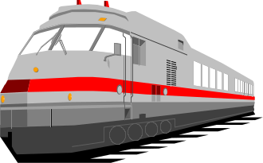

What are goals?
Goal = prescriptive statement of intent the system should
satisfy through cooperation of its agents
  "prescriptive statement": in optative mood
    “shall”, “should”, “must”, ...
    e.g. “Train doors shall be closed while the train is moving”
    “Loan periods shall be limited to 2 weeks”
  formulated in terms of problem world phenomena
  "system": system-as-is, system-to-be
    software + environment
  "agent": active system component
  responsible for goal satisfaction

Slide 5

Goal satisfaction requires agent cooperation
  Maintain [SafeTransportation] ↔
    on-board train controller + tracking system + station computer + passenger + train driver + ...
  Achieve [BookCopyReturnedToShelves] ↔
  patron + staff + library software
Agent = role, rather than individual
  must restrict its behavior to meet its assigned goals
  must be able to monitor/control phenomena involved in assigned goals
Agent types
  software (software-to-be, legacy software, foreign software)
  device (sensor, actuator, ...)
  human

Slide 6
Goals, requirements & expectations
Requirement = goal assigned to single agent in software-to-be
"doorState = ‘closed’ while measuredSpeed≠ 0" ↔ TrainController
  ”Acceleration command sent every 3 secs” ↔ StationComputer
Expectation = goal assigned to single agent in environment
  prescriptive assumption on environment
  cannot be enforced by software-to-be (unlike requirements)
”Train left when doors open at destination” ↔ Passenger

Slide 7
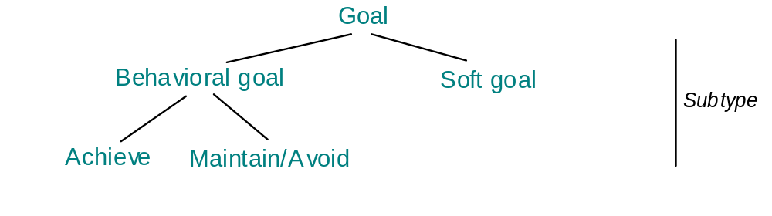
Goal types
Behavioral goals: prescribe behaviors
vs.
Soft goals: state preferences among alternative behaviors

Slide 8
Goal types: behavioral goals
Prescribe intended system behaviors declaratively
  implicitly define maximal sets of admissible agent behaviors
Can be satisfied in a clear-cut sense: YES or NO
  goal satisfaction, formal analysis
Used for building operation models to meet them
  ”Worst-case stopping distance maintained”
  “Reminder sent if book not returned on time”

Slide 9
Behavior goals prescribe sets of desired behaviors
DoorsClosed
WhileMoving
moving
closed
stopped
closed
stopped
open
stopped
closed
moving
closed

Slide 10
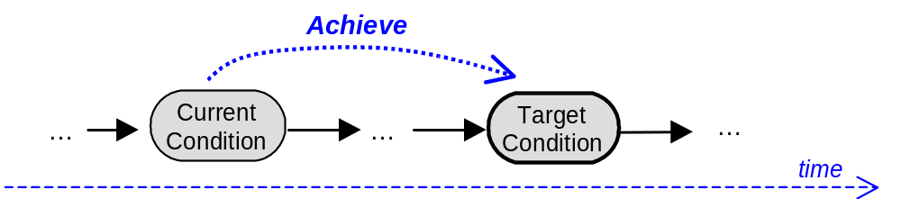
Behavioral goals: subtypes and specification patterns
Achieve [TargetCondition]:
    [if CurrentCondition then] sooner-or-later TargetCondition
  Achieve [BookRequestSatisfied]:
  if a book is requested then sooner-or-later
  a copy of the book is borrowed by the requesting patron
  Achieve [FastJourney]:
  if train is at some platform then within 5 minutes it is at next platform

Slide 11
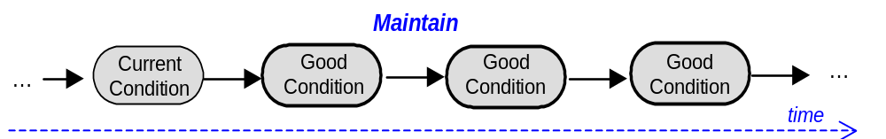
Behavioral goals: subtypes and specification patterns (2)
Maintain [GoodCondition]:
    [if CurrentCondition then] always GoodCondition
    always (if CurrentCondition then GoodCondition)
  Maintain [DoorsClosedWhileMoving]:
    always (if a train is moving then its doors are closed)
  Maintain [WorstCaseStoppingDistance]:
    always (if a train follows another then
    its distance is sufficient to allow the other to stop suddenly)

Slide 12
Behavioral goals: subtypes and specification patterns (3)
Accuracy goals are usually of type Maintain
  Maintain [AccurateBookClassification]:
    if a book is registered in the library directory then
    always its keyword-based classification reflects its covered topics
Avoid [BadCondition]: dual of Maintain ...
    [if CurrentCondition then] never BadCondition
  Avoid [BorrowerLoansDisclosed]:
  never patron loans disclosed to other patrons
  Many security goals are Avoid goals

Slide 13
Goal types: soft goals
Capture preferences among alternative behaviors
Cannot be satisfied in clear-cut sense:
  more satisfied in one option, less satisfied in another
  goal satisficing, qualitative analysis
Used for comparing options to select preferred
Often take the form
  Maximize / Minimize, Incresase / Reduce, Improve, ...
  “Stress conditions of air traffic controllers shall be reduced”
  “The workload of library staff shall be reduced”
  “The bibliographical search engine shall be usable by non-CS students”

Slide 14
Goal categories
Classification into functional, quality, development goals
Categories may overlap; boundary not always clear
  unlike goal types
Functional goals
  prescribe intended services to be provided by the system
  used for building operational models of such services
    use cases, state machines (see later)
    e.g. “Passengers transported to their destination”
    “Train acceleration computed”
    ”Book request satisfied"

Slide 15
Goal categories: non-functional goals
Quality goals (not to be confused with soft goals, cf. book p. 271)
  about quality of service ...
    security "info about other patrons kept confidential"
    safety "worst-case stopping distance maintained"
    accuracy ”measured speed = physical speed”
    ”book displayed as available iff there is a copy in shelves"
    performance ”acceleration command sent every 3 seconds”
    usability
    interoperability, ...
Development goals
  about quality of development ...
    cost, deadline, variability, maintainability, reusability, etc.

Slide 16
Goal categories (2)
goal
development
functional
quality
...
usability
satisfaction
information
...
safety
security
accuracy
performance
...
...
confidentiality
availability
integrity
time
space
...
...
See book, Fig. 7.5 p. 269
Helpful for eliciting overlooked application-specific instances
through taxonomy browsing

Slide 17
Using goal types & categories
Lightweight specification patterns
Heuristic rules for elicitation, validation, reuse, conflict management, ...
    "Is there any conflict between Information goals and
Confidentiality goals?"
"Confidentiality goals are Avoid goals on sensitive info"
"Safety goals have highest priority in conflict resolution"
More specific types & categories
⇒ more specific heuristics

Slide 18
Avoid frequent misconceptions
Goal-oriented ≠ top-down
  bottom-up elaboration as well (goal abstraction)
Goal-oriented ⇒ agent-oriented,
scenario-oriented
the magic RE triangle:
goals
coverage
responsibility
scenarios
agents
interaction

