Slide 1

InCollege
Team Montana

Slide 2

Agenda
Functionality
Code Design
Q/A

Slide 3
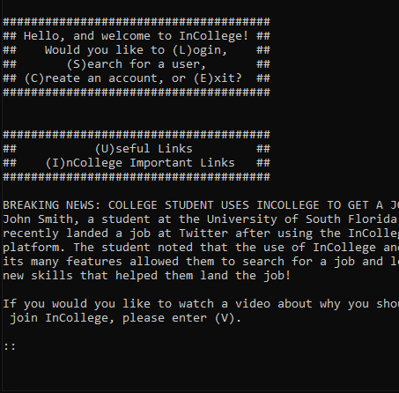
Main Menu

Slide 4
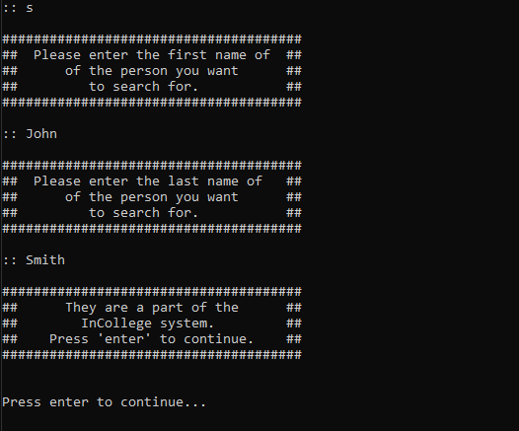
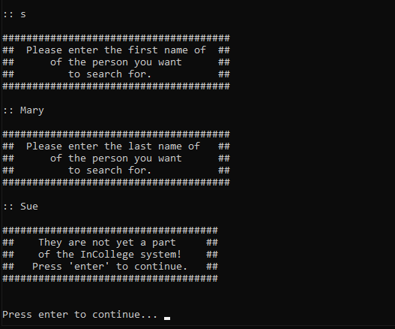
        Searching for users.

Slide 5
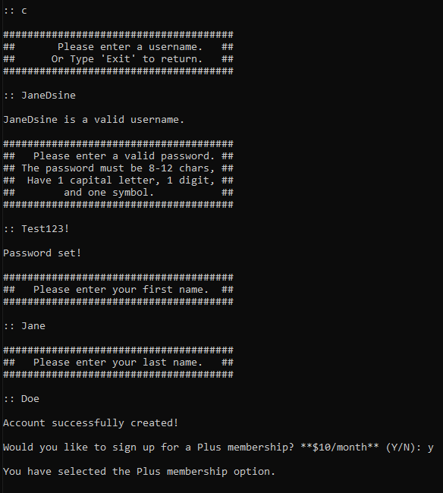
Creating an Account

Slide 6
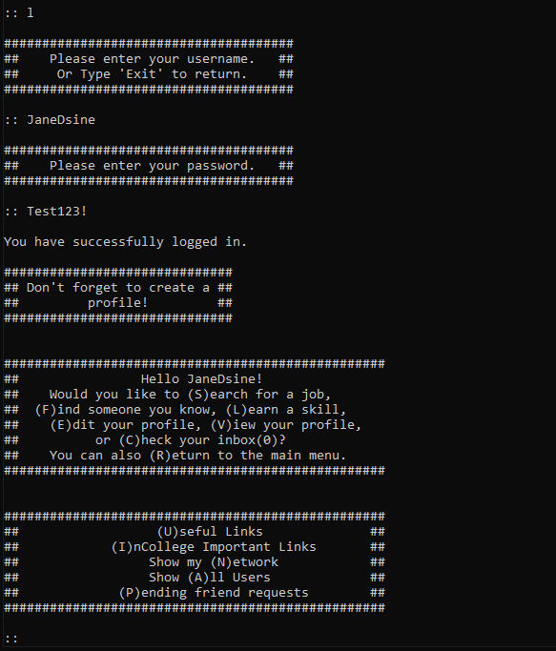
Logging in

Slide 7
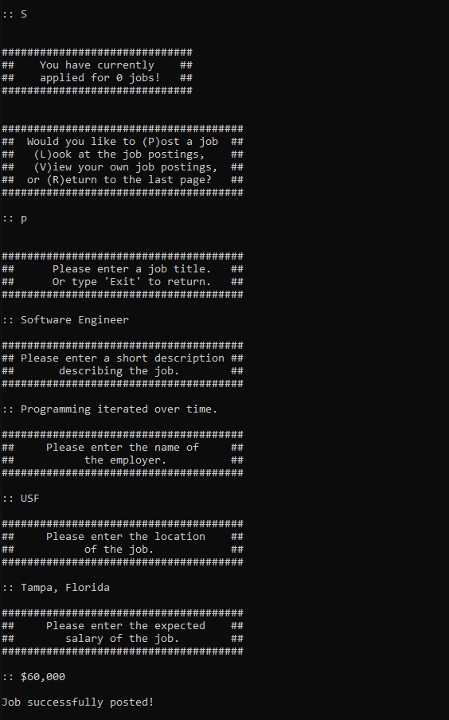
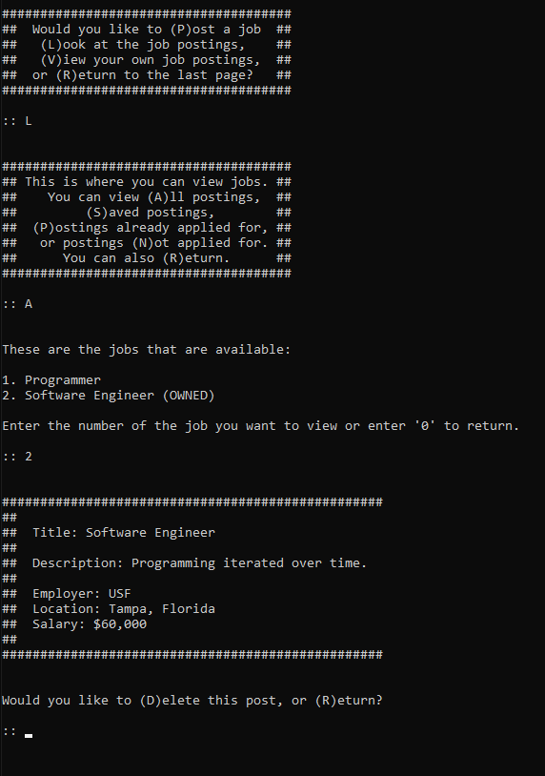
Post A Job
And
Display A List of Jobs

Slide 8
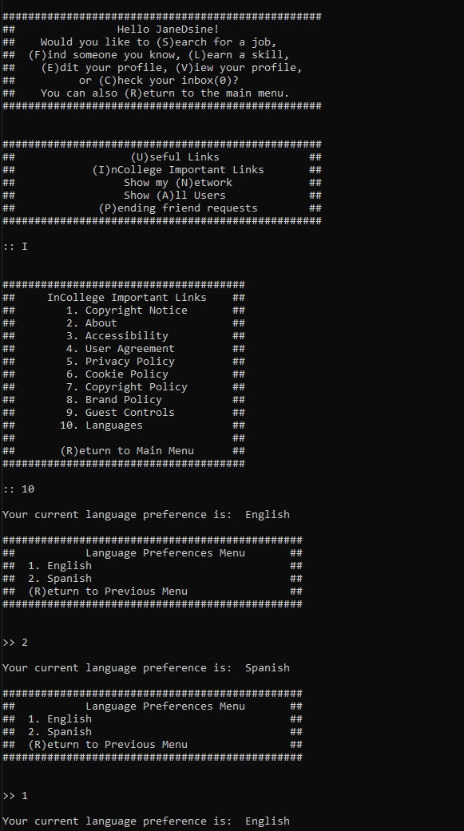
Setting your language

Slide 9
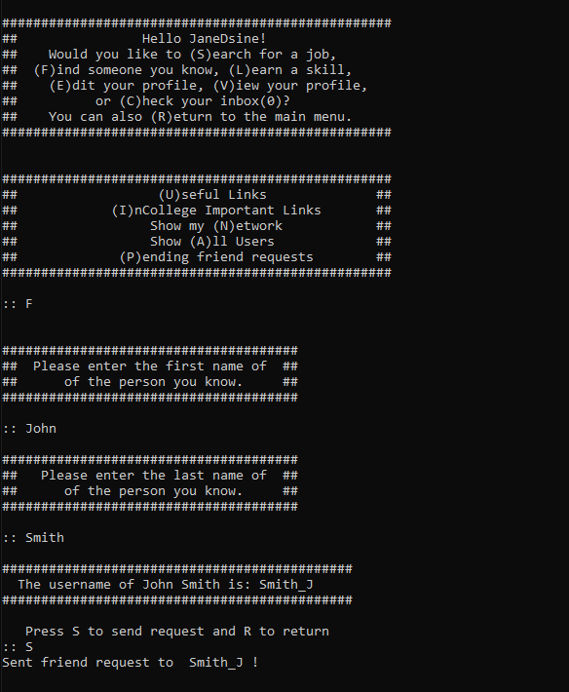
Sending Friend Requests

Slide 10
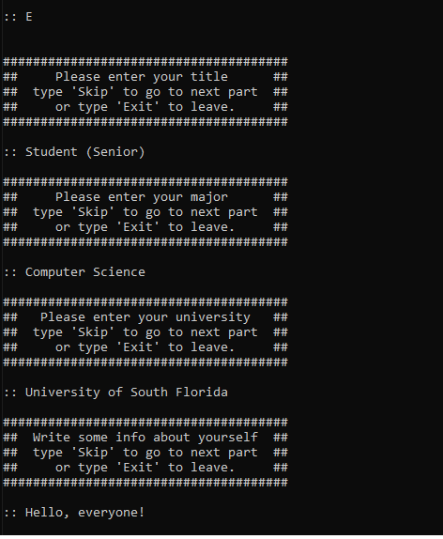
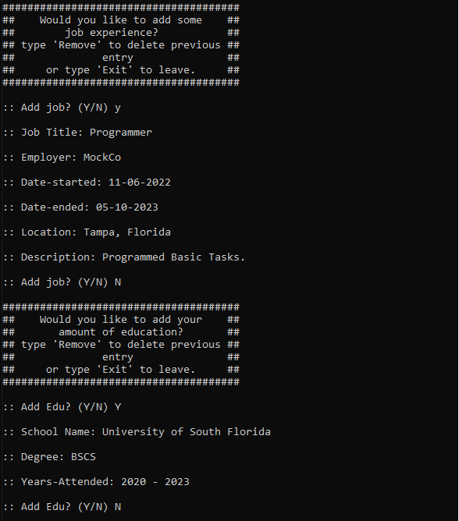
Creating A Profile

Slide 11
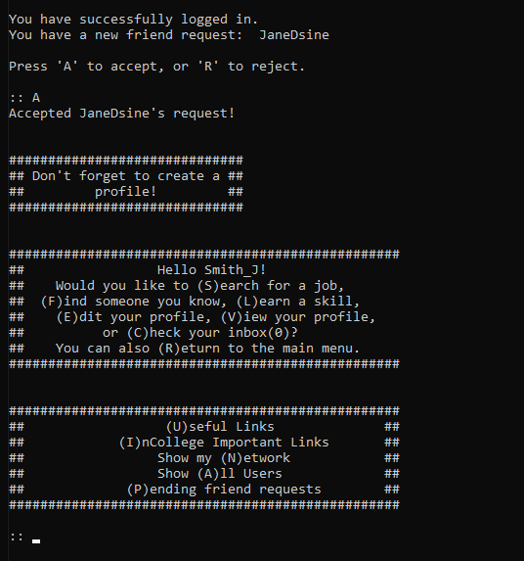
Accepting Friend Requests

Slide 12
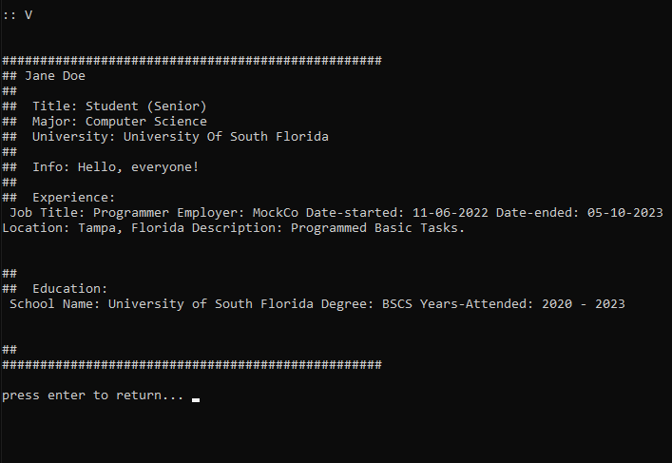
View Your Profile

Slide 13
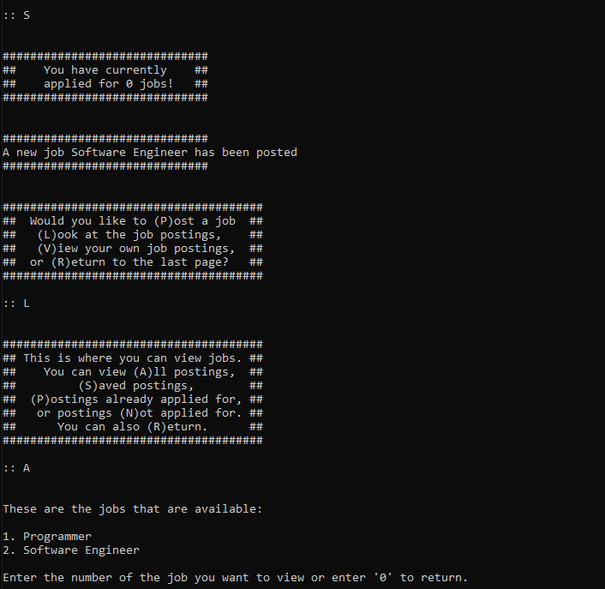
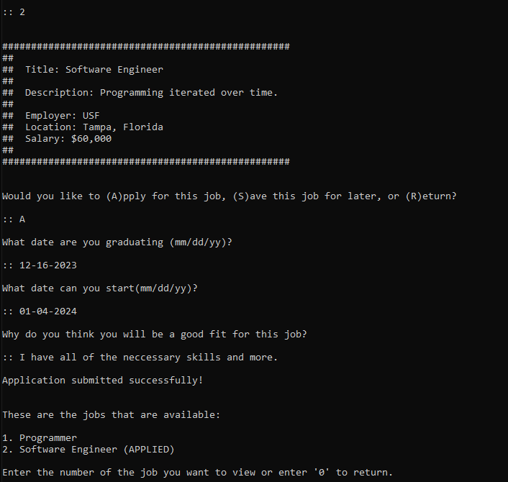
Get Notifications of New Job Postings
Apply For Jobs

Slide 14
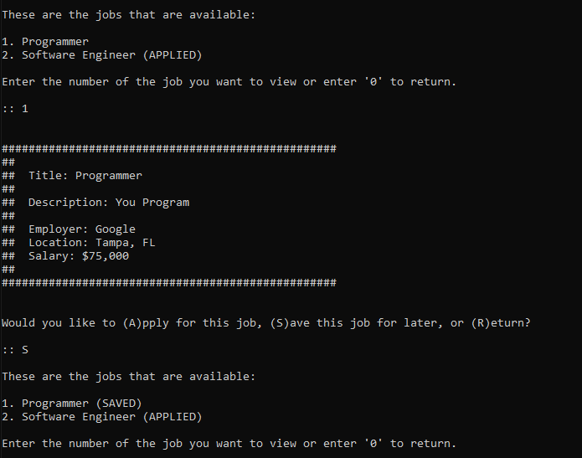
Save a Job

Slide 15
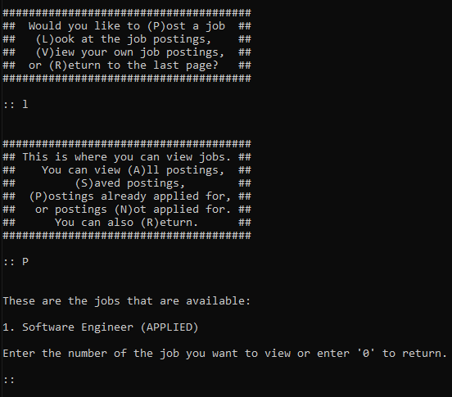
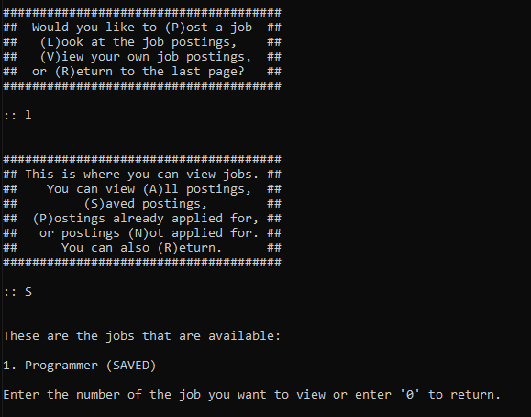
View a List of Applied Jobs
View a List of Saved Jobs

Slide 16
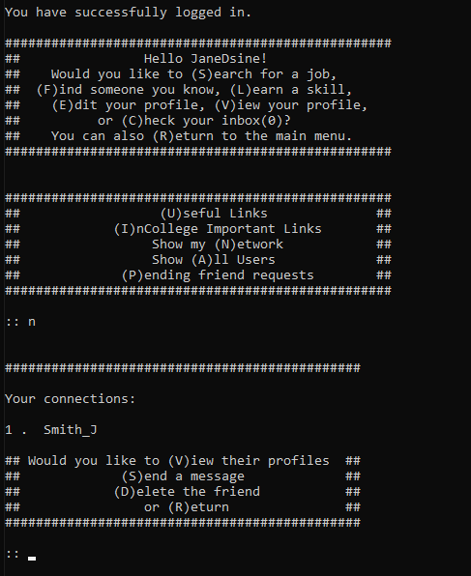
View Friends List

Slide 17
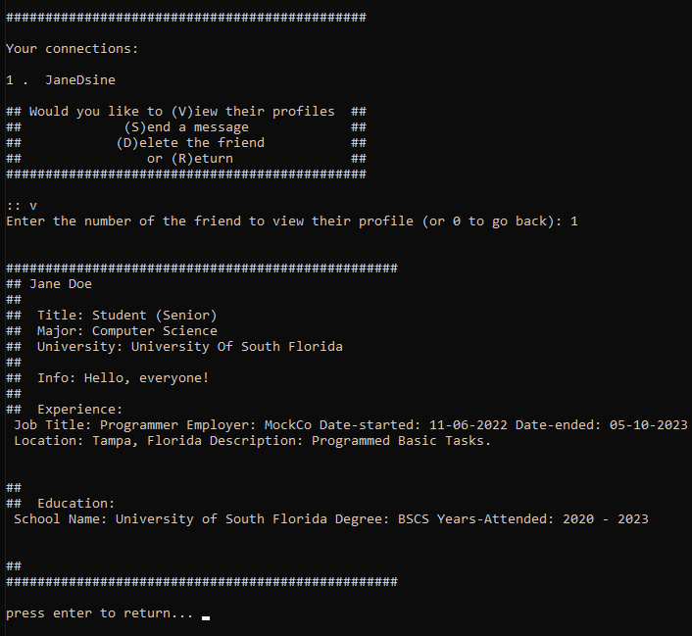
View Friend's Profile

Slide 18
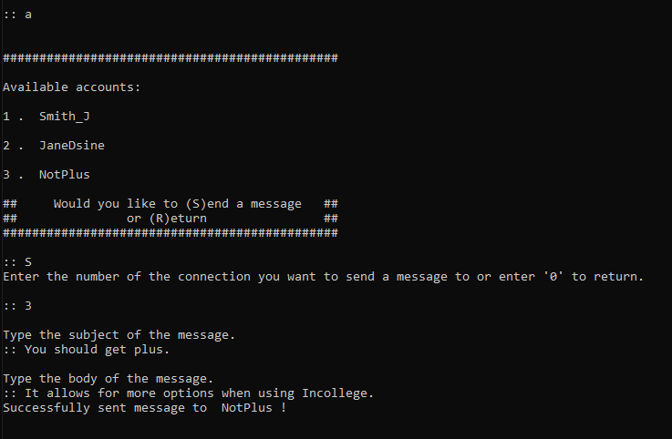
As a Plus Member, You can send messages to any account!

Slide 19
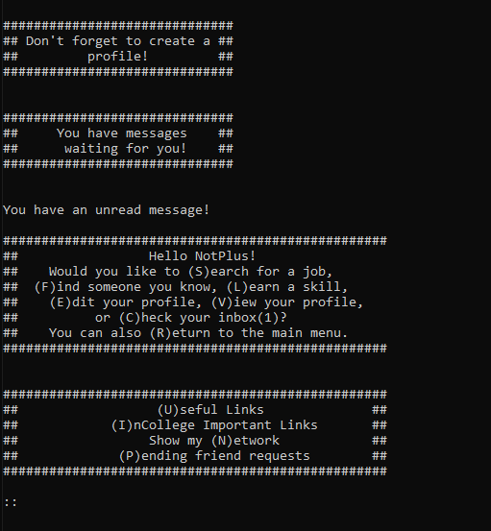
Get Notifications of new Messages
As a basic account, the 'Show All Users' feature is disabled

Slide 20
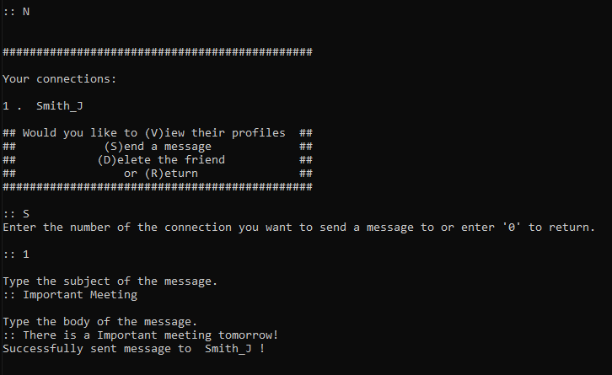
As A Basic account, You can only send messages to friends

Slide 21
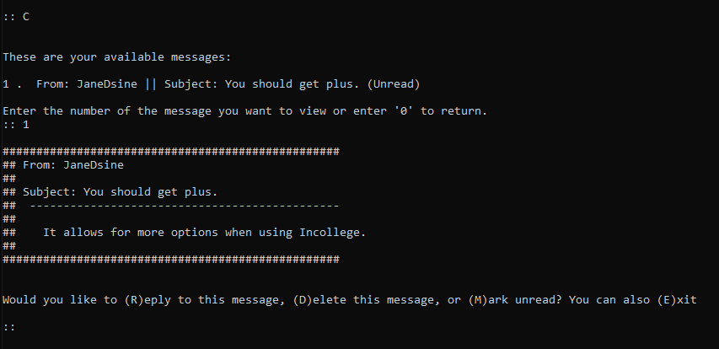
You can check your Inbox to view your messages

Slide 22

Code Design
What module / functions / classes does your program have? sqlite3, math, accounts class and initialization functions
How is data stored and retrieved?
SQLite database (accounts.db)
What security features have been incorporated into your program?Error handling, password strength check, authentication and input validation
How many test cases have been developed for your program? ~50 cases

Slide 23
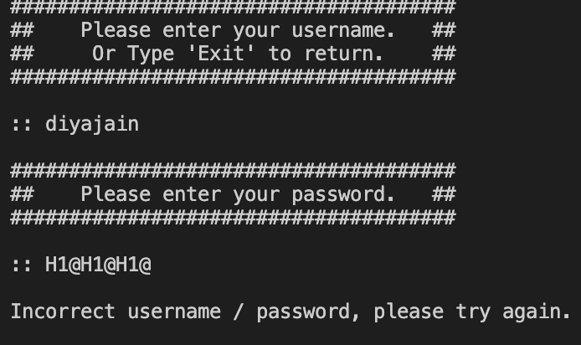
Security Features
Won’t let you login if username is not found in the database.

Slide 24

Security Features
Further additions will include security features like:
Storing passwords in plain text:
To improve security, hashing passwords with safe hashing methods like bcrypt would work well before storing them in a database.
SQL Injection Vulnerability:
SQL injection attacks can arise when user inputs directly impact SQL queries in the absence of appropriate sanitization. This risk can be reduced by using ORM frameworks like SQLAlchemy or parameterized queries.
Limited error handling:
To avoid any security flaws, appropriate error handling should be put in place.

Slide 25
Test Cases
Wide range of scenarios are tested to verify many features of the application, including friend requests, job posts, account administration, login, profile settings, and privacy regulations.
Fixtures are used in each test case to create the required environment, supply input values, mimic user inputs, and make assertions on the output to guarantee that the program will behave as intended.
The test cases exhibit a good variety and attempt to cover a wide range of potential circumstances, which adds to the program's overall robustness and reliability.

Slide 26
Test Cases Include:
Account Creation and Validation Tests:
  test_create_account: Checks if an account is successfully created.
  test_create_account_already_exist: Checks that an account cannot be created if the username already exists.
  test_create_account_when_max: Tests that no more accounts can be created when reaching the maximum limit.
  Password Validation Tests: Various tests to validate password criteria such as length, capital letters, digits, and symbols.
Login Functionality Tests:
  test_login_success: Checks if a user can successfully log in.
  test_login_failure: Verifies unsuccessful login attempts.
  test_login_on_next_attempt: Validates the login process after multiple attempts.
Profile and Privacy Policy Tests:
  Tests related to displaying privacy policies, user agreements, and settings related to guest controls and languages.
Friend Request and Relationship Tests:
  Tests related to sending and accepting friend requests, searching for users, and handling friend relationships.
Job Posting and Application Tests:
  test_create_job: Checks if a job can be successfully posted.
  test_create_job_when_max: Ensures that no more jobs can be created when reaching the maximum limit.
  Tests related to job application, deletion of jobs, and their impact on applications.
Job Listing and Details Display Tests:
  test_job_listing: Verifies the display of job listings.
  test_job_details_display: Checks if job details are displayed correctly.
Other Functionality Tests:
  Tests related to video playing, copyright notice, accessibility, brand policy, and more.

Slide 27

Thank you!
Please let us know if there are any questions or concerns.

