Slide 1
Saathi — Your Multimodal AI Accessibility Copilot
Unified Learning Platform with Real-Time Vision AI, Zero-Latency Subtitles, Cognitive Simplifier & AI Lady Tutor
PROPOSED BY: TEAM SARVASHRESTHA | TRACK 2: AI AGENT / ACCESSIBILITY COPILOT (SOFC 2.0)

Slide 2
SAATHI ACCESSIBILITY COPILOT | TEAM SARVASHRESTHA
The Problem & Our Solution
❌ THE PROBLEM
• Students with disabilities juggle 5+ disconnected tools (screen reader, translator, captioner, PDF simplified reader).
• No tool understands the student's unique learning profile across senses.
• Existing apps suffer high latency, complex UI setups, or costly subscriptions.
• Campuses lack a single unified accessibility layer for inclusive classrooms.
✨ THE SAATHI SOLUTION
• Single PWA powered by Personalization-Aware Modality Router (PAMR).
• Set your accessibility profile once — Visual, Hearing, Cognitive, or Math.
• Automatic routing to Vision OCR, 0ms Live Speech Subtitles & 5th-Grade Simplifier.
• Includes Saathi AI Studio with Chibi AI Lady Tutor for interactive campus study.

Slide 3
SAATHI ACCESSIBILITY COPILOT | TEAM SARVASHRESTHA
Core Assistive Features & Profiles
👁️ Visual Assist
Llama-3.2 Vision & OCR for printed notes, environment photos & audio screen reader.
🎤 Hearing Assist
0ms latency live classroom subtitles with instant Hindi/Marathi translation.
🧠 Cognitive Assist
5th-grade textbook simplifier with OpenDyslexic font & rich markdown highlights.
📐 Math & LaTeX Assist
Phonetic math formula speech reader & symbol breakdown.

Slide 4
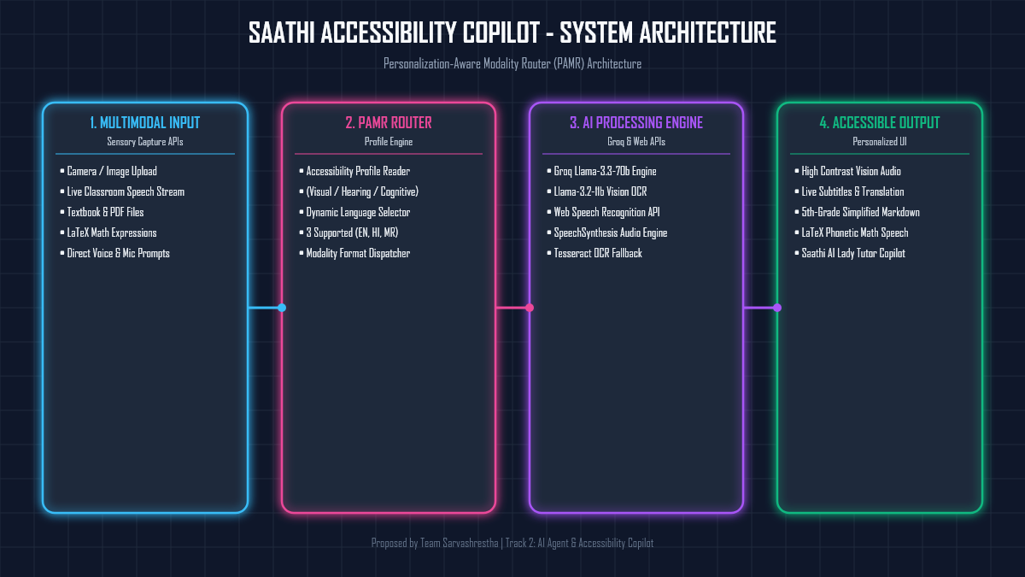
SAATHI ACCESSIBILITY COPILOT | TEAM SARVASHRESTHA
System Architecture: PAMR Framework

Slide 5
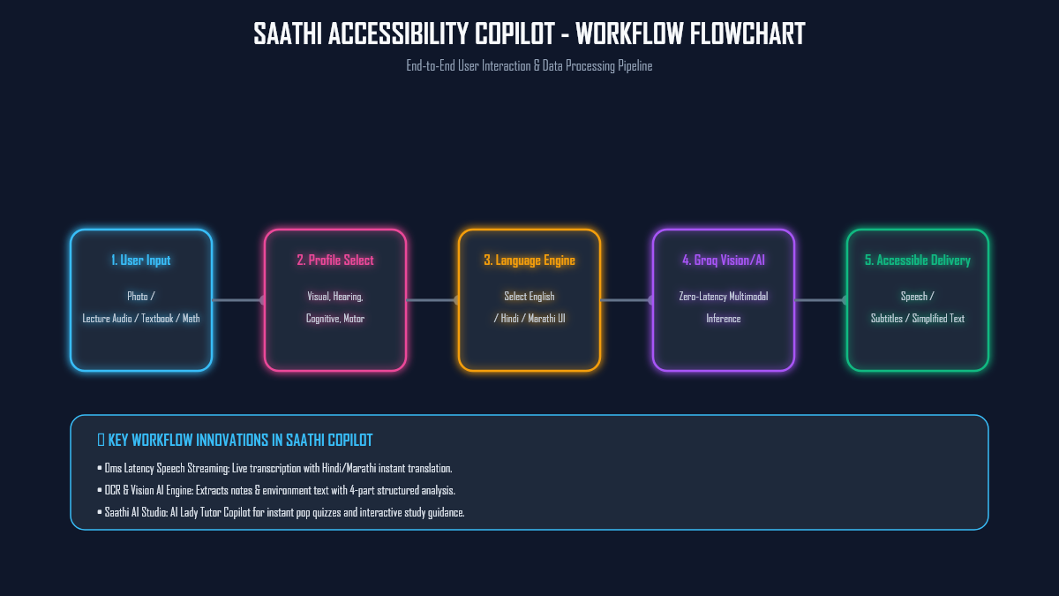
SAATHI ACCESSIBILITY COPILOT | TEAM SARVASHRESTHA
End-to-End User Workflow & Data Pipeline

Slide 6
SAATHI ACCESSIBILITY COPILOT | TEAM SARVASHRESTHA
Full Site Multilingual Translation Engine
🌐 3 SUPPORTED LANGUAGES: ENGLISH, HINDI (हिंदी), MARATHI (मराठी)
• Instant Dynamic Language Switcher: Changing language updates the ENTIRE PWA interface in real time.
• Navbar, Hero Section, Sidebar Navigation, Tool Headers & Profile Controls are fully translated.
• Groq AI Engine generates study summaries in the student's selected native language.
• Bridges the language barrier for regional Indian university students.

Slide 7

SAATHI ACCESSIBILITY COPILOT | TEAM SARVASHRESTHA
Saathi AI Studio & Chibi Lady Tutor
👩‍🏫 INTERACTIVE LADY AI TUTOR COPILOT
• Dedicated Saathi AI Studio accessible directly from the left sidebar.
• Cute AI Lady Tutor character with smart glasses & pointer stick for friendly learning.
• Interactive 1-Click Chips: Pop Quiz Master, 5th-Grade Story, Academic Joke & Study Motivation.
• Hands-Free Continuous Speech Loop with automatic voice readout.

Slide 8
SAATHI ACCESSIBILITY COPILOT | TEAM SARVASHRESTHA
Updated Technical Stack
Frontend Framework
React 18 + Vite PWA (Zero Install, Progressive Web App)
AI Inference Engine
Groq Llama-3.3-70b-versatile & Llama-3.2-11b-vision-preview
OCR & Speech APIs
Web Speech API, SpeechSynthesis & Tesseract.js fallback engine
UI & Design System
Platinum Silver & Dark Charcoal CSS with Glassmorphism & Lucide Icons

Slide 9
SAATHI ACCESSIBILITY COPILOT | TEAM SARVASHRESTHA
Feasibility & Zero-Cost Architecture
⚡ HACKATHON FEASIBILITY & DEPLOYMENT
1. 4-Person Team: Roles clearly scoped across AI, Frontend, Accessibility, and Design.
2. Zero-Cost Infrastructure: Groq AI, Vercel hosting & Web Speech API — 100% free tier.
3. Zero Hardware Barrier: Runs on any browser phone/laptop without special hardware.
4. Pre-trained AI Models: Zero custom model training required; instant high accuracy out of the box.

Slide 10
SAATHI ACCESSIBILITY COPILOT | TEAM SARVASHRESTHA
Risk Mitigation & Live Demo Readiness
🛡️ OVERCOMING TECHNICAL CHALLENGES
• Speech Latency: Progressive streaming & client-side SpeechSynthesis voice buffer.
• Image / Note Noise: Built-in filter Garbled OCR regex engine cleans illegible symbols.
• Guest Authentication: 1-Click Guest Sign In for instant reviewer access without sign-up delay.
• Live Deployment: Deployed on Vercel with automatic GitHub sync.

Slide 11
SAATHI ACCESSIBILITY COPILOT | TEAM SARVASHRESTHA
Impact & Campus Benefits
🌟 REAL-WORLD CAMPUS IMPACT
• Replaces 5+ fragmented apps with one unified accessibility PWA.
• Empowers visually impaired, deaf/hard-of-hearing, and dyslexic students in university classrooms.
• Zero-install PWA eliminates device compatibility barriers for low-income students.
• Supports non-native English speakers with live Hindi and Marathi translation.

Slide 12
SAATHI ACCESSIBILITY COPILOT | TEAM SARVASHRESTHA
Why Choose Saathi?
💡 THE PAMR DIFFERENCE
1. All-in-One Platform: Vision, Speech, Text & Math tools in one unified PWA.
2. Automatic AI Routing: PAMR eliminates manual settings — set your profile once.
3. Browser-Based PWA: Zero app store installation needed — works instantly on any phone or laptop.

Slide 13
SAATHI ACCESSIBILITY COPILOT | TEAM SARVASHRESTHA
Academic References & Research Foundations
📚 RESEARCH PAPERS & FOUNDATIONS
• Manduchi, R., & Coughlan, J. (2012). 'The Role of Computer Vision in Accessible Technology.' Proceedings of the IEEE, 100(5), 1680–1698.
• Karamolegkou, A., et al. (2025). 'Evaluating multimodal language models as visual assistants for visually impaired users.' ACL 2025 / arXiv.
• Microsoft Research — 'Seeing AI: Helping People See the World' (real-world assistive framework reference).

Slide 14
SAATHI ACCESSIBILITY COPILOT | TEAM SARVASHRESTHA
Future Roadmap & Vision
🚀 SCALABILITY & VISION
• Short-Term: Add 10+ regional Indian languages & offline web worker OCR mode.
• Mid-Term: Smart Classroom LMS integration & AI campus navigation.
• Long-Term: Wearable glass camera & smart mic integration for hands-free university lectures.
• Mission: 'To build an inclusive digital learning ecosystem where every student accesses education independently.'

Slide 15
SAATHI ACCESSIBILITY COPILOT | TEAM SARVASHRESTHA
Team Sarvashrestha
👥 TEAM MEMBERS & CONTRIBUTIONS
• Diya Poulkar & Team Sarvashrestha
• Track 2: AI Agent & Accessibility Copilot
• Repository: https://github.com/diyaapoulkar-alt/Team-Sarvashrestha-Diya-Poulkar.git
• Live Deployment: https://team-sarvashrestha-diya-poulkar.vercel.app/

Slide 16
THANK YOU!
Saathi — Universal Learning with Multimodal AI Accessibility
Live Demo: https://team-sarvashrestha-diya-poulkar.vercel.app/

