Slide 1


Project Presentation On:-
Host a Static Website Using AWS On Other Clouds
SUPERVISED BY: MS. AMBIKA GUPTA
Presented By: Diya Bansal
Tanisha Agrawal
Anya Gupta
Kanhaiya
Sahil
(GLA University, Mathura)

Slide 2
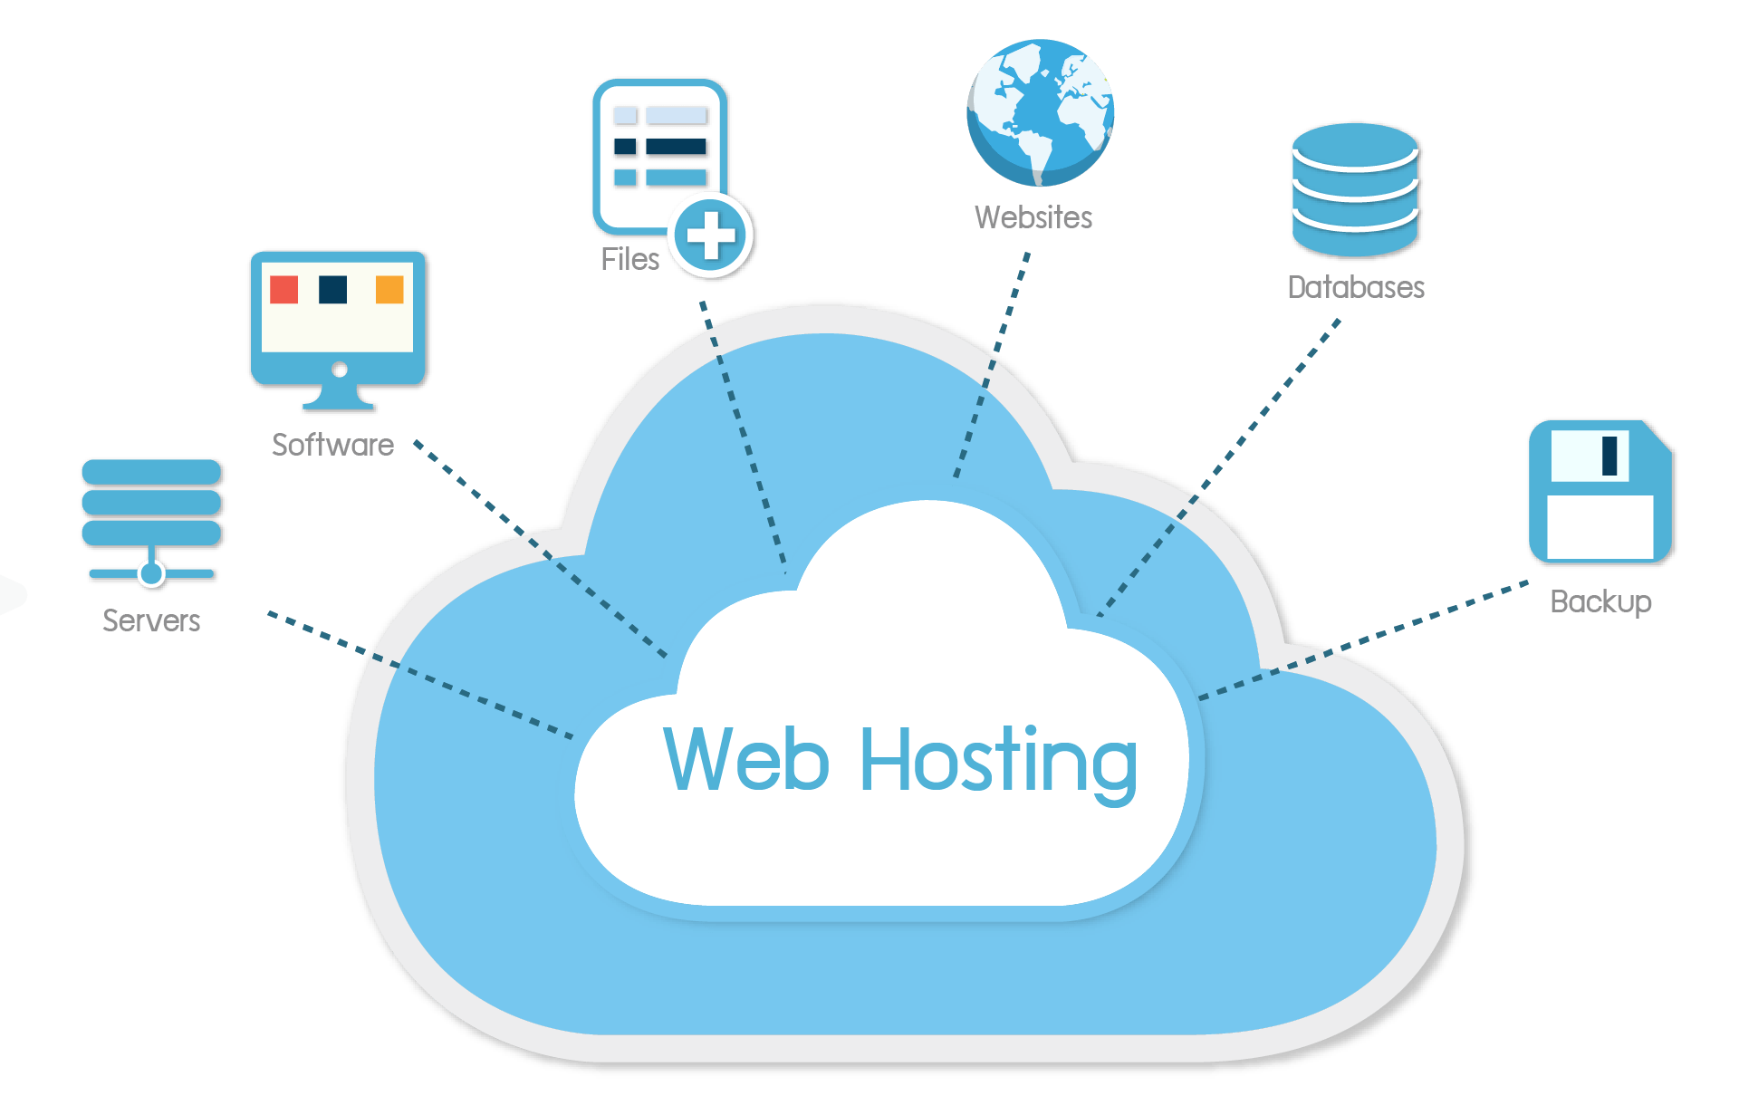
Content:-
What Is Static Website
What Is Hosting
What Is Google Firebase Cloud
How We Got Inspired To Do Such A Project
How We Made It
Conclusion

Slide 3

How We Got Inspired To Do Such A Project
Improved Site Performance.
Effective Data Management.
Enhanced Security

Slide 4
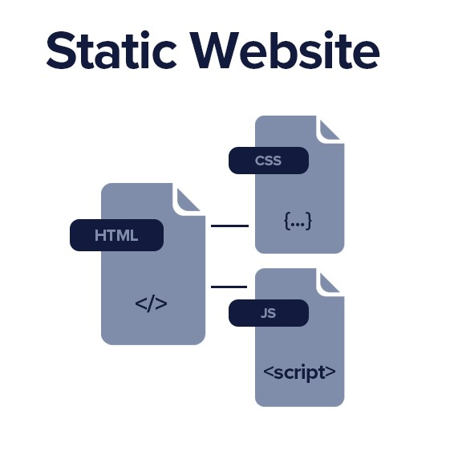
What Is Static Website
A static site is a website built with pages of static content, or plain html, JavaScript, or CSS code.
This content stays consistent regardless of the user or where the user is and offers little interactivity.
The content that is served is not dependent on a particular user, the content can be pre-rendered leading to fast performance and lightweight overhead, in simple use cases.

Slide 5
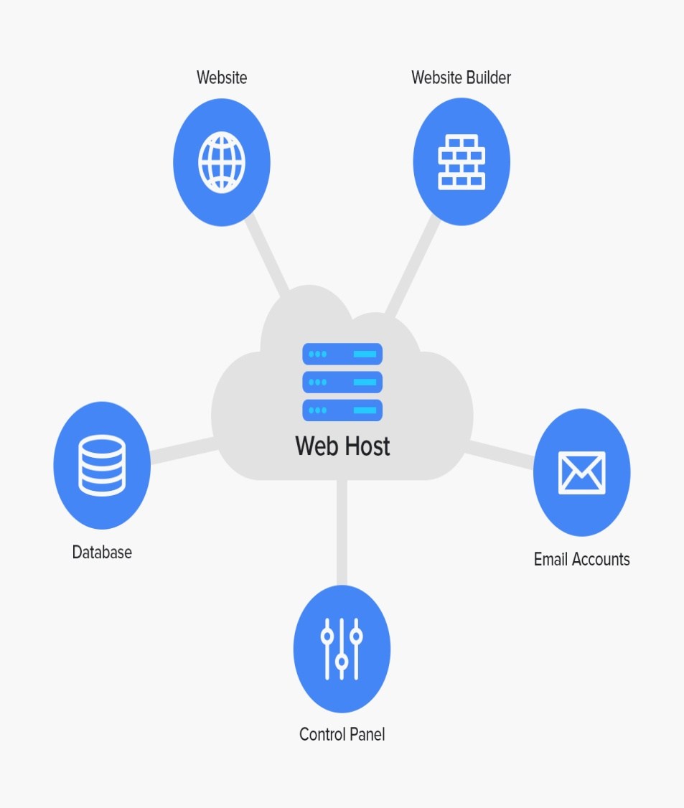
What Is Hosting
Web hosting is a service that allows organizations and individuals to post a website or web page onto the Internet.
A web host, or web hosting service provider, is a business that provides the technologies and services needed for the website or webpage to be viewed in the Internet.
Websites are hosted, or stored, on special computers called servers. When Internet users want to view your website, all they need to do is type your website address or domain into their browser.

Slide 6

Google Firebase
Cloud Messaging for Cross-Platform Apps.
Higher Website Traffic with App Indexing.

Slide 7
How We Made It
Firstly we opened Google firebase and chose the option free spark plan.
Now we named our project and then we accepted all terms and conditions and then Google created our project.
Then we added firebase to our web app and then registered the app.
After going back to hosting option it asked us to install firebase CLI.
Then we opened the terminal, we should already have node installed in our pc already to continue forward.
Then we installed firebase tools ,after doing so we went back to our website now it asked us to initialize our project. We copied those commands on terminal.
After that firebase asked to login into our Google account, after we allowed Google firebase to use Google account.
Now going back to the website the next step was to initialize our project using firebase in it.

Slide 8

For this we copied the path of our website than copied the init command. After that only command left was firebase deploy.
Deploy command deploys our application to web hosting servers.
After this we checked whether our website was hosted or not for this we copied the URL and searched it on internet, all this worked correctly.

Slide 9
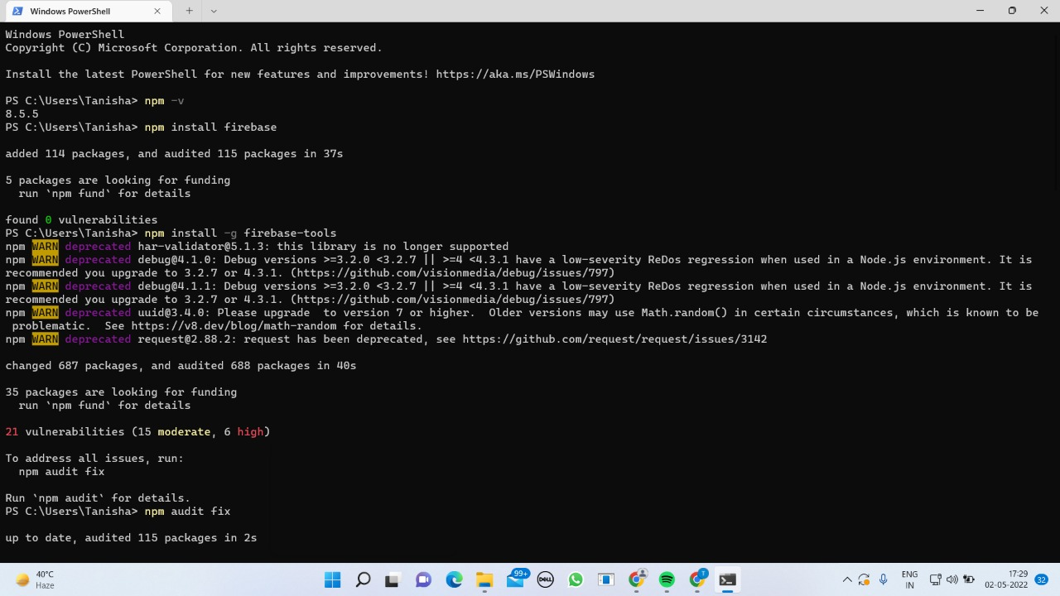
These are the screenshots of us performing the above mentioned steps

Slide 10
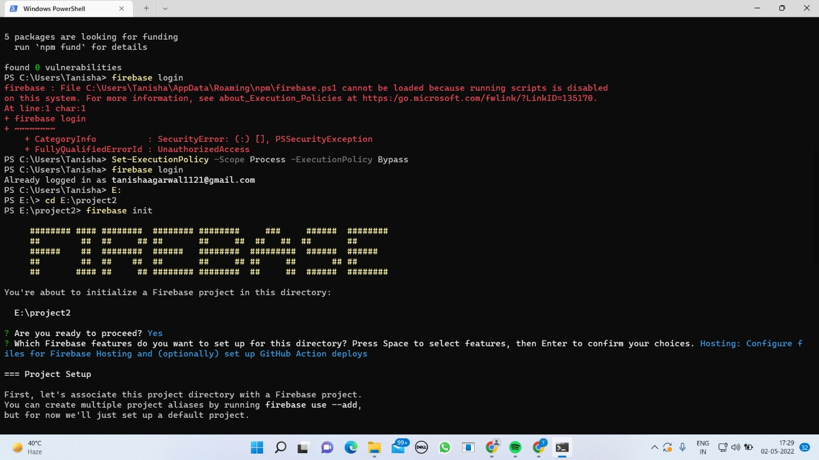
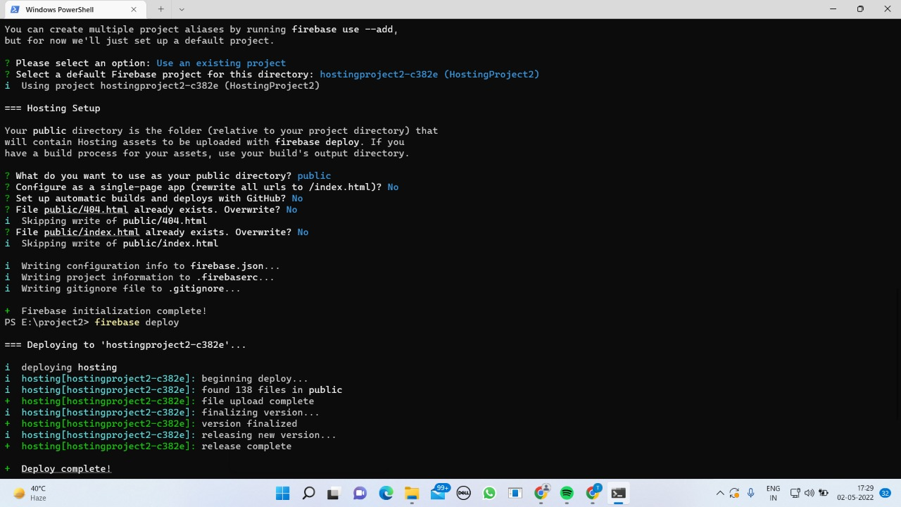

Slide 11
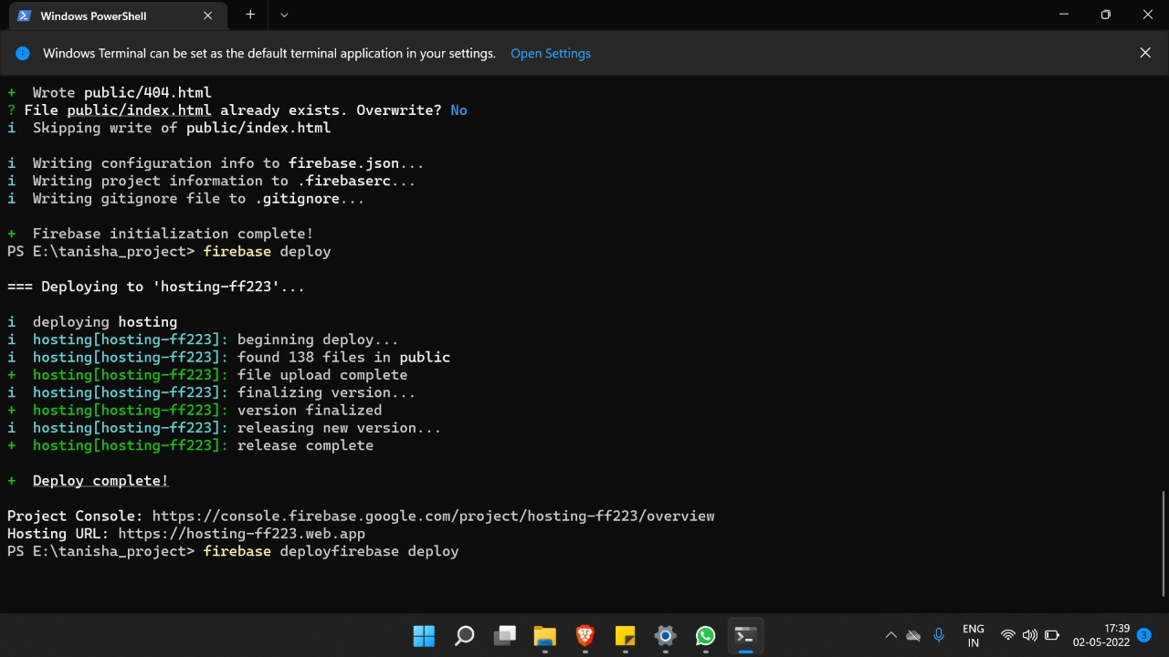
This is the link to our website—
https://hosting-ff223.web.app/

Slide 12
Conclusion
We understood the concept of hosting a website, how does hosting works .
We got to know about the importance of hosting a website works. For example, for an online business owner having a website with understanding uptime can help maximize sales and improve experience.
We got to know about cloud computing ,which is a type of hosting that utilizes multiple web servers to ensure maximum performance.

Slide 13
THANK YOU

