Slide 1



“ANIME PLAYING BOT”
TEAM MEMBERS :
Diya Bhat | 2022a1r017
Ujjawal Singh Charak |2022a1r029
Submitted to ; Vani Malgar

Slide 2

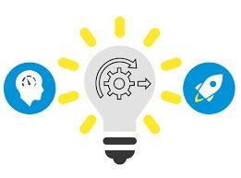



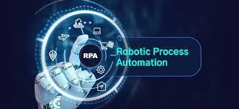

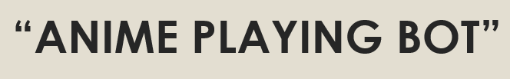
Project summary

Slide 3
Procedure:
To create an anime play both in UiPath Studio, we follow the following procedure:
Define the Scope and Objectives:
Clearly define the purpose and objectives of the anime play bot.
Determine the key functionalities you want to include, such as anime information retrieval, dialogue simulation, mini-games, voice acting, etc.
2. Gather Anime Data:
Identify reliable sources for obtaining anime-related data, such as anime databases, websites, or APIs.
Research and analyze the data structure and available information points, such as series details, characters, episodes, and release dates.
Design the User Interface:
Sketch or wireframe the user interface design for the anime play bot.
Determine the necessary components, such as buttons, input fields, dropdown menus, and interactive elements.
Set Up UiPath Studio:
Install UiPath Studio and ensure it is properly configured on your machine.
Create a new UiPath project and set the necessary project settings.

Slide 4
User Interface Interaction:
Use UiPath activities like "Click," "Type Into," and "Get Text" to interact with the anime play bot's graphical user interface.
Implement the designed user interface, allowing users to navigate, input commands, and make selections.
Data Retrieval:
Utilize web scraping techniques to extract anime-related data from the identified sources.
Use UiPath's web scraping activities to navigate web pages, extract data from tables or specific elements, and store it for further processing.
Text Processing and Dialogue Simulation:
Implement text processing activities like "Split," "Substring," "Replace," and "Regex" to manipulate and extract relevant information from anime scripts or dialogue.
Design and develop a dialogue simulation feature where users can engage in conversations with anime characters.
Use UiPath activities and predefined dialogue options to generate dynamic responses based on user inputs.

Slide 5
Additional Features:
Implement mini-games inspired by popular anime genres, such as quizzes, puzzles, or memory games. Use UiPath activities to implement game mechanics and track user scores.
Develop a voice acting module where users can record their voices or use pre-recorded lines to dub anime scenes or dialogue. Utilize UiPath's audio recording and playback capabilities.
Error Handling and Exception Management:
Implement error handling mechanisms to gracefully handle errors and provide meaningful error messages to guide users.
Use exception handling activities and workflows to handle unexpected scenarios and ensure the bot operates smoothly.
Testing and Iteration:
Test the functionality and performance of the anime play bot.
Gather feedback from users and make any necessary improvements or adjustments based on the feedback

Slide 6
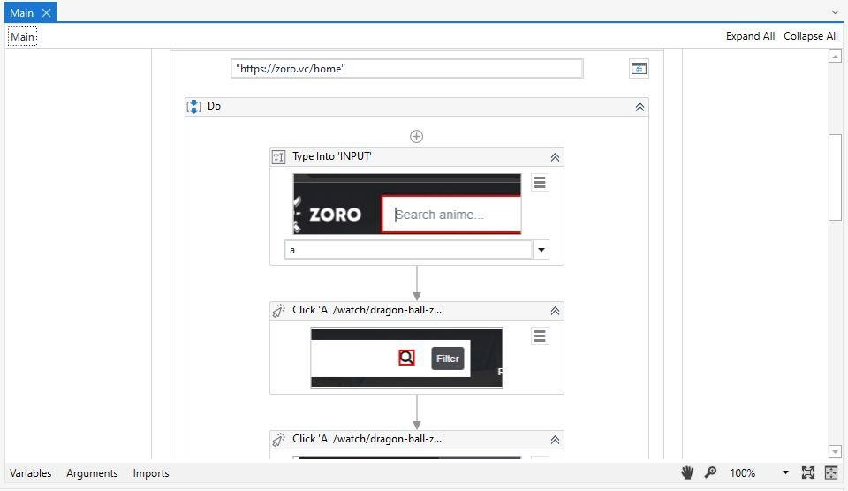
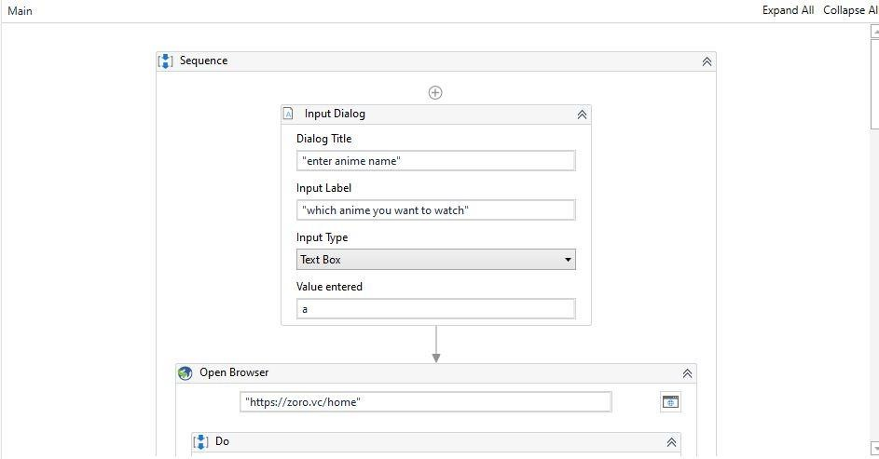
PROCESS:
Building the data table:

Slide 7
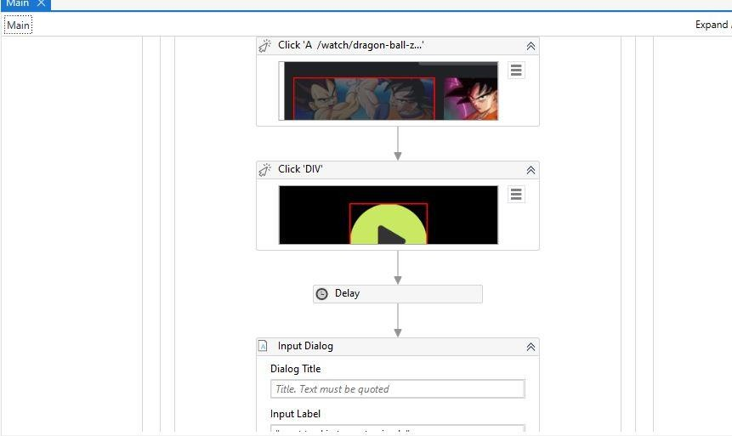
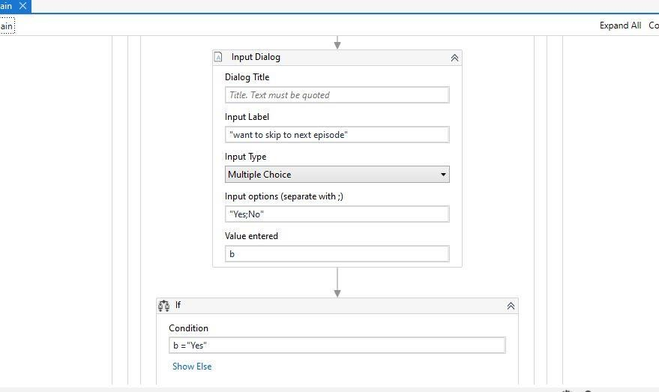

Slide 8
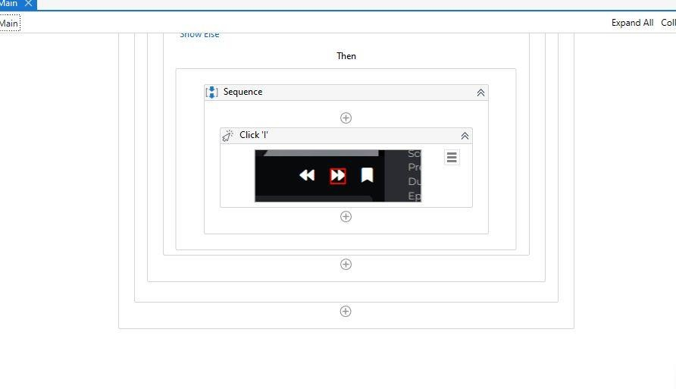
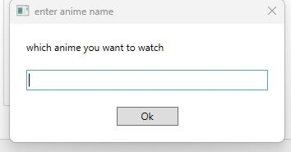

Slide 9
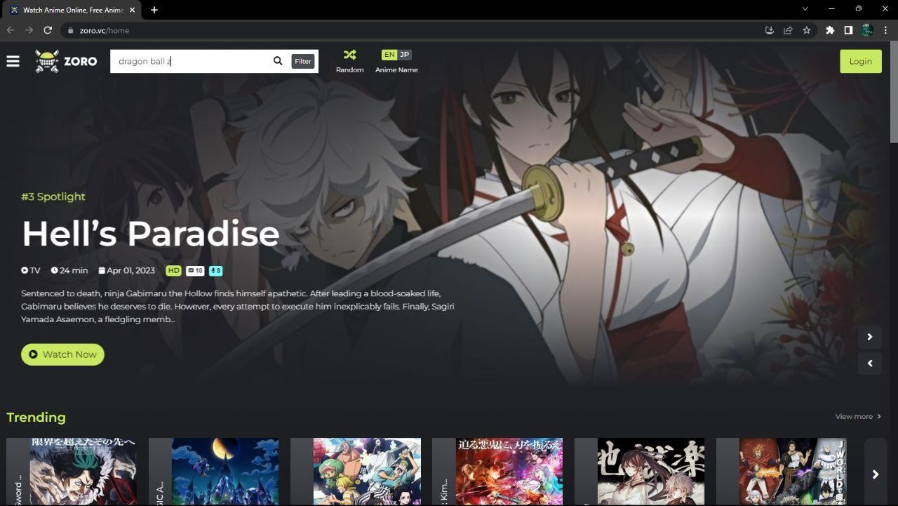
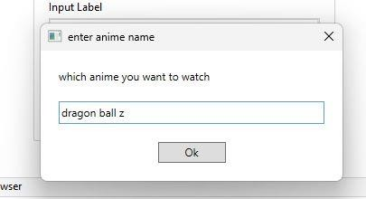
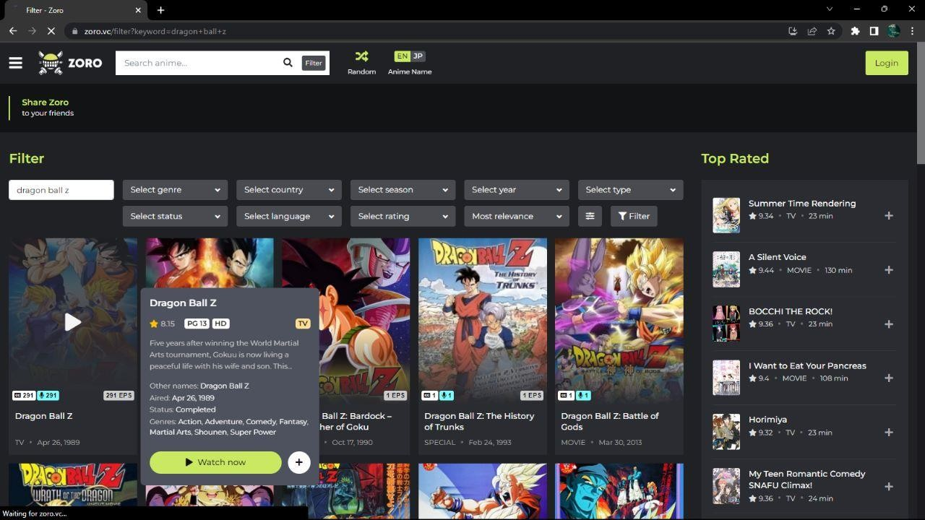

Slide 10
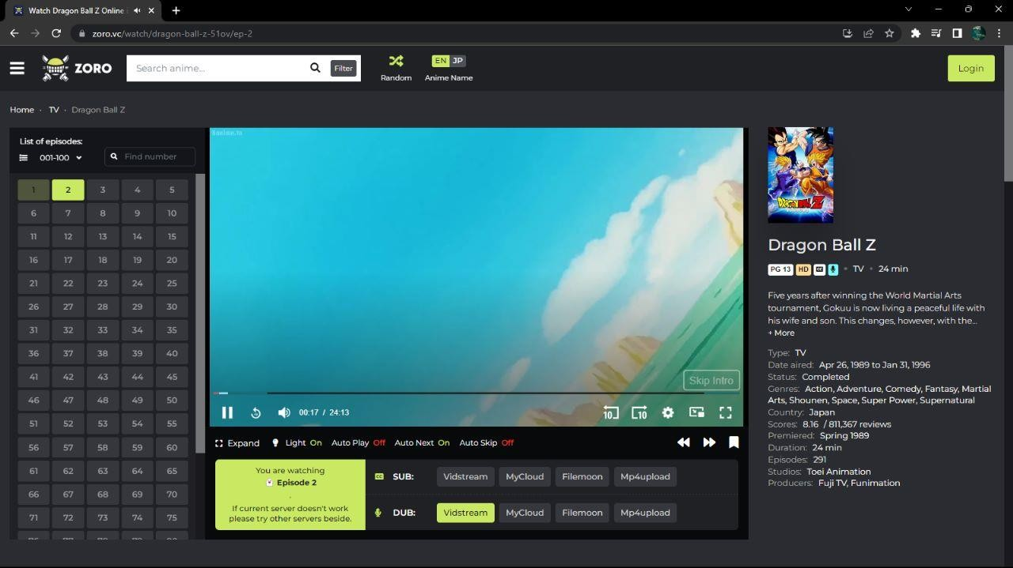
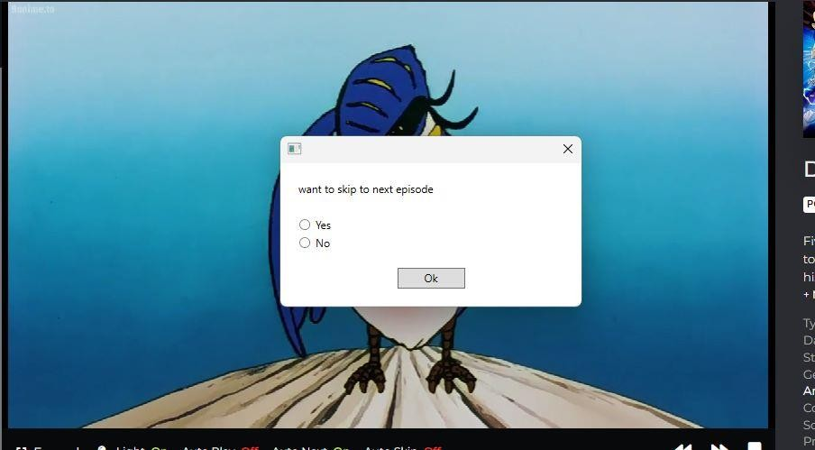

Slide 11
ボットが実行中です
Thank You

