Slide 1
Converge Walmart
Sparkathon

Slide 2
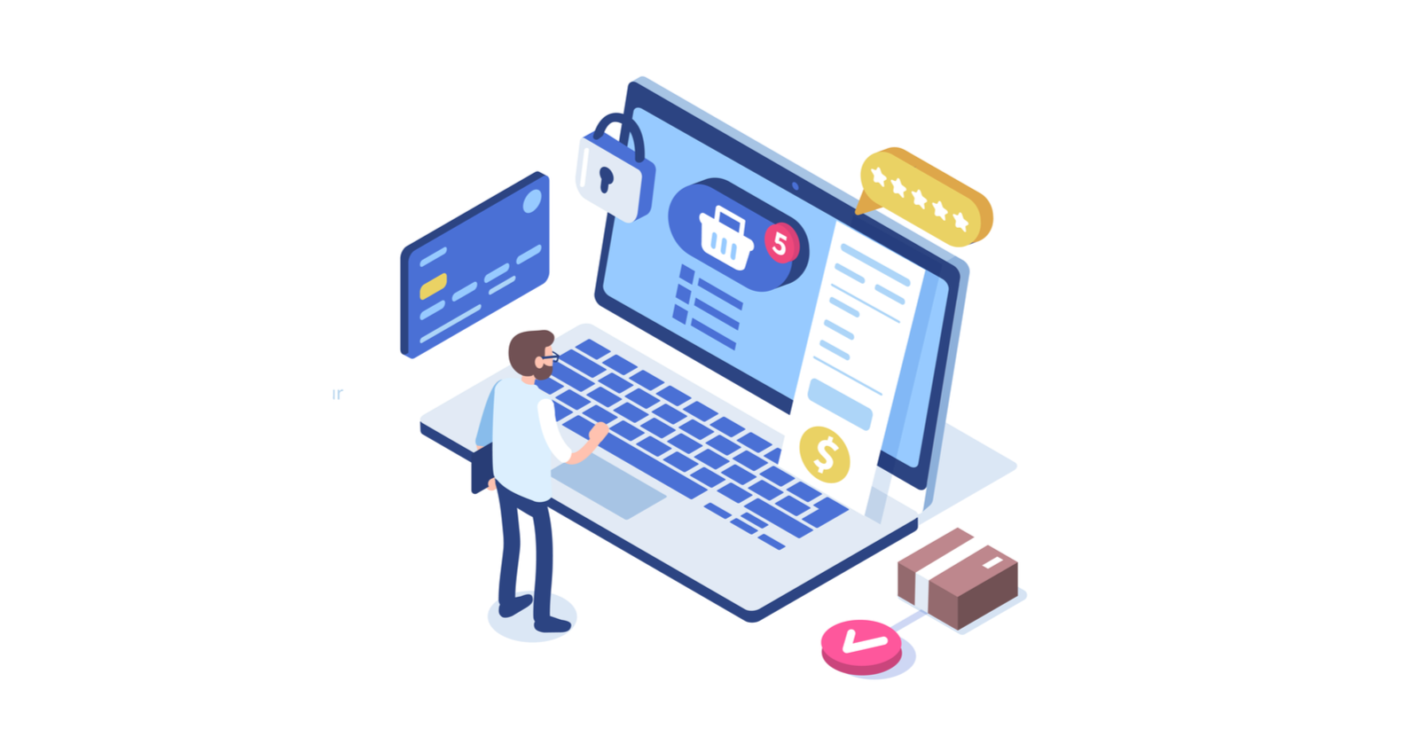
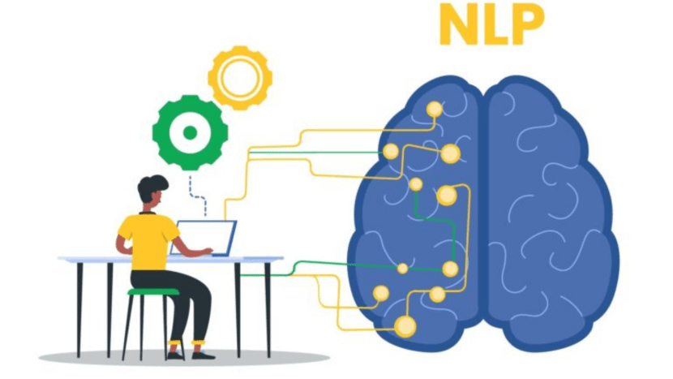


Our Theme
DATA
Imagine a future where shopping is super connected, where the line between online and in-store shopping disappears. This new way of shopping focuses on making things easy for everyone. It's not just one way of shopping anymore – it's like having many ways to choose from. The most important things are making sure everyone can shop easily, using simple tools, and getting the things they want, no matter where they shop. To make this happen, we need new ideas and technology to create better ways for people who buy and sell things. Let's work on smart ideas to make shopping a great experience for everyone, using good ways of working, understanding what people want, and using the latest technology.

Slide 3
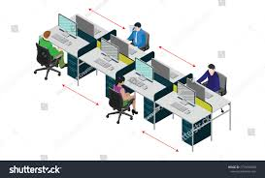
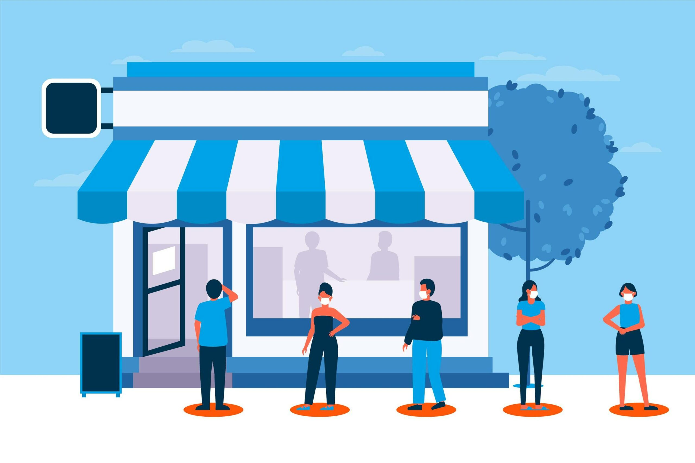
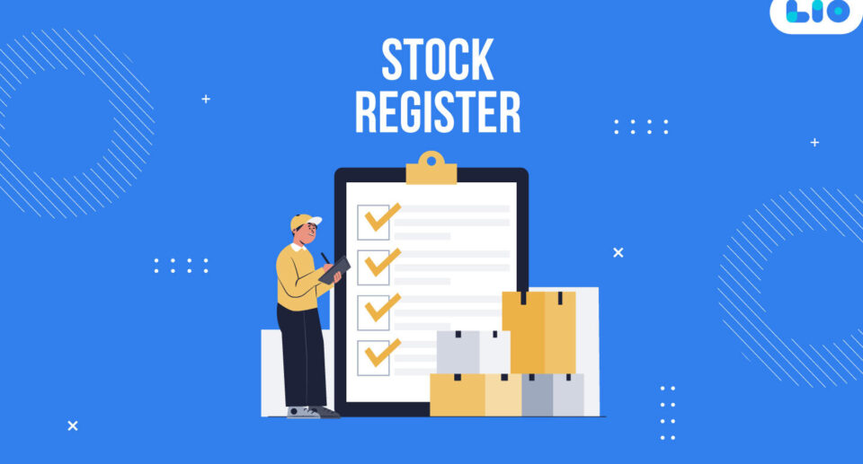
Problem Statement
Some of the greatest challenges faced by the large-scale retailers like Walmart include maintaining the required stock, providing personalized experience to the user at each step and at the same time coordinating with the Walmart employees and the merchants for the customer history, stock availability, any upcoming sales etc.
To handle these issues, it relies on basic traditional softwares to keep the records or other related information. However, it is very tedious task and a time-taking process to query the data telephonically or via mail etc.

Slide 4
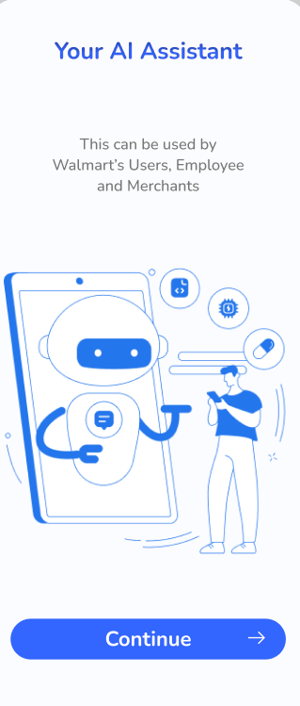
Proposed Solution
We have designed a Chatbot which provides a personalized experience to the users and meets their expectations in the best way in the least possible time. It has been divided into three user segments i.e., Customer, Employee and Merchant.
It provides all the necessary details like accessing catalogue, any product related information, upcoming sales, product prices, stock availability, making payments, status of shipment etc.
Also, it uses a recommendation system that suggests the customers based on the trends and their buying patterns. Hence, it is a multi-purpose chatbot which eases the human effort and helps solve an issue in a more effective manner.

Slide 5

Key Differentiators
In the market, usually all the e-commerce websites or retail corporations provide chatbot service. But the difference and the low point is that it only provides assistance at the Customer end whereas our proposed solution targets the multi-user objective of handling the customers, employees and merchants at the same place.
Also, it provides customized experience with more additional functionalities with 24/7 service availability.

Slide 6



TECH STACK USED
Dialogflow
Python
Figma

Slide 7


Slide 8
THANKYOU

