Slide 1


Cyber Security Website (case-1)
Name: Patel Diya Hirenbhai
Roll no: 7
Enrollment No: 24002170220012
Batch: C7
Branch: IT
1

Slide 2
Project Outline
Idea that lead to the concept
Promote security service
Educate users
Build trust and credibility
Business growth
Simplify user interaction
2

Slide 3
Project Outline
Functionality
Navbar
Service card
About us
Plans
Blogs & articles
Technology used
HTML
CSS
Bootstrap
JavaScript
3

Slide 4

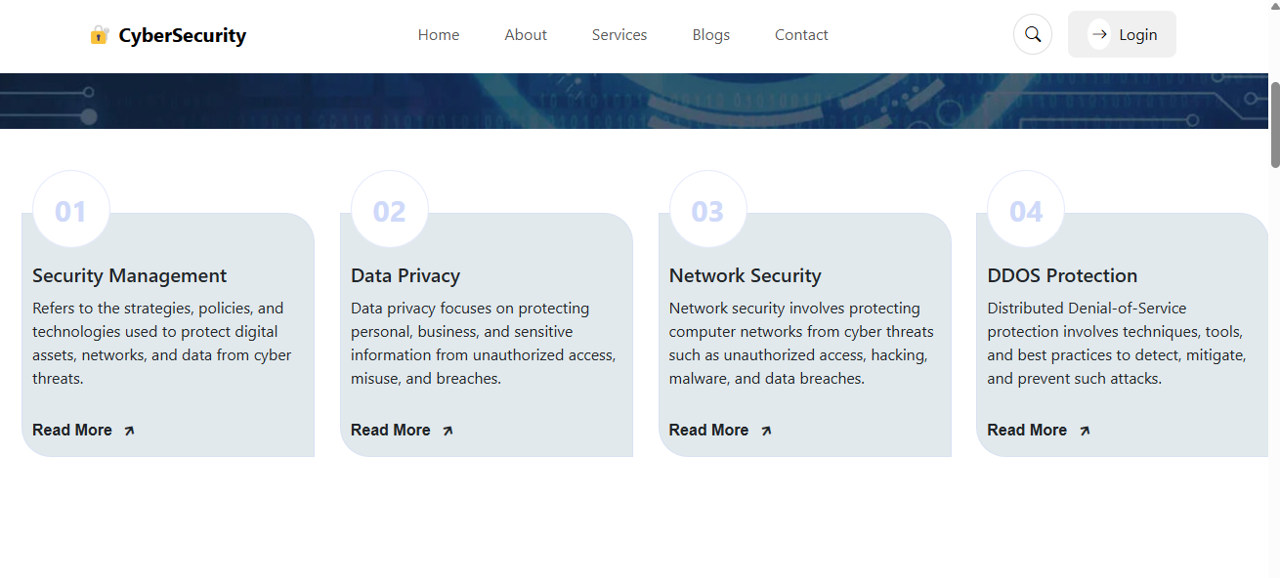
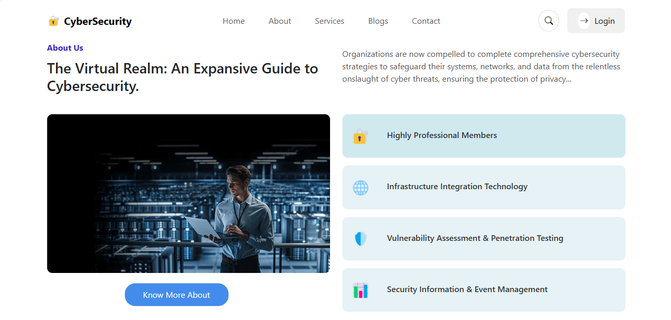
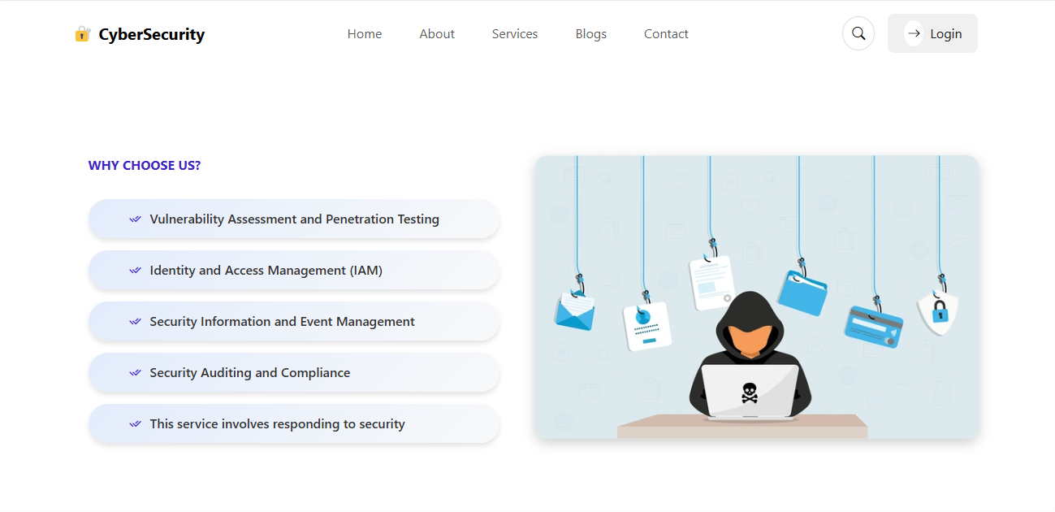
Website Images
4

Slide 5
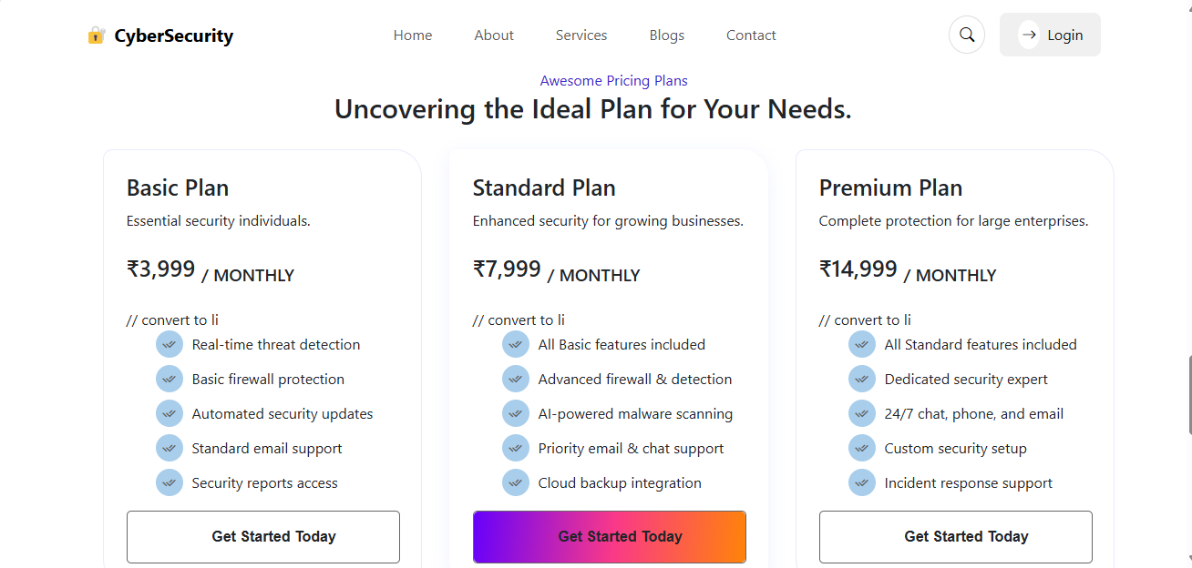
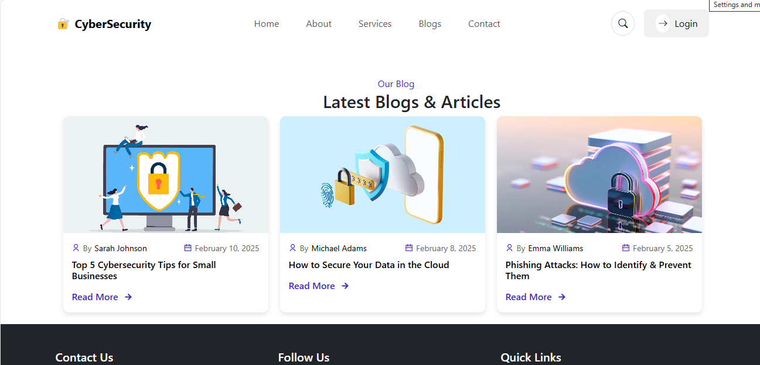
Website Images
5

Slide 6
Merits
Efficient development
Enhance user experience
Educational resources
Trust building
Demerits
No backed functionality
Limited dynamic content
Responsiveness
6

Slide 7
Future Scope
Backend integration
Real time threat monitoring
Payment gateway for service plans
Enhance search functionality
Emails
7

Slide 8
THANK YOU
8

