Slide 1


Task Manager
Name: Patel Diya Hirenbhai
Roll no: 329
Enrollment No: 24002170220012
Branch: IT
1

Slide 2
Introduction
Task Manager is a web application used to organize and manage daily tasks.
It helps users create, update, track, and delete tasks efficiently.
The system improves productivity by keeping tasks organized in one place.
2

Slide 3
Objectives
• Create and manage tasks
• Track task status
• Edit and delete tasks
• Store task data in database
• Provide simple and responsive interface
3

Slide 4
Technologies Used
Frontend: Blazor Server
Backend: .NET 9
Database: MongoDB
Styling: TailwindCSS
Validation: FluentValidation
4

Slide 5
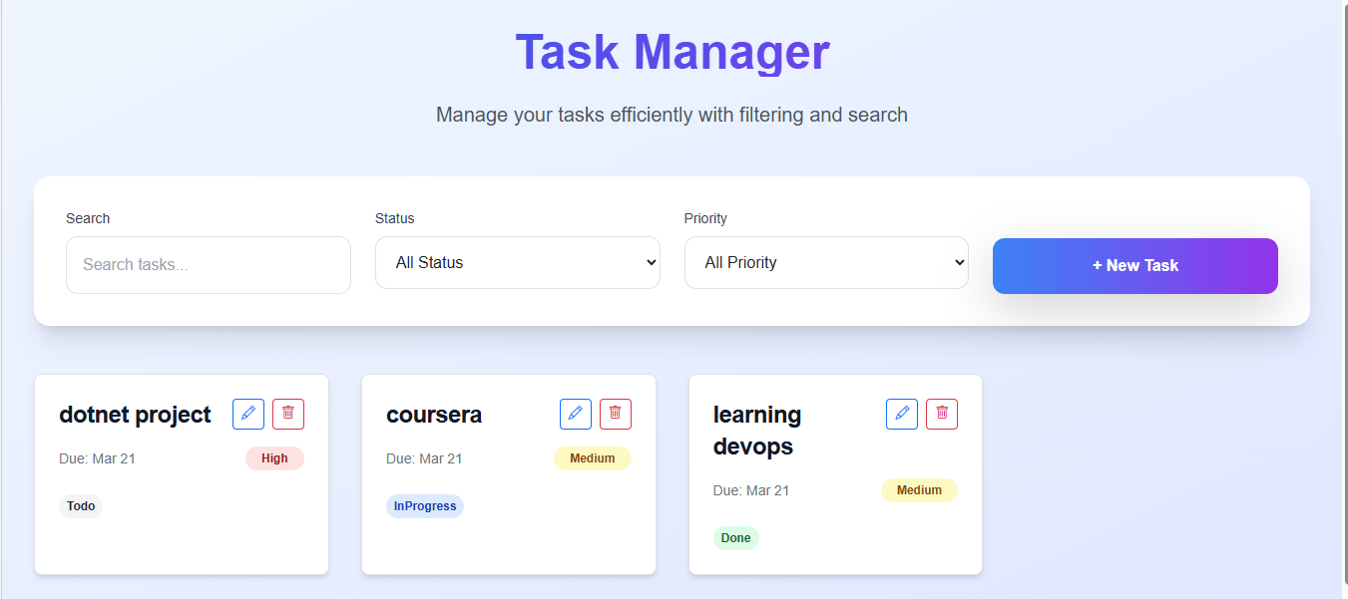
5

Slide 6
Future Scope
• User authentication
• Notifications & reminders
• Mobile application
• File attachments in tasks
• Team collaboration
6

Slide 7
THANK YOU
7

