Slide 1
Digital Portfolio
STUDENT NAME: DIYA MATHAN
REGISTER NO AND NMID: 2428C0471 AND 704AE932D490C47833A41C268CFDD1B7
DEPARTMENT: II BSC AIML
COLLEGE: KPR COLLEGE OF ARTS SCIENCE AND RESEARCH/BHARATHIAR UNIVERSITY

Slide 2
DIGITAL PORTFOLIO A digital portfolio is used to showcase skills, achievements, and growth in a professional, creative, and easily accessible way, serving as a powerful tool for career advancement, learning, and personal branding. Digital portfolios present concrete examples of work, demonstrating both technical and soft skills beyond what a resume or cover letter can show.Online portfolios are easily shareable via a link, making it convenient to present work to employers, educators, or collaborators from anywhere and at any time.

Slide 3

AGENDA
Problem Statement
Project Overview
End Users
Tools and Technologies
Portfolio design and Layout
Features and Functionality
Results and Screenshots
Conclusion
Github Link
3/21/2024 Annual Review

Slide 4

PROBLEM STATEMENT
The need for visibility and recognition of diverse teaching activities and successes, not just isolated classroom events.
The challenge of collecting varied, meaningful evidence of teaching and learning over time.
The importance of facilitating reflective practice, leading to ongoing instructional improvement and lifelong learning.
The requirement for a practical, user-friendly format that serves both reflective and evaluative purposes in the educational context.
A problem statement like this can form the foundation for creating and justifying the use of a teacher’s portfolio as a core professional tool

Slide 5

PROJECT OVERVIEW
It highlights expertise in lesson planning, teaching strategies, class management, and student engagement via curated artifacts such as lesson plans, presentations, syllabi, student work (anonymized), teaching awards, and course evaluations.
The portfolio organizes materials in a user-friendly, visually appealing format, often with categories or pages dedicated to themes, subjects, or professional accomplishments.
Each artifact is accompanied by thoughtful reflections, describing the rationale, process, and outcomes for classroom strategies and experiences, helping communicate a teacher’s philosophy and continuous learning.
The design incorporates various media—documents, images, videos, and audio—making the presentation engaging and demonstrating digital competencies.

Slide 6

WHO ARE THE END USERS?
The primary end users of a teacher's digital portfolio include:
Teachers themselves as a tool for showcasing their professional skills, reflecting on their teaching practices, and documenting their growth and achievements.
School administrators and evaluators who use the portfolio for performance reviews, professional development planning, and making informed decisions about promotions or tenure.
Students, indirectly benefiting as teachers use portfolios to improve instructional quality and personalize learning experiences.
Parents and families, who gain insight and engagement in their child's learning progress by having access to parts of the teacher’s or student’s portfolio, enhancing communication and support.

Slide 7

TOOLS AND TECHNIQUES
html
javascript
css
vs code
git and github

Slide 8
POTFOLIO DESIGN AND LAYOUT
1. Hero Section
2.Skills / Services Highlight
3.Featured Projects
4.Social Proof & Testimonials
5.About
6.Contact Options

Slide 9
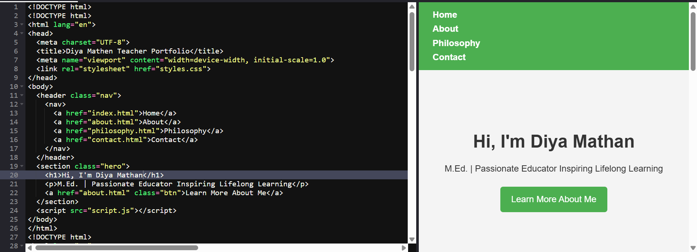

RESULTS AND SCREENSHOTS
3/21/2024 Annual Review

Slide 10
FEATURES AND FUNCTIONALITY
Multimedia Support: Ability to embed images, videos, audio, and interactive elements to make the portfolio dynamic and engaging.
Customizable Layouts and Templates: Tools for personalizing portfolio appearance while maintaining professional standards.
Integration with Other Platforms: Linking to external websites, social networks, or digital resumes to provide comprehensive professional visibility.
Easy Updating and Maintenance: Allowing regular additions or edits to keep the portfolio current and reflective of ongoing achievements.
Sharing and Privacy Controls: Options to share publicly or privately with specific audiences such as employers, peers, or clients.
Analytics and Tracking: Some platforms offer insights on portfolio views and engagement, helping the owner understand audience interaction.
These combined features and functionalities make digital portfolios effective tools for personal branding, career advancement, and professional communication in diverse fields.

Slide 11
CONCLUSION
Remind visitors of your core strengths and unique offerings. Reframe your value in a compact, memorable way—your personal tagline or essence
Offer a quick recap of your showcased work or capabilities, to jog memory
Encourage engagement by setting the stage for next steps
These components mirror strong finishing touches in essays and content strategy—restating core messages, summarizing key points, and ensuring clarity on what comes next all help leave a powerful final impression

Slide 12
GITHUB LINK
https://github.com/diyamathan24/website.html

