Slide 1
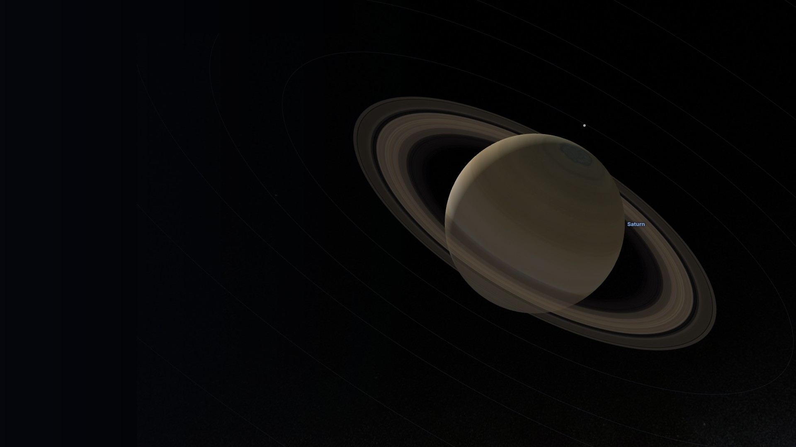
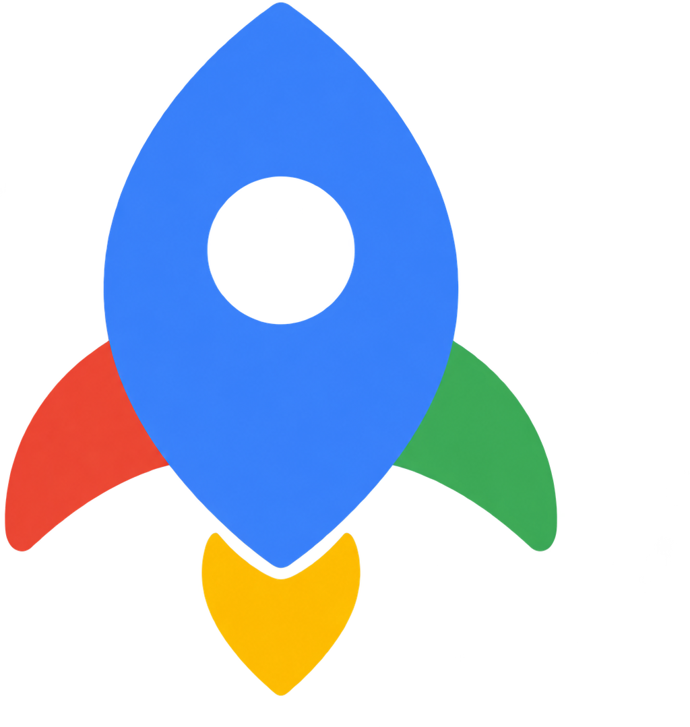

GalaxyMaps
Navigate the universe.
TWRD — Towards a new frontier.
Teddy Lampert, Yijun Wang, Raj Iyer, Diyar Niyazov
BigRed//Hacks 2026
Major League Hacking
Notes:
Slide 1 · 0:00–0:25
SAY:
We’re TWRD — Towards a new frontier: Teddy, Yijun, Raj, and Diyar. We thought it would be cool to navigate through space. We wanted a way for people to explore space and understand what they’re looking at. This is GalaxyMaps. Navigate the universe.
Visual: genuine GalaxyMaps desktop render of Saturn (quiet view). Saturn texture: Solar System Scope; sky: NASA SVS.

Slide 2
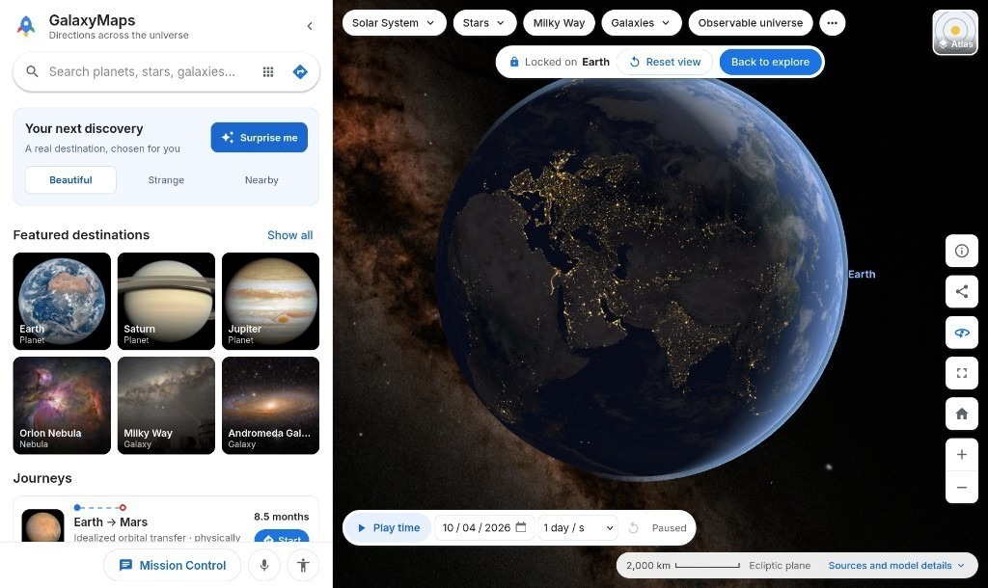
Space is vast.
Now it’s yours
to explore.
Whether you're a student or just curious, GalaxyMaps guides you through the stars and helps you discover awesome places.
Plot your course.
Travel from Earth to Mars, or venture beyond.
Let Grok guide you, or take exploration into your own hands.
Explore in your browser.
Step inside with VR.
Notes:
Slide 2 · 0:25–1:05
SAY:
Space is vast. Now it’s yours to explore. Whether you're a student or just curious, GalaxyMaps guides you through the stars. Plot a course from Earth to Mars, or venture beyond. Let Grok guide you, or explore with your own hands — in a browser, or inside VR.
Visual: genuine GalaxyMaps home view supplied by the team (Explore panel, Earth locked, Earth → Mars journey).

Slide 3
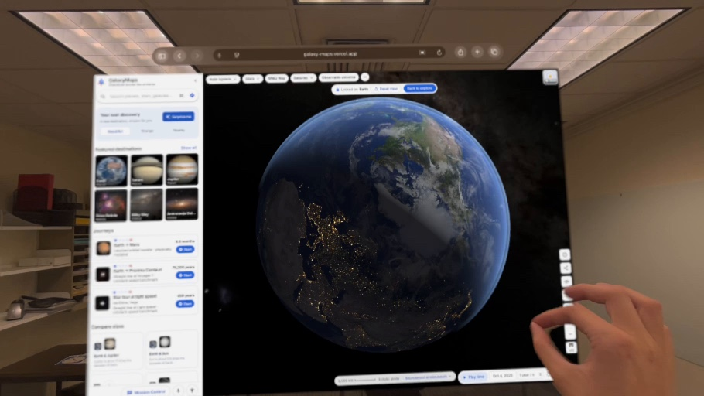
Bring the universe
into the classroom.
Explore in a browser, or step into the stars with any WebXR-compatible VR headset.
Let curiosity lead.
Ask questions. Navigate by voice. Learn as you explore.
Making space accessible to all.
Both keyboard and voice controlled navigation, larger text, high contrast, and reduced motion.
Apple Vision Pro demo · GalaxyMaps in the spatial browser
Notes:
Slide 3 · 1:05–1:50
SAY:
Bring the universe into the classroom. Explore in a browser, or step into the stars with any WebXR headset. Ask questions, navigate by voice, and learn as you go. We designed GalaxyMaps so more people can get in: keyboard and voice, larger text, high contrast, and reduced motion.
Visual: genuine Apple Vision Pro capture: GalaxyMaps (Earth) in a spatial browser window, with the room and a pinch gesture visible. It is a still; don't describe it as showing motion.
Accessibility options named here exist in the app's Accessibility panel: keyboard navigation, Describe current view (spoken descriptions), larger text, high contrast, reduced motion. Voice control uses Grok. The app aims toward WCAG 2.2 AA and states its known limitations; it does not claim full conformance.

Slide 4
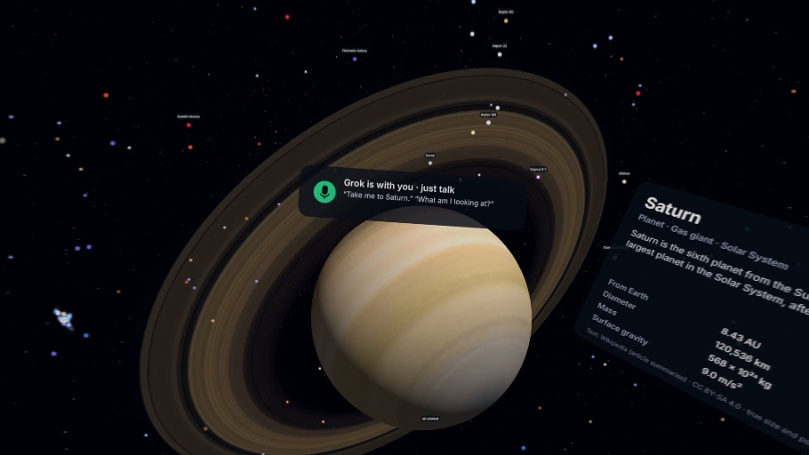
“Grok, take me
to Saturn and
tell me more.”
Your navigator. Your astronomy tutor. Your companion through the cosmos.
Grok combines scientific knowledge with voice navigation, turning every destination into a hands-on lesson.
Ask why Mars is red, how the Sun produces energy, or why light can’t escape a black hole.
With immersive visuals and Grok beside them, students can move through space, examine worlds up close, and connect each explanation to what they see.
Apple Vision Pro · immersive view with the Grok mic HUD
Notes:
Slide 4 · 1:50–2:40
SAY:
Ask Grok to take you to Saturn and tell you more. Grok is your navigator and your astronomy tutor. It can fly the map and explain what you’re looking at — why Mars is red, how the Sun produces energy, why light can’t escape a black hole.
Visual: genuine Apple Vision Pro capture of the immersive WebXR scene: Saturn, the Grok mic HUD and the in-world Saturn card. It shows the interface, not a completed spoken command; don't describe it as a live response.
Grok can act through validated app tools and may use outside knowledge to explain objects. Do not claim a completed spoken command from this still.

Slide 5
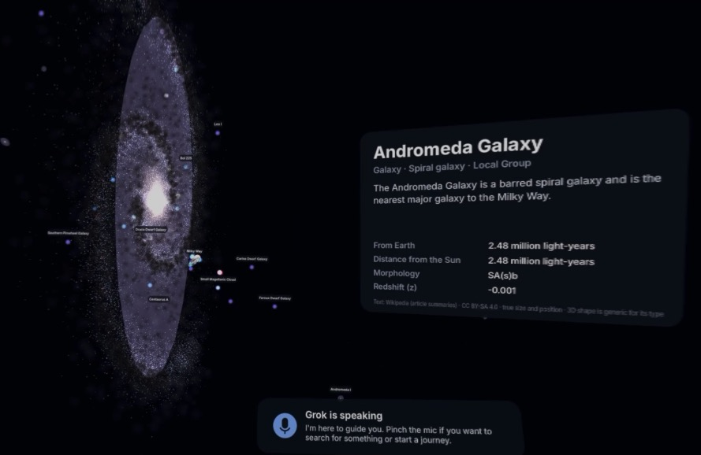
Space should be
accessible to
everyone.
Voice-controlled navigation
Explore and ask questions hands-free.
Accessible by design
Keyboard controls, larger text, high contrast, and reduced motion.
One universe. Many ways to explore.
Browser, VR, voice, touch, mouse, or keyboard.
GalaxyMaps on Apple Vision Pro · spatial exploration with natural interaction
Notes:
Slide 5 · 2:40–3:20
SAY:
Space should be accessible to everyone. Voice, keyboard, mouse, touch, or spatial interaction. You can explore hands-free, and the same universe is there in a browser or a headset.
Visual: genuine Apple Vision Pro capture of Andromeda with the destination card and Grok HUD. Designed with accessibility in mind; do not claim audited ADA or WCAG conformance.

Slide 6
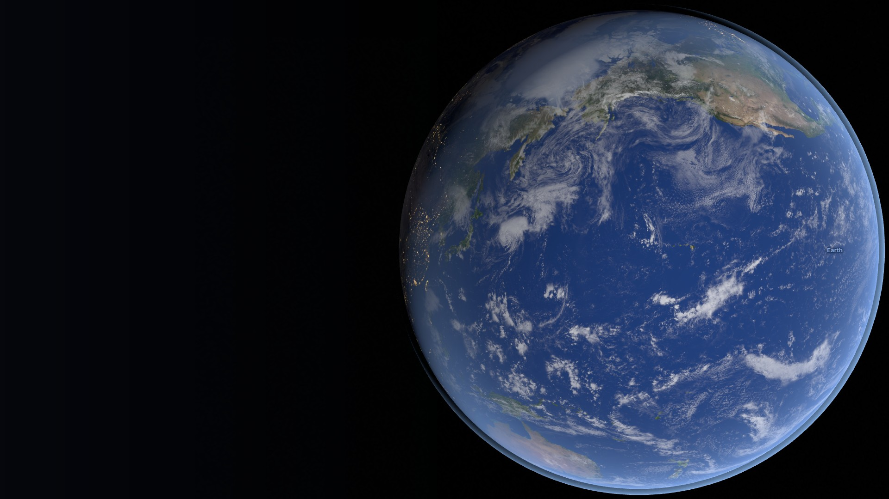


Where would
you go?
galaxies.wiki
GitHub
TWRD — Towards a new frontier.
Notes:
Slide 6 · 3:20–3:45 (buffer to 4:00)
SAY:
We want a student to ask a question about space and explore the answer. That’s our take on navigation. We’re TWRD — Towards a new frontier, and this is GalaxyMaps.
QR codes verified: https://www.galaxies.wiki/ and https://github.com/diyar-niyazov/GalaxyMaps. Leave this slide up during Q&A.

Slide 7
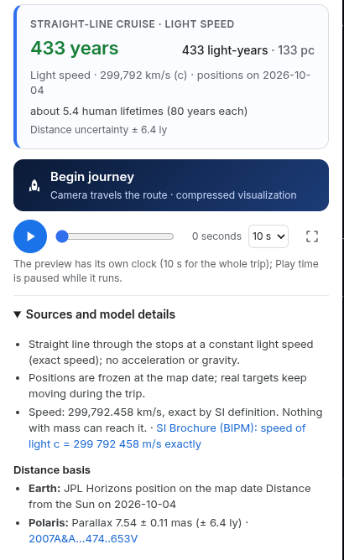
Under the map
Astronomy data and route math power every trip.
Precise 3D positions
Camera-relative rendering
Separate travel models
Validated Grok tools
React, TypeScript, Three.js, WebXR
Notes:
Backup
SAY:
Positions stay high-precision and render relative to the camera. Route math is separate from the display. Constant-speed comparisons and idealized orbital transfers are labeled differently.
Visual: the genuine Earth → Polaris "Sources and model details" panel (constant-speed straight line, positions frozen at the map date, SI definition of c, JPL Horizons position for Earth, Polaris parallax 7.54 ± 0.11 mas).
Verified in the repository: catalog positions are float64 ICRF kilometres, projected relative to the camera every frame (docs/ARCHITECTURE.md); route math lives in TypeScript separate from rendering; the straight-line benchmark and the idealized Hohmann transfer are separate models; Grok can act only through validated app tools. Don't quote frame rates or performance numbers.

Slide 8
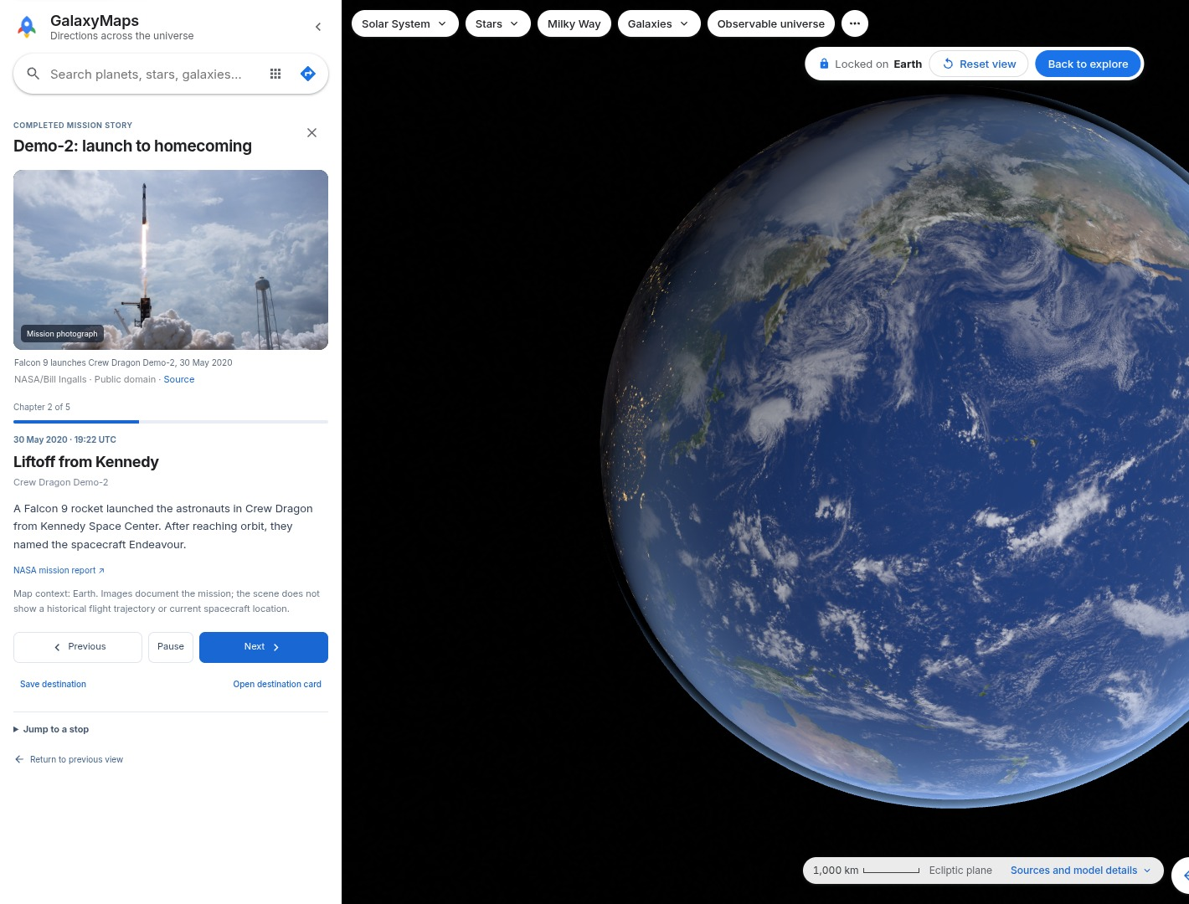
Demo-2: launch to homecoming
Five chapters from the real mission
NASA photographs and source links
SpaceX spacecraft profiles
Notes:
Backup
SAY:
Our Demo-2 story follows the mission through five chapters, with NASA photographs and source links. Falcon 9, Dragon, and Starship profiles sit alongside it.
Visual: the genuine Demo-2 mission story (chapter 2 of 5, "Liftoff from Kennedy"), with the NASA/Bill Ingalls photograph credit and NASA source link preserved. The story says the map shows destination context and does not reconstruct a flight trajectory; don't call it a trajectory replay.

Slide 9
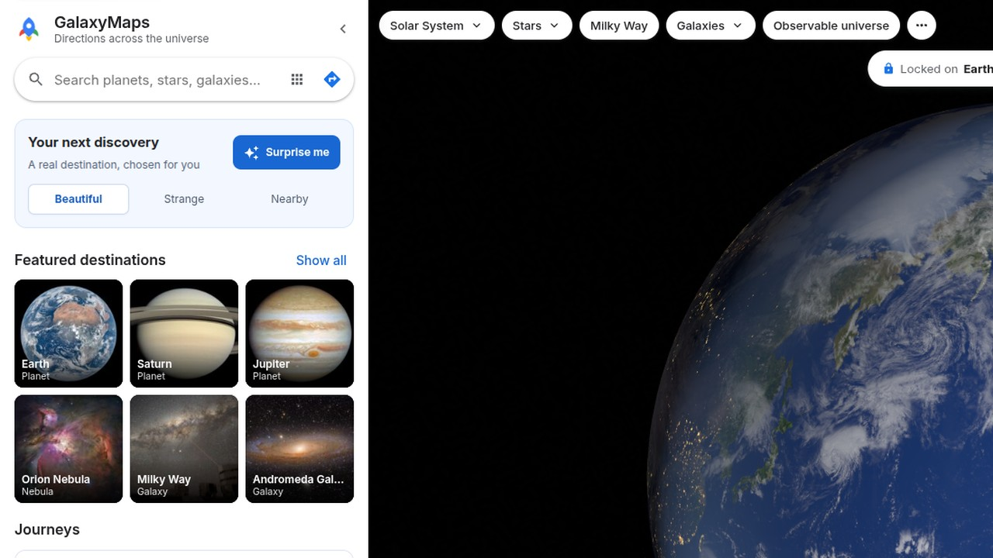
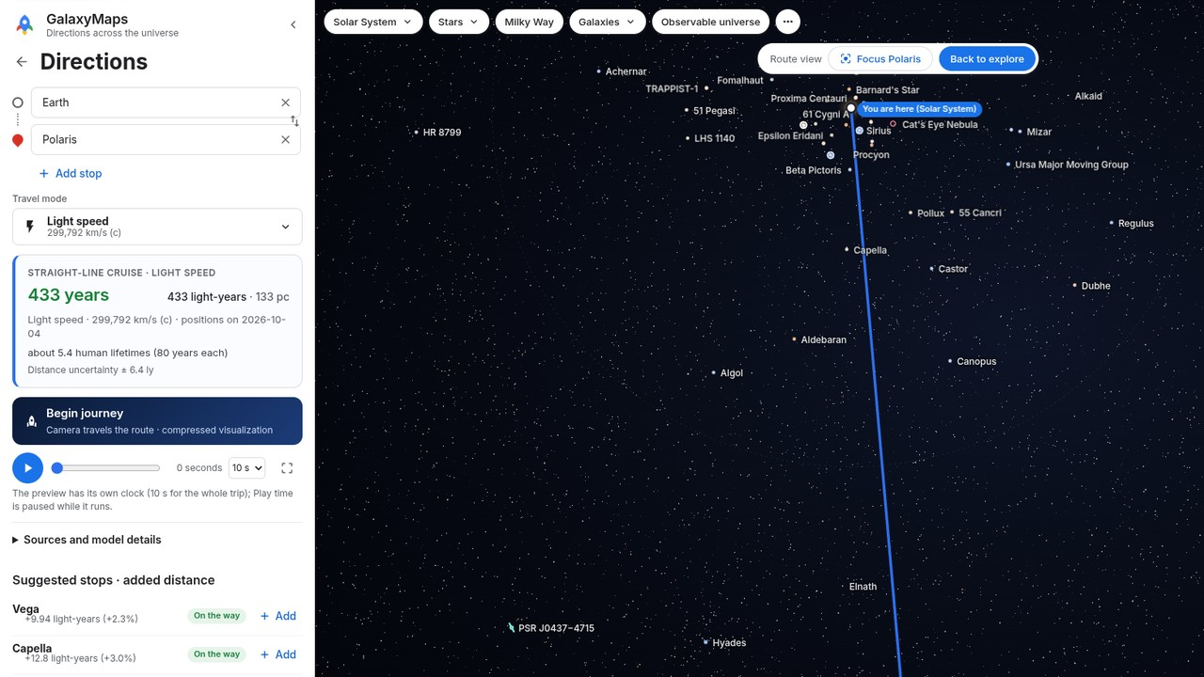
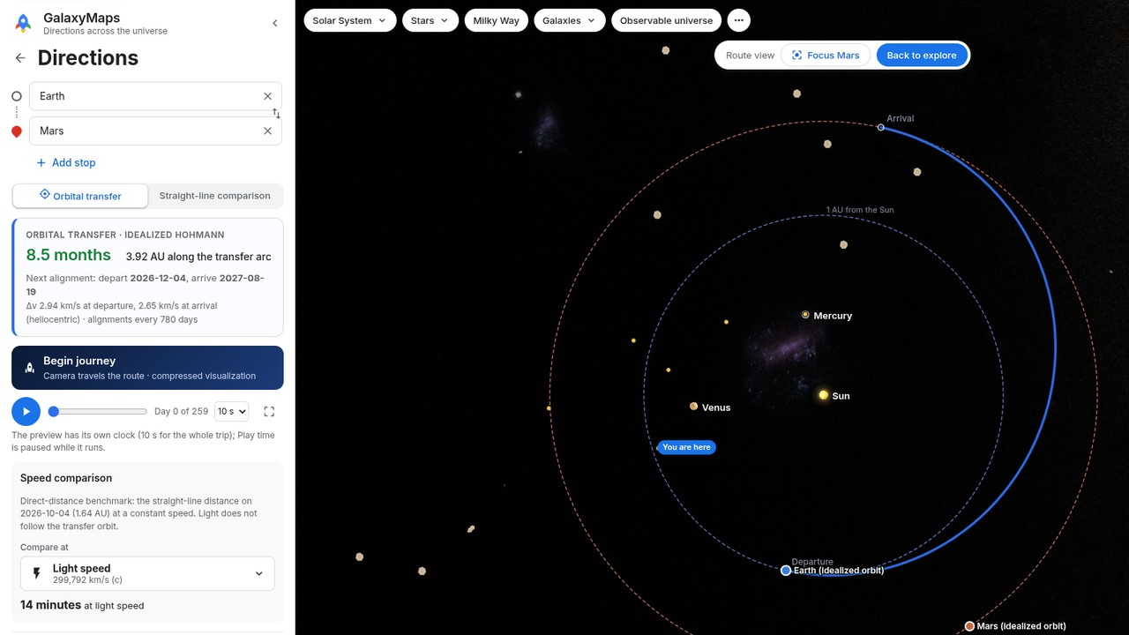
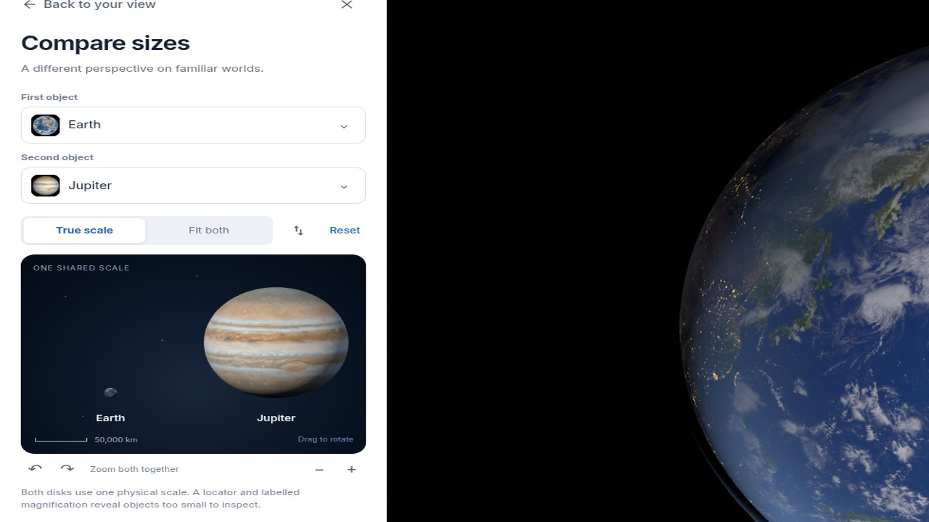
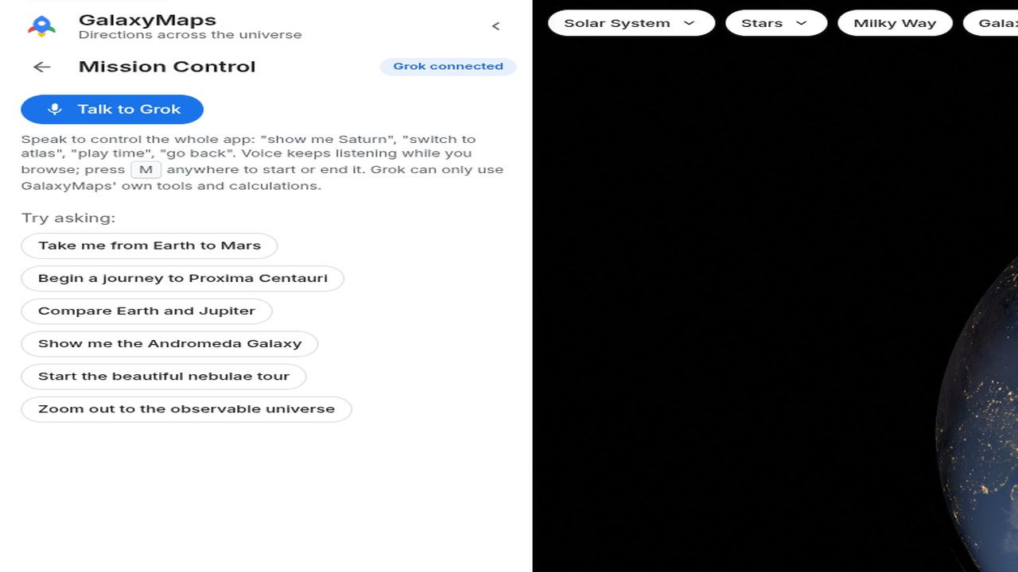
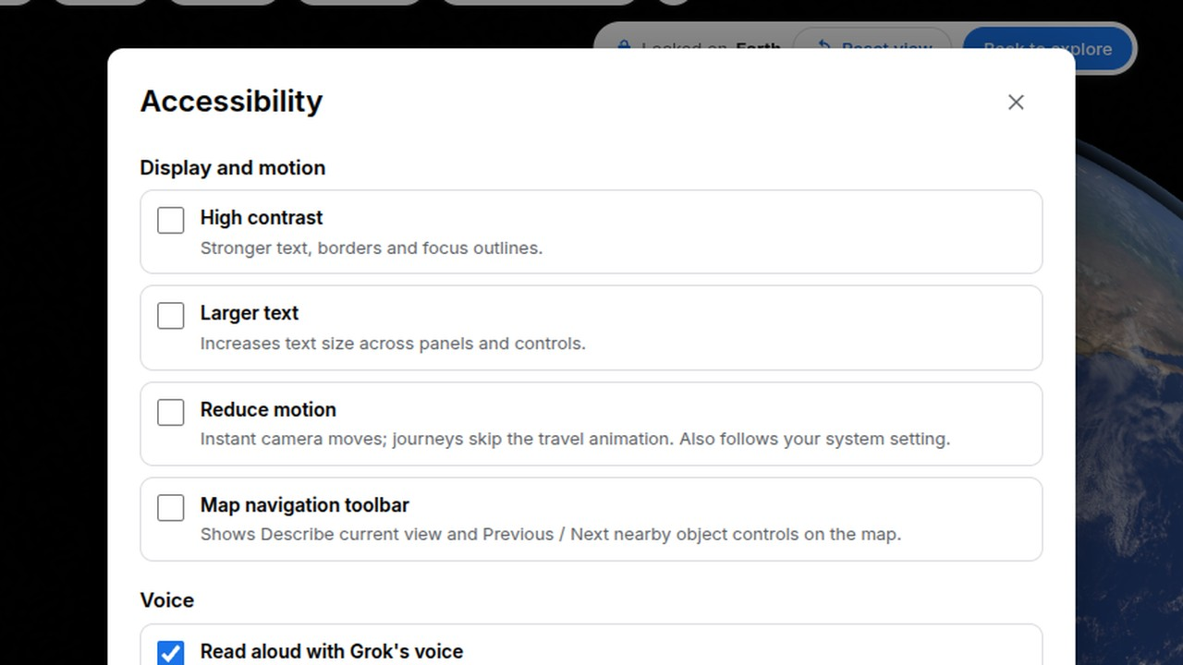
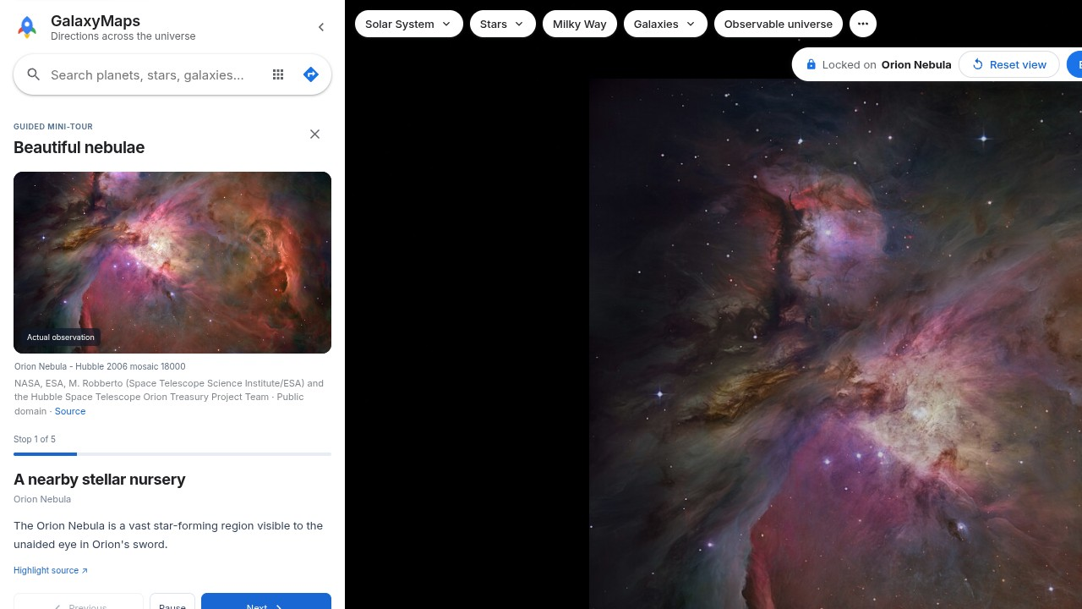
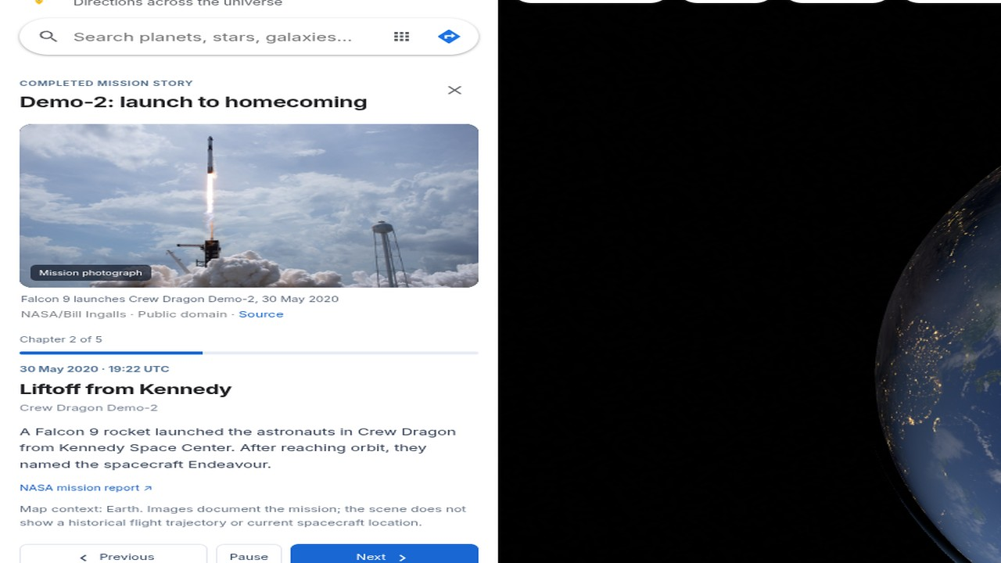
More of GalaxyMaps
Explore
Search, Surprise me, saved places
Earth to Polaris
Light speed · Voyager 1 · 433 years
Earth to Mars
Idealized Hohmann · 8.5 months
Compare sizes
True scale · Earth and Jupiter
Grok
Voice or typed commands
Accessibility
Keyboard, speech, contrast, motion
Guided tours
Beautiful nebulae · sourced photos
Demo-2
Five NASA-sourced chapters
Cited catalogs · app-calculated distances · React, TypeScript, Three.js, WebXR · keys stay on the server · built with Cursor · next: a classroom pilot
Notes:
Backup for Q&A, not timed. Replaces the six text inventory slides. Every tile is a genuine capture of the current app.
Explore: search, categories, Surprise me, saved places, Realistic and Atlas layers, shareable views, Play time.
Earth to Polaris: multi-stop routes, light speed and Voyager 1, journey playback, suggested detours. Captured: 433 years at c, 7.7 million years at Voyager 1.
Earth to Mars: idealized Hohmann transfer (~8.5 months), separate from the constant-speed comparison. Assumptions and uncertainty are in Sources and model details.
Compare sizes: Earth/Jupiter (also Earth/Sun, Sun/Sirius A, Earth/Moon).
Grok: voice and typed Mission Control through validated app tools; dictation and spoken replies. Needs a microphone and a configured server.
Accessibility: keyboard, Describe current view, larger text, high contrast, reduced motion. Aims toward WCAG 2.2 AA; does not claim full conformance.
Guided tours: Beautiful nebulae and other self-paced tours with sourced photographs.
Demo-2: five-chapter educational story with NASA photographs; Falcon 9, Dragon, and Starship profiles. No SpaceX API or telemetry.
Classroom next step (proposed, not yet run): predict travel time, change the mode, compare, explain.

